Slide 1
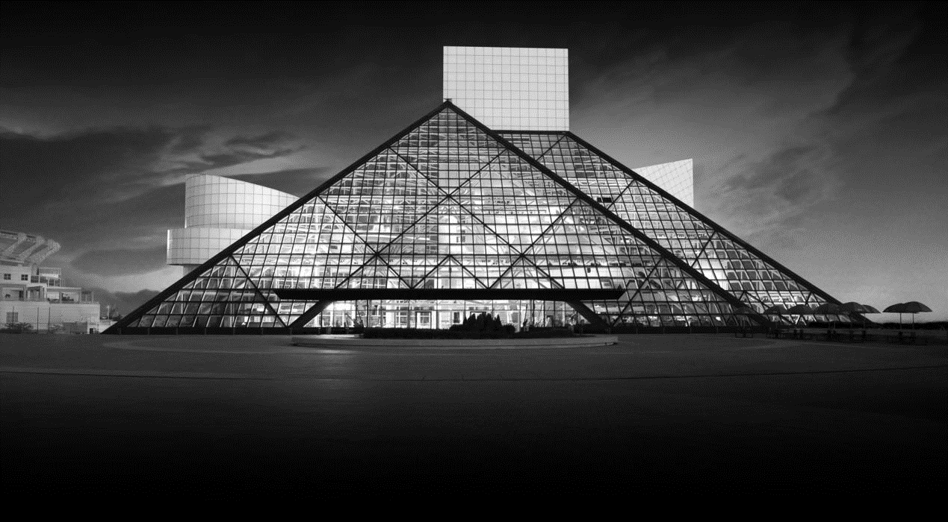
PREDICTING THE ROCK AND ROLL HALL OF FAME Grayson Bates, Michael Borenstein and Andrew Malanowski

Slide 2
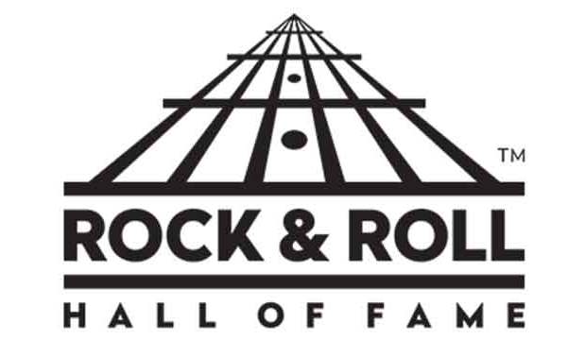
BACKGROUND
Founded in 1983 by Atlantic Records founder Ahmet Ertegun, Rolling Stone founder Jann Wenner, longtime Bruce Springsteen manager Jon Landau and a small group of music executives, managers and attorneys.
214 artists have been inducted as performers since annual inductions began in 1986.
The nominating committee, chaired by Landau, currently consists of 29 members, and nominates 15 artists each year. The only criteria is that it has been 25 years since the artist’s first record was released.
Ballots are then sent to 600 “rock experts.” Artists with the highest number of votes and more than 50% of the vote are inducted. Number of inductees varies.

Slide 3
2019 NOMINEES
Def Leppard
Devo
Janet Jackson
John Prine
Kraftwerk
LL Cool J
MC5
Radiohead
Rage Against the Machine
Roxy Music
Rufus feat. Chaka Khan
Stevie Nicks
The Cure
The Zombies
Todd Rundgren

Slide 4
2019 PREDICTIONS
Mike’s Picks
Def Leppard
Devo
Radiohead
Janet Jackson
Kraftwerk
Billboard Picks
Radiohead (Even)
Stevie Nicks (3 to 2)
Janet Jackson (2 to 1)
The Zombies (2 to 1)
Def Leppard (5 to 2)
Model Picks
Janet Jackson (95.2%)
Radiohead (94.2%)
Todd Rundgren (93%)
Def Leppard (88.6%)
The Cure (88%)

