Slide 1
Build the Perfect Job Posting
The power of words and timing.

Slide 2
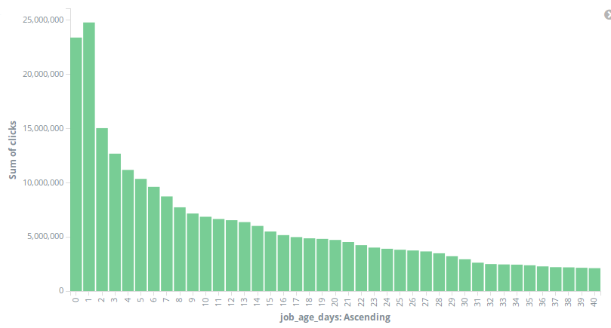
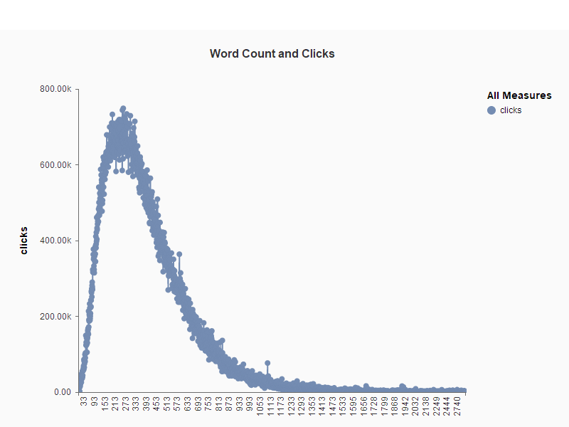
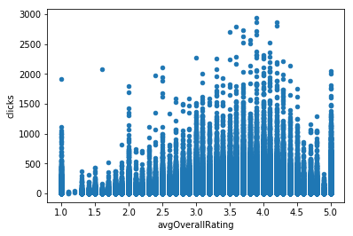
Keep it simple
Number of clicks by job age
Word count: 260 Clicks: 748,921

Slide 3
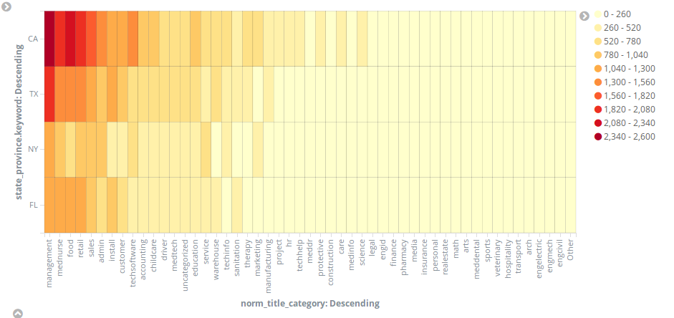
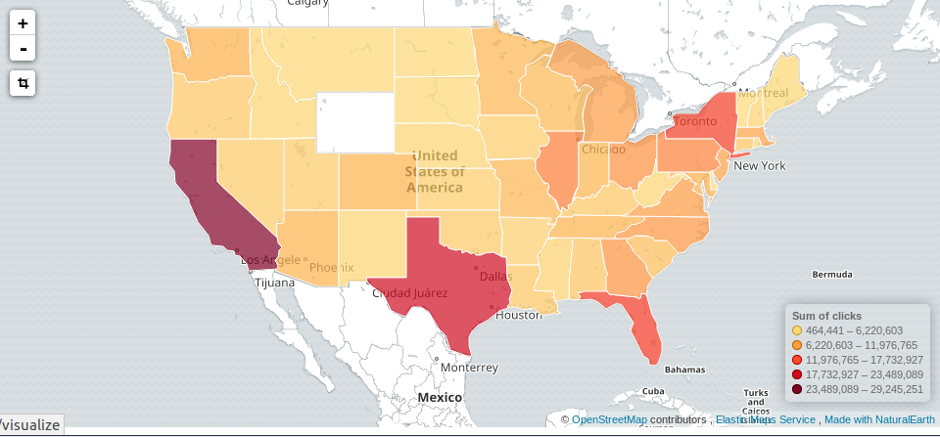
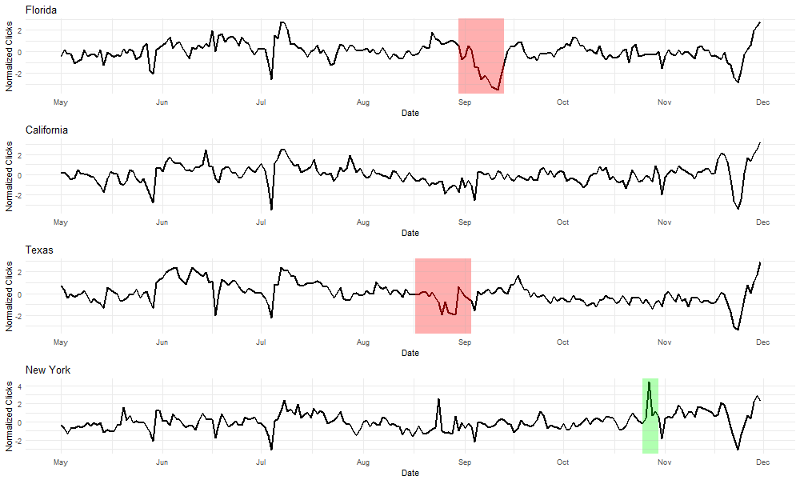
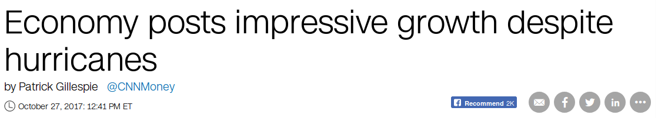
Who’s clicking and when
Hurricane Irma hits Florida and Harvey hits Texas

