Slide 1


A Path To Your Future
The Squadratics:
Eduardo Gomez, Jerry Tucay, Mariby Cruz, Mitch Borgert

Slide 2
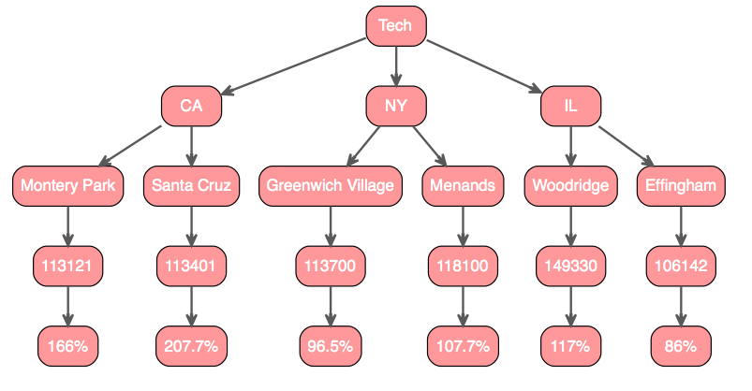
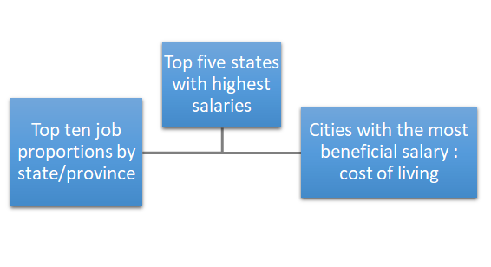
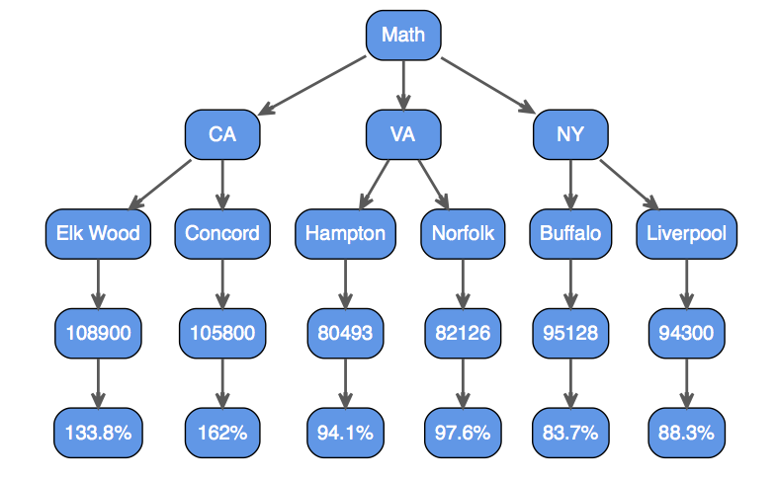
Steps to Succeeding in a Capitalist Society
Cost of living data from the website Sperling’s Best Place

Slide 3

What’s Next…
Job Categories
science
accounting
arts
childcare
construction
education
finance
food
hospitality
therapy
veterinary
etc..
Automation

