Slide 1

DS II Final Project Presentation
Title???
Micah Botkin-Levy
University of Vermont
Spring 2019

Slide 2
Overview of Presentation
Introduction
Motivation and Approach
Reinforcement Algorithms
Comparison of Simulated Methods
Conclusions and Future Work

Slide 3
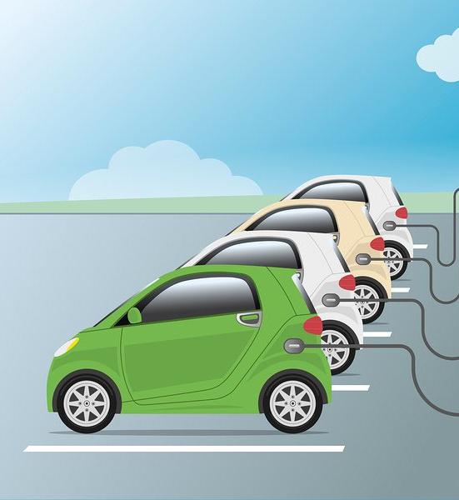
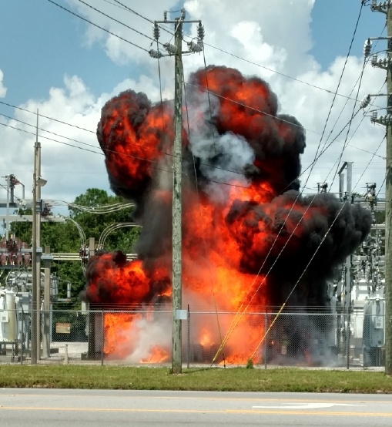


Overview & Motivation

Slide 4
Questions? Comments? Thank you!
Contact info
Micah Botkin-Levy
mbotkinl@uvm.edu

