Slide 1
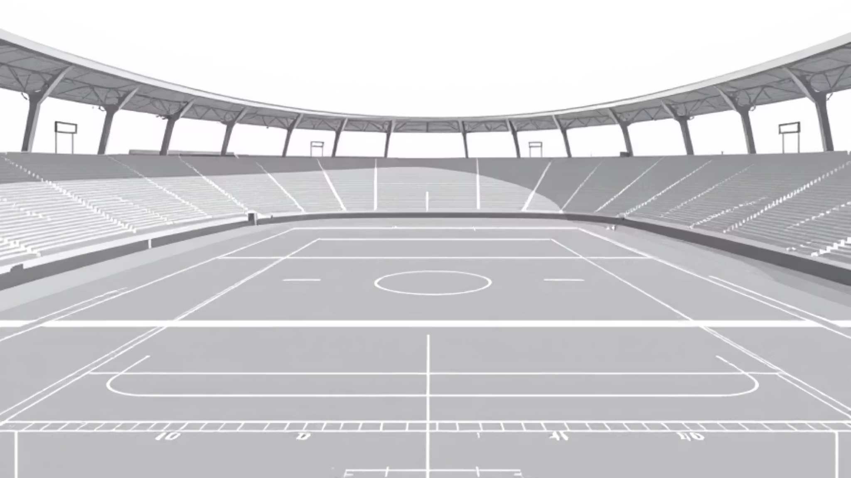
Data-Driven Squad Construction
Building the Inaugural Roster for Durham Top Dogs F.C.

Slide 2



STRATEGIC OVERVIEW
Gaining a Competitive Edge in an Inefficient Market
The Problem: Speculation & Risk
Our Solution: Empirical Data Science
The Strategic Advantage: ROI
The global transfer market is driven by speculation, leading to inflated prices and high-risk investments. Traditional scouting is subjective and often misses high-value opportunities.
A multi-stage data science model replaces speculation with empirical evidence to identify undervalued talent and build a tactically balanced squad.
By leveraging data, we assemble a highly competitive team for a fraction of the market cost, ensuring financial sustainability and maximizing return on investment.
The result is a complete, deployable 25-man roster, chemistry-optimized tactical lineups, and a data-driven playbook to guide the coaching staff from day one.

Slide 3



The Process: Our 3-Stage Analytical Engine
From 18,000 Players to a Championship-Caliber Squad
1. Style Identification (K-Means)
2. Value Discovery (Random Forest)
3. Squad Optimization (Linear Programming)
What: We segment all players into four distinct tactical archetypes based on 30+ skill attributes.
What: We build a model to predict a player's objective market value, identifying those the market has undervalued.
What: We select the final 25 players that maximize "value for money" while meeting strict budget, positional quotas and favoring player chemistry.
Why: To ensure the final squad is tactically diverse and versatile, not just a collection of high-rated individuals.
Why: To create a shortlist of high-potential, cost-effective transfer targets and avoid overpaying.
Why: To translate our data insights into the final, actionable team roster, also considering player chemistry factors like nationality and previous club connections when building the starting XI, not just individual player value and tactical balance.
Note : During the Value Discovery stage, we leveraged Random Forest to reassign player positions in our dataset. This crucial step ensures players are considered for positions that best fit their unique skill profiles, rather than relying solely on their original listed positions.

Slide 4
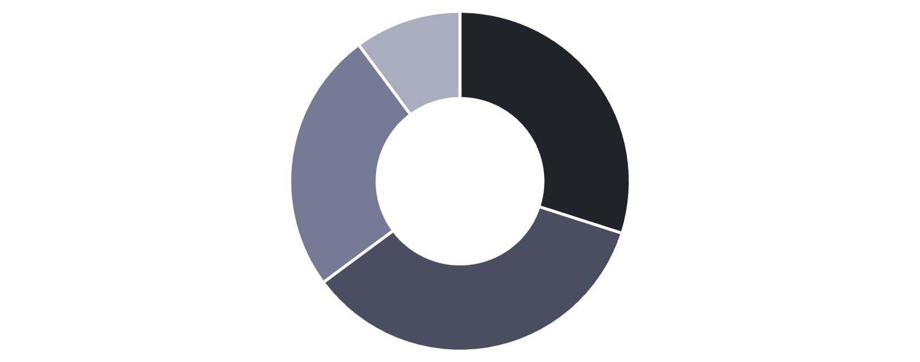
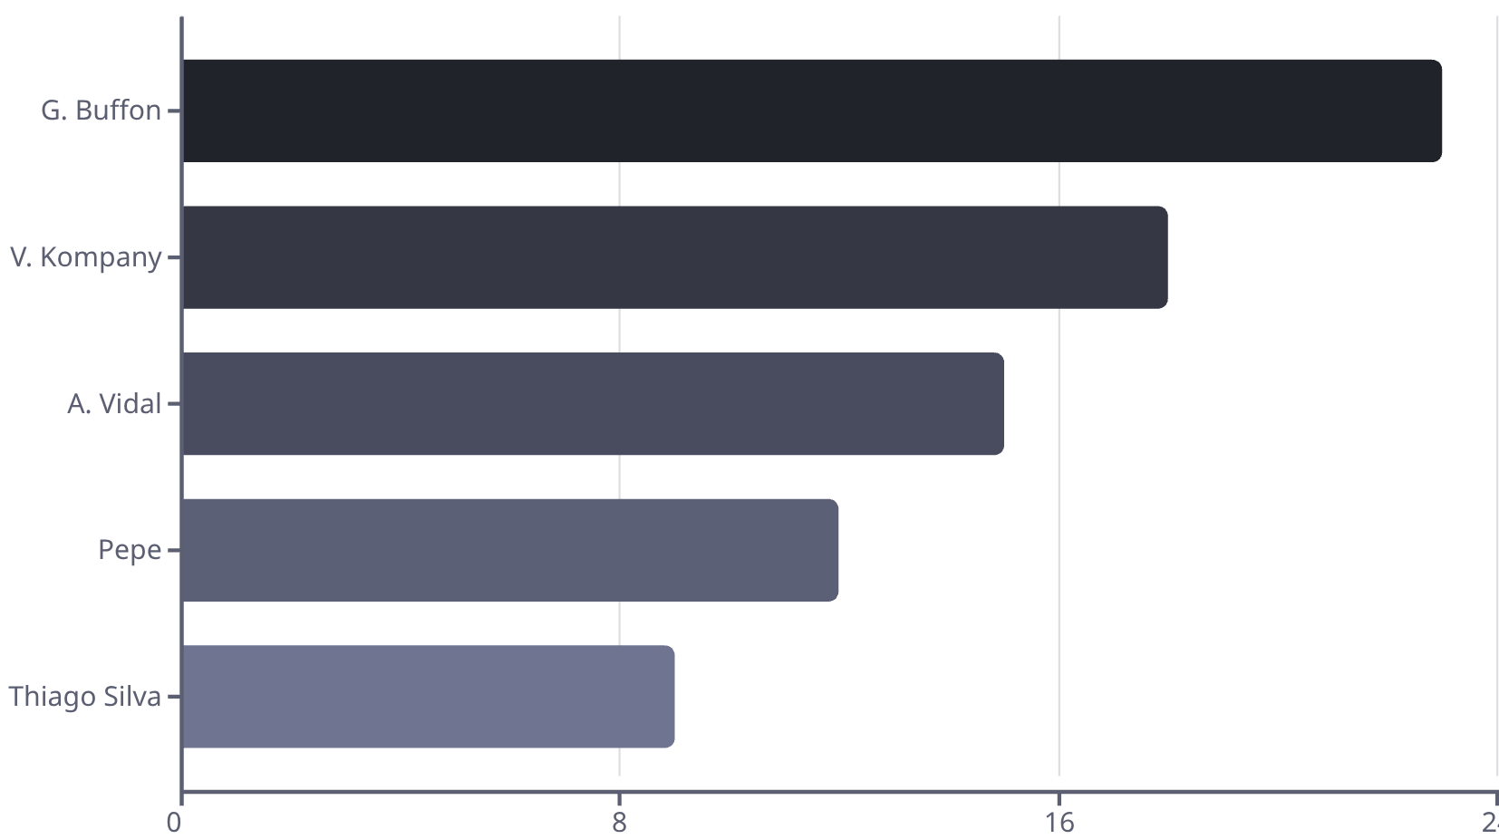
Stage 1 & 2 - Identifying Targets
Pinpointing Tactical Fits and Market Inefficiencies
Player Archetypes (K-Means Distribution)
Top Undervalued Players (Value Gap)
Defensive Rocks
Creative Playmakers
Pacy Attackers
Solid Goalkeepers
Key Takeaway: Our transfer shortlist is balanced across all four key player styles, guaranteeing tactical flexibility for the manager.
Key Takeaway: Our valuation model successfully identifies elite players with large "Value Gaps" available for significantly less than their data suggests they are worth.

Slide 5

The Result: The Inaugural 25-Man Squad
Unveiling the Durham Top Dogs F.C. Roster
Name
Position
Overall
Value Score
Cost (€)
Thiago Silva
RCB
88
3.67
24,000,000
G. Buffon
GK
88
22.00
4,000,000
Ederson
GK
86
2.07
41,500,000
R. Mahrez
RW
85
2.10
40,500,000
A. Vidal
CAM
85
3.27
26,000,000
V. Kompany
CB
85
3.86
22,000,000
Pepe
RCB
85
9.44
9,000,000
Lucas Vázquez
RW
83
3.07
27,000,000
Summary: The final squad was acquired within the €500M budget, meets all positional quotas (3 GKs, 8 DEFs, 8 MIDs, 6 FWDs), and has a great average Overall rating, making it competitive from its inception. (Full 25-man roster available in the appendix.)

Slide 6
The Playbook: Chemistry-Optimized Starting XIs
Tactical Flexibility for Any Opponent
⚽ Balanced (4-4-2) ⚽
Defensive (5-3-2)
⚔️ Offensive (4-3-3) ⚔️
Our go-to lineup, selected for the best combination of overall quality and player cohesion.
Built to protect a lead or neutralize a superior attacking opponent. Focuses on highest Defensive Score.
Designed to dominate possession and apply relentless pressure in attack. Focuses on highest Offensive Score.
GK: Ederson
DEF: Thiago Silva, Naldo, V. Kompany, Pepe
GK: No Change
GK: No Change
DEF: +1 Defender (Highest Defensive Score)
DEF: No Change
MID: A. Vidal, R. Dourado, D. García, T. Delaney
MID: -1 Midfielder (To support the attack)
MID: -1 Midfielder (Sacrifice one winger)
FWD: R. Mahrez, Lucas Vázquez
FWD: +1 Forward (Highest Offensive Score)
FWD: No Change

Slide 7
The Playbook: In-Game Specialists
Data-Driven Decisions for Critical Moments
Set-Piece Specialists
⚡ Impact Substitutes ⚡
Penalty Taker
Offensive Spark
A. Vidal (Consistent conversion rate and composure under pressure)
M. Parolo (High sprint speed and stamina for chasing a goal)
Direct Free Kick
Defensive Closer
R. Mahrez (High curve and accuracy rating)
S. Nzonzi (Dominant aerial ability and tactical awareness for protecting a lead)
Corner Kicks
Lucas Vázquez (Optimal delivery and trajectory for attacking headers)
Key Takeaway: Our analysis provides the coaching staff with clear, data-backed recommendations for high-leverage situations, removing guesswork when the pressure is on.

Slide 8




Deployment & Next Steps
From Analysis to Action: Operationalizing the Model
Immediate Roster Delivery
Integration with Scouting
The 25-man roster and playbook will be delivered to the Director of Football and Managerial Staff to serve as a primary decision-support tool for the upcoming transfer window.
This model is designed to augment, not replace, traditional scouting. The generated shortlist provides high-potential targets for our scouts to perform final, in-person evaluations.
Long-Term Strategy & Adaptation
Risk Mitigation
The model will be continuously updated with new player data each season to identify emerging talent and adapt to market trends, forming the core of our club's sustainable transfer policy.
The risk of player underperformance is mitigated by our "value for money" approach, which diversifies investment and prevents over-reliance on a single, high-cost signing.

Slide 9

Your touch
We have successfully demonstrated an end-to-end data science methodology to build a competitive, cost-effective, and tactically versatile football club from the ground up.
Football is magic. Data cannot predict the human aspect of it. It is up to the Durham dogs and their management to ignite that flame.

