Slide 1

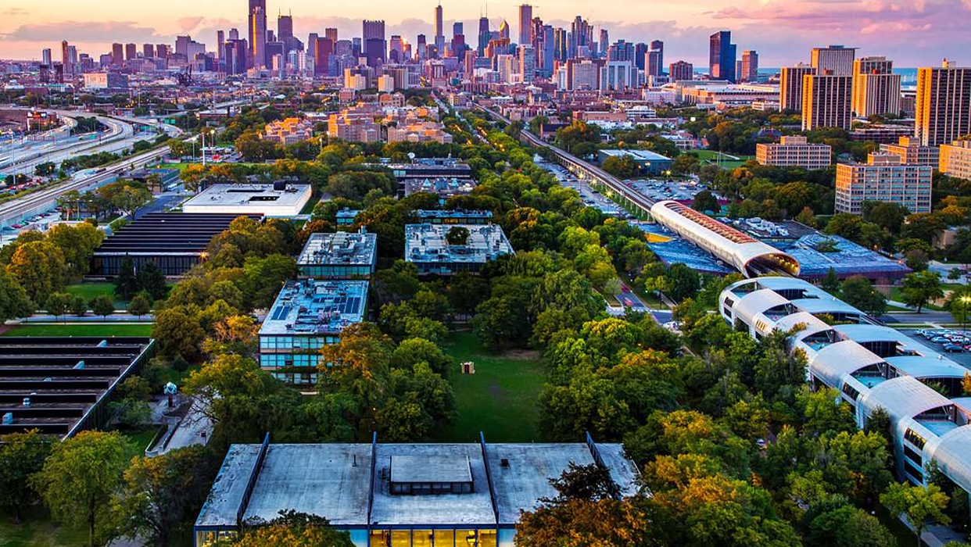

Team E

Slide 2

Problem
Solution
Result
- Unsafe campus
- Inability to access safety information or recent local incidents
- Need for easy access to emergency services and AED locations
A safer and happier campus community
A pedestrian commuter safety website

Slide 3
Improved campus safety
Safety Incidents
Crime incidents
AED Locations

Slide 4

Name: Sofia Background: English is second language Small hometown Out of country freshman On-campus No car Goal: Safely travel to and from and around campus view and report crime/safety incidents Near real-time updates for nearby crime/safety incidents Get GPS based directions Link with other commuters via the walk buddy network

Slide 5
User Functions
Report a recent incident or safety hazard
Read recent reports
View a map of campus AED locations and recent crime and safety incidents
Call emergency services
Find a walk buddy

Slide 6
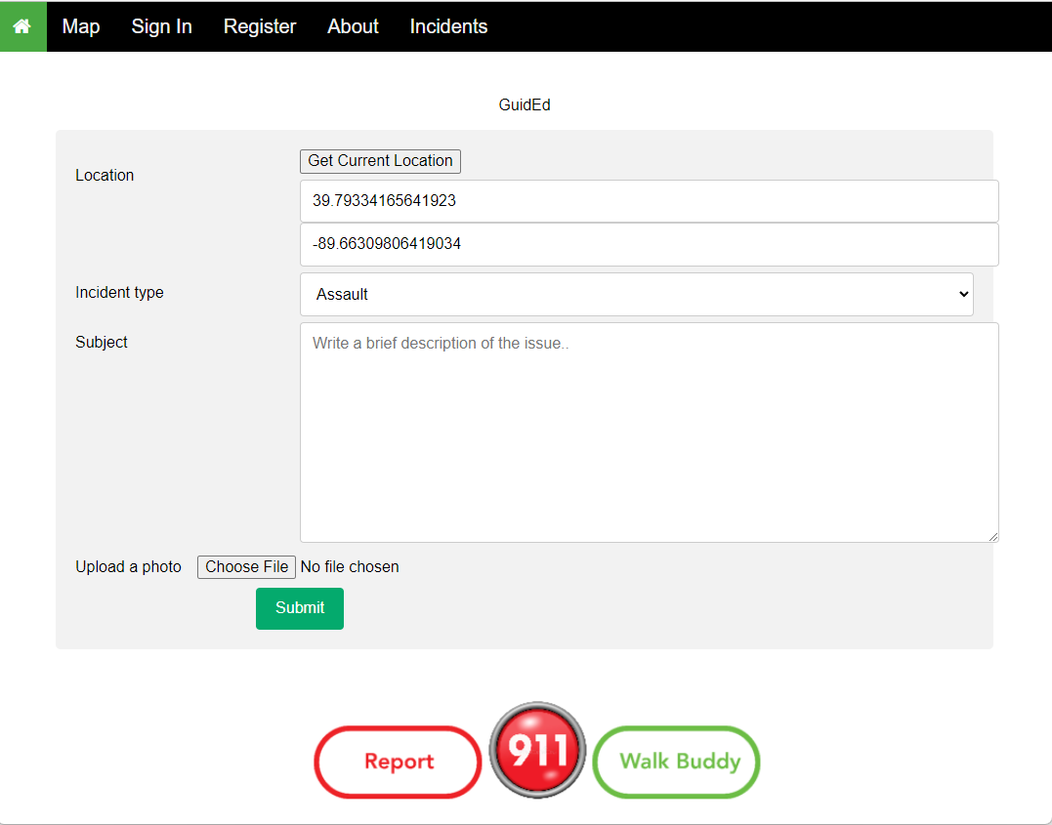
Find your location
Write a brief description
Upload a photo of the incident
Select type of incident
Submit for approval for posting

Slide 7
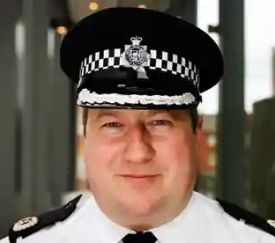
Name: Stewart Background: IIT Public Safety worker driving a Public Safety vehicle Working on-campus Goal: Keep campus safe by reviewing and keeping the information about incidents updated. Monitors and responds to reported incidents Develops the safety plans based on incidents reports Analyze hotspots for incidents / hazards

Slide 8
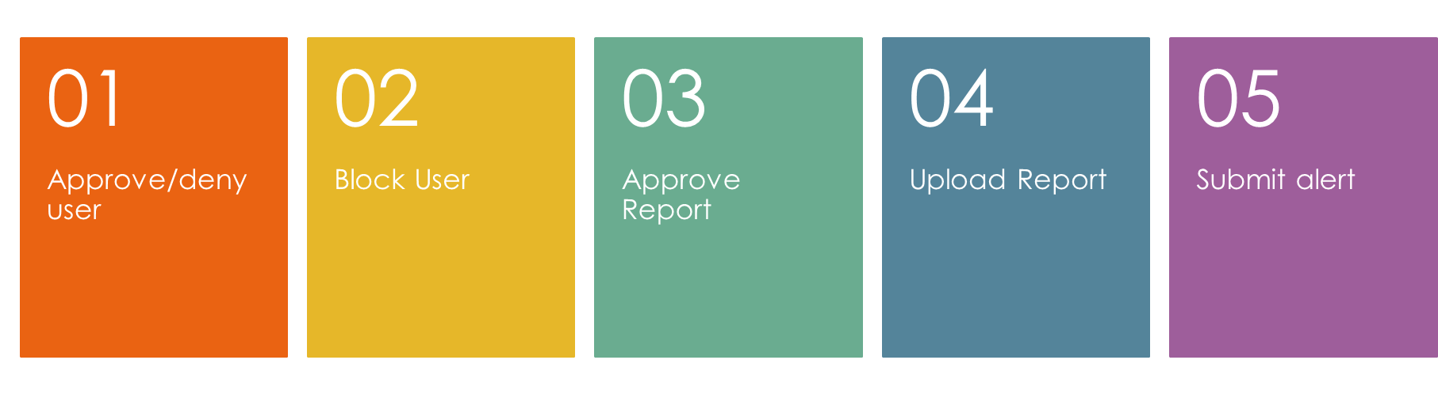
Administrative Functions

Slide 9
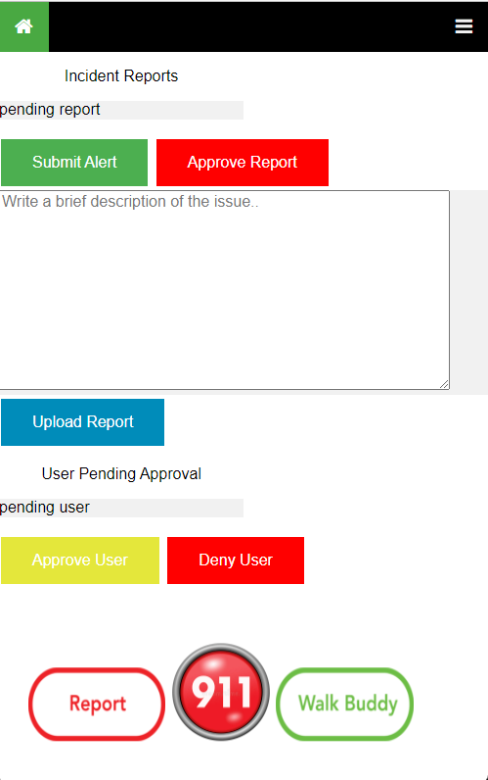
Submit an alert to appear on the news feed and on the map
Approve a report
Upload a report to be displayed on the incident report and map
Approve a user
Deny a user

Slide 10
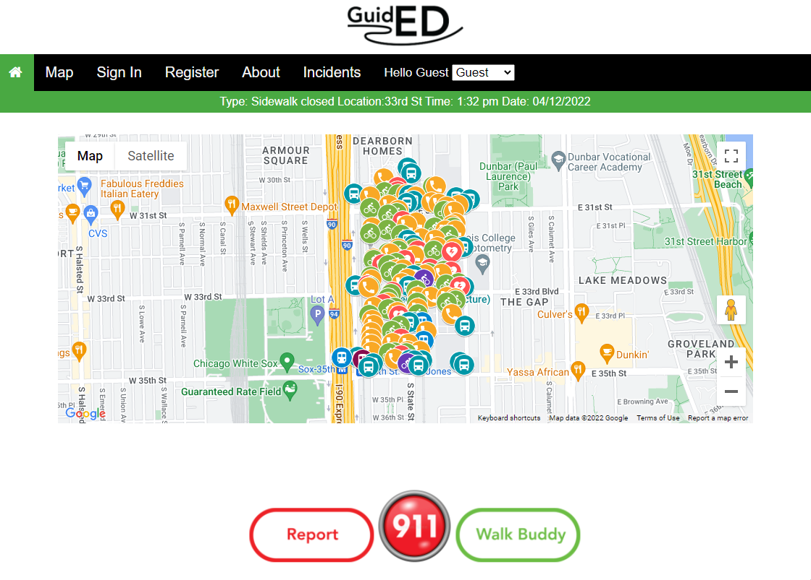
View incidents on map
View recent alerts
Call emergency services
Find a walk buddy
Report an incident

Slide 11


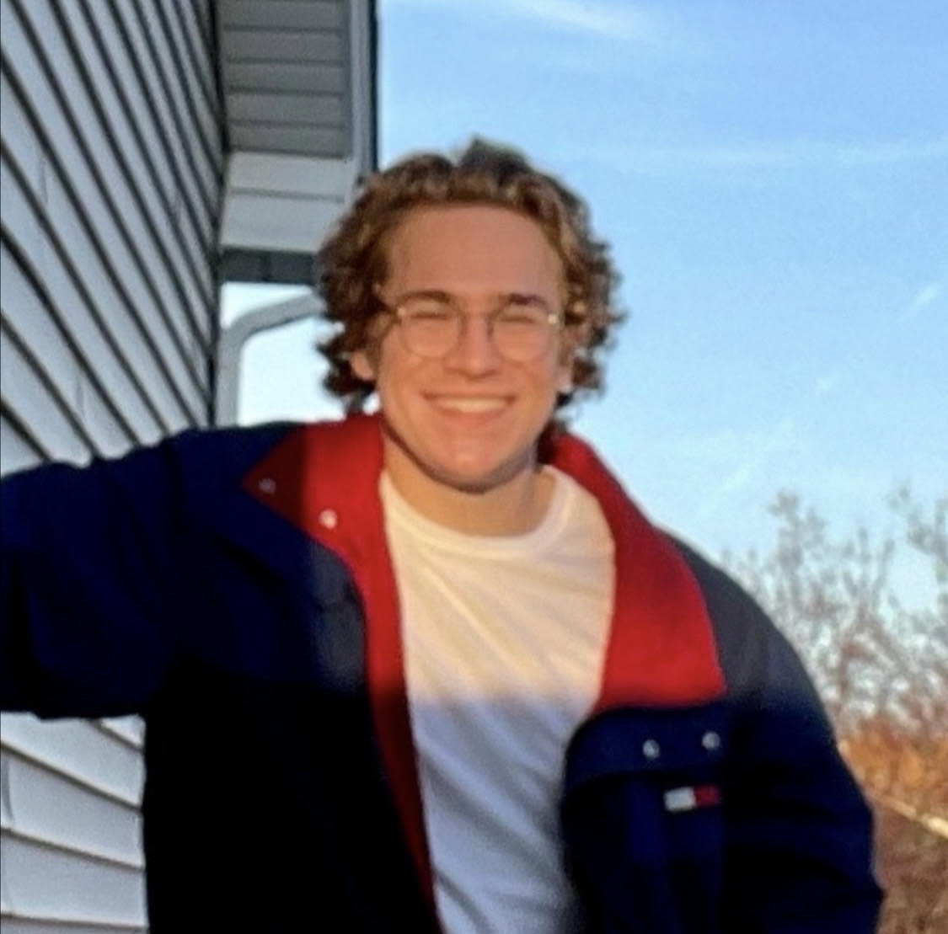

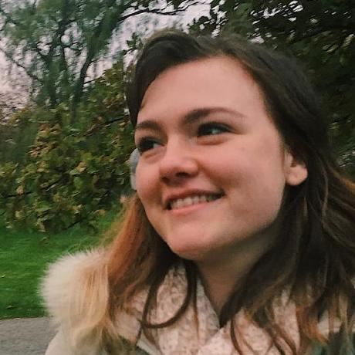
The Team
Angie
Magda
Jake
Hannah
Maciej

