Slide 1

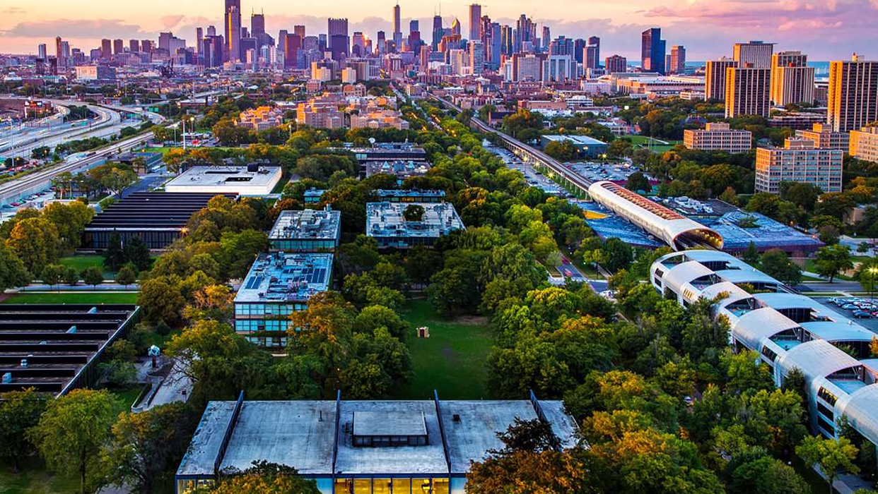

Team E

Slide 2

Problem
Solution
Result
- Unsafe campus
- Inability to access safety information or recent local incidents
- Need for easy access to emergency services and AED locations
A safer and happier campus community
A pedestrian commuter safety website

Slide 3
Improved campus safety
Safety Incidents
Crime incidents
AED Locations

Slide 4
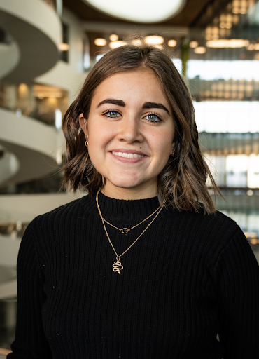
Name: Sofia Background: English is second language Small hometown Out of country freshman On-campus No car Goal: Safely travel to and from and around campus view and report crime/safety incidents Near real-time updates for nearby crime/safety incidents Get GPS based directions Link with other commuters via the walk buddy network

Slide 5
User Functions
Report a recent incident or safety hazard
Read recent reports
View a map of campus AED locations and recent crime and safety incidents
Call emergency services
Find a walk buddy

Slide 6
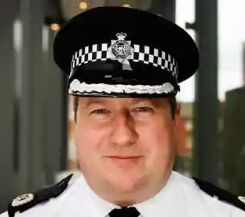
Name: Stewart Background: IIT Public Safety worker driving a Public Safety vehicle Working on-campus Goal: Keep campus safe by reviewing and keeping the information about incidents updated. Monitors and responds to reported incidents Develops the safety plans based on incidents reports Analyze hotspots for incidents / hazards

Slide 7
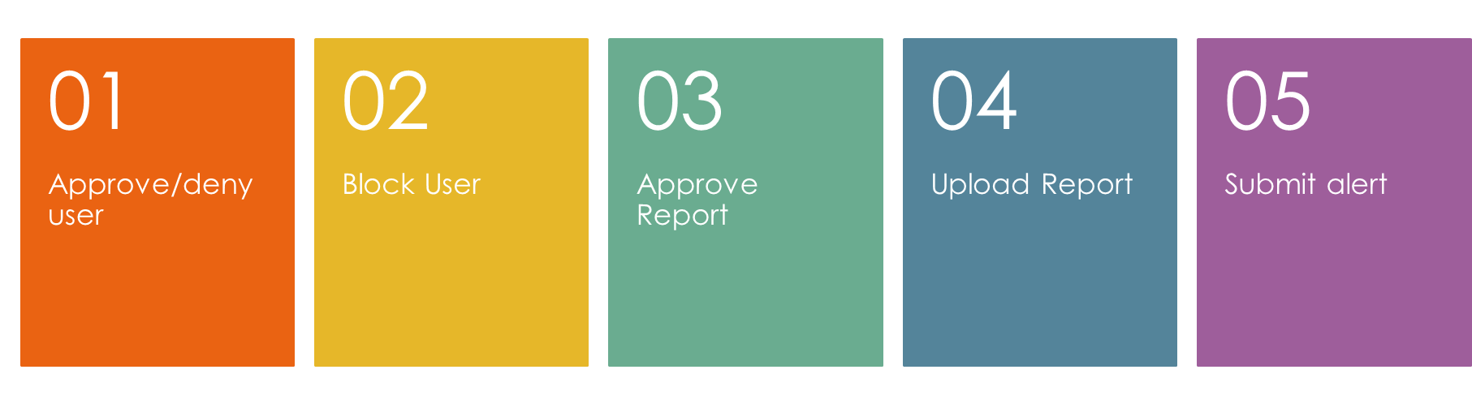
Administrative Functions

Slide 8
Next Steps
Integrating Chicago Police API
Administrative functionality
Adding filtering options to the map function
Create a secure functional walk buddy network

Slide 9
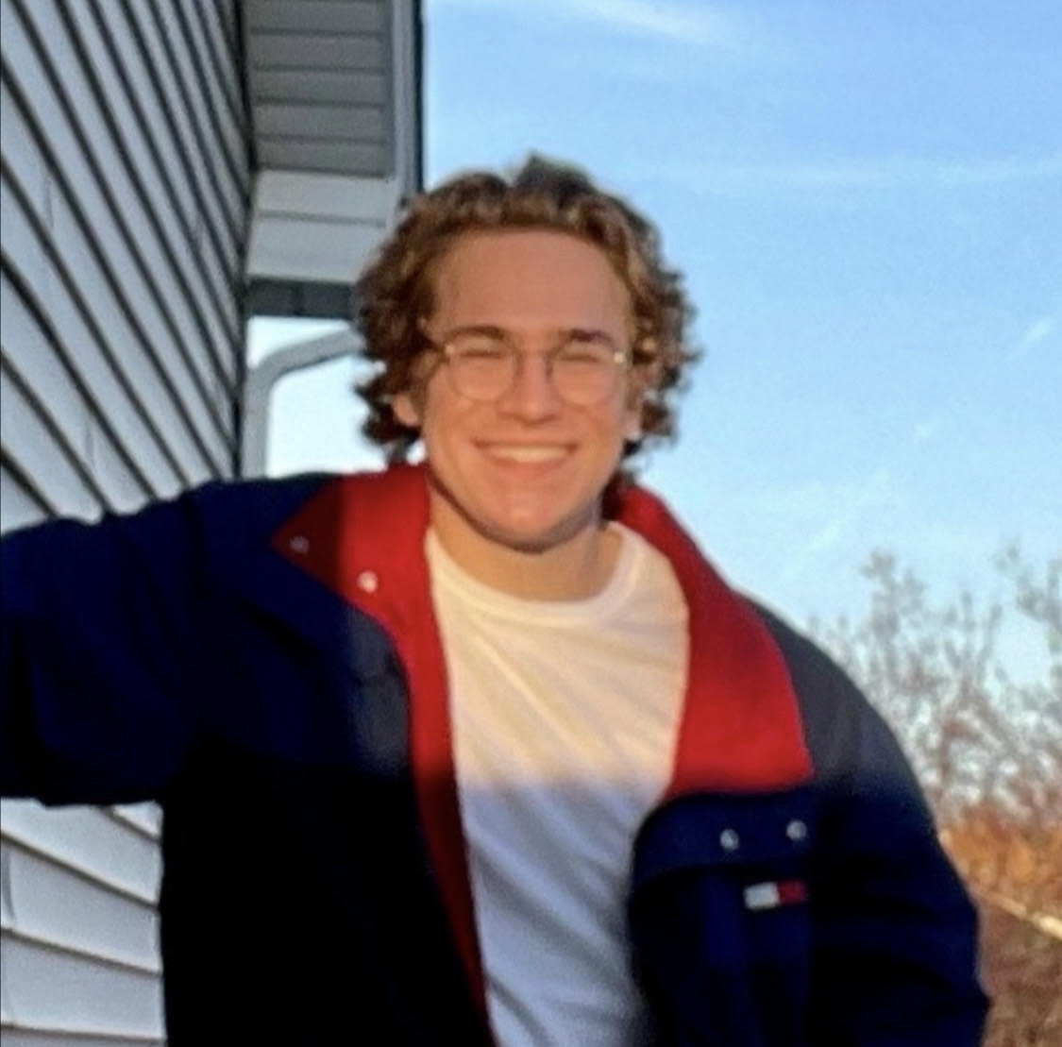
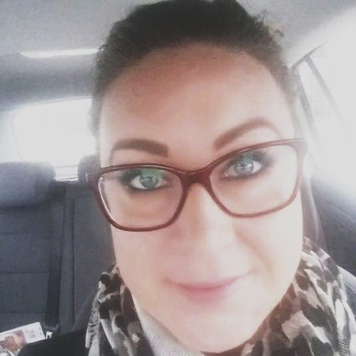
The Team
Backend
Maps
Jake
What did you learn about yourself? I learned some of the places I can make myself useful in a development team.
What did you learn about software development/Agile Process/Teams I learned the importance of keeping an organized kanban board and how that can facilitate the development process and workflows between team members.
What you would do differently in your next project/team? Make kanban tasks more granular, so that individual tasks are completed on time and tracked, instead of broad tasks with more parts taking longer to move through the development cycle.
What did you learn about yourself? When I hit a mental block I do better to take a break and come back with fresh eyes than to try to power through.
What did you learn about software development/Agile Process/Teams?
HTML and CSS What you would do differently in your next project/team?
Be more prepared/come with a better working knowledge of how achieve solving the problem
Frontend
HTML/CSS
Angie

Slide 10
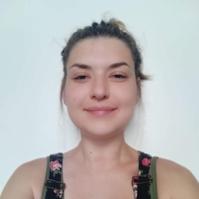
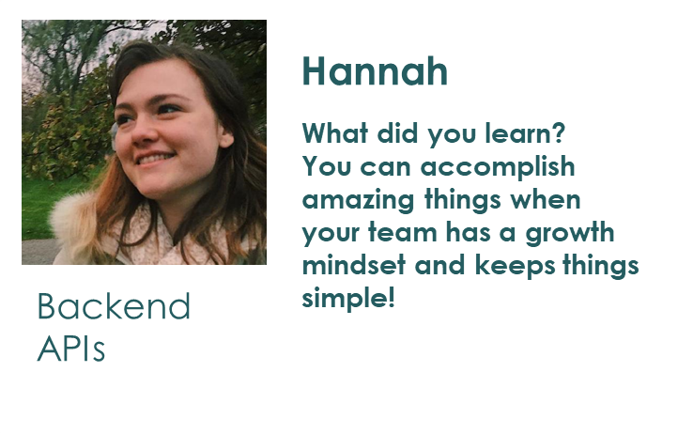

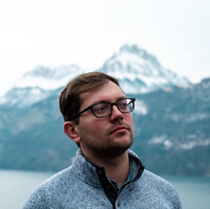
The Team
What did you learn about yourself? I work better when using an organized list
What did you learn about software development/Agile Process/Teams?
Perfected the ability to work in an agile workflow, (re)learned programming languages including markdown, and developed the ability to break down tasks into smart "stories" for better workflow.
What did you learn about the team?
The team makes the project stronger even if you lack the programming background needed there is always a way to contribute. It's always a learning process.
Magda
Frontend
CSS
Databases
What did you learn about yourself? I work better when using an organized list
What did you learn about software development/Agile Process/Teams?
Perfected the ability to work in an agile workflow, (re)learned programming languages including markdown, and developed the ability to break down tasks into smart "stories" for better workflow.
What did you learn about the team?
The team makes the project stronger even if you lack the programming background needed there is always a way to contribute. It's always a learning process.
Maciej
Maciej
Frontend
CSS

Slide 11
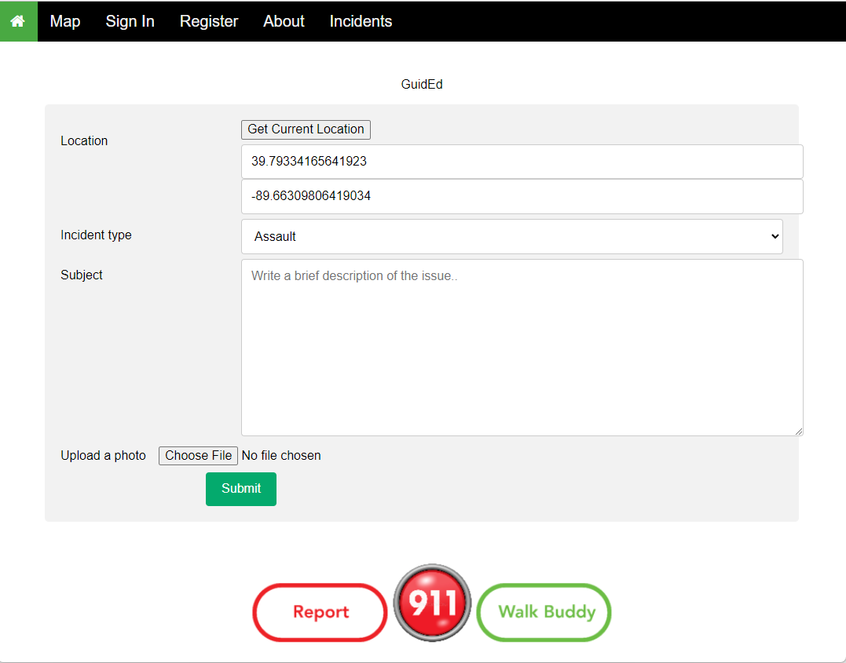
Find your location
Write a brief description
Upload a photo of the incident
Select type of incident
Submit for approval for posting

Slide 12
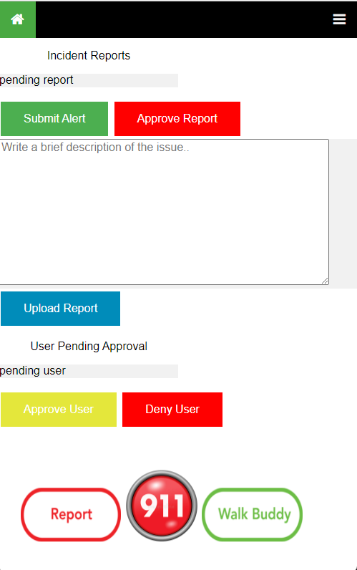
Submit an alert to appear on the news feed and on the map
Approve a report
Upload a report to be displayed on the incident report and map
Approve a user
Deny a user

Slide 13
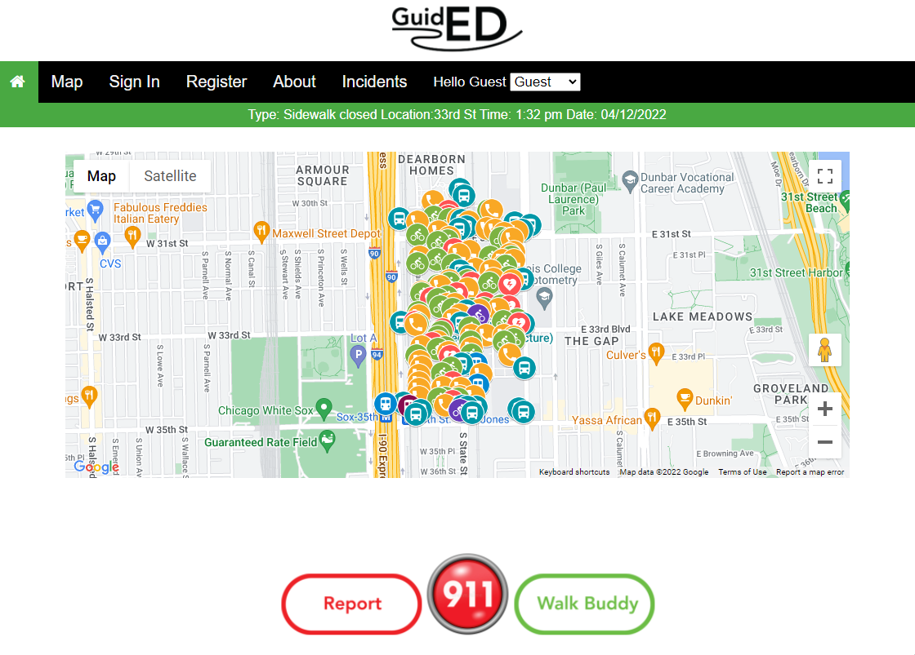
View incidents on map
View recent alerts
Call emergency services
Find a walk buddy
Report an incident

