Slide 1


University of Western Ontario and MathWorks present:
MATLAB ONRAMP
Michelle Bourdon
mbourdo@uwo.ca
Notes:
- Hi my name is Michelle and I am the MATLAB Ambassador for Western.
- Today I’ll give you a brief overview of MATLAB and then you will all have a chance to complete a MATLAB Onramp and win some fun prizes.

Slide 2
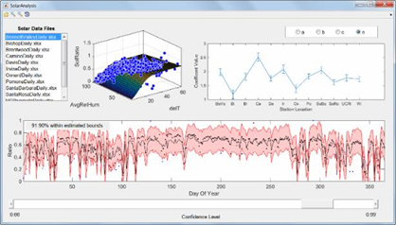
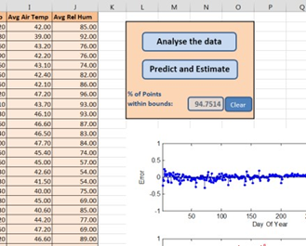

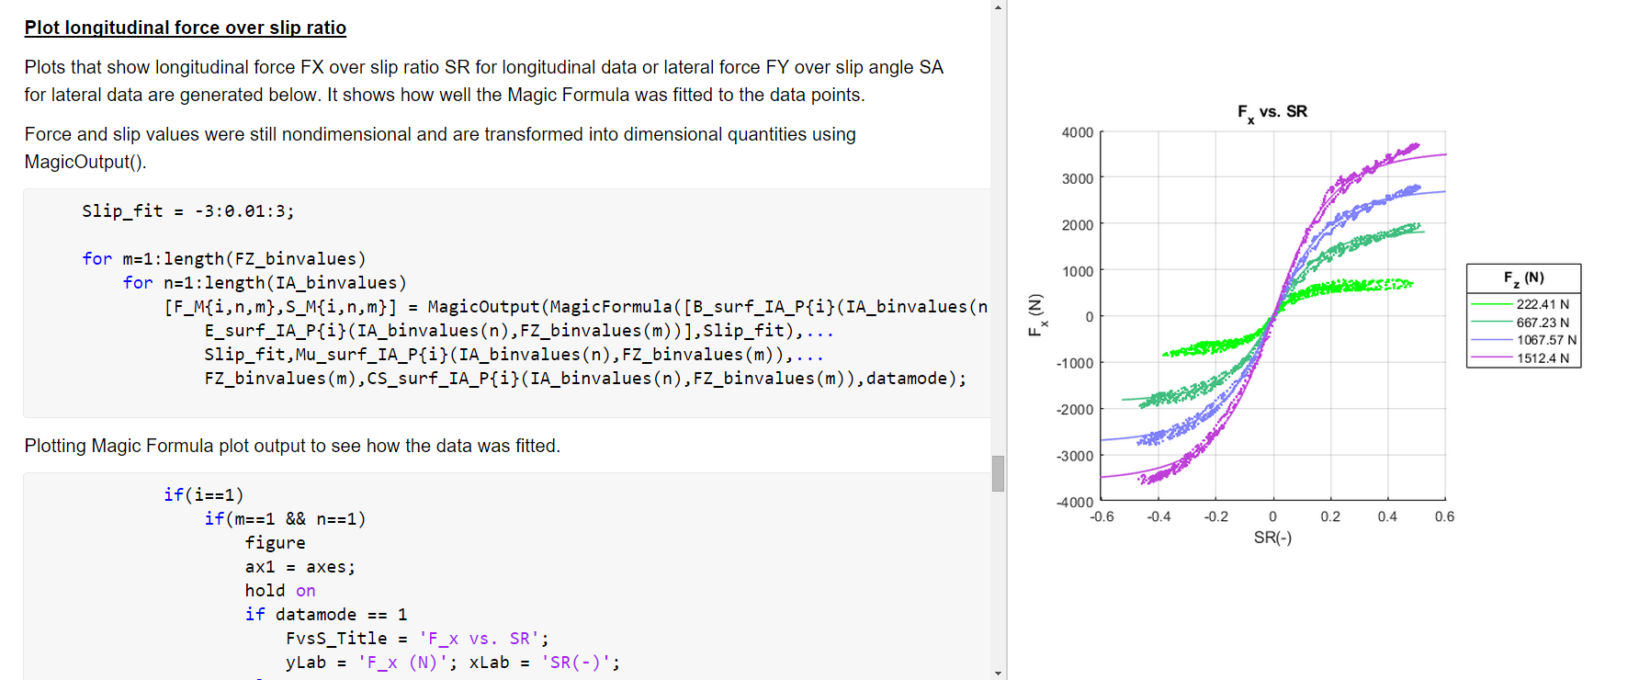
What is MATLAB?
Programming platform designed specifically for engineers and scientists
Matrix-based language
Allowing the most natural expression of computational mathematics
Using MATLAB, you can:
Analyze data
Develop algorithms
Create models and applications
Notes:
- If you don’t already know what MATLAB is, it is a programming platform designed for engineers and scientists.
- MATLAB can be used for analyzing data, developing algorithms, and creating models.

Slide 3




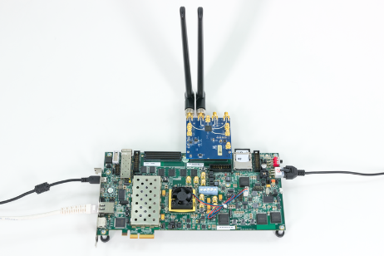




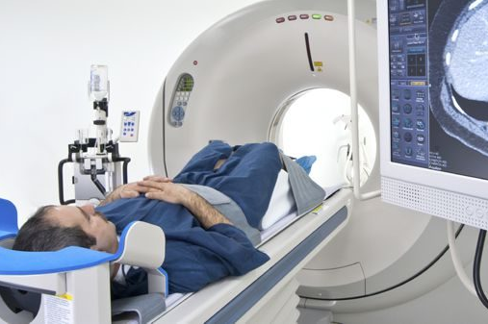




Key Industries that use MATLAB
Aerospace and Defense | Automotive | Biological Sciences | Biotech and Pharmaceutical | Communications
Electronics | Energy Production | Financial Services | Industrial Machinery | Medical Devices
Metals, Materials, Mining | Neuroscience | Railway Systems | Semiconductors | Software and Internet
Notes:
MATLAB is used in over 20 industries, from aerospace and automotive, to biotech, energy production, financial services, medical devices, and railway systems.
What about the companies that use MATLAB? Let’s take a look at some of the key companies that use MATLAB and see if you recognize any.

Slide 4




A few companies that use MATLAB
4 million+
users in 185 countries
Amazon
Apple
AT4 wireless
BAE Systems
Bank of England/PRA
BMW
Boeing
Facebook
Ford Motor Company
Genentech
Google
Huawei
Hydro-Québec
Intel
Johnson & Johnson
JP Morgan
NASA
Nokia
Qualcomm
Samsung
Siemens
Tetra Pak
Texas Instruments
Toyota
“If you want to work at Google, make sure you can use MATLAB”
Jonathan Rosenburg,
former Google Senior Vice President
Business Insider 2014
100,000+
businesses, governments, and universities
All of the top 10 automotive and aerospace companies
OICA: 2017 World Motor Vehicle Production PwC: Aerospace and Defense 2018 Year in Review
Notes:
Over 4 million engineers & scientists worldwide use MATLAB & Simulink
MATLAB software is used at over 100,000 businesses, governments, and universities around the world
And all of the top automotive and aerospace companies worldwide
Knowing MATLAB is important when looking for jobs in many industries and at top companies like Google

Slide 5
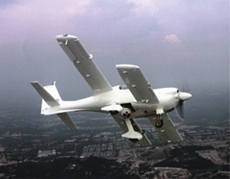
How do companies use MATLAB? BAE Systems - Develops Autopilot for Unmanned Aerial Vehicle (UAV) - Aerospace
Challenge
Enable teams working in separate locations to design a sophisticated UAV autopilot system quickly and inexpensively
Solution
Use MathWorks tools, modify existing software designs with Model-Based Design, and automatically generate embedded control code
Results
Design and rework costs substantially reduced
Testing cycle time minimized
Coding errors and manual documentation work minimized
An Eagle 150 unmanned aerial vehicle flight.
(Image courtesy of Composites Technology Research Malaysia.)
“MATLAB and Simulink greatly reduced development cycle time and cut system software design and testing costs by 50%.”
- Feng Liang, BAE Systems Controls
Link to user story
Notes:
Here is another example of how MATLAB is used
This time, in an Aerospace company
BAE systems used MATLAB to quickly design the autopilot system for a UAV

Slide 6

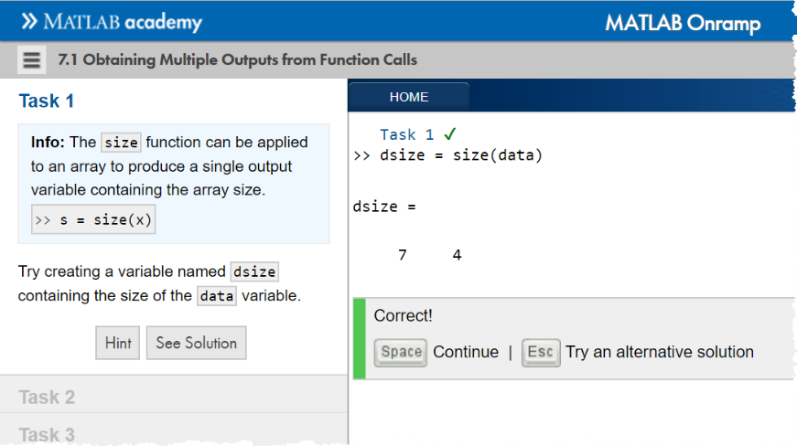

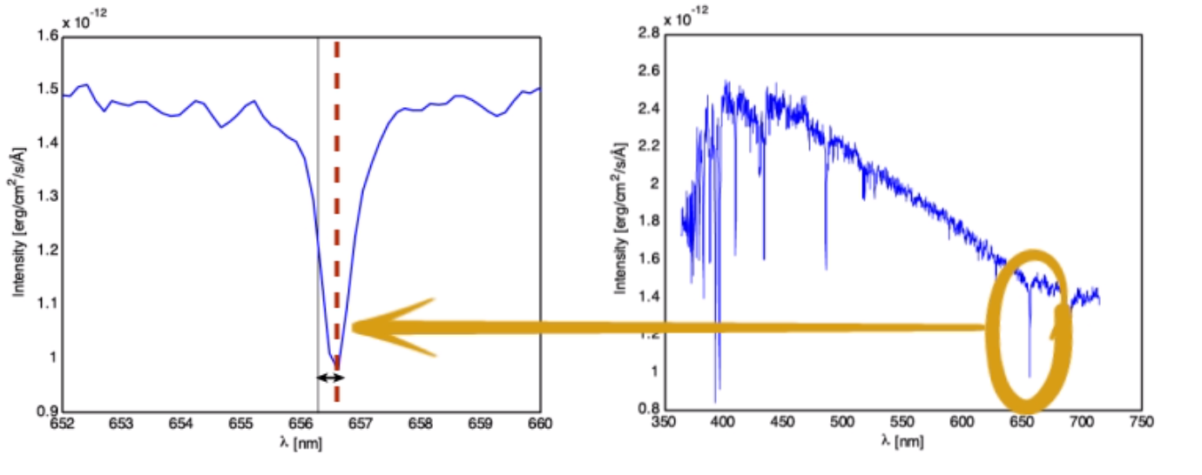
MATLAB Onramp
Learn the basics of MATLAB in 2 hours, at no cost
Hands-on exercises with feedback
Topics include:
MATLAB commands
Importing and manipulating data
Creating and annotating plots
Scripts and basic programming constructs
Notes:
Today you will be doing the MATLAB Onramp
This is a quick crash course in MATLAB which takes 2 hours or less
With hands on exercises

Slide 7
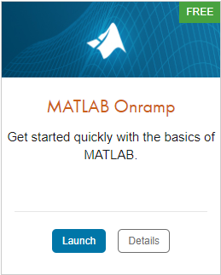
TO DO
Create your UWO - MathWorks Account
https://www.mathworks.com/academia/tah-portal/western-university-964054.html
Go to MATLAB Onramp https://matlabacademy.mathworks.com/
Launch MATLAB Onramp
Notes:
The first step is to setup a MathWorks account tied to your UWO login
After this, you can run the MATLAB Onramp from the second URL online or
from your installed version of MATLAB

Slide 8
Prizes
Complete at least 60% of MATLAB Onramp to be eligible for any prize
Bring your laptop when you come to collect the prize
Follow us on Instagram!
@UWOMATLAB
Notes:
We have prizes for those who get more than half way through the OnRamp in the hour here
Also, you MUST follow us on Instagram to receive a prize!
Come up and show me your laptop at the end of the event to get your prize
For those online – email me a screenshot of your browser showing the % done,
and your name – at the end of the event. I will send out details of a place and time to meet me for your prizes.)
My email address is mbourdo@uwo.ca

Slide 9
Other Course Offerings
These courses are free for students enrolled to a university with a MATLAB Academic Online Training Suite (MAOTS) license
MATLAB Programming Techniques
MATLAB for Data Processing and Visualization
Solving Ordinary Differential Equations with MATLAB
https://matlabacademy.mathworks.com/

Slide 10
Additional Resources
MATLAB Central
https://www.mathworks.com/matlabcentral/
Mathworks Academia
https://www.mathworks.com/academia.html?s_tid=gn_acad
Cody Problems
https://www.mathworks.com/matlabcentral/cody/

