Slide 1
1
2
Source: Balsamiq Mockups
3
See Page 3

Slide 2
Step 1
The user will select a shapefile containing the project boundary of the site by clicking the “Select Site Boundary” button . This project boundary is required to be either a shapefile or feature class of the polygon type. The add-data dialog box will allow the user to navigate to the dataset using the ESRI specific file selector as opposed to a windows file selector.
Step 2
The user will now select the folder where the final JD form will be saved. This will be accomplished by clicking the “JD Form Save Location” button and opening the folder selection dialog box. After selecting the save destination, the folder will be used as the final workspace for all JD info.
Step 3
After both of the previous steps have been completed the user can then click the “Create JD Form” button to create the final Microsoft Word document with all geographic data completed. Please see the next page to view the JD Form and the fields that will be automated. The automated fields reside in Section C, which is mostly background information.

Slide 3
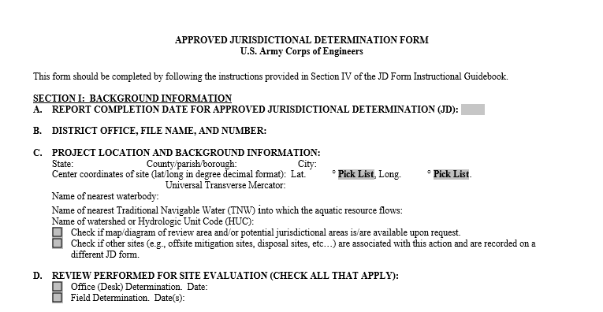
Parameters
Parameter 1: State in which the project resides
Parameter 2: County in which the project resides
Parameter 3: Latitude of center point of project
Parameter 4: Longitude of center point of project
Parameter 5: UTM coordinates of center point of project
Parameter 6: Name of nearest waterbody to site
Parameter 7: Name of nearest traditionally navigable waterway (TNW)
Parameter 8: Name of watershed boundary (HUC)
1
2
3
4
5
6
7
8

