Slide 1



Job_Market_Intelligence_Cameroon_pbip
View in Power BI
Last data refresh:
30/10/2026 22:13:37 UTC
Downloaded at:
30/10/2026 22:45:21 UTC

Slide 2
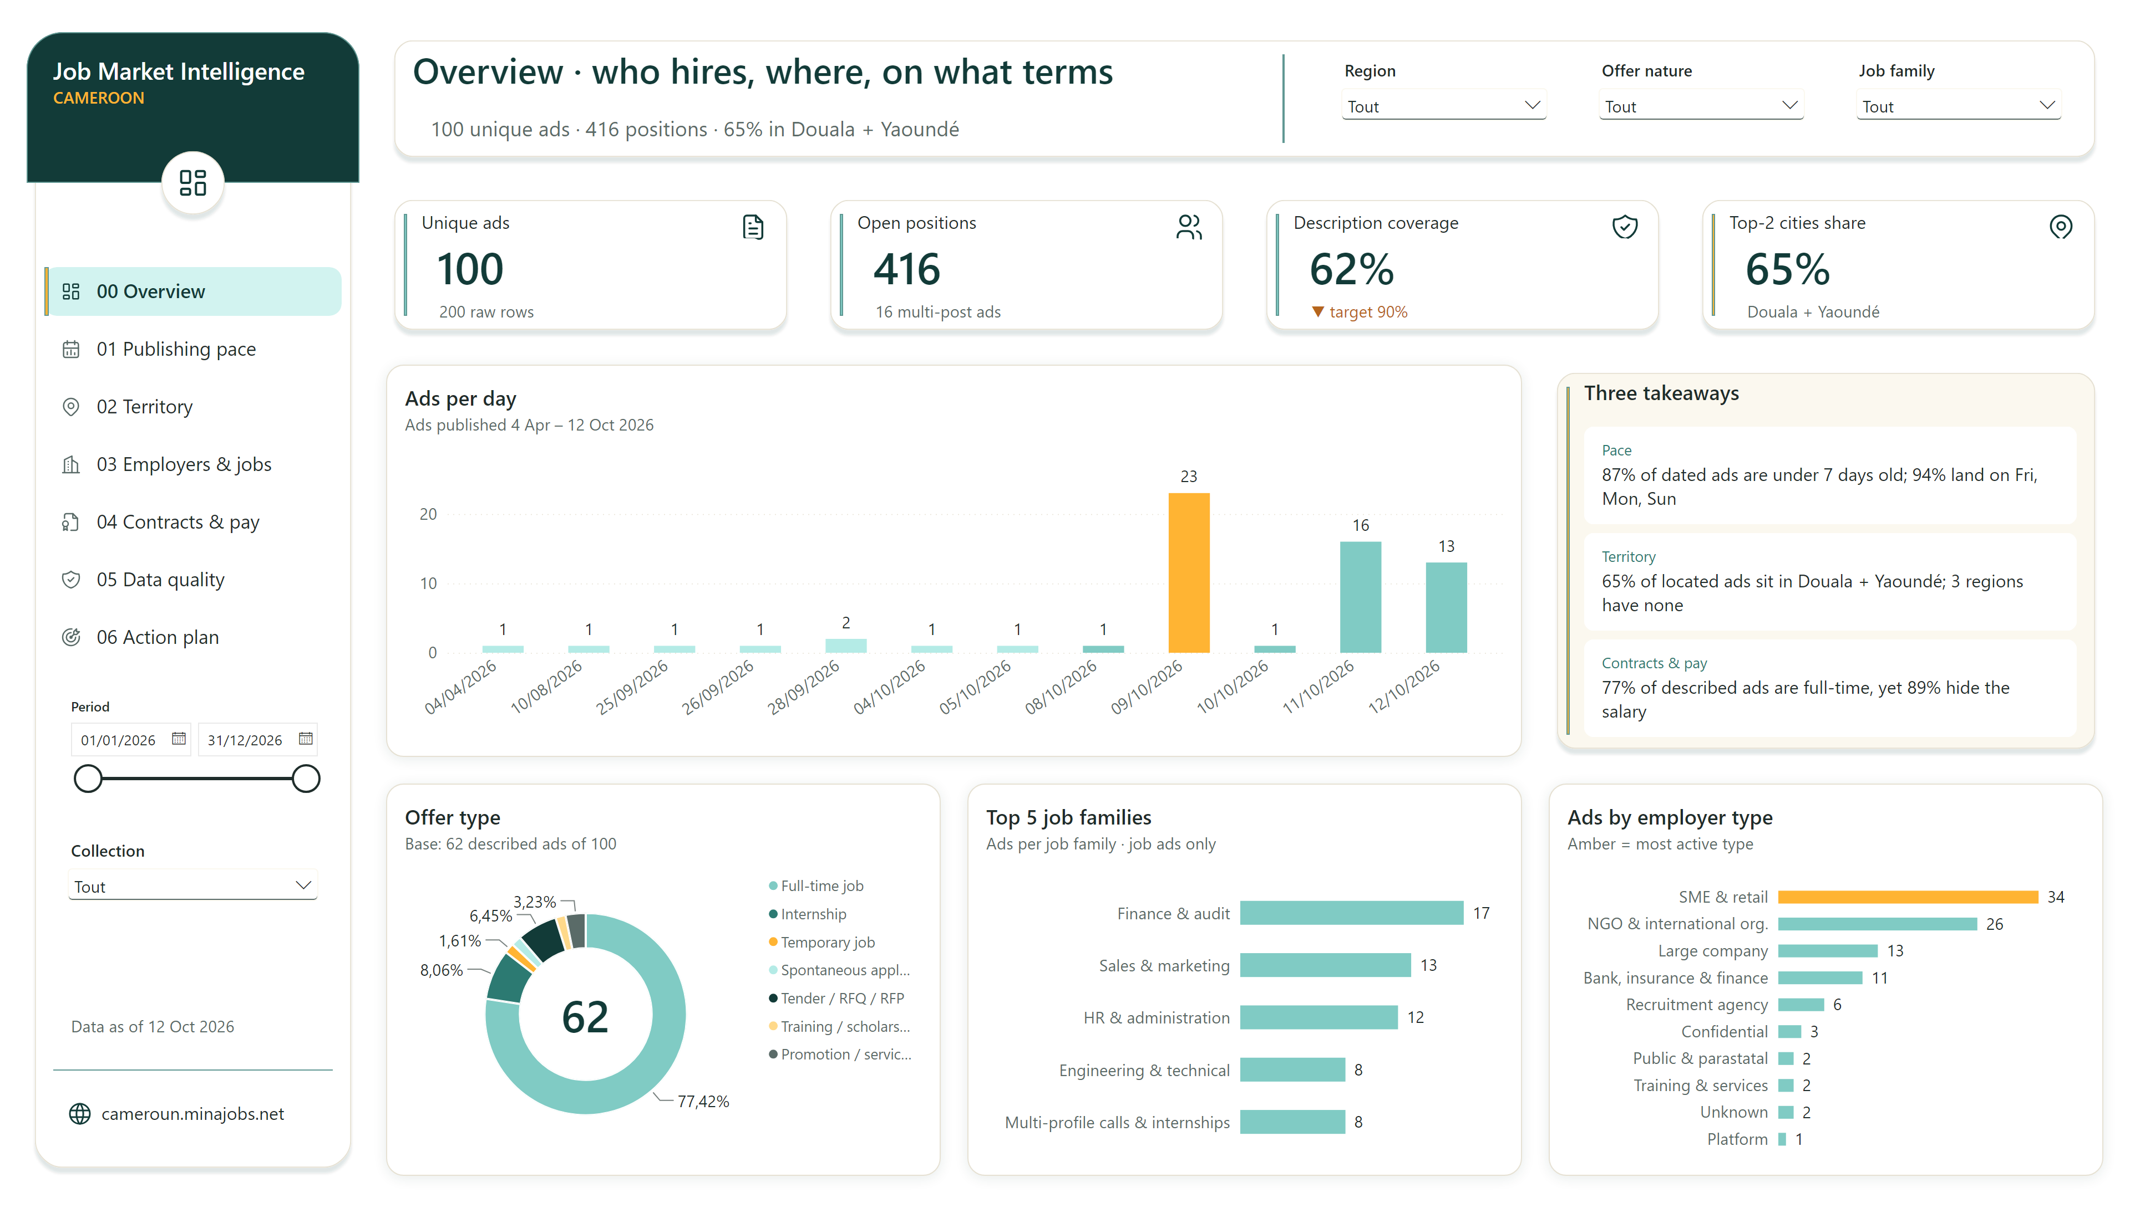
00 Overview
Notes:
textbox
No alt text provided
slicer
No alt text provided
shape
No alt text provided
actionButton
Navigate to 05 Data quality
shape
No alt text provided
Ads per day
Ads per day
actionButton
Navigate to 00 Overview
textbox
No alt text provided
image
users icon
image
target-arrow icon
image
calendar-stats icon
shape
No alt text provided
cardVisual
Top-2 cities share
textbox
Report name: Job Market Intelligence, Cameroon
Offer type
Offer type
slicer
No alt text provided
shape
No alt text provided
actionButton
Navigate to 04 Contracts & pay
image
layout-dashboard icon
slicer
No alt text provided
slicer
No alt text provided
image
shield-check icon
shape
No alt text provided
shape
No alt text provided
cardVisual
Page headline
cardVisual
Takeaway: Territory
cardVisual
Description coverage
shape
No alt text provided
image
map-pin icon
textbox
No alt text provided
Ads by employer type
Ads by employer type
actionButton
Navigate to 06 Action plan & risks
image
building icon
textbox
No alt text provided
image
file-certificate icon
shape
No alt text provided
image
map-pin icon
cardVisual
Top-2 cities share context
textbox
No alt text provided
shape
No alt text provided
cardVisual
Date of the latest data collection
shape
No alt text provided
cardVisual
Description coverage context
shape
No alt text provided
shape
No alt text provided
cardVisual
Takeaway: Contracts & pay
textbox
Page title: Overview · who hires, where, on what terms
shape
No alt text provided
cardVisual
Unique ads context
image
file-text icon
actionButton
Navigate to 03 Employers & jobs
cardVisual
Unique ads
cardVisual
Open positions
image
world icon
actionButton
Source: cameroun.minajobs.net
cardVisual
Open positions context
shape
No alt text provided
actionButton
Navigate to 02 Territory
image
shield-check icon
actionButton
Navigate to 01 Publishing pace
shape
No alt text provided
image
layout-dashboard icon
Top 5 job families
Top 5 job families
slicer
No alt text provided
cardVisual
Takeaway: Pace
shape
No alt text provided
shape
No alt text provided

Slide 3
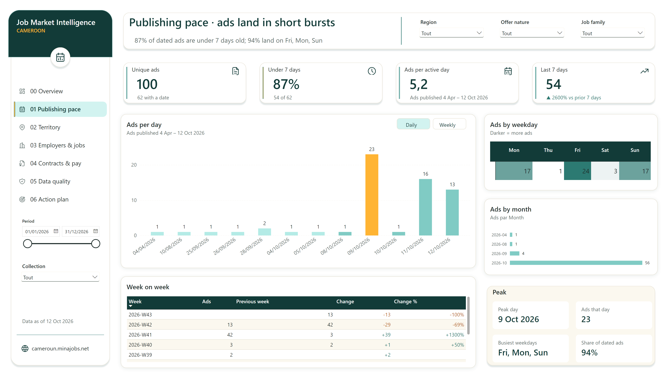
01 Publishing pace
Notes:
actionButton
Daily
cardVisual
No alt text provided
shape
No alt text provided
image
layout-dashboard icon
cardVisual
Ads per active day
image
world icon
shape
No alt text provided
slicer
No alt text provided
clusteredColumnChart
No alt text provided
actionButton
Navigate to 05 Data quality
textbox
Page title: Publishing pace · ads land in short bursts
slicer
No alt text provided
cardVisual
Last 7 days
cardVisual
Under 7 days context
slicer
No alt text provided
shape
No alt text provided
shape
No alt text provided
shape
No alt text provided
cardVisual
Date of the latest data collection
shape
No alt text provided
image
file-certificate icon
cardVisual
Page headline
cardVisual
No alt text provided
textbox
No alt text provided
image
calendar-stats icon
image
calendar-stats icon
actionButton
Navigate to 00 Overview
actionButton
Source: cameroun.minajobs.net
image
building icon
actionButton
Navigate to 04 Contracts & pay
image
map-pin icon
actionButton
Navigate to 01 Publishing pace
shape
No alt text provided
cardVisual
Unique ads context
image
shield-check icon
image
calendar-stats icon
cardVisual
No alt text provided
textbox
No alt text provided
Week on week
Week on week
Ads per day
Ads per day
actionButton
Navigate to 02 Territory
cardVisual
Ads per active day context
shape
No alt text provided
shape
No alt text provided
Ads by month
Ads by month
shape
No alt text provided
image
clock icon
cardVisual
Last 7 days context
actionButton
Navigate to 06 Action plan & risks
actionButton
Weekly
image
trending-up icon
shape
No alt text provided
image
file-text icon
shape
No alt text provided
actionButton
Navigate to 03 Employers & jobs
Ads by weekday
Ads by weekday
textbox
No alt text provided
shape
No alt text provided
slicer
No alt text provided
textbox
Report name: Job Market Intelligence, Cameroon
shape
No alt text provided
cardVisual
Unique ads
textbox
No alt text provided
shape
No alt text provided
shape
No alt text provided
slicer
No alt text provided
textbox
No alt text provided
image
target-arrow icon
cardVisual
No alt text provided
cardVisual
Under 7 days

Slide 4
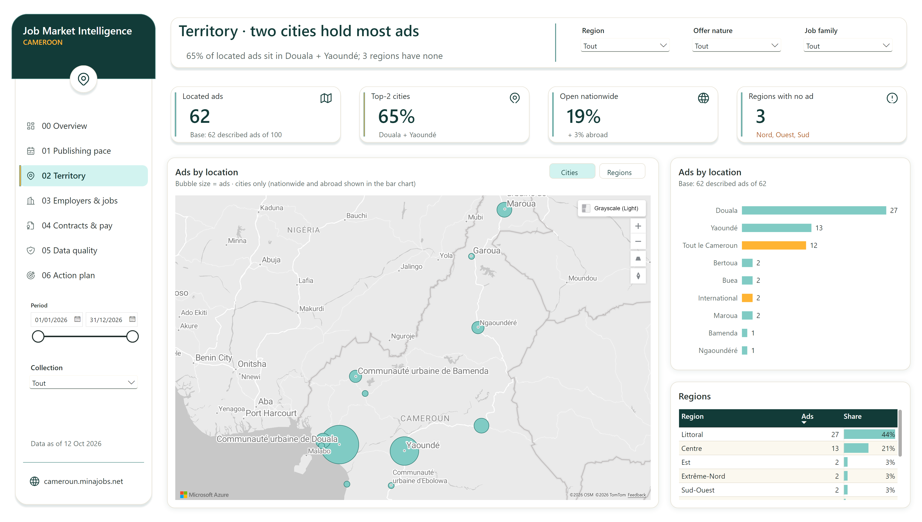
02 Territory
Notes:
cardVisual
Located ads context
actionButton
Source: cameroun.minajobs.net
actionButton
Navigate to 02 Territory
image
alert-circle icon
shape
No alt text provided
Ads by location
Ads by location
cardVisual
Regions with no ad
clusteredBarChart
No alt text provided
slicer
No alt text provided
image
world icon
image
map icon
actionButton
Navigate to 03 Employers & jobs
cardVisual
Top-2 cities
shape
No alt text provided
shape
No alt text provided
textbox
No alt text provided
textbox
Report name: Job Market Intelligence, Cameroon
cardVisual
Page headline
slicer
No alt text provided
actionButton
Navigate to 06 Action plan & risks
image
map-pin icon
shape
No alt text provided
actionButton
Regions
cardVisual
Open nationwide
image
calendar-stats icon
shape
No alt text provided
cardVisual
Open nationwide context
shape
No alt text provided
shape
No alt text provided
image
file-certificate icon
image
building icon
slicer
No alt text provided
cardVisual
Top-2 cities context
shape
No alt text provided
actionButton
Navigate to 04 Contracts & pay
image
target-arrow icon
actionButton
Cities
shape
No alt text provided
cardVisual
Regions with no ad context
textbox
Page title: Territory · two cities hold most ads
actionButton
Navigate to 00 Overview
image
map-pin icon
slicer
No alt text provided
shape
No alt text provided
textbox
No alt text provided
shape
No alt text provided
shape
No alt text provided
Regions
Regions
image
layout-dashboard icon
image
map-pin icon
cardVisual
Date of the latest data collection
actionButton
Navigate to 01 Publishing pace
Ads by location
Ads by location
slicer
No alt text provided
image
world icon
shape
No alt text provided
cardVisual
Located ads
actionButton
Navigate to 05 Data quality
image
shield-check icon
textbox
No alt text provided
shape
No alt text provided
shape
No alt text provided
textbox
No alt text provided

Slide 5
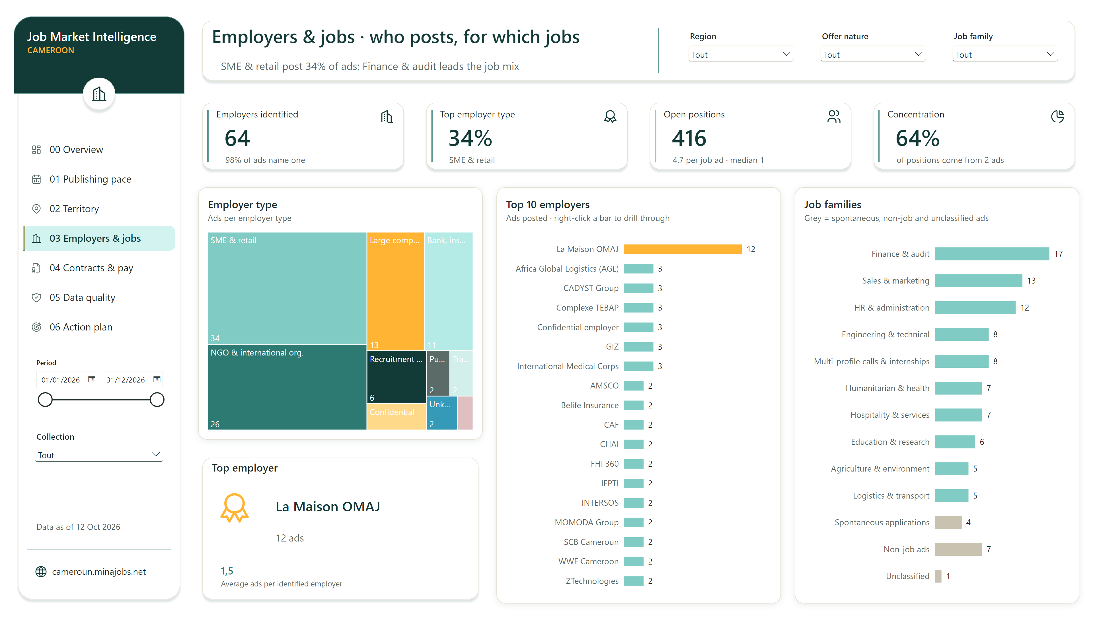
03 Employers & jobs
Notes:
shape
No alt text provided
actionButton
Navigate to 01 Publishing pace
actionButton
Navigate to 04 Contracts & pay
slicer
No alt text provided
slicer
No alt text provided
textbox
No alt text provided
textbox
No alt text provided
actionButton
Navigate to 02 Territory
cardVisual
Employers identified context
cardVisual
Date of the latest data collection
textbox
Report name: Job Market Intelligence, Cameroon
image
target-arrow icon
image
layout-dashboard icon
cardVisual
No alt text provided
shape
No alt text provided
Employer type
Employer type
slicer
No alt text provided
shape
No alt text provided
shape
No alt text provided
shape
No alt text provided
shape
No alt text provided
shape
No alt text provided
cardVisual
Employer with the most ads
image
file-certificate icon
image
building icon
shape
No alt text provided
shape
No alt text provided
textbox
Page title: Employers & jobs · who posts, for which jobs
cardVisual
Concentration
image
award icon
shape
No alt text provided
cardVisual
No alt text provided
image
shield-check icon
cardVisual
Concentration context
actionButton
Navigate to 05 Data quality
cardVisual
Employers identified
textbox
No alt text provided
cardVisual
Top employer type
actionButton
Navigate to 06 Action plan & risks
actionButton
Navigate to 00 Overview
shape
No alt text provided
cardVisual
Open positions
cardVisual
Open positions context
image
building icon
image
building icon
slicer
No alt text provided
Top 10 employers
Top 10 employers
Job families
Job families
image
chart-pie icon
slicer
No alt text provided
shape
No alt text provided
image
world icon
image
map-pin icon
textbox
No alt text provided
cardVisual
Top employer type context
shape
No alt text provided
image
users icon
shape
No alt text provided
shape
No alt text provided
cardVisual
Page headline
shape
No alt text provided
textbox
No alt text provided
image
award icon
image
calendar-stats icon
actionButton
Source: cameroun.minajobs.net
actionButton
Navigate to 03 Employers & jobs

Slide 6
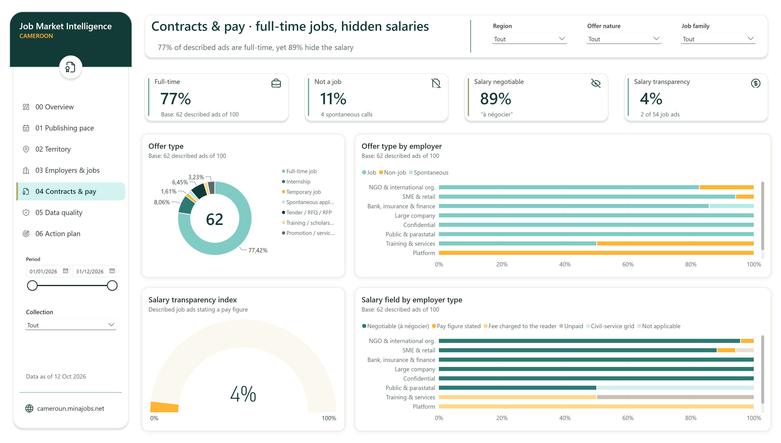
04 Contracts & pay
Notes:
shape
No alt text provided
slicer
No alt text provided
textbox
No alt text provided
cardVisual
Full-time
actionButton
Source: cameroun.minajobs.net
cardVisual
Date of the latest data collection
shape
No alt text provided
image
world icon
Salary field by employer type
Salary field by employer type
textbox
No alt text provided
textbox
No alt text provided
image
shield-check icon
shape
No alt text provided
actionButton
Navigate to 04 Contracts & pay
slicer
No alt text provided
cardVisual
Full-time context
image
file-certificate icon
Offer type
Offer type
cardVisual
Not a job
actionButton
Navigate to 03 Employers & jobs
actionButton
Navigate to 01 Publishing pace
image
calendar-stats icon
slicer
No alt text provided
image
file-off icon
cardVisual
Salary transparency
shape
No alt text provided
shape
No alt text provided
cardVisual
Not a job context
image
coin icon
image
eye-off icon
shape
No alt text provided
shape
No alt text provided
textbox
Report name: Job Market Intelligence, Cameroon
actionButton
Navigate to 00 Overview
cardVisual
Salary negotiable context
cardVisual
Page headline
Salary transparency index
Salary transparency index
textbox
No alt text provided
slicer
No alt text provided
shape
No alt text provided
image
building icon
actionButton
Navigate to 06 Action plan & risks
shape
No alt text provided
image
target-arrow icon
image
briefcase icon
image
file-certificate icon
shape
No alt text provided
cardVisual
Salary negotiable
actionButton
Navigate to 05 Data quality
textbox
Page title: Contracts & pay · full-time jobs, hidden salaries
shape
No alt text provided
slicer
No alt text provided
shape
No alt text provided
image
layout-dashboard icon
shape
No alt text provided
Offer type by employer
Offer type by employer
cardVisual
Salary transparency context
shape
No alt text provided
shape
No alt text provided
actionButton
Navigate to 02 Territory
image
map-pin icon

Slide 7
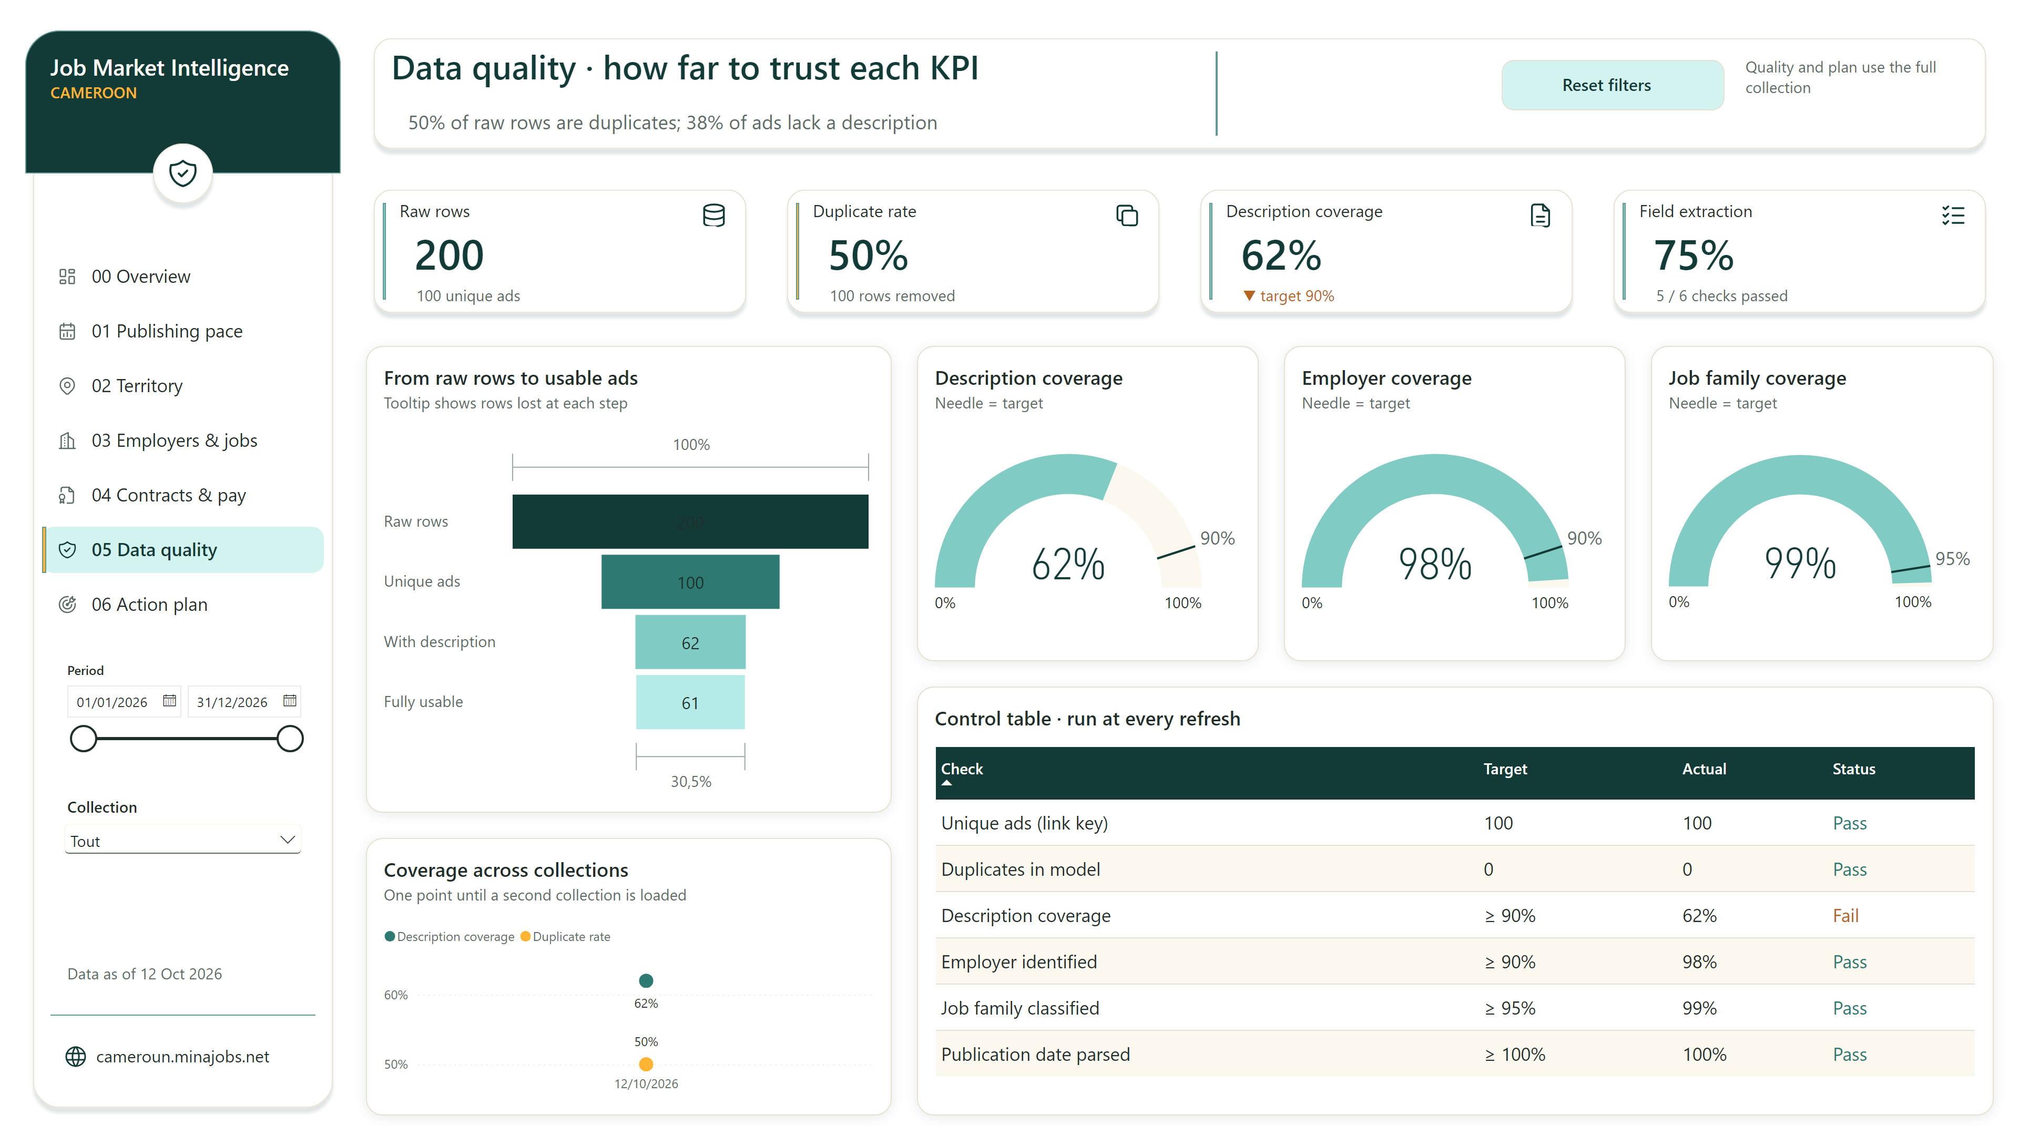
05 Data quality
Notes:
actionButton
Source: cameroun.minajobs.net
cardVisual
Date of the latest data collection
image
calendar-stats icon
shape
No alt text provided
image
target-arrow icon
textbox
No alt text provided
image
layout-dashboard icon
slicer
No alt text provided
Description coverage
Description coverage
shape
No alt text provided
shape
No alt text provided
Coverage across collections
Coverage across collections
image
list-check icon
textbox
No alt text provided
textbox
No alt text provided
shape
No alt text provided
image
map-pin icon
From raw rows to usable ads
From raw rows to usable ads
image
shield-check icon
actionButton
Navigate to 05 Data quality
shape
No alt text provided
shape
No alt text provided
Job family coverage
Job family coverage
actionButton
Navigate to 00 Overview
actionButton
Navigate to 03 Employers & jobs
textbox
No alt text provided
shape
No alt text provided
shape
No alt text provided
image
shield-check icon
image
database icon
cardVisual
Raw rows
actionButton
Navigate to 02 Territory
actionButton
Navigate to 01 Publishing pace
actionButton
Navigate to 04 Contracts & pay
cardVisual
Description coverage context
actionButton
Reset filters
cardVisual
Field extraction context
cardVisual
Page headline
image
copy icon
textbox
Report name: Job Market Intelligence, Cameroon
shape
No alt text provided
cardVisual
Description coverage
textbox
Page title: Data quality · how far to trust each KPI
Control table · run at every refresh
Control table · run at every refresh
shape
No alt text provided
image
file-certificate icon
image
building icon
cardVisual
Raw rows context
shape
No alt text provided
cardVisual
Duplicate rate
shape
No alt text provided
actionButton
Navigate to 06 Action plan & risks
shape
No alt text provided
shape
No alt text provided
shape
No alt text provided
slicer
No alt text provided
Employer coverage
Employer coverage
image
world icon
cardVisual
Field extraction
image
file-description icon
cardVisual
Duplicate rate context
textbox
No alt text provided

Slide 8
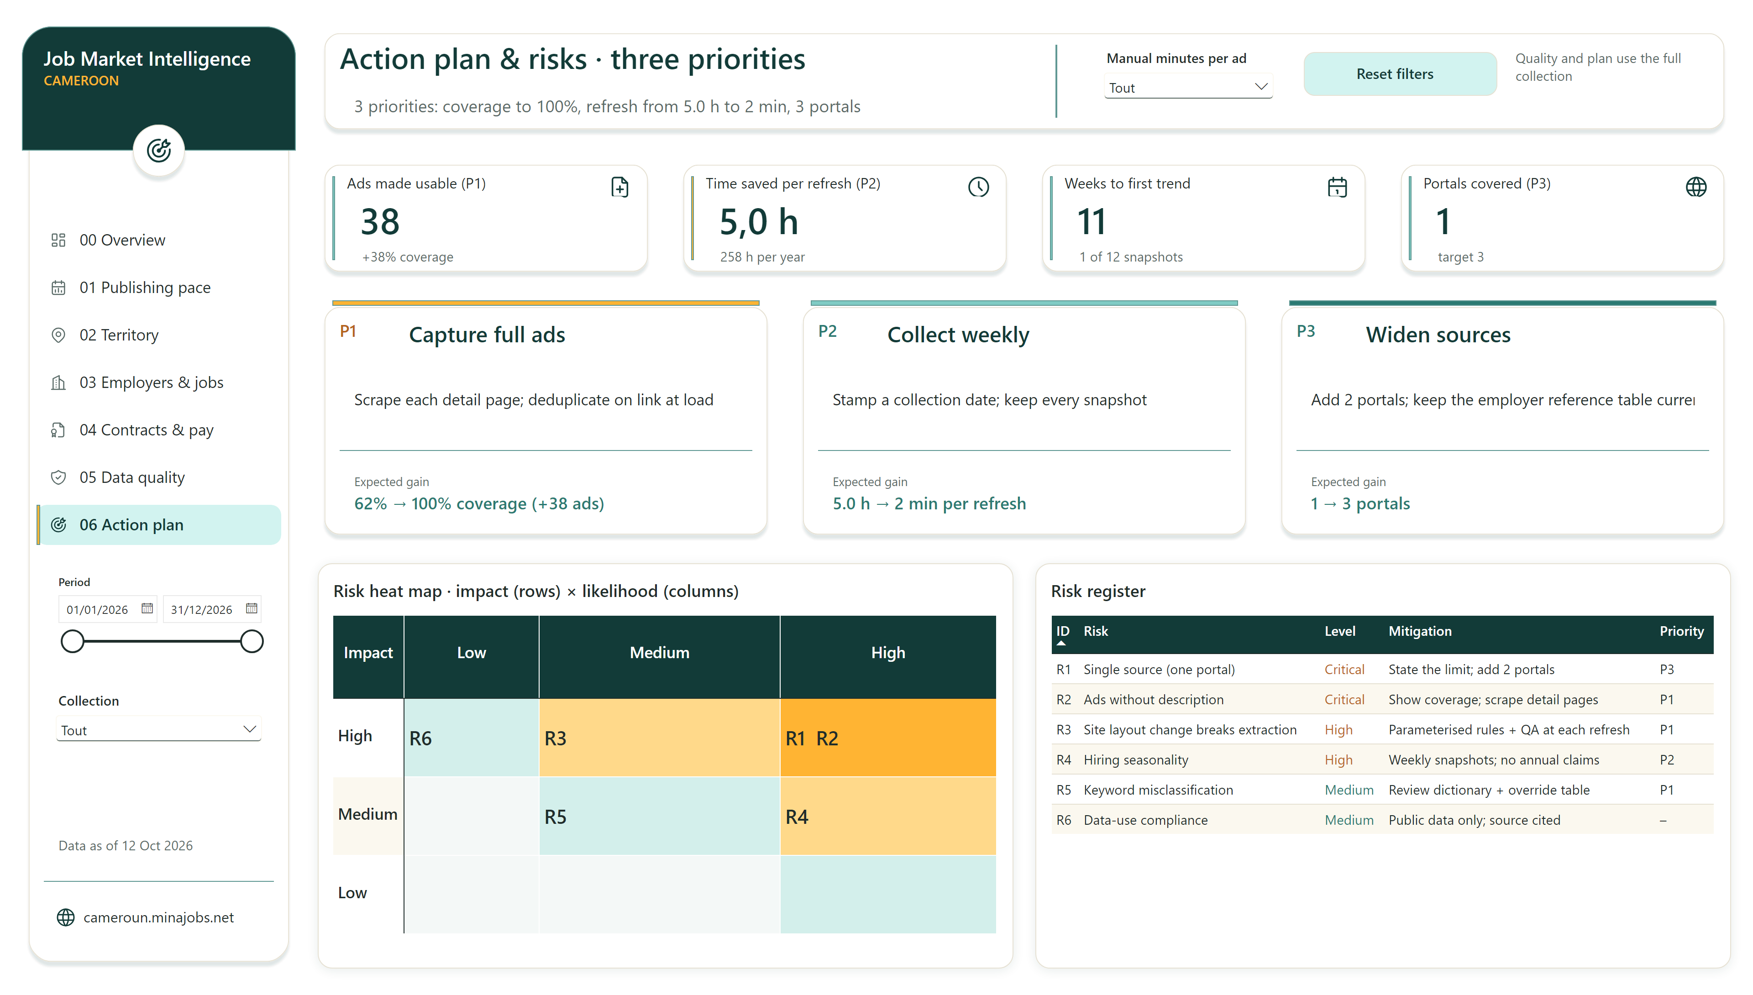
06 Action plan & risks
Notes:
shape
No alt text provided
shape
No alt text provided
actionButton
Navigate to 02 Territory
actionButton
Navigate to 00 Overview
shape
No alt text provided
actionButton
Source: cameroun.minajobs.net
textbox
No alt text provided
textbox
No alt text provided
image
calendar-stats icon
textbox
No alt text provided
shape
No alt text provided
actionButton
Navigate to 04 Contracts & pay
shape
No alt text provided
cardVisual
No alt text provided
actionButton
Navigate to 03 Employers & jobs
cardVisual
No alt text provided
slicer
No alt text provided
shape
No alt text provided
shape
No alt text provided
shape
No alt text provided
textbox
No alt text provided
image
target-arrow icon
shape
No alt text provided
image
map-pin icon
shape
No alt text provided
cardVisual
Ads made usable (P1) context
actionButton
Navigate to 01 Publishing pace
textbox
Report name: Job Market Intelligence, Cameroon
image
building icon
shape
No alt text provided
image
target-arrow icon
image
file-plus icon
actionButton
Reset filters
shape
No alt text provided
shape
No alt text provided
shape
No alt text provided
Risk heat map · impact (rows) × likelihood (columns)
Risk heat map · impact (rows) × likelihood (columns)
shape
No alt text provided
image
world icon
shape
No alt text provided
image
shield-check icon
textbox
No alt text provided
cardVisual
No alt text provided
textbox
No alt text provided
shape
No alt text provided
image
layout-dashboard icon
cardVisual
Portals covered (P3) context
cardVisual
Portals covered (P3)
slicer
No alt text provided
shape
No alt text provided
cardVisual
Time saved per refresh (P2)
cardVisual
No alt text provided
cardVisual
No alt text provided
cardVisual
No alt text provided
shape
No alt text provided
textbox
No alt text provided
textbox
Page title: Action plan & risks · three priorities
image
file-certificate icon
cardVisual
Weeks to first trend context
cardVisual
No alt text provided
actionButton
Navigate to 06 Action plan & risks
cardVisual
Page headline
shape
No alt text provided
shape
No alt text provided
textbox
No alt text provided
cardVisual
Time saved per refresh (P2) context
cardVisual
No alt text provided
Risk register
Risk register
shape
No alt text provided
cardVisual
Weeks to first trend
image
clock icon
actionButton
Navigate to 05 Data quality
image
calendar icon
cardVisual
Ads made usable (P1)
cardVisual
Date of the latest data collection
cardVisual
No alt text provided
shape
No alt text provided
slicer
No alt text provided
image
world icon
shape
No alt text provided

