Slide 1
Introduction to the Prosci ADKAR® Model
A Model for Individual Change
Notes:
Purpose
A ready-to-deliver resource that a change practitioner can use to facilitate a 30-minute group session to introduce the Prosci ADKAR Model and establish a common language for change. Establishing the ADKAR Model as a common language for change is a pre-requisite for engaging key stakeholders in applying the ADKAR Model, including the ADKAR Blueprint and ADKAR Assessments.
Intended Use
This resource is intended to be used with a representative group of project stakeholders, including the change management team, project team, senior leaders and key business leaders from the impacted groups. You are encouraged to adapt the resource for your situation by considering your practitioner competency level, facilitation skills, project conditions and time constraints.
How to Use this Resource
Customize the resource by adding your company logo and project name to the title slide.
The PowerPoint slides are divided into sections, which correspond to the agenda topics.
The content slides include speaking notes and facilitation tips.
The slides for the optional engagement activities are hidden. The use of these hidden slides is up to you and will depend on the needs and interests of your project stakeholders, as well as your time constraints.

Slide 2


Agenda
Suggested Time:
30 minutes
Materials Required:
ADKAR Assessment
The ADKAR Model enables individual adoption and usage
Introduction to the ADKAR Model (10 min)
ADKAR Assessment Activity (10 min)
ADKAR Model Summary (10 min)
Notes:
Activity timing for a 30-minute session
Introduction to the ADKAR Model- 10 minutes
Complete an ADKAR Assessment Activity - 10 minutes
ADKAR Model Summary – 10 minutes

Slide 3



Jeff Hiatt Quote About ADKAR
“
The secret to successful change lies beyond the visible and busy activities that surround change. Successful change, at its core, is rooted in something much simpler: how to facilitate change with one person.”
Jeff Hiatt
Prosci founder
Creator of ADKAR
© Prosci. All Rights Reserved.
3
Notes:
Jeff Hiatt is the founder of Prosci and created the ADKAR Model.
Prior to founding Prosci, he worked for nearly 20 years as an engineer with Bell Laboratories and as a project leader for other companies on large-scale process, system and organizational changes. His experience was a mixture of successes and failures.
Despite his extensive education and work experience as an engineer, finding the solution to why one change initiative was successful and another, of seemingly equal business value was not, proved elusive. As an engineer, he was surprised to find the most challenging problems dealt with people, not things.
This quote from Jeff summarizes his conclusion regarding the secret to successful change.
Discussion
Solicit reactions to the quote from your participants.

Slide 4
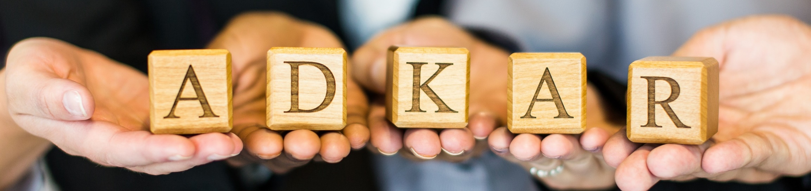
Prosci® ADKAR® Model
5 Elements of Successful Change
Change
Patterns
Individual and Organizational Levels
The ADKAR Model represents the five elements of change that must be achieved for the change to be a success.
The ADKAR Model was developed by Prosci after studying the change patterns of more than 700 organizations.
The ADKAR Model is an effective tool for enabling change at an individual level and guides activities at an organizational level.
Notes:
The ADKAR Model is a results-oriented framework for understanding and enabling change at an individual level.
The model describes the five “building blocks” or elements an individual needs to achieve for a personal or business change to be successful.
The building blocks are:
Awareness of the need for change
Desire to support and participate in the change
Knowledge on how to change
Ability to implement required skills and behaviors
Reinforcement to sustain the change.
A successful change requires all five elements of the ADKAR model to be present.
The ADKAR Model was developed by Prosci after studying the change patterns of more than 700 organizations.

Slide 5

The 5 Elements of Successful Change
Change begins with understanding why
Awareness
Desire
Knowledge
Ability
Reinforcement
Awareness
What is the nature of the change?
Why is the change needed?
What is the risk of not changing?
Notes:
Explain the five elements of the ADKAR Model by using a personal story to show that the individual change model can be applied to support both personal and business changes.
Your story should illustrate all five ADKAR elements and include a barrier point, which you will describe in more detail later in your presentation.
Begin with Awareness.
Emphasize that while it’s important to explain the nature of the change, it is even more important to explain why the change is needed and the risk of not changing.

Slide 6

The 5 Elements of Successful Change
Change involves personal decisions
Awareness
Desire
Knowledge
Ability
Reinforcement
Desire
What’s in it for me (WIIFM)?
A personal choice
A decision to engage and participate
Notes:
Next, explain Desire.
Emphasize the importance of WIIFM – What’s In It For Me to provide the intrinsic motivation necessary to produce Desire.
Acknowledge the reality that the Desire to change is a personal choice. Ultimately, the individual that you would like to adopt a change must make the personal decision to engage and participate.

Slide 7

The 5 Elements of Successful Change
Change requires knowing how
Awareness
Desire
Knowledge
Ability
Reinforcement
Knowledge
Understanding how to change
Training on new processes and tools
Learning new skills
Notes:
The third element is Knowledge.
The development of Knowledge often requires learning new skills to be able to successfully adopt and use a change.

Slide 8

The 5 Elements of Successful Change
Change requires action in the right direction
Awareness
Desire
Knowledge
Ability
Reinforcement
Ability
The demonstrated capability to implement the change
Achievement of the desired change in performance or behavior
Notes:
The fourth element is Ability.
Distinguish between Knowledge and Ability. A person may have the training they need but are unable to translate the Knowledge into Ability.
To explain the distinction, use an example, such as a person who has taken many lessons with a golf professional, but still slices or hooks every one of their drives.

Slide 9

The 5 Elements of Successful Change
Change must be reinforced to be sustained
Awareness
Desire
Knowledge
Ability
Reinforcement
Reinforcement
Actions that increase the likelihood that a change will be continued
Recognition and rewards that sustain the change
Notes:
The fifth and final element of the ADAKR Model is Reinforcement.
Explain that just demonstrating the Ability to apply the change doesn’t mean the change has been successful. The change must be Reinforced to ensure that the person will sustain the change.

Slide 10

Complete the ADKAR Assessment and Determine the Barrier Point
Complete a personal ADKAR Assessment.
Identify a score for each of the five elements.
To create an ADKAR profile bar graph, mark your score for each element and shade the area below the mark to create each “bar.”
Share your ADKAR scores.
The best way to learn the ADKAR Model is to apply it on a personal change that matters to you.
Notes:
Instructions
Have each of your participants complete a personal ADKAR Assessment. The ADKAR Assessment as a downloadable resource in the Applying the PCT Model Knowledge Hub.
Identify a score for each of the five elements.
To create an ADKAR profile bar graph, mark your score for each element and shade the area below the mark to create each “bar.”
Share your ADKAR scores. NOTE: participants do not need to share their personal change example.
Facilitation Tips
Capture ADKAR Scores in a poll or chat pane using the format:
A-D-K-A-R (4-3-2-2-1)
If you are delivering your presentation in person, have your participants record their scores on a flip chart.

Slide 11
ADKAR Barrier Point
Defined as the first ADKAR element that is insufficient and impedes change progress.
A score of “3” or feeling
“neutral” is a barrier.
Barrier
point
Barrier
point
The barrier point tells us where to focus our attention in order to make progress.
It can be very frustrating for people, and ineffective for the initiative, if our responses and adjustments are focused on the wrong ADKAR element.
A
D
K
A
R
A
D
K
A
R
Barrier
point
Barrier
point
A
D
K
A
R
A
D
K
A
R
Notes:
Provide the definition of the barrier point: the first ADKAR element in the sequence that is insufficient and impedes change progress.
Numerically, the barrier point is a score of 3 (feeling neutral) or lower.
Even in situations where there are multiple elements with scores of 3 or less, we need to focus our attention on the first element in the sequence with a score of 3 or less.

Slide 12

What is the Barrier Point in Your Example?
Notes:
Facilitation Tips
Choose a report out option that works for your delivery mode:
Annotate: Have stakeholders annotate, using a symbol, the element which represents the barrier point for their personal example.
Poll: Conduct an online poll asking the question: What was the barrier point for the individual in your example?
Flip Chart: Have the stakeholders identify the barrier point using an image of the ADKAR Model.
Questions for Discussion
What new insights or opportunities are created by identifying the barrier point in your example?
What do you notice about the barrier points for all the examples?
Are most of the barrier points associated with one of the elements?
Discuss why the barrier point is typically at Desire for personal examples.
Can you make someone have Desire?
You can only influence another person. Ultimately, they need to make the choice to change.

Slide 13
ADKAR Model on a Page
ADKAR element |  | Definition | What you hear | Triggers for building
 | Awareness | Of the need for change | “I understand why…” | Why? Why now? What if we don’t?
 | Desire | To participate and support the change | “I have decided to…” | WIIFM Personal motivators Organizational motivators
 | Knowledge | On how to change | “I know how to…” | Within context (after A&D) Need to know during Need to know after
 | Ability | To implement required skills and behaviors | “I am able to…” | Size of the K-A gaps Barriers/capacity Practice/coaching
 | Reinforcement | To sustain the change | “I will continue to…” | Mechanisms Measurements Sustainment
A
D
K
A
R
Notes:
Consolidate learning by providing a summary of the ADKAR Model.
The third column, “What you hear” illustrates that what a person says about a change is indicative of their progress in moving through the five elements of the ADKAR model.
Conversely, what you hear may be the inverse of these statements, indicating a barrier point. For example:
Instead of “I understand why …” you hear “I don’t understand why”
Instead of “I have decided to …” you hear “I won’t do it …”
Instead of “I know how to …” you hear “I don’t know how to …”

Slide 14

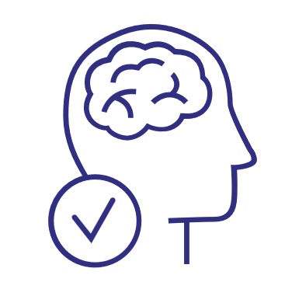
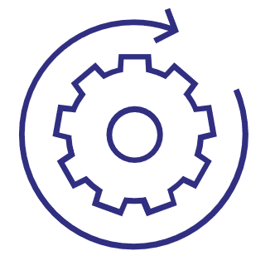
Consequences of Missing ADKAR Elements
Employees asking the same questions over and over
Lower productivity and higher turnover
Hoarding of resources and information
Delays in implementation
Without Awareness and Desire you will see:
Lower utilization or incorrect usage of new systems
Employees worry whether they can be successful in the future
Greater impact on customers and partners
Sustained reduction in productivity
Without Knowledge and Ability you will see:
Without Reinforcement you will see:
Employees revert back to old ways of doing work
Ultimate utilization is less than anticipated
The organization creates a history of poorly managed change
Notes:
This slide provides examples of the consequences, in terms of beliefs, behaviors or actions, resulting from barrier points at different elements of the model.
Encourage your participants to view the listed behaviors not as signs of resistance, but as a lack of readiness to adopt and use a change due to inadequate preparation and support.

Slide 15






















The ADKAR Model Defines Successful Change at Scale
Change with one person…
Or 1,000 people…
Or five people…
Or 20 people…
Notes:
Organizational change requires individual change.
Change may happen with one person, five people, 20 people, or 1,000 people. Regardless of the total number of people impacted by a change, every one of them needs to successfully transition through the five elements of the ADKAR to be able to adopt and use the change.

Slide 16










People Change at Different Paces
Awareness
Desire
Knowledge
Ability
Reinforcement
Kavita
Rahim
Grace
Alana
Eric
Notes:
An effective analogy to use to explain this slide is to ask the stakeholders to imagine the start of a marathon involving thousands of runners.
The fastest runners are positioned at the head of the pack and are off and running as soon as the starting gun is fired.
Runners in the middle of the pack may not start moving for a few minutes.
Runners at the back of the pack may have to wait a considerable amount of time before they can begin to move.
Questions for Discussion
Choose one of the personas on the slide and ask:
What factors might be contributing to the pace of change for this individual?
What other factors can contribute to people changing at different paces?

Slide 17
Discussion Question(s)
Choose one or more of the following questions to discuss:
How might you use the ADKAR Model to enable individual change?
What challenges do you anticipate using the ADKAR Model?
What outstanding questions do you have about the ADKAR Model?
Notes:
Engagement Activity (Optional)
Choose one or more of the suggested questions or develop your own question(s) to engage your participants in a deeper discussion of the ADKAR Model.
Facilitation Tip(s)
Facilitation options include:
Large group discussion of one question
Breakout into small groups and have each group discuss an assigned or selected question. Debrief the discussions as a large group.

Slide 18
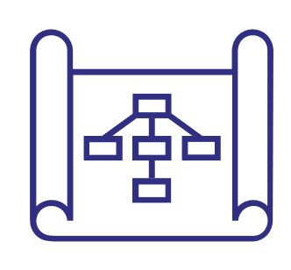
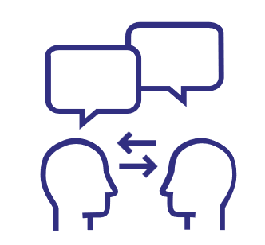

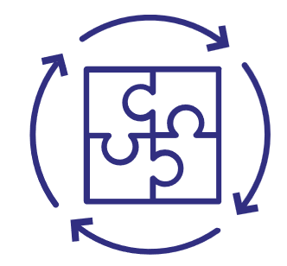


Applications of the ADKAR Model
A Structured Approach and Methodology
The ADKAR Model is an outcome-oriented model, describing the milestones an individual must achieve to successfully adapt to change. These milestones guide the development of change management plans.
A Common Language for Change
The ADKAR Model provides a helpful framework for discussing change. A common language makes difficult conversation outcome-oriented.
Facilitating Individual Change
You can use the ADKAR Assessment to identify the barrier point of any individual impacted by a change. Once you understand the root cause of their inability to change, you can develop a strategy for helping the individual move through the change.
Integration with Project Management
Achieving results requires more than just “finishing the project”. The ADKAR Model focuses on adoption and usage, which supports project execution and drives benefit realization.
Measuring Change Outcomes
Simply measuring activities doesn’t tell you if your approach is achieving the intended outcomes. The ADKAR Model is outcome-oriented and can be used as a measuring stick to evaluate the impact of your change management activities.
Empower Managers and Senior Leaders
Teaching people managers the ADKAR Model helps make great leaders become great leaders of change. The ADKAR Model equips them to pinpoint where their employees are in the change process so they can coach each person based on their unique needs.
Notes:
This is an optional slide that describes the most typical uses cases for the ADKAR Model.

