Slide 1


Slide 2


Quality Assurance Project
Michel Diener Braga
/michel-braga/
michel.diener@gmail.com

Slide 3
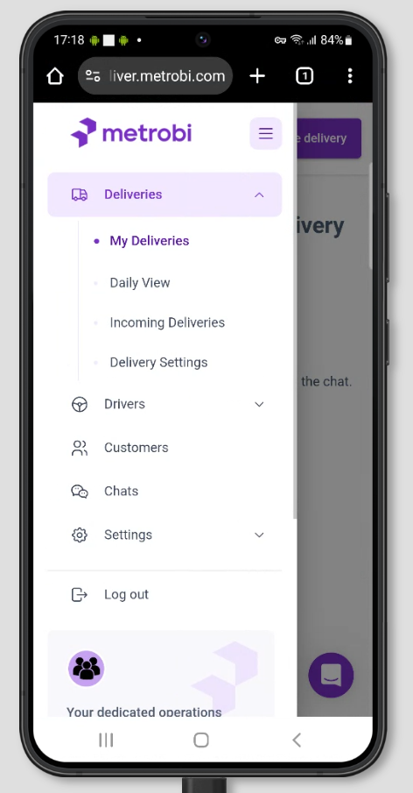
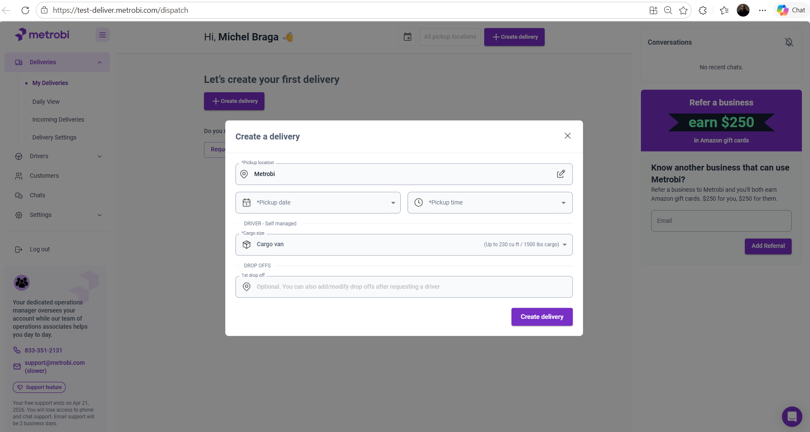
Understanding the Product

Slide 4
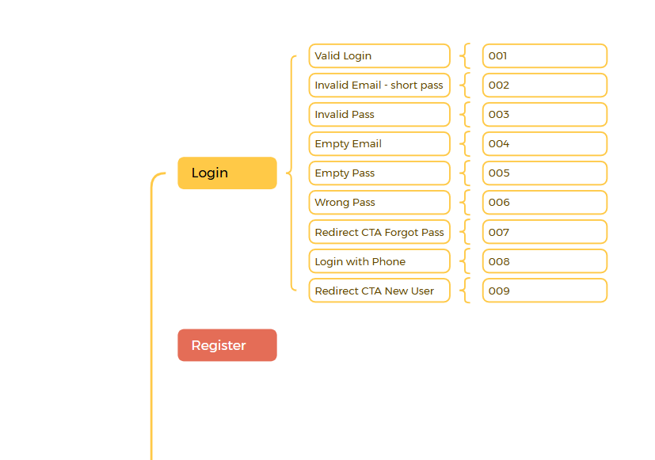
Test Strategy
Mapping scenarios

Slide 5
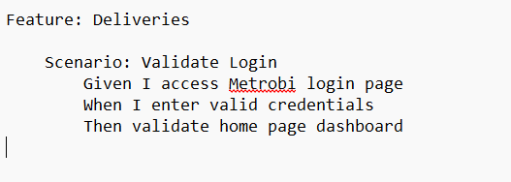
Communication
Gherkin Layer

Slide 6


Automation
Cypress + Cucumber
Fast feedback and real-time debugging
Automatic waiting (which is very useful for dynamic UI like snackbars)
Strong DOM interaction for modern frameworks

