Slide 1
Chess Games
Brought to you by CAPT Michael Brannon
Data analytics Immersive: Cohort 3

Slide 2

Overview
Extraction, analysis, and visualization of over 20,000 chess games from a selection of users on the site Lichess.org
Notes:
Lots of information is contained within a single chess game, let alone a full dataset of multiple games. It is primarily a game of patterns, and data science is all about detecting patterns in data, which is why chess has been one of the most invested in areas of AI in the past.

Slide 3
Background information
Number of Turns
Game Status
Winner
White Player Rating
Black Player Rating
Opening Ply (Number of moves in the opening phase)
All Moves in Standard Chess Notation
Opening Eco (Standardized Code for any given opening, list here)
Opening Name
Game ID
Rated (T/F)
Start Time
End Time
Time Increment
White Player ID
Black Player ID

Slide 4
Background information
Number of Turns
Game Status
Winner
White Player Rating
Black Player Rating
Opening Ply (Number of moves in the opening phase)
Notes:
With that being said, it was determined to remove the following columns in the dataset: All
The dataset provides a multitude of factors pertaining to chess games. After analyzing and cleaning the data [Chess Games](data/games.csv), it was initially determined that a logical focus would be on the outcomes of the [games](#chess-outcomes-breakdown) and more specifically the partitioning of [wins versus draws](#chess-outcomes-breakdown). Delving deeper, the overarching goal was to implement various methods to statistically analyze games where white and black are superior, with supporting supplemental features, and draw conclusions on our findings as it relates to wins versus draws and losses along with determining if white has an innate advantage by moving first.
Moves in Standard Chess Notation, Opening Eco (Standardized Code for any given opening, list here), Opening Name, Game ID, Rated (T/F), Start Time, End Time, Time Increment, White Player ID, Black Player ID. These columns didn't contain content essential to the correlations, t-tests, logistic regression, and overall analysis performed on this dataset.

Slide 5
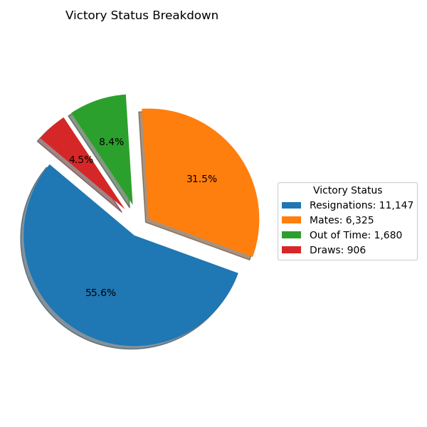
CHESS OUTCOMES BREAKDOWN
Craft a focus for dataset: outcomes of games
Far more wins [resignations, mates, out of time] than draws
Notes:
The dataset provides a multitude of factors pertaining to chess games. After analyzing and cleaning the data Chess Games, it was initially determined that a logical focus would be on the outcomes of the games.

Slide 6
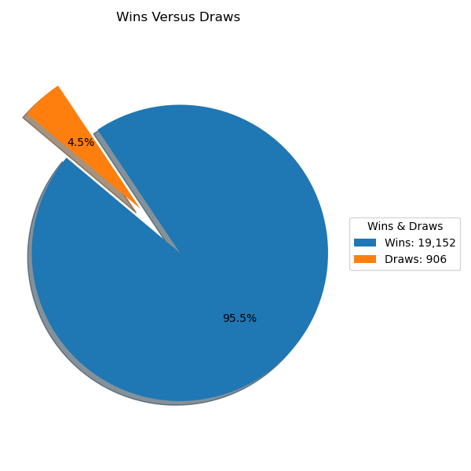
WINS VERSUS DRAWS
Further refine focus: wins versus draws
Partition Dataset: White & Black [Superior Opponent]
Generate an overarching goal: Does white have an innate advantage by moving first?
Notes:
More specifically, the dataset was partitioned by overall number of wins versus draws. Delving deeper, the overarching goal was to implement various methods to statistically analyze games where white and black are superior, with supporting supplemental features, and draw conclusions on our findings as it relates to wins versus draws and losses along with determining if white has an innate advantage by moving first.

Slide 7
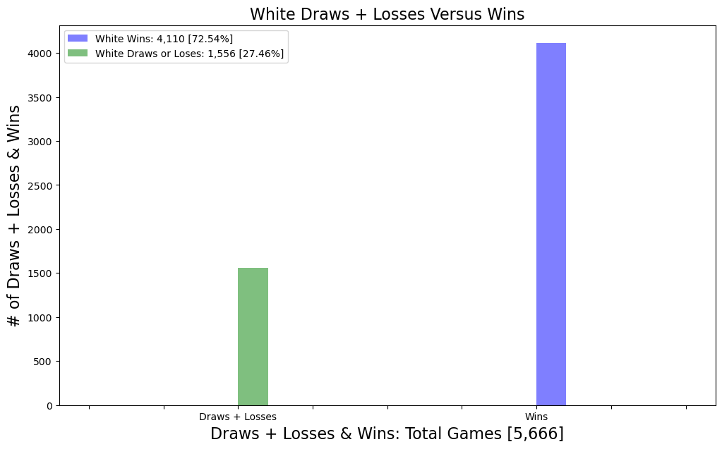
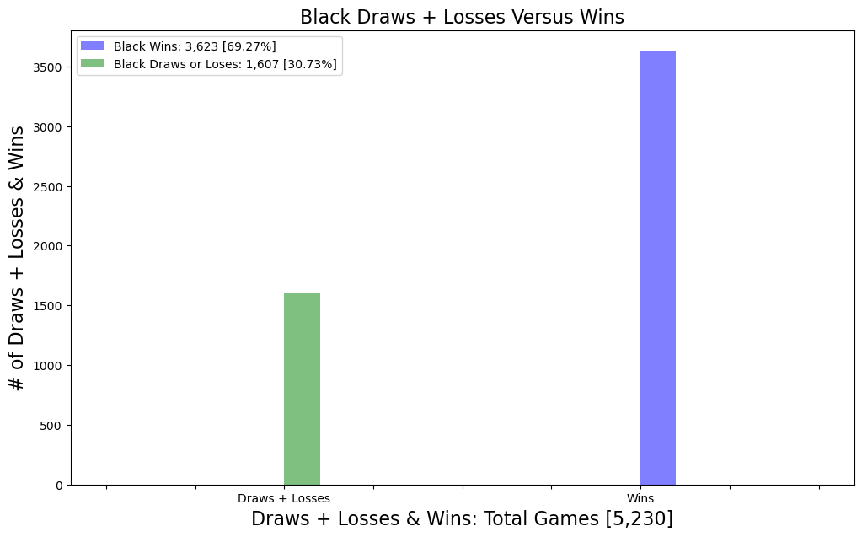
Draws + Losses VERSUS wins
Notes:
When only considering wins and draws plus losses of a higher-ranked white opponent, white wins 72.54% of the time and draws or loses 27.46% of the time over 5,666 games.
When only considering wins and draws plus losses of a higher-ranked black opponent, black wins 69.27% of the time and draws or loses 30.73% of the time over 5,230 games.

Slide 8

Significant Factors: Win VS Draw Or loss
Rating differential [ > 100 rating minimum]
Number of consecutive moves a player follows an optimal book opening
Number of turns in a game
Notes:
After seeing the disparity in overall wins versus losses, the next approach was to partition the dataset into two separate datasets for white and black based on the respective player being the superior opponent, or greater than 100 ELO difference, and mapped wins to 1 and draws or losses to 0. Then, for both datasets, we generated our null and alternative hypothesis, which are depicted below, and performed two-sample independent t-tests to analyze the p-values and ultimately the null & alternative hypotheses for rating differentials, number of consecutive moves where a player follows an optimal book, and number of turns in the game.

Slide 9
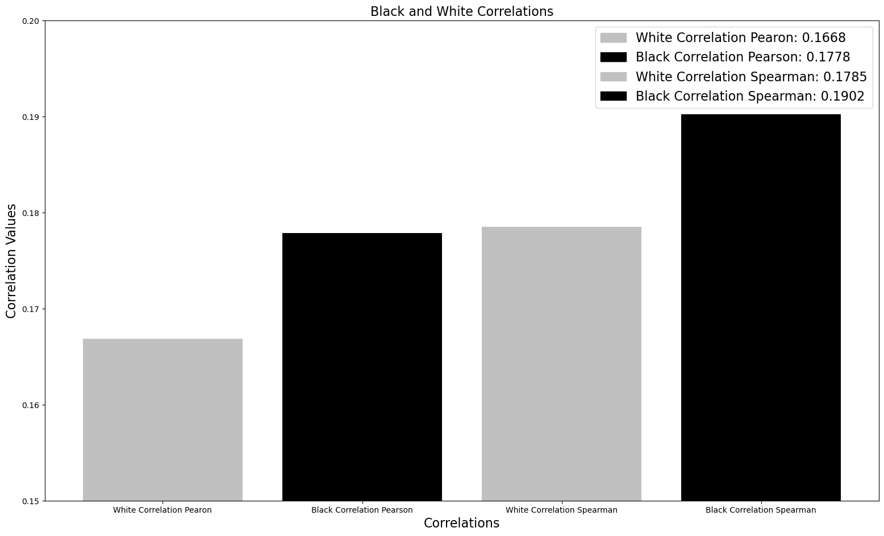
Relationships: Stronger opponent & Winning
Weak correlation between being a stronger opponent and winning versus losing or drawing games!
Notes:
Despite all of the players having respectable ratings at the very least, this counterintuition could be due to players still being considerably lower rated than grandmasters which leads to miscalculations and outright blunders, despite being the higher-rated player.
Next, perform linear, Pearson correlations and nonlinear, Spearman correlation to see potential correlations between rating differentials, for white and black respectively, and their victory status.
Shockingly, there is only weak correlations between white or black being a significantly stronger opponent, in terms of ELO rating, and winning games versus losing or drawing games, as seen from the linear, Pearson correlations and the nonlinear, Spearman correlations below. Intuitively, one would think that over a continuous span of gradually increasing ELO differentials, there would be a strong correlation to the majority, binary class of 1, which is wins.

Slide 10
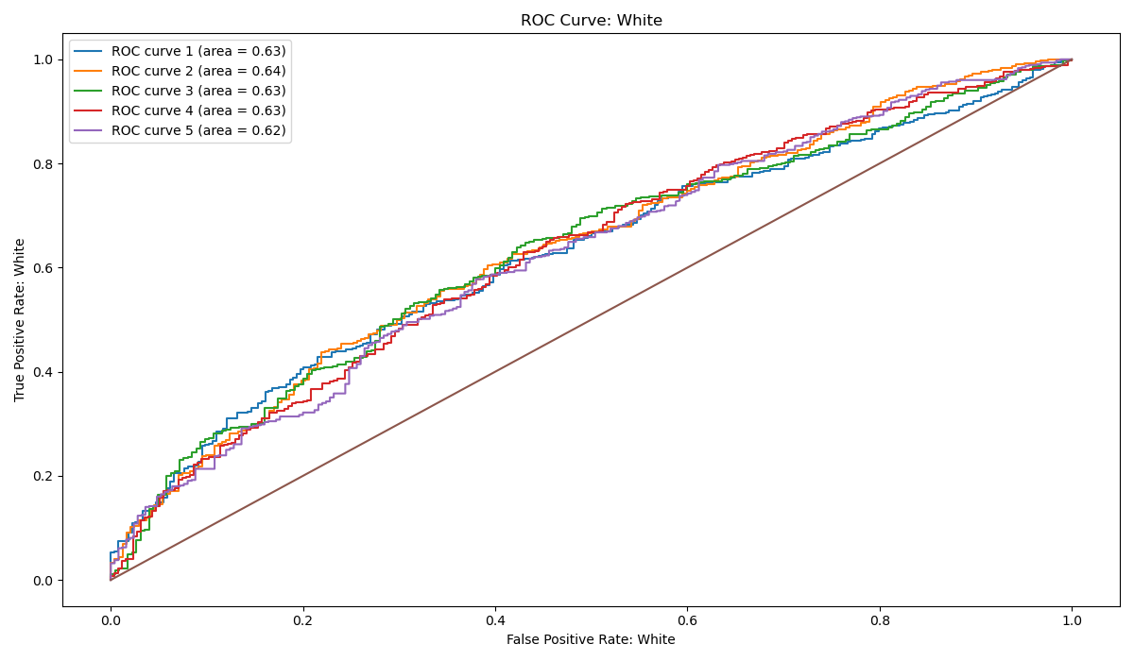
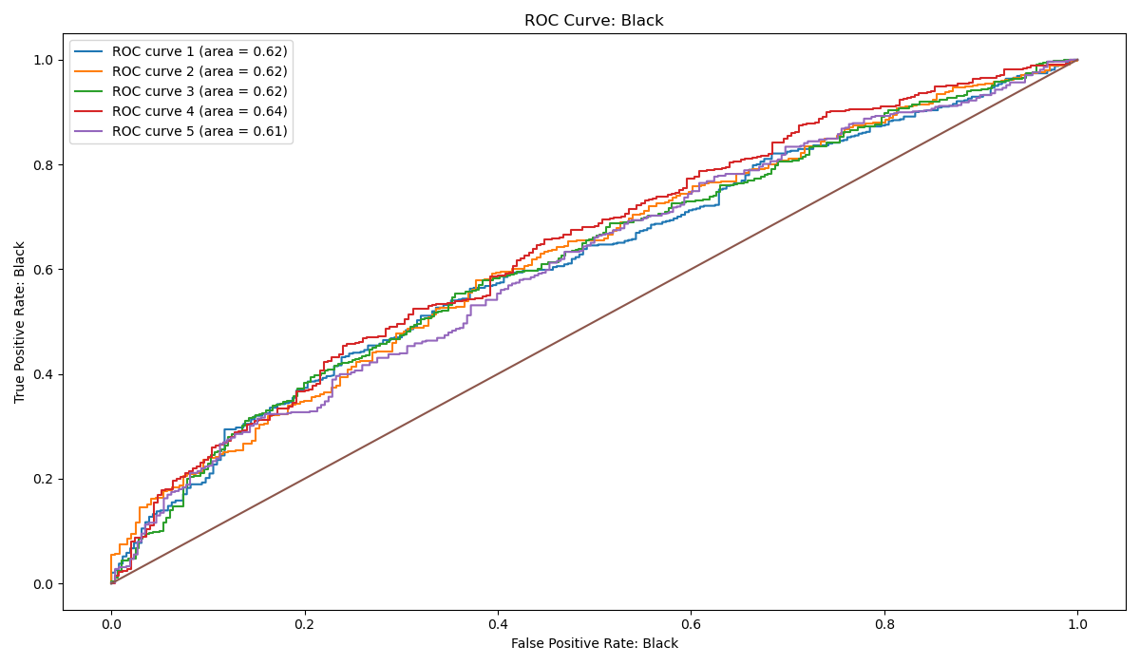
Predictive Models
Notes:
Since the dataset contains continuous numerical inputs, or features, in the form of: rating differentials, consecutive moves where a player follows an optimal book opening, and number of turns in the game along with a transformation of the target, or wins versus draws and losses, to binary values, a logistic regression model was selected. The logistic regression for both white and black utilized 5 folds, or subsets, with an 80% split of the samples into the training set and the remaining 20% of the data was held out for the test set. A graphical output was generated for the true positive rate, or probability of detection, as a function of false positive rate, or probability of false alarm, on a Receiver Operating Characteristic (ROC) plot with curves for all 5 folds. Additionally, an Area Under the Curve (AUC) was generated for our ROC curves to determine the model's predictive accuracy and found that for all 5 folds, for both black and white, the AUC was bound between 0.61 and 0.64, which is indicative of poor predictive accuracy for our model as 1.0 would be a perfect prediction. It's believed that the model's predictive accuracy would increase if additional quantitative features were provided in the dataset that factor into winning a chess game versus losing or drawing. Some, but not all, of the excluded features are: hours of individual study/preparation, hours of analysis of the opponent's playstyle and openings selection, hours of sleep preceding the game, number of times the opponents have previously faced each other. Finally, perhaps introducing class-weights to punish the model for any wrong prediction of the class, 0 and 1 respectively, to overcome the imbalanced dataset that contains far more wins, or 1’s, than draws plus losses, or 0’s.

Slide 11

Useful Model data: Accuracy improvement
Hours of individual study/preparation
Hours of analysis of the opponent’s playstyle
Hours of analysis of the opponent’s typical selection of openings
Hours of sleep preceding the game
Number of times the opponents have previously faced each other
Notes:
It's believed that the model's predictive accuracy would increase if additional quantitative features were provided in the dataset that factor into winning a chess game versus losing or drawing. Some, but not all, of the excluded features are: hours of individual study/preparation, hours of analysis of the opponent's playstyle and openings selection, hours of sleep preceding the game, number of times the opponents have previously faced each other.

Slide 12
SIMILARITIES: Black vs White
Similarities:
# of games [Superior Opponents]
% of wins & losses + draws
Metrics [Average]
Predictive Accuracies
Notes:
When comparing filtered games where white is the superior opponent with black being the superior opponent, the total games in each respective database very similar with comparable wins versus draws and losses. When running one version of a logistic regression model for both white and black games, one see very similar average metrics for the accuracy, precision, recall, F1 score, log loss, and log loss probability. However, when utilizing a different logistic regression statistical model, a worthwhile not is looking at the respective inputs, or features, for our white and black chess games, respectively. The three features utilized for both black and white games were rating differential, number of turns in the game, and opening play, which is the consecutive moves from the initiation of the game that opponents stick to an optimal, book opening. In general, typically skilled players, even with reasonable rating differentials, will have games with a substantial amount of moves because they avoid suboptimal moves and outright blunders. More specifically, with the white games, our three features all had p-values of 0.000, which are significant since they are less than 0.05, and thus are a good choice to be incorporated into predicting our target, or binary output of wins versus draws and losses. Regarding the black games, the rating differential feature was determined to be significant at 0.000, but interestingly enough the number of terms and opening play were didn't yield significant p-values, or greater than 0.05, at 0.225 and 0.372, respectively. There has been extensive, cumulative analysis on chess throughout the years to determine that white has an innate advantage simply by being the first player to make a move. The respective difference in significances of our features between white and black games might indicate the fact that due to the inherent disadvantage of black being the responsive player, there is no significance on the number of moves and sticking to an optimal book opening. Essentially, the disadvantage of moving second might trump the ability to follow optimal book openings and play in technically sound games that contain a large number of moves.

Slide 13
DIFFERENCES: Black vs White
Differences:
White: All features were significant [rating differential, opening play, & # of turns
Black: Only significant feature [ rating differential]
Notes:
When comparing filtered games where white is the superior opponent with black being the superior opponent, the total games in each respective database very similar with comparable wins versus draws and losses. When running one version of a logistic regression model for both white and black games, one see very similar average metrics for the accuracy, precision, recall, F1 score, log loss, and log loss probability. However, when utilizing a different logistic regression statistical model, a worthwhile not is looking at the respective inputs, or features, for our white and black chess games, respectively. The three features utilized for both black and white games were rating differential, number of turns in the game, and opening play, which is the consecutive moves from the initiation of the game that opponents stick to an optimal, book opening. In general, typically skilled players, even with reasonable rating differentials, will have games with a substantial amount of moves because they avoid suboptimal moves and outright blunders. More specifically, with the white games, our three features all had p-values of 0.000, which are significant since they are less than 0.05, and thus are a good choice to be incorporated into predicting our target, or binary output of wins versus draws and losses. Regarding the black games, the rating differential feature was determined to be significant at 0.000, but interestingly enough the number of terms and opening play were didn't yield significant p-values, or greater than 0.05, at 0.225 and 0.372, respectively. There has been extensive, cumulative analysis on chess throughout the years to determine that white has an innate advantage simply by being the first player to make a move. The respective difference in significances of our features between white and black games might indicate the fact that due to the inherent disadvantage of black being the responsive player, there is no significance on the number of moves and sticking to an optimal book opening. Essentially, the disadvantage of moving second might trump the ability to follow optimal book openings and play in technically sound games that contain a large number of moves.

Slide 14
Project information
Dataset: https://www.kaggle.com/datasets/datasnaek/chess
Github Link: https://github.com/mbrann2/chess_games
Contact Information:
Email [Military]: michael.brannon.6@us.af.mil
Email: [Civilian]: musclem3mory@gmail.com
Phone #: (708) 845-7791
Github Handle: mbrann2
Python Libraries Used: Numpy, Pandas, Matplotlib, Scipy, SKlearn, StatsModels

Slide 15
APPENDIX

Slide 16
HYPOTHESES TESTINGS
Null Hypothesis 1: The average rating differential between black and white has no significance on which player wins the game.
Alternative Hypothesis 1: The average rating differential between black and white has a significance on which player wins the game.
Null Hypothesis 2: The average number of consecutive moves where a player follows an optimal book opening has no significance on which player wins the game.
Alternative Hypothesis 2: The average number of consecutive moves where a player follows an optimal book opening has a significance on which player wins the game.
Null Hypothesis 3: The average number of turns in a game has no significance on which player wins the game.
Alternative Hypothesis 3: The average number of turns in a game has significance on which player wins the game.

Slide 17
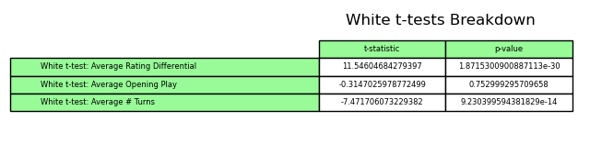
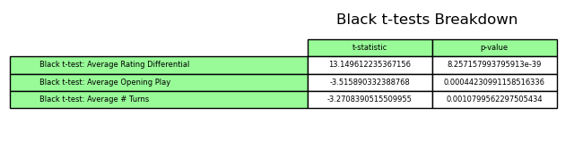
t-tests Breakdown [Welch’s two-sample independent]
Notes:
The p-value for average rating differential and average opening play is less than 0.05, so we reject all the null hypotheses and there is significant difference, or impact, between the white rating differentials and the number of turns in the game, all in relation to white winning the game. The p-value for average number of consecutive moves where white follows an optimal book opening is greater than 0.05, so we can accept the null hypothesis and state that there is no significance in following an average amount of consecutive moves of an optimal book opening and white winning the game. Additionally, the relatively high t-statistic of approximately 11.55 and -7.47 for rating differentials and number of turns simply indicates the confidence in the predictor coefficient, since they're both far greater than 1 standard deviation away, or an absolute value of 1.96, for an alpha value of 0.05, and further supports the decision to reject the null hypothesis. The low t-statistic of -0.31 for opening play shows a lack of confidence in the predictor coefficient and further supports the decision to accept the null hypothesis since it's less than 1 standard deviation away, or an absolute value of 1.96, for an alpha value of 0.05. The positive t-statistic indicates that the sample mean for rating differentials greater than or equal to the average have a large sample size than the sample mean for rating differentials less than the average. The negative t-statistic indicates that the sample means for opening plays and number of turns greater than or equal to the average have a smaller sample size than the sample means for opening plays and number of turns less than the average. The fact that white moves first might overcome the necessity to follow an optimal book opening for a consecutive amount of moves in order to win.
The p-value for rating differential, number of turns, and opening play is less than 0.05, so we reject all the null hypotheses and there is significant difference, or impact, between: the black rating differentials, the consecutive moves used from an optimal book opening, the number of turns in the game, all in relation to who wins the game. Additionally, the relatively high t-statistic of approximately 13.15, -3.52, and -3.27 for rating differentials, opening book play, and number of turns simply indicates the confidence in the predictor coefficient, since they're all far greater than 1 standard deviation away, or an absolute value of 1.96, for an alpha value of 0.05, and further supports the decision to reject the null hypothesis. The positive t-statistic indicates that the sample mean for rating differentials greater than or equal to the average have a large sample size than the sample mean for rating differentials less than the average. The negative t-statistic indicates that the sample means for opening plays and number of turns greater than or equal to the average have a smaller sample size than the sample means for opening plays and number of turns less than the average.

Slide 18
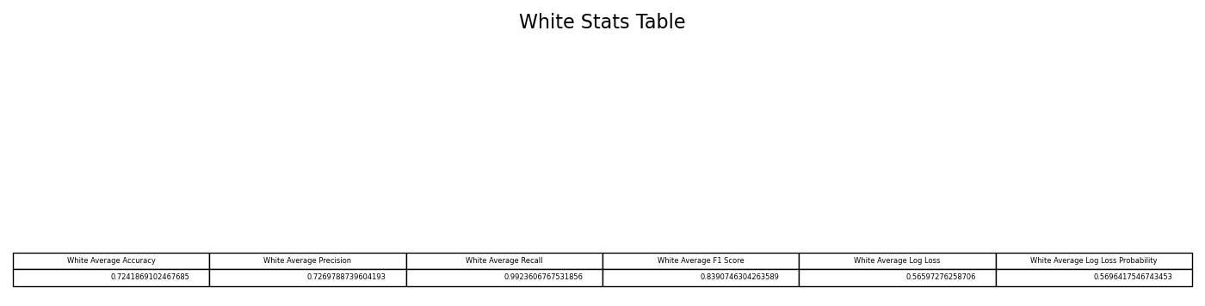
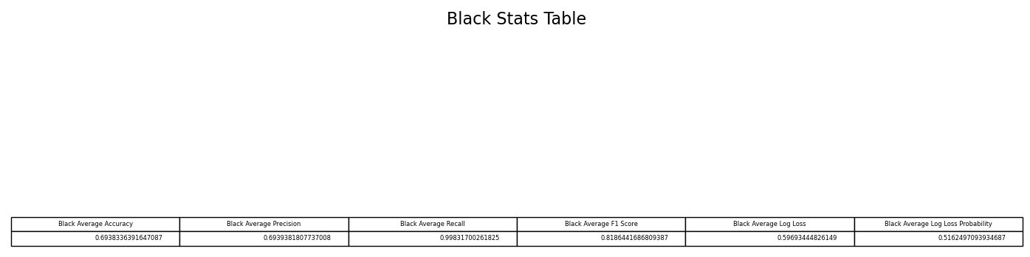
Predictive Models metrics
Notes:
The average accuracy and average precision across all 5 folds for white are both respectable and nearly the same with the average accuracy being approximately 72.42% and the average precision being approximately 72.70%. Accuracy is a function of true positives, true negatives, false positives, or probability of false alarms, and false negatives, or probability of incorrectly identifying that an attribute is absent. One can ascertain that our logistic regression model is being reduced due to the reasonable amount of false positives that are present and is supported by our precision also being reduced due to the same false positive generation. Precision is a function of true positives, or probability of detection, and false positives, which is the probability of a false alarm. One can ascertain that our logistic regression model has a reasonable amount of false positives, or incorrectly predicting the positive class of 1, when it should be predicting the negative class of 0, hence false positives are generated. The average recall across all 5 folds for white was excellent with a result of approximately 99.24%. Recall is a function of true positives, or probability of detection, and false negatives, which is the probability of incorrectly identifying that an attribute is absent. One can ascertain that our logistic regression model has very few false negatives, which would be missing the ability to successfully predict the correct, positive class of 1 and instead predicting a negative class of 0. The average F1 Score across all 5 folds for white was very good with a result of approximately 83.91%. The average F1 score is a function of the average precision and average recall. The relatively good mean precision of 72.70% and stellar mean recall of 99.24% is yielding the great F1 score of approximately 83.91%. The average log loss across all 5 folds for white was only average with a result of approximately 0.5660, where 0 is optimal. The average log loss is effectively how close the model is to predicting the corresponding true values of 0 and 1, respectively. The associated average probability of the log loss across all 5 folds for white was determined to be approximately 0.5696, which effectively denotes the probability of the logistic regression model predicting the proper class, 0 for draws & losses, and 1 for wins, respectively. The mediocre result for average log loss and average log loss probability could be due to an imbalanced dataset that truly contains significantly more wins, or binary values of 1, in comparison to draws & losses, or binary values of 0.
The average accuracy and average precision across all 5 folds for black are both respectable and nearly the same with the average accuracy being approximately 69.38% and the average precision being approximately 69.39%. Accuracy is a function of true positives, true negatives, false positives, or probability of false alarms, and false negatives, or probability of incorrectly identifying that an attribute is absent. One can ascertain that our logistic regression model is being reduced due to the reasonable amount of false positives that are present and is supported by our precision also being reduced due to the same false positive generation. Precision is a function of true positives, or probability of detection, and false positives, which is the probability of a false alarm. One can ascertain that our logistic regression model has a reasonable amount of false positives, or incorrectly predicting the positive class of 1, when it should be predicting the negative class of 0, hence false positives are generated. The average recall across all 5 folds for black was excellent with a result of approximately 99.83%. Recall is a function of true positives, or probability of detection, and false negatives, which is the probability of incorrectly identifying that an attribute is absent. One can ascertain that our logistic regression model has very few false negatives, which would be missing the ability to successfully predict the correct, positive class of 1 and instead predicting a negative class of 0. The average F1 Score across all 5 folds for black was very good with a result of approximately 81.86%. The average F1 score is a function of the average precision and average recall. The relatively good mean precision of 69.39% and stellar mean recall of 99.83% is yielding the great F1 score of approximately 81.86%. The average log loss across all 5 folds for black was only average with a result of approximately 0.5969, where 0 is optimal. The average log loss is effectively how close the model is to predicting the corresponding true values of 0 and 1, respectively. The associated average probability of the log loss across all 5 folds for black was determined to be approximately 0.5162, which effectively denotes the probability of the logistic regression model predicting the proper class, 0 for draws & losses, and 1 for wins, respectively. The mediocre result for average log loss and average log loss probability could be due to an imbalanced dataset that truly contains significantly more wins, or binary values of 1, in comparison to draws & losses, or binary values of 0.

Slide 19
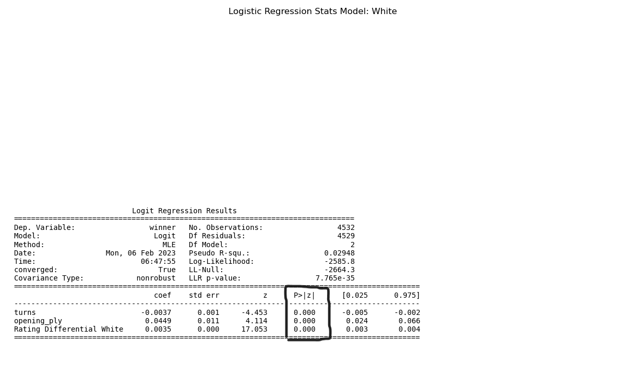
Logistic Regression Stats Model: White
Notes:
However, when utilizing a different logistic regression statistical model, a worthwhile not is looking at the respective inputs, or features, for our white and black chess games, respectively. The three features utilized for both black and white games were rating differential, number of turns in the game, and opening play, which is the consecutive moves from the initiation of the game that opponents stick to an optimal, book opening. In general, typically skilled players, even with reasonable rating differentials, will have games with a substantial amount of moves because they avoid suboptimal moves and outright blunders. More specifically, with the white games, our three features all had p-values of 0.000, which are significant since they are less than 0.05, and thus are a good choice to be incorporated into predicting our target, or binary output of wins versus draws and losses.

Slide 20

Logistic Regression Stats Model: black
Notes:
Regarding the black games, the rating differential feature was determined to be significant at 0.000, but interestingly enough the number of terms and opening play were didn't yield significant p-values, or greater than 0.05, at 0.225 and 0.372, respectively

