Slide 1
Privacy Communication Complexity and Information Complexity Toniann Pitassi
Notes:
Will give very few reference soas not to disrupt the flow.

Slide 2
2-Party Communication Complexity
2-party communication: each party has an input.
Goal is to compute a function f(x,y)
m₁
D_{A}
x₁
x₂

x_{n}
D_{B}
y₁
y₂

y_{m}
m₂
m₃
m_{k-1}
m_{k}
f(x,y)
f(x,y)
Communication complexity of a protocol for f is the number of bits exchanged between A and B.
Privacy: how much do Alice and Bob learn?
In this talk, most protocols are assumed to be randomized.

Slide 3
Two Different Notions of Privacy
Cryptographic [deterministic protocols]
(Perfect privacy, PRIV, PAR)
Differential Privacy [randomized protocols]
All of our privacy applications require information complexity lower bounds (cc is not enough)

Slide 4
Two Different Notions of Privacy
Cryptographic
(Perfect privacy, PRIV, PAR)
Differential Privacy

Slide 5
Cryptographic Privacy
Goal: Ideal protocol for f should reveal only f(x,y) and no other information
A deterministic protocol partitions M_{f} into disjoint rectangles (submatrices) until every rectangle is monochromatic (f is constant on all inputs in the submatrix)
Notes:
M_f the (x,y) entry is f(x,y). For now we will consider only determinsitic protocols.

Slide 6
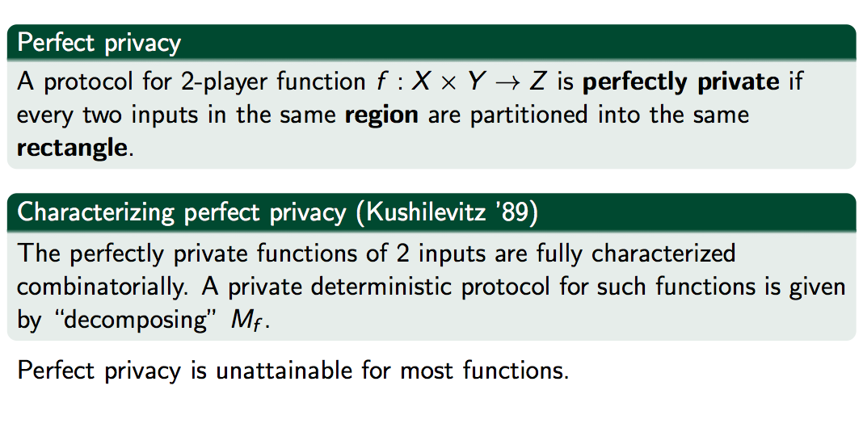
Perfect Privacy
Notes:
Perfect privacy not too interesting since unattainable. Even when it is attainable the
Perfectly private protocol can be incredibly long.

Slide 7
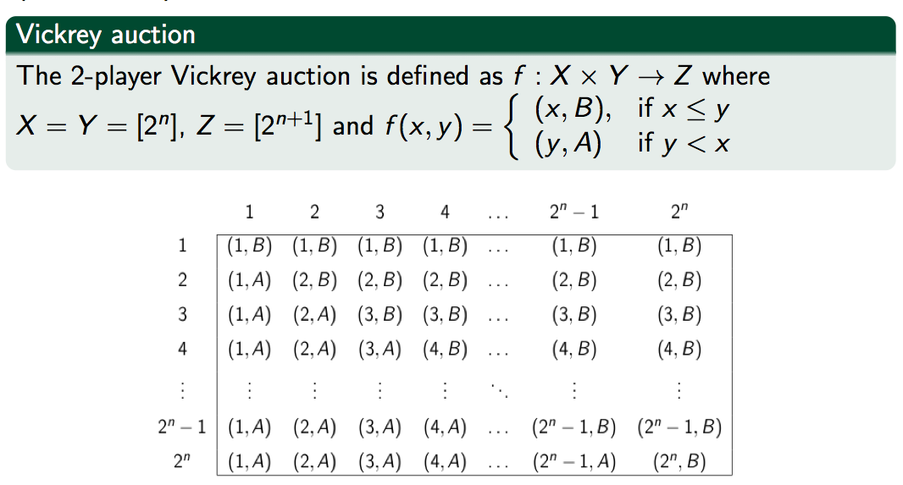
Important Example: Vickrey Auction
Notes:
Example where perfect privacy is attainable but protocol is very long…already in 89 kushilevitz
Is seeing that we can in some situations have a very long protocol that can’t be compressed if we want to preserve privacy.

Slide 8
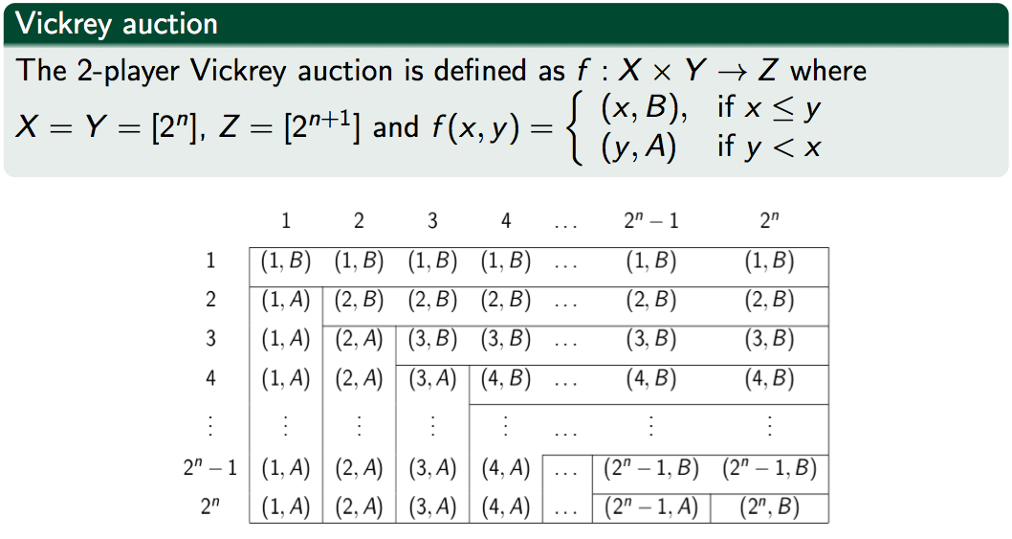
Vickrey (cont’d)
Notes:
Same picture but showing the monochromatic regions defined by the function.

Slide 9
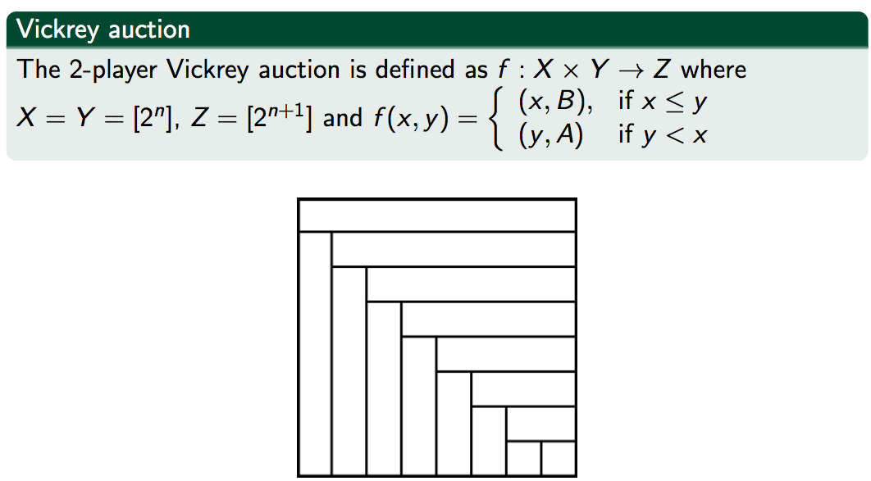
Vickrey (cont’d)

Slide 10
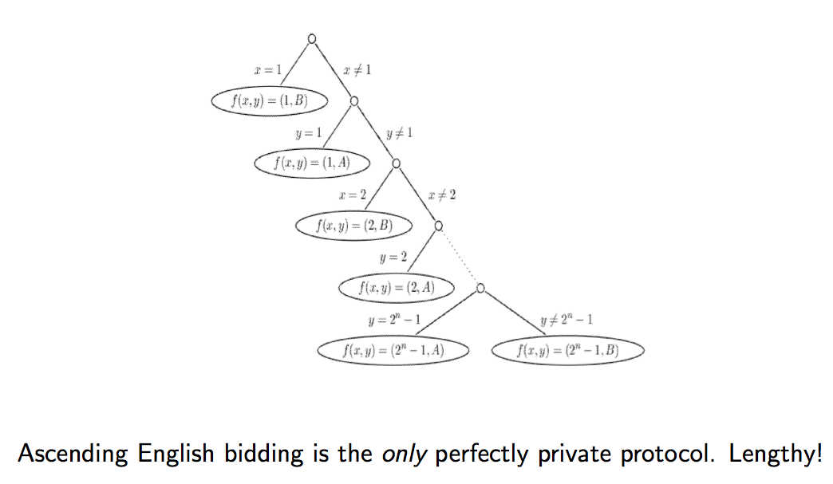
Perfectly Private Protocol for Vickrey
Notes:
Motivated by limitations of perfect privacy (most interesting functions are not perfetly private,
And even if a function is, the cost of protocol could be prohibitively expensive..introduced approx privacy

Slide 11
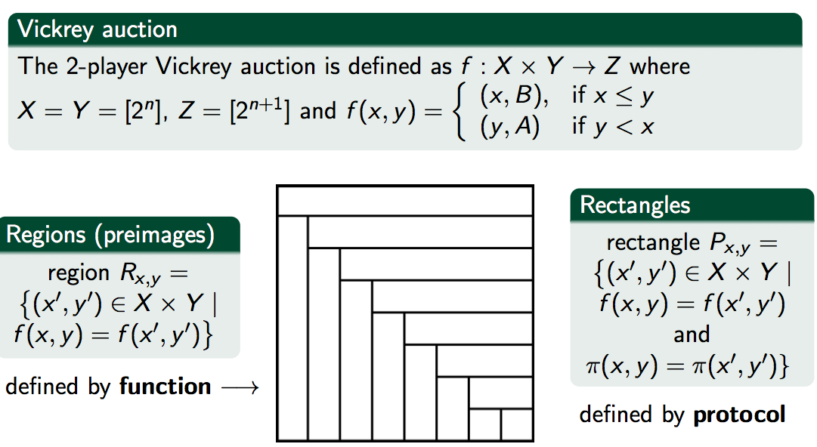
Approximate Privacy (PAR)

Slide 12
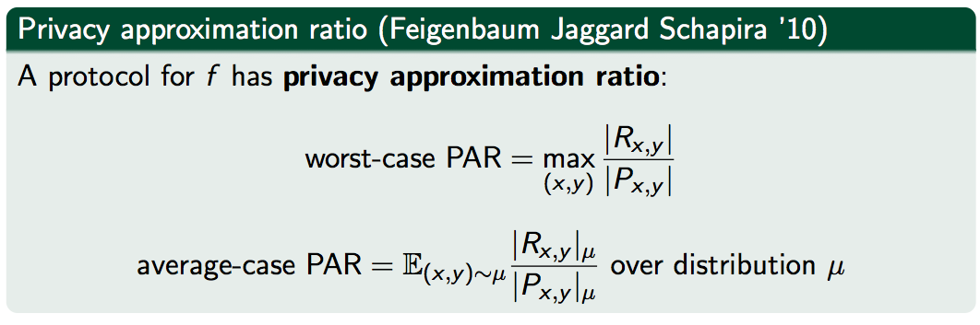
Approximate Privacy (PAR)
Notes:
Above is External PAR. Internal PAR can also be defined. For Vickrey, they are equal.
Equivalent characterization of average-case PAR: Σ_{R} |R|_{D} ×cut_{P}(R)

Slide 13
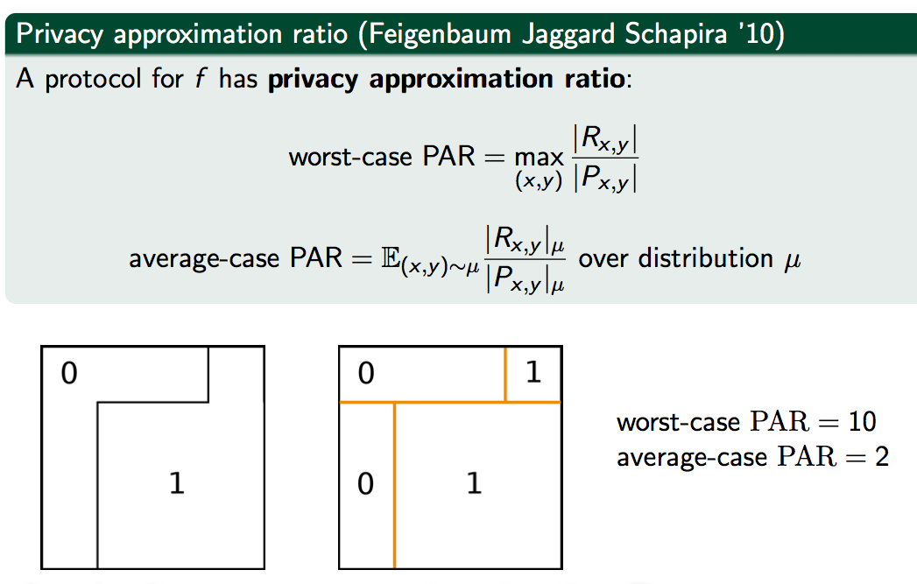
PAR
Above matrices are 4-by-4. |R₁|=10, |R₀|=6
Avg case PAR = |R₁|_{U} × 2 + |R₀|_{U} × 2 = 10/16 ×2 + 6/16 ×2 = 2

Slide 14
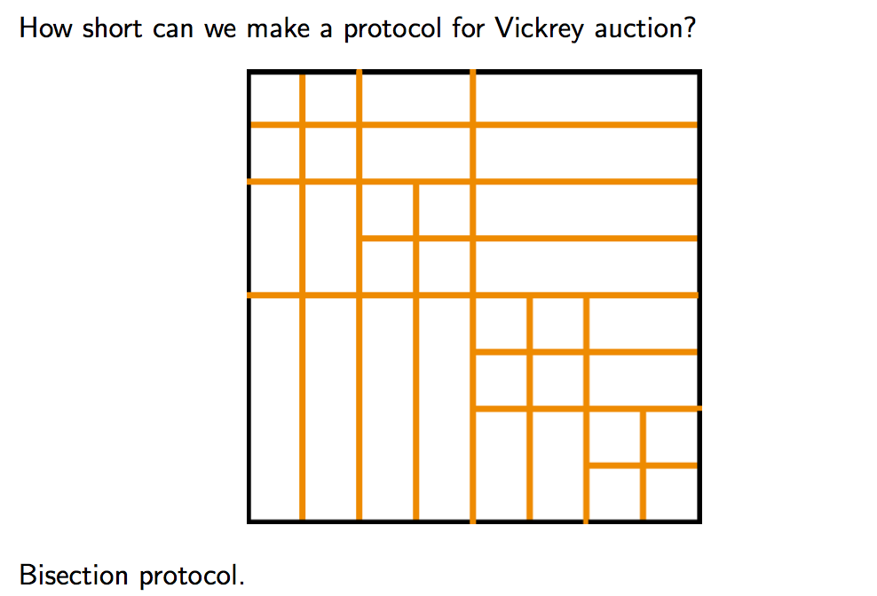
Back to Vickrey: The Bisection Protocol

Slide 15
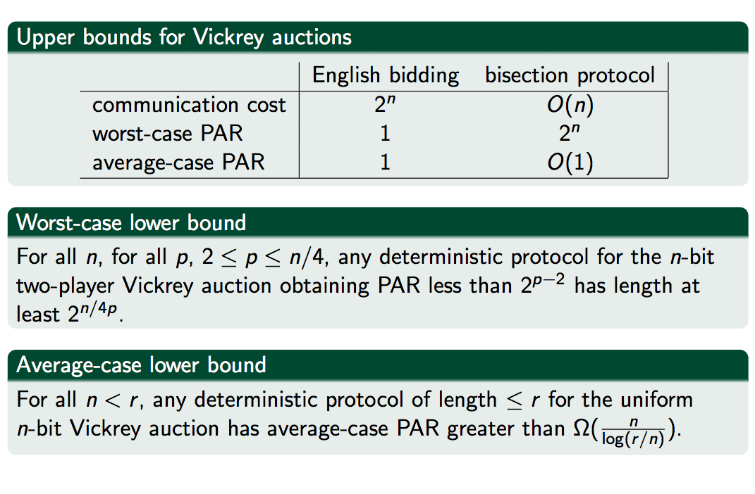
Tradeoffs between privacy and communication [ACCFKP]
Notes:
Shows there is a real tradeoff between communication and privacy (PAR) both in avg case and worst case

Slide 16
Information Complexity and Avg-case PAR
Definition (Klauck)
Priv^{ext}_{D}(P) = I (XY; π_{P}(X,Y) | f(X,Y)),
Proposition:
Priv^{ext}_{D}(P) ≤ IC^{ext}_{D}(P) ≤ Priv^{ext}_{D}(P) + log|Z|
Theorem: Priv^{ext}_{D}(P) ≤ log(avg_{D} PAR^{ext}(P)) (concavity)
Analagous relationships hold for internal case.
Thus IC lower bounds imply avg case PAR lower bounds!
Notes:
This is subjective/internal par

Slide 17
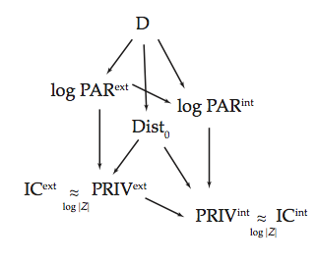
Relationships between measures (deterministic protocols, avg case PAR, boolean functions)
Also known that PAR^{ext} is at least rank(M_{f}). So under log-rank
conjecture, D and log PAR^{ex}t are polynomially related

Slide 18
Consequences of IC Connection: Lower Bounds for Avg PAR
Theorem (Braverman).
Let P be a randomized protocol for DISJn with error at most 1/3. Then IC^{int}(P) = Ω(n)
Theorem (ACCFKP). For all n ≥ 1, and any protocol P for set intersection,
avg_{U} PAR(P) = exp(Ω(n))

Slide 19
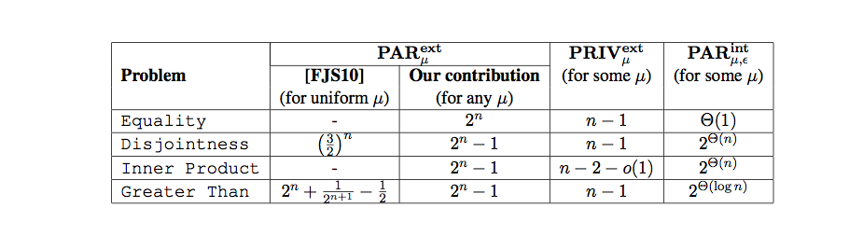
Consequences of IC Connection [ACCFKP,KLX]

Slide 20
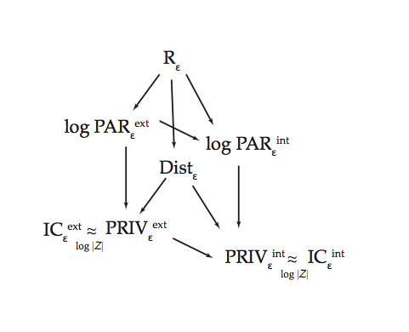
Randomized PAR [KLX]
Suggests that PAR could be helpful to study the randomized CC versus IC question.

Slide 21
Two Different Notions of Privacy
Cryptographic
(Perfect privacy, PRIV, PAR)
Differential Privacy

Slide 22
Differential Privacy [DwMcNiSm06]
Holy Grail: Get utility of statistical analysis (i.e., give reasonably accurate answers) while protecting privacy of every individual participant.
Guarantee: outcome of the analysis is nearly identical whether any user is in or out of the dataset. Thus participation does not increase risk of privacy violation.
Notes:
Describe here the usual (“modern”) privacy setting

Slide 23
The Basic DP Scenario (Client-Server Setting)
Data is owned by a curator.
Statistical queries are made. The curator computes the query releases a sanitized version .
Sanitizer
Output
Data

Slide 24
Differential Privacy: The Distributed Setting
Multiple databases, each with private data.
D1
D2
F(D1,D2,..,D5)
D3
D4
D5
Goal: compute a joint function while maintaining privacy for any individual, with respect to both the outside world and the other database owners.
Notes:
Have a bunch of databases, like hospital records. Two different hospitals could contain different info about the same people, or info about different people. Want to compute a global statistic across all of the records, without any hospital learning anything about any individual that it didn’t know already.

Slide 25
2-Party Setting: Differentially Private CC [MMPRTV]
Each party has a dataset; want to compute a joint function f(D_{A},D_{B})
m₁
D_{A}
x₁
x₂

x_{n}
D_{B}
y₁
y₂

y_{m}
m₂
m₃
m_{k-1}
m_{k}
Z_{A} ≈ f(D_{A},D_{B})
Z_{B}≈ f(D_{A},D_{B})
A’s view should be a differentially private function of D_{B} (even if A deviates from protocol), and vice-versa

Slide 26
Two-Party Differential Privacy
Let P(x,y) be a 2-party protocol. P is ε-DP if:
(1) for all y, for every pair x, x’ that are neighbors, and for every transcript π,
Pr[P(x,y) = π ] ≤ exp(ε) Pr[P(x’,y) = π ]
(2) symmetrically, for all x, for every pair of neighbors y,y’ and for every transcript π
Pr[P(x,y)=π ] ≤ exp(ε) Pr[P(x,y’) = π]
Question: Can anything that can be done DP-ly in client-server setting also be done DP-ly in multiparty setting?

Slide 27
Examples
Ones(x,y) = the number of ones in xy
Ones(00001111,10101010) = 8.
CC(Ones) = logn.
There is a low error DP protocol.
2. Hamming Distance HD(x,y) = the number of positions i
where x_{i} ≠ y_{i}.
HD(00001111, 10101010) = 4
CC(HD)=n.
No low error DP protocol ?
Is this a coincidence? Is there a connection between low cc and low-error DP protocols?
What is the smallest (additive) error of any protocol for computing the Hamming distance between x,y that is differentially private for both sides?
Notes:
Add a small amt of noice calibrated to the sensitivity of the function.
For functions with constant sensitivy, can be aprpoximated up to constant additive error by adding
Laplacian (symmetric exponential) noise with standard dev inversely prop to privacy param
BOTH can be approximated in client-server setting with constant additive error. In 2party setting, error is (sqrt n)!

Slide 28
Lower Bounds for DP Protocols and Information Cost
I(X;Y) = H(X) – H(X | Y)
measures the average amount of info Y reveals about X.
IC^{ext}_{μ}(P) = I(XY; π(X,Y))
measures the average amount of information the transcript reveals about XY
IC^{ext}_{μ}(F) = min_{P} (IC^{ext}_{μ}(P) )
Theorem. If P has ε-DP, then for every distribution μ on X x Y, IC^{ext}_{μ}(P) ≤ 3εn
Note: over uniform distribution, bound improved to ε²n
Notes:
X a random variable (distribution of values).
H(X)= - \sum_i p(x_i) log p(x_i)

Slide 29
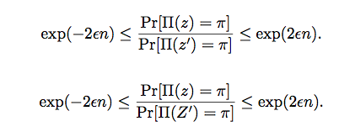
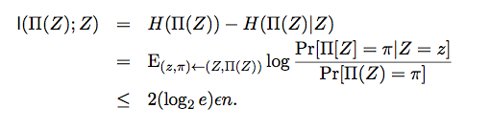
Lower Bounds for DP Protocols via IC
Theorem. If P has ε-DP, then for every distribution μ on X x Y,
IC^{ext}_{μ}(P) ≤ 3εn
Proof. Let z=(x,y). For every z, z’ differential privacy implies
where Z’ is an independent sample. Thus by definition of IC we have:
Notes:
X a random variable (distribution of values).
H(X)= - \sum_i p(x_i) log p(x_i)

Slide 30
Lower Bounds for Hamming Distance
Theorem. The Gap-Hamming Problem (distinguishing inputs with distance at most n/2-c√n from those with distance at least n/2+c√n) has information complexity Ω(n).
Corollary. There exists an ε such that any ε-DP protocol for Hamming Distance must incur an additive error Ω(√n)
Notes:
Our lower bound for Hamming distance is tight since there is an O(√n) error ε-DP protocol.
There are other functions (with sensitivity 1) where any ε-DP must incur an additive error Ω(n)

Slide 31
Implications of DP Lower bounds: I. Separation beteen computational and info-theoretic DP
[MPRV] defined computational ε-DP protocols.
Loosely speaking, now the probability distribution over the transcripts for neighboring x,x’ is e^{ε}- indistinguishable to a polytime algorithm.
Via fully homomorphic encryption, any low sensitivity f(x,y) has a O(1) error computational ε-DP protocol, including Hamming distance.
Thus our lower bound shows that in the context of distributed protocols, there can be a huge gain by relaxing DP to computational DP.

Slide 32
Implications of DP Lower Bounds: II. Pan-Private Streaming Model [DPRNY]
Data is a stream of items; each item belongs to a user. Sanitizer sees each item and updates internal state. Generates output at end of the stream (single pass).
state
Pan-Privacy: For every two adjacent streams, at any single point in time, the internal state (and final output) are differentially private.

Slide 33
Pan-private algorithms exist for many statistics!
Stream density / number of distinct elements
t-cropped mean: mean, over users, of min(t, #appearances)
Fraction of users appearing exactly k times
Fraction of users appearing exactly 0 times modulo k
Fraction of heavy-hitters, users appearing at least k times

Slide 34
DP Lower Bounds imply lower bounds for Pan Private Protocols
Lower Bounds for ε-DP communication protocols imply pan privacy lower bounds for density estimation (via Hamming distance lower bound).
Lower bounds also hold for multi-pass pan-private models
Analogy: 2-party communication complexity lower bounds imply lower bounds in streaming model.

Slide 35
DP Protocols and Compression
So back to Ones(x,y) and HD(x,y)...is DP the same as compressible?
Theorem. [BBCR] (Low Icost implies compression)
For every product distribution μ, and protocol P, there exists a protocol Q (β-approximating P) with comm. complexity ∼ Icost_{μ}(P) x polylog(CC(P))/β
Corollary. (DP protocols can be compressed)
Let P be an ε-DP protocol P. Then there exists a protocol Q of cost 3εn polylog(CC(P))/β and error β.
DP almost implies low cc, except for this annoying polylog(CC(P)) factor
Moreover, the low cc protocol can often be made DP (if the number of rounds is bounded.)

Slide 36
Differential Privacy and Compression
We have seen that DP protocols have low information cost
By BBCR this implies they can be compressed (and thus have low comm complexity)
What about the other direction? Can functions with low cc be made DP?
Yes! (with some caveats..the error is proportional not only to the cc, but also the number of rounds.)
Proof uses the exponential mechanism [MT]

Slide 37
Open Problems
PAR for randomized protocols
Better relationship between DP protocols, IC, and CC (Can small cc protocols with unbounded rounds be made DP?)
Approximate DP
No connection known between approx DP and IC
Approx DP in client-server setting versus 2-party setting
Approx DP in info-theoretic versus computational setting
Unifying view of all of these concepts
Notes:
Approx DP: mu(x) \leq exp(eps) mu(x’) + delta

Slide 38
Thanks!

Slide 39
Differential Privacy [DMNS 2006]
M is ε-differentially private if ∀ adjacent D₁D₂, ∀ C⊆ range(M): Pr[M(D1) ϵ C] ≤ e^{ε} Pr[M (D2) ϵ C]
Neutralizes all linkage attacks.
Composes automatically: Σ_{i} ε _{i}
ratio bounded
Pr [response]
Bad Responses:
X
X
X
Notes:
Formally, we can look at any set of behaviors and bound the ratio of the probability that one of these behaviors occurs when I am in the database and when I am not in the database. The parameter epsilon describes this ratio: smaller epsilon means better privacy.
For example, if I am hoping to buy insurance, and the insurance company consults the database before quoting a rate, some behaviors of the database are bad for me, and some are good. The guarantee says that whether or not I am in the database, the probability of a bad behavior is essentially the same.
Of course, insurance is just one example. The concept is completely general. You can make up your own examples.

Slide 40
Sensitivity of a Function
Δf = max_{adj D,D’} |f(D) – f(D’)|
Adjacent databases differ in at most one row.
Counting queries have sensitivity 1.
Sensitivity captures how much one person’s data can affect output.
Notes:
Variance is 2R^2

Slide 41
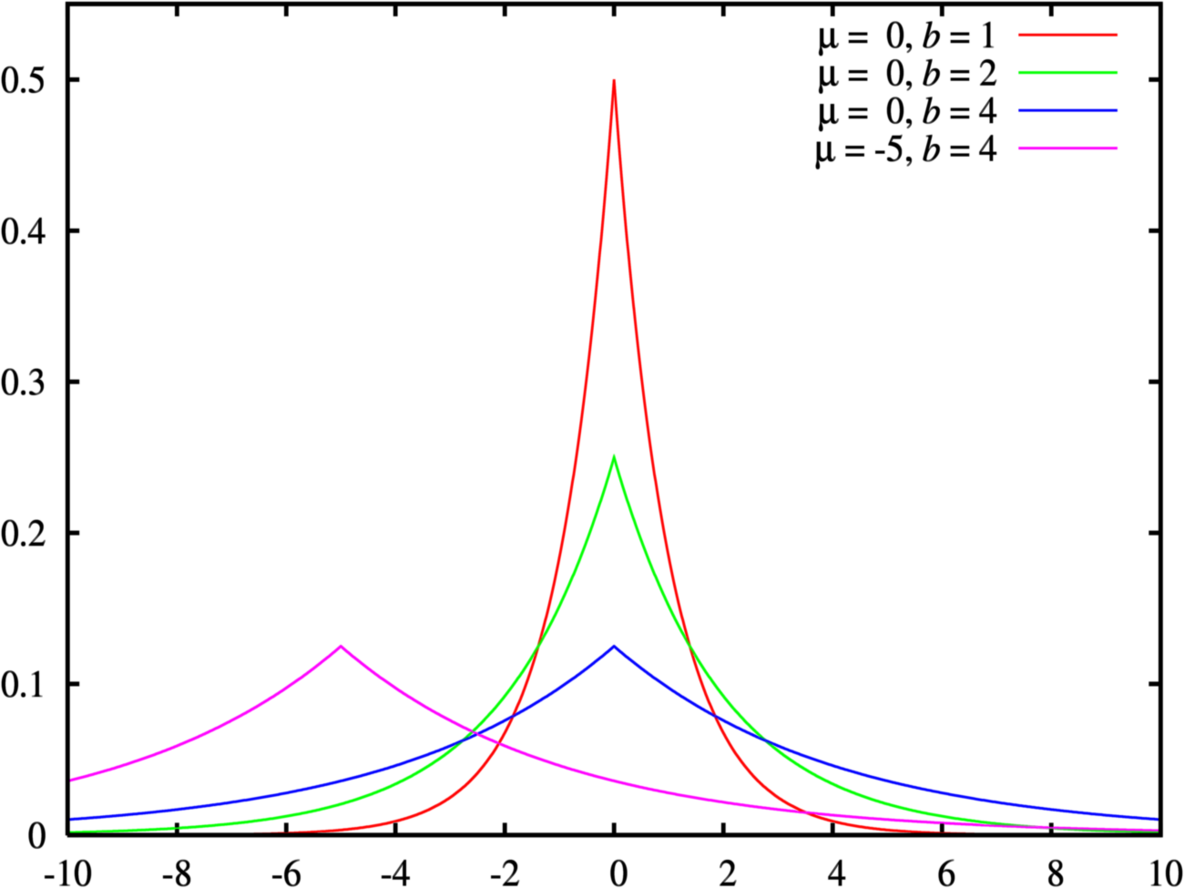
Laplacian Distribution Lap(b)
p(x) = exp(-|x|/b)/2b
variance = 2b²
¾ = √2 b
Increasing b flattens curve

Slide 42
Calibrate Noise to Sensitivity
Δf = max_{adj D,D’} |f(D) – f(D’)|
Theorem: To achieve ε-differential privacy for f, use
scaled symmetric noise [Lap(b)] with b = Δf/ε.
-4b
-3b
-2b
-b
0
b
2b
3b
4b
5b
Noise depends on f and ε, not on the database
Smaller sensitivity (Δf) means less distortion
Notes:
Variance is 2R^2

Slide 43
Why Does it Work ?
Δf = max_{D,D’} |f(D) – f(D’)|
Theorem: To achieve ε-differential privacy, add scaled symmetric noise [Lap(b)] with b = Δf/ε.
-4b
-3b
-2b
-b
0
b
2b
3b
4b
5b
Pr[ K (f, D) = t]
= exp(-(||t- f(D)||-||t- f(D’)||)/b) ≤ exp(Δf/b)
Pr[ K (f, D’) = t]
Notes:
Variance is R^2

