Slide 1
Applications of Information Complexity II
David Woodruff
IBM Almaden

Slide 2
Outline
New Types of Direct Sum Theorems
  Direct Sum with Aborts
  Direct Sum of Compositions

Slide 3




Distributional Communication Complexity
D_{μ, δ}(f) = minimum communication over all correct protocols Π
Can’t we fix the private randomness?
2 players with private randomness: Alice and Bob
Joint function f
Alice
Bob
…
Distribution μ on inputs (x, y)
Correctness: Pr_{(X,Y) » μ, private randomness} [Π(X,Y) = f(X,Y)] ¸ 1-δ
Communication: max_{x,y, private randomness} |Π(x,y)|
Notes:
TODO: maybe change \delta-protocol for “protocols with error \delta”. Then in multiple copies, say “protocol with total error \delta”

Slide 4


Distributional Communication Complexity vs. Information Complexity
By averaging, there is a good fixing of the randomness:
D _{μ, δ} (f) = min_{correct deterministic Π} max_{x,y} |Π(x,y)|
However, we’ll use the notion of information complexity:
IC^{ext}_{μ, δ}(f) = min_{correct Π} I(X, Y ; Π) = H(X, Y) – H(X, Y | Π)
Can’t fix private randomness of Π and preserve I(X, Y ; Π)
Input X
Randomness R
X © R

Slide 5











Multiple Copies of a Communication Problem
Require that the protocol solves all k instances
Alice
Bob
…
…
Distribution μ^{k} on inputs (x,y) = (x₁, y₁), …, (x_{k}, y_{k})
Correctness: Pr_{(X,Y) » μ}k_{, private randomness} [Π(X,Y) = f^{k}(X,Y)] ¸ 1-δ
D_{μ}k_{, δ} (f^{k}) = min_{correct Π} max_{x,y, private randomness} |Π(x,y)|

Slide 6
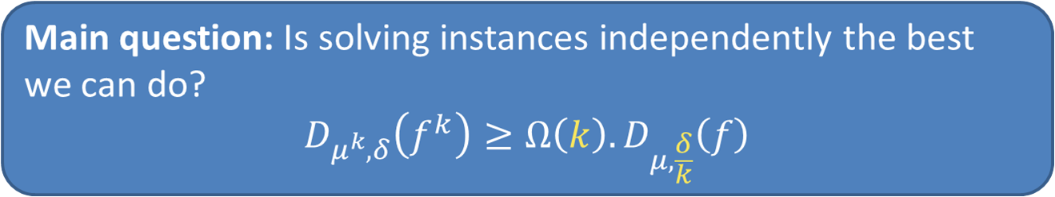
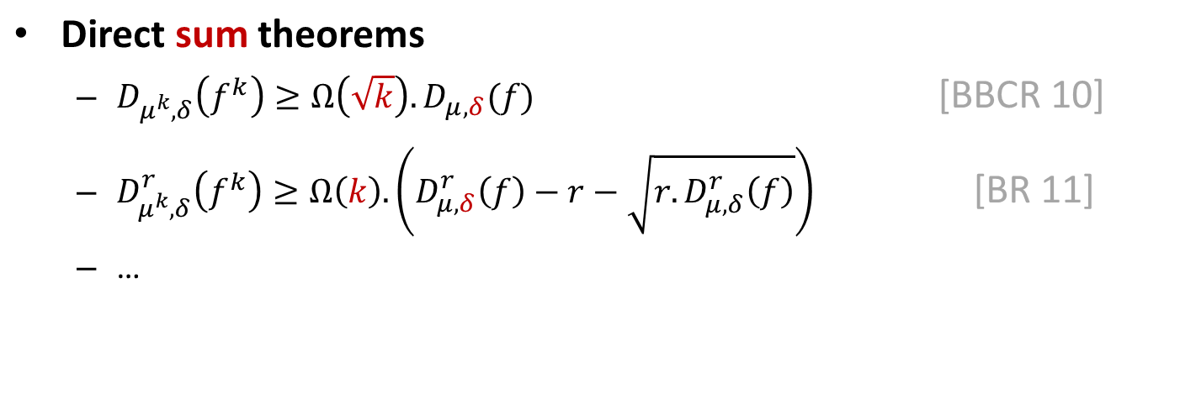
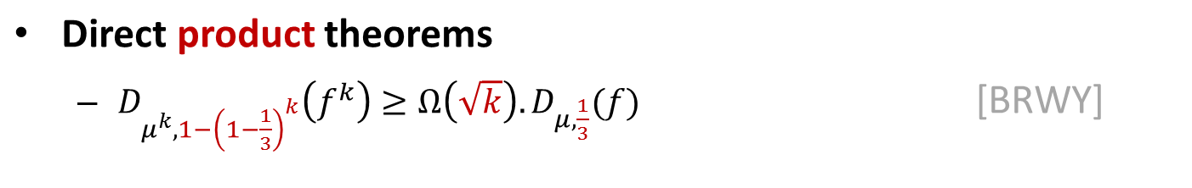
How Hard is Solving all k Copies?
?
Jain et al (bounded rounds)

Slide 7
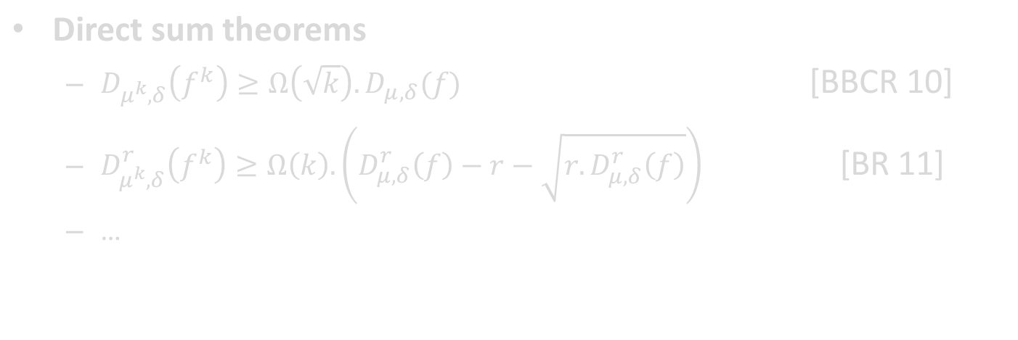
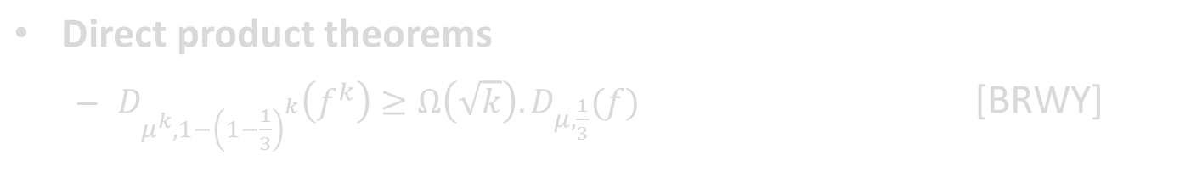
How Hard is Solving all k Copies?
?
None attains above bound!
Impossible for general problems [FKNN95]
However, general but relaxed statement (with aborts) is true
for information complexity

Slide 8


Protocols with Aborts [MWY]
We fix α = 1/20 and write IC^{ext}_{μ, 1/20, β, δ} (f) = IC^{ext} _{μ, β, δ}(f)
Definition: A randomized protocol Π (μ, α, β, δ)-computes f if with probability 1-α over its private randomness:
  (Abort) Pr_{(X,Y) » μ} [Π aborts] · β
  (Error) Pr_{(X,Y) » μ} [Π(X,Y) ≠ f(X,Y) | Π does not abort] · δ
?
abort
error
right
When protocol aborts, it “knows it is wrong”
IC^{ext}_{μ, α, β, δ}(f) = min I(X, Y ; Π), over Π that (μ, α, β, δ)-compute f

Slide 9
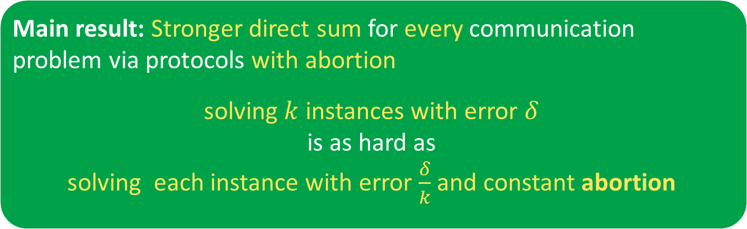
Direct Sum with Aborts
Formally, IC^{ext} _{μ}k_{, δ} (f^{k}) = Ω(k) ¢ IC^{ext} _{μ, 1/10, δ/k} (f)
Number r of communication rounds is preserved
IC^{ext, r} _{μ}k_{, δ} (f^{k}) = Ω(k) ¢ IC^{ext,} ^{r} _{μ, 1/10, δ/k} (f)
Notes:
Say the cool thing about each result

Slide 10
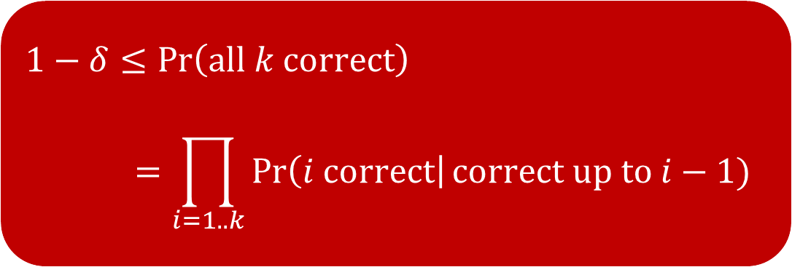
Proof Idea
I(X¹, Y¹, …, X^{k}, Y^{k} ; Π) = ∑_{i} I(X^{i}, Y^{i} ; Π | X^{<i}, Y^{<i})
        = ∑_{i} ∑_{x, y} I(X^{i}, Y^{i} ; Π | X^{<i} = x, Y^{<i} =y )
¢ Pr[X^{<i} = x, Y^{<i} =y]
Bound I(X^{i}, Y^{i} ; Π | X^{<i} = x, Y^{<i} =y ) by IC^{ext}_{μ, 1/10, δ/k} (f)
Create protocol Π_{x,y} (A,B) for f:
  Run Π with inputs (X^{<i} , Y^{<i}) = (x,y) and (X^{i}, Y^{i}) = (A,B), and use private randomness to sample X^{>i}, Y^{>i}
  Check if Π’s output is correct on first i-1 instances
  If correct, then Π_{x,y} (A,B) outputs the i-th output of Π
  Else, Abort

Slide 11
Application: Direct Sum for Equality
For strings x and y, EQ(x,y) = 1 if x = y, else EQ(x,y) = 0
x₁, …, x_{k} 2 {0,1}^{n}
y₁, …, y_{k} 2 {0,1}^{n}
EQ^{k} = (EQ(x₁, y₁), EQ(x₂, y₂), …, EQ(x_{k}, y_{k}))
Standard direct sum:
IC^{ext, 1} _{μ}k_{, 1/3}(EQ^{k}) = Ω(k) ¢ IC^{ext, 1} _{μ, 1/3} (EQ)
For any ¹, IC^{ext, 1} _{μ, 1/3} (EQ) = O(1), so LB is Ω(k)
Direct sum with aborts:
IC^{ext, 1} _{μ}k_{, 1/3}(EQ^{k}) = Ω(k) ¢ IC^{ext, 1} _{μ, 1/10, 1/(3k)} (EQ) = Ω(k log k)

Slide 12
Sketching Applications
Optimal lower bounds (improve by a log k factor)
- Sketching a sequence u₁, …, u_{k} of vectors, and sequence v₁, …, v_{k} of vectors in a stream to (1+ε)-approximate all distances |u_{i} – v_{j}|_{p}
- Sketching matrices A and B in a stream so that for all i, j, (A¢B)_{i,j} can be approximated with additive error ε |A_{i}|*|B_{j}|

Slide 13
Set Intersection Application
S µ [n]
|S| = k
T µ [n]
|T| = k
Each party should locally output S Å T
Randomized protocol with O(k) bits of communication.
In O(r) rounds, obtain O(k ilog^{(r)} k) communication [WY]
  ilog⁽¹⁾ k = log k, ilog⁽²⁾ k = log log k, etc.
Combining [BCK] and direct sum with aborts, any r-round
protocol w. pr. ¸ 2/3 requires Ω(k ilog^{(r)} k) communication

Slide 14
Outline
New Types of Direct Sum Theorems
  Direct Sum with Aborts
  Direct Sum of Compositions

Slide 15
Composing Functions
2-Party Communication Complexity
  Alice has input x. Bob has input y
Consider x = (x¹, …, x^{r}) and y = (y¹, …, y^{r}) 2 ({0,1}^{n})^{r}
f(x,y) = h(g(x¹, y¹), …, g(x^{r}, y^{r})) for Boolean function g
h
Outer function
Inner function
g(x¹, y¹)
g(x², y²)
…
g(x^{r-1}, y^{r-1})
g(x^{r}, y^{r})
Given information complexity lower bounds for h and g,
when is there an information complexity lower bound for f?

Slide 16
Composing Functions
OR function
sensitive to individual
coordinates
ALL-COPIES = (g(x¹, y¹), …, g(x^{r}, y^{r}))
DISJ(x,y) = Ç_{i=1}^{r} (x^{i} Æ y^{i} )
TRIBES(x,y) = Æ_{i=1}^{r} DISJ(x^{i}, y^{i})
Key to information complexity lower bounds for these functions is an embedding step
  Lower bound I(X, Y ; Π) = Σ_{i} I(X^{i}, Y^{i} ; Π | X^{<i}, Y^{<i}) by creating a protocol for each i to solve the primitive problem g
  Lower bound I(X^{i}, Y^{i} ; Π | X^{<i}, Y^{<i}) by information complexity of g
  Combining function h needs to be sensitive to individual coordinates (under appropriate distribution)
AND function
sensitive to individual
instances of DISJ

Slide 17
Composing Functions
What if outer function h is not sensitive to individual coordinates?
Gap-Thresh(z¹, …, z^{r}) for bits z¹, …, z^{r}
  = 1 if Σ_{i=1}^{r} z^{i} > r/4 + r^{1/2}
  = 0 if Σ_{i=1}^{r} z^{i} < r/4 – r^{1/2}
  Otherwise output is undefined (promise problem)
No obvious embedding step for Gap-Thresh!
For specific choices of inner function [BGPW, CR]:
IC^{ext}_{μ, δ}(Gap-Thresh(a¹Æb¹, … , a^{r}Æb^{r})) = Ω(r) for μ a product uniform distribution on a=(a¹, … , a^{r}), b=(b¹, … , b^{r})
Can we use IC^{ext}(Gap-Thresh(AND)) to bound IC^{ext}(Gap-Thresh(g)) for other functions g?

Slide 18
Embedding AND [WZ]
On other coordinates j, choose a random player P^{i}j 2 {Alice, Bob}
If P^{i}_{j} = Alice, X^{i}_{j} 2_{R} {0,1}, Y^{i}_{j} = 0
If P^{i}_{j} = Bob, X^{i}_{j} = 0, Y^{i}_{j} 2_{R} {0,1}
Want to bound IC^{ext}(Gap-Thresh(g(x¹, y¹), …, g(x^{r}, y^{r})))
Know IC^{ext}_{μ, δ}(Gap-Thresh(AND)) = Ω(r) for uniform distribution
What if we could embed the uniform bits a_{i}, b_{i} into x^{i}, y^{i} so that inner function g(x^{i}, y^{i}) = a^{i} Æ b^{i} ?
Example embedding for g = DISJ
Call this distribution ¹
Say ¹ is collapsing
Embed into random special coordinate S^{i}
0 | 1 | 0 | a_{i} | 0 | 0 | 0 | 0 | 0 | 1
0 | 0 | 0 | b_{i} | 1 | 1 | 0 | 0 | 1 | 0

Slide 19
Analyzing the Information
X^{<i}, Y^{<i} determines A^{<i}, B^{<i} given P, S
Let Π be protocol for Gap-Thresh(DISJ(x¹, y¹), …, DISJ(x^{r}, y^{r})))
Embedding AND into DISJ: I(Π ; A¹, …, A^{r}, B¹, …, B^{r} | P, S)
¸ IC^{ext}_{μ, δ}(Gap-Thresh(AND)) = Ω(r)
By chain rule, for most i, I(Π ; A^{i} , B^{i} | A^{<i}, B^{<i}, P, S) = Ω(1)
Maximum likelihood estimation: from Π, A^{<i}, B^{<i}, P, S, there is a predictor θ which guesses A^{i}, B^{i} with pr. ¼ + Ω(1)
  Holds for Ω(1) fraction of fixings of A^{<i}, B^{<i}, P^{-i}, S^{-i}
I(Π ; X¹,…,X^{r},Y¹,…,Y^{r} | P, S) = Σ_{i=1}^{r} I(Π ; X^{i}, Y^{i} | X^{<i}, Y^{<i}, P, S)
= Σ_{i=1}^{r} I(Π ; X^{i}, Y^{i} | X^{<i},Y^{<i},A^{<i},B^{<i}, P, S)
¸ Σ_{i=1}^{r} I(Π ; X^{i}, Y^{i} | A^{<i}, B^{<i}, P, S)
Chain rule
Now let’s look at the information cost
Independence of X^{i}, Y^{i} from X^{<i}, Y^{<i}
Conditioning reduces entropy
Normally we would look at information cost.
Here we look at an intermediate measure

Slide 20
Guessing Game
Protocol Ψ is correct if can guess (A,B) w. pr. 1/4 + Ω(1) given Ψ(U,V), S, P
CIC^{ext}(Guessing Game) =
min_{correct Ψ} I (Π ; U, V | S, P)
On other coordinates j, choose a random player P_{j} 2 {Alice, Bob}
If P_{j} = Alice, U_{Pj} 2_{R} {0,1}, V_{Pj} = 0
If P_{j} = Bob, U_{Pj} = 0, V_{Pj} 2_{R} {0,1}
I(Π ;X¹,…,X^{r},Y¹,…,Y^{r}| P,S) ¸ Σ_{i=1}^{r} I(Π ; X^{i}, Y^{i} | A^{<i}, B^{<i},P,S)
= Σ_{i=1}^{r} Σ _{a,b,p,s} I(Π ; X^{i}, Y^{i} | P^{i}, S^{i}, A^{<i} =a,B^{<i}= b,P^{-i} =p, S^{-i} =s)
¢ Pr[(A^{<i} , B^{<i} , P^{-i} , S^{-i}) = (a,b,p,s)]
Embedding Step
  Consider a protocol Ψ for the following “Guessing Game”
Choose a random coordinate S
Embed random bits A, B on S
u 2 {0,1}^{n}
v 2 {0,1}^{n}
Lower bounds for this problem imply lower bound for DISJ
U and V are chosen from collapsing distribution μ:
0 | 1 | 0 | A | 0 | 0 | 0 | 0 | 0 | 1
0 | 0 | 0 | B | 1 | 1 | 0 | 0 | 1 | 0

Slide 21
Embedding the Guessing Game
Show CIC^{ext}(Guessing Game) = Ω(n)
Proof related to DISJ lower bound
I(Π ;X¹,…,X^{r},Y¹,…,Y^{r} | P, S) ¸ Σ_{i=1}^{r} I(Π ; X^{i}, Y^{i} | A^{<i}, B^{<i}, P, S)
= Σ_{i=1}^{r} Σ _{a,b,p,s} I(Π ; X^{i}, Y^{i} | P^{i}, S^{i}, A^{<i} = a, B^{<i} = b, P^{-i} = p, S^{-i} = s)
¢ Pr[A^{<i},B^{<i}, P^{-i},S^{-i} = (a,b,p,s)]
Embedding Step
  Create a protocol Π_{i,a,b,p,s} for Guessing Game on inputs (U,V)
  Use private randomness, a, b, p, s to sample X^{j}, Y^{j} for j ≠ i
  Set (X^{i}, Y^{i}) = (U,V)
  Let the transcript of Π_{i,a,b,p,s} equal the transcript of Π
  Use predictor θ, given a, b, p, s, P^{i}, S^{i}, and the transcript Π, to guess A^{i}, B^{i} w. pr. ¼ + Ω(1), so solve Guessing Game
= Ω(r) ¢ CIC^{ext}(Guessing Game)

Slide 22
Distributed Streaming Model
coordinator:
C
players:
P₁
P₂
P₃
…
P_{k}
inputs:
x¹
x²
x³
x^{k}
Each x^{i} 2 {-M, -M+1, …, M}^{n}
Problems on x = x¹ + x² + … + x^{k}: sampling, p-norms, heavy
hitters, compressed sensing, quantiles, entropy
Direct Sum of Compositions (generalized to k players): tight
bounds for approximating |x|₂ and additive ε approx. to entropy

Slide 23
Open Questions
Direct Sum with Aborts:
  D_{μ, δ} (f^{k}) = Ω(k) ¢ IC^{ext}_{μ, 1/10, δ/k} (f)
Instead of f^{k}, when can we improve the standard direct sum
theorem for combining operators such as MAJ, OR, etc.?
Direct Sum of Compositions: for which functions g is
IC^{ext}(Gap-Thresh(g(x¹, y¹), …, g(x^{r}, y^{r}))) = Ω(r ¢ n)?
- See Section 4 of http://arxiv.org/abs/1112.5153 for work on a related Gap-Thresh(XOR) problem (a bit different than Gap-Thresh(DISJ))
- Gap-Thresh(DISJ) problem in followup work [WZ]

