Slide 1
PoC Rendering Spreadshirt Product Images with Cloudinary
Martin Breest

Slide 2
Agenda
Spreadshirt product image generation explained
Cloudinary explained
Rendering Spreadshirt product images with Cloudinary

Slide 3
Spreadshirt Product Image Generation Explained

Slide 4
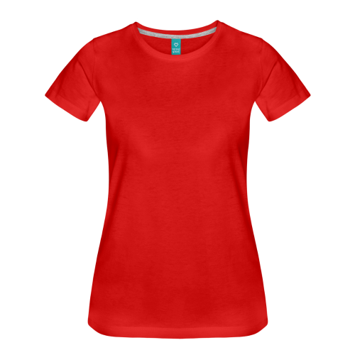

Product Image Explained
Product image: http://image.spreadshirtmedia.net/image-server/v1/products/200636457/views/1,width=100.png
consists of
ProductType image
Product image
Design image
Notes:
Product image consists of configurations applying text or designs to a product type
In most cases we just add one design to a product type

Slide 5
Product Image Rendering Explained
Product
Data
Product
Type
Data
Image Server
Design
Data
Request product image
Product
Type View Image
Loads data from API
and file system
Design
Image
Product data: http://www.spreadshirt.de/api/v1/shops/205909/products/200636457
ProductType data: http://www.spreadshirt.de/api/v1/shops/205909/productTypes/813
Design data: http://www.spreadshirt.de/api/v1/shops/205909/designs/m12720381-2
ProductType View image: http://image.spreadshirtmedia.net/image-server/v1/productTypes/813/views/1/appearances/366
Design image:
http://image.spreadshirtmedia.net/image-server/v1/designs/12720381

Slide 6
Design Positioning on Product Image
View width and height
from ProductType
PrintArea offset x and y
from ProductType
Design offset x and y
from Product’s DesignConfiguration
Design width and height
from Product’s DesignConfiguration

Slide 7
Design Position Calculation
int defaultImageSize = 600;
String productId = "200636457";
String viewId = "1”;
Product product = loadSpreadshirtProduct(productId);
DesignConfiguration config = (DesignConfiguration)product.configurations.get(0);
ProductType productType = loadSpreadshirtProductType(product.productType.id);
View view = productType.getView(viewId);
ViewMap viewMap = view.getViewMap(config.printArea.id);
double viewScaleX = (double) defaultImageSize / view.size.width;
double viewScaleY = (double) defaultImageSize / view.size.height;
double viewMapX = viewMap.offset.x * viewScaleX;
double viewMapY = viewMap.offset.y * viewScaleY;
double designConfigurationOffsetX = config.offset.x * viewScaleX;
double designConfigurationOffsetY = config.offset.y * viewScaleY;
double designConfigurationWidth = config.content.svg.image.width * viewScaleX;
double designConfigurationHeight = config.content.svg.image.height * viewScaleY;
int x = (int) (viewMapX + designConfigurationOffsetX);
int y = (int) (viewMapY + designConfigurationOffsetY);
int width = (int) (designConfigurationWidth);
int height = (int) (designConfigurationHeight);

Slide 8
Cloudinary Explained

Slide 9
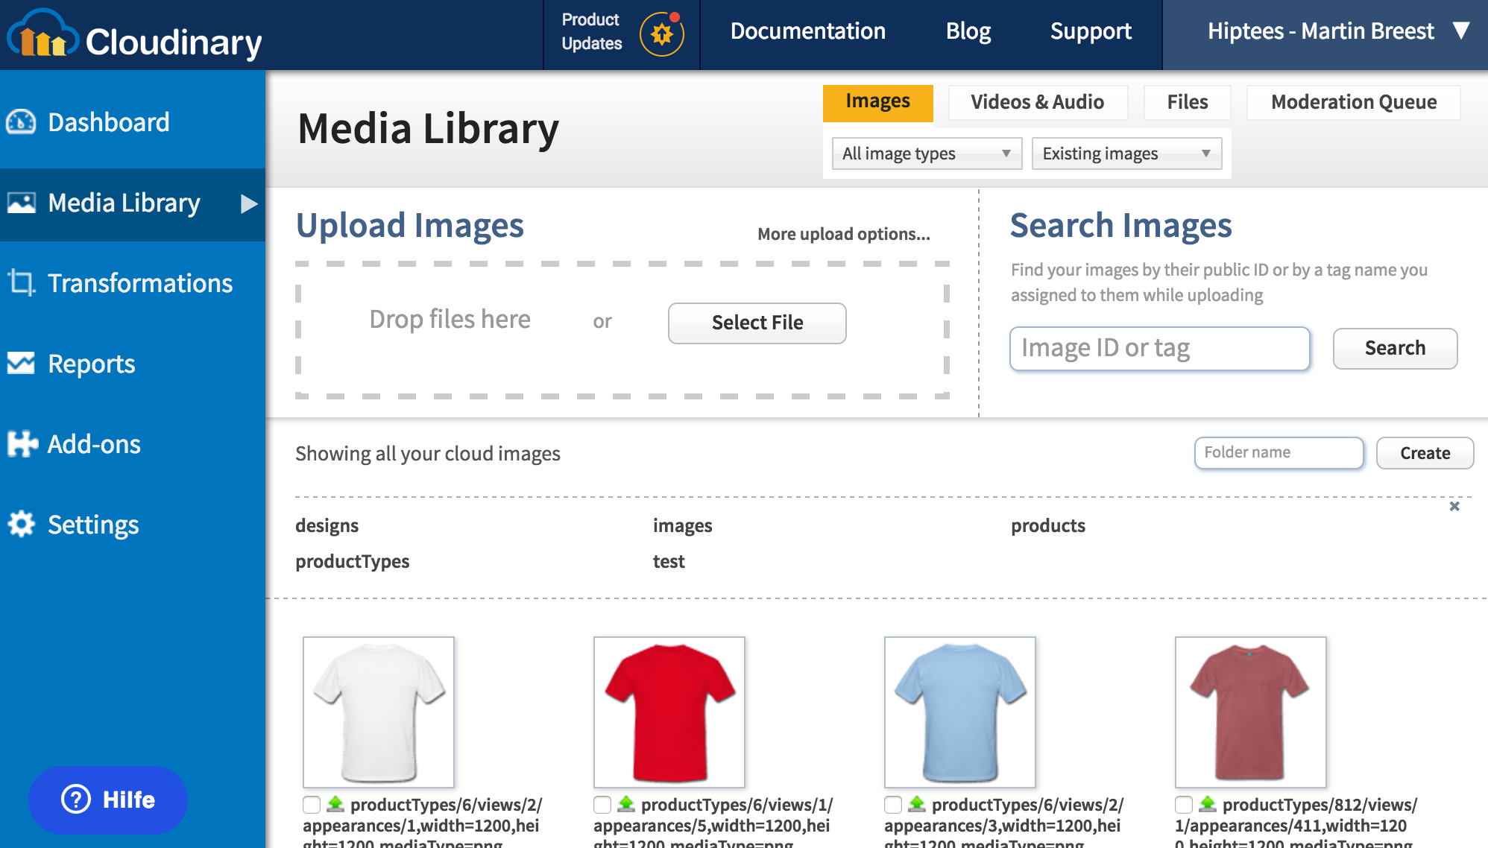



Cloudinary Features
Nice image management
admin UI
Powerful image retrieval
and manipulation API
Various integrations for
fetching source images
Notes:
Use Cloudinary for images managed by content team already
Cloudinary provides scalable image management solution in the cloud
Cloudinary provides nice UI to manage images (and other media files)
Cloudinary provides powerful API to retrieve and modify images
Cloudinary allows to dynamically fetch images from a remote origin
Cloudinary delivers optimized image per browser

Slide 10




Cloudinary Infrastructure
Processes data on AWS EC2
Stores data on AWS S3
Caches data on AKAMAI CDN

Slide 11
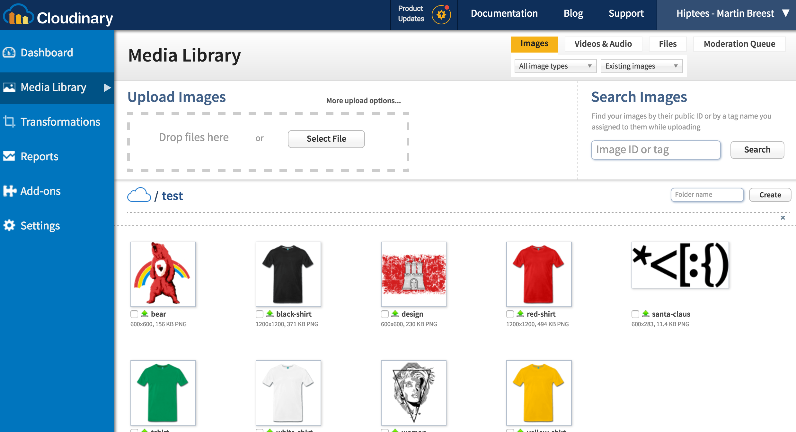
Uploading an Image using the Admin UI
Image upload
Uploaded images

Slide 12

Retrieving Images using the API
http://res.cloudinary.com/hiptees/image/upload /test/red-shirt.png
http://res.cloudinary.com/hiptees/image/upload /test/santa-claus.png

Slide 13
Fetching Images from a Remote Source
http://res.cloudinary.com/hiptees/image/fetch/ http://image.spreadshirtmedia.net /image-server/v1/productTypes/813 /views/1/appearances/366 ,width=1200,height=1200,mediaType=png
http://res.cloudinary.com/hiptees/image/fetch/ http://image.spreadshirtmedia.net /image-server/v1/designs/12720381 ,width=600,mediaType=png

Slide 14
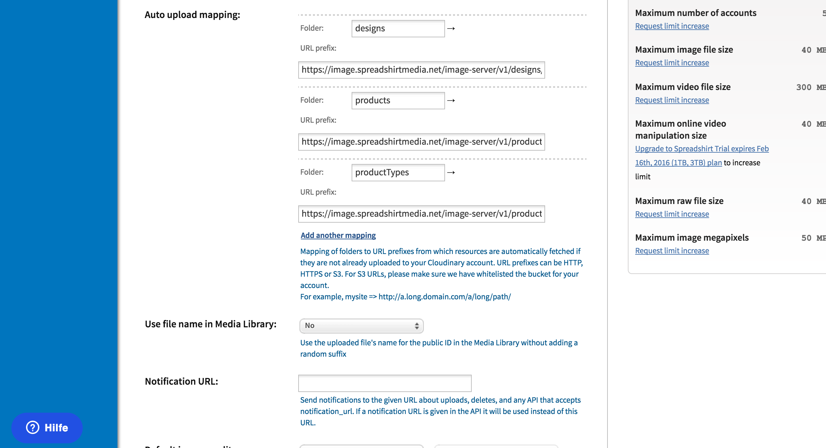
Configuring Remote Image Folders
Configured remote
folder

Slide 15
Fetching Images Using a Remote Folder
http://res.cloudinary.com/hiptees/image/upload /productTypes/813/views/1/appearances/366,width=1200,height=1200,mediaType=png
http://res.cloudinary.com/hiptees/image/upload /designs/12720381,width=600,mediaType=png

Slide 16
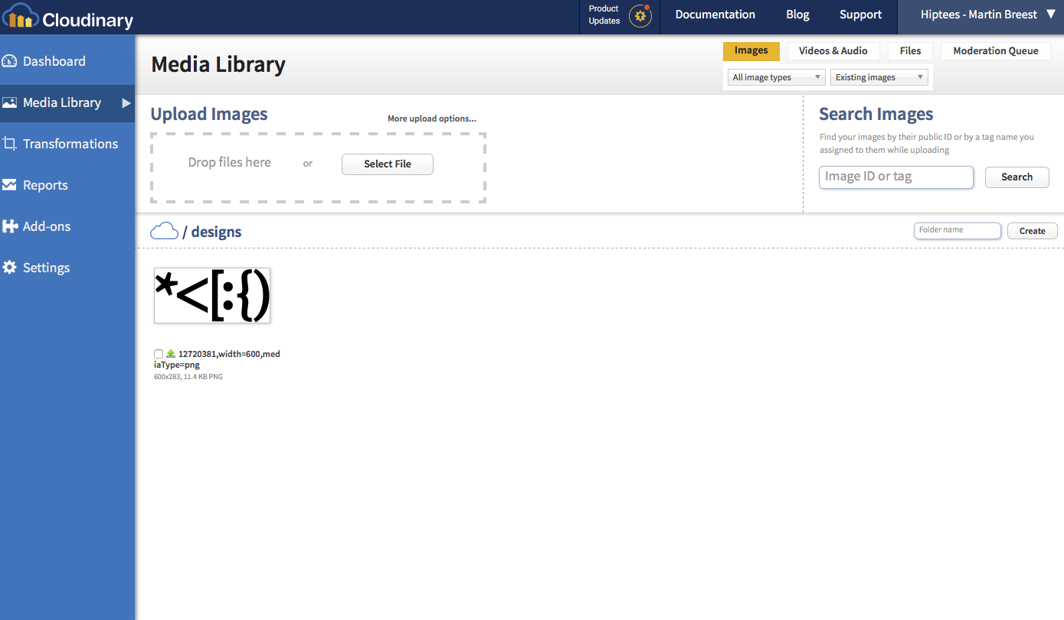
Behind the Scenes
Fetched image version stored in Cloudinary file system for later reuse

Slide 17
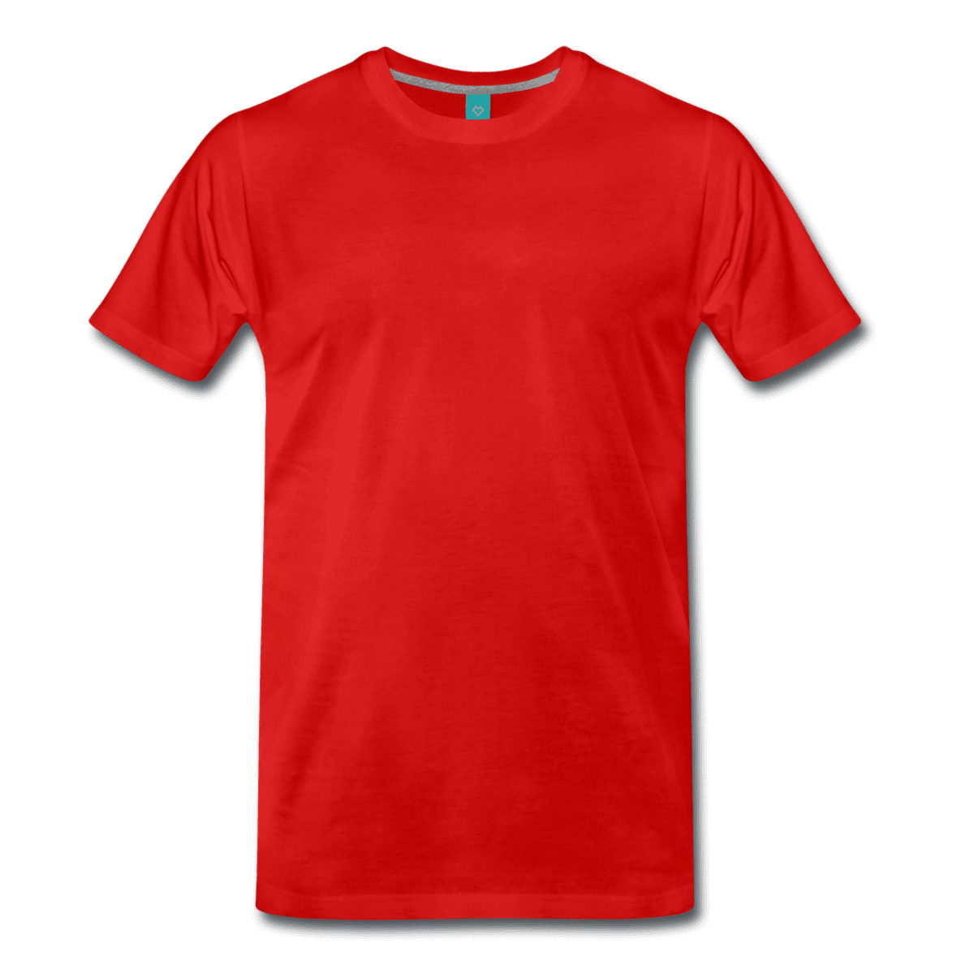
Cloudinary Image Transformation Functions …
Deliver optimized image with q_auto – 494 vs 167 kb http://res.cloudinary.com/hiptees/image/upload /q_auto/test/red-shirt.png
Deliver optimized image format with f_auto – 167 vs 41 kb (webp) http://res.cloudinary.com/hiptees/image/upload /q_auto,f_auto/test/red-shirt.png
Resize image with w_{width} – http://res.cloudinary.com/hiptees/image/upload /q_auto,f_auto,w_100/test/red-shirt.png

Slide 18
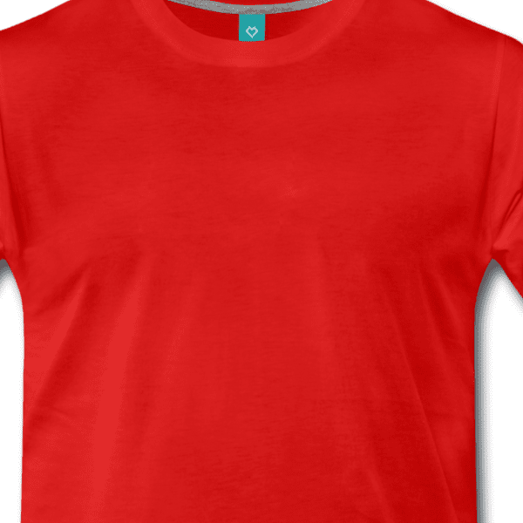
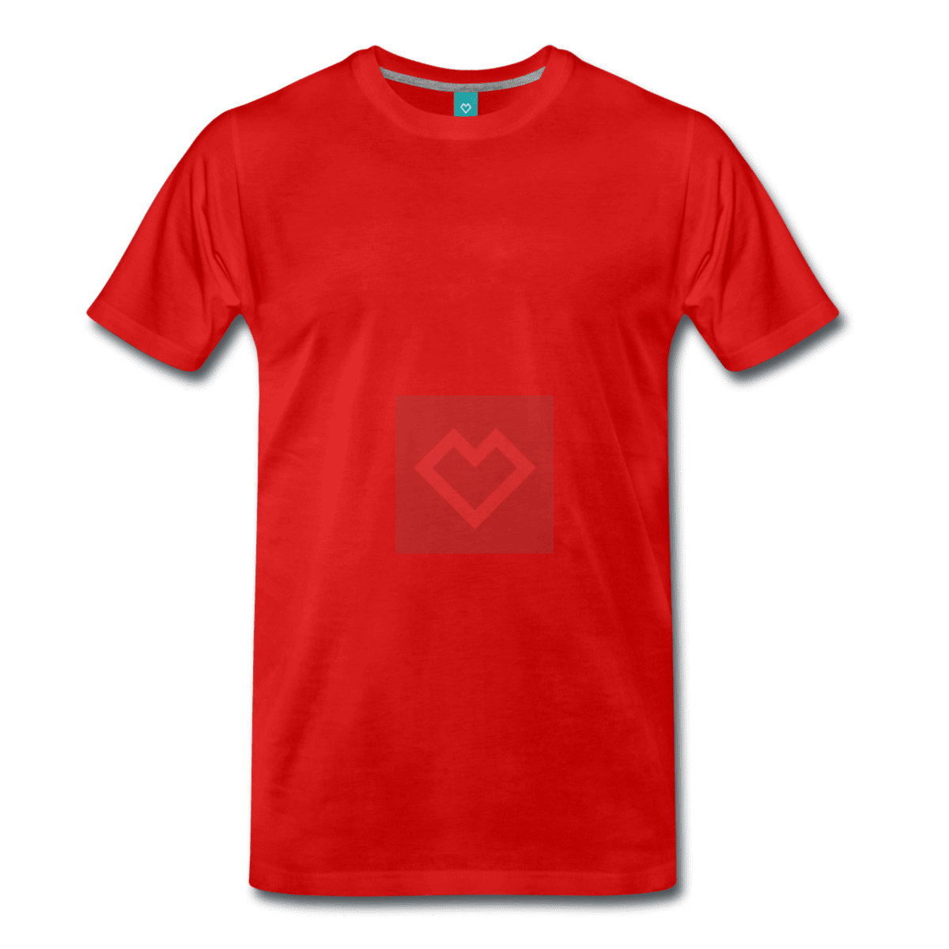
Cloudinary Image Transformation Functions …
Crop image with c_crop – http://res.cloudinary.com/hiptees/image/upload /q_auto,f_auto,c_crop,g_north_west,x_300,y_100,w_600,h_600 /test/red-shirt.png
Add watermark with overlay l_{image} – http://res.cloudinary.com/hiptees/image/upload /q_auto,f_auto,l_test:spreadshirt-logo,w_200,g_center,o_10 /test/red-shirt.png
… and a lot more features ...

Slide 19
Rendering Spreadshirt Product Images with Cloudinary

Slide 20

Composing Images using Cloudinary’s Transformation Functions
Scale down to a default image size – c_scale,w_600
Use Cloudinary’s overlay function to add image to another – l_designs:12720381
Position image using gravity, position and size - g_north_west,x_200,y_100,w_200,c_scale
Putting the things together
http://res.cloudinary.com/hiptees/image/upload /c_scale,w_600 /l_designs:12720381,g_north_west, x_200,y_200,w_200,c_scale /v12345/productTypes/813/views/1/appearances/366,width=1200,height=1200,mediaType=png

Slide 21
Design Position Calculation Recap
int defaultImageSize = 600;
String productId = "200636457";
String viewId = "1”;
Product product = loadSpreadshirtProduct(productId);
DesignConfiguration config = (DesignConfiguration)product.configurations.get(0);
ProductType productType = loadSpreadshirtProductType(product.productType.id);
View view = productType.getView(viewId);
ViewMap viewMap = view.getViewMap(config.printArea.id);
double viewScaleX = (double) defaultImageSize / view.size.width;
double viewScaleY = (double) defaultImageSize / view.size.height;
double viewMapX = viewMap.offset.x * viewScaleX;
double viewMapY = viewMap.offset.y * viewScaleY;
double designConfigurationOffsetX = config.offset.x * viewScaleX;
double designConfigurationOffsetY = config.offset.y * viewScaleY;
double designConfigurationWidth = config.content.svg.image.width * viewScaleX;
double designConfigurationHeight = config.content.svg.image.height * viewScaleY;
int x = (int) (viewMapX + designConfigurationOffsetX);
int y = (int) (viewMapY + designConfigurationOffsetY);
int width = (int) (designConfigurationWidth);
int height = (int) (designConfigurationHeight);

Slide 22
Scale Down and Image Optimization per Browser
Scale output image to desired size – c_scale,w_300
Optimize image format and quality for delivery to browser – q_auto,f_auto
Putting the things together
http://res.cloudinary.com/hiptees/image/upload /c_scale,w_600 /l_designs:12720381,g_north_west, x_200,y_200,w_200,c_scale /w_300,c_scale,q_auto,f_auto /v12345/productTypes/813/views/1/appearances/ 366,width=1200,height=1200,mediaType=png

Slide 23
Hiding the Ugly URLs
http://res.cloudinary.com/hiptees/image/upload /c_scale,w_600 /l_designs:12720381,g_north_west, x_200,y_200,w_200,c_scale /w_300,c_scale,q_auto,f_auto /v12345/productTypes/813/views/1/appearances/366,width=1200,height=1200,mediaType=png
Yes!
http://image.spreadshirtmedia.net /products/medium/200636457/v1/women’s-premium-t-shirt.jpg

Slide 24
Problems Solved
http://image.spreadshirtmedia.net/products /<sizes>/<productId>/<modifications>/<seo>.<ending>
Sizes – Use predefined sizes small, medium, large so URLs don’t break on size changes
ProductId – Extra context for productId so we have all modifications for one size on one context
Modifications – Put version, appearance, … in one modification string to reduce path length
Seo – Add SEO part and redirect on SEO part changes
Ending - Deliver optimized image formats per browser on the same URL
TTL - Use short TTL for browser caching, 365 day TTL for AKAMAI and Edge-Content-Tag header and FastPurge to purge images on changes

Slide 25
Cloudinary Image Service
Product
Data
Load data
from API
Product
Type
Data
Cloudinary
Image Server
Design
Data
Load images
from image server
Request
product image
Product
Type View Image
Request
product image
Design
Image

Slide 26
Implementation Details
https://github.com/mbreest/cloudinary-image-server
Start it as follows
mvn package && java -jar target/cloudinary-image-server-1.0-SNAPSHOT.jar
Request image
http://localhost:8080/products/medium/200636457/v1/women%E2%80%99s-premium-t-shirt.jpg
Request different size - http://localhost:8080/products/small/200636457/v1/women%E2%80%99s-premium-t-shirt.jpg
Request different appearance – http://localhost:8080/products/small/200636457/v1a1/women%E2%80%99s-premium-t-shirt.jpg
Request with wrong SEO string – http://localhost:8080/products/small/200636457/v1a1/seo-issue.jpg

Slide 27
More Cloudinary Documentation
Cloudinary API documentation - http://cloudinary.com/documentation
Cloudinary blog - http://cloudinary.com/blog
Product image rendering examples https://spaces.spreadomat.net/display/IT/Rendering+Product+Images+with+Cloudinary

Slide 28
Conclusion

Slide 29
Conclusion
Cloudinary
Provides nice admin UI for managing images
Provides a powerful API for retrieving and transforming images
Provides different integration options where one is fetching source images from a remote source on-the-fly
Runs on proven and scalable infrastructure like AWS and AKAMAI
Provides required features for creating image compositions

Slide 30
Conclusion
PoC Cloudinary Image Server
Encapsulates product image generation logic
Solves problem of ugly Cloudinary URLs and a couple of common SEO issues
Can be deployed globally and close to Cloudinary data centers on AWS cloud
Thinking more radically, we can even upload our images to Cloudinary directly and get rid of the whole S3/Ceph problem

Slide 31
Q&A

