Slide 1
G6 20×20 LED Panel
Timing & Grayscale Characterization
RP2354 MCU (150 MHz)
PIO-driven BCM
Zero-jitter architecture
Reiser Lab — March 2026

Slide 2
Zero-Jitter BCM Architecture
Architecture
0.000 µs
4-bit BCM: 16 intensity levels
PIO drives 20 columns simultaneously
CPU manages rows via gpio_set_mask64
Single row per 8 kHz trigger
T = 0.5 µs base time (configurable)
Jitter
640k measurements
9.5 µs
Burst time
5.5 µs margin in 15 µs window
Zero-Jitter Recipe (all required)
__not_in_flash_func + noinline
noInterrupts() during burst
multicore_lockout (Core 1 paused)
100-trigger warm-up
400 Hz
Frame rate
8 kHz trigger / 20 rows

Slide 3
External Trigger & Optical Validation
Saleae Pulse-Triggered Average
External Trigger (GP45)
499 pulses averaged at 50 MHz
4 BCM bit-planes clearly resolved:
B0 = 0.5 µs (weight 1)
B1 = 1.0 µs (weight 2)
B2 = 2.0 µs (weight 4)
B3 = 4.0 µs (weight 8)
~0.4 µs PIO overhead gaps visible
between each bit-plane
Real 8 kHz waveform generator
BCMBURST 10k: 0.000 µs jitter
GPIO edge detection (polling)
Per-burst noInterrupts()
Spectrometer + Linearity
Ocean Insight Flame X
LED peak: 570.8 nm
Integration-based averaging
BCMWEIGHTS: 6.67 ns resolution
Enables per-channel linearization

Slide 4
Next Steps
Optical Linearity
Calibration
Spectrometer sweep: 16 BCM levels
100 ms integration, full spectrum per level
1s OFF gaps for clean segmentation
Sweep T values for optimal linearity
BCMWEIGHTS: custom bit-plane durations
6.67 ns resolution (1 CPU cycle)
Measured LED response → correction LUT
Non-power-of-2 weights (e.g. 1.2, 2.2, 4.1, 8)
PCB Redesign
Production Path
Option B: add EINT trace to GP45 (minimal)
Option C: SPI1 on GP44-47, contiguous rows
40 UCC27517 drivers (symmetric, both sides)
GP45-47 for trigger + sync outputs
Per-pixel pattern loading via SPI
Frame double-buffering at 400 Hz
Core 1 lockout (USB debug only)
PIO wait-pin for hardware trigger

Slide 5
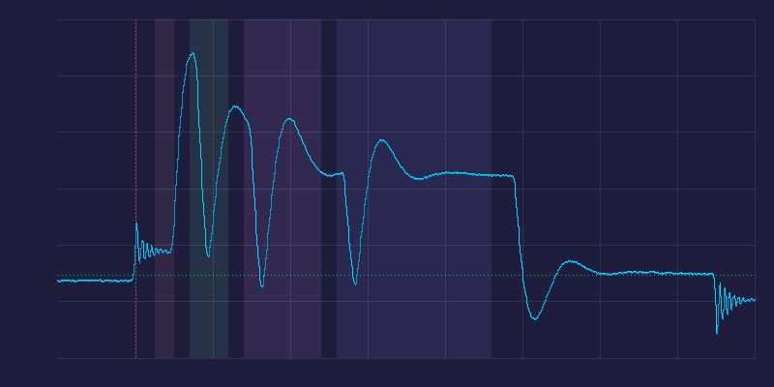
BCM Waveform — Pulse-Triggered Average
Key Observations
499 pulses averaged
50 MHz analog capture
4 bit-planes resolved:
B0: 0.5 µs (1T)
B1: 1.0 µs (2T)
B2: 2.0 µs (4T)
B3: 4.0 µs (8T)
~0.4 µs gaps between bit-planes (PIO overhead)
~1 µs trigger latency
(GPIO polling + driver)
Photodiode signal (Saleae Logic Pro 8 analog input)

Slide 6
BCM Burst Timing Budget (4-bit, 8 kHz)
T (µs) | Burst (µs) | Jitter (µs) | Outliers | Fits 15 µs? | Margin
0.25 | 5.727 | 0.000 | 0 / 160k | YES | 9.3 µs
0.50 | 9.460 | 0.000 | 0 / 160k | YES | 5.5 µs
0.75 | 13.227 | 0.000 | 0 / 160k | YES (barely) | 1.8 µs
1.00 | 16.960 | 0.000 | 0 / 160k | NO | -2.0 µs
Recommended: T = 0.50 µs
8 kHz Trigger Period (125 µs)
Burst
9.5 µs
Idle: 115.5 µs — SPI, precompute, interrupts OK
640,000 measurements (4 T values × 16 intensities × 10,000 frames) — zero jitter, zero outliers

