Slide 1
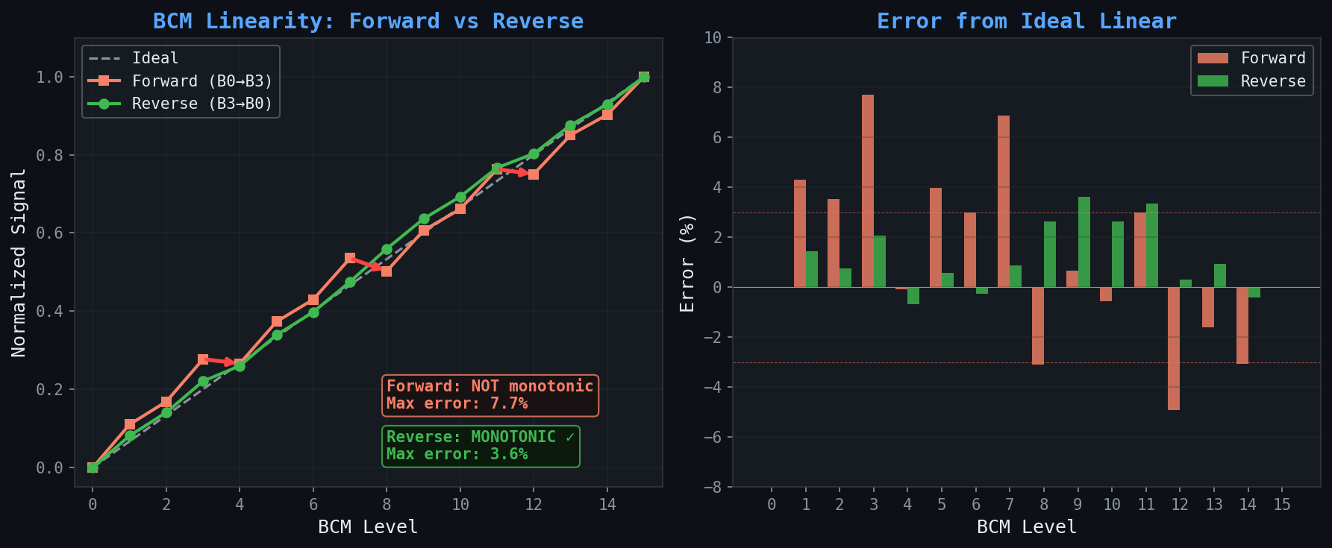
BCM Bit-Plane Scan Order: Forward vs Reverse
T = 0.7 µs | Default weights [1, 2, 4, 8] | All 400 LEDs | 50 ms integration | Ocean Insight Flame X

Slide 2
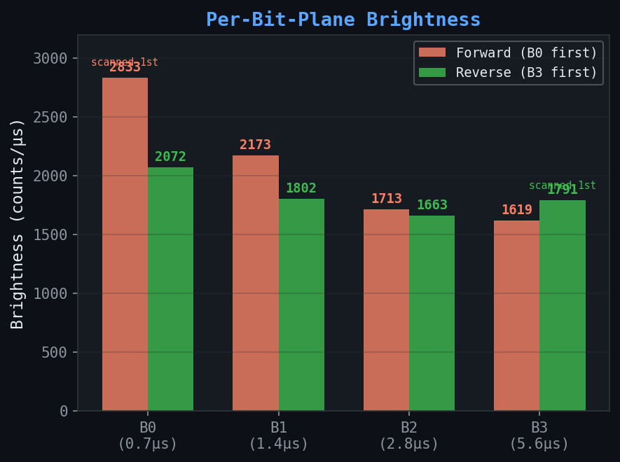
Brightness Per Microsecond — Scan Order Effect
Key Finding
First-scanned bit-plane always produces more light per µs
Reverse order (B3 first) gives B3 the brightness boost → fixes monotonicity without weight correction
Forward: NOT mono, 7.7% err
Reverse: MONOTONIC, 3.6% err
Caveats & Open Questions
Measured with all 400 LEDs ON
→ Need to test single-LED and partial-row patterns to confirm effect doesn't depend on load
How dependent on LED type?
→ Janelia batch (reversed polarity) may behave differently than standard iorodeo panels
→ UCC27517 source/sink asymmetry
could interact with scan order

