Slide 1
G6 20×20 LED Panel
Timing, Grayscale & Linearity Characterization
RP2354 MCU (150 MHz)
PIO-driven BCM
Zero-jitter architecture
Spectrometer-calibrated
Reiser Lab — March 2026

Slide 2
Zero-Jitter BCM Architecture
0.000 µs
Zero-Jitter Recipe
__not_in_flash_func + noinline
noInterrupts() during burst
multicore_lockout (Core 1)
100-trigger warm-up
Jitter
640k measurements
9.5 µs
Burst time
5.5 µs margin in 15 µs
Architecture
4-bit BCM: 16 intensity levels
PIO drives 20 columns simultaneously
CPU manages rows (gpio_set_mask64)
Single row per 8 kHz trigger
External trigger on GP45 (zero jitter)
400 Hz
Frame rate
8 kHz ÷ 20 rows

Slide 3
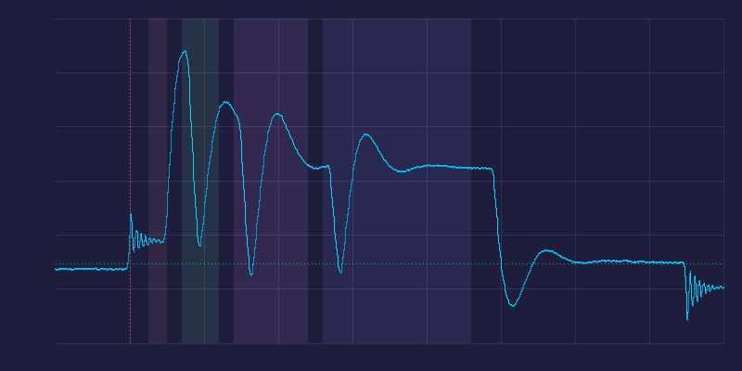
BCM Waveform — Pulse-Triggered Average
Key Observations
499 pulses averaged
50 MHz analog capture
4 bit-planes resolved:
B0: 0.5µs B1: 1.0µs
B2: 2.0µs B3: 4.0µs
~0.4µs PIO overhead gaps between bit-planes
Peak amplitude decreases
with each successive
bit-plane — key finding
for linearity calibration
Photodiode signal via Saleae Logic Pro 8 analog input

Slide 4
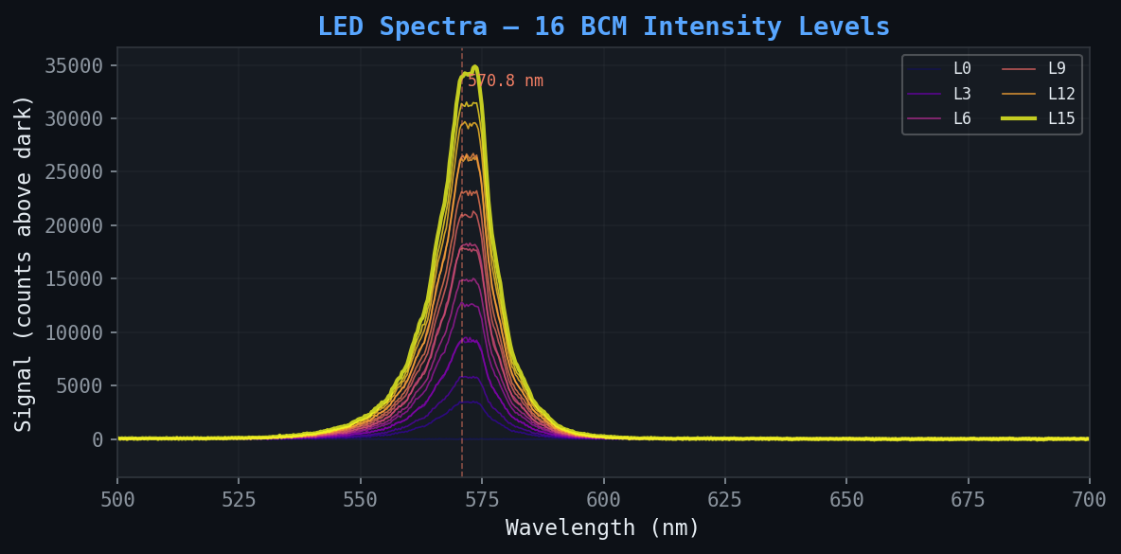
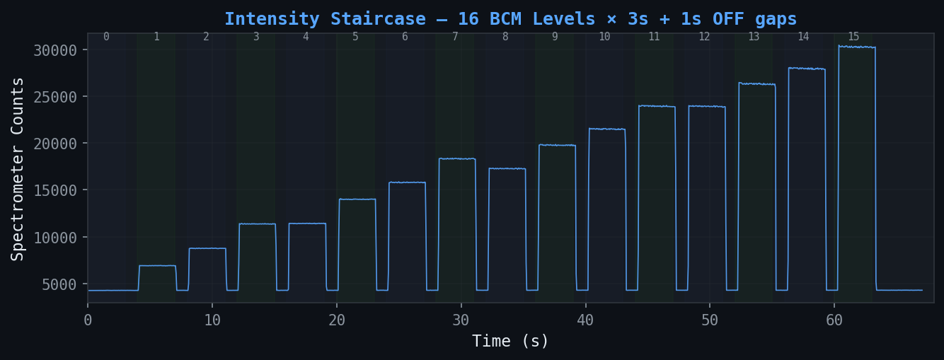
LED Spectra — 16 BCM Intensity Levels
Ocean Insight Flame X
570.8 nm peak
50ms integration
560-580nm window (20nm)
T = 0.7 µs
All 400 LEDs active
Signal grows linearly with BCM level (0→15)
Spectra captured at
middle of each 3s hold
Raw time trace (16 levels × 3s + 1s OFF gaps)

Slide 5
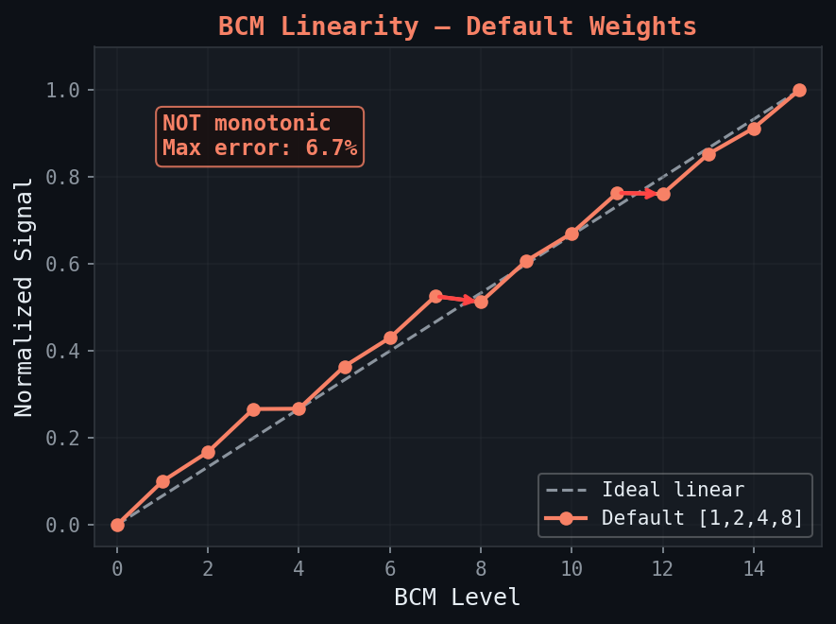
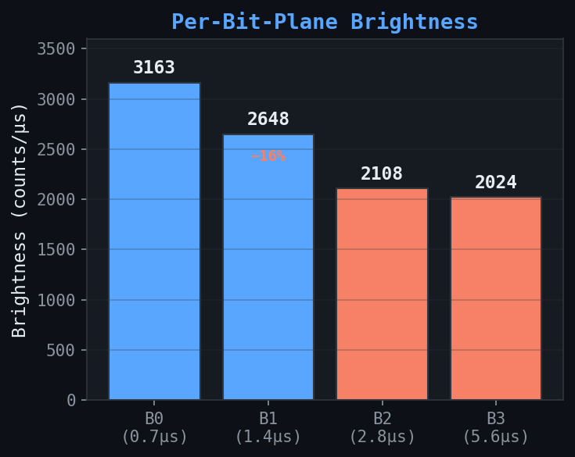
BCM Linearity — Default Weights [1, 2, 4, 8]
Non-monotonic at bit-plane boundaries:
L3 (B0+B1) ≈ L4 (B2) | L7 (B0+B1+B2) > L8 (B3) | L11 ≈ L12
Longer bit-planes produce less light per µs — 56% drop from B0 to B3

Slide 6
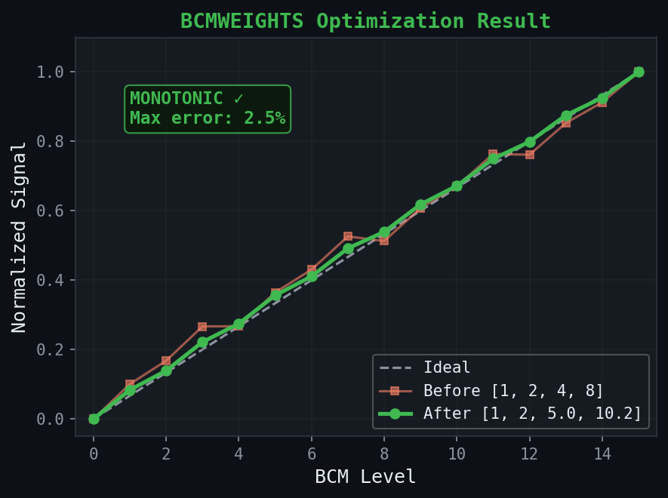
BCMWEIGHTS Optimization — Converged in 6 Iterations
Iter | B0 | B1 | B2 | B3 | Mono? | Max Err
0 | 1.00 | 2.00 | 4.00 | 8.00 | NO | 6.7%
1 | 1.00 | 2.00 | 4.00 | 8.69 | NO | 5.4%
2 | 1.00 | 2.00 | 4.66 | 8.69 | NO | 5.5%
3 | 1.00 | 2.00 | 4.66 | 9.41 | YES | 3.5%
4 | 1.00 | 2.00 | 4.66 | 9.80 | YES | 3.0%
5 | 1.00 | 2.00 | 5.02 | 9.80 | YES | 3.4%
6 | 1.00 | 2.00 | 5.02 | 10.19 | YES | 2.5%
Before → After
Level | 0 | 1 | 2 | 3 | 4 | 5 | 6 | 7 | 8 | 9 | 10 | 11 | 12 | 13 | 14 | 15
Before | 0% | 3% | 3% | 7% | 0% | 3% | 3% | 6% | -2% | 1% | 0% | 3% | -4% | -1% | -2% | 0%
After | 0% | 2% | 1% | 2% | 1% | 2% | 1% | 3% | 1% | 2% | 1% | 2% | -0% | 1% | -1% | 0%
NOT monotonic, 6.7% error
MONOTONIC, 2.5% error ✓

Slide 7
Timing Budget — Production Configuration
Config | T (µs) | Weights | Burst (µs) | Margin | Monotonic | Error
Default | 0.50 | 1, 2, 4, 8 | 9.46 | 5.5 µs | —* | —*
Default | 0.70 | 1, 2, 4, 8 | 12.1 | 2.9 µs | NO | 6.7%
Optimized | 0.70 | 1, 2, 5.0, 10.2 | 12.7 | 2.3 µs | YES | 2.5%
Default | 1.00 | 1, 2, 4, 8 | 16.96 | −2.0 µs | YES | 5.6%
Recommended: T=0.7µs + optimized weights
*T=0.5 linearity not yet measured with spectrometer (too dim for full-panel test)
8 kHz Trigger Period (125 µs)
Burst 12.7µs
Idle: 112.3 µs — SPI, precompute, interrupts

Slide 8
Next Steps
Reverse Bit-Plane Order
Single LED vs Full Row
BCMORDER REVERSE: scan B3→B0
Test if longest-first improves linearity
Compare with spectrometer + photodiode
May eliminate need for weight calibration
Measure 1 LED → 5 → 10 → 20 → 400
Test current-sharing / voltage-drop effects
May explain brightness-per-µs decay
Focal LED on row 7 (nearest to fiber)
PCB Redesign
Production Path
Option B: add EINT trace to GP45
Option C: SPI1 on GP44-47, contiguous rows
40 UCC27517 drivers symmetric (both sides)
EINT + sync output pins on next revision
Per-pixel pattern loading via SPI
Frame double-buffering at 400 Hz
BCMWEIGHTS calibration per panel
PIO wait-pin for hardware trigger

