Slide 1
G6 20×20 LED Panel
Timing Characterization & BCM Grayscale
Zero-jitter BCM scanning for 2-photon microscope synchronization
0.000 µs
9.5 µs
16
400 Hz
Jitter
Burst time
Gray levels
Frame rate
Reiser Lab — RP2354 MCU, PIO-driven BCM, External 8 kHz Trigger

Slide 2
Zero-Jitter Architecture
How we achieve deterministic LED timing for 2P microscope sync
8 kHz Trigger Cycle (125 µs)
Zero-Jitter Recipe (all required)
1
__not_in_flash_func + noinline
TRIGGER EDGE
External GPIO (GP45)
All timing code in SRAM — prevents XIP cache jitter
noInterrupts()
~10 ns
noInterrupts() per burst
2
BCM BURST
9.5 µs — 4 bit-planes via PIO
Disable Core 0 interrupts during ~10 µs scan
3
Core 1 multicore lockout
interrupts()
~10 ns
Pause USB stack — eliminates bus contention
IDLE WINDOW
115 µs — SPI, precompute, etc.
4
100-trigger warm-up
Stabilize CPU pipeline before measurement
Result: 0.000 µs jitter across 640,000 measurements — confirmed with real external trigger

Slide 3
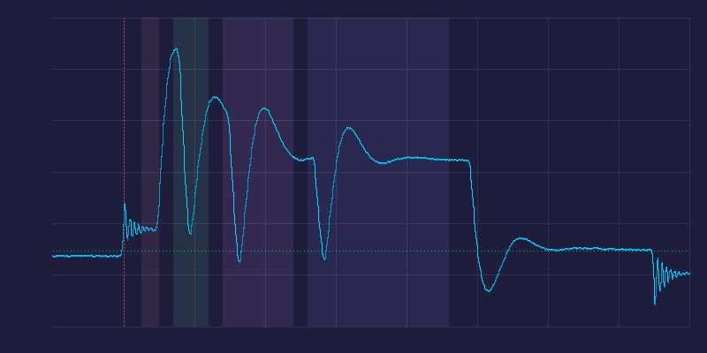
PIO-Driven BCM Scanning
Hardware-timed column patterns via RP2350 Programmable I/O
How It Works
Saleae Optical Validation
1
Trigger arrives (GP45)
External 8 kHz pulse from microscope
499 pulses averaged at 50 MHz — BCM bit-plane structure confirmed
2
CPU activates row GPIO
gpio_set_mask64() — one of 20 rows
3
PIO drives 4 bit-planes
out pins, 20 sets all columns in 1 cycle
B0: 0.5 µs (weight 1)
B1: 1.0 µs (weight 2)
B2: 2.0 µs (weight 4)
B3: 4.0 µs (weight 8)
4
CPU deactivates row
Total burst: 9.5 µs — fits 15 µs budget
B0 B1 B2 B3
← 9.5 µs burst →
5
Idle: 115 µs
SPI frame loading, precompute, USB
PIO out pins, 20 drives all columns in 1 clock cycle (6.67 ns) — CPU only manages row switching

Slide 4
BCM Burst Timing — All Configurations
4-bit BCM, 16 intensities × 4 base times × 10,000 frames at 8 kHz
Base T (µs) | Burst (µs) | Jitter (µs) | Outliers | Fits 15 µs? | Margin
0.25 | 5.73 | 0.000 | 0 / 160k | ✓ YES | 9.3 µs
0.50 | 9.46 | 0.000 | 0 / 160k | ✓ YES | 5.5 µs
0.75 | 13.23 | 0.000 | 0 / 160k | ~ YES | 1.8 µs
1.00 | 16.96 | 0.000 | 0 / 160k | ✗ NO | -2.0 µs
Recommended: T = 0.50 µs
16 intensity levels • 9.5 µs burst • 5.5 µs margin • 400 Hz frame rate • Zero jitter
Custom bit-plane weights (BCMWEIGHTS) available for linearity calibration — 6.67 ns resolution

Slide 5
External Validation & Next Steps
Validated with Real Hardware
Next Steps
✓ External 8 kHz trigger (waveform generator → GP45)
Spectrometer linearity
✓ Zero jitter with real trigger: 0.000 µs / 10k frames
Ocean Optics with integration averaging — sweep T × intensity for calibration LUT
✓ BCM bit-plane structure (1:2:4:8) resolved on Saleae
LED pin probing
✓ 16 intensity levels visually confirmed
GP1 on Saleae to measure true trigger-to-LED latency
✓ Saleae Logic Pro 8 automation via Python API
PCB redesign
✓ Pulse-triggered averaging (499 pulses, 50 MHz analog)
Route EINT to GP45, add sync/debug pins (GP46-47)
SPI frame loading
Arena controller sends pixel data via hardware SPI
Production-ready: 4-bit BCM, T=0.5µs, zero jitter, 400 Hz, fits 15 µs budget with 5.5 µs margin

