Slide 1

Controller template with DSA
For 2.14, 2.737
Instructor – Prof. David L. Trumper
Useful tips for LabVIEW:
To open LabVIEW in-context help within LabVIEW, press Ctrl+H.
To switch between Front-panel and block diagram, press Ctrl+E.
Always open the top-level project file with the “*.lvproj” extension to access the LV program.
- Brij M Bhushan

Slide 2
Overview
Controller template with up to 2 kHz loop rate.
Dynamic Signal Analyzer to get the frequency response bode plots built in.
Plant
Loop return ratio
Etc.

Slide 3
Pinout Configuration
All connections will be made through the myRIO protoboard provided:
AI 0 : Plant output being read by the myRIO
AI 1 : Reference signal for the control loop
AO 0 : Control effort signal to the plant
These connections are on the protoboard side of myRIO, called the Mini-system Port (MSP) or the “C” connector.

Slide 4
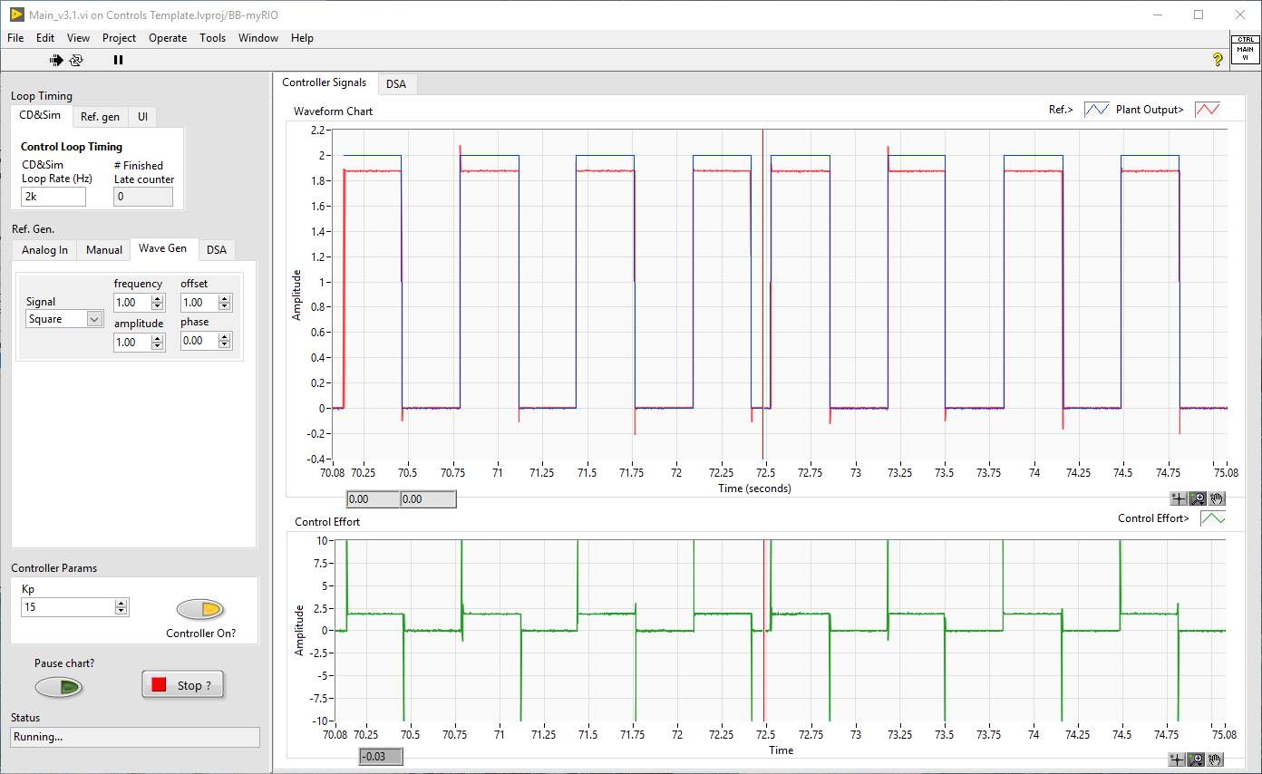
Front Panel
Loop timing
Set loop rate of each loop (Restart program for changes to take effect).
Also displays the #Finished late counter (refreshed after stopping the program), which shows the number of times the particular loop ran late. Useful to check jitter in your discrete control system.

Slide 5
Front Panel
Ref. Gen
Various options of generating the reference signal.
Analog In: Uses C/AI-1 as the input voltage signal.
Manual: manually set DC value of the reference signal.
Wave Gen.: use an in-built function generator to set the reference signal.
DSA: Dynamic Signal Analyzer (used to get frequency responses).

Slide 6
Front Panel
Controller Params
Set Proportional Gain (Kp) of the controller.
Controller On?: If off, the controller output is forced to 0.

Slide 7
Front Panel
Program options
Pause chart:
Pauses the chart plotting to allow for zooming into the signals.
Stop?: Stops the program
Status:
Displays current program status

Slide 8
Front Panel
Waveform tabs
Controller signals:
View reference, plant output and control-effort.
DSA:
View Dynamic Signal Analyzer (DSA) signals and frequency response measurement (after measurement is completed).
More on DSA later.

Slide 9
Block-diagram overview
3 parallel loops
User-Interface (UI) loop (non-deterministic)
Control and Simulation Loop (CD&Sim) – deterministic
Reference Generation / DSA loop – deterministic
Inter-loop communication using local variables and RT-FIFO variables.
State machine architecture for User-Interface.

Slide 10
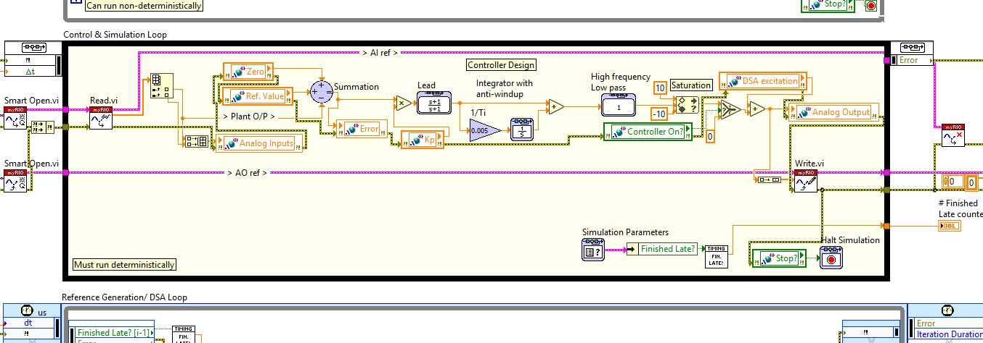
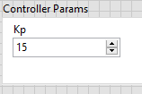
Block diagram - controller
Proportional gain value comes from the control on the block diagram.
Controller template with Proportional, Lead, integrator with anti-wind up and high frequency roll-off.
Double-click on each block to change its value.
Press Ctrl+H for in-context help.

Slide 11
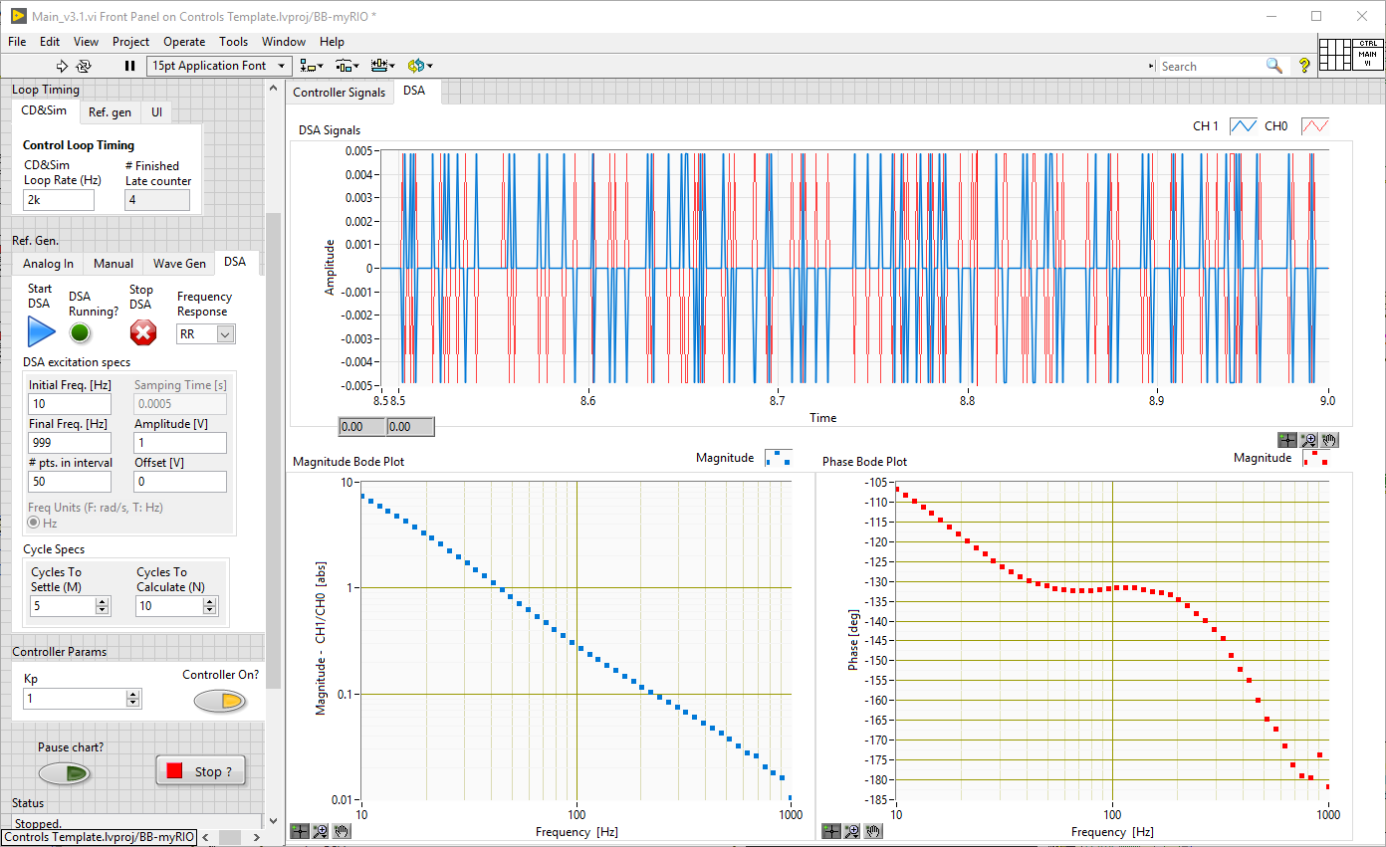
Using the Dynamic Signal Analyzer
Select options on the User interface:
Select DSA tab in the Waveform control.
Select DSA tab in the Ref. Gen. control.
Select frequency response:
Frequency response
Plant – Plant, takes AO 0 (control effort) as its input and gives AI 0 as its output (measured plant output).
RR (Loop Return Ratio) – Input: Error Output: Plant output
CL (Closed loop) – Input: Reference Output: Plant output

Slide 12
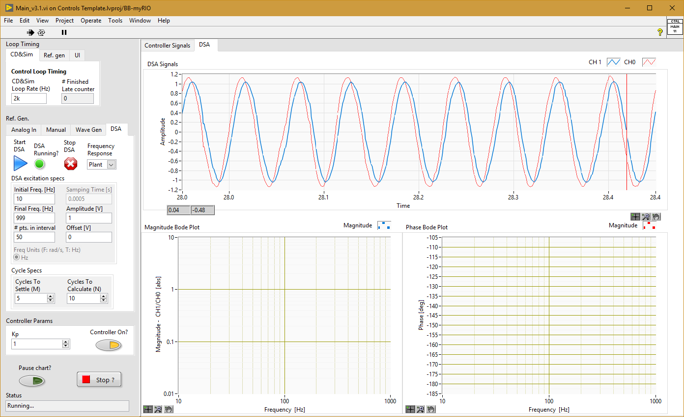
Using the Dynamic Signal Analyzer
Select DSA options:
Initial frequency – low frequency can take a long time to capture.
Final frequency – maximum limited to Nyquist frequency of the loop sample time (f_{s}/2)
# pts. in interval – number of points logarithmically distributed between initial and final frequency.
Amplitude – input signal at which to get the frequency response.
Offset – to add a bias to the input signal.
Cycles to settle (M) – Number of sine cycles for setting at each frequency before measurement starts.
Cycles to calculate (N) – Number of sine cycles to average over to make measurement at a frequency
Note: For low frequency, use low values of M and N to reduce measurement time (2,2). For high frequency use large M and N to get more stable measurements (20,50).

Slide 13
Using the Dynamic Signal Analyzer
Start the DSA:
Press start to start the DSA.
When running, the DSA running indicator will be on.
It can take a while, especially if starting from low frequencies.
Press stop to abort the Capture.
Note:
Make sure that your control-effort doesn’t saturate as you sweep the frequencies. If so, reduce amplitude.
If amplitude of error signal for the RR bode plot is too small, reduce Kp, get the RR bode plot, export it to excel and then manually shift the magnitude plot (abs) upwards by Kp times.

Slide 14
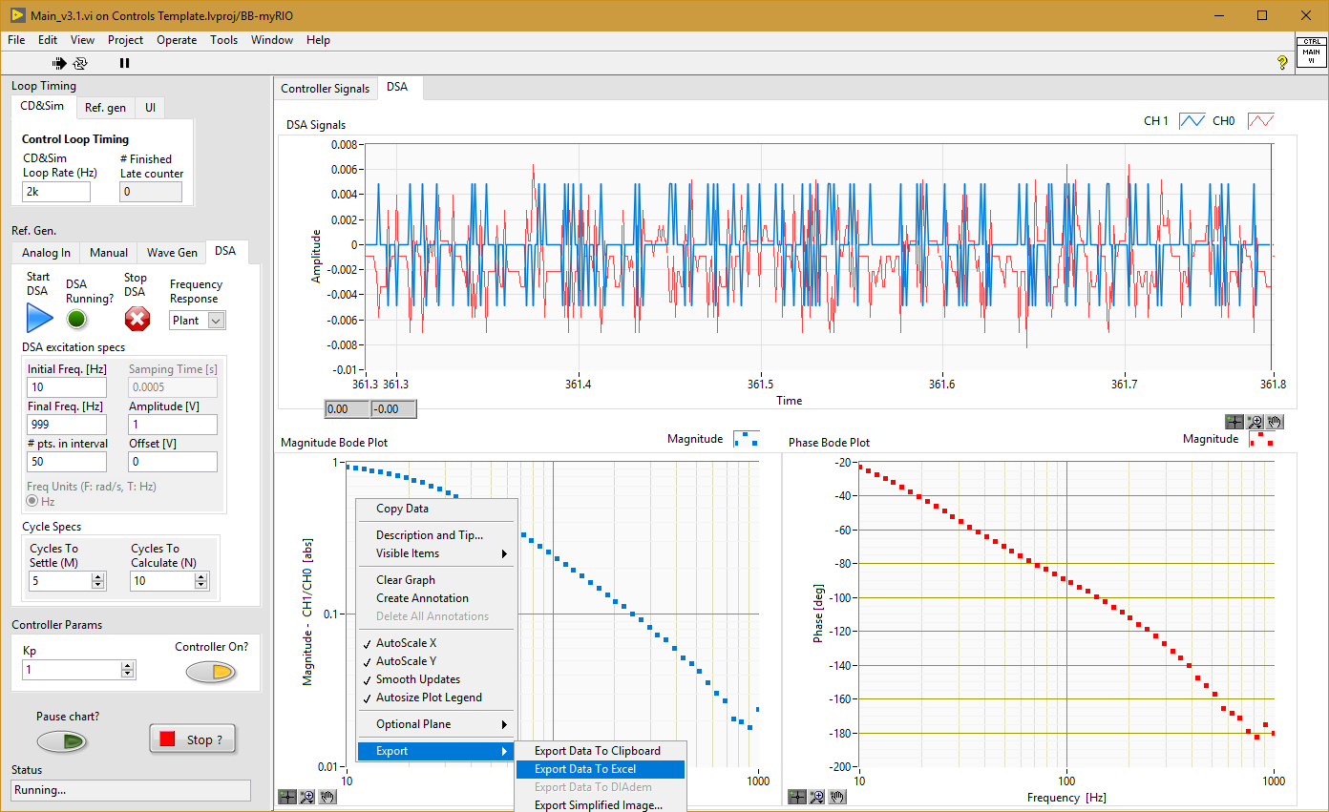
Using the Dynamic Signal Analyzer
Export the Mag and phase bode plots
Once the DSA stops, it will plot the magnitude and phase plots.
You can export the magnitude and phase plots to excel by right-click and selecting Export->to Excel as shown.

Slide 15
Sample DSA results

Slide 16
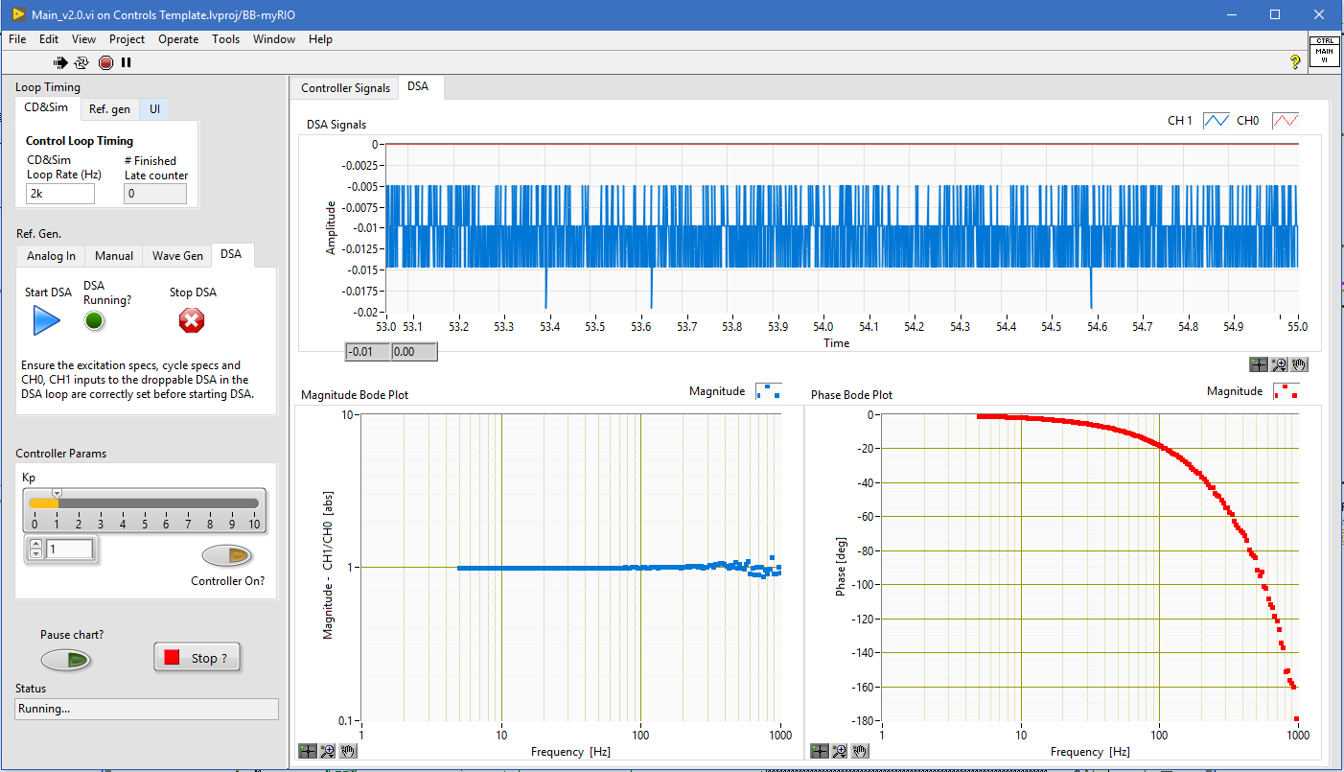
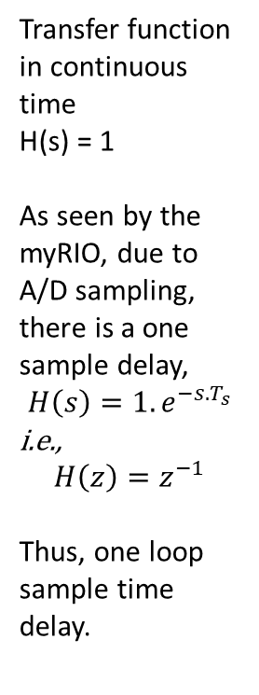
Unity plant (AO connected to AI), Ts = 0.5 msec
Transfer function in continuous time H(s) = 1
As seen by the myRIO, due to A/D sampling, there is a one sample delay,
$$H\left(s\right)=1.e^{−s.T_{s}}$$
i.e.,
$$H\left(z\right)=z^{−1}$$
Thus, one loop sample time delay.
fs = 2 kHz
180 deg. Phase lag at Nyquist freq. (1 kHz)

Slide 17
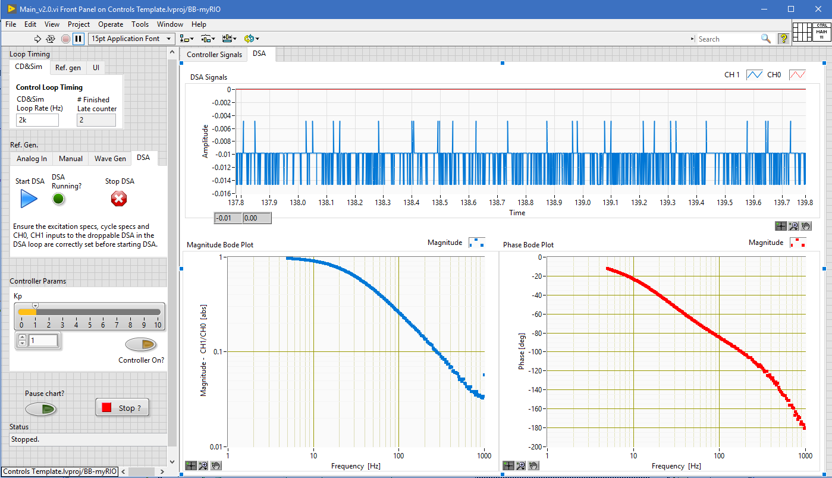
RC low pass filter, $τ=4.7 ms$, $f_{3dB}≈34 Hz$
myRIO sample time: 0.5 ms

Slide 18
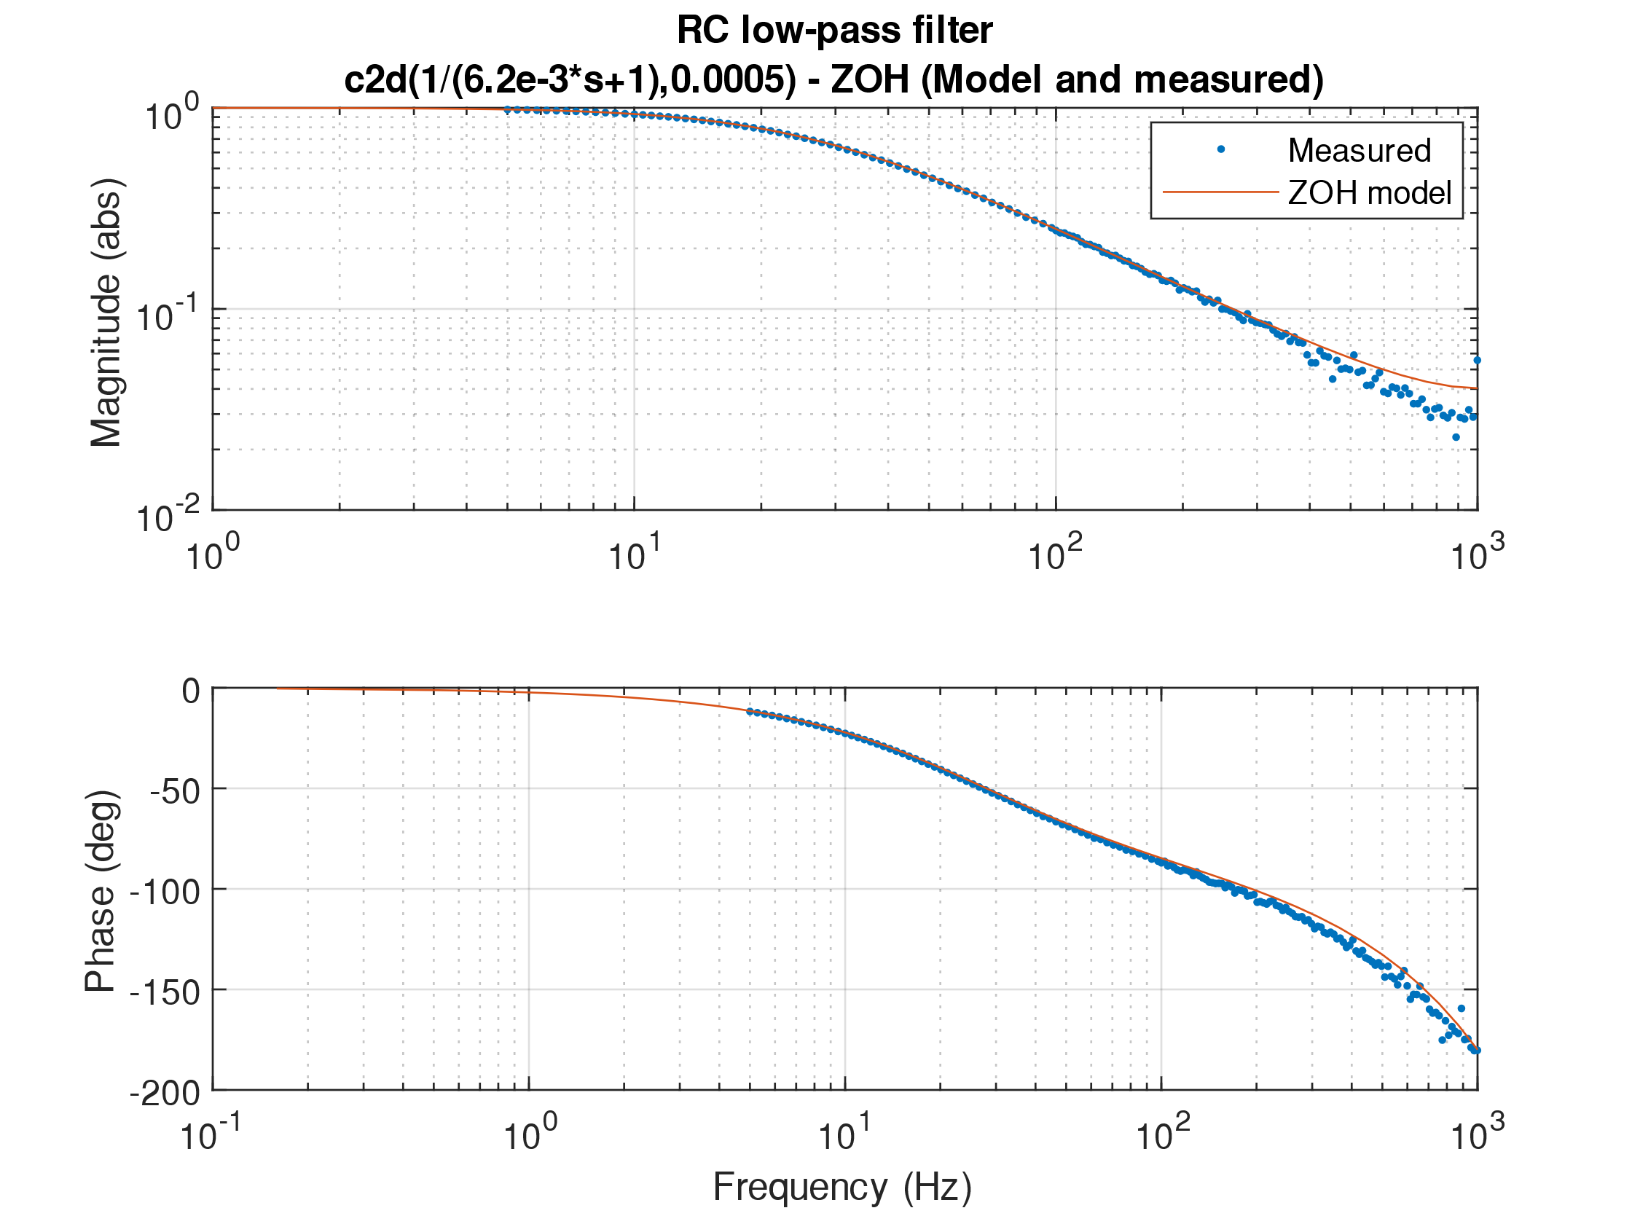
Another low pass filter, $τ=6.2 ms$, $f_{3dB}≈25 Hz$, Ts = 0.0005 s
In MATLAB, to convert from continuous time transfer function H(s) to discrete time transfer function H(z), use the c2d command:
sys_d = c2d(sys_c, Ts)
Ts = sample time, sys_c = continuous time transfer function and sys_d = discrete time transfer function.
We obtain the zero-order hold equivalent of our transfer function in discrete domain. That will match pretty well with the bode plots you obtain from the DSA functionality of the program.

Slide 19
More information

Slide 20
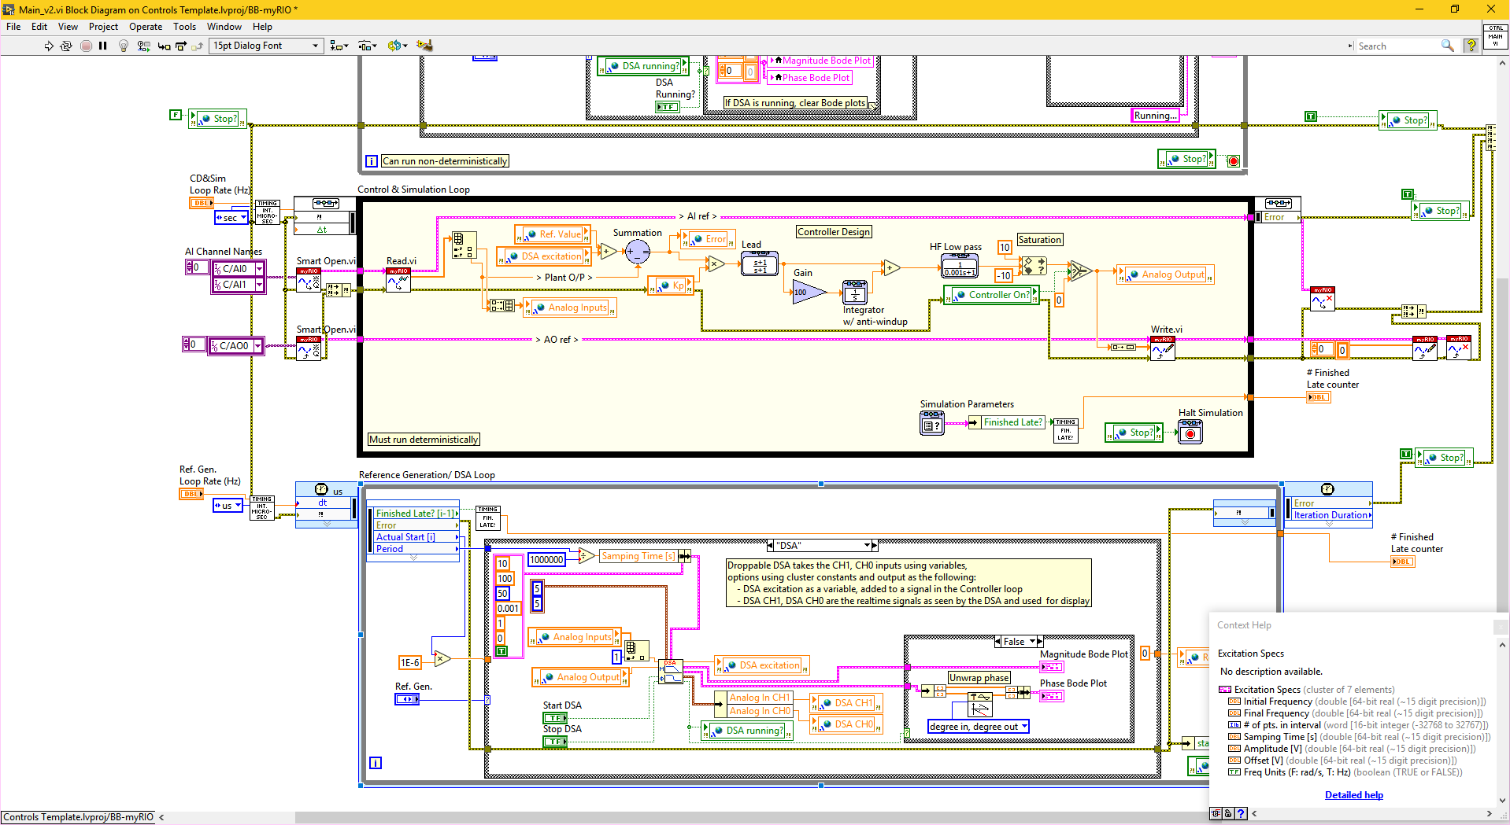
Excitation specs and cycle specs
Cycle specs are directly entered as constants into the Droppable DSA. Hover over them with context help on (Ctrl+H) to see the description.

Slide 21
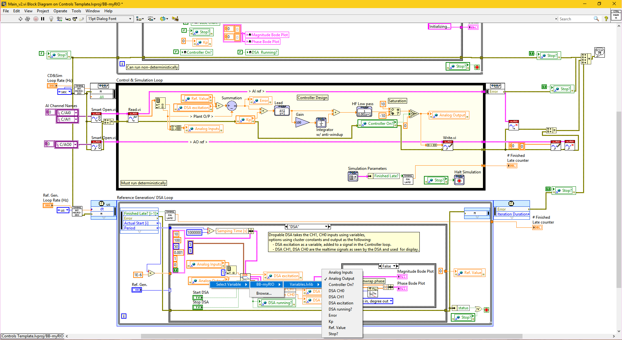
Selecting CH1, CH0 and location of excitation
Change location of adding DSA excitation in the control loop. It can be added either to the reference or to the analog output.
Reference value set to 0 when the DSA mode is selected.
Left click on the variables connected to CH1, CH0 of the droppable DSA to change them to the variables required. Analog Input = Plant output, Analog Output = Control effort, Error = Ref – Plant Output.

Slide 22
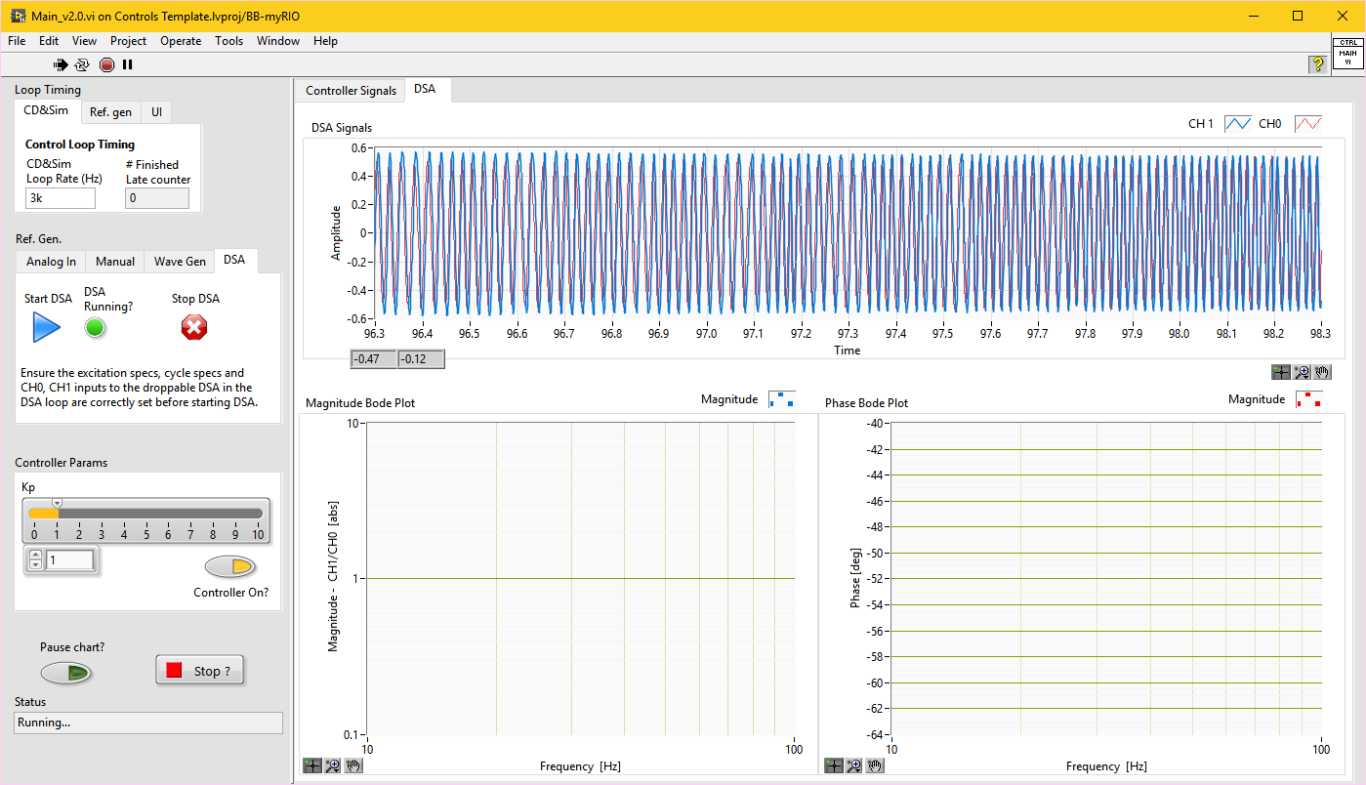
DSA running
When DSA is running the Bode plot is cleared and it is replotted with the DSA generated data after it stops.

Slide 23
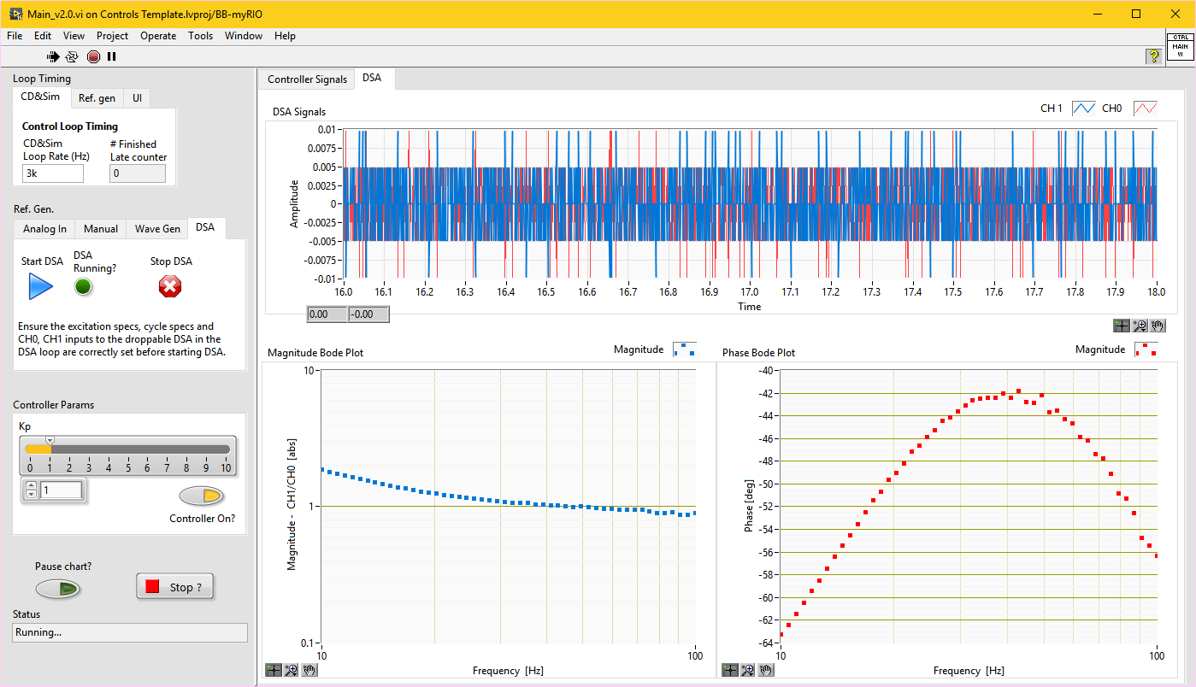
DSA results
Note: There is a time delay of one sample time (Ts) due to the DAQmx implementation in which it sends the Analog Output for this sample at the clock edge for the next sample. (http://www.ni.com/tutorial/3215/en/, http://zone.ni.com/reference/en-XX/help/370466Y-01/mxcncpts/controlappcase6/ )

