Slide 1



Super Bikes!
Data Management and Warehousing
Data Science for Management Master
6th Grade
Maria Briones
Riccardo Dondi
Sayantan Mandal

Slide 2
Agenda
01 OUR IDEA
  ER-Diagram
  Logical Schema
  DDL constraints
02 The Data
DML Data Population
Checking Data consistency
03 Insights
Station Popularity
Revenue Analysis
Maintenance Alert
User Behavior: ridden distance

Slide 3
Repository
  Code Scripts for DDL, population DML and Queries DML can be found on github!
github.com/mbrionesr96/SuperBikes

Slide 4


Our Idea
Data structure

Slide 5
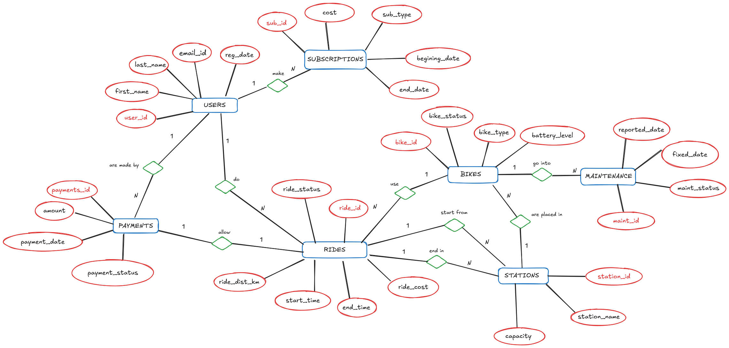
What data structure solves the issue?

Slide 6
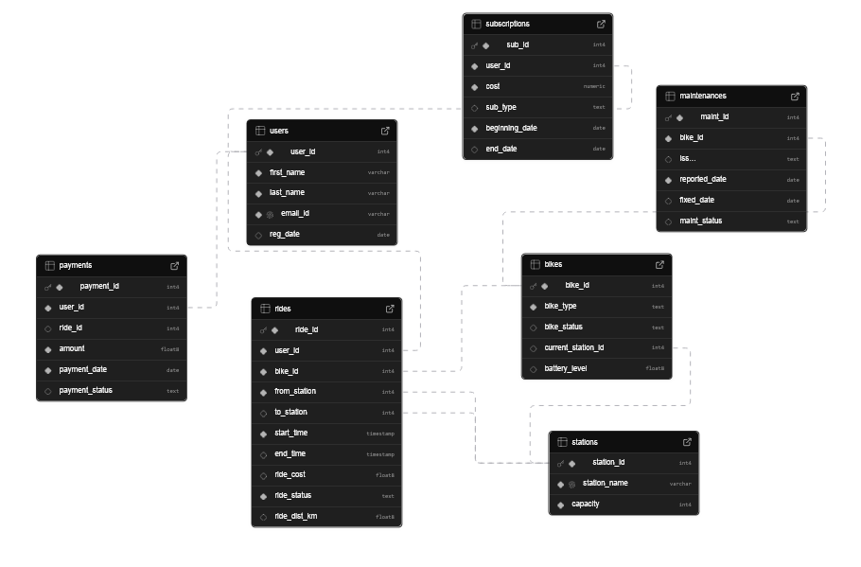
What data structure solves the issue?

Slide 7
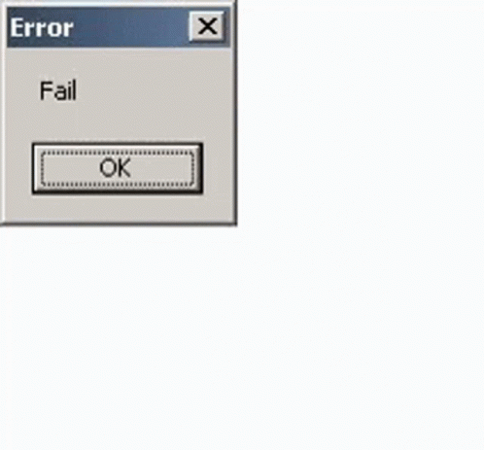
Relevant constraints
Regarding Battery %:
                If bike type is electric then Battery must be between 0 and 100
                If bike type is manual the Battery must be NULL.
Key Design Principles Applied
                SET NULL is used on rides for all its FKs because rides are the core financial and operational record of the system — they should survive the deletion of any related entity.
                CASCADE is used where the child record is existentially dependent on the parent — a payment without a ride, or a maintenance log without a bike, is meaningless.

Slide 8
The data
Data Population

Slide 9
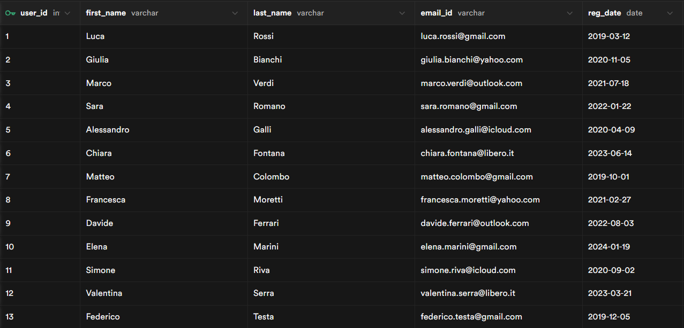
Tables and dimensions
Users (20 users, 1 PK, 4 features)

Slide 10
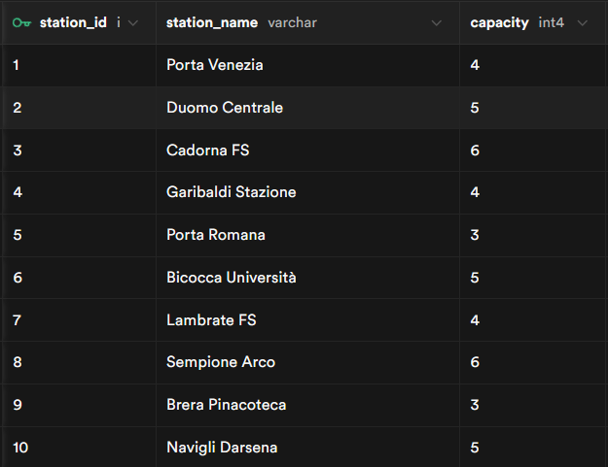
Tables and dimensions
Stations (15 stations, 1PK, 2 features)

Slide 11
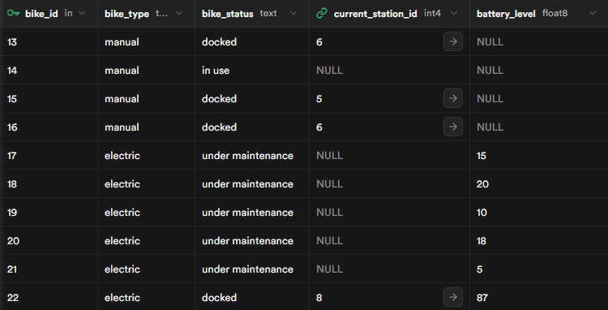
Tables and dimensions
Bikes (66 bikes, 1PK, 4 features, 1 FK)

Slide 12
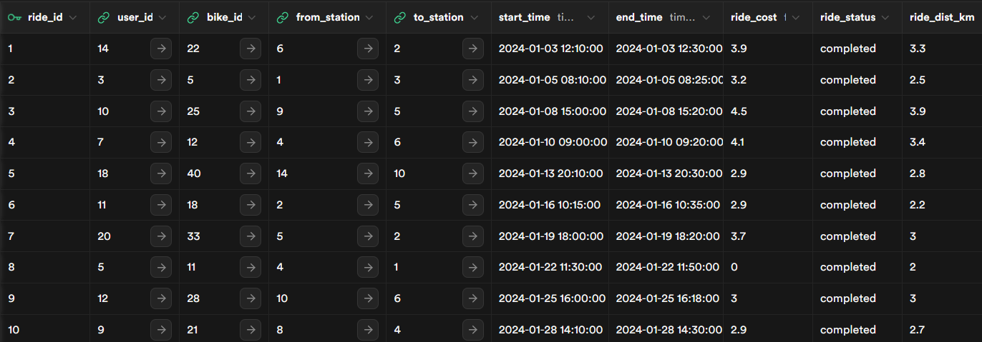
Tables and dimensions
Rides (94 rides, 1PK, 9 features, 4FK)

Slide 13
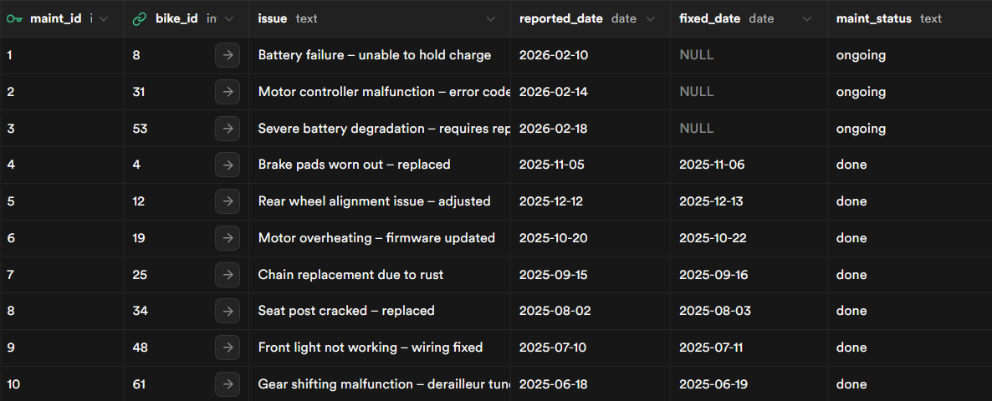
Tables and dimensions
Maintenances (20 maintenances, 1PK, 5 features, 1FK)

Slide 14
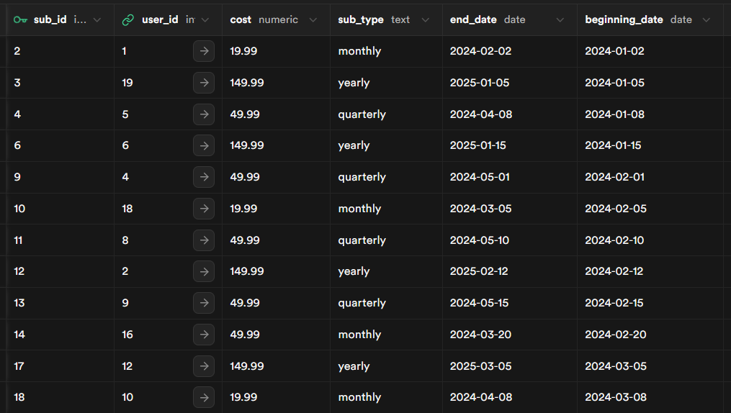
Tables and dimensions
Subscriptions (30 subscriptions, 1PK, 5features, 1FK)

Slide 15
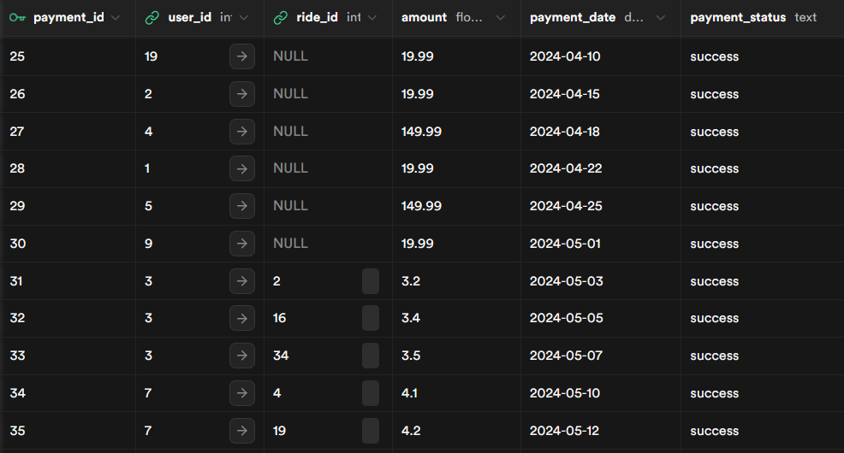
Tables and dimensions
Payments (58 payments, 1PK, 5features, 1FK)

Slide 16

Data consistency
Total capacity of stations (66) >= Total N° of bikes (66)
Capacity on each station >= N° of docked bikes on such station:
station_id | station_name | capacity | docked_bikes
1 | Porta Venezia | 4 | 4
2 | Duomo Centrale | 5 | 4
3 | Cadorna FS | 6 | 5
4 | Garibaldi Stazione | 4 | 4
5 | Porta Romana | 3 | 3
6 | Bicocca Università | 5 | 3
7 | Lambrate FS | 4 | 2
8 | Sempione Arco | 6 | 2
9 | Brera Pinacoteca | 3 | 2
10 | Navigli Darsena | 5 | 2
11 | Isola Piazza | 4 | 2
12 | San Babila | 5 | 2
13 | Porta Genova | 4 | 2
14 | CityLife Mall | 4 | 2
15 | Tre Torri | 4 | 2

Slide 17
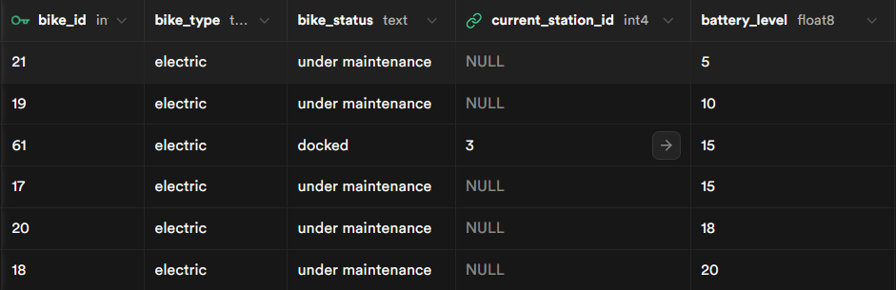
Data consistency
Positive N° of ‘Low Battery Bikes’ (6)

Slide 18

Insights
for the City Council

Slide 19
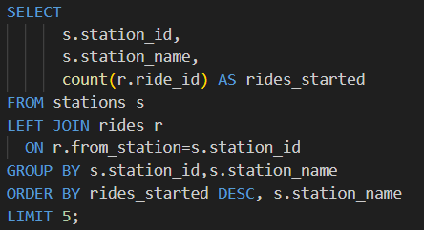
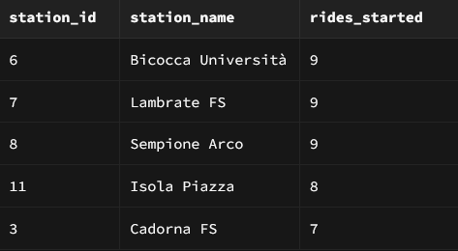
Station Popularity

Slide 20
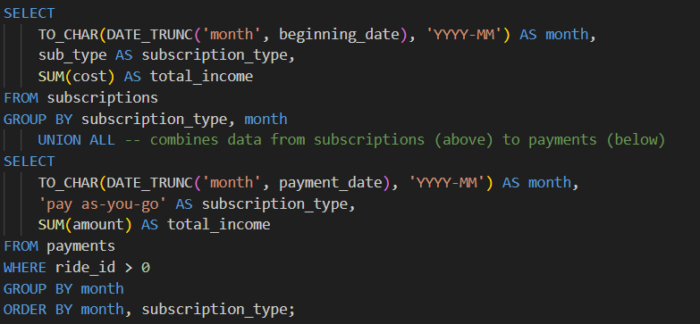
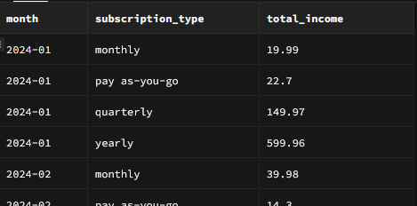
Revenue Analysis

Slide 21
Revenue Analysis
Month | Pay as-you-go | Monthly | Quarterly | Yearly
ene-24 | € 227 | € 1.999 | € 14.997 | € 59.996
feb-24 | € 143 | € 3.998 | € 19.996 | € 14.999
mar-24 | € 157 | € 7.996 | € 4.999 | € 29.998
abr-24 | € 94 | € 5.997 | € 4.999 | € 44.997
may-24 | € 422 | € 1.999 | € - | € -
jun-24 | € 11 | € - | € - | € -

Slide 22
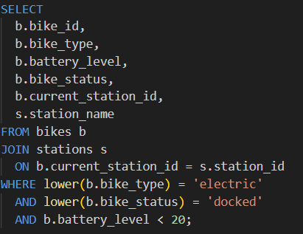

Maintenance Alert

Slide 23
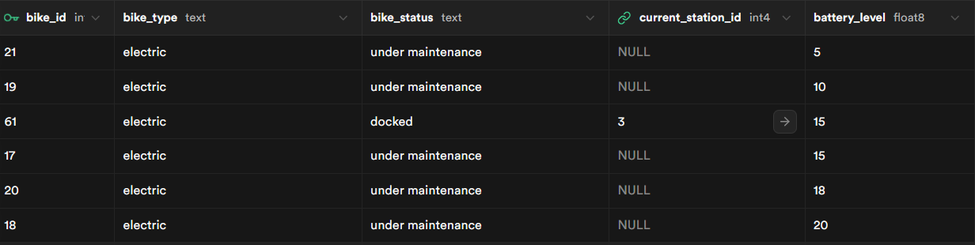
Maintenance Alert

Slide 24
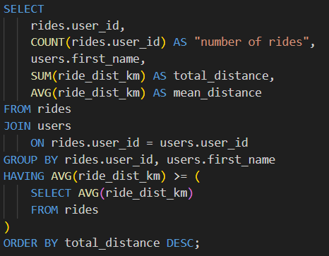
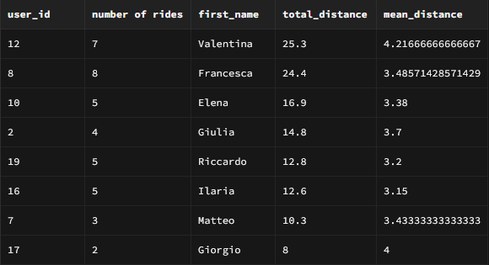
User Behavior
The average ridden distance in the dataset is 3,069

Slide 25
Thank you!
Maria Briones
Riccardo Dondi
Sayantan Mandal
Data Management and Warehousing
Data Science for Management Master

Slide 26

EcoRide
The city of Neo-Metropolis is launching a massive green initiative. They are deploying thousands of bicycles (both electric and standard) across hundreds of docking stations. They need a robust back-end system to manage users, track bike inventory in real-time, handle subscriptions, and analyze ride patterns to optimize bike distribution.
As the Lead Database Architects, your job is to design a system that ensures data integrity (e.g., a bike cannot be in two stations at once) and provides high-performance querying for the city's mobile app.

Slide 27
Deliverables
This project follows the full lifecycle of database development. You will submit a comprehensive technical report containing the following four sections:
1. Conceptual Design (E-R Diagram)
You must translate the business requirements into an Entity-Relationship (E-R) Diagram. Identify the core entities (Users, Bikes, Stations, Maintenance Logs, etc.), their attributes, and the cardinalities of their relationships.
Key Requirement: Clearly mark Primary Keys and relationship types between entities, both left-to-right and right-to-left.

Slide 28
Deliverables
2. Logical and Physical Models
Next, map your E-R diagram to a Relational Schema.
Logical Model: Convert entities into tables. Normalize your tables to at least Third Normal Form (3NF) to avoid redundancy.
Physical Model:
- Provide the SQL DDL script. You must specify:
  Data types (e.g., VARCHAR, TIMESTAMP, DECIMAL).
  Integrity constraints (NOT NULL, UNIQUE, CHECK constraints for bike battery levels).
  Foreign Keys and Foreigh Keys actions (ON DELETE CASCADE, etc.)
- Provice also a SQL DML script to initially populate your DB

Slide 29
Deliverables
3. Advanced Analytical Reports
The city council needs insights. You must provide the SQL code for the following "Business Intelligence" reports:
Station Popularity: A list of the top 5 stations where rides most frequently start.
Revenue Analysis: Calculate the total monthly revenue grouped by membership type (e.g., "Pay-as-you-go" vs. "Monthly Subscriber").
Maintenance Alert: A query using a JOIN to find all Electric Bikes with a battery level below 20% that are currently docked.
User Behavior: Find users who have ridden more than the average distance, sorted by ridden distance.

