Slide 1

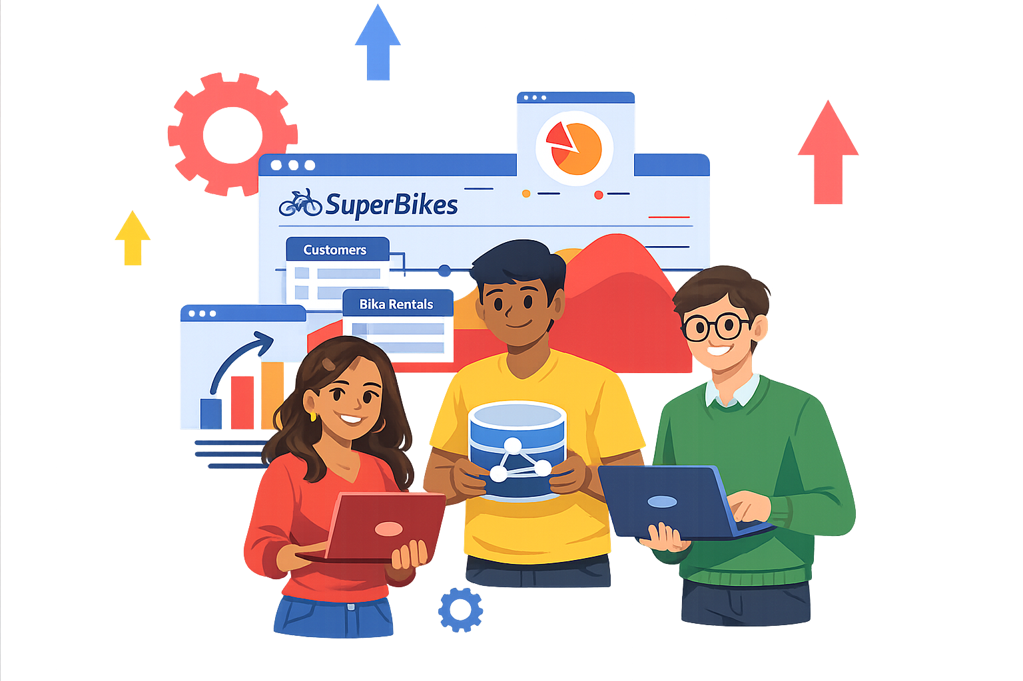
Super Bikes!
Data Management and Warehousing
Data Science for Management Master
6th Grade
Maria Briones
Riccardo Dondi
Sayatan Mandal

Slide 2
Course Program
01
a. Data
b. Databases & DBMS
What a DBMS is
DBMS main features
c. Data models
d. Relational model
Relations and tables
Integrity constraints
e. Relational algebra
02
a. SQL DBMS
b. Tools setup
b. SQL Data Definition
c. SQL Data Manipulation
d. Advanced SQL

Slide 3
Our idea

Slide 4
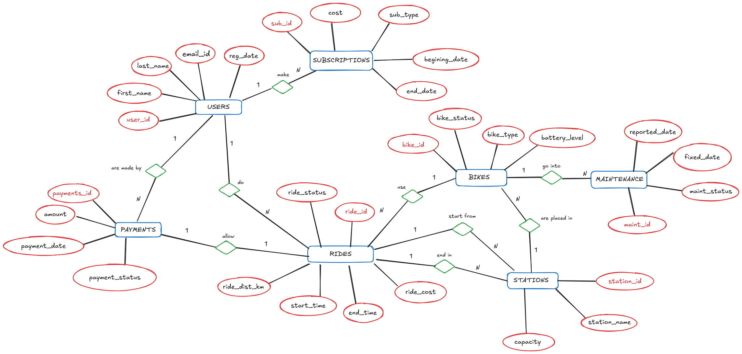
What data structure solves the issue?

Slide 5
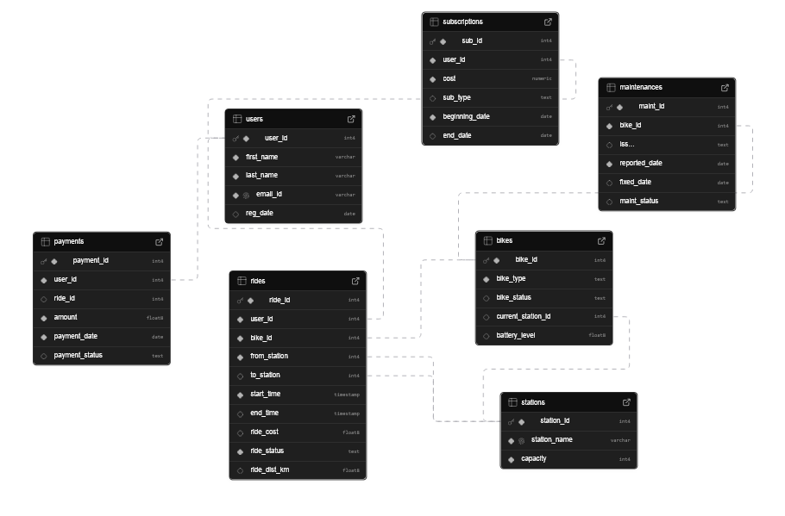
What data structure solves the issue?

Slide 6
Relevant constraints
Regarding Battery %:
If bike type is electric then Battery must be between 0 and 100
If bike type is manual the Battery must be NULL.
Regarding Bike status:
If the registered battery level is 20 or below then bike status must be ‘under maintenance’
- We ensure data integrity with ON DELETE CASCADE.

Slide 7
The data

Slide 8
Tables and dimensions
Users (20 users, 1 PK, 4 features)
Stations (15 stations, 1PK, 2 features)
Bikes (66 bikes, 1PK, 4 features, 1 FK)
Rides (80 rides, 1PK, 9 features, 4FK)
Maintenances (20 maintenances, 1PK, 5 features, 1FK)
Subscriptions (30 subscriptions, 1PK, 5features, 1FK)
Payments (44 payments, 1PK, 5features, 1FK)

Slide 9
Data consistency
Total capacity of stations (66) >= Total N° of bikes (66)
Capacity on each station >= N° of docked bikes on such station
Positive N° of ‘Low Battery Bikes’ (5)

Slide 10
The questions

Slide 11
Station Popularity

Slide 12
Revenue Analysis

Slide 13
Maintenance Alert

Slide 14
User Behavior

Slide 15
What data structure solves the issue?
Big Data refers to datasets that are
very frequently inserted
extremely large
diverse
complex
that grow exponentially and cannot be effectively captured, managed, processed, or analyzed using traditional data management tools.

Slide 16

EcoRide
The city of Neo-Metropolis is launching a massive green initiative. They are deploying thousands of bicycles (both electric and standard) across hundreds of docking stations. They need a robust back-end system to manage users, track bike inventory in real-time, handle subscriptions, and analyze ride patterns to optimize bike distribution.
As the Lead Database Architects, your job is to design a system that ensures data integrity (e.g., a bike cannot be in two stations at once) and provides high-performance querying for the city's mobile app.

Slide 17
Deliverables
This project follows the full lifecycle of database development. You will submit a comprehensive technical report containing the following four sections:
1. Conceptual Design (E-R Diagram)
You must translate the business requirements into an Entity-Relationship (E-R) Diagram. Identify the core entities (Users, Bikes, Stations, Maintenance Logs, etc.), their attributes, and the cardinalities of their relationships.
Key Requirement: Clearly mark Primary Keys and relationship types between entities, both left-to-right and right-to-left.

Slide 18
Deliverables
2. Logical and Physical Models
Next, map your E-R diagram to a Relational Schema.
Logical Model: Convert entities into tables. Normalize your tables to at least Third Normal Form (3NF) to avoid redundancy.
Physical Model:
- Provide the SQL DDL script. You must specify:
Data types (e.g., VARCHAR, TIMESTAMP, DECIMAL).
Integrity constraints (NOT NULL, UNIQUE, CHECK constraints for bike battery levels).
Foreign Keys and Foreigh Keys actions (ON DELETE CASCADE, etc.)
- Provice also a SQL DML script to initially populate your DB

Slide 19
Deliverables
3. Advanced Analytical Reports
The city council needs insights. You must provide the SQL code for the following "Business Intelligence" reports:
Station Popularity: A list of the top 5 stations where rides most frequently start.
Revenue Analysis: Calculate the total monthly revenue grouped by membership type (e.g., "Pay-as-you-go" vs. "Monthly Subscriber").
Maintenance Alert: A query using a JOIN to find all Electric Bikes with a battery level below 20% that are currently docked.
User Behavior: Find users who have ridden more than the average distance, sorted by ridden distance.

Slide 20
Getting started
I recommend starting with a simple pen-and-paper sketch of your entities before moving to a digital E-R tool.
Remember, a mistake in the conceptual phase is cheap to fix; a mistake in the physical phase requires rewriting your entire DDL script!

Slide 21
THE END
Fifth Day Data Management and Warehousing

