Slide 1


Machine Learning Engineer
15.10.2026
CERTIFICATION · Module: MLOPS
OPENING / CERTIFICATION PROJECT
Industrial Image Anomaly Detection
Convolutional Autoencoder
and MLOps Pipeline
SCHEMATIC · DETECTION AND CLASSIFICATION
End-to-end project: training, deployment, automation and monitoring
Input image
Autoencoder
Error map |x − x̂|
PRESENTED TO LIORA
Ayoub Hamdoun
Mohamed Bouraaman
Paweł Flak
Image x · 128×128 RGB
Reconstruction x̂, trained on normal images only
High error = suspicious region
Three potential production use cases
Product images feed automated visual inspection.
Bottle · Wood · Pill: one MLOps workflow, a separate model per category
Classification: score s(x) vs threshold τ
s(x) ≤ τ → OK, good product
s(x) > τ → ANOMALY
normal
THRESHOLD τ
s(x)
Separate model and threshold for each category: Bottle · Wood · Pill
Ayoub Hamdoun, Mohamed Bouraaman, Paweł Flak
Presenting: Ayoub Hamdoun
01 / 26
Notes:
Opening by Ayoub Hamdoun.
Goal: detect visual anomalies in product images with a convolutional autoencoder (CAE).
The CAE is trained on normal images only.
Score s(x) is the reconstruction error; s(x) > τ means anomaly.
One MLOps workflow serves three categories: Bottle, Wood, Pill.
Each category has its own model and threshold.
The three production use cases illustrate potential applications.

Slide 2

Machine Learning Engineer
CERTIFICATION · Module: MLOPS
AGENDA / PROJECT TEAM
Presentation outline
Presentation order: Ayoub → Mohamed → Paweł
01
Ayoub Hamdoun
Team contributions; system architecture; anomaly detection problem; convolutional autoencoder; dataset and batches; TensorFlow training; MLflow tracking and evaluation
02
Mohamed Bouraaman
Docker Compose; PostgreSQL; batch release; Airflow orchestration; FastAPI and inference
03
Paweł Flak
MLflow Champion; Streamlit and Spotlight; Evidently data drift; Prometheus and Grafana; assessment and live demonstration
Ayoub Hamdoun, Mohamed Bouraaman, Paweł Flak
Presenting: Ayoub Hamdoun
02 / 26
Notes:
Order: Ayoub → Mohamed → Paweł.
Ayoub: contributions, architecture, problem, CAE, data batches, training, evaluation.
Mohamed: Docker Compose, PostgreSQL, batch release, Airflow, FastAPI and inference.
Paweł: MLflow champion, Streamlit and Spotlight, Evidently, Prometheus and Grafana, assessment, demo.

Slide 3
Machine Learning Engineer
CERTIFICATION · Module: MLOPS
AUTHOR CONTRIBUTIONS
Team contributions
Ayoub Hamdoun
Mohamed Bouraaman
Paweł Flak
GitHub: ahamdoun14
GitHub: mbrmpro
GitHub: flak92
CNN/CAE model in src/training.py
Model training and MLflow experiment tracking
Data splitting and incremental batch automation
MLflow/Airflow integration and workflow documentation
Project initialization and core structure
Database import and baseline pipeline
Training/prediction API and basic tests
Docker microservices and scheduled Airflow training
MLflow Registry and champion selection
Prometheus and Grafana monitoring
Streamlit frontend and Spotlight guided tour
Dataset/Git provenance and README updates
Ayoub Hamdoun, Mohamed Bouraaman, Paweł Flak
Presenting: Ayoub Hamdoun
03 / 26
Notes:
Contributions are taken from the GitHub history.
Ayoub: CAE model, training, MLflow tracking, batch automation.
Mohamed: project structure, database, API, Docker and Airflow scheduling.
Paweł: MLflow Registry, monitoring, Streamlit and Spotlight, dataset provenance.

Slide 4



Machine Learning Engineer
CERTIFICATION · Module: MLOPS
USE-CASE SCENARIO
One ML solution addresses three example production problems
Shared problem: visual defects must be detected before the next process step.
Bottling facility
Tablet manufacturer
Wood processing facility
Bottles before shipping
Surface before packaging
Material before furniture selection
Illustrative use-case scenario for the mlops_anomaly_detection application.
Ayoub Hamdoun, Mohamed Bouraaman, Paweł Flak
Presenting: Ayoub Hamdoun
04 / 26
Notes:
Three example cases: bottling, tablet manufacturing, wood processing.
Shared requirement: detect visual defects before the next process step.

Slide 5
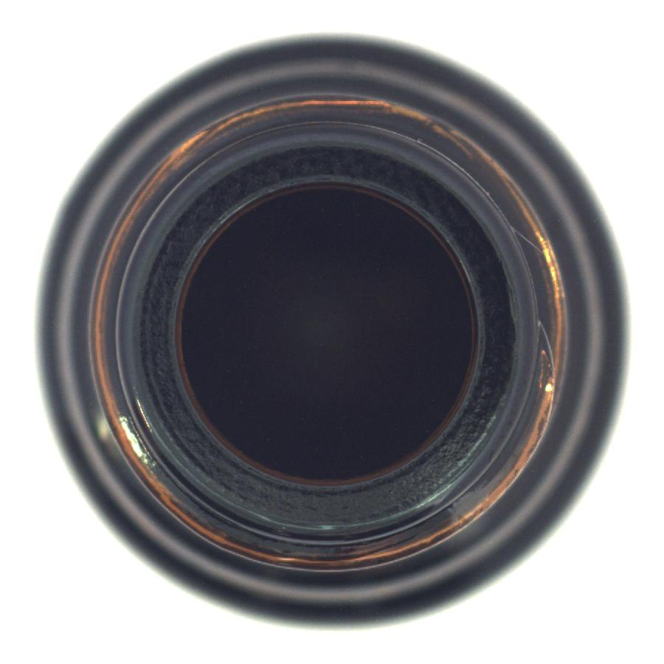
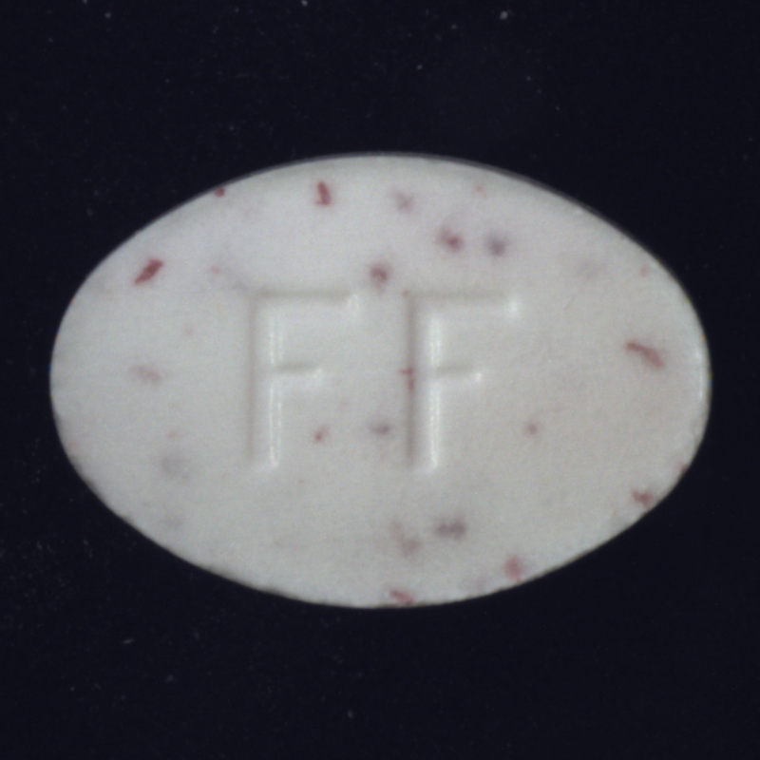

Machine Learning Engineer
CERTIFICATION · Module: MLOPS
USE-CASE SCENARIO
Fixed cameras capture images at defined inspection points.
BOTTLES
Camera before shipping
Re-inspection
Manufactured bottle
Product image
Inspection signal
TABLETS
Overhead line camera
Surface assessment
Finished tablet
Product image
Inspection signal
WOOD
Camera before sorting
Material assessment
Machined surface
Product image
Inspection signal
Fixed framing and lighting produce comparable images.
Ayoub Hamdoun, Mohamed Bouraaman, Paweł Flak
Presenting: Ayoub Hamdoun
05 / 26
Notes:
Each case uses a fixed camera at a defined inspection point.
Fixed framing and lighting keep images comparable with the training data.
The model output is an inspection signal, not an automatic line stop.
Direct camera integration (RTSP/PLC) is outside the current project scope.
An adapter would save images and call the prediction API.

Slide 6
Machine Learning Engineer
CERTIFICATION · Module: MLOPS
SYSTEM ARCHITECTURE
System architecture: from data to prediction
Training and serving use shared infrastructure but follow distinct workflows
PostgreSQL
Image metadata
TensorFlow
CAE training
MLflow
Run + Champion
FastAPI
HTTP endpoints
Airflow
Schedule / release
Prediction
Champion inference
Streamlit
Demo / results
DATA MONITORING
Prediction logs
Evidently / PostgreSQL
Grafana
PERFORMANCE
FastAPI
Prometheus
Grafana
Source: docker-compose.yml, airflow/dags, api/main.py, src/
Ayoub Hamdoun, Mohamed Bouraaman, Paweł Flak
Presenting: Ayoub Hamdoun
06 / 26
Notes:
Seven components: PostgreSQL, Airflow, FastAPI, TensorFlow, MLflow, Prediction, Streamlit.
FastAPI is the central HTTP interface between services.
Training path: TensorFlow → MLflow run → champion.
Serving path: Streamlit → Prediction → champion inference.
Data monitoring: prediction logs → Evidently / PostgreSQL → Grafana.
Performance monitoring: FastAPI → Prometheus → Grafana.

Slide 7
Machine Learning Engineer
CERTIFICATION · Module: MLOPS
MODEL ARCHITECTURE
Convolutional Autoencoder: architecture
Image data are the starting point of the complete MLOps workflow
Input
MVTec AD images:
Bottle, Wood and Pill
Process
Separate normal and defective images
Copy data into project structure
Output
Training: only normal images
Test: normal + defective images
COMPRESS A 128 × 128 RGB IMAGE INTO LATENT FEATURES, THEN RECONSTRUCT IT
Input
128×128×3
Encoder
Conv 32/64
Pooling ×2
Encoder
Conv 128/256
Pooling ×2
Latent
8×8×256
Decoder
Transposed conv.
Upsampling
Output
128×128×3
Feature extraction and downsampling
Upsampling and sigmoid output
Image x
Reconstruction x̂
Score s(x)
Decision
Training: reconstruction loss
Classification rule
Ayoub Hamdoun, Mohamed Bouraaman, Paweł Flak
Presenting: Ayoub Hamdoun
07 / 26
Notes:
Data: MVTec AD, categories Bottle, Wood, Pill.
Training uses normal images only; the test set contains normal and defective images.
Input: 128×128×3 RGB.
Encoder: Conv 32/64 and Conv 128/256, each with pooling ×2.
Latent representation: 8×8×256.
Decoder: transposed convolutions and upsampling, sigmoid output 128×128×3.
Loss: 0.7 × MSE + 0.3 × (1 − SSIM).

Slide 8
Machine Learning Engineer
CERTIFICATION · Module: MLOPS
MVTec AD / DATA BATCHES
Data preparation and incremental batches
Simulated incremental data arrival with cumulative retraining
Normal images
Source images for each category
Split
About 20% of normal images into the test set
Training pool
Remaining images split into three batches
Dataset structure
Batches 1/2/3 · fixed test set
Run | Available batches | Bottle | Wood | Pill
Run 1 | Batch 1 | 61 | 71 | 78
Run 2 | Batches 1 + 2 | 122 | 142 | 156
Run 3 | Batches 1 + 2 + 3 | 183 | 213 | 234
Image counts per category (Bottle / Wood / Pill) from the repository README.
AN HOURLY DAG ORCHESTRATES THE WORKFLOW THROUGH FASTAPI HTTP ENDPOINTS
Release data
release-next
Bottle
POST /training
Wood
POST /training
Pill
POST /training
Defective source images are included in the fixed test set. Training batches are initially unavailable and released later by the API.
Source: database/load_data.py
Ayoub Hamdoun, Mohamed Bouraaman, Paweł Flak
Presenting: Ayoub Hamdoun
08 / 26
Notes:
About 20% of normal images form the fixed test set.
The remaining normal images are split into three batches.
Runs 1–3 train cumulatively on batches 1, 1+2 and 1+2+3.
Defective images appear only in the test set.
Hourly DAG: release-next, then POST /training for Bottle, Wood, Pill.
Image counts come from the repository README.
DAG implementation details follow on slide 14 (Mohamed).

Slide 9
Machine Learning Engineer
CERTIFICATION · Module: MLOPS
TRAINING AND MLflow TRACKING
TensorFlow training and MLflow tracking
From available normal images to a traceable CAE model and saved test results
Input
Available normal images
Split
80% training
20% validation
CAE
TensorFlow optimization
Threshold τ
95th percentile of normal scores
Output
Test metrics + MLflow run
All released batches are used cumulatively; ReduceLROnPlateau adjusts the learning rate.
MLFLOW TRACKING AND REPRODUCIBILITY
Logs parameters and metrics
Category, epochs, available batches
Training and validation loss
Test AUROC and F1
Records provenance
git_commit — code provenance
SHA-256 dataset_version — data provenance
Stores
MLflow run history
Evaluation reports (evaluation.json)
cae.keras and threshold.json
Image manifest (dataset/manifest.tsv) logged to MLflow together with dataset_version
Source: src/training.py
Ayoub Hamdoun, Mohamed Bouraaman, Paweł Flak
Presenting: Ayoub Hamdoun
09 / 26
Notes:
Input: all currently available normal images.
Split: 80% training, 20% validation.
Threshold τ: 95th percentile of normal-image scores.
ReduceLROnPlateau lowers the learning rate when validation loss stalls.
MLflow logs parameters, losses, test AUROC and F1.
Provenance: git_commit and SHA-256 dataset_version.
Artifacts: evaluation.json, cae.keras, threshold.json, image manifest.

Slide 10
Machine Learning Engineer
CERTIFICATION · Module: MLOPS
EVALUATION
Evaluation: saved reports per category
AUROC, F1 and confusion counts from saved JSON reports for Bottle, Wood and Pill
Category | AUROC (area under the ROC curve) | F1 (precision + recall) | TN (true negatives) | FP (false positives) | Report section
Bottle | 0.665 | 0.865 | 0 | 14 | holdout_metrics
Wood | 0.887 | 0.945 | 8 | 5 | calibrated_holdout
Pill | 0.272 | 0.895 | 1 | 17 | calibrated_holdout
Interpretation: Wood AUROC is higher than Pill AUROC; Pill has high F1 despite low AUROC.
Comparison limitation
Report sections differ (holdout_metrics vs calibrated_holdout) — results are not directly comparable final benchmarks.
Sources: src/training.py; models/*/evaluation.json
Ayoub Hamdoun, Mohamed Bouraaman, Paweł Flak
Presenting: Ayoub Hamdoun
10 / 26
Notes:
Values come from the saved evaluation reports (evaluation.json).
Wood: highest AUROC (0.887), F1 0.945.
Pill: AUROC 0.272 but F1 0.895; TN 1 and FP 17 mean almost every normal image is flagged.
Bottle: TN 0, so every normal test image is flagged.
Bottle uses holdout_metrics; Wood and Pill use calibrated_holdout.
Results are not directly comparable final benchmarks.

Slide 11
Machine Learning Engineer
CERTIFICATION · Module: MLOPS
DOCKER COMPOSE
Docker Compose: integrated microservices
A reproducible deployment with seven cooperating services
Input
Project code
Dockerfiles + settings
Process
docker compose up -d
Build/start containers
Connect services
Output
API, DB, Airflow, MLflow,
Streamlit, Prometheus, Grafana
SERVICES AND HOST PORTS
Service | Host port | Service | Host port
FastAPI | 8000 | Streamlit | 8501
Airflow | 8081 | MLflow | 5001
PostgreSQL | 5432 | Prometheus | 9090
Grafana | 3000
Compose network
Internal names such as api, postgres and mlflow resolve through the Compose network.
Volumes
Persist database and experiment data.
Source: docker-compose.yml
Ayoub Hamdoun, Mohamed Bouraaman, Paweł Flak
Presenting: Mohamed Bouraaman
11 / 26
Notes:
docker compose up -d builds and starts all containers.
Seven services: FastAPI 8000, Airflow 8081, PostgreSQL 5432, Grafana 3000, Streamlit 8501, MLflow 5001, Prometheus 9090.
Services reach each other by internal names (api, postgres, mlflow).
Volumes persist database and experiment data.
TensorFlow and Evidently run as libraries in the code, not as containers.

Slide 12
Machine Learning Engineer
CERTIFICATION · Module: MLOPS
POSTGRESQL
PostgreSQL: central metadata and batch status
PostgreSQL stores image paths, labels and availability flags — not image pixels
Input
Path, category, dataset split
Batch ID and defect type
Process
Store and query rows in images
Update availability
Output
Available training images and fixed test-image paths
IMPORTANT FIELDS
WHO USES POSTGRESQL?
category · image_path · split
FastAPI: release batches and inspect status
batch_id · is_anomaly
Training: query eligible image paths
is_available · released_at
Monitoring: store predictions and drift reports
Source: database/init.sql, database/load_data.py, src/monitoring.py
Ayoub Hamdoun, Mohamed Bouraaman, Paweł Flak
Presenting: Mohamed Bouraaman
12 / 26
Notes:
PostgreSQL stores image paths, labels and availability flags, not pixels.
Key fields: category, image_path, split, batch_id, is_anomaly, is_available, released_at.
FastAPI uses it to release batches and report their status.
Training queries eligible image paths.
Monitoring stores predictions and drift reports.

Slide 13
Machine Learning Engineer
CERTIFICATION · Module: MLOPS
FASTAPI + PostgreSQL
Batch release through FastAPI
A controlled database update simulates incoming production data
Input
POST /batches/release-next
HTTP request from Airflow
Process
Find next locked batch
Set is_available = TRUE
Output
JSON response
Released batch ID + image count
BATCH RELEASE CYCLE
Initially
All three batches locked
After three requests
All batches released
Then
No new batch / skip
Why does this matter?
Industrial datasets typically grow over time.
Retraining is triggered only when new data become available.
Source: api/main.py: release_next_batch, airflow/dags/training_dag.py
Ayoub Hamdoun, Mohamed Bouraaman, Paweł Flak
Presenting: Mohamed Bouraaman
13 / 26
Notes:
Airflow calls POST /batches/release-next.
The API sets is_available = TRUE for the next locked batch.
Response: JSON with batch ID and image count.
After three releases no batch remains; the run is skipped.
Retraining happens only when new data arrive.

Slide 14
Machine Learning Engineer
CERTIFICATION · Module: MLOPS
AIRFLOW ORCHESTRATION / DEEP DIVE
Airflow: hourly DAG implementation
Implementation of the hourly sequence introduced on slide 08
Release batch
POST /batches/release-next
task_id: release_next_batch
Bottle
POST /training
task_id: train_bottle
Wood
POST /training
task_id: train_wood
Pill
POST /training
task_id: train_pill
No new batch
AirflowSkipException — further training skipped
DAG configuration: anomaly_detection_incremental_training
Schedule @hourly · catchup=False
max_active_runs=1 — at most one active DAG run
No new batch ends the DAG run without training
Source: airflow/dags/training_dag.py, api/main.py
Ayoub Hamdoun, Mohamed Bouraaman, Paweł Flak
Presenting: Mohamed Bouraaman
14 / 26
Notes:
DAG: anomaly_detection_incremental_training.
Tasks: release_next_batch → train_bottle → train_wood → train_pill.
Schedule @hourly, catchup=False.
max_active_runs=1 prevents overlapping runs.
No new batch raises AirflowSkipException; training is skipped.

Slide 15
Machine Learning Engineer
CERTIFICATION · Module: MLOPS
HTTP CONTRACT
FastAPI: communication between services
HTTP endpoints expose training, batch management, prediction and monitoring
Input
Requests from Airflow
or Streamlit / clients
Process
FastAPI validates requests
Calls Python functions and PostgreSQL
Output
JSON responses
Status, predictions
Monitoring results
Endpoint | Purpose
POST /training | Start a CAE training run
POST /predict, /predict/upload | Predict from a path or uploaded image
GET /batches/status | Retrieve dataset batch status
POST /batches/release-next | Release the next data batch
POST /monitoring/drift | Generate a data-drift report
GET /metrics, /health/db | API metrics / database health
Source: api/main.py
Ayoub Hamdoun, Mohamed Bouraaman, Paweł Flak
Presenting: Mohamed Bouraaman
15 / 26
Notes:
Callers: Airflow (automation), Streamlit and other clients.
FastAPI validates requests, calls Python functions and PostgreSQL, returns JSON.
POST /training starts a CAE training run.
POST /predict and /predict/upload score a file path or an uploaded image.
GET /batches/status and POST /batches/release-next manage data batches.
POST /monitoring/drift creates a drift report.
GET /metrics and /health/db expose service health.

Slide 16
Machine Learning Engineer
CERTIFICATION · Module: MLOPS
MODEL SERVING
Inference: from image to decision
The prediction service loads the current champion from the MLflow Registry
Input
Image file + category
File path or upload
Process
Load champion from MLflow
Normalize image to 128 × 128
Score and compare with τ
Output
normal / anomaly
Score, threshold
Model name and version
Model serving
load_champion() queries the MLflow Registry.
The per-category cache reloads when the champion changes.
Traceability
Every response contains an anomaly score.
The prediction identifies the model version used.
Source: src/predict.py
Ayoub Hamdoun, Mohamed Bouraaman, Paweł Flak
Presenting: Mohamed Bouraaman
16 / 26
Notes:
load_champion() fetches the current champion from the MLflow Registry.
Models are cached per category and reloaded when the champion changes.
Images are normalized to 128 × 128.
Decision rule: s(x) ≤ τ normal, s(x) > τ anomaly.
Response: decision, score, threshold, model name and version.
The score is a deviation measure, not a defect probability.

Slide 17
Machine Learning Engineer
CERTIFICATION · Module: MLOPS
MLflow MODEL REGISTRY
MLflow Model Registry: champion selection
Newly trained models do not automatically replace the serving model
Candidate
New model version
test_auroc
Comparison
Candidate better than champion?
Registry
Move champion alias if better
Deployment
Inference loads champion model
Selection rules
The first registered model becomes champion.
A new model is promoted only if AUROC is strictly higher.
A tie keeps the existing champion.
Operational benefit
Registries: cae-bottle, cae-wood, cae-pill.
Model and category threshold are kept together.
Source: src/training.py: register_and_select_champion
Ayoub Hamdoun, Mohamed Bouraaman, Paweł Flak
Presenting: Paweł Flak
17 / 26
Notes:
A new model version becomes a candidate with its test_auroc.
The first registered model becomes champion.
The champion alias moves only if AUROC is strictly higher; a tie keeps the current champion.
Registries: cae-bottle, cae-wood, cae-pill.
Model and category threshold are stored together.

Slide 18
Machine Learning Engineer
CERTIFICATION · Module: MLOPS
STREAMLIT
Streamlit: interactive project interface
An interactive demonstration layer that communicates with FastAPI
Input
User selects category
Sample image or file upload
Process
Streamlit sends HTTP requests
to http://api:8000
Output
Visualize anomaly score
Threshold, decision
Model version and history
Presentation content
Problem overview and datasets
MLflow and interactive model demonstration
Decision logic and system architecture
Interactive capabilities
API and database health information
Sample selection and file uploads
Prediction and ground truth where available
Illustration: MVTec AD image
Source: frontend/app.py
Ayoub Hamdoun, Mohamed Bouraaman, Paweł Flak
Presenting: Paweł Flak
18 / 26
Notes:
The user selects a category and a sample image, or uploads a file.
Streamlit calls FastAPI at http://api:8000.
Output: anomaly score, threshold, decision, model version, history.
The app also shows API and database health, and ground truth where available.
The image on the slide is an MVTec AD sample.

Slide 19
Machine Learning Engineer
CERTIFICATION · Module: MLOPS
SPOTLIGHT GUIDED TOUR
Spotlight: guided UI walkthrough
An interactive tour helps explain the Streamlit application
Input
Streamlit page
Predefined UI targets
Process
JavaScript and CSS highlight elements
Contextual guidance at each step
Output
Guided tour:
function, system role, implementation and decisions
WHAT THE TOUR EXPLAINS
Function
System role
Implementation
Decisions
Purpose
Make the application easier to present and understand.
Connect interface sections with technical components.
Technical separation
spotlight.py defines the tour content and steps.
Spotlight does not train models or change data.
Source: frontend/spotlight.py, frontend/spotlight/spotlight.js
Ayoub Hamdoun, Mohamed Bouraaman, Paweł Flak
Presenting: Paweł Flak
19 / 26
Notes:
Spotlight is a guided UI tour built with JavaScript and CSS.
Each step explains function, system role, implementation and decision rationale.
spotlight.py defines the tour content and steps.
Spotlight does not train models or change data.

Slide 20
Machine Learning Engineer
CERTIFICATION · Module: MLOPS
DATA DRIFT
Evidently: data-drift detection
Detect changes in image characteristics relative to the training reference
Input
Reference: training images
Current: predictions in last 24 h
Process
Extract four image features
Compare their distributions
Output
Feature-level drift results
Drifted feature share
Report in PostgreSQL
Image features
Orchestration
Separate hourly Airflow DAG
POST /monitoring/drift for each category
Requires at least 10 recent predictions
Brightness
Contrast
Sharpness (Laplacian)
Saturation
Input data drift does not necessarily mean worse anomaly detection performance.
Source: src/monitoring.py
Ayoub Hamdoun, Mohamed Bouraaman, Paweł Flak
Presenting: Paweł Flak
20 / 26
Notes:
Reference: training images; current data: predictions from the last 24 h.
Four features: brightness, contrast, Laplacian sharpness, saturation.
A separate hourly DAG calls POST /monitoring/drift per category.
At least 10 recent predictions are required.
Output: feature-level drift, drifted feature share, report in PostgreSQL.
Drift does not trigger retraining automatically.
Input drift does not necessarily mean worse detection.

Slide 21
Machine Learning Engineer
CERTIFICATION · Module: MLOPS
METRICS AND ALERTS
Prometheus: API performance and alerts
Monitor service health independently of machine learning quality
Input
FastAPI /metrics
Requests, latency, CPU, memory
Process
Prometheus collects metrics
15-second scraping + alert rules
Output
Time series and alerts
API unavailable, errors
Slow predictions
Observed signals
Request latency and HTTP status per endpoint
Concurrent HTTP requests
CPU and memory usage
Example alert conditions
> 1 min
API unavailable for over one minute
> 5%
HTTP 5xx error ratio above 5%
> 2 s
Prediction p95 latency above 2 seconds
Source: api/main.py, monitoring/prometheus.yml, monitoring/alert_rules.yml
Ayoub Hamdoun, Mohamed Bouraaman, Paweł Flak
Presenting: Paweł Flak
21 / 26
Notes:
Prometheus scrapes FastAPI /metrics every 15 seconds.
Signals: latency and HTTP status per endpoint, concurrent requests, CPU, memory.
Alert: API unavailable for more than 1 min.
Alert: HTTP 5xx ratio above 5%.
Alert: prediction p95 latency above 2 s.
These metrics are independent of model quality.

Slide 22
Machine Learning Engineer
CERTIFICATION · Module: MLOPS
GRAFANA
Grafana: operational and data dashboards
Two data sources provide complementary operational perspectives
Prometheus
API latency
Error rates
Resource use
FastAPI
/metrics
Grafana
Provisioned data sources and dashboards
Output
API Health
Data Drift
PostgreSQL
Drift reports
Image features
Historical trends
Evidently
Drift reports
Evidently creates drift reports stored in PostgreSQL. Prometheus collects technical API metrics. Grafana visualizes both sources in separate dashboards.
Source: monitoring/grafana/dashboards, monitoring/grafana/provisioning
Ayoub Hamdoun, Mohamed Bouraaman, Paweł Flak
Presenting: Paweł Flak
22 / 26
Notes:
Grafana uses provisioned data sources and dashboards.
API Health dashboard: latency, errors and resource use from Prometheus.
Data Drift dashboard: drift reports, image features and trends from PostgreSQL.
Evidently writes to PostgreSQL, not to Prometheus.

Slide 23
Machine Learning Engineer
CERTIFICATION · Module: MLOPS
TECHNICAL ASSESSMENT
Technical assessment and limitations
What works well, and what would be the next engineering improvements?
Strengths
End-to-end demo: data release, training, serving and monitoring
Model versioning and automated champion selection
Separate data-drift and technical API monitoring
Accessible demonstration through Streamlit
Improvements
Selecting the champion on test AUROC risks test-set overfitting over time.
Stored report formats and thresholding logic are not fully uniform.
Low Pill AUROC requires further diagnosis.
DVC and CI/CD remain planned according to project documentation.
Recommended: select candidate models on a dedicated validation set and keep one untouched final test set.
Source: src/training.py, src/evaluate.py, README.md
Ayoub Hamdoun, Mohamed Bouraaman, Paweł Flak
Presenting: Paweł Flak
23 / 26
Notes:
Strength: end-to-end flow from data release to monitoring.
Strength: model versioning with automated champion selection.
Risk: selecting the champion on test AUROC can overfit the test set over time.
Report formats and thresholding logic are not fully uniform.
Low Pill AUROC needs further diagnosis.
DVC and CI/CD are planned, not implemented.
Recommendation: select on a validation set and keep one untouched test set.

Slide 24
Machine Learning Engineer
CERTIFICATION · Module: MLOPS
LIVE DEMO
Live demonstration and key takeaways
Walk through the complete lifecycle: new data, training, deployment, monitoring
Input
Start Docker services
Check batch availability
Process
Release next batch
Run Airflow training
Inspect MLflow champion
Output
Select image in Streamlit
Inspect score and model version
Open dashboards
Demo commands and links
docker compose up -d
localhost:8501 (Streamlit)
localhost:8081 (Airflow)
Key takeaways
The CAE is the core visual anomaly detection model.
MLOps services automate, version and monitor its lifecycle.
Ayoub Hamdoun, Mohamed Bouraaman, Paweł Flak
Presenting: Paweł Flak
24 / 26
Notes:
Start services: docker compose up -d.
Release the next batch and run Airflow training (localhost:8081).
Check the new run and champion in MLflow (localhost:5001).
Score an image in Streamlit (localhost:8501); show score and model version.
Open Grafana dashboards (localhost:3000).
Repository: mbrmpro/mlops_anomaly_detection.

Slide 25
Machine Learning Engineer
CERTIFICATION · Module: MLOPS
OUTCOME AND NEXT STEPS
One shared ML workflow, a separate model per product
Automation
Traceability
Observability
New data triggers reproducible retraining.
Every response identifies the model version.
Dashboards expose service health and data drift.
Ayoub Hamdoun, Mohamed Bouraaman, Paweł Flak
Presenting: Paweł Flak
25 / 26
Notes:
One shared workflow; separate model and threshold per product.
Automation: new data trigger reproducible retraining.
Traceability: every response names the model version.
Observability: dashboards show service health and data drift.
Next steps: camera adapter, separate holdout validation, cost of false alarms and missed defects.

Slide 26
Machine Learning Engineer
CERTIFICATION · Module: MLOPS
AUTHORS AND SOURCES
Project, authors and sources
AUTHORS
Source | Reference
Technical Content | anomaly_detection.pdf
GitHub Repository | mbrmpro/mlops_anomaly_detection
Product Photographs | MVTec AD · CC BY-NC-SA 4.0 licence
Use-case Illustrations | Generated with OpenAI GPT-6 Astra (slides 04, 05, 25)
Ayoub Hamdoun ahamdoun14
Mohamed Bouraaman mbrmpro
Paweł Flak flak92
Mentor: Nicolas Fradin
Machine Learning Engineer · MLOps certification project
15.10.2026
Thank you!
Ayoub Hamdoun, Mohamed Bouraaman, Paweł Flak
Presenting: Paweł Flak
26 / 26
Notes:
Authors: Ayoub Hamdoun, Mohamed Bouraaman, Paweł Flak; mentor: Nicolas Fradin.
GitHub repository: mbrmpro/mlops_anomaly_detection.
Product photos: MVTec AD, CC BY-NC-SA 4.0.
Use-case illustrations (slides 04, 05, 25): generated with OpenAI GPT-6 Astra.

