Slide 1
Diet Manager Final Project Presentation
GROUP G3
Matea Boderistanac, Matija Brnas, Toma Jeronim Culic, Luka Krpan, Doroteja Krtalic, Amar Zagorcic
SWEN.383.800

Slide 2
agenda
Diet Manager Demo 5
Diet Manager “Under the Hood” 6
Final Notes 16
Q & A

Slide 3
program overview

Slide 4
timeline
ADDING functionalities
communication & data transmission
DEFINING NEW CLASSES
befitting of MVC architecture
IMPLEMENTING CALCULATIONS
adding the burning equation and
net calories + refining the code
UML CLASS & SEQUENCE DIAGRAMS
Documentation & PRESENTATION

Slide 5
summary
architecture
complexity
Execution
DMView updates itself based on the controller’s actions and displays all data from the model
DMController makes use of the ActionListener classes in the same package to ensure data flow
DMModel uses Handlers to load and save data to external files
MVC architectural pattern
Composite pattern
DRY
SRP
High Cohesion / Low Coupling
DMView split into meaningful sections
Log based on date (display and save to log.csv)
Enter weight & calorie limit / goal
Add Exercise, BasicFood & Recipe (stores user input to food.csv /exercise.csv, displays upon saving)
Calculation of caloric intake, calories burned, net calories, goal (not)achieved & display of dietary stats
Remove log & update the UI

Slide 6
UML
Class Diagram

Slide 7
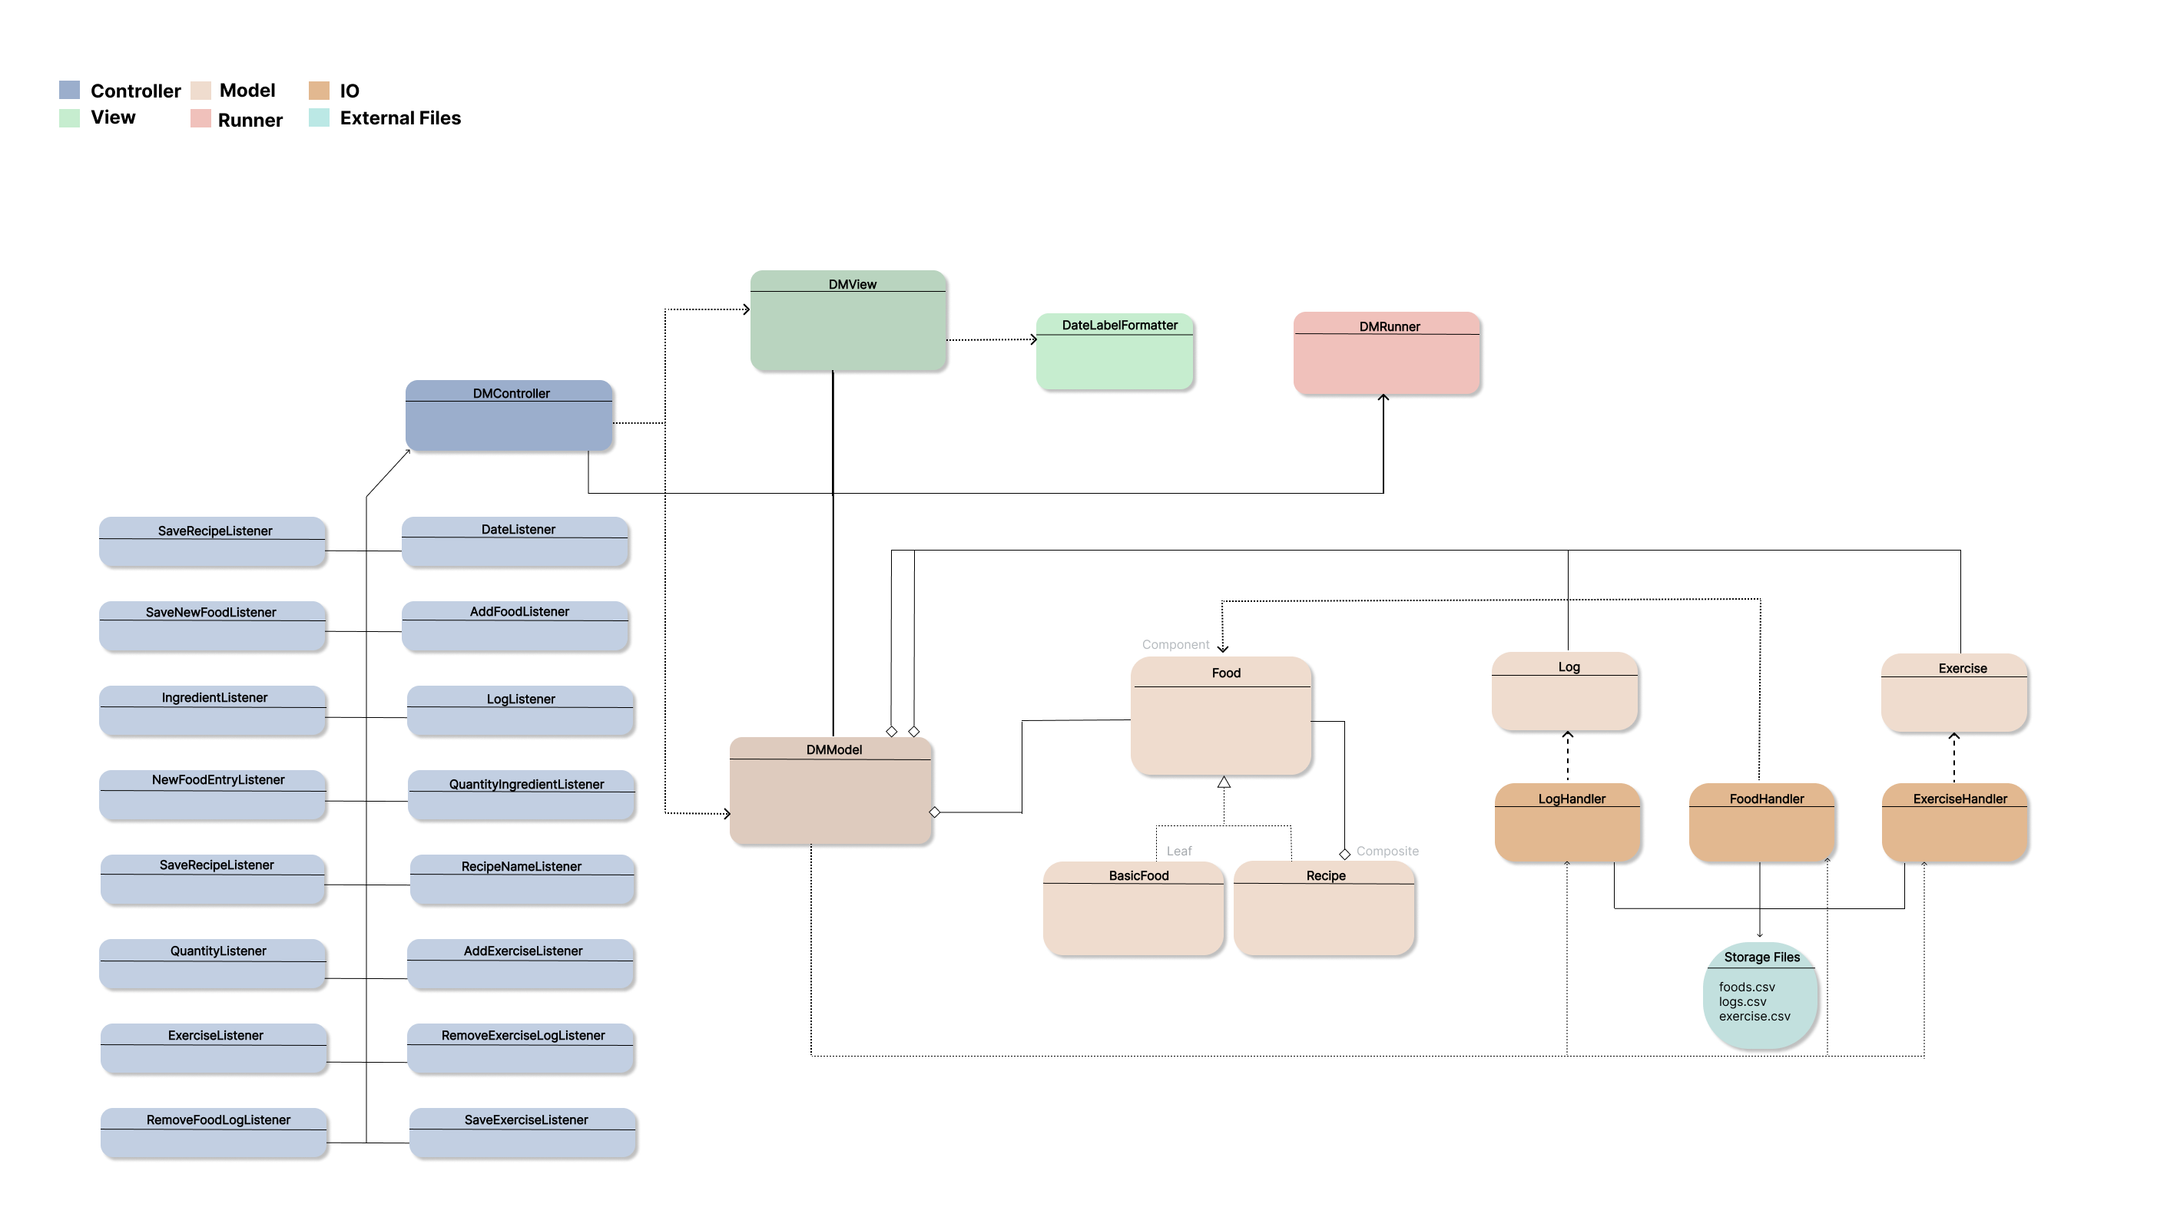

Slide 8
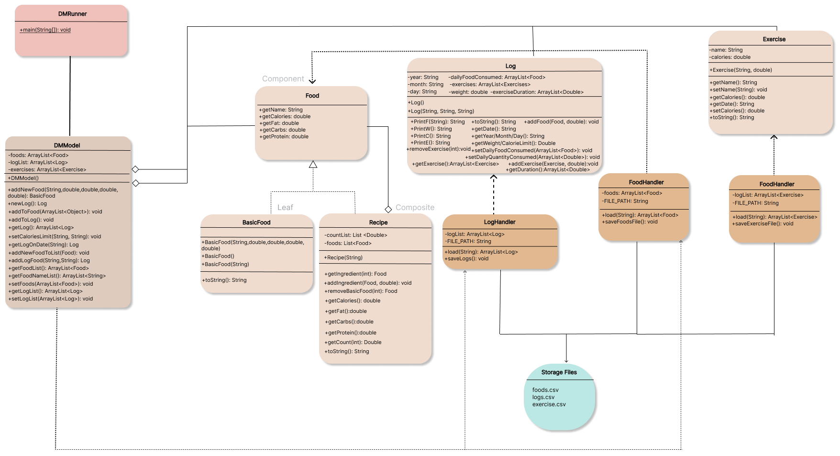
subsystem {model}

Slide 9
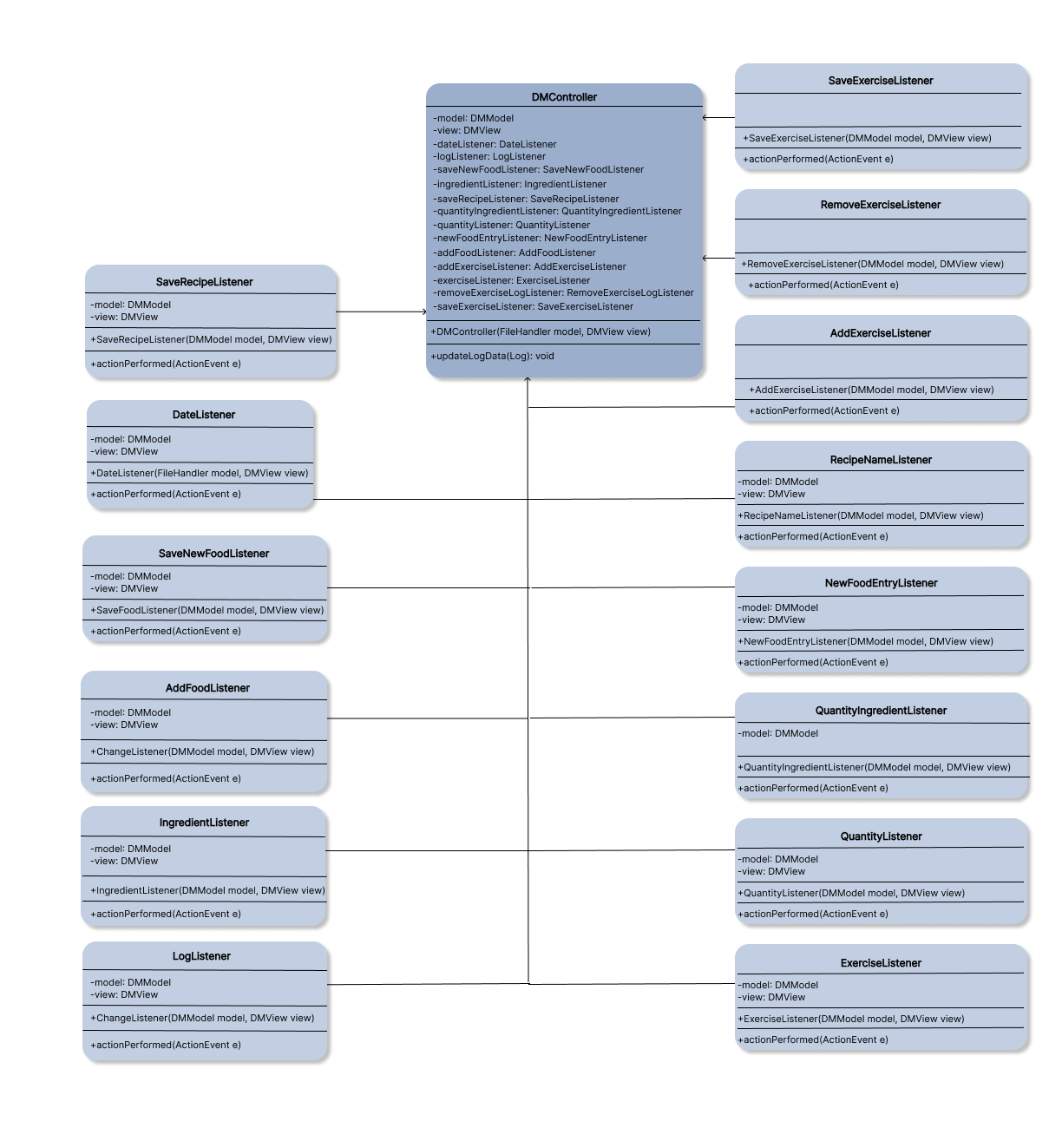
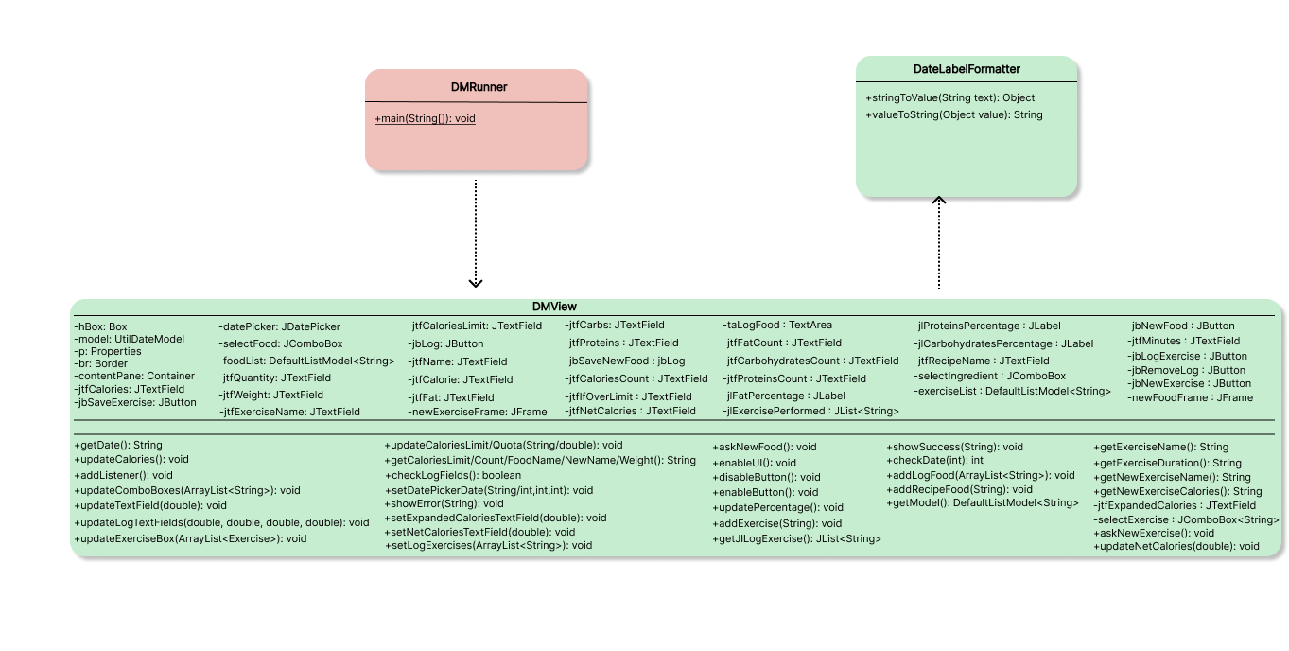
subsystem {view & controller}

Slide 10
UML
Sequence Diagrams

Slide 11
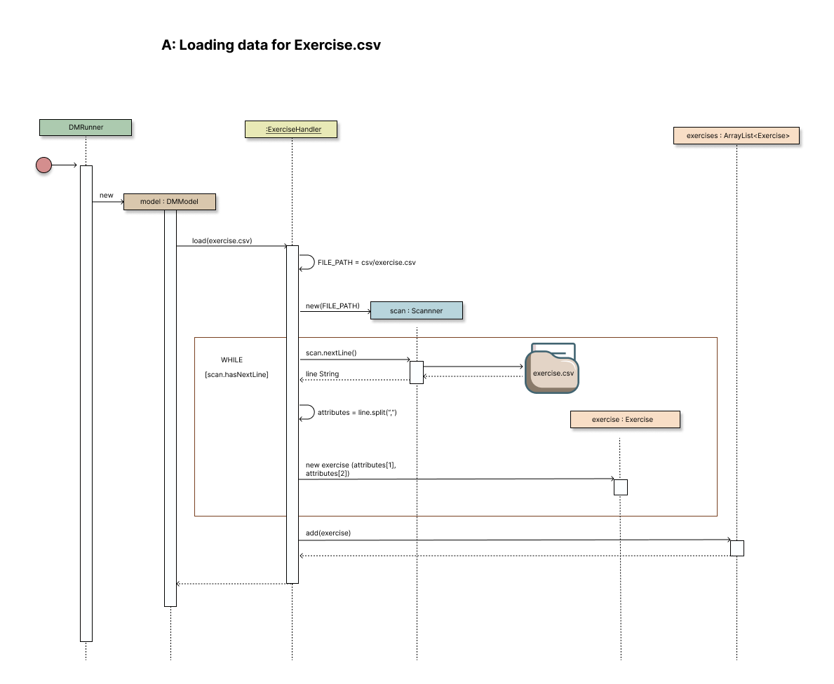
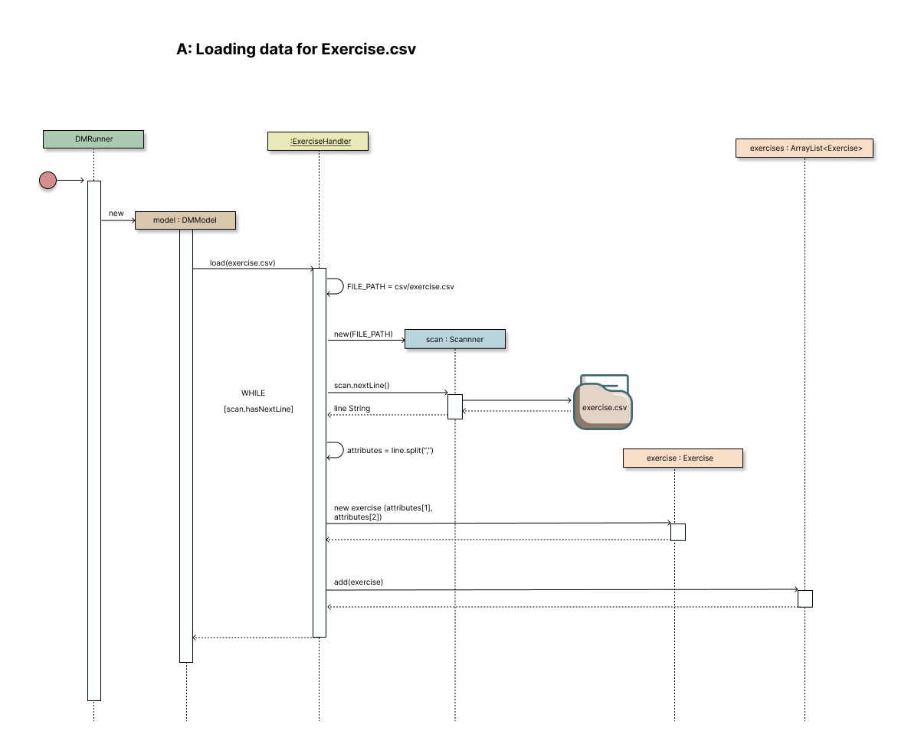
Exercise records loaded from exercise.csv into the model

Slide 12
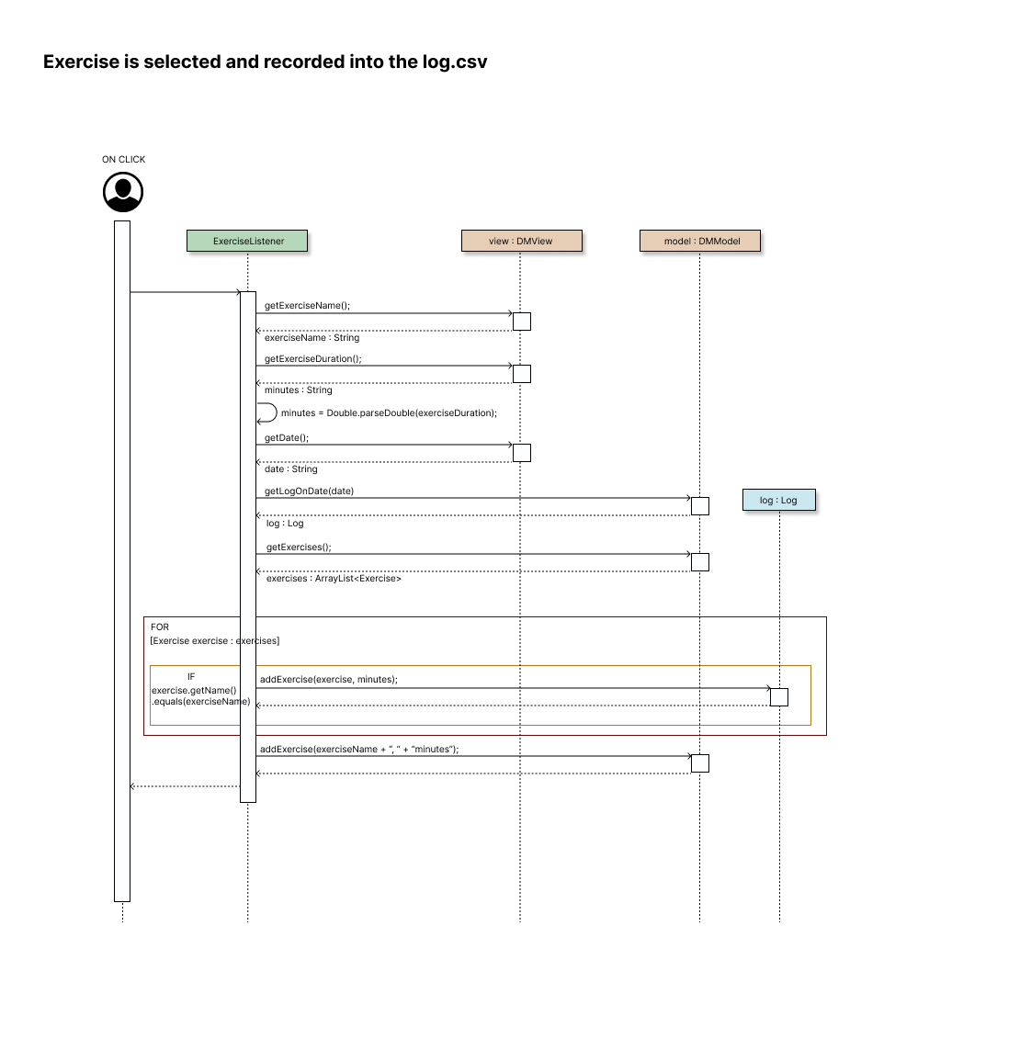
An exercise is selected and recorded into the log.csv file

Slide 13
An exercise is selected and recorded into the log.csv file

Slide 14
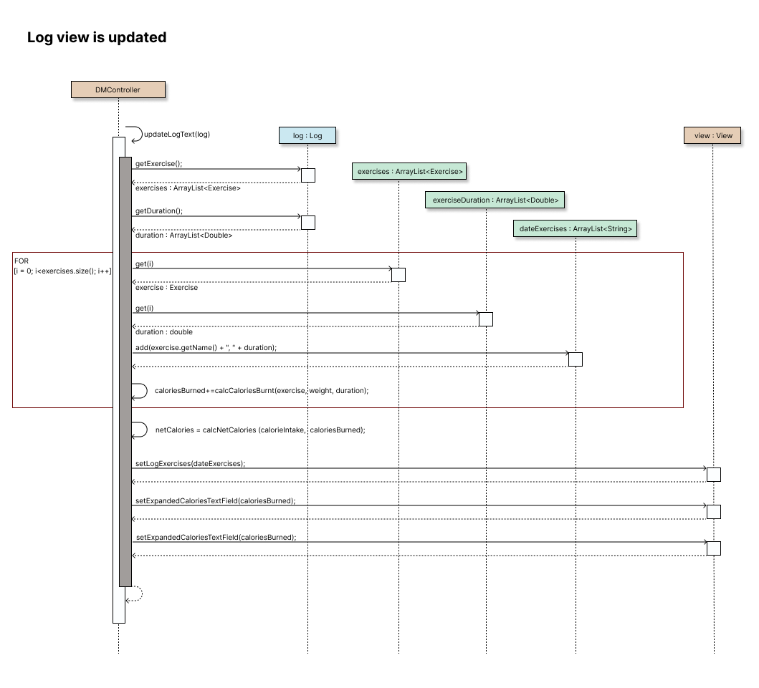
Log view is updated in relation to calories burned via exercise

Slide 15
Computing the total number of calories for the current date

Slide 16
FINAL NOTES
Highlights & Alterations

Slide 17
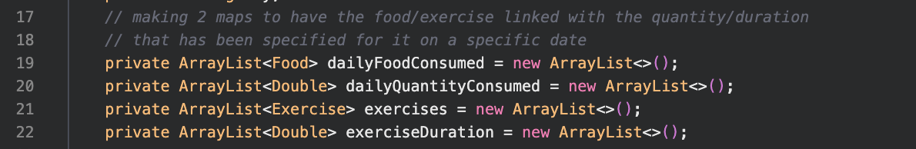
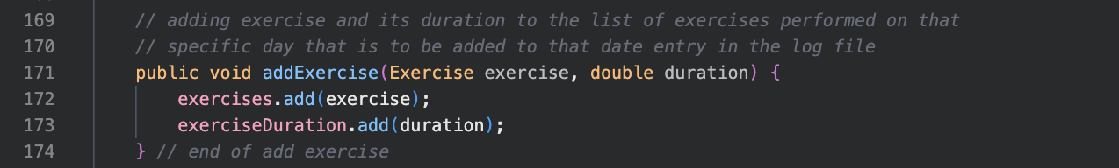
highlights
Log model
Log class contains the following code which simplifies the instantiation of our Log objects and allows us to have only one constructor

Slide 18
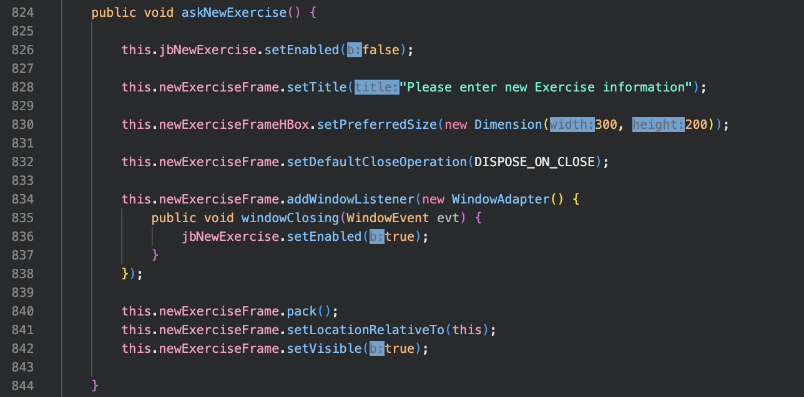
highlights
dmView ui
The separation of windows is maintained by the add exercise window being hidden rather than having separate Java classes (adhering to high cohesion / low coupling)

Slide 19
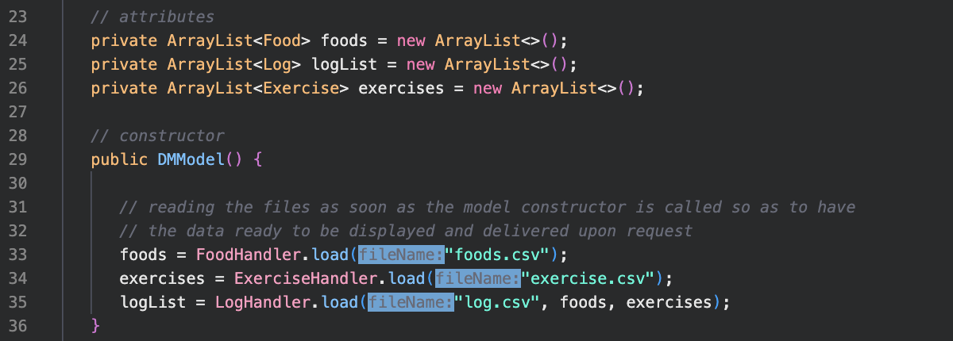
highlights
Dmmodel + 3 handlers
By introducing an “io” (input-output) package, we followed the split of the responsibility of CRUD operations into specialized handlers – one for each csv file in storage, which simplified our model class

Slide 20
improvements / alternatives?
test other possible data structures to hold collections ?
VIEW
JavaFX instead of SWING ?
MODEL
introduce Listener packages ?
DESIGN
look & feel (more user-friendly)
limit the length of user input (e.g., up to xx digits)
STRUCTURE
VALIDATION

Slide 21
thank you
SWEN.383.800 G3
RIT Croatia
Spring 2022/2023

