Slide 1
Diet Manager Project Presentation
GROUP G3
Matea Boderistanac, Matija Brnas, Toma Jeronim Culic, Luka Krpan, Doroteja Krtalic, Amar Zagorcic
SWEN.383.800

Slide 2
agenda
Diet Manager Demo 3
Diet Manager “Under the Hood” 4
Final Notes 16
Q & A

Slide 3
program overview

Slide 4
timeline
Basic functionalities
communication & data transmission
Code skeleton
implementing MVC architecture
Finalizing activity 1
refining the code and adding necessary functionalities
Activity 2
improving the architecture and adding new functionalities
Activity 3
refactoring and adding new features

Slide 5
summary
architecture
complexity
Execution
DMView updates itself based on the controller’s actions and displays all data from the model
DMController makes use of the ActionListener classes in the same package to ensure data flow
DMModel uses Handlers to load and save data to external files
MVC architectural pattern
Composite pattern
DRY
SRP
High Cohesion / Low Coupling
DMView split into meaningful sections
Log based on date (display and save to log.csv)
Enter weight & calorie limit
Add BasicFood & Recipe (takes input, stores it to food.csv, displays upon saving)
Calculation of caloric intake & display of dietary stats

Slide 6
UML
Class Diagram

Slide 7
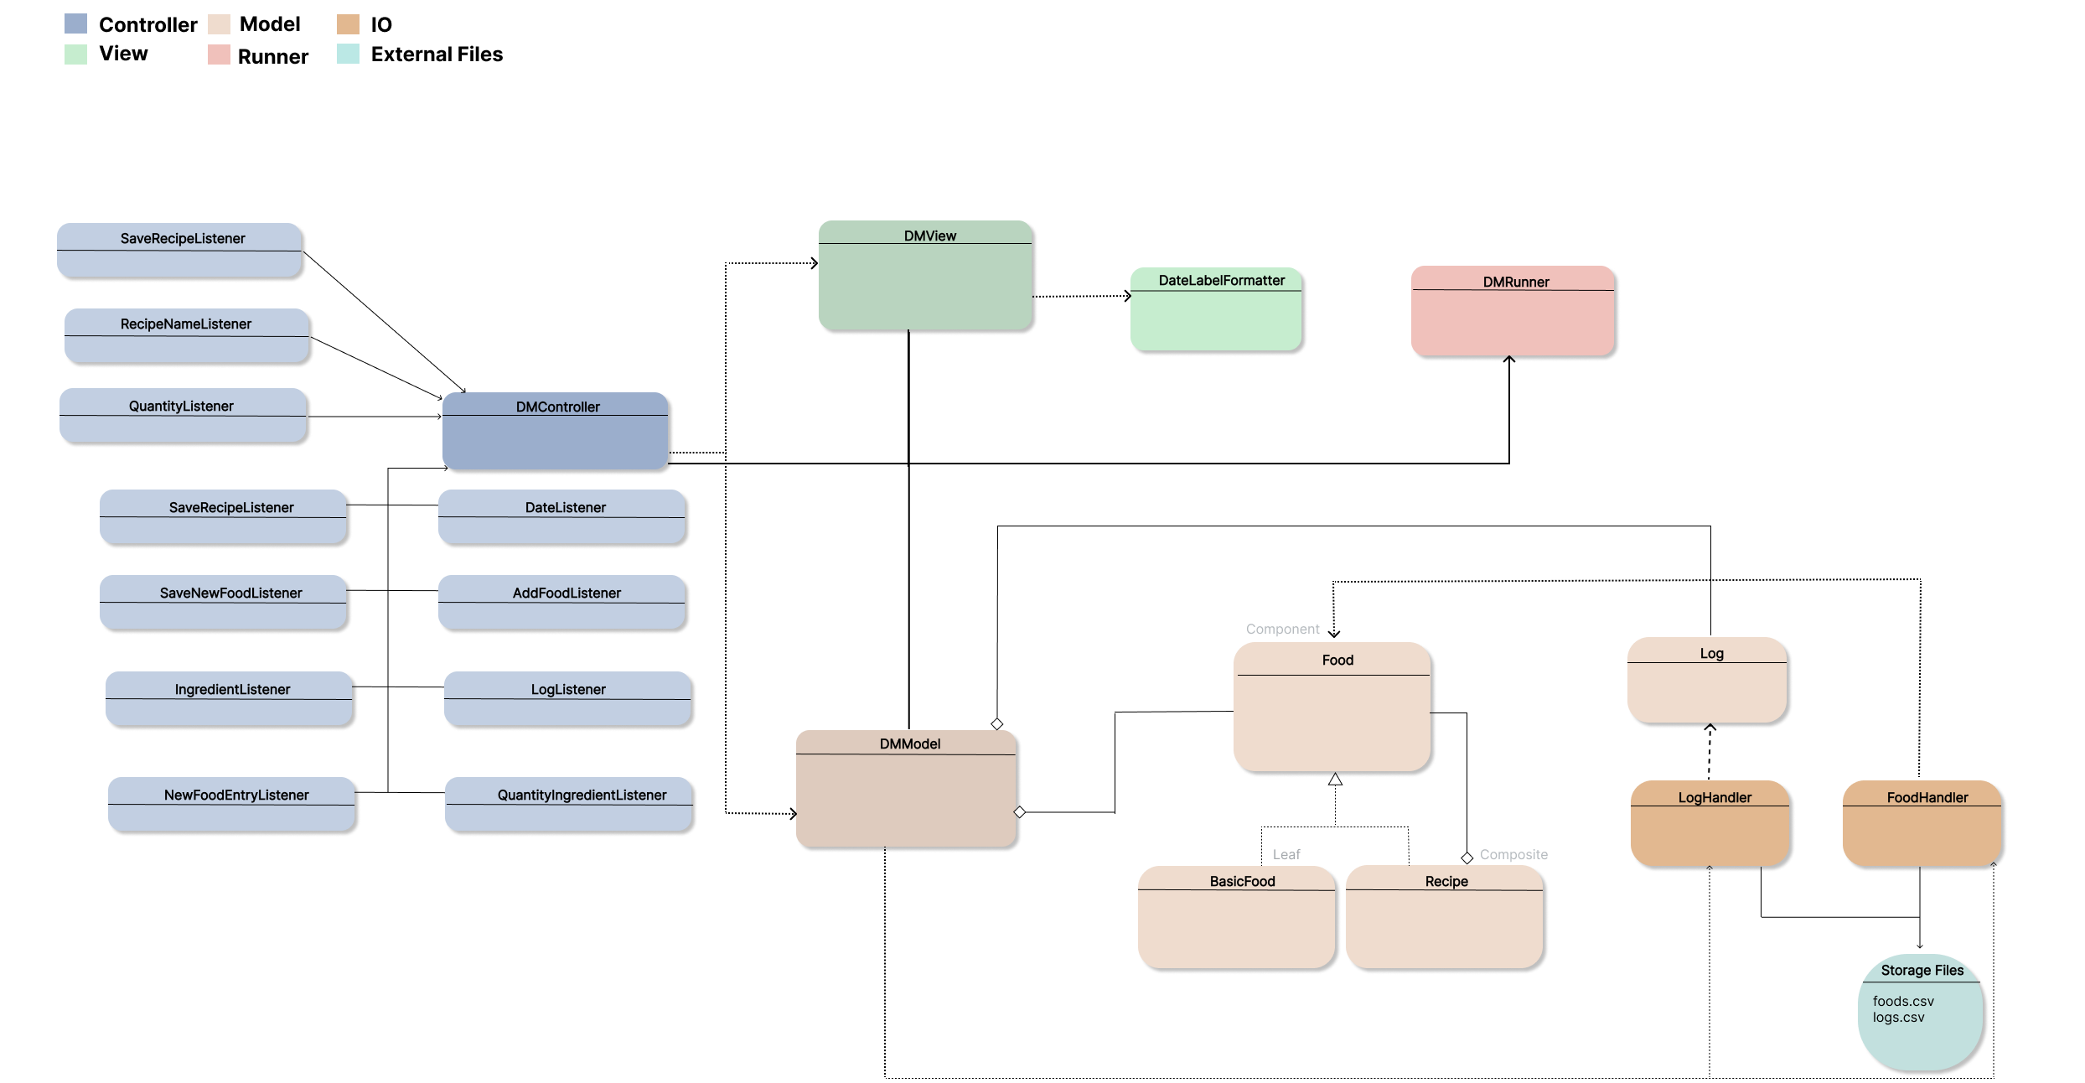

Slide 8
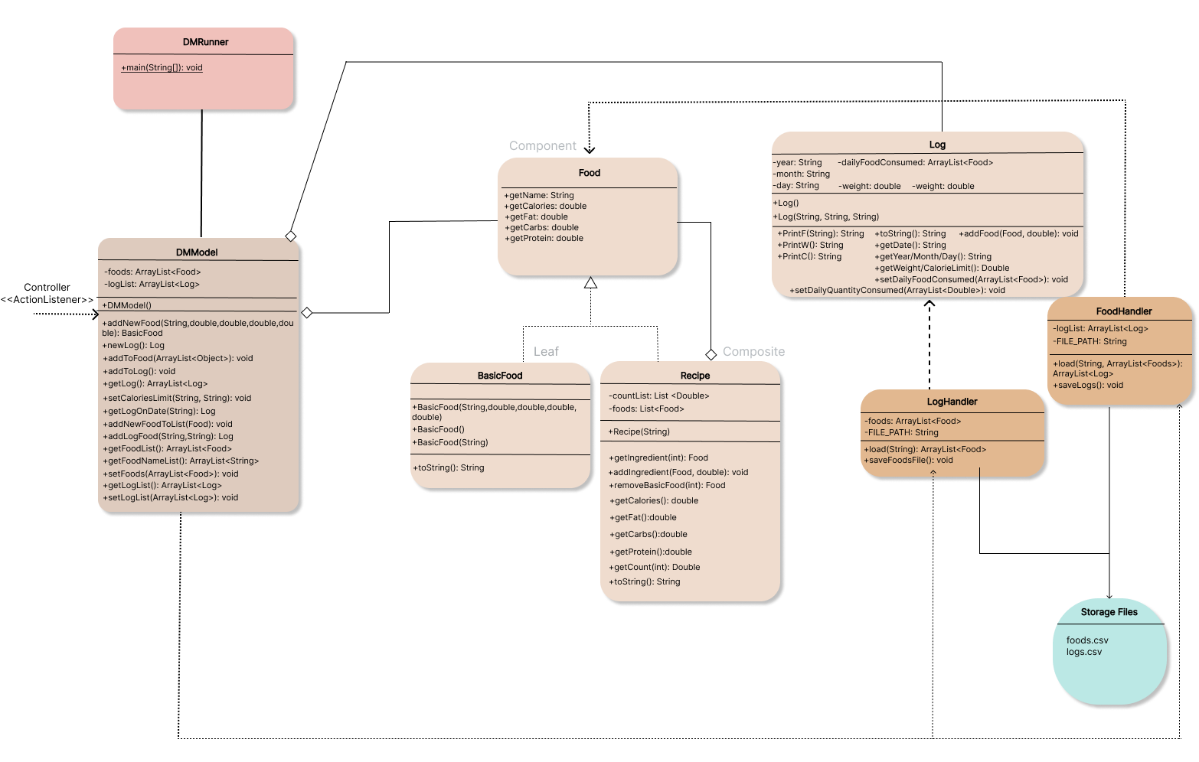
subsystem {model}

Slide 9
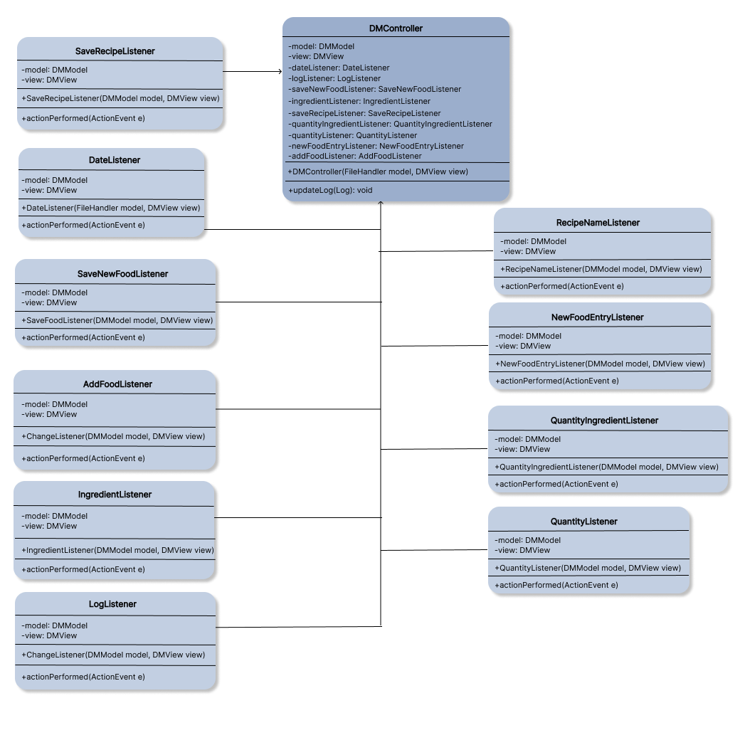
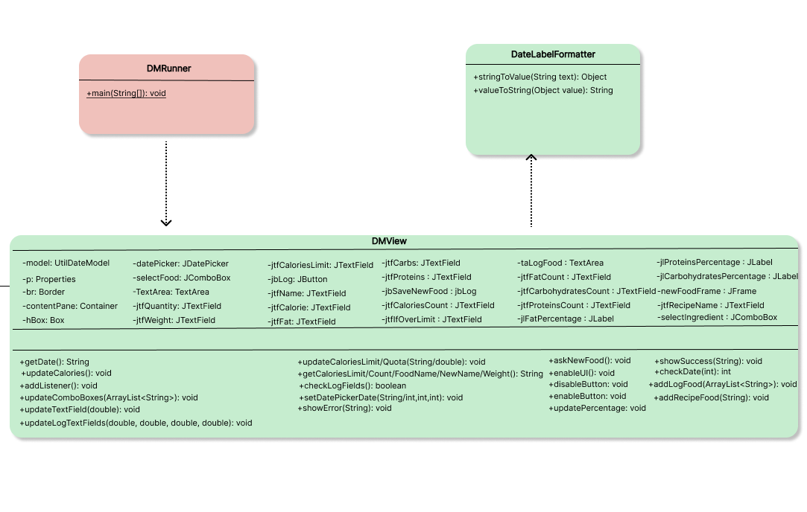
subsystem {view & controller}

Slide 10
UML
Sequence Diagrams

Slide 11
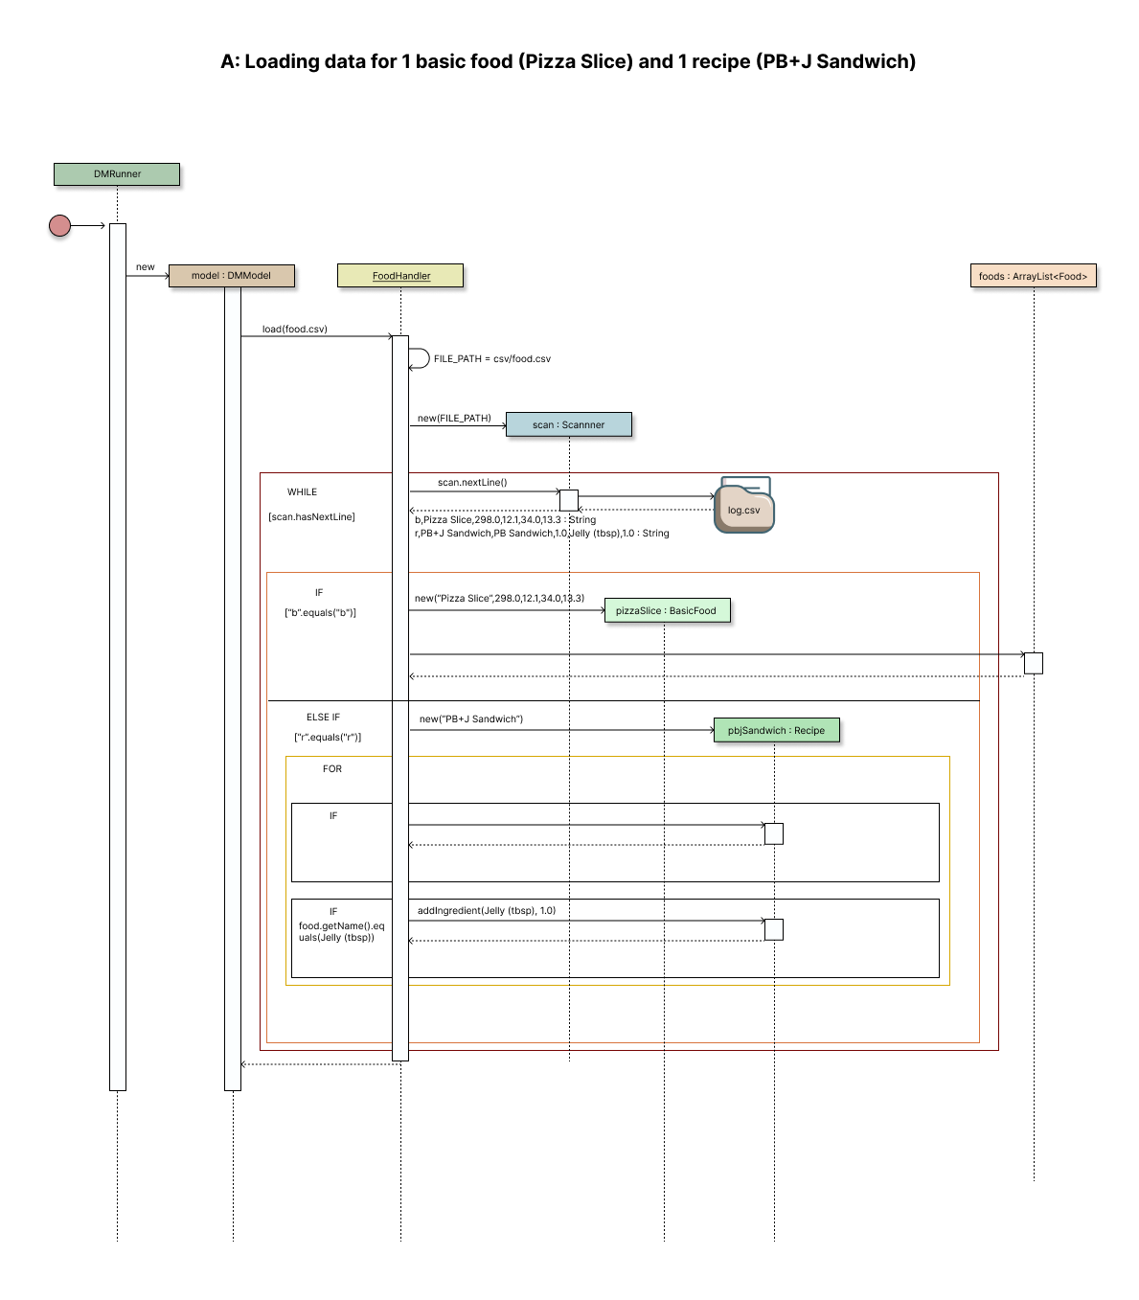
Loading data for 1 basic food (Pizza Slice) and 1 recipe (PB+J Sandwich)

Slide 12
Loading data for 1 basic food (Pizza Slice) and 1 recipe (PB+J Sandwich)

Slide 13
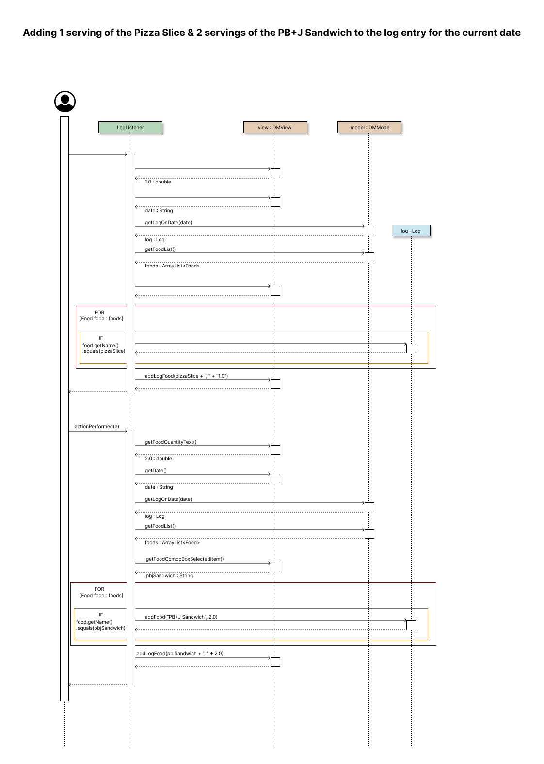
Adding 1 Pizza Slice & 2 servings of the PB+J Sandwich to the current date

Slide 14
Adding 1 Pizza Slice & 2 servings of the PB+J Sandwich to the current date

Slide 15
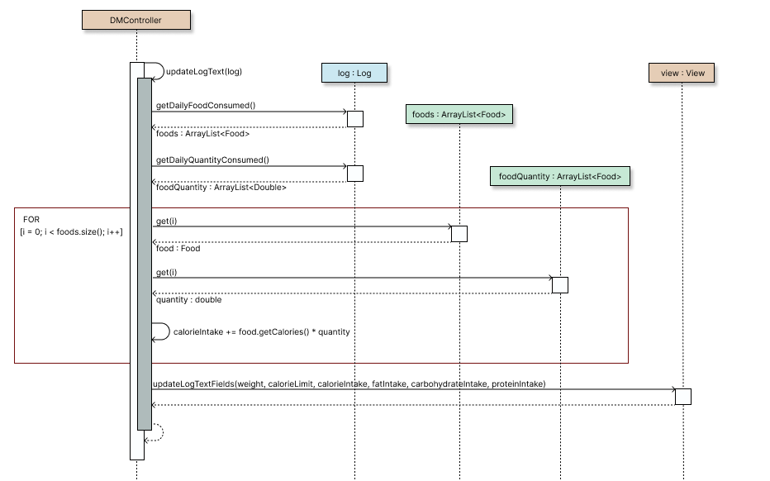
Computing the total number of calories for the current date

Slide 16
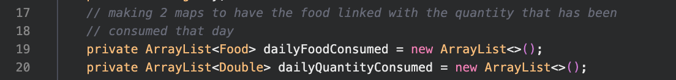
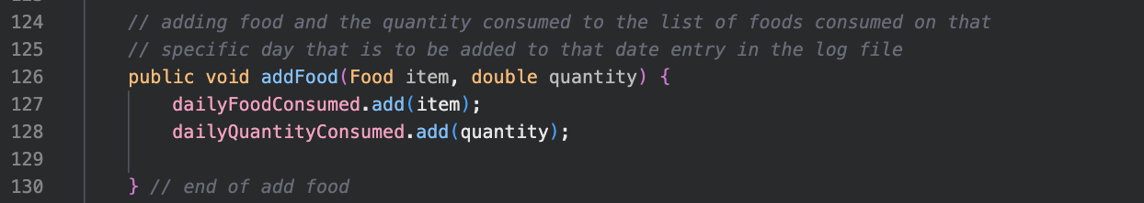
highlights
Log model
Log class contains the following code which simplifies the instantiation of our Log objects and allows us to have only one constructor

Slide 17
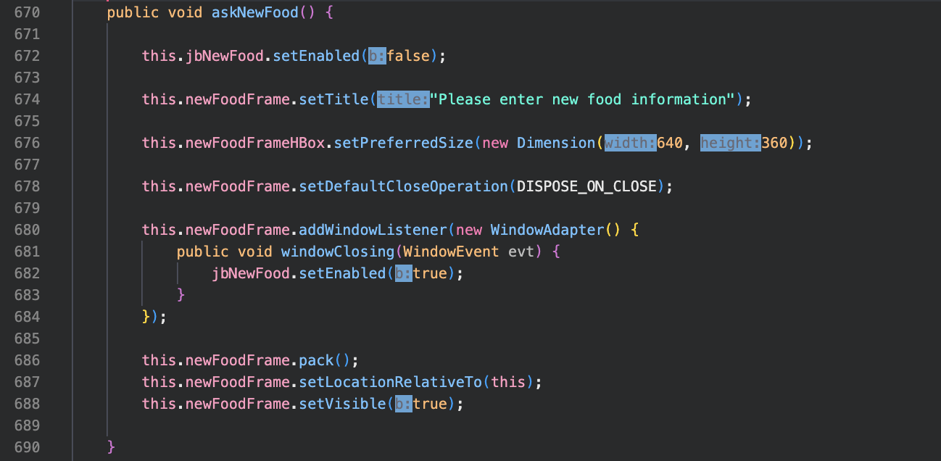
highlights
dmView ui
The separation of windows occurs by the add food and recipe window being hidden rather than separate Java classes in order to follow high cohesion / low coupling

Slide 18
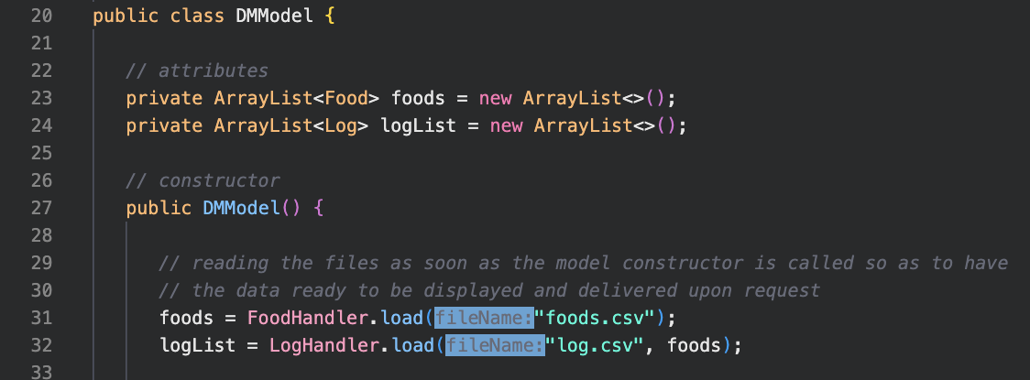
highlights
Dmmodel + 2 handlers
By creating an “io” (input-output) package, we split the responsibility of CRUD operations into 2 specialized handlers – one for each csv file in storage, which simplified our model class

Slide 19
improvements / alternatives?
test possible data structures to hold collections for easier maintenance ?
VIEW
clear the class organization and have it solely concerned with the UI
MODEL
have separate classes for collections ; results in a single FileHandler ?
DESIGN
improve the look & feel (more user-friendly)
provide a more informative UI (errors / warnings based on user input)
STRUCTURE
VALIDATION

Slide 20
thank you
SWEN.383.800 G3
RIT Croatia
Spring 2022/2023

