Slide 1
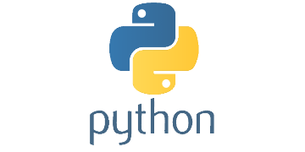
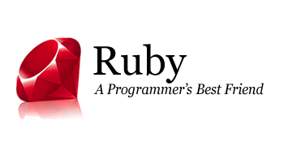
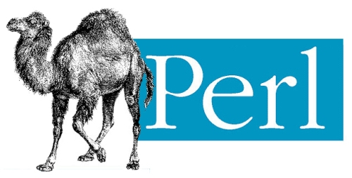
Perl, Python, and Ruby

Slide 2
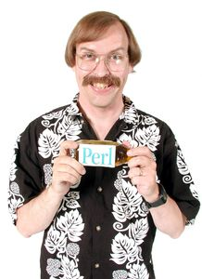
#!perl
perl.org: “Perl 5 is a highly capable, feature-rich programming language with over 29 years of development.”
Supports object-oriented, procedural and functional programming
Created by Larry Wall and first released in 1987 (29 years ago).
Current version: 5.24.1

Slide 3
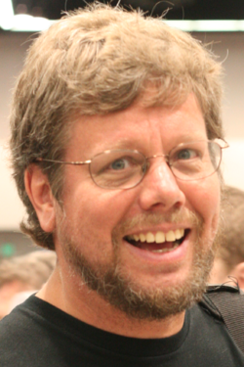
#!python
python.org: “Python is a programming language that lets you work quickly and integrate systems more effectively.”
Supports object-oriented, imperative, functional, and procedural programming styles.
Created by Guido van Rossum and first released in 1991.

Slide 4

#!ruby
ruby-lang.org: “A dynamic, open source programming language with a focus on simplicity and productivity. It has an elegant syntax that is natural to read and easy to write.”
Supports object-oriented, imperative, functional, and procedural programming styles.
Created by Yukihiro "Matz" Matsumoto in the mid 1990s in Japan.

Slide 5
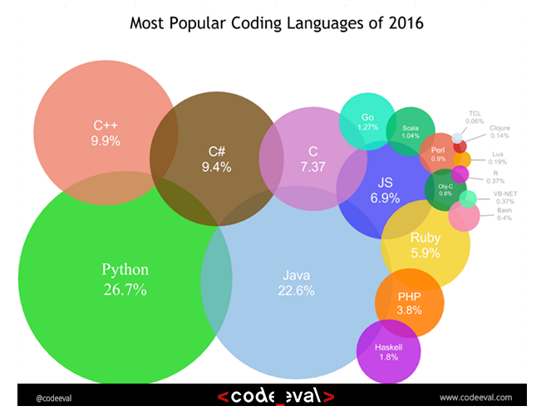
Market Share
http://blog.codeeval.com/codeevalblog/2016/2/2/most-popular-coding-languages-of-2016

