Slide 1

Geography’s Impact on the NFL Draft
Matthew Robinson
Notes:
This was my final project from Dr. Ed’s Data Science class last semester.

Slide 2
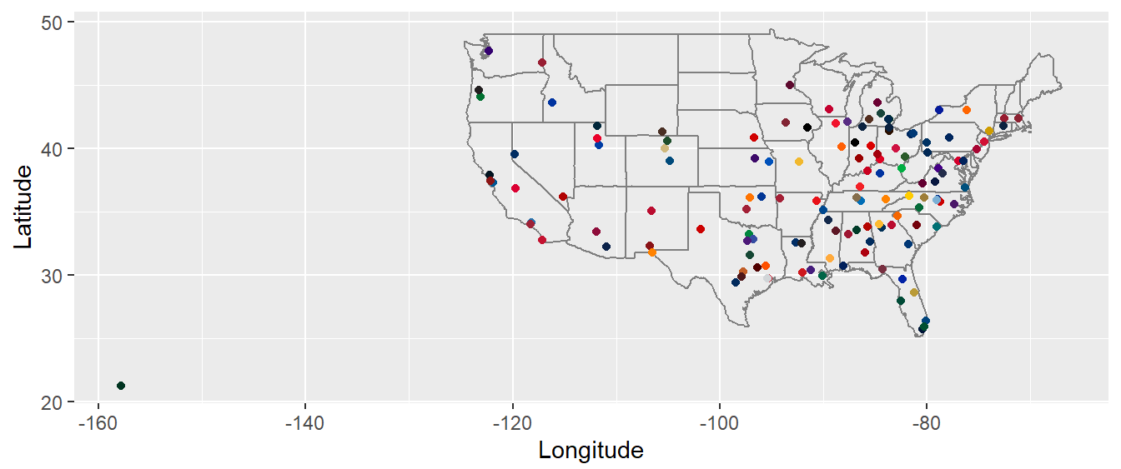
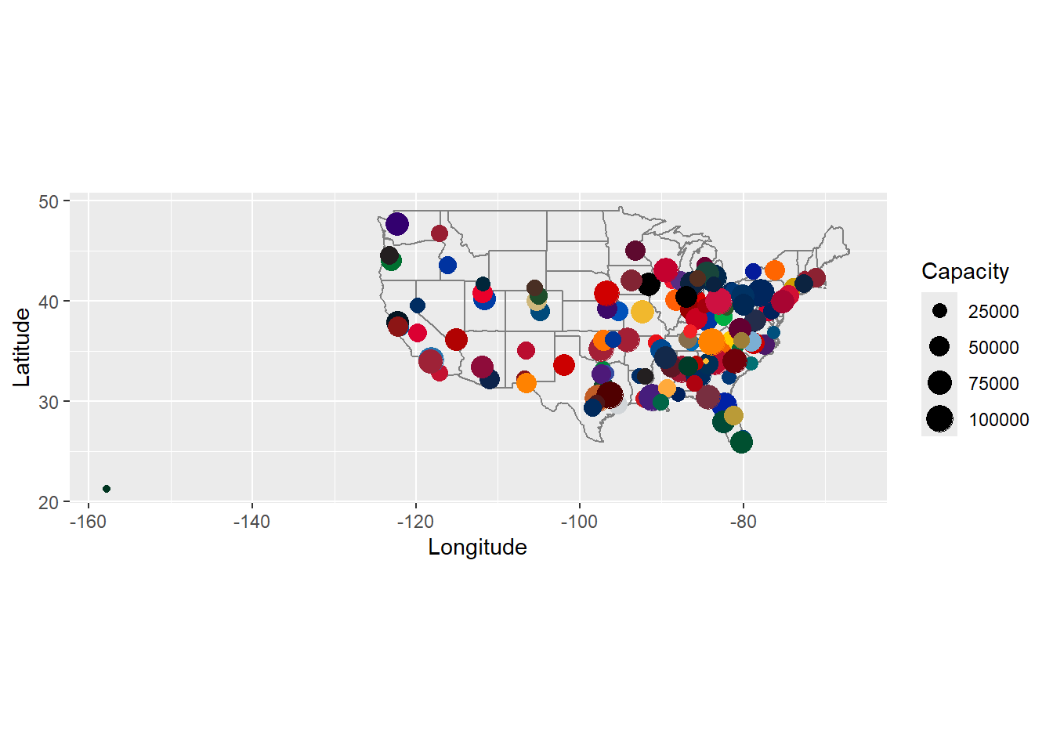
Why did I research this topic?
I am a big sports fan who also has a fascination with geography.
I have always been interested in the intersection between these two areas.
This topic is one that I have always wanted to investigate.
Notes:
Both maps were made in previous Data Science assignments.
Top map is every FBS school on a map.
Bottom map is every FBS stadium based on their capacity on a map.

Slide 3

My Hypothesis
I expected geography to have a small but noticeable impact on the NFL draft.
I expected geography to have a larger impact in later rounds of the draft.
I expected some teams to draft more local talent than other teams.

Slide 4
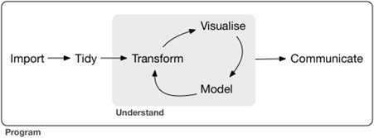
Goals of this Project
Data Science Workflow:
Import: Find a data set and import it into RStudio.
Tidy: Put data set in correct format to be analyzed.
Transform: Create new variables and sort and filter data.
Visualize: Show data in tables, charts, and graphs.
Model: Create models based on data.
Communicate: Explain your findings from your analysis.

Slide 5
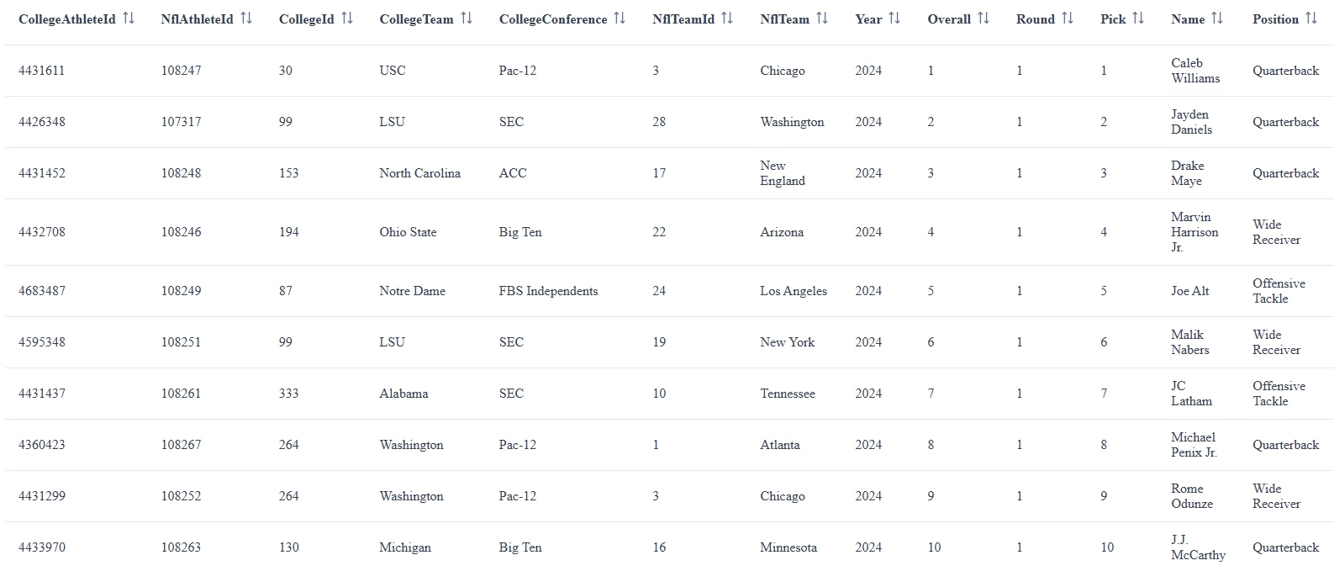
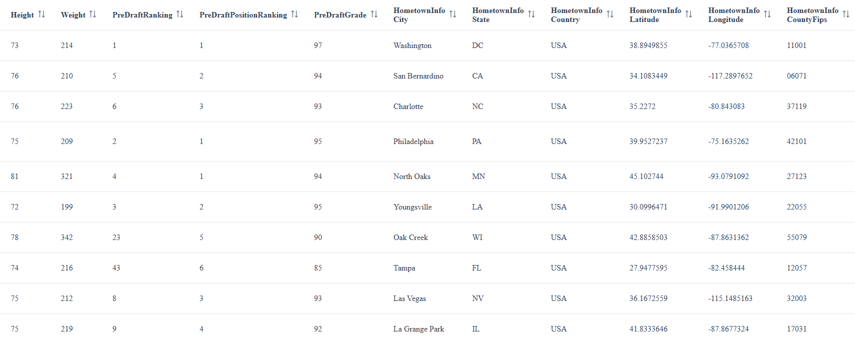
Step 1: Import Data
Notes:
Data was taken from collegefootballdatabase.com.

Slide 6
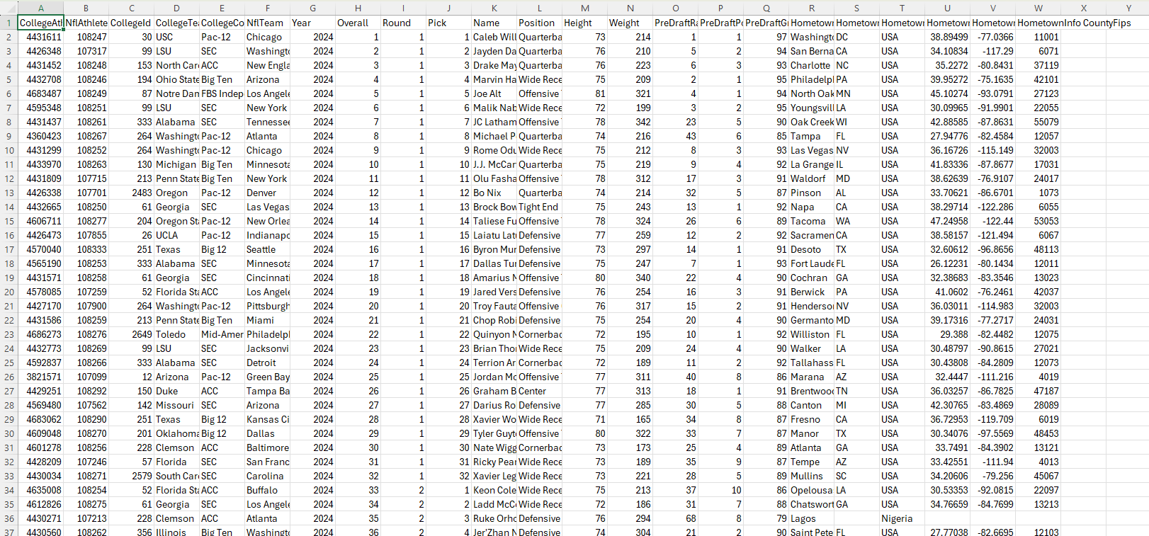
This data set was downloaded as a csv file.

Slide 7
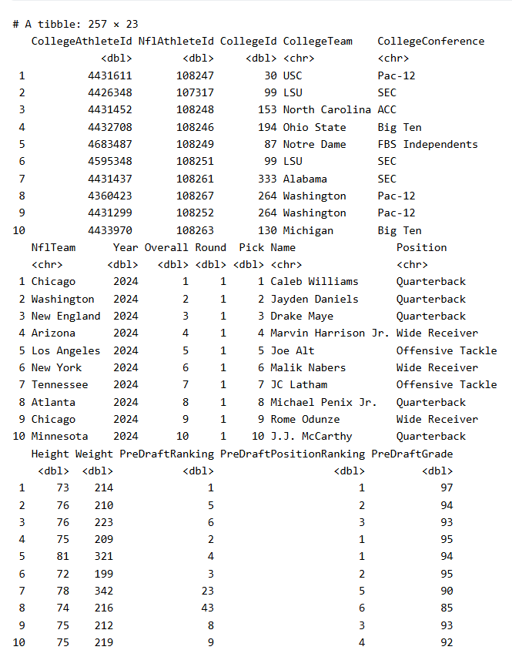
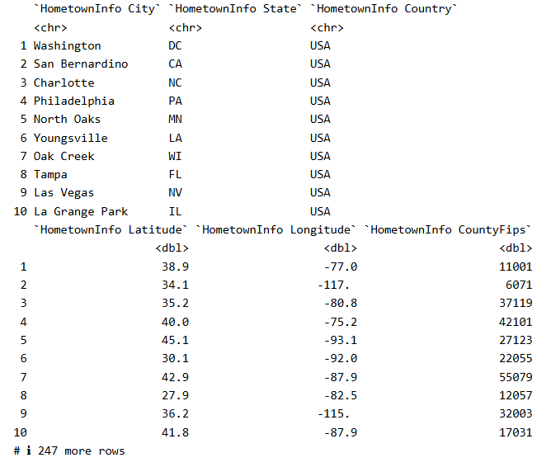
This csv data set was transferred into a data frame.

Slide 8
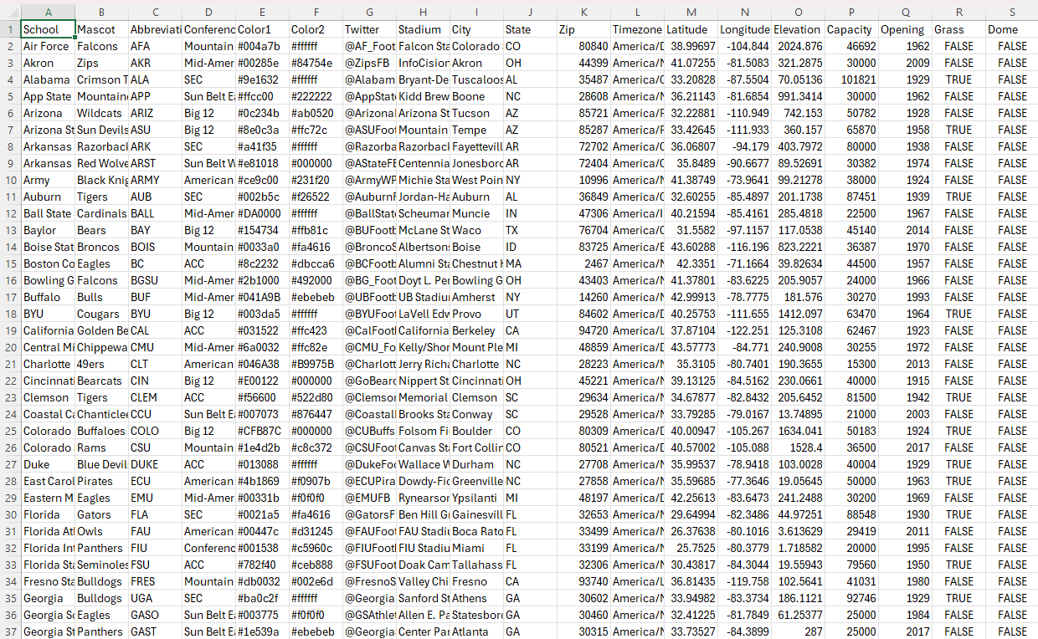
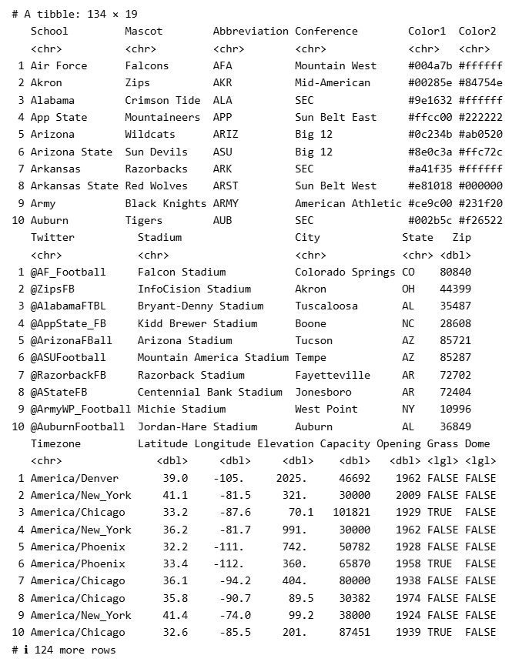
A tidy version of another data set from a previous project was also used.
Notes:
This data was also taken from collegefootballdatabase.com.
The left picture is from the CSV file in Excel.
The right picture is from the tibble in Rstudio.

Slide 9
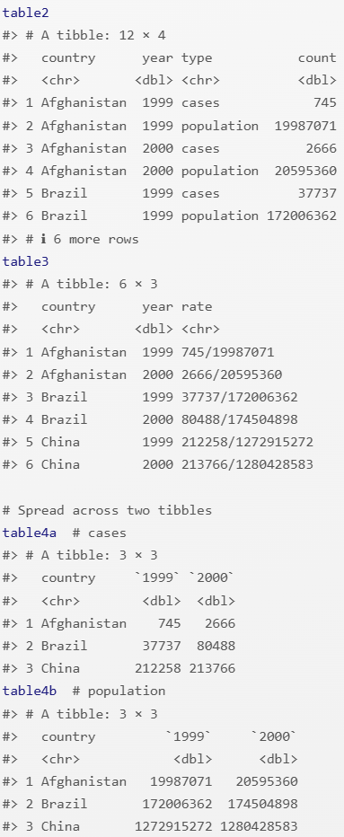
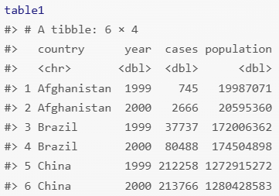
Step 2: Tidy Data
Three Properties of Tidy Data:
Each variable has its own column.
Each observation has its own row.
Each value has its own cell.
Notes:
Table 1: Tidy
Table 2: Each observation has two rows.
Table 3: Two values share a single cell.
Tables 4: Variables do not have columns.

Slide 10
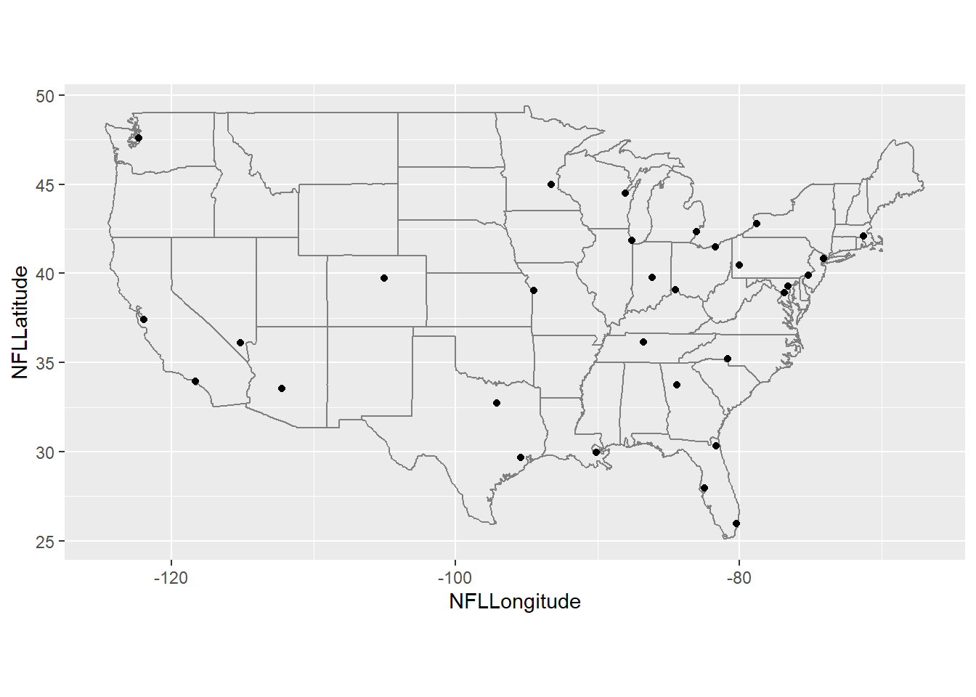
Several steps were taken to tidy this data set.
Removed unneeded columns.
Renamed several columns.
Added data from FBS data set.
Added data for each NFL team.
Changed the order of columns.
Separated NY and LA teams.
Added missing data.
Notes:
Removed Columns: "CollegeAthleteId", "NflAthleteId", "CollegeId", "Year", "Height", "Weight", "PreDraftRanking", "PreDraftPositionRanking", "PreDraftGrade", "HometownInfo Country", "HometownInfo CountyFips“
Renamed Columns: CollegeTeam → College, CollegeConference → Conference, Nflteam → Team, Name → Player, HometownInfo City → HTCity, HometownInfo State → HTState, HometownInfo Latitude → HTLatitude, HometownInfo Longitude → HTLongitude
FBS Data: School, City, State, Latitude, Longitude
NFL Data: City, State, Latitude, Longitude
Order of Columns: Overall, Round, Pick, Player, Position, Team, NFLCity, NFLState, NFLLatitude, NFLLongitude, College, Conference, AMCity, AMState, AMLatitude, AMLongitude, HTCity, HTState, HTLatitude, HTLongitude
New York → NYJ & NYG
Los Angeles → LAC & LAR
Missing Data: Non-FBS Colleges & Foreign Countries

Slide 11
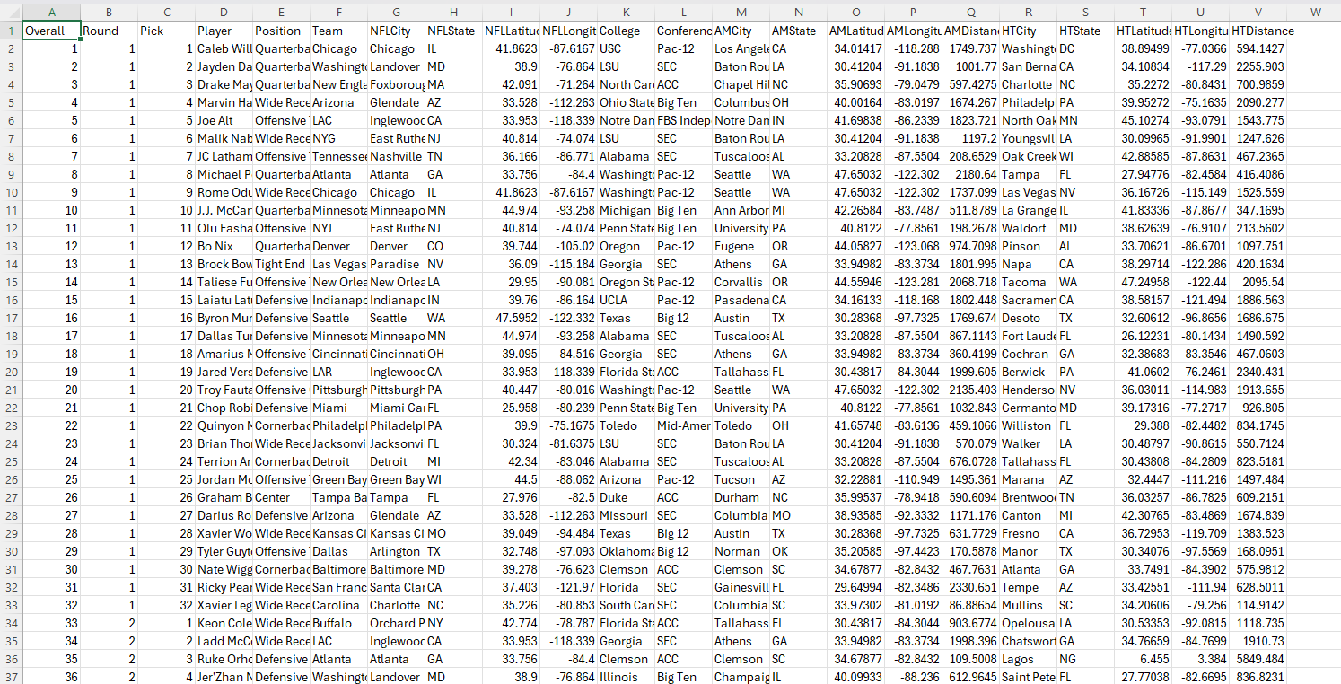
This data set is now tidy!
Notes:
AMDistance and HTDistance columns were added later.

Slide 12
Step 3: Understand Data
Understanding the data involves transforming, visualizing, and modelling the data.
Analyze based on states.
Create distance variables.
Check extremities.
Create linear models.
Analyze individual teams.

Slide 13
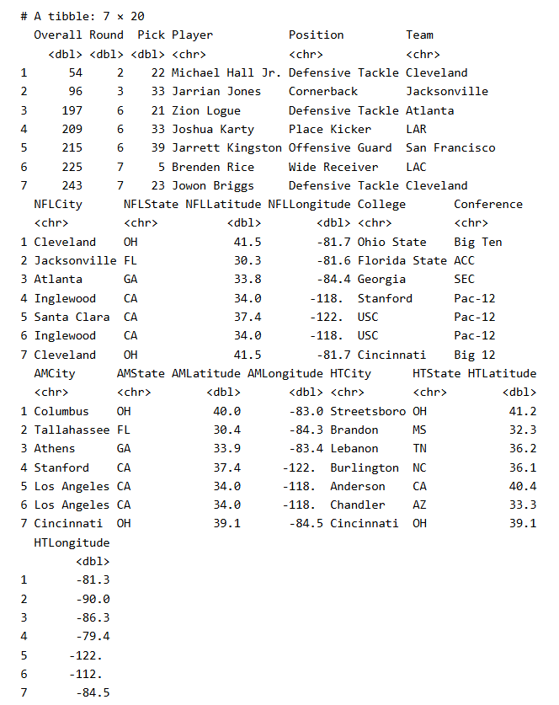
Players Drafted in Same State as Alma Mater
7 Players
2.7% of 257 Players Drafted
Mostly Final Two Rounds
2 Drafted by Cleveland Browns
3 Drafted by California Teams
2 Drafted by Los Angeles Teams

Slide 14
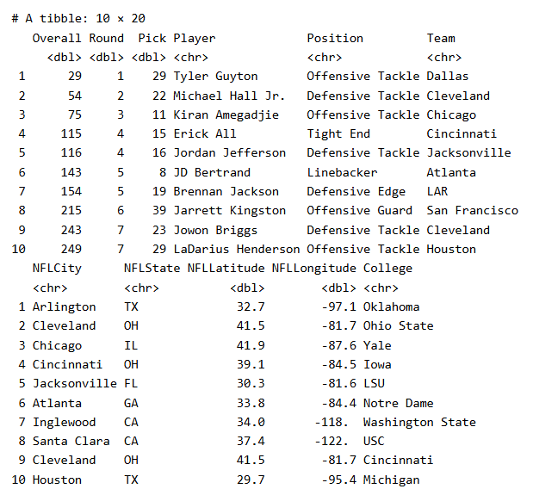
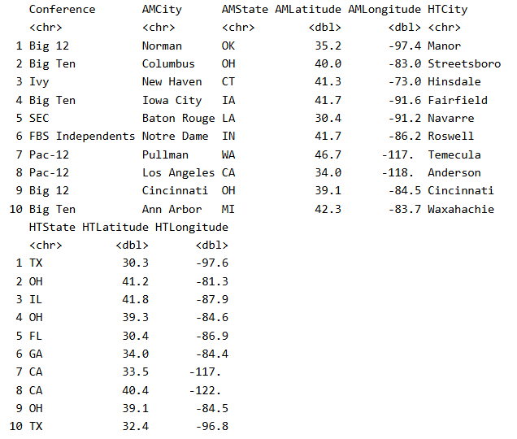
Players Drafted in Same State as Hometown
10 Players
3.9% of 257 Players Drafted
Every Round Represented
3 Drafted by Ohio Teams
2 Drafted by Cleveland Browns
2 Drafted by California Teams
2 Drafted by Texas Teams

Slide 15
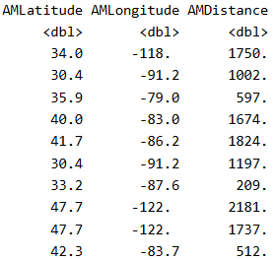
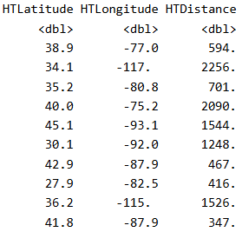
Distance Variables
distGeo(p1, p2)
p1, p2 = Coordinates
The result is given in meters.
Each result was divided by 1609.34 to convert to miles.

Slide 16
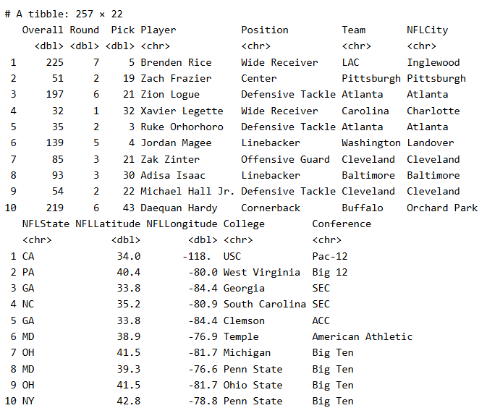
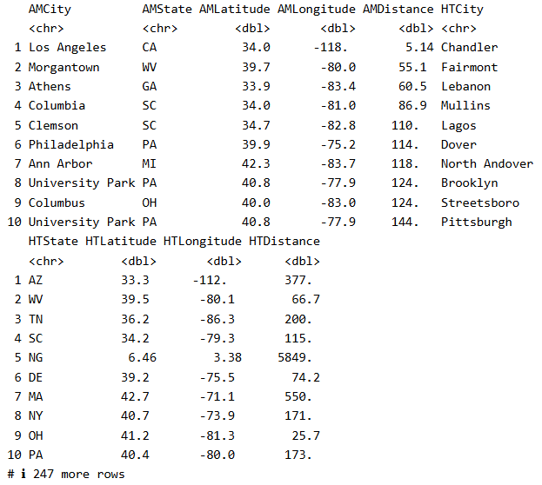
Players Drafted Closest to Alma Mater
Every Round except 4th Represented
Brendan Rice: USC → LAC (Los Angeles County)
1 Player within 50 Miles
4 Players within 100 Miles
2 Drafted by Cleveland Browns
2 Drafted by Atlanta Falcons

Slide 17
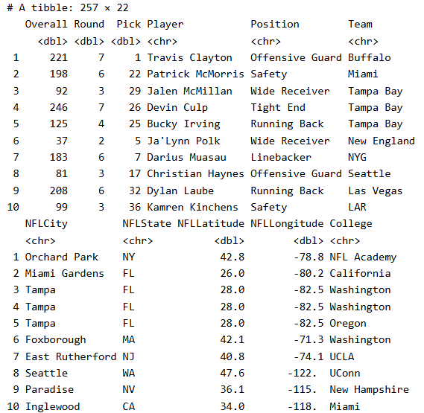
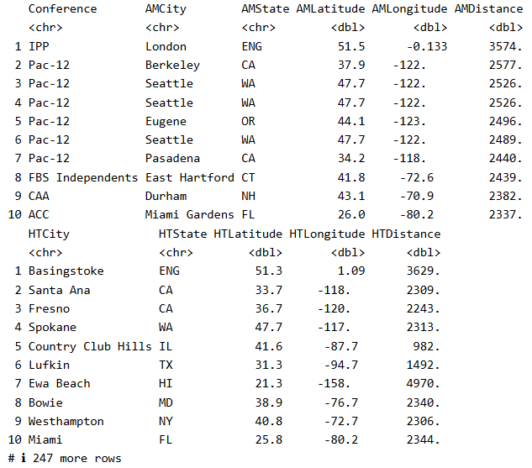
Players Drafted Furthest from Alma Mater
Every Round except 1st and 5th Represented
Travis Clayton: NFL Academy (London, England)
1 Player over 3,000 Miles Away
6 West Coast → East Coast
3 East Coast → West Coast
3 Drafted by Tampa Bay Buccaneers

Slide 18
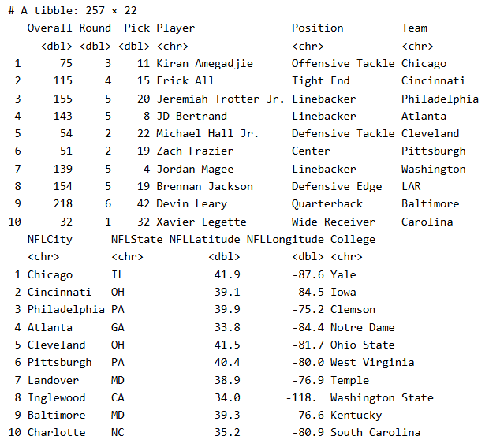
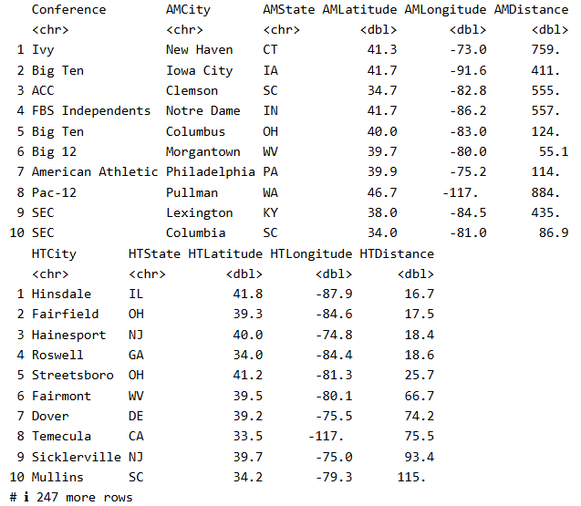
Players Drafted Closest to Hometown
Every Round except 7th Represented
JD Bertrand: Roswell, GA → Atlanta, GA (Fulton County)
3 Players in Same MSA
5 Players in Same CSA
5 Players within 50 Miles
9 Players within 100 Miles
None Drafted by Same Team
Notes:
JD Bertrand: Atlanta MSA
Kiran Amegadjie: Chicago MSA
Erick All: Cincinnati MSA
Jeremiah Trotter Jr: Philadelphia CSA (Camden MSA)
Michael Hall Jr: Cleveland MSA (Akron MSA)

Slide 19
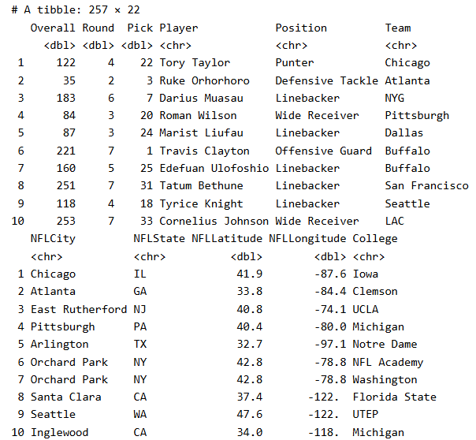
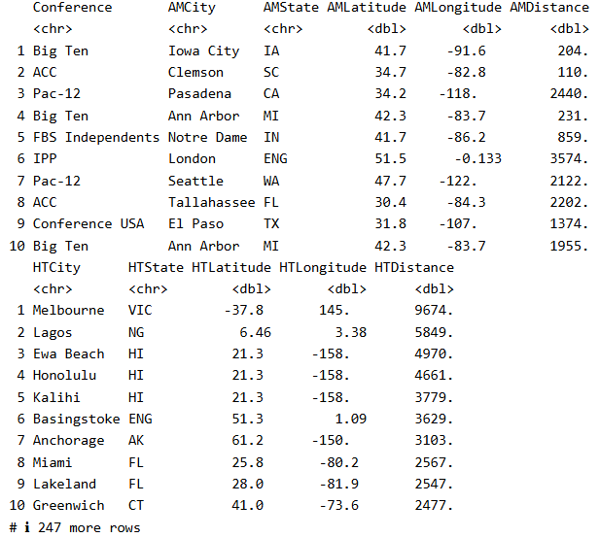
Players Drafted Furthest from Hometown
Every Round except 1st Represented
3 Players from Outside US
3 Players from Hawaii
2 Players over 5,000 Miles Away
7 Players over 3,000 Miles Away
2 Drafted by Buffalo Bills
Notes:
Tory Taylor: Australia
Ruke Orhorhoro: Nigeria
Travis Clayton: England

Slide 20
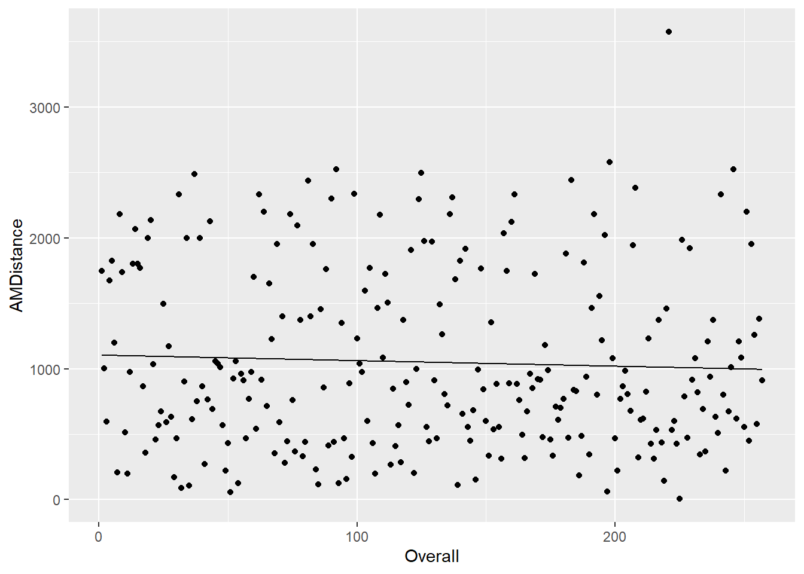
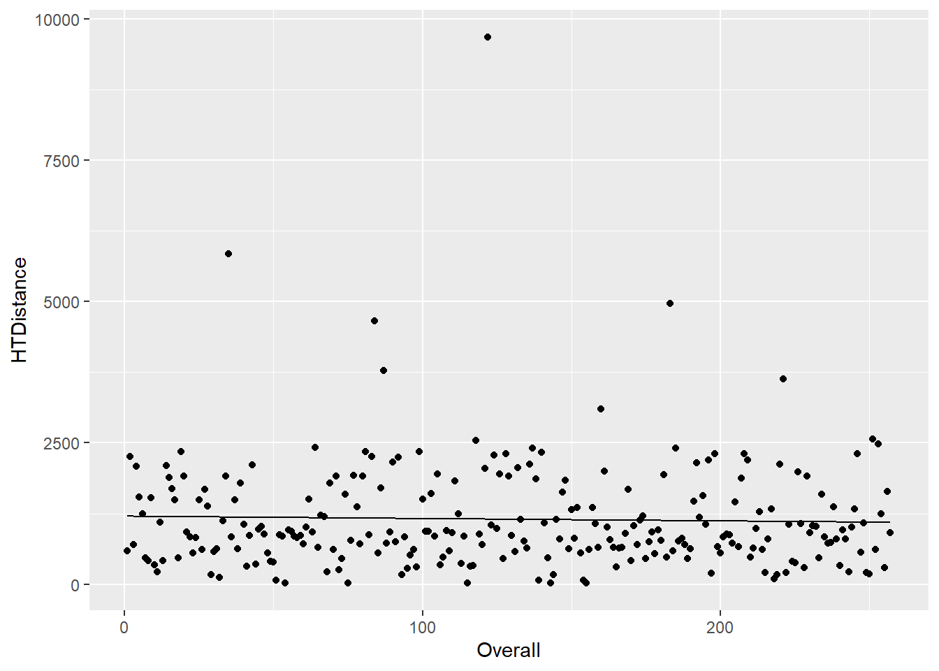
Linear Models
Distance from Alma Mater as Draft Progresses
Distance from Hometown as Draft Progresses
Notes:
Both have slightly downward trends which are barely noticeable.
Hometown is more spread out.

Slide 21
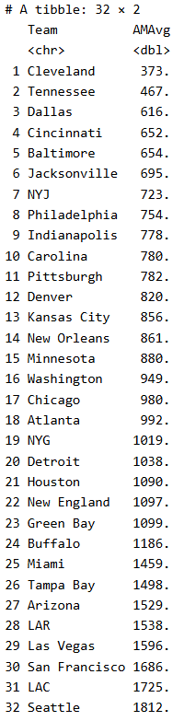
Average Distance from Alma Mater
2 Teams under 500 Miles
18 Teams under 1,000 Miles
26 Teams under 1,500 Miles
All Teams under 2,000 Miles
Lowest Average: Cleveland Browns
Highest Average: Seattle Seahawks
Bottom 6 All on West Coast

Slide 22
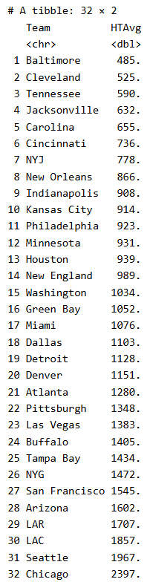
Average Distance from Hometown
1 Team under 500 Miles
14 Teams under 1,000 Miles
26 Teams under 1,500 Miles
31 Teams under 2,000 Miles
Lowest Average: Baltimore Ravens
Highest Average: Chicago Bears
2nd Lowest & Highest were Lowest and Highest of Previous List

Slide 23
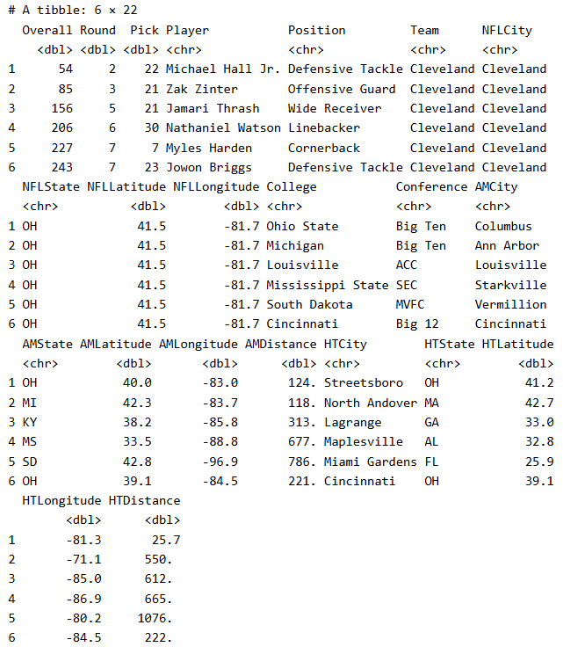
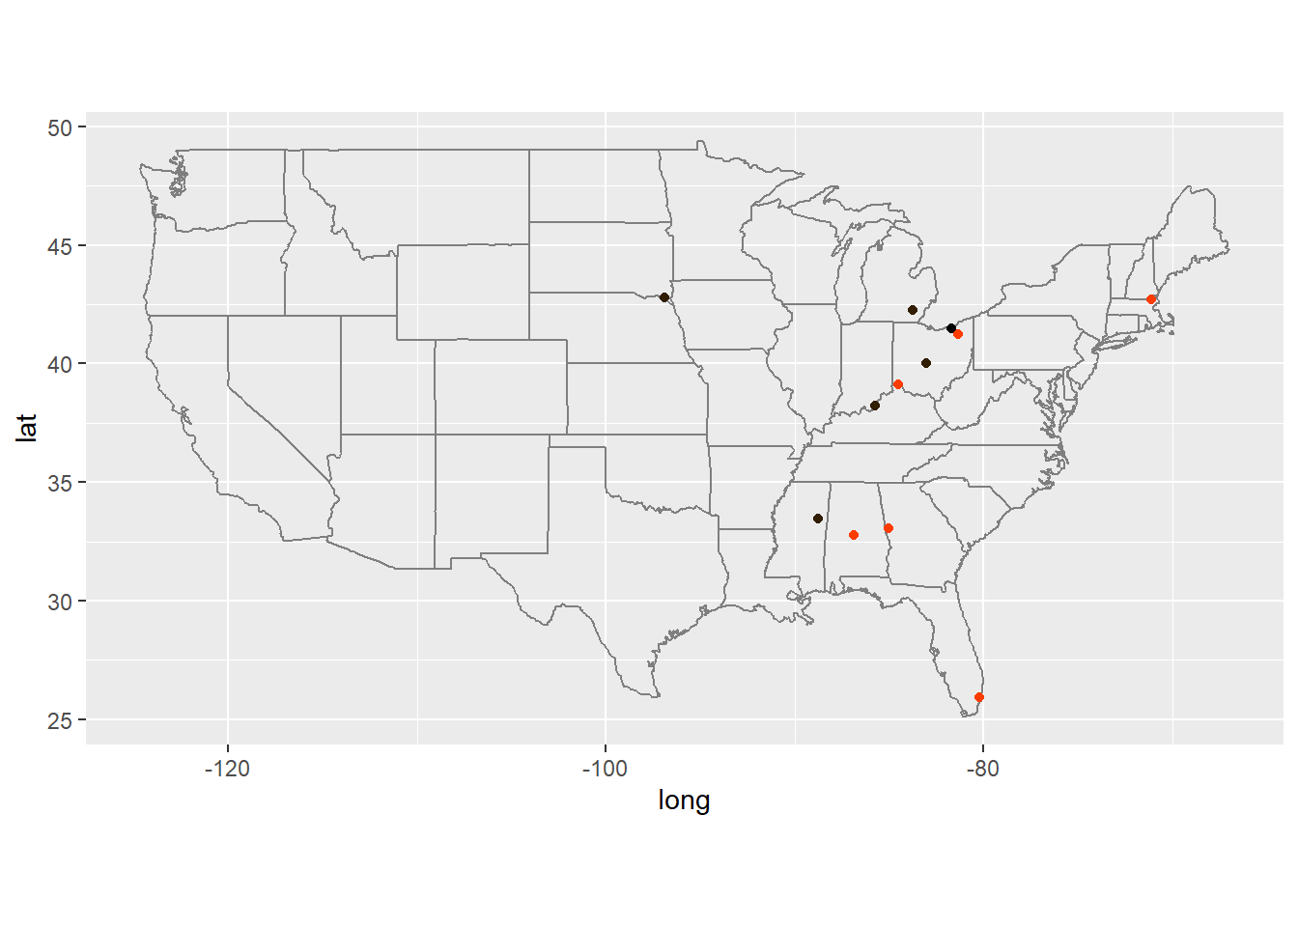
Cleveland Browns
Notes:
Black: Browns
Brown: Alma Maters
Orange: Hometowns
1st Based on Alma Maters
2nd Based on Hometowns
6 Players
2 from Ohio
2nd Round Michael Hall Jr. (Streetsboro & Ohio State)
7th Round Jowon Briggs (Cincinnati & Cincinnati)
Closest Alma Mater: 2nd Round Zak Zinter (Michigan)
Closest Hometown: 1st Round Michael Hall Jr. (Streetsboro, OH)
Furthest Alma Mater & Hometown: 7th Round Myles Harden (South Dakota & Miami Gardens, FL)

Slide 24
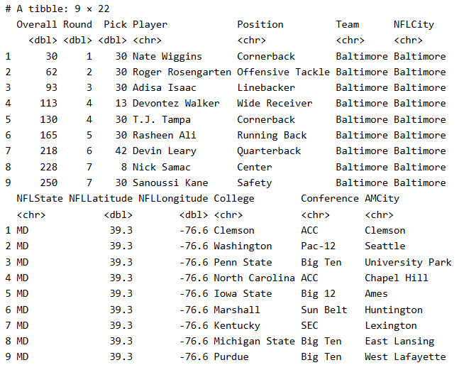
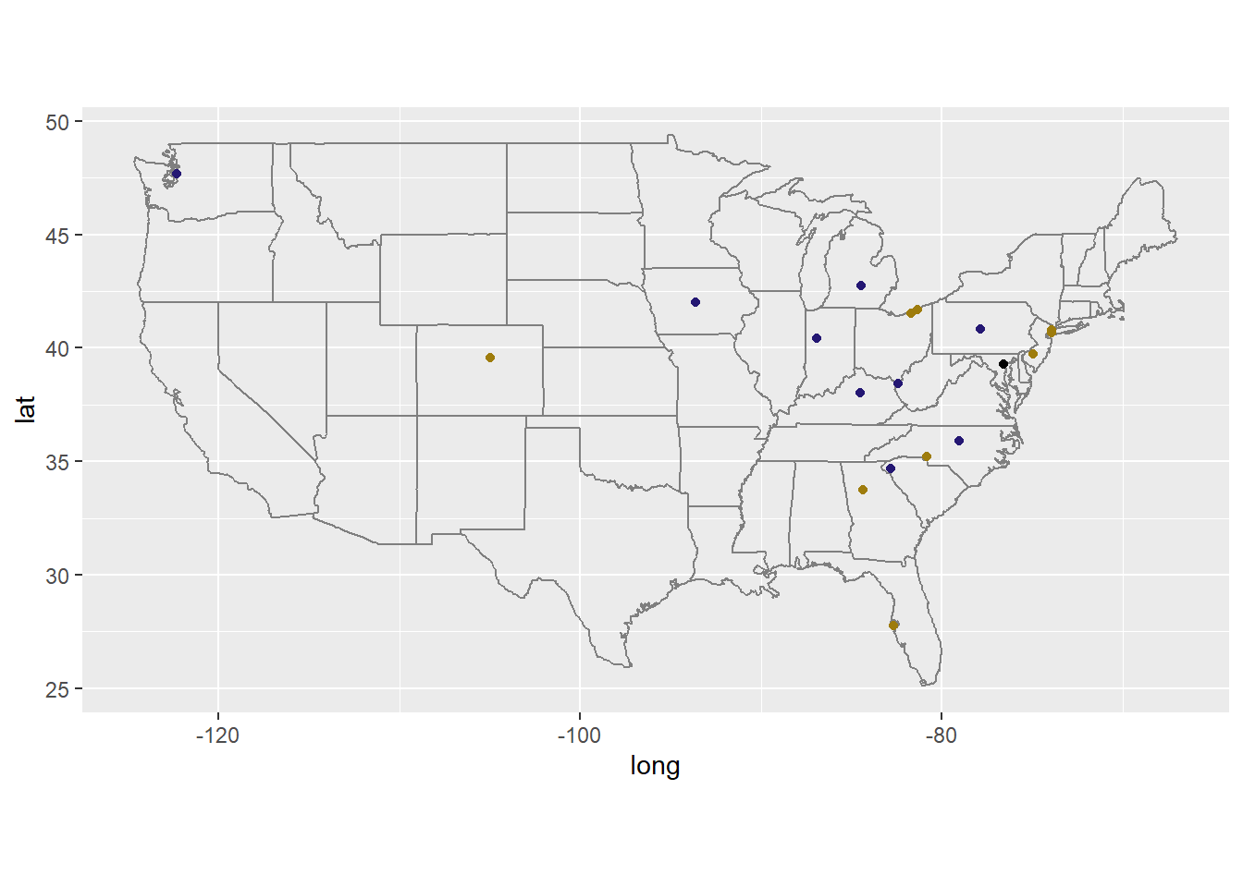
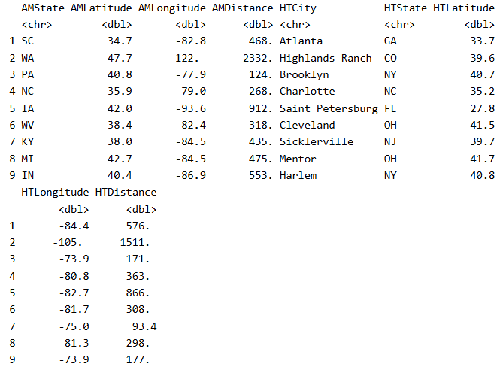
Baltimore Ravens
Notes:
Black: Ravens
Purple: Alma Maters
Gold: Hometowns
1st Based on Hometowns
5th Based on Alma Maters
9 Players
None from Maryland
Closest Alma Mater: 3rd Round Adisa Isaac (Penn State)
Closest Hometown: 6th Round Devin Leary (Sicklerville, NJ)
Furthest Alma Mater & Hometown: 2nd Round Roger Rosengarten (Washington & Highlands Ranch, CO)

Slide 25
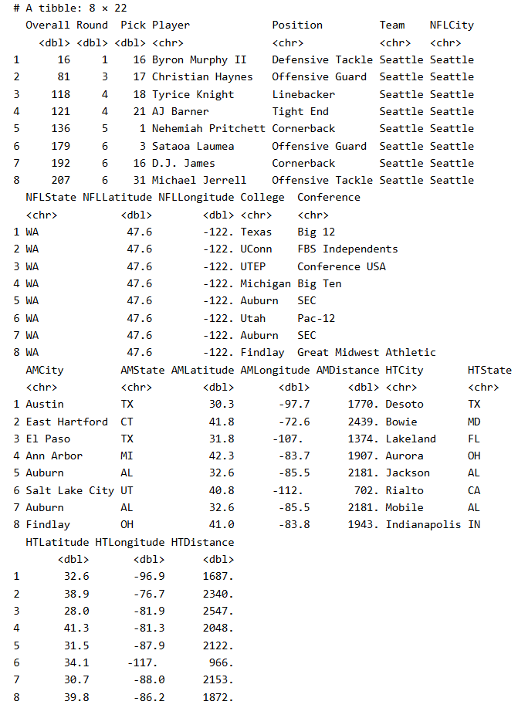
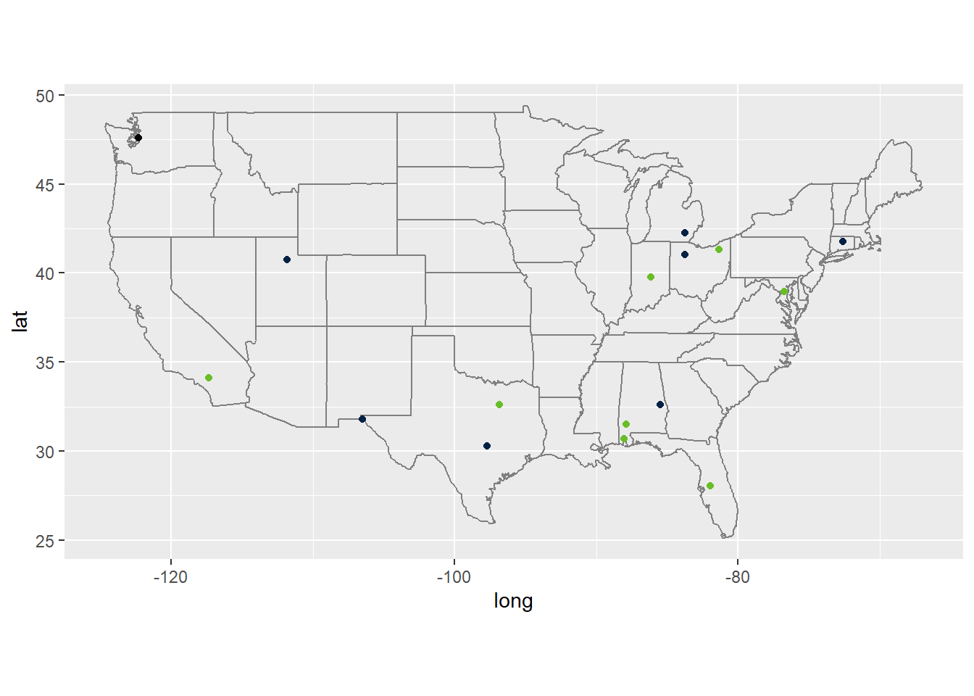
Seattle Seahawks
Notes:
Black: Seahawks
Blue: Alma Maters
Green: Hometowns
32nd Based on Alma Maters
31st Based on Hometowns
8 Players
None from Washington
Closest Alma Mater & Hometown: 6th Round Satoa Laumea (Utah & Rialto, CA)
Furthest Alma Mater: 3rd Round Christian Hayes (UCONN)
Furthest Hometown: 4th Round Tyrice Knight (Lakeland, FL)

Slide 26
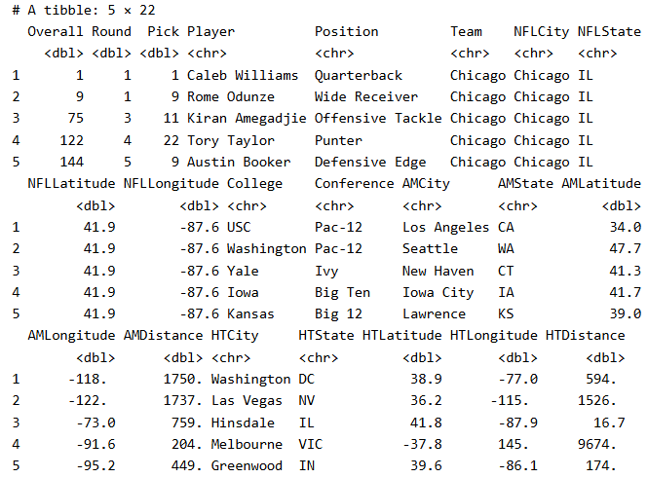
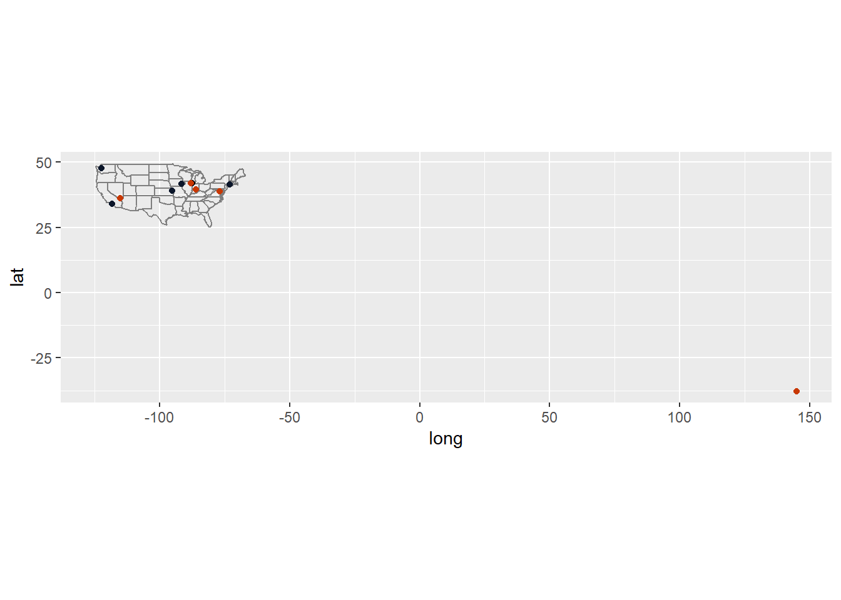
Chicago Bears
Notes:
Black: Bears
Blue: Alma Maters
Orange: Hometowns
32nd Based on Hometowns
17th Based on Alma Maters
5 Players
1 from Illinois Hometown
Closest Alma Mater & Furthest Hometown: 4th Round Tory Taylor (Iowa & Melbourne, VIC)
Closest Hometown: 3rd Round Kiran Amegadjie (Hinsdale, IL)
Furthest Alma Mater: 1st Round Caleb Williams (USC)

Slide 27
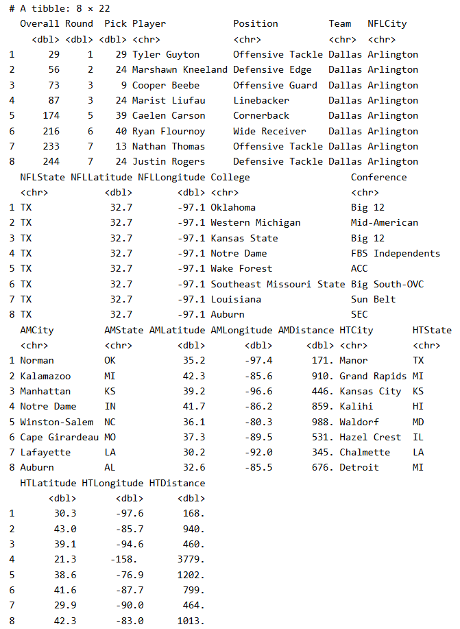
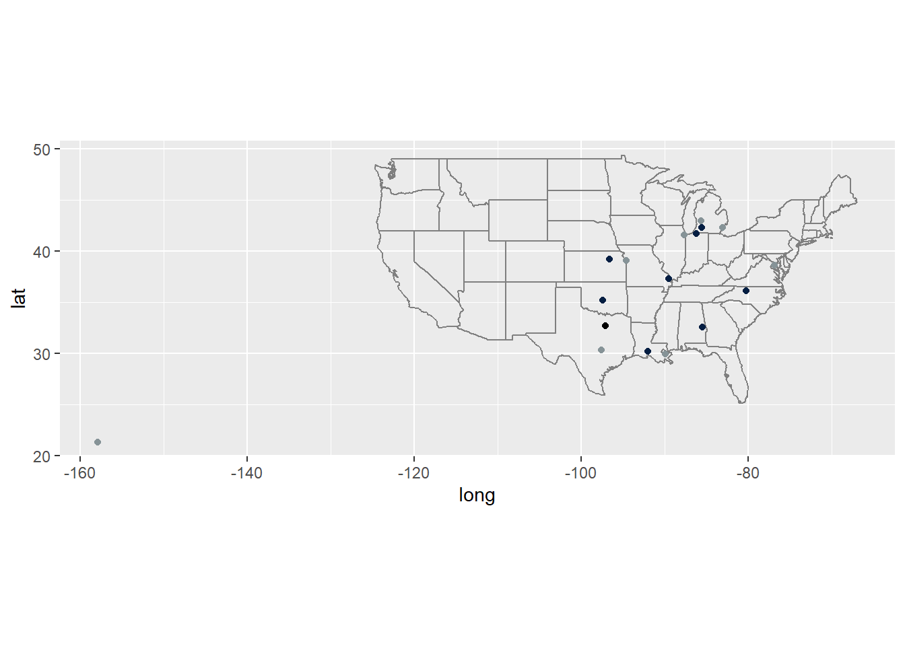
Dallas Cowboys
Notes:
Black: Cowboys
Blue: Alma Maters
Gray: Hometowns
3rd Based on Alma Maters
18th Based on Hometowns
8 Players
1 from Texas Hometown
Closest Alma Mater & Hometown: 1st Round Tyler Guyton (Oklahoma & Manor, TX)
Furthest Alma Mater: 5th Round Caelon Carson (Wake Forest)
Furthest Hometown: 3rd Round Marist Liufau (Kalihi, HI)

Slide 28
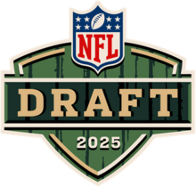
Conclusion
Unfortunately, no definitive conclusions can be made from our analysis of the 2024 NFL draft.
More drafts would have to be analyzed to see if geography has any impact on the NFL draft.
Comparing the results of an analysis on the 2025 NFL draft in April could be interesting.

Slide 29
Sources
Draft Data Set: https://collegefootballdata.com/exporter/draft/picks?year=2024
FBS Data Set:
https://collegefootballdata.com/exporter/teams/fbs?year=2024

