Slide 1
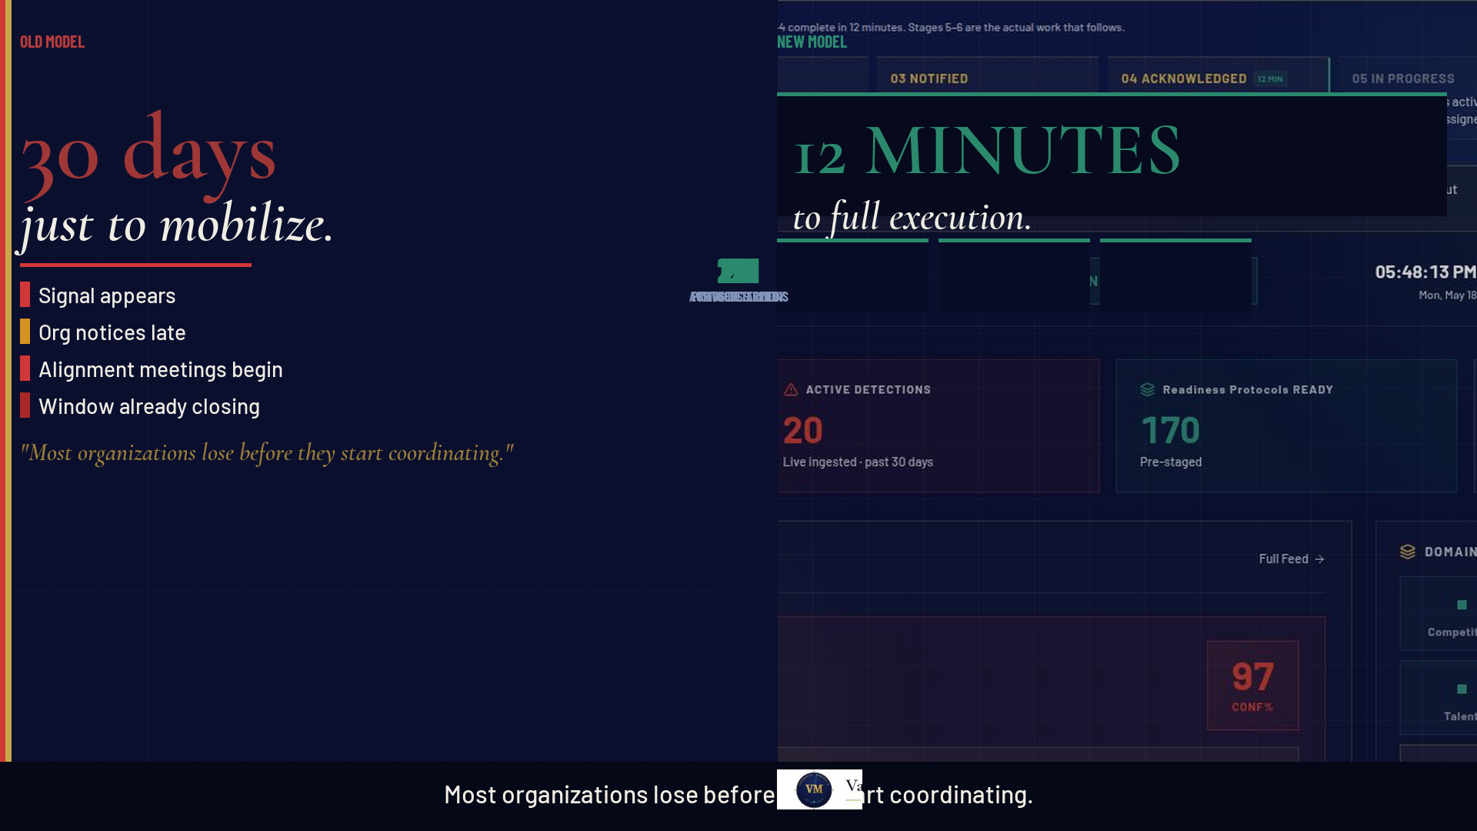
Notes:
FIRST 45 SEC — PAIN + THESIS
Talking points:
• "When a strategic trigger fires in your organization today — who calls who? Where's the brief? Who owns it? Who authorizes?"
• "Most Fortune 1000s spend 30 days figuring that out — while the window closes, the regulator moves, the competitor acts."
• Point to the left: "This is the old model. 30 days just to mobilize."
• Point to the right: "This is Readiness OS. 12 minutes to full execution."
• "The product you're about to see compresses that entire mobilization cycle."
Pause for effect. Let the split visual land.

Slide 2
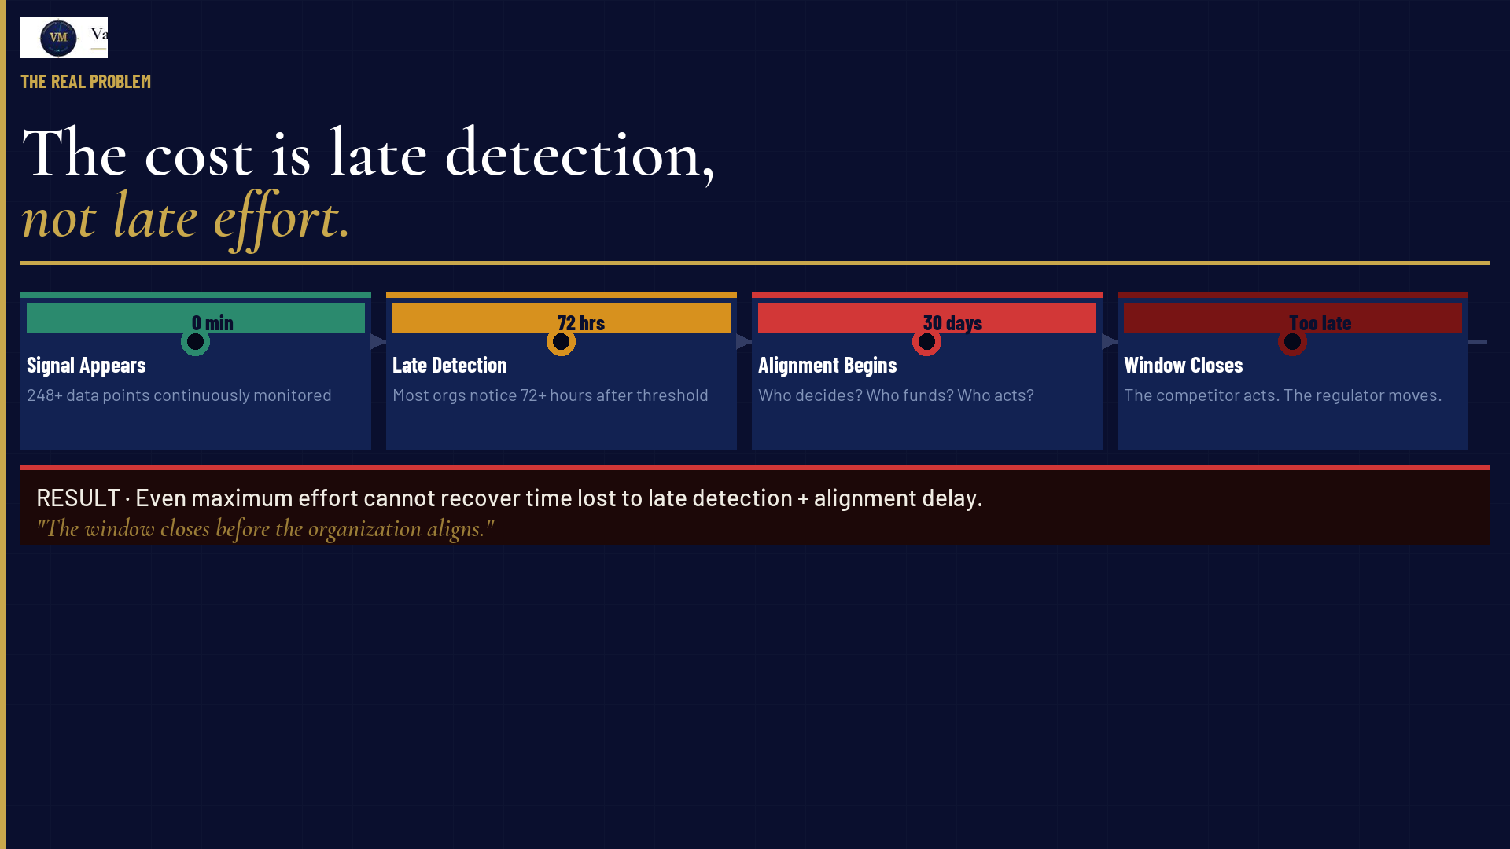
Notes:
FIRST 45 SEC CONTINUED
Talking points:
• "The cost is not effort. Every organization you compete with is trying hard."
• "The cost is late detection plus late alignment. That sequence is lethal."
• Walk through the timeline: Signal → Late Notice → Alignment Delay → Window Closed
• "By the time you're coordinating, you've already lost the best window."
• "We built Readiness OS to eliminate both gaps — detection and alignment — before the trigger fires."
Transition: "Here's how we do it."

Slide 3
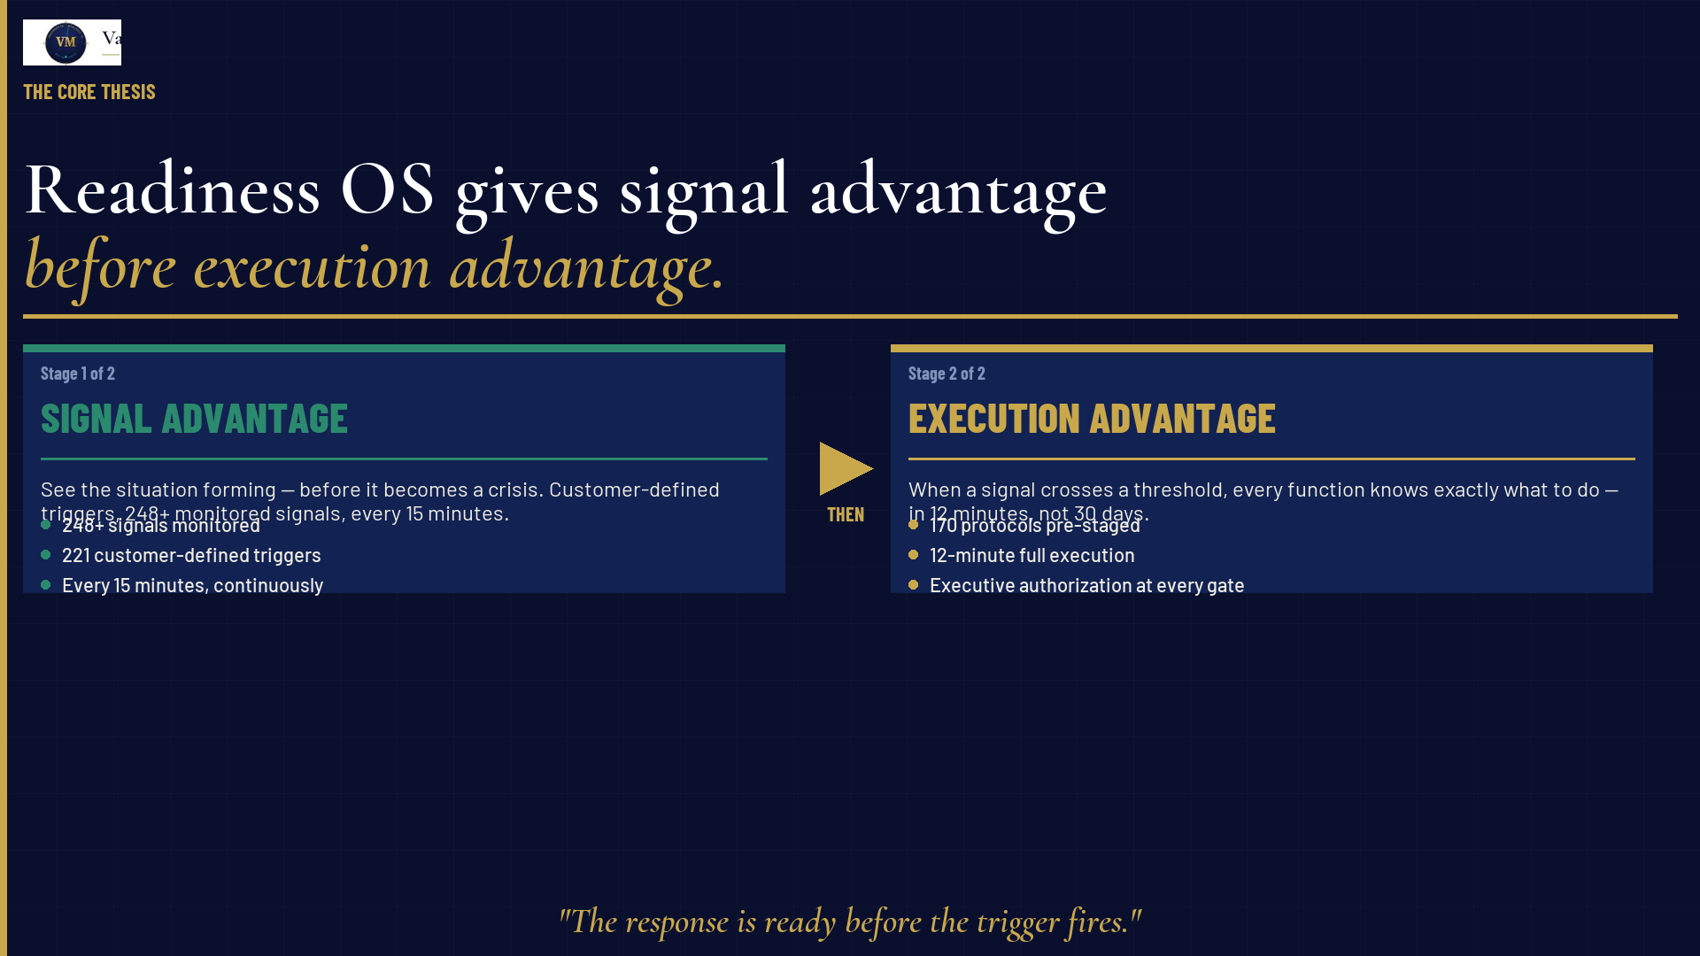
Notes:
FIRST 45 SEC — THESIS LANDING
Talking points:
• "The thesis is two stages. Stage one is signal advantage — see it before others do."
• "Stage two is execution advantage — act in 12 minutes when others take 30 days."
• "But here's the key: signal advantage must come first. You cannot execute what you haven't detected."
• "Readiness OS gives you both. That's the system. Let me show you what it looks like in production."
This must land hard before moving to product slides.

Slide 4
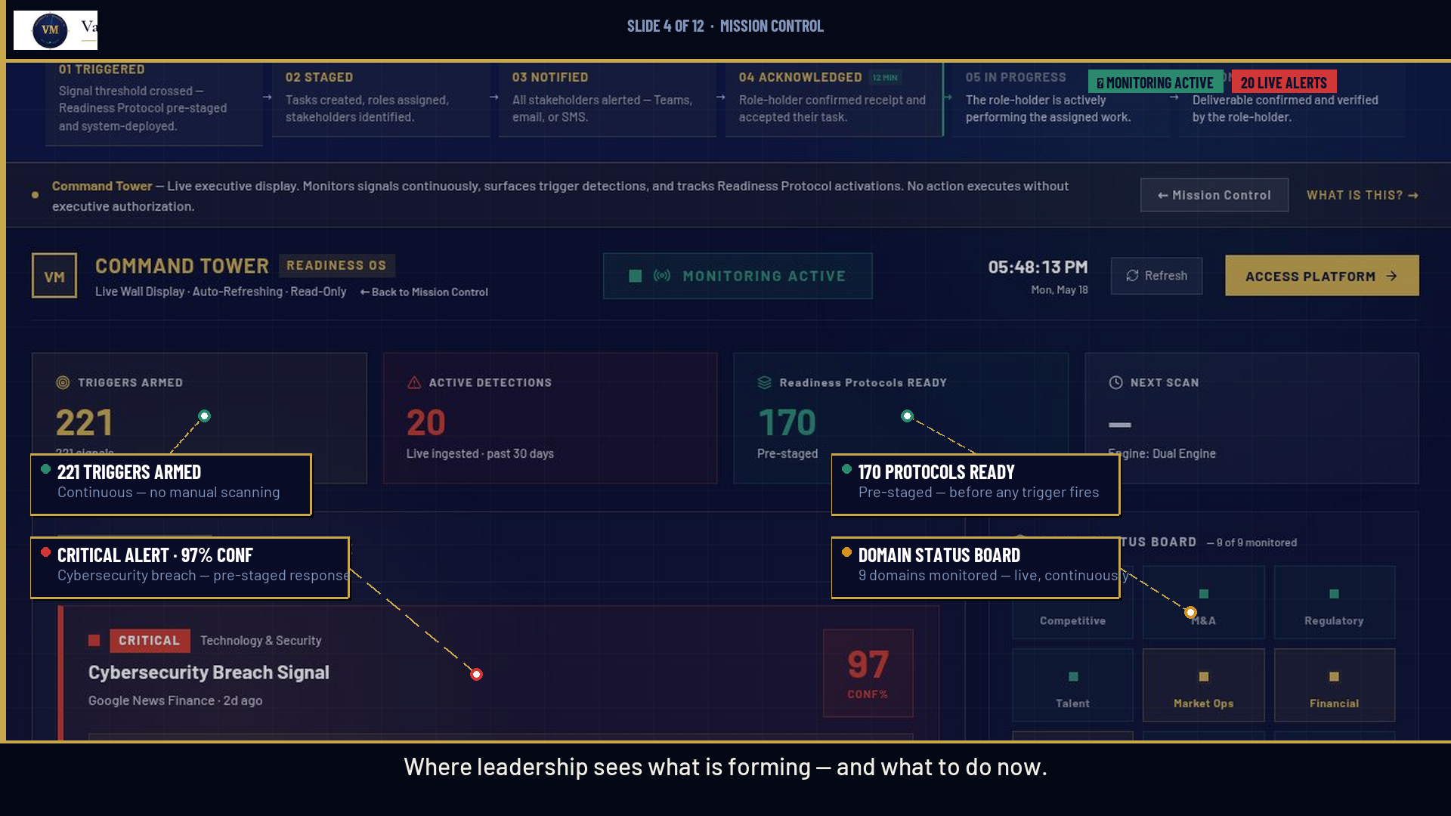
Notes:
NEXT 2 MIN — PRODUCT PROOF
Talking points:
• "This is the Command Tower. The executive display. Live, auto-refreshing, read-only for leadership."
• Point to 221 stat: "221 triggers armed right now. Continuously monitoring."
• Point to CRITICAL alert: "20 active detections. This one — Cybersecurity Breach — 97% confidence. System has already matched it to a Readiness Protocol."
• Point to 170 stat: "170 protocols pre-staged. Ready to deploy on executive authorization."
• "Leadership sees what is forming. And what to do about it. Before the board hears about it elsewhere."
Let the live UI speak. Don't over-explain.

Slide 5
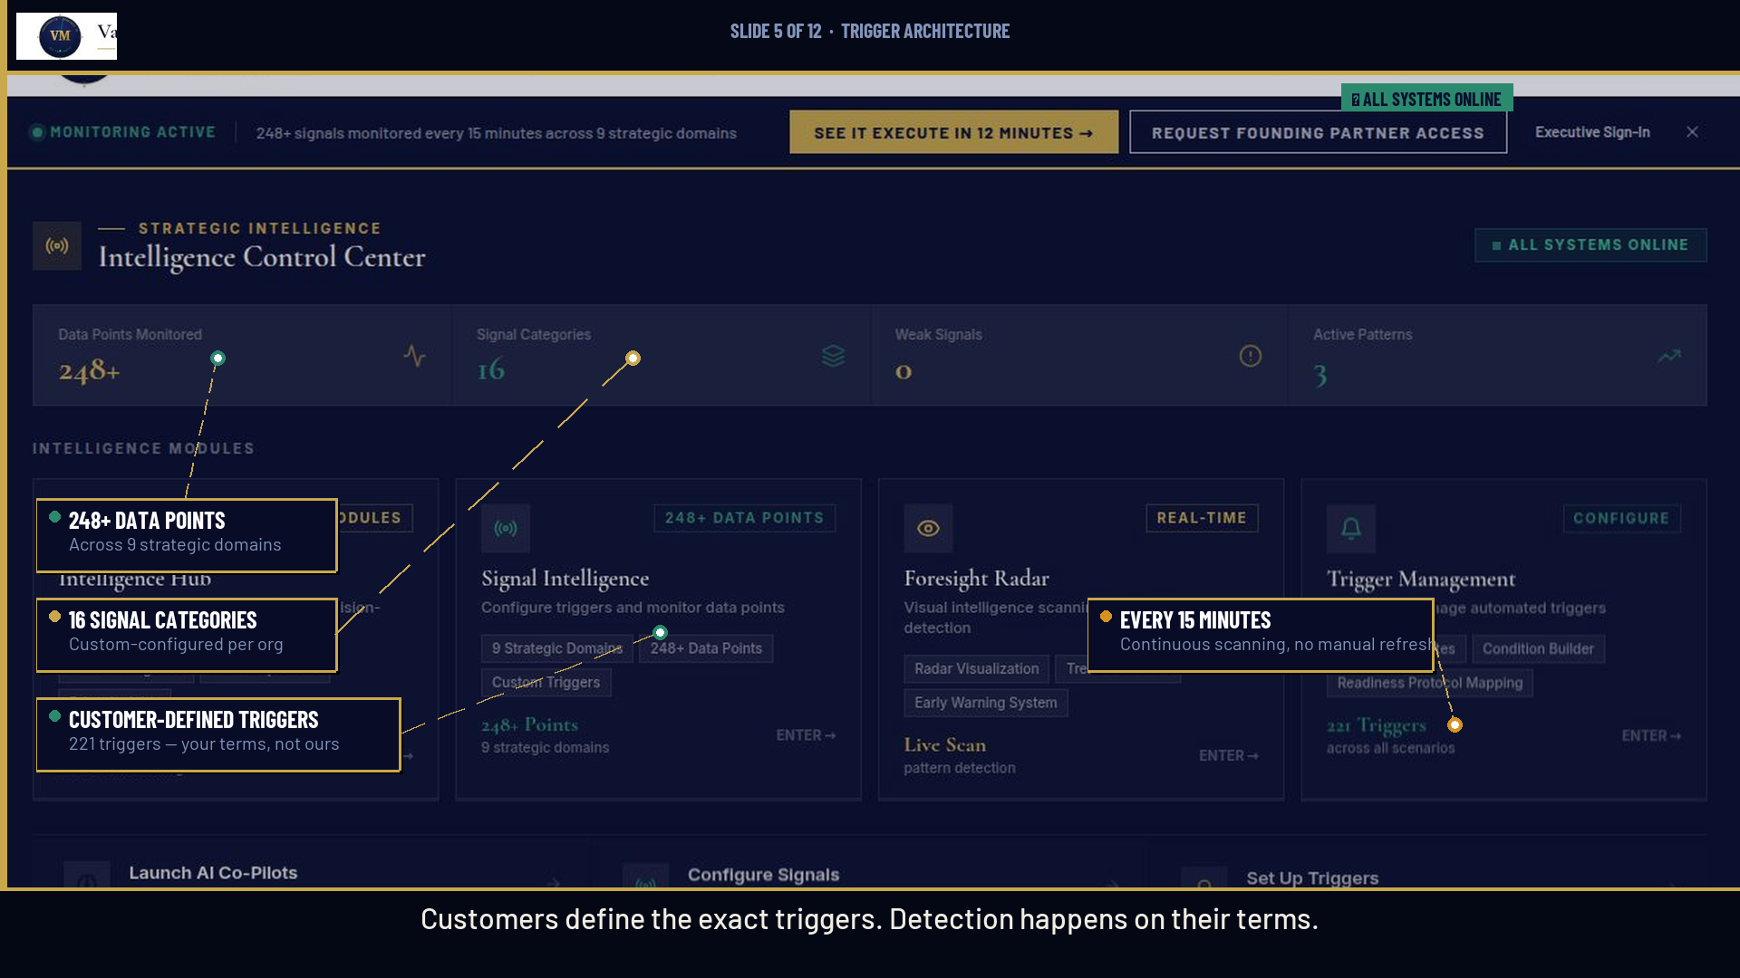
Notes:
NEXT 2 MIN — PRODUCT PROOF CONTINUED
Talking points:
• "Where do these signals come from? The customer defines them."
• "248+ data points monitored. 16 signal categories. Every 15 minutes."
• "The key word is customer-defined. This is not a generic alert system."
• "Organizations configure the exact thresholds, the exact triggers, on their terms."
• "What's material to a $40B manufacturer is not what's material to a $8B healthcare system."
• "They configure it. We monitor it. Continuously."
"Let me show you what happens when a threshold is crossed."

Slide 6
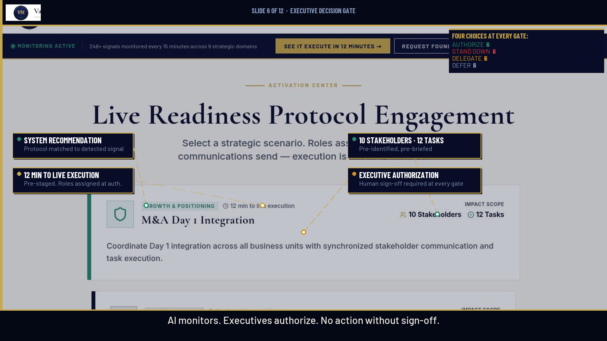
Notes:
NEXT 2 MIN — PRODUCT PROOF CONTINUED
Talking points:
• "When a signal crosses a threshold, the system surfaces a recommendation — but takes no action."
• "The executive sees: here is what's forming. Here is the matched Readiness Protocol. Here are your four choices."
• "Authorize. Stand Down. Delegate. Defer. Human choice at every gate."
• "No action deploys without executive sign-off. Ever. This is not autonomous execution."
• "AI monitors. Executives authorize. That's the governance model."
• "When authorized, this is what happens next."

Slide 7
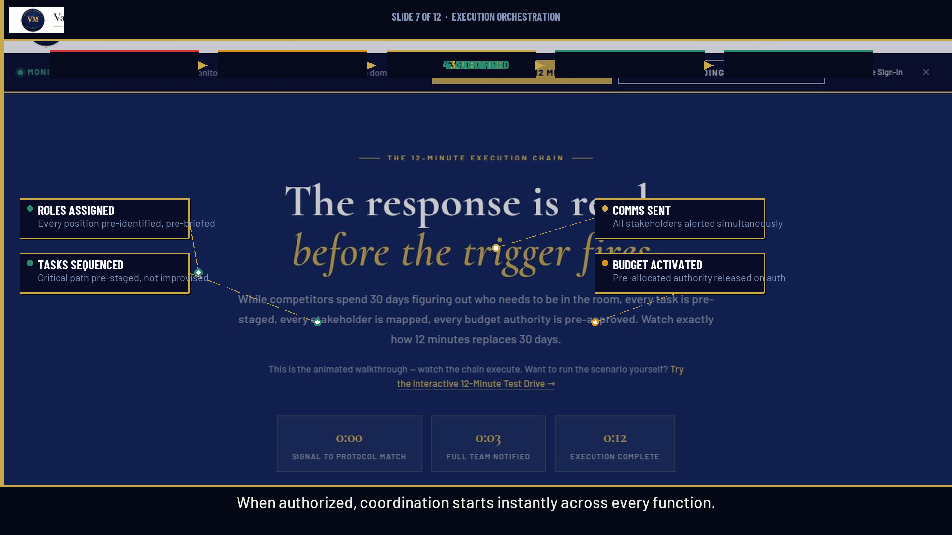
Notes:
NEXT 2 MIN — PRODUCT PROOF CONTINUED
Talking points:
• "Authorization triggers instant coordination across every function."
• "Roles are pre-assigned — not discovered in real-time. Everyone already knows their part."
• "Tasks are sequenced — the critical path is pre-staged, not improvised under pressure."
• "Communications go out simultaneously — teams, email, the Microsoft stack."
• "Budget authority is pre-allocated — no emergency procurement cycle."
• "All of this in 12 minutes. Not 30 days."
"Now let me show you the full architecture — not just one stage of it."

Slide 8
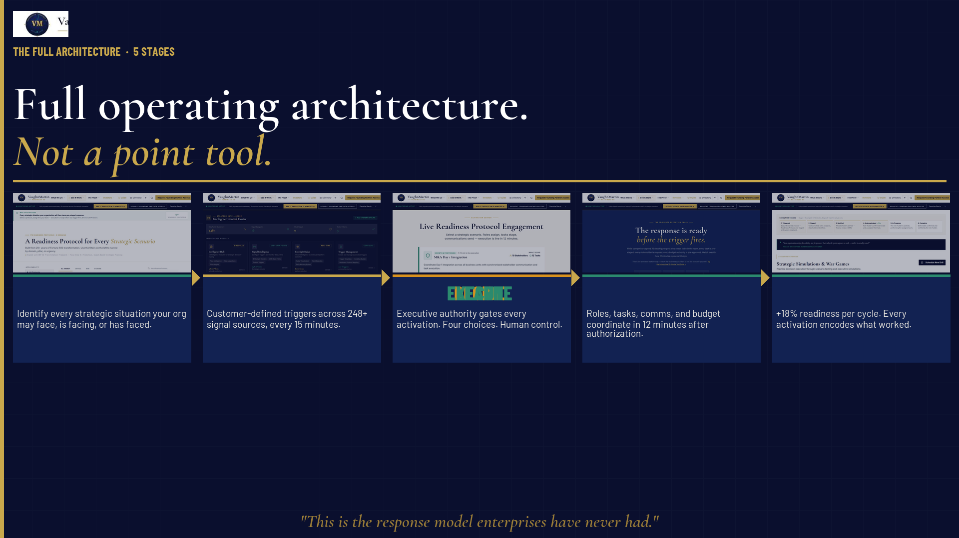
Notes:
NEXT 60 SEC — WHY THIS WINS
Talking points:
• "Most solutions solve one stage. Faster alerts. Smarter summaries. Better notes from the same slow meetings."
• "We built the complete operating cycle: Map → Monitor → Decide → Execute → Learn."
• Walk each stage briefly (5 sec each).
• "This is not a point tool bolted onto the old model. This is the new operating model."
• "And because it's a complete cycle, it gets better with every use."

Slide 9
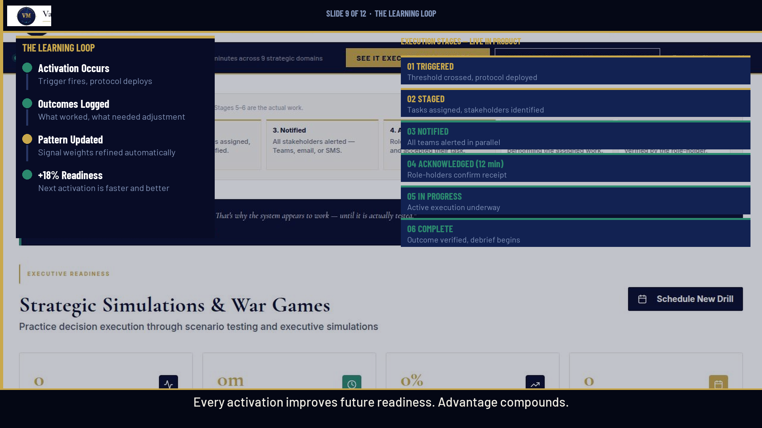
Notes:
NEXT 60 SEC — WHY THIS WINS CONTINUED
Talking points:
• "Every activation encodes what worked. Every cycle, the protocols improve."
• "+18% readiness per activation cycle — measured, not estimated."
• "The organization that runs Readiness OS for 12 months is categorically more prepared than the one that just signed up."
• "This is the compounding moat. No competitor can instantly replicate 12 months of embedded organizational readiness."
• "Let me show you that this is real — not a concept."

Slide 10
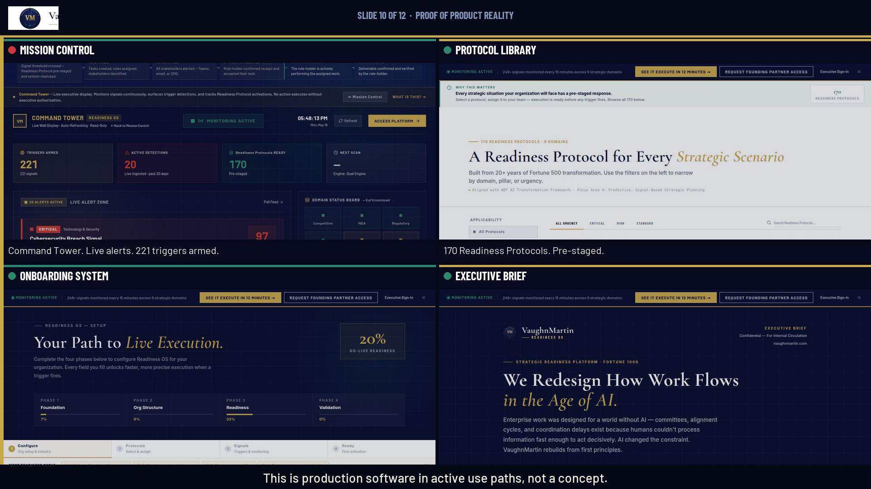
Notes:
NEXT 60 SEC — PROOF LANDING
Talking points:
• "What you're seeing are four live production surfaces."
• "The Command Tower is live. The Protocol Library is live — 170 protocols ready."
• "The onboarding system is live — new partners configure in 4 phases."
• "The Executive Brief is board-ready, one-click, printable."
• "This is not a mockup. Not a demo environment. Production software in active use paths."
• "You can visit vaughnmartin.com right now and walk through it."

Slide 11
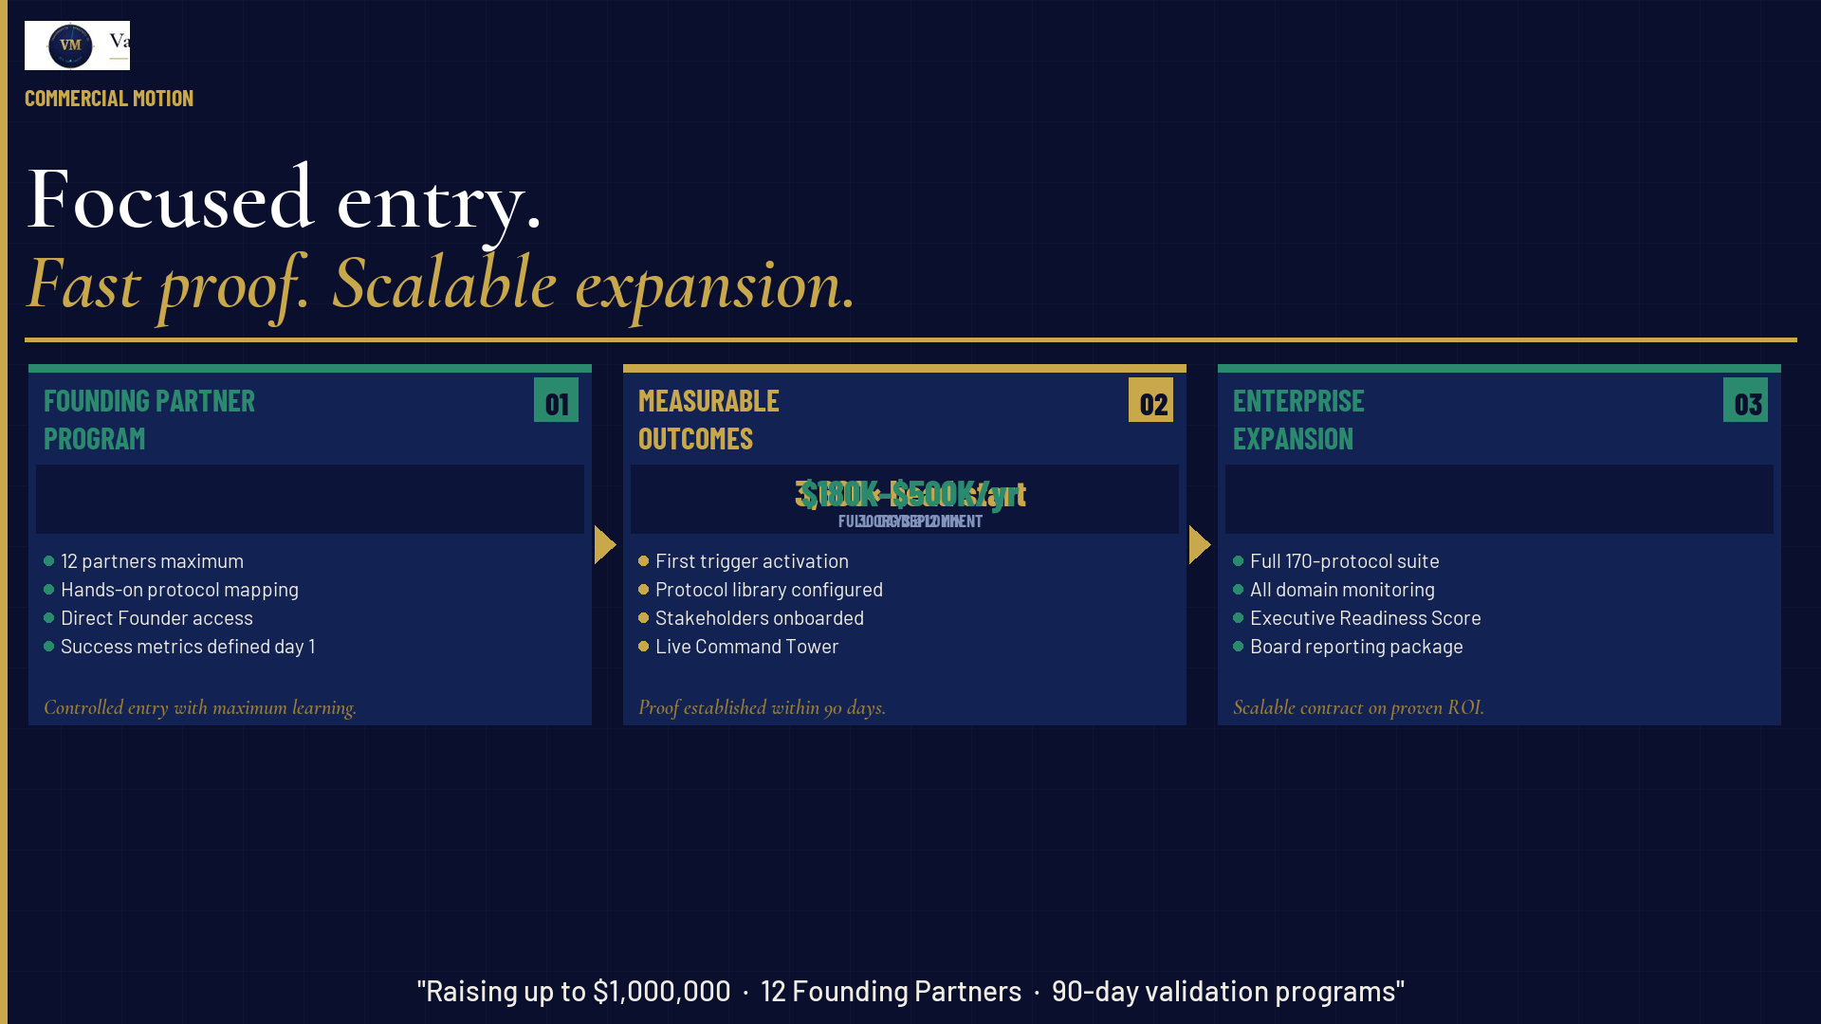
Notes:
FINAL 30 SEC — COMMERCIAL CLARITY + ASK
Talking points:
• "The entry model is disciplined: 12 Founding Partners maximum."
• "90-day validation — we measure outcomes, not intentions."
• "When the 90 days proves the model, the expansion path is clear."
• "We are raising up to $1,000,000 — product hardening, enterprise controls, Founding Partner GTM."
• "Use of funds is precise: not runway, not marketing. Infrastructure."

Slide 12
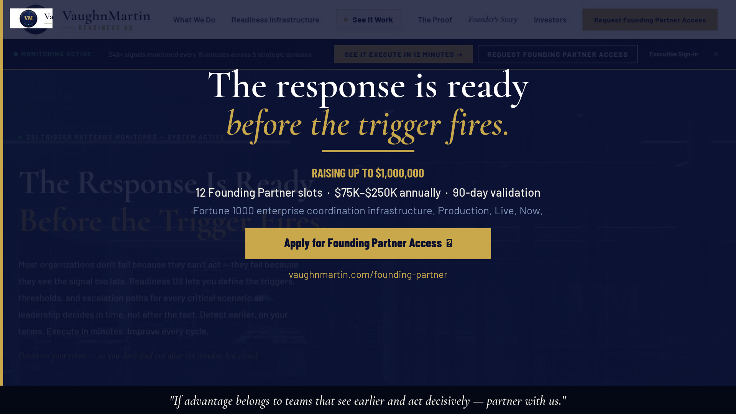
Notes:
CLOSE — THE ASK
Talking points:
• "One line: if your thesis is that advantage belongs to organizations that see earlier and execute decisively — we should talk."
• "The response is already ready. The only question is whether your organization will have it when the trigger fires."
• [Pause]
• "12 Founding Partner slots. The program closes when they're full."
• "vaughnmartin.com/founding-partner — or reach me directly after this session."
Choreography: Make eye contact. Let the line land. Don't rush to the URL.

