Slide 1

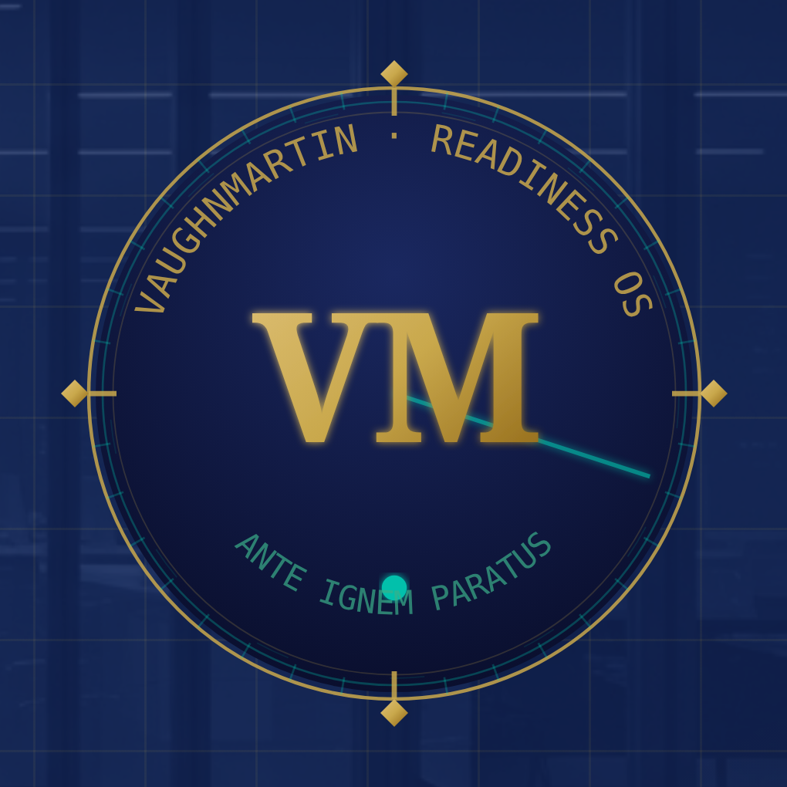
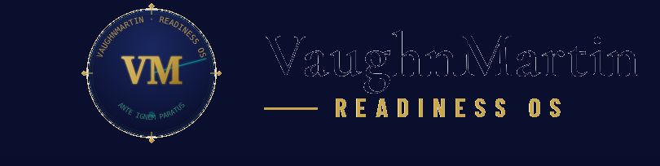
● MONITORING ACTIVE · 1 SIGNAL DETECTED · SYSTEM ARMED
The Response Is Ready
before the trigger fires.
Defense + Offense System · Startup to Fortune 500
Preparation Infrastructure for a Volatile World
12 MIN
3,600×
170
221
trigger to execution
execution head start
Readiness Protocols
trigger patterns
INVESTOR BRIEF · MAY 2026 · CONFIDENTIAL
ANTE IGNEM PARATUS
Prepared Before the Fire
REQUEST FOUNDING PARTNER ACCESS →
CONFIDENTIAL · NOT FOR DISTRIBUTION
Notes:
HOOK:
"Every company in your portfolio has an AI stack to process information faster. Yet when a strategic trigger fires, it still takes 30 days of committee meetings to act. We built the operating model that closes that gap permanently — a 3,600× execution head start. The response is pre-staged before the crisis hits."

Slide 2
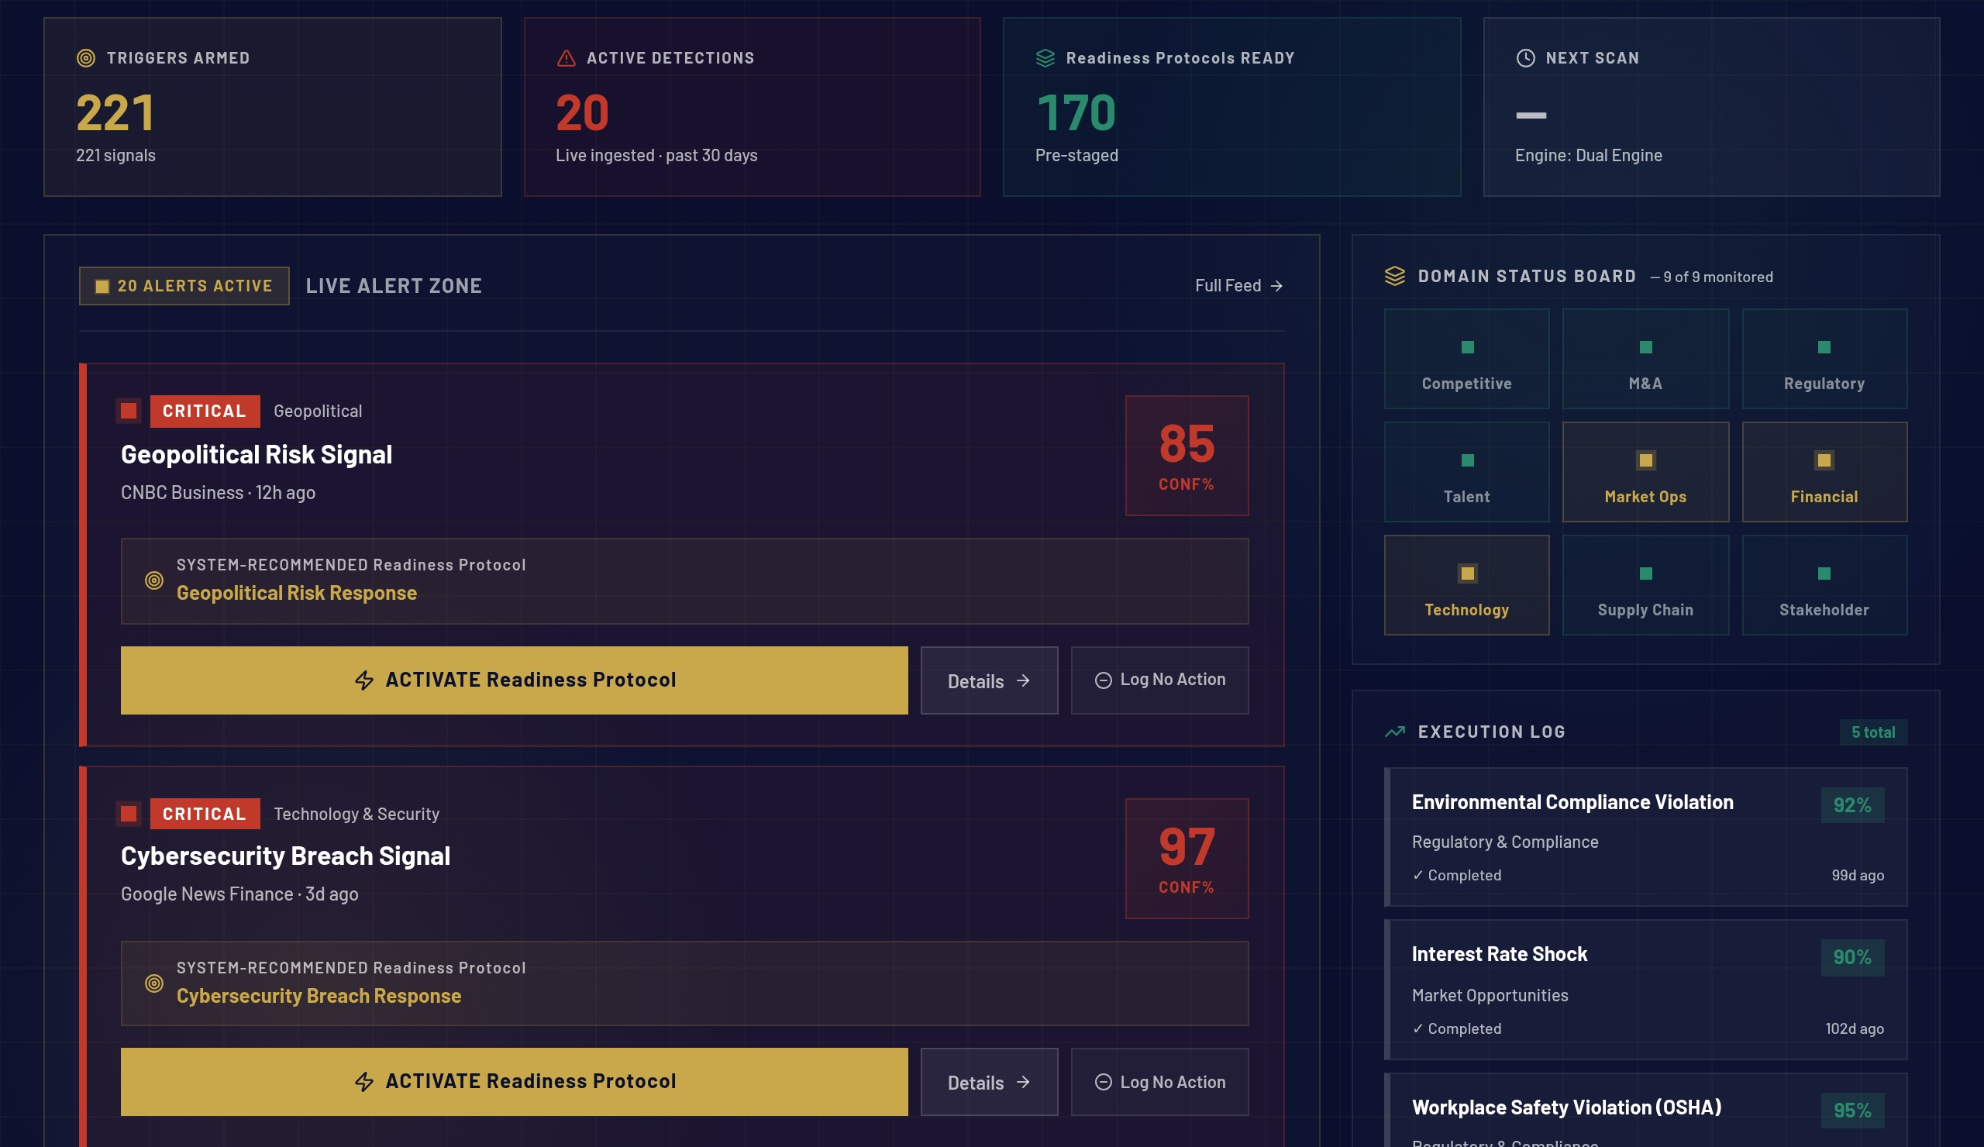
01 / 13
THE PROBLEM
THE 30-DAY
MOBILIZATION BLACK HOLE.
DETECTION
MOBILIZATION
< 1 SEC
30 DAYS
→
Signal identified Pattern matched Protocol staged Score computed
Who decides? Who calls who? Who owns it? Who authorizes?
▸ Startup to Fortune 500 — same trigger, identical 30-day drift
▸ The delay is not execution — it is mobilization architecture
▸ Every day of drift: a window activists, regulators, competitors own
$4.4T COORDINATION FAILURE ANNUALLY
The 30-day mobilization gap is an architecture problem. We eliminate it permanently.
vaughnmartin.com
01 / 13
Notes:
TALK TRACK:
"The market thinks companies have a strategy problem. They don't — they have an architecture problem. Leadership spends the first two to three weeks just figuring out who has authority to make the first move. That 30-day delay is an existential window that activists, regulators, and competitors completely own."

Slide 3
02 / 13
THE OPPORTUNITY
A $42 Billion
coordination failure.
TAM
SAM
SOM
$42B
$4.8B
$180M
Enterprise coordination, governance
Operating model layer for Fortune 5000
5-year capture target across
and execution infrastructure
and PE-backed enterprises
Founding Partner and Growth tiers
Gartner SPM + GRC + EPMO categories
~25K target accounts × $200K avg ACV
600 customers × $300K avg ACV by Y5
Sources: Gartner Strategic Portfolio Management 2025 · McKinsey 2025 coordination cost · WEF × Accenture March 2026
THE MICROSOFT MULTIPLIER
"Every enterprise has Microsoft's AI stack. None have the operating model to use it." — Readiness OS is the operating model layer that sits above the Microsoft investment. Not a replacement. The orchestrator.
vaughnmartin.com
02 / 13
Notes:
TALK TRACK:
"This is a $42 billion market defined by Gartner across SPM, GRC, and EPMO categories — three categories that have never been unified under a single execution layer. We are building that layer. And every enterprise already has the Microsoft investment sitting idle without the operating model to activate it — we are that operating model."

Slide 4
03 / 13
THE FOUNDER
THE ONLY TEAM ALIVE
THAT COULD BUILD THIS.
FORTUNE 500 OPERATIONS · 20+ YEARS
STANFORD UNIVERSITY · FOOTBALL COACHING · 5 YEARS
· Ford · Toyota · Lockheed Martin · Charles Schwab · Vantiv/Worldpay · Boyd Gaming
· Major college football — billion-dollar coordinated operation under pressure
· Watched the 30-day mobilization failure repeat across every vertical
· 40-second play clock — full team response, zero committee meetings
· Same architecture gap — different trigger, identical delay
· The response is pre-staged before the snap — not designed after it
· Built Readiness OS in 2023 to eliminate this pattern permanently
· That preparation discipline is the foundation of the IDEA Framework
MARTY BRUNKE · FOUNDER & CEO · THE INTERSECTION WHERE PREPARATION BECOMES PERFORMANCE
"I spent 20 years at Ford and Lockheed Martin watching the same 30-day mobilization failure repeat. And 5 years at Stanford — 40 seconds to orchestrate a multi-million dollar operation under extreme pressure. You don't huddle after the snap. The response is pre-staged. That's the architecture I built for the enterprise."
vaughnmartin.com
03 / 13
Notes:
TALK TRACK:
"I am the only person at this intersection of depth. You cannot replicate this from a job description. 20 years watching the same mobilization gap across Ford, Lockheed, Charles Schwab. 5 years at Stanford where the 40-second clock is absolute — the response is pre-staged before the snap fires. That discipline is the entire product thesis."

Slide 5
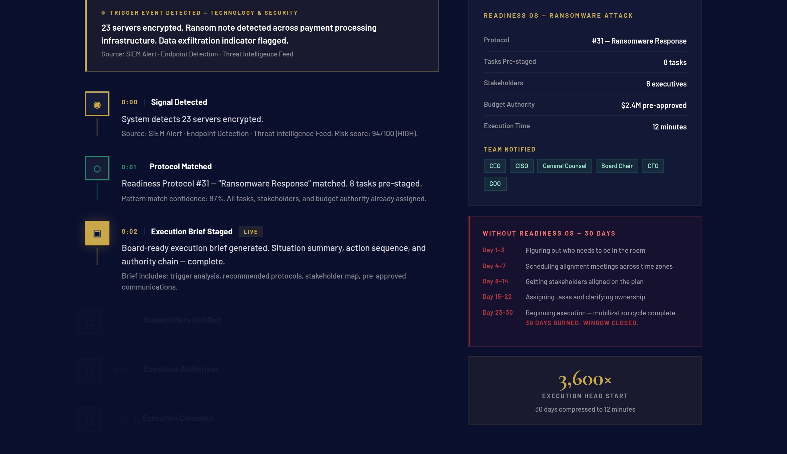
04 / 13
THE PRODUCT
READINESS OS:
THE RESPONSE IS READY
BEFORE THE TRIGGER FIRES.
▸ 170 Readiness Protocols — Growth & Positioning, Risk & Resilience, Transformation
▸ 221 trigger patterns monitored across 8 live data sources every 15 minutes
▸ 248+ data points confidence-scored continuously
▸ AI monitors. Executives authorize. No protocol fires without executive sign-off.
▸ 90-day configuration onboarding — not a consulting project
THE SYSTEM STAGES THE CHOICE IN SECONDS.
THE EXECUTIVE MUST CLICK AUTHORIZE.
"Every enterprise has Microsoft's AI stack. None have the operating model to use it. Readiness OS is that operating model — the orchestration layer above the Microsoft investment."
vaughnmartin.com/how-it-executes
04 / 13
Notes:
TALK TRACK:
"When a ransomware signal hits, in less than 120 seconds the system delivers a board-ready execution brief with pre-approved communication streams and a mapped authority chain. The AI monitors, but humans decide. 30 days of chaos becomes a 12-minute executive sign-off."
KEY: "The system stages the choice in seconds. The executive must click authorize."

Slide 6
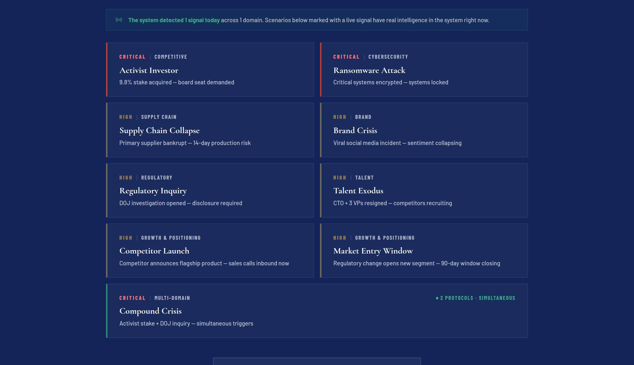
05 / 13
HOW IT EXECUTES
FROM TRIGGER TO
EXECUTION IN 12 MINUTES.
①
Signal detected — confidence-scored against 221 live trigger patterns
②
Matching Readiness Protocol staged — tasks assigned, stakeholders mapped
③
Board-ready execution brief delivered in < 120 seconds — authority chain mapped
④
Executive authorizes — four real choices including Stand Down. No autonomous action.
⑤
Response live — 12 minutes from signal to coordinated organizational execution
3,600× EXECUTION HEAD START
30 days of mobilization compressed to 12 minutes · startup to Fortune 500
"The AI monitors, but humans decide. We turn 30 days of unmanaged chaos into a controlled, 12-minute executive sign-off — with full audit trail and board-ready documentation."
vaughnmartin.com/how-it-executes
05 / 13
Notes:
TALK TRACK:
"The system doesn't autonomously execute. In less than 120 seconds, it delivers a board-ready brief. STEP 4 — four real choices, including Stand Down. Human authority is preserved at every point. AI monitors. Executives authorize. Teams execute."

Slide 7
06 / 13
WHY WE WIN
THE MOAT COMPOUNDS.
COMPETITORS START AT ZERO.
THEY STOP AT ROUTING. WE PRE-STAGE THE ALIGNMENT.
THE MOAT — THREE COMPOUNDING ADVANTAGES
Signal Labs
Routes the signal. Stops before the response is staged.
Compounding Loop
ServiceNow
Async workflow router — post-alignment only. We pre-stage the alignment itself.
Every activation encodes what held. Preparation compounds — the platform gets smarter at your org's specific trigger patterns.
Microsoft Copilot
Produces intelligence. We pre-stage the org response to it.
McKinsey
Arrives after the trigger fires. We were ready before the first call.
Org Context Intelligence
Signal confidence + preparedness score unique to each org. Not replicable. Not transferable.
Encoding Permanence
18 months of activations creates an intelligence layer competitors cannot replicate on day one — or day 365.
"They track the work. We engineer the capability to do it. And the data moat becomes completely uncatchable by month 18."
vaughnmartin.com
06 / 13
Notes:
KEY LINE: "Signal Labs routes the signal. ServiceNow runs the workflow. McKinsey arrives after the trigger. VaughnMartin had the response pre-staged before any of them were called — and the data moat becomes uncatchable by month 18."

Slide 8
07 / 13
BUSINESS MODEL
PRICING TIERED.
EXPANSION BUILT IN.
Founding Partner
Ready
Responsive
Orchestrated
Validation cohort · 12 seats
SMB and PE-backed startups
Mid-market and Fortune 5000
Global enterprise
$75K
$75K
$150K
$250K
/ 90 days
/ year
/ year
/ year
COHORT FORMING NOW
UNIT ECONOMICS
80%
120%+
5:1
$300K
Target gross margin
Net revenue retention
Target LTV:CAC
Target avg ACV by Year 3
Founding Partner → Growth tier → industry pack add-ons. Same platform. Compounding ACV. Break-even before the second activation.
vaughnmartin.com
07 / 13
Notes:
TALK TRACK:
"Enterprises already burn $400K–$800K on reactive consulting retainers. We replace that spend with software infrastructure at $75K–$250K that compounds. Break-even before the second activation fires — and the $300K average ACV by Year 3 is driven by industry pack expansion on top of the core license, not price increases."

Slide 9
08 / 13
TRACTION & TEAM
BUILT.
LIVE.
VALIDATED.
BUILT — Production Platform
LIVE — Operating Now
VALIDATED — Independent Endorsement
· 208-page components
· vaughnmartin.com in production
· Dr. Kerry Huang — ESI Top 1% Researcher
· 215+ registered routes
· 8-feed signal pipeline live
· 408-firm governance study aligned
· 170 Readiness Protocols seeded
· 15-minute monitoring cycles
· Named publicly on LinkedIn, April 2026
· 189 unit tests passing
· 12 Founding Partner seats forming
· Category language adopted by peers
· 121 E2E tests passing
· $75K / 90-day offer open
· Gartner/McKinsey/WEF sourced market thesis
MARTY BRUNKE · FOUNDER & CEO
20+ years Fortune 500 operations: Ford, Toyota, Lockheed Martin, Charles Schwab, Vantiv/Worldpay, Boyd Gaming.
Five years major college football coaching at Stanford University — origin of the IDEA Framework. Prepare. Practice. Perform fearless. Never give up.
"The intersection where preparation discipline meets enterprise execution — no one else is at this intersection."
vaughnmartin.com
08 / 13
Notes:
TALK TRACK:
"The platform isn't a pitch deck — it's live and testable right now. Pull out your phone: vaughnmartin.com/how-it-executes. And the category validation came unsolicited — Dr. Kerry Huang, ESI Top 1% researcher across 408 firms, publicly endorsed the framework on LinkedIn. The thesis is independently confirmed."

Slide 10
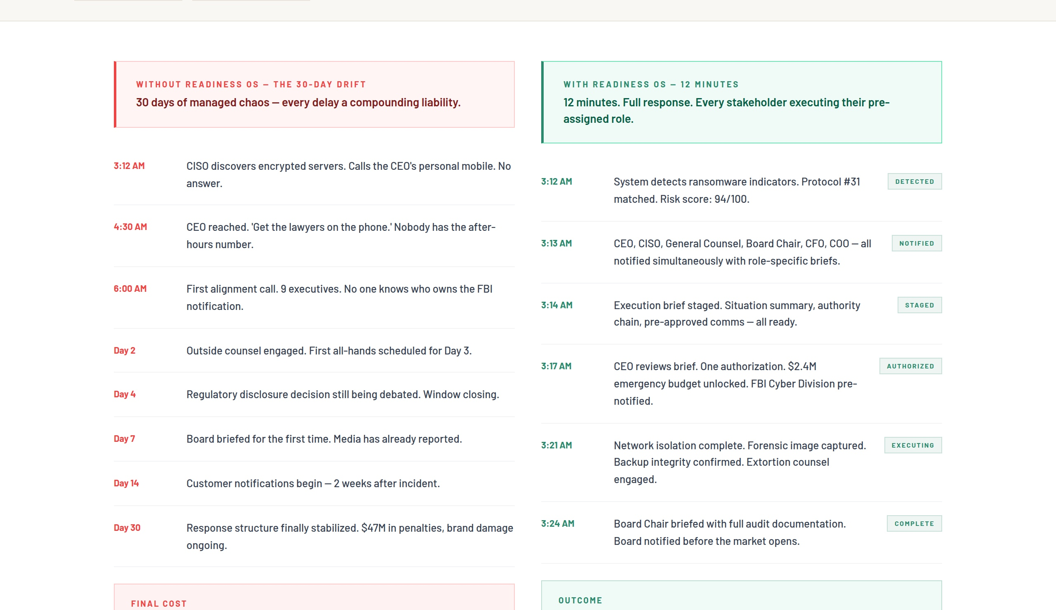
09 / 13
PROOF — NOT ROADMAP
BUILT. LIVE.
IN PRODUCTION NOW.
▸ Production platform live — vaughnmartin.com
▸ 170 protocols active · 221 triggers · 248+ data points scored
▸ 12-Minute Test Drive — 7 scenarios, runnable live right now
▸ Founding Partner cohort open — 90-day validation partnership
▸ Proof Story live — 3 full activation narratives with timelines
"Same trigger. Same company. Entirely different outcome. The only variable: whether the response was pre-staged before the trigger fired."
— vaughnmartin.com/proof-story
PULL OUT YOUR PHONE — THIS IS LIVE RIGHT NOW
vaughnmartin.com/how-it-executes · Run the 12-minute activation chain yourself
vaughnmartin.com/proof-story
09 / 13
Notes:
TALK TRACK:
"Pull out your phone right now. Go to vaughnmartin.com/how-it-executes. Watch the 12-minute execution chain run live. This is not a roadmap — it is live and testable today. The proof story shows the same trigger, same company, entirely different outcome based on one variable: whether the response was pre-staged."

Slide 11
10 / 13
FINANCIAL PROJECTIONS
PATH TO $8M+ ARR
BY YEAR THREE.
YEAR 1
YEAR 2
YEAR 3
$625K ARR
$3.75M ARR
$8M+ ARR
5 customers
30 customers
65 customers
Founding Partner closes
2–3 closes / month
3 closes / month
6-person team
14-person team
22-person team
85% Gross Margin · $125K Land → $175K Expand · 90% Retention · < 12mo CAC Payback · LTV:CAC > 5×
SERIES A TRIGGER · MONTH 18
$3.75M ARR run rate · 30 customers · documented proof stories · Microsoft integration certified · positioned to raise from strength
6 Founding Partners × $75K = $450K validation revenue at Milestone 1 — GTM spend self-funds at milestone 1
vaughnmartin.com
10 / 13
Notes:
TALK TRACK:
"Year 1 is Founding Partner closes — founder-led, very high touch. The ARR trajectory is driven by our expansion motion: $125K land, $175K expand through industry pack add-ons. The Series A trigger is a $3.75M ARR run rate at month 18 — we raise from strength, not desperation."

Slide 12
11 / 13
THE ASK
$750K PRE-SEED.
USE OF FUNDS
TWELVE MONTHS. THREE MILESTONES.
50%
GTM & Founding Partner success
VP Sales, AEs, SDRs — demand gen
M1
Six Founding Partners signed
$450K validation revenue · 90-day cycles
25%
Engineering & industry packs
Platform hardening, integrations
M2
Three Growth tier conversions
$450K ARR run rate at month 9
15%
Infra, security, compliance
M3
$1M ARR run rate by month 12
Enterprise-grade certifications
Series A trigger · raise from strength
FOUNDING PARTNER COHORT · 12 SEATS · FORMING NOW · LIMITED AVAILABILITY
investor@vaughnmartin.com · vaughnmartin.com
10%
Founder + reserves
Operating runway buffer
vaughnmartin.com
11 / 13
Notes:
TALK TRACK:
"$750K pre-seed. Twelve months. Three milestones. Six Founding Partners signed at month 1 self-funds GTM from that point forward — $450K validation revenue in the first 90-day cohort. We hit $1M ARR at month 12 and raise Series A from strength, not desperation. The 12 Founding Partner seats are limited — this is a capacity decision, not a confidence one."

Slide 13
Three lines. That's the pitch.
PROBLEM
Enterprise work was built for a world without AI — coordination delays exist because humans couldn't act fast enough. AI changed the constraint. The operating model hasn't.
SOLUTION
170 Readiness Protocols. 221 strategic triggers. The response pre-staged before the trigger fires. Executives authorize in minutes, not meetings.
OUTCOME
Any organization prepared for every situation it will face is no longer afraid of what comes next. It is fearless.
PREPARATION → READINESS → FEARLESS
investor@vaughnmartin.com · vaughnmartin.com
12 / 13
Notes:
CLOSE:
"PREPARATION → READINESS → FEARLESS.
Any organization prepared for every situation it expects to face is no longer afraid — it is fearless. That is the endpoint. Not speed. Fearless.
The platform is live. 12 Founding Partner seats. Let's build the future of fearless execution together."

Slide 14
PITCH DEFENSE · 3 OBJECTIONS, 3 ANSWERS
TRAP 1 · "Can't ServiceNow just add this?"
"No. ServiceNow is an async ticketing router for post-alignment execution. VaughnMartin pre-stages the organizational alignment itself. They track the work. We engineer the capability to do it."
TRAP 2 · "What about AI taking autonomous action?"
"The system stages the choice in seconds, but an executive must click authorize. No action deploys without explicit sign-off. Four real choices — including Stand Down. Human authority preserved at every trigger."
TRAP 3 · "How long to configure 170 protocols for a new client?"
"They don't build from scratch. VaughnMartin ships 170 out-of-the-box protocols. Onboarding is configuration — not a consulting project. 90 days to live."
PITCH DEFENSE · OBJECTION HANDLING

