Slide 1
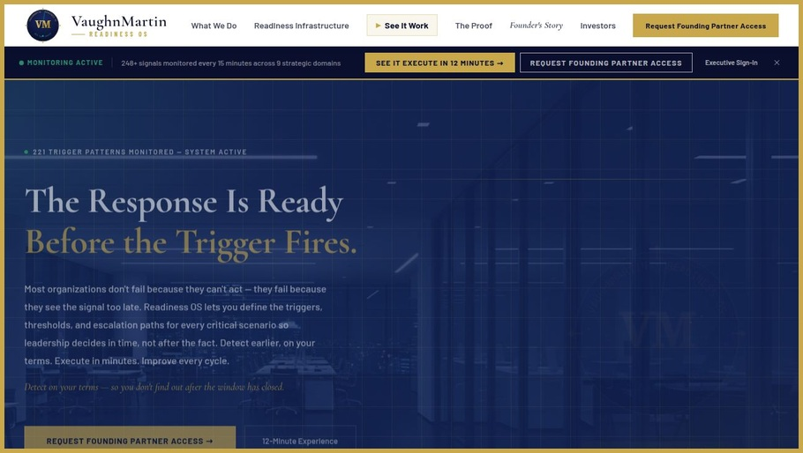
STRATEGIC ADVANTAGE PLATFORM · FORTUNE 1000
VaughnMartin Readiness OS
Signal advantage before execution advantage.
Most organizations lose because they detect too late and coordinate too slowly. Readiness OS gives enterprises a full-cycle advantage: map, monitor, decide, execute, learn.
THE RESPONSE IS READY BEFORE THE TRIGGER FIRES.
The canonical hero — live at vaughnmartin.com
248+
221
170
9
DATA POINTS
TRIGGERS
PROTOCOLS
DOMAINS
"We're not selling another dashboard. We're selling a repeatable advantage system."
VM
VAUGHNMARTIN · READINESS OS
01 · 10
vaughnmartin.com

Slide 2
THE PROBLEM
The window closes before the organization aligns.
DETECTION GAP
Most organizations find out about strategic situations after the optimal window has already moved.
Signals unmonitored · Thresholds undefined · No early warning architecture
MOBILIZATION GAP
Even when detected in time, the first 30 days are spent figuring out who decides, who funds, who acts — before execution even begins.
Who owns response · Who can decide · What gets funded · Who must be notified
RESULT · Find out late. Mobilize slowly. By the time alignment happens, the best window is often gone.
"Failure is usually late detection + late coordination, not effort."
VM
VAUGHNMARTIN · READINESS OS
02 · 10
vaughnmartin.com

Slide 3
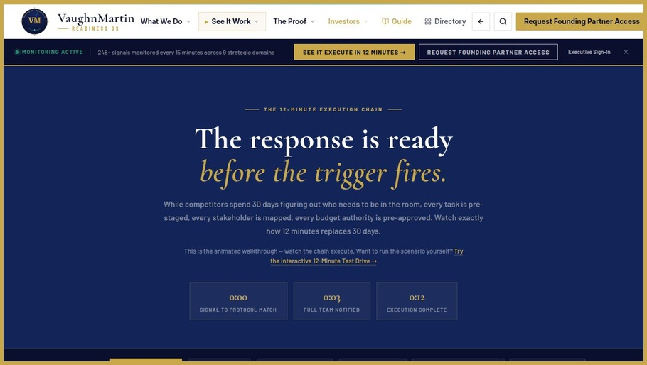
THE ADVANTAGE
See it earlier. Execute in 12 minutes.
Readiness OS delivers compounding advantage:
Earlier signal detection across customer-defined triggers
Faster authorized execution using pre-staged protocols
THE 12-MINUTE EXECUTION CHAIN
Signal → Protocol matched → Team notified → Executive authorizes → Execution live in 12 minutes
Readiness that compounds with every activation cycle
248+
221
170
data points
triggers
protocols
"Speed matters, but timing matters first."
VM
VAUGHNMARTIN · READINESS OS
03 · 10
vaughnmartin.com/how-it-executes

Slide 4
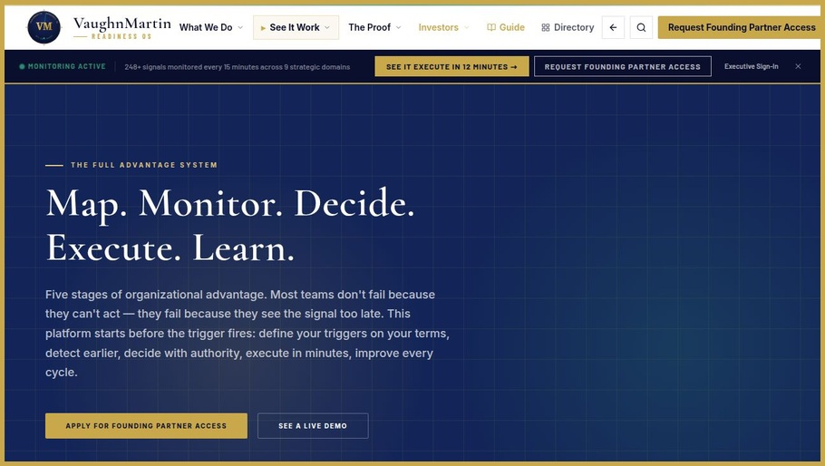
THE PRODUCT SYSTEM · 5 STAGES
Map → Monitor → Decide → Execute → Learn
MAP
Situations faced, facing, may face — defined before pressure arrives.
MONITOR
Trigger & alert architecture on customer terms. 248+ data points, every 15 min.
FULL ADVANTAGE SYSTEM — LIVE IN PRODUCTION
DECIDE
Executive authority at every decision gate. Four choices including Stand Down.
All five stages active. vaughnmartin.com/how-it-executes
EXECUTE
Roles, budgets, PR, comms, tasks — coordinated in 12 minutes.
LEARN
+18% readiness per cycle. Every activation encodes what held.
"This is full operating architecture, not a point solution."
VM
VAUGHNMARTIN · READINESS OS
04 · 10
vaughnmartin.com/how-it-executes

Slide 5
GOVERNANCE · TRUST · CONTROL
AI monitors. Executives authorize.
SIGNAL INTELLIGENCE
EXECUTIVE AUTHORITY
BOARD-READY AUDIT
System surfaces patterns, signal confidence scores, and threshold alerts across 248+ data points — continuously, every 15 minutes.
Humans retain all decision rights. No action deploys without explicit executive authorization. Four choices at every gate, including Stand Down.
Every activation, decision, and outcome is logged, timestamped, and exportable. Full governance trail for board and compliance review.
"We accelerate decision quality without surrendering control."
VM
VAUGHNMARTIN · READINESS OS
05 · 10
vaughnmartin.com

Slide 6
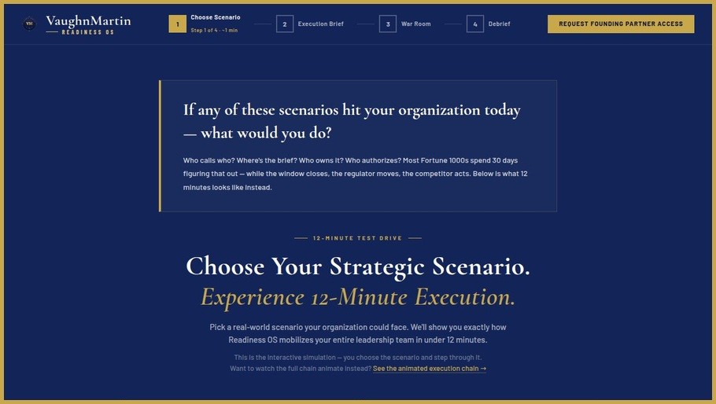
LIVE IN PRODUCTION · TESTABLE NOW
Production platform with guided onboarding is live.
Public product and onboarding flows are active
Users move from discovery to first guided execution path
12-MINUTE TEST DRIVE — PUBLIC
Core surfaces accessible for evaluation, demos, and partner onboarding
Interactive simulation. Choose a scenario. Step through execution. No sign-in required.
Live at vaughnmartin.com — no sign-in required to begin exploration
"This is live, testable software, not slides-only."
VM
VAUGHNMARTIN · READINESS OS
06 · 10
vaughnmartin.com/12-minute-experience

Slide 7
COMMERCIAL MODEL
Founding Partner motion with enterprise expansion path.
INITIAL MOTION
Founding Partner engagement — focused deployment, scenario setup, and measurable readiness outcomes.
$75K – $250K / year · Annual recurring · No per-seat pricing
EXPANSION PATH
Deeper protocol coverage, broader functional adoption, and long-term annual platform relationship inside each account.
Month 6: 3 partners recurring · Month 9: Controls complete · Month 12: Repeatable GTM
"We start focused, prove operational value, then scale inside the account."
VM
VAUGHNMARTIN · READINESS OS
07 · 10
vaughnmartin.com/founding-partner

Slide 8
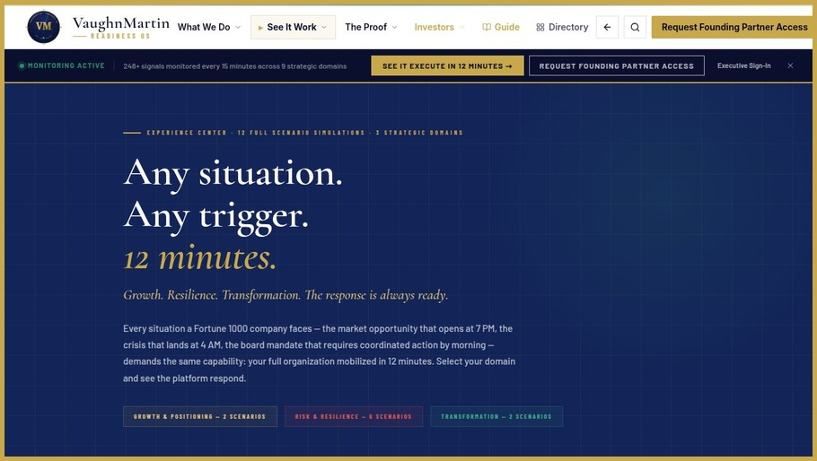
THE TIMING
Volatility increased. Reaction models did not.
Enterprises now face:
Higher signal volume
More situations, faster cycle times, fewer clear windows
ANY SITUATION. ANY TRIGGER. 12 MINUTES.
Tighter decision windows
12 full scenario simulations across Growth, Risk & Resilience, and Transformation.
The gap between signal and consequence is compressing
Greater cross-functional complexity
More stakeholders, same 30-day coordination model
"The environment modernized. The operating model didn't."
VM
VAUGHNMARTIN · READINESS OS
08 · 10
vaughnmartin.com/demo-hub

Slide 9
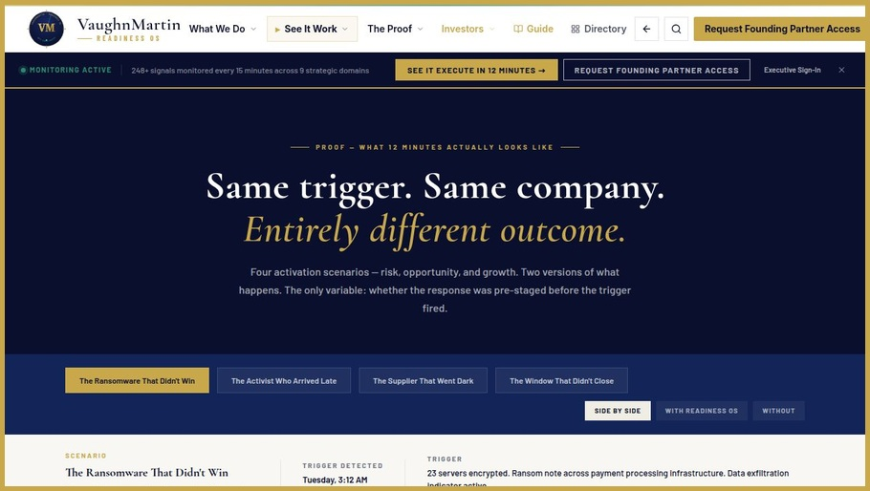
DIFFERENTIATION · THE MOAT
Not just faster response — better operating model.
Full lifecycle
Detection through learning — not just execution speed
Customer-defined triggers
Architecture built on your terms, not generic templates
SAME TRIGGER. ENTIRELY DIFFERENT OUTCOME.
Authority-aware design
$47M in penalties → $0 · 7 weeks disruption → 0 days · −11% stock → +4% recovery
Pre-assigned decision rights — no alignment delay at trigger point
Compounding readiness
Every activation encodes what held. +18% improvement per cycle.
"This is durable infrastructure, not campaign software."
VM
VAUGHNMARTIN · READINESS OS
09 · 10
vaughnmartin.com/proof-story

Slide 10
THE ASK
Partner with us to scale Readiness OS.
THE RESPONSE IS READY BEFORE THE TRIGGER FIRES.
RAISING
Up to $1,000,000
"If your thesis is that advantage belongs to organizations that see earlier and execute decisively — we should talk."
USE OF FUNDS
Product hardening · Enterprise controls · Founding Partner GTM
FOUNDING PARTNERS
12 seats · $75K–$250K/yr · 90-day validation · Annual recurring
vaughnmartin.com/founding-partner
18-MONTH MILESTONES
Mo.6: 3 partners recurring · Mo.9: Controls complete · Mo.12: Repeatable GTM
VM
VAUGHNMARTIN · READINESS OS
10 · 10
vaughnmartin.com/founding-partner

