Slide 1
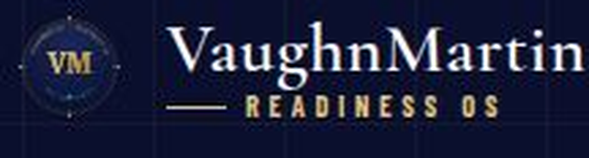
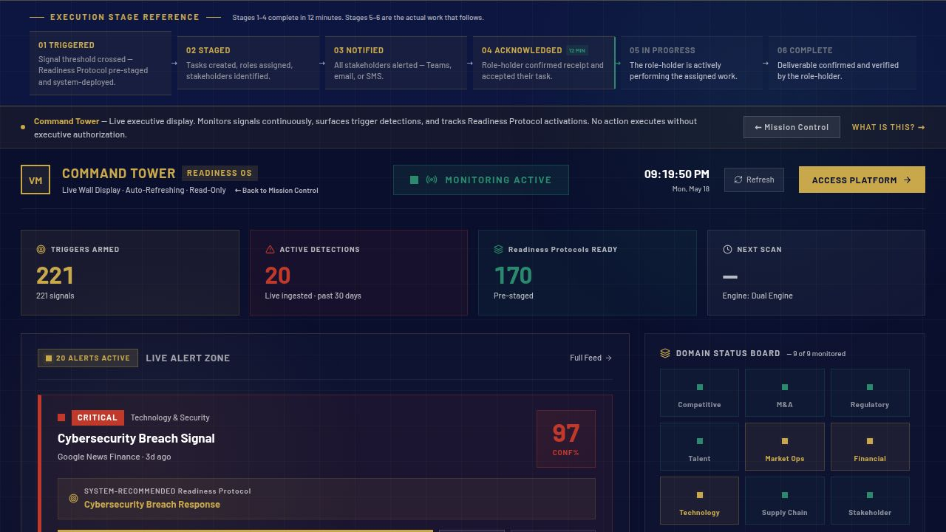
STRATEGIC READINESS PLATFORM · STARTUP TO FORTUNE 500
The response is ready before the trigger fires.
Most enterprises plan to respond. VaughnMartin is already executing.
Activist Investor · 91% confidence
COMMAND TOWER · LIVE SIGNAL MONITORING · PRODUCTION
Ransomware · 95% confidence
Regulatory Inquiry · 87% confidence
AI monitors continuously. Executives authorize decisively. Teams execute.
01 / 13
Notes:
S1 · HOOK · ~15s Every enterprise has the same problem: when a strategic trigger fires — activist investor, ransomware, supply chain failure — they spend thirty days just figuring out who needs to be in the room. We changed that. The response is ready before the trigger fires.

Slide 2
THE REALITY
THE READINESS QUESTION
30
Who calls who? Where's the brief? Who owns it? Who authorizes?
DAYS
This is a readiness problem, not a talent problem.
Average mobilization time before execution begins.
— Coordination restarts from zero at every trigger
— The strategic window closes before execution begins
02 / 13
Notes:
S2 · THE REALITY · ~20s Thirty days. That's not a crisis response — that's the mobilization time before the response even begins. Who calls who? Where's the brief? Who owns it? Who authorizes? This is not a talent problem. It's a readiness problem. And no one has built the infrastructure to solve it — until now.

Slide 3
THE PROBLEM IS ALREADY HERE
One of these is forming in your organization right now
RISK & RESILIENCE
95%
REGULATORY
87%
RISK & RESILIENCE
91%
Ransomware Attack Confirmed
Regulatory Inquiry Opened
Activist Investor
Pressure Filed
Signal · 248 data points
Signal · threshold crossed
Signal · 13D filing detected
221 triggers monitored · 248 data points · refreshed every 15 minutes
03 / 13
Notes:
S3 · PROBLEM IS HERE · ~20s One of these is forming in your portfolio right now. Ransomware at 95% confidence. A regulatory inquiry at 87%. An activist at 91%. The signal is live. The organization is cold. Thirty days of alignment — before a single action is taken.

Slide 4
THE ANSWER
The response is ready
before the trigger fires.
Preparation → Readiness → Fearless
170
221
12 MIN
Readiness Protocols
Strategic Triggers
Execution Window
AI monitors. Executives authorize. Teams execute.
04 / 13
Notes:
S4 · THE ANSWER · ~20s 170 Readiness Protocols. 221 strategic triggers. One operating model. The response is pre-staged before the signal fires. AI monitors continuously. Executives authorize. Teams execute. Twelve minutes from trigger detection to coordinated action.

Slide 5
VaughnMartin
READINESS OS
THE OPPORTUNITY
A $42 billion
coordination failure.
Fortune 5000 enterprises lose 30+ days to mobilization before every strategic event.
TAM
SAM
SOM
$42B
$4.8B
$180M
Enterprise coordination, governance, and execution infrastructure
Operating model layer for Fortune 5000 and PE-backed enterprises
5-year capture target across Founding Partner and Growth tiers
Gartner SPM + GRC + EPMO categories
~25K target accounts × $200K avg ACV
600 customers × $300K avg ACV by Y5
Sources: Gartner Strategic Portfolio Management 2025 · McKinsey 2025 coordination cost · WEF × Accenture March 2026
VaughnMartin · Readiness OS
05 / 13
Notes:
S5 · MARKET OPPORTUNITY · ~25s The enterprise coordination market is a $42 billion problem. We're not competing with Copilot or task software — we're competing with the 40-year-old meeting-heavy operating model itself. Every vendor bolted AI onto the old model. We rebuilt from first principles. Our SAM is $4.8 billion — 25,000 target accounts at $200K average ACV.

Slide 6
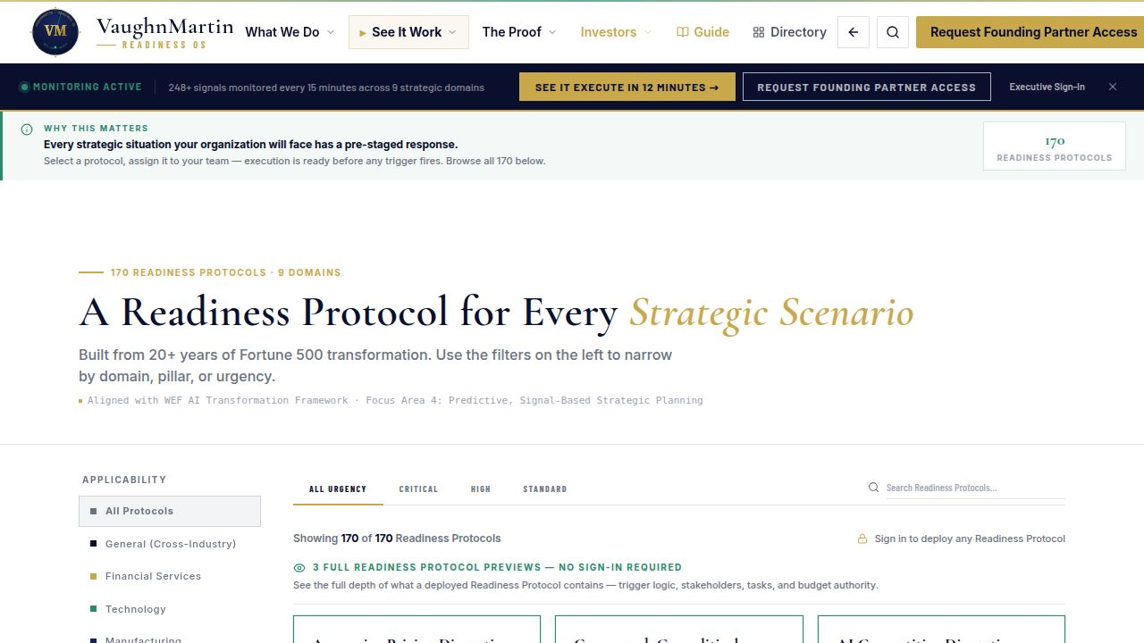
WHY THIS IS DEFENSIBLE
The architecture that separates execution from mobilization
Old Model
VaughnMartin Readiness OS
✕ Faster notes from the same slow meetings
✓ Response pre-staged before the trigger fires
✕ No readiness architecture — triggers catch you cold
✓ 170 protocols · 221 triggers · ready before the moment
✕ Authority unclear when pressure arrives
✓ Executive authorization gate at every activation
✕ 30 days to mobilize before execution starts
✓ 12-minute execution window from signal to action
e.g. Microsoft Copilot · ServiceNow · management consulting retainers
LIVE PLATFORM · 170 Readiness Protocols · startup to Fortune 500 · vaughnmartin.com
06 / 13
Notes:
S6 · WHY DEFENSIBLE · ~20s Every competitor built faster notes from the same slow meetings. We built the layer beneath — the coordination infrastructure that makes mobilization unnecessary. Readiness Protocols replace real-time coordination. Pattern detection replaces committee deliberation. This is not a feature set. It is an operating model shift.

Slide 7
BUSINESS VALUE
Readiness is not overhead.
It is value protection.
3,600×
COMMERCIAL LOGIC
Replaces the $400K–$800K consulting retainer. Break-even before the 2nd activation.
Execution head start — 30 days compressed to 12 minutes
FOUNDING PARTNER
$75K / 90 days
▶ Founding Partner: $75K / 90-day validation
GROWTH TIER
$75K–$250K annually
▶ Growth: $75K–$250K annually
COHORT
startup to Fortune 500
▶ Cost of delay is often higher than cost of readiness.
BOARD LINE
Cost of delay > cost of readiness
07 / 13
Notes:
S7 · BUSINESS VALUE · ~20s 3,600 times. Thirty days compressed to twelve minutes. And the commercial case is simple: the cost of one missed response — one ransomware recovery, one activist campaign managed late — exceeds the cost of this platform many times over. Readiness is not overhead. It is value protection.

Slide 8
VaughnMartin
READINESS OS
BUSINESS MODEL
Pricing tiered.
Expansion built in.
PRICING LADDER
UNIT ECONOMICS
Founding Partner
$75K
/ 90 days
80%
Target gross margin
Validation cohort · 12 seats
Software at scale
Ready
$75K
/ year
120%+
Net revenue retention
SMB and PE-backed startups
Industry pack expansion drives upsell
Responsive
$150K
/ year
5:1
Target LTV:CAC
Mid-market and Fortune 5000
Multi-year ACV, low churn
Orchestrated
$250K
/ year
$300K
Target avg ACV by Year 3
Global enterprise
Up from $150K via tier and pack expansion
Founding Partner → Growth tier → industry pack add-ons. Same platform. Compounding ACV.
VaughnMartin · Readiness OS
08 / 13
Notes:
S8 · BUSINESS MODEL · ~25s We enter at $75,000 for a 90-day Founding Partner validation. The platform expands through tier and industry pack — Ready, Responsive, and Orchestrated at the global enterprise level. Target gross margin: 80%. Net revenue retention: 120-plus percent. Target ACV by year three: $300,000. Expansion is built into the architecture.

Slide 9
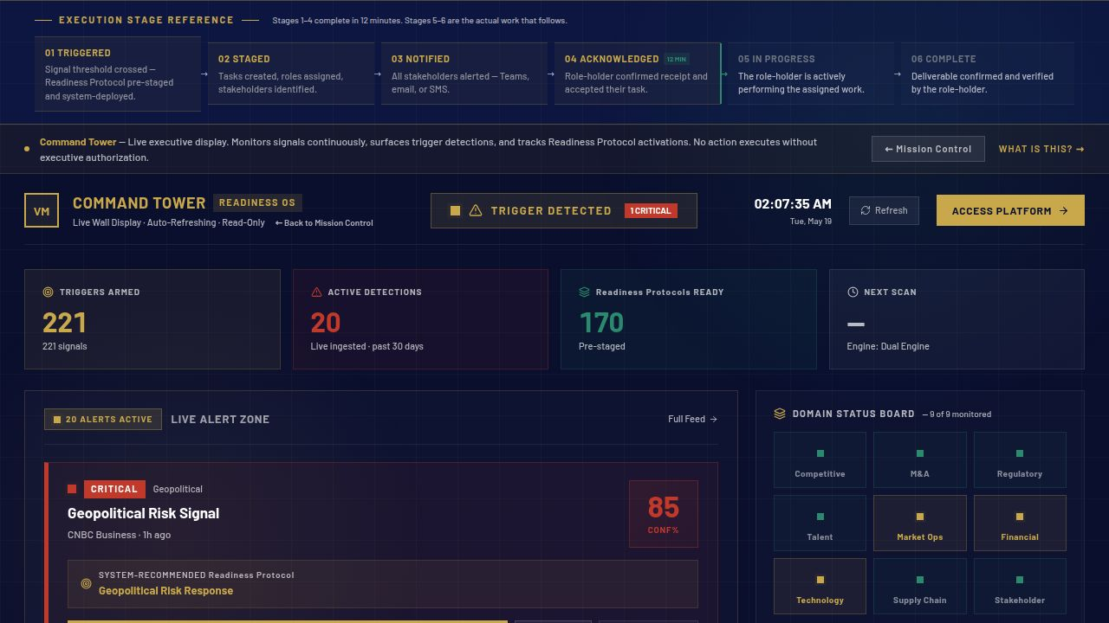
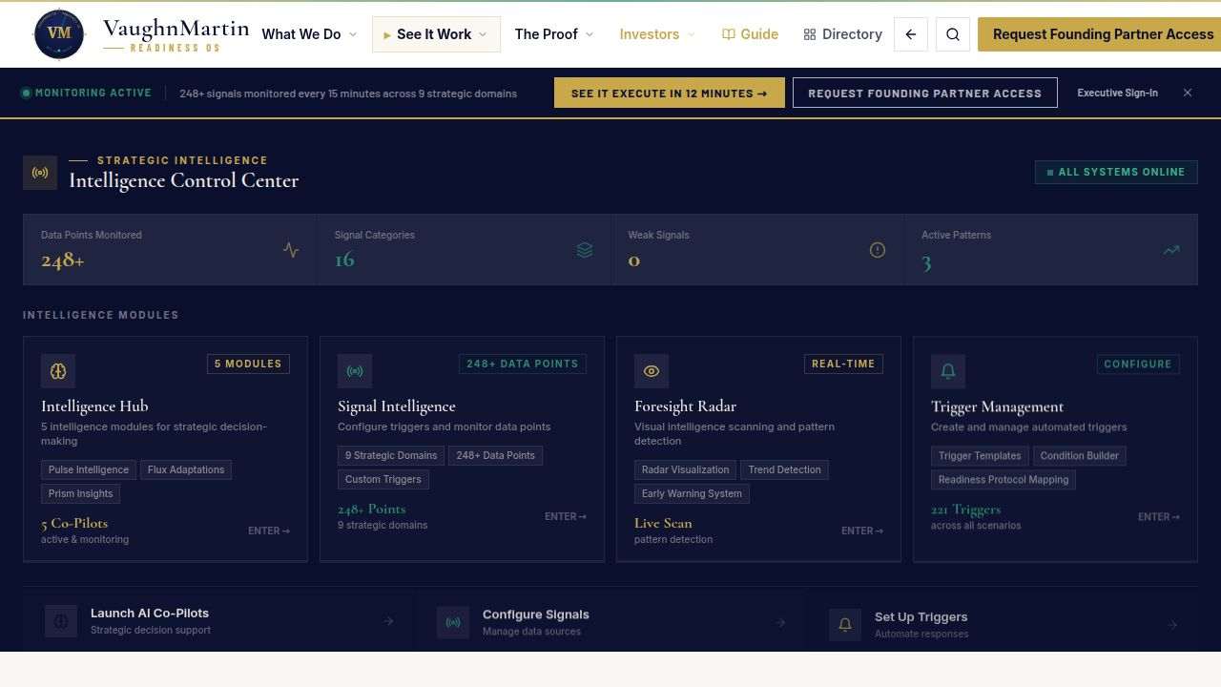
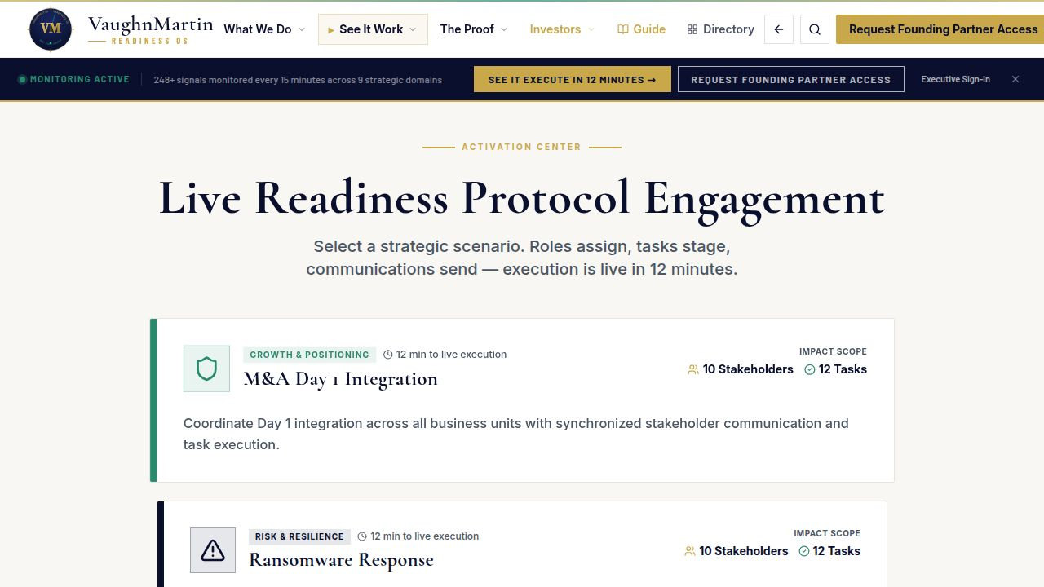
BUILT. LIVE. IN PRODUCTION.
Not a roadmap — operating now
170
221
248
15m
Protocols
Triggers
Data Points
Refresh
Signal Intelligence · Live Detection Feed
Live Activation Console · Execution in Progress
SIGNAL INTELLIGENCE FEED · LIVE DETECTIONS · VAUGHNMARTIN.COM
LIVE ACTIVATION CONSOLE · AUTHORIZED EXECUTION · VAUGHNMARTIN.COM
09 / 13
Notes:
S9 · BUILT. LIVE. IN PRODUCTION. · ~20s This is not a roadmap. The platform is operating now. 170 protocols seeded. 221 triggers active. An 8-feed signal pipeline on 15-minute monitoring cycles. 208 page components. 189 unit tests passing. vaughnmartin.com is live. We are not asking you to bet on a concept.

Slide 10
VaughnMartin
READINESS OS
TRACTION & TEAM
Built. Live.
Validated.
BUILT
LIVE
VALIDATED
Production platform
Operating now
Independent endorsement
208 page components
vaughnmartin.com in production
Dr. Kerry Huang public endorsement
215+ registered routes
8-feed signal pipeline
ESI Top 1% Researcher
170 Readiness Protocols seeded
15-minute monitoring cycles
408-firm governance study aligned
189 unit tests passing
12 Founding Partner seats forming
Named publicly on LinkedIn, April 2026
121 E2E tests passing
$75K / 90-day validation offer open
Category language adopted by peers
FOUNDER
Marty Brunke · Founder & CEO
20+ years Fortune 500 operations: Ford, Toyota, Lockheed Martin, Charles Schwab, Vantiv/Worldpay, Boyd Gaming.
Five years coaching major college football at Stanford. Origin of the IDEA Framework: Prepare. Practice. Perform fearless. Never give up.
VaughnMartin · Readiness OS
10 / 13
Notes:
S10 · TRACTION & TEAM · ~25s I spent twenty years inside Fortune 500 operations — Ford, Toyota, Lockheed Martin, Charles Schwab, Vantiv, Boyd Gaming — watching the same coordination failure repeat. And five years coaching major college football at Stanford, where I watched pre-staged execution work under the most high-pressure conditions in American sport. I built this because I could not stop seeing the gap.

Slide 11
WHY NOW
AI capability is accelerating faster than enterprise readiness.
01
AI capability accelerating. Enterprise mobilization readiness is not.
02
Execution readiness is now the competitive bottleneck.
03
Winners pair signal detection with governed 12-minute execution.
LIVE ACTIVATION CONSOLE · EXECUTION IN PROGRESS · PRODUCTION
Sources: Stanford HAI AI Index 2026 · Gartner Autonomous Business
11 / 13
Notes:
S11 · WHY NOW · ~15s AI capability is accelerating. Enterprise readiness is not. The organizations that pair signal detection with governed 12-minute execution will separate from those still aligning in thirty days. That window is open right now — and it will not stay open.

Slide 12
VaughnMartin
READINESS OS
THE ASK
$750K pre-seed.
Twelve months. Three milestones.
6 Founding Partners × $75K = $450K revenue at M1 — GTM spend self-funds at milestone 1.
M1
M2
M3
Six Founding Partners signed
Three Growth tier conversions
$1M ARR run rate by month 12
$450K validation revenue · 90-day cycles
$450K ARR run rate at month 9
Series A trigger · positioned to raise from strength
USE OF FUNDS
50%
25%
15%
10%
GTM & Founding Partner success
Engineering & industry packs
Infra, security, compliance
Founder + reserves
investor@vaughnmartin.com · vaughnmartin.com · currently in active conversations
VaughnMartin · Readiness OS
12 / 13
Notes:
S12 · THE ASK · ~20s $750,000 pre-seed. Twelve months. Three milestones: six Founding Partners signed, $450K ARR at month nine, $1M ARR at month twelve — Series A trigger from strength. 50% to GTM and Founding Partner success. We are in active conversations. investor@vaughnmartin.com.

Slide 13
Three lines. That's the pitch.
PROBLEM
Enterprise work was built for a world without AI — coordination delays exist because humans couldn't act fast enough. AI changed the constraint. The operating model hasn't.
SOLUTION
170 Readiness Protocols. 221 strategic triggers. The response pre-staged before the trigger fires. Executives authorize in minutes, not meetings.
OUTCOME
Any organization prepared for every situation it will face is no longer afraid of what comes next. It is fearless.
Let's build this · investor@vaughnmartin.com · vaughnmartin.com
13 / 13
Notes:
S13 · CLOSE · ~15s The problem: enterprise work was built for a world without AI. The solution: 170 Readiness Protocols — the response pre-staged before the trigger fires. The outcome: any organization prepared for every situation it will face is no longer afraid of what comes next. That is fearless. Let's build this.

