Slide 1
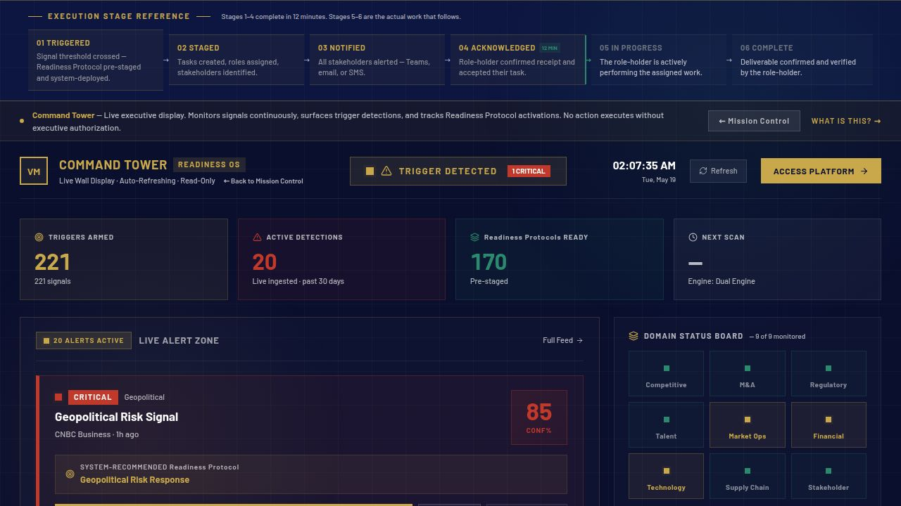
SLIDE 01 · 08
THE PROBLEM
THE TRIGGER FIRES.
MOBILIZATION TAKES 30 DAYS.
▶ Startup to Fortune 500 enterprises detect strategic triggers quickly
▶ Most spend 30 days aligning ownership, authority, and sequence before execution begins
▶ The delay is not execution — it is mobilization
▶ 3,600× — that gap, compressed to 12 minutes
MARKET OPPORTUNITY · Enterprise coordination failures put an estimated $4.4T in annual value at risk. Preparation Infrastructure is the unclaimed software layer above every existing AI stack.
"Most organizations do not have a strategy problem. They have a mobilization problem. When a trigger fires, the first weeks are spent figuring out who decides and who owns the response."
VaughnMartin · READINESS OS
vaughnmartin.com

Slide 2
SLIDE 02 · 08
THE FOUNDER
BUILT FROM BOTH WORLDS.
FORTUNE 500 OPERATIONS · 20 YEARS
STANFORD UNIVERSITY · 5 YEARS
· Ford · Toyota · Lockheed Martin
· Major college football — billion-dollar operation
· Charles Schwab · Boyd Gaming
· 40-second play clock — full organizational coordination
· Watched the 30-day mobilization failure repeat across every org
· Every response pre-staged before the trigger fires
· Same preparation gap — different trigger, same delay
· Preparation architecture built before game day
· Built Readiness OS in 2023 to end that pattern permanently
· The preparation IS the execution
THE INTERSECTION — WHERE PREPARATION DISCIPLINE MEETS ENTERPRISE EXECUTION FAILURE
"Very few people get exposure to both worlds at the depth where those lessons translate directly into each other. I did. And I built the infrastructure that closes the gap permanently."
VaughnMartin · READINESS OS
vaughnmartin.com

Slide 3
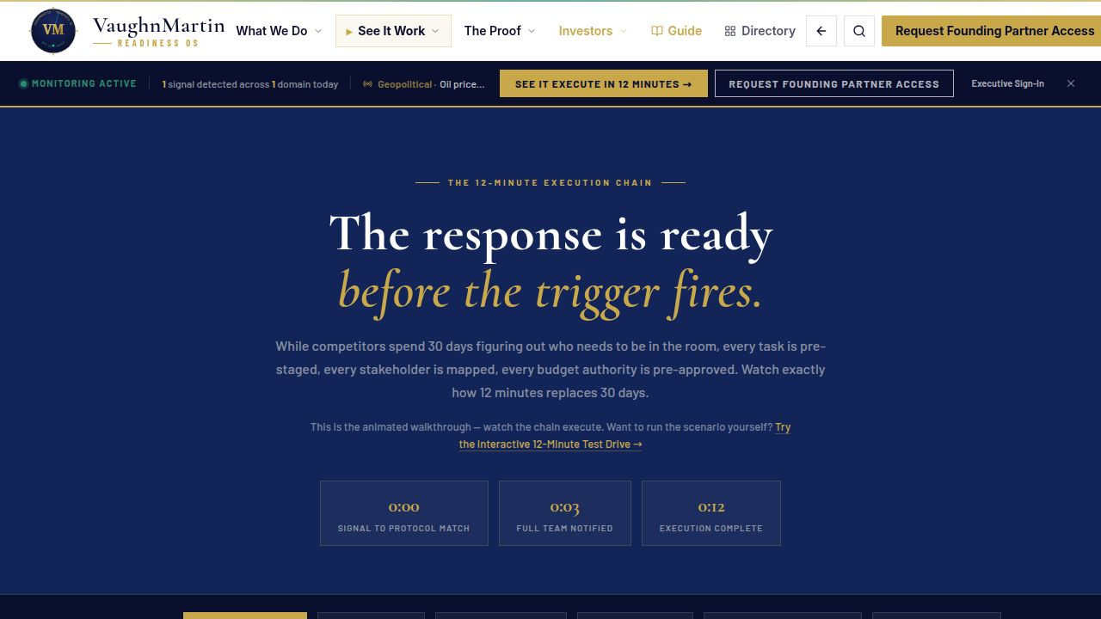
SLIDE 03 · 08
THE PRODUCT
READINESS OS:
THE RESPONSE IS READY
BEFORE THE TRIGGER FIRES.
▶ 170 Readiness Protocols pre-staged — Growth & Positioning, Risk & Resilience, Transformation
▶ 221 strategic trigger patterns monitored continuously
▶ 248+ data points scored every 15 minutes
▶ AI monitors. Executives authorize. No protocol activates without sign-off.
▶ 3,600× Execution Head Start — 30 days compressed to 12 minutes
"Every enterprise has Microsoft's AI stack. None have the operating model to use it. Readiness OS is that operating model layer — not a replacement, the orchestrator."
VaughnMartin · READINESS OS
vaughnmartin.com/how-it-executes

Slide 4
SLIDE 04 · 08
WHY WE WIN
THE MOAT COMPOUNDS.
COMPETITORS START AT ZERO.
WHERE COMPETITORS STOP SHORT
THE MOAT — WHAT MAKES US HARD TO CATCH
Signal Labs
Routes the signal. Stops before the response is staged.
Compounding Loop
ServiceNow
Automates workflows after alignment. We pre-stage the alignment.
Close-Out Gate encodes learning after every activation. Preparation compounds continuously.
Microsoft Copilot
Produces intelligence. We pre-stage the organizational response to it.
McKinsey
Arrives after the trigger fires. We were ready before it.
Org Context Intelligence
Signal confidence + preparedness score. No generic platform replicates this without our architecture.
Encoding Permanence
18 months of activations creates an intelligence layer competitors cannot offer on day one.
"Signal Labs routes the signal. ServiceNow runs the workflow. McKinsey arrives after the trigger. We had the response pre-staged before any of them were called."
VaughnMartin · READINESS OS
vaughnmartin.com/platform-reality

Slide 5
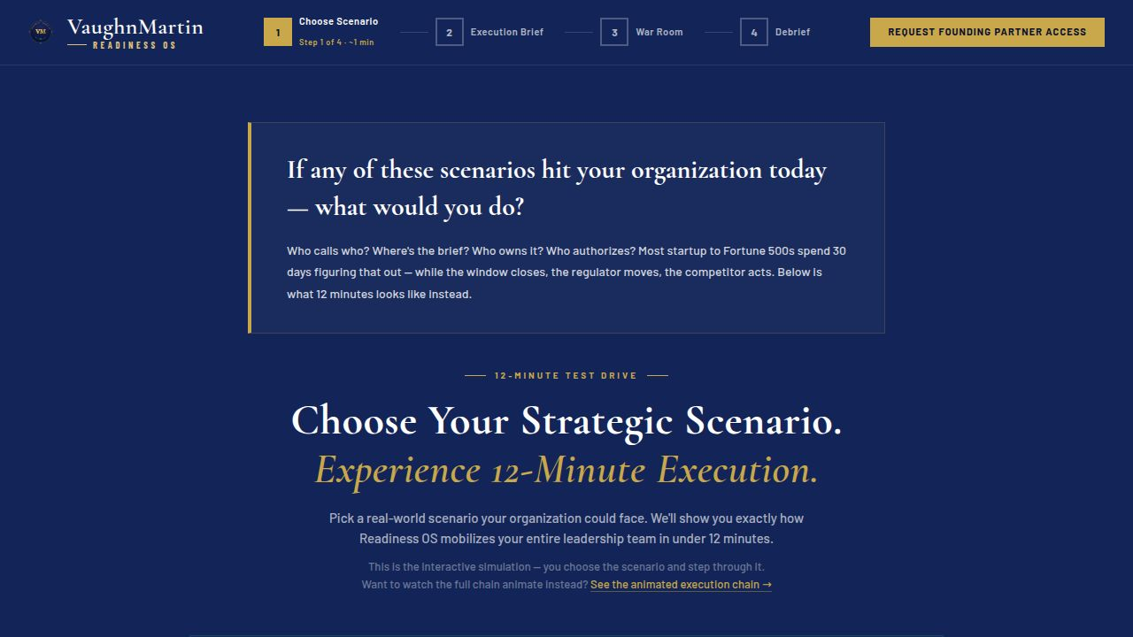
SLIDE 05 · 08
HOW IT WORKS
FROM TRIGGER TO
EXECUTION IN 12 MINUTES.
①
Signal detected — confidence scored against 221 strategic trigger patterns
②
Matching Readiness Protocol staged — tasks assigned, stakeholders mapped
③
Execution Brief delivered — full decision context pre-staged
④
Executive authorizes — four real choices including Stand Down. No action without sign-off.
⑤
Execution launches — 12 minutes from signal to live coordinated response
3,600× EXECUTION HEAD START · 30 days of mobilization compressed to 12 minutes
"The preparation is the execution. When the trigger fires, the response is already designed, assigned, and waiting for authorization."
VaughnMartin · READINESS OS
vaughnmartin.com/how-it-executes

Slide 6
SLIDE 06 · 08
PROOF — NOW, NOT ROADMAP
BUILT.
LIVE.
IN PRODUCTION NOW.
▶ Production platform live at vaughnmartin.com
▶ 170 protocols active · 221 triggers monitored · 248+ data points
▶ Full public execution walkthrough — vaughnmartin.com/how-it-executes
▶ 12-Minute Test Drive live — run any of 7 scenarios now
▶ Founding Partner cohort open for 90-day validation partnership
"This is not a roadmap concept. The platform is live, running, and testable now. Run a full scenario at vaughnmartin.com/how-it-executes."
VaughnMartin · READINESS OS
vaughnmartin.com/proof-story

Slide 7
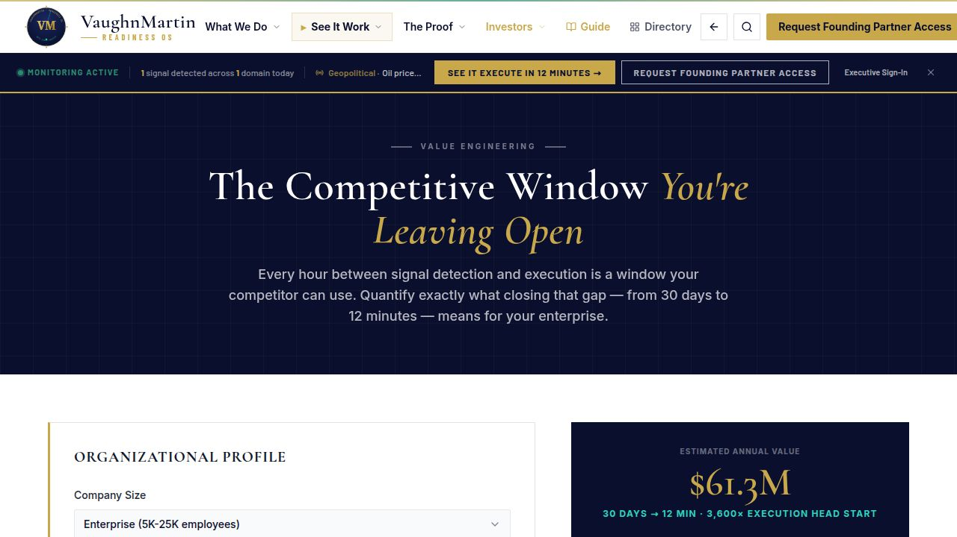
SLIDE 07 · 08
BUSINESS CASE
REPLACE EXISTING
RESPONSE SPEND WITH
EXECUTION INFRASTRUCTURE.
▶ Existing budgets already fund reactive, post-trigger response motions
▶ Readiness OS shifts that spend to pre-staged execution readiness
▶ Estimated $61.3M annual value — enterprises facing 3+ strategic triggers
▶ Replaces $400K–$800K consulting retainer with repeatable infrastructure
PRICING
Founding Partner
$75K / 90-day validation · 12 seats · Cohort forming now
Growth
$75K–$250K annually · Annual recurring · No per-seat pricing
Enterprise
$250K+ · Custom SLA · Microsoft stack integration included
"We are not asking enterprises to invent new budget. We are replacing existing response spend with a repeatable operating model that compounds in value with every activation."
VaughnMartin · READINESS OS
vaughnmartin.com/roi-calculator

Slide 8
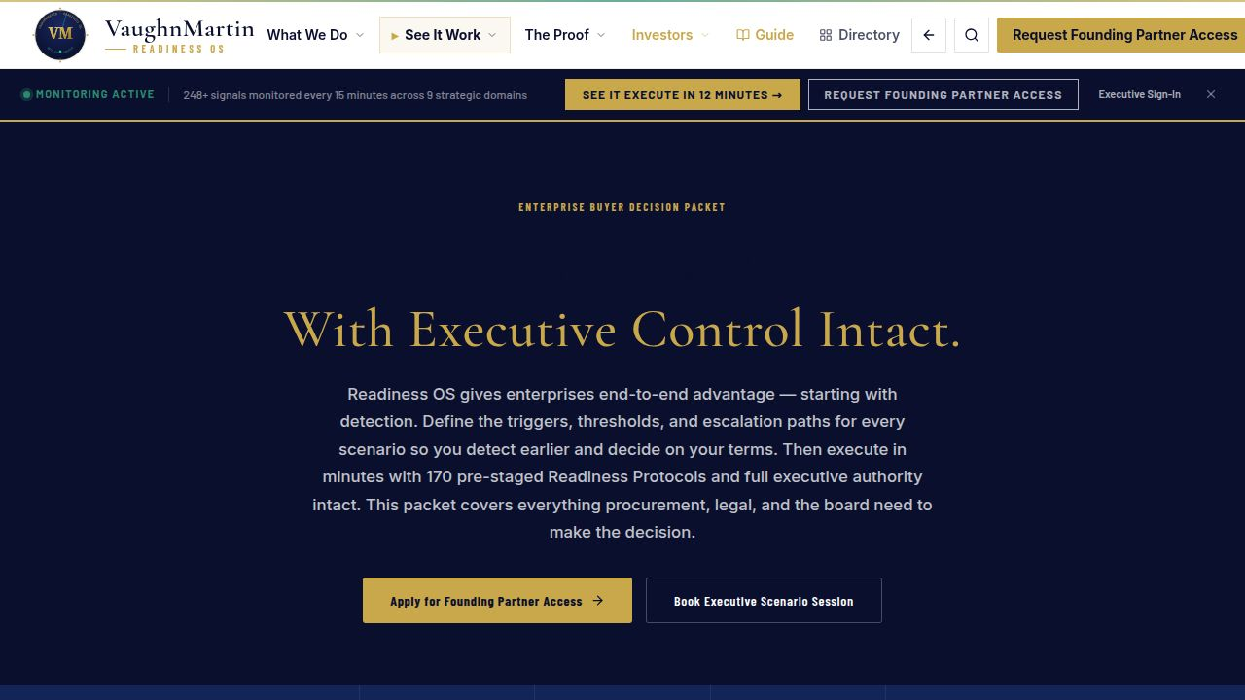
SLIDE 08 · 08
THE ASK
CATEGORY CREATION:
PREPARATION INFRASTRUCTURE
▶ Raising: Up to $1,000,000
▶ Product hardening + enterprise-grade access controls
▶ Founding Partner conversions + repeatable GTM motion
18-MONTH RUNWAY
Mo. 6
3 Founding Partners on recurring contracts
Mo. 9
Enterprise controls complete · Microsoft integration certified
Mo. 12
Repeatable GTM with documented proof stories
Mo. 18
Category established · Series A ready
"Every enterprise has AI capability. Very few have mobilization readiness. We built that layer. The response is ready before the trigger fires."
VaughnMartin · READINESS OS
vaughnmartin.com/founding-partner-program

Slide 9
APPENDIX · SOURCES & REFERENCES
VaughnMartin Readiness OS · Investor Pitch · May 2026 · vaughnmartin.com

