Slide 1
VM
VaughnMartin Readiness OS
Signal Advantage
Before Execution Advantage
See earlier. Decide with authority. Execute in 12 minutes.
VaughnMartin · READINESS OS
1 / 12

Slide 2
THE PROBLEM
Most organizations miss
the window before they align.
THE TYPICAL RESPONSE TIMELINE
T+0
Days 1–14
Day 30+
▶ Triggers are detected too late
▶ Authority is unclear in the moment
▶ Coordination starts after opportunity or risk is already moving
SIGNAL
DETECTED
ALIGNMENT
MEETINGS
RESPONSE
BEGINS
⚠ LOST WINDOW
The trigger fired. The competitor acted. Your organization was still aligning.
"The window does not wait for the org chart."
Readiness OS collapses mobilization to 12 minutes.
VaughnMartin · READINESS OS
2 / 12

Slide 3
THE ADVANTAGE
Earlier signal.
Faster mobilization.
Compounding edge.
Signal Lead Time + Mobilization Compression = Compounding Advantage
SIGNAL LEAD TIME
MOBILIZATION COMPRESSION
System-based monitoring across 248+ data points and 221 trigger patterns. Defined on your terms — not discovered after the fact.
170 Readiness Protocols pre-staged across 9 strategic domains. Execution architecture ready before the trigger fires.
248+
221
170
9
data points monitored
trigger patterns
Readiness Protocols
strategic domains
VaughnMartin · READINESS OS
3 / 12

Slide 4
THE PRODUCT SYSTEM
Map → Monitor → Decide → Execute → Learn
1
2
3
4
5
MAP
MONITOR
DECIDE
EXECUTE
LEARN
SCENARIOS
TRIGGERS
WITH AUTHORITY
COORDINATED ACTION
INTO FUTURE READINESS
Define every strategic situation your organization has faced, is facing, or is likely to face. Build the pre-staged response before pressure arrives.
System-based monitoring of customer-defined thresholds across 221 trigger patterns, 248+ data points, every 15 minutes.
Executive authorization at explicit decision points. AI monitors and surfaces the recommended Readiness Protocol. Executives decide.
Cross-functional plan deploys: roles assigned, budgets unlocked, internal and external comms staged — in minutes.
Every activation improves the next. Signal patterns, decision latency, and outcomes feed forward into the protocol library.
VaughnMartin · READINESS OS
4 / 12

Slide 5
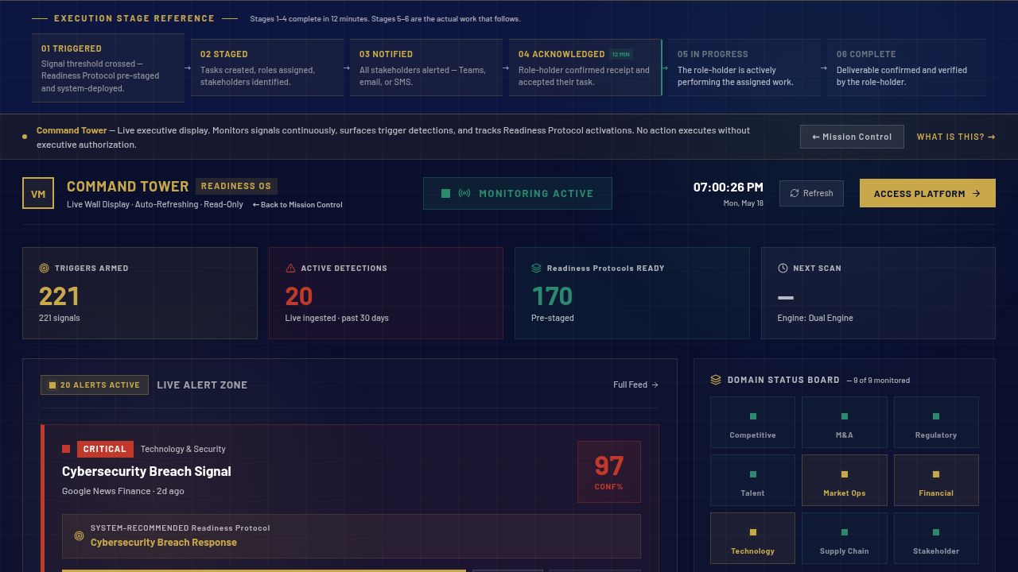
MISSION CONTROL
vaughnmartin.com/command-tower
Where leadership sees
what is forming
and what to do now.
EMERGING SITUATION
Live signal detections scored against 221 trigger patterns
DECISION WINDOW
System-recommended Readiness Protocol surfaced with confidence score
RECOMMENDED PROTOCOL
One-click executive authorization. Pre-staged execution deploys immediately.
VaughnMartin · READINESS OS
5 / 12

Slide 6
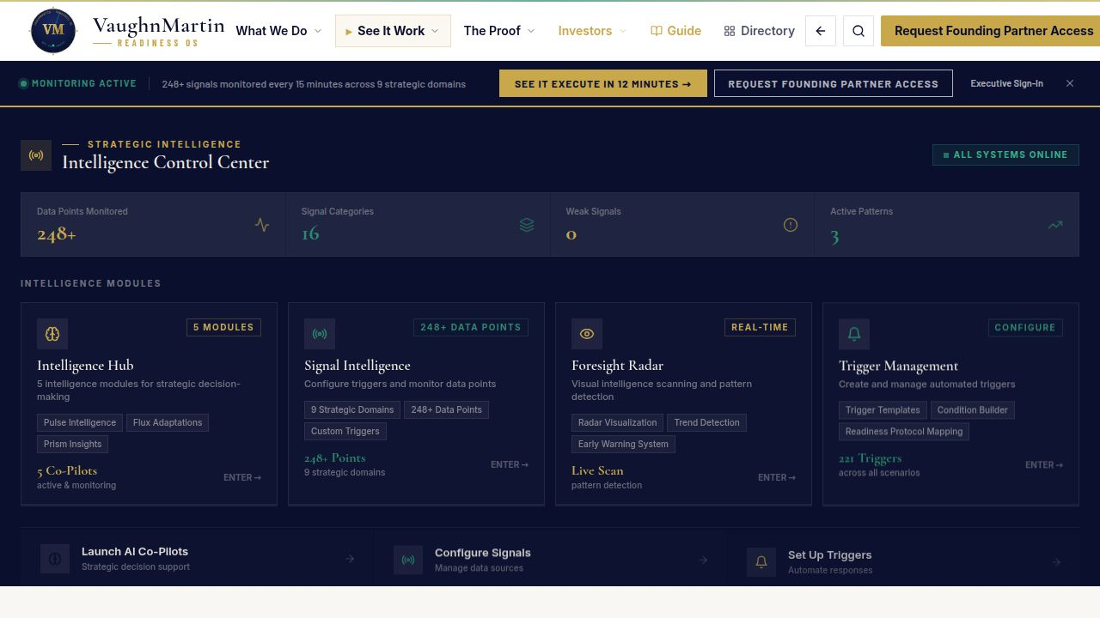
TRIGGER ARCHITECTURE
vaughnmartin.com — Live Signal Monitoring
Detection on your terms,
not after the fact.
Customer-defined thresholds + escalation logic
You define what constitutes a trigger for your organization — not a generic alert system.
Reduces missed and late detection risk by design
Continuous monitoring every 15 minutes. 248+ data points. System-scored, not manual.
VaughnMartin · READINESS OS
6 / 12

Slide 7
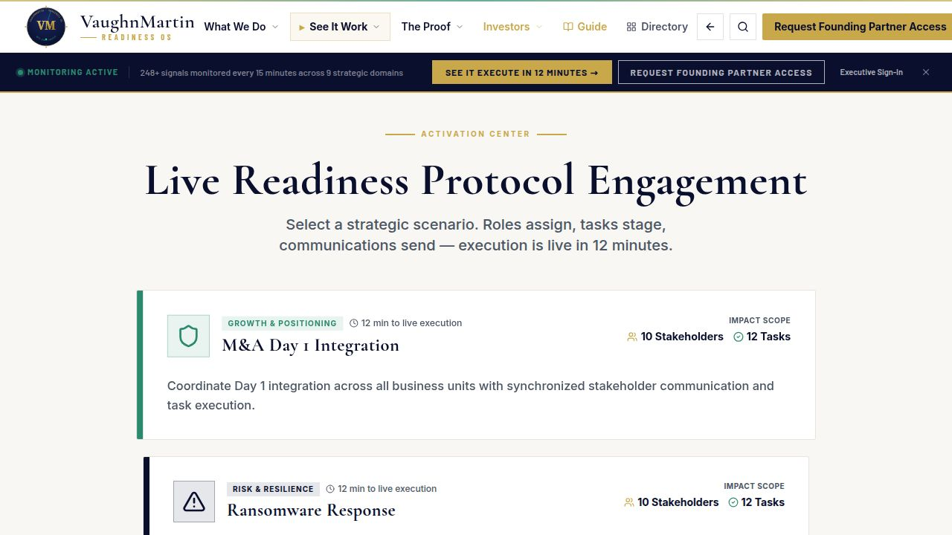
DECISION + GOVERNANCE
vaughnmartin.com — Activation Console
AI monitors.
Executives authorize.
Human decision authority preserved
No Readiness Protocol activates without explicit executive sign-off. The preparation compresses mobilization; the decision remains human.
Traceable, auditable activation pathway
Every authorization is logged with timestamp, decision-maker, and context. Board-ready audit trail from trigger to execution.
VaughnMartin · READINESS OS
7 / 12

Slide 8
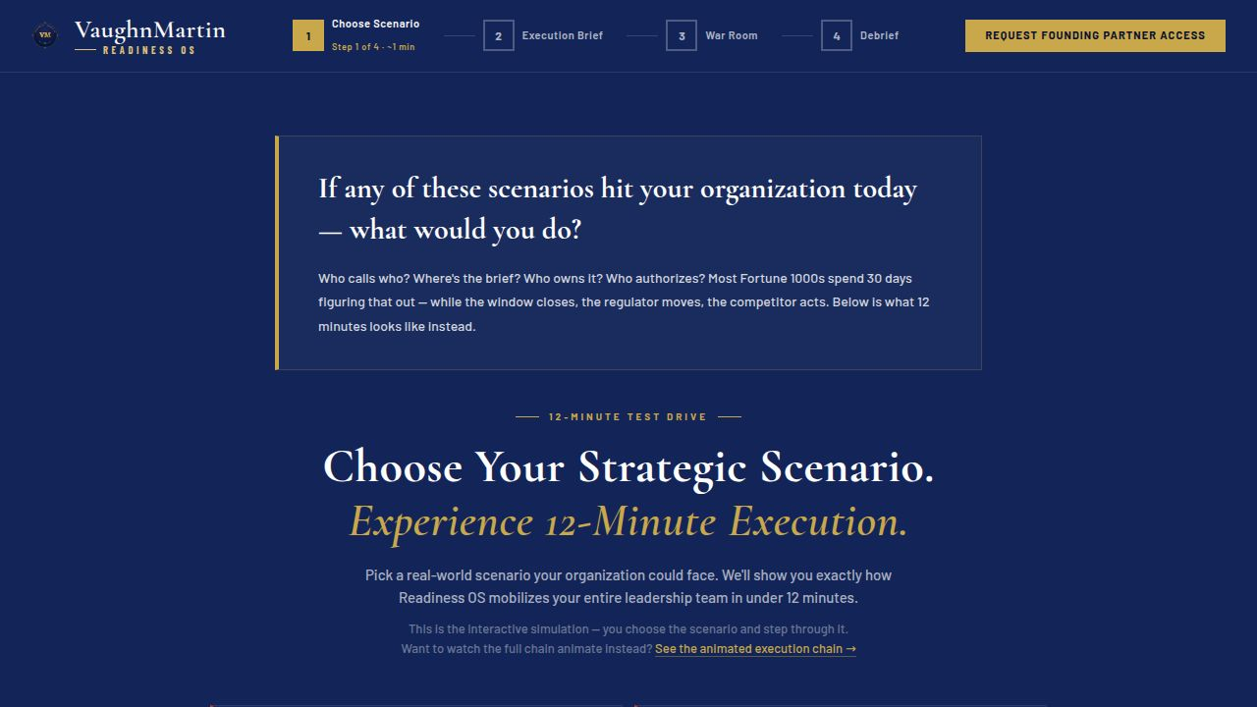
EXECUTION ORCHESTRATION
vaughnmartin.com/12-minute-experience
From decision to
coordinated action
in minutes.
ROLES
BUDGET
Every stakeholder notified with pre-assigned ownership
Spending authority unlocked to the right role instantly
INTERNAL COMMS
EXTERNAL COMMS
Leadership messaging staged and ready to deploy
Customer, partner, and media messaging pre-drafted
VaughnMartin · READINESS OS
8 / 12

Slide 9
THE SCENARIO
One trigger. Two outcomes.
WITHOUT READINESS OS
WITH READINESS OS
T+0
Signal emerges
Signal emerges
T+12 min
Still in the first meeting
Coordinated execution live
T+Days 1–14
Ownership alignment ongoing
Protocol full deployed
T+Day 30+
Response finally begins
Retrospective complete
"The response is ready before the trigger fires."
VaughnMartin · READINESS OS
9 / 12

Slide 10
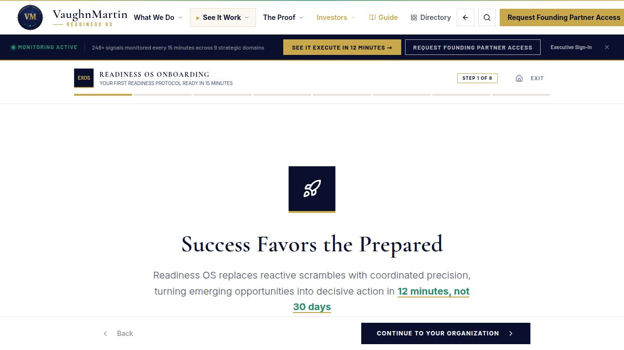
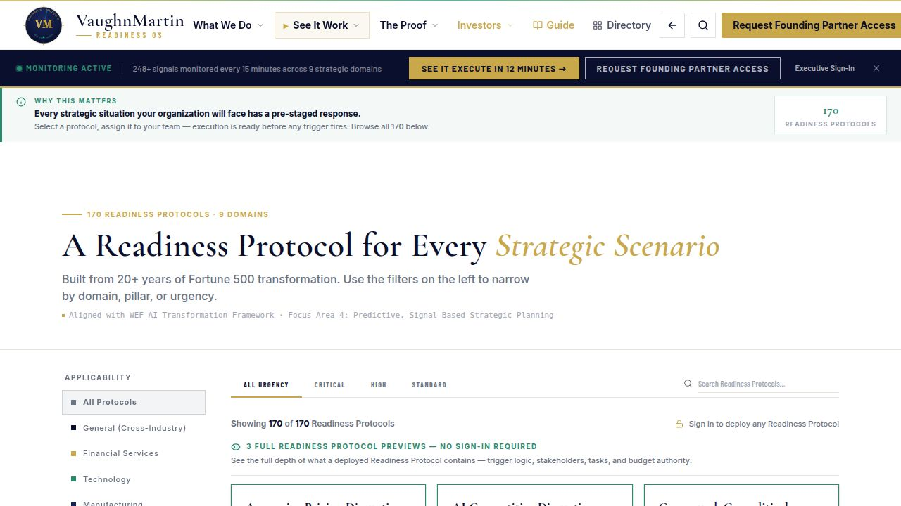
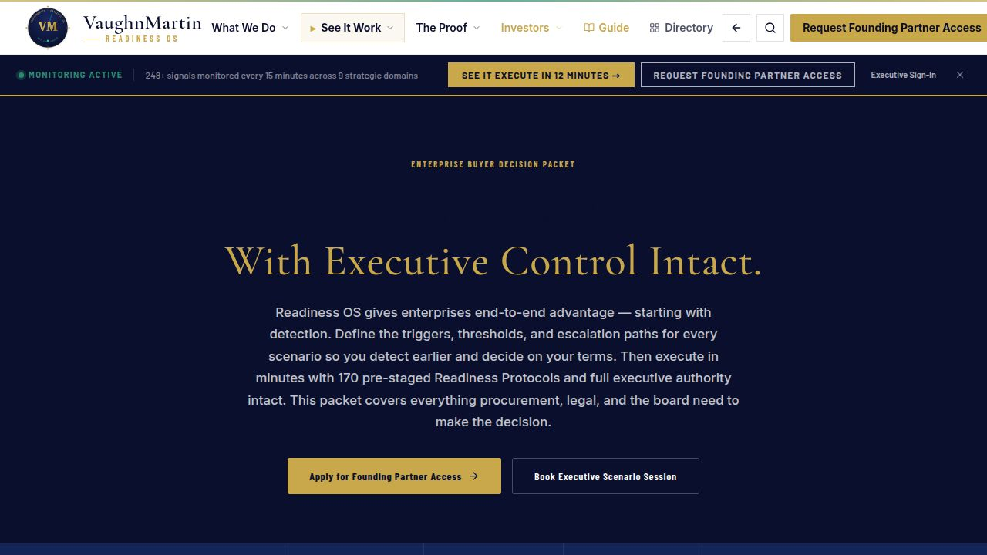
LIVE PRODUCTION — PROOF
Live production platform,
not concept slides.
✓
Live onboarding flow
✓
Live protocol activation path
✓
Live executive decision materials
Onboarding
Protocol Library
Mission Control
Buyer Decision Packet
VaughnMartin · READINESS OS
10 / 12

Slide 11
COMMERCIAL MOTION
Focused entry,
measurable proof,
scalable expansion.
01
02
03
FOUNDING PARTNER
ENGAGEMENT
OPERATIONAL
OUTCOME PROOF
ENTERPRISE
EXPANSION
Select Fortune 1000 enterprises in a structured 90-day validation partnership. Full platform access, onboarding support, and direct founder engagement.
90-day success definition: one live trigger handled inside Readiness OS with measurable reduction in mobilization time versus baseline.
Proven ROI case drives expansion to additional domains, protocol packs, and organization-wide deployment. Predictable contract growth.
VaughnMartin · READINESS OS
11 / 12

Slide 12
VM
ASK + CLOSE
Partner with us to scale Readiness OS.
"If advantage belongs to organizations that see earlier and execute decisively, let's partner."
FOUNDING PARTNERS +
ALIGNED INVESTORS
IMMEDIATE NEXT STEP
90-day validation partnership · Direct founder access · First-mover enterprise positioning
Executive Scenario Session — we walk your specific trigger context through Readiness OS live.
vaughnmartin.com · founding@vaughnmartin.com
VaughnMartin · READINESS OS
12 / 12

