Slide 1
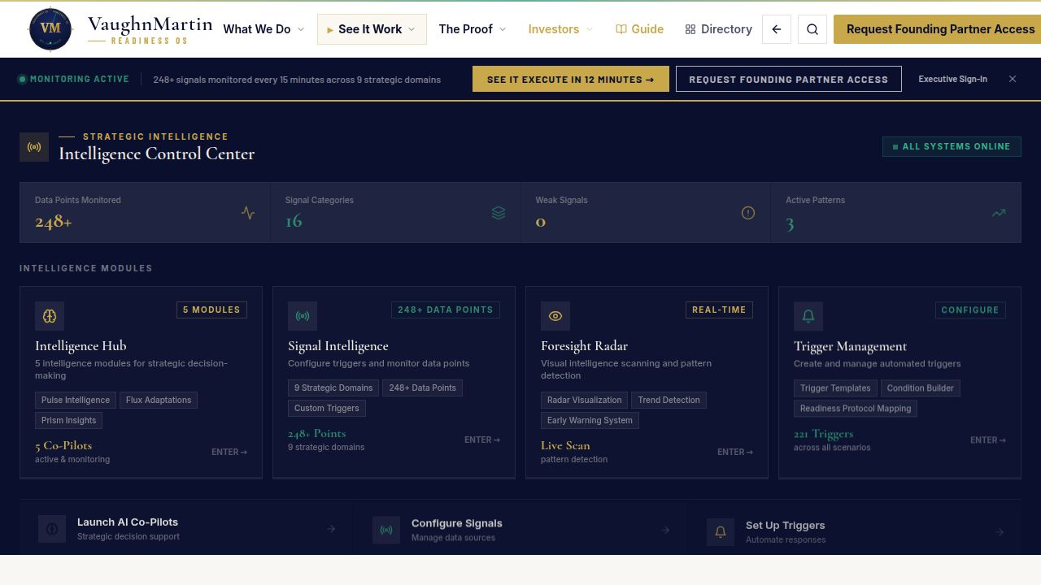
01 / 06
THE PROBLEM
vaughnmartin.com
The trigger fires in seconds.
Mobilization takes 30 days.
▶ Fortune 1000 organizations detect strategic triggers quickly
▶ Most still spend weeks aligning ownership, authority, and sequence
▶ The delay is not execution — it is mobilization
"Most organizations do not have a strategy problem. They have a mobilization problem. When a trigger fires, the first weeks are spent figuring out who decides and who owns the response."
VaughnMartin · READINESS OS

Slide 2
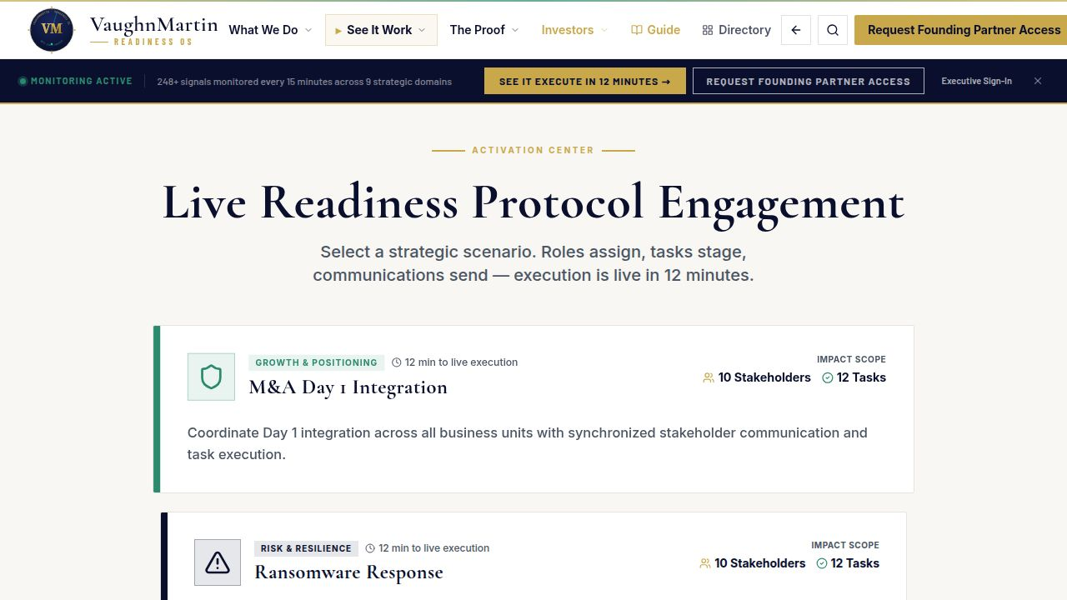
02 / 06
THE PRODUCT
vaughnmartin.com/how-it-executes
Readiness OS:
The response is ready before the trigger fires.
▶ 170 Readiness Protocols pre-staged
▶ 221 trigger patterns mapped
▶ 248+ data points monitored every 15 minutes
▶ AI monitors. Executives authorize.
"We built Readiness OS to pre-stage the response architecture before pressure arrives. Authority remains human; mobilization becomes immediate."
VaughnMartin · READINESS OS

Slide 3
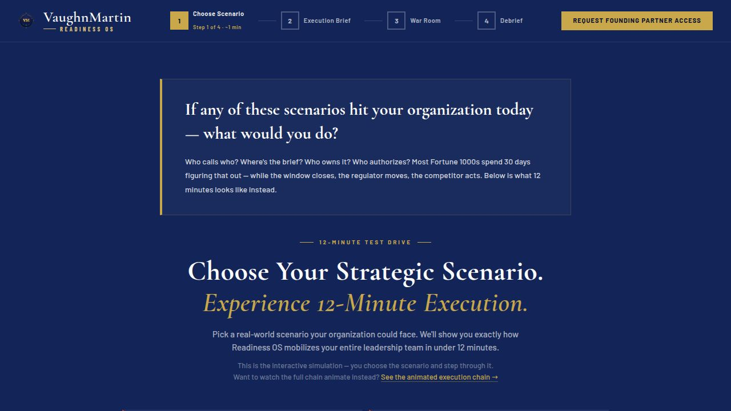
03 / 06
HOW IT WORKS
vaughnmartin.com/how-it-executes
From trigger to coordinated execution in minutes.
▶ ① Signal detected
▶ ② Matching protocol staged
▶ ③ Stakeholders notified
▶ ④ Executive authorizes
▶ ⑤ Execution launches
"The key change is that coordination is pre-built, so when the trigger fires, execution starts."
VaughnMartin · READINESS OS

Slide 4
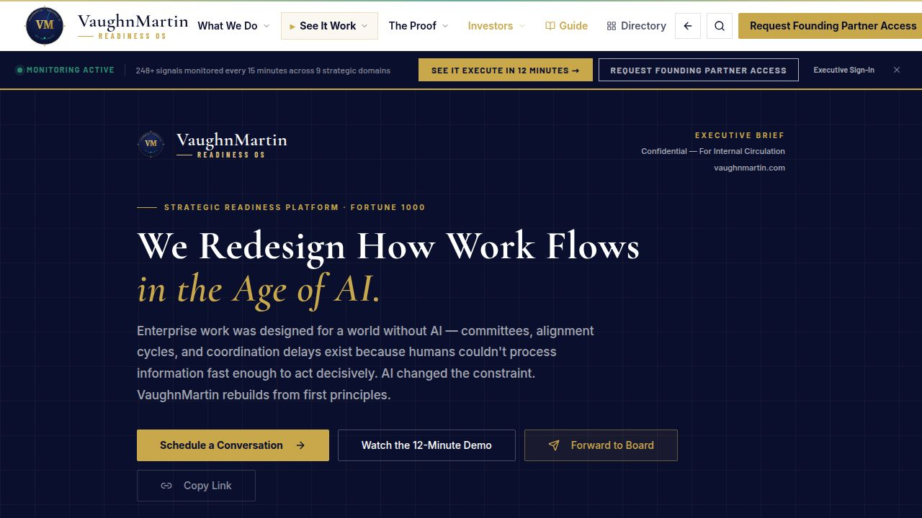
04 / 06
PROOF — NOW, NOT ROADMAP
vaughnmartin.com/executive-brief
Built. Live.
In production now.
▶ Production platform live at vaughnmartin.com
▶ Full public execution walkthrough available
▶ Founding Partner cohort open for 90-day validation
"This is not a roadmap concept. The platform is live and testable now."
VaughnMartin · READINESS OS

Slide 5
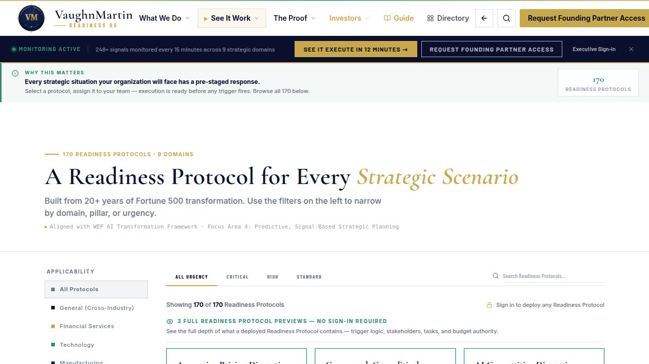
05 / 06
BUSINESS CASE
vaughnmartin.com/roi-calculator
Replace existing response spend with execution infrastructure.
▶ Existing budgets already fund reactive response motions
▶ Readiness OS shifts spend to pre-staged execution readiness
▶ One high-impact trigger handled well can justify annual investment
"We are not asking enterprises to invent new budget. We are replacing existing response spend with a repeatable operating model."
VaughnMartin · READINESS OS

Slide 6
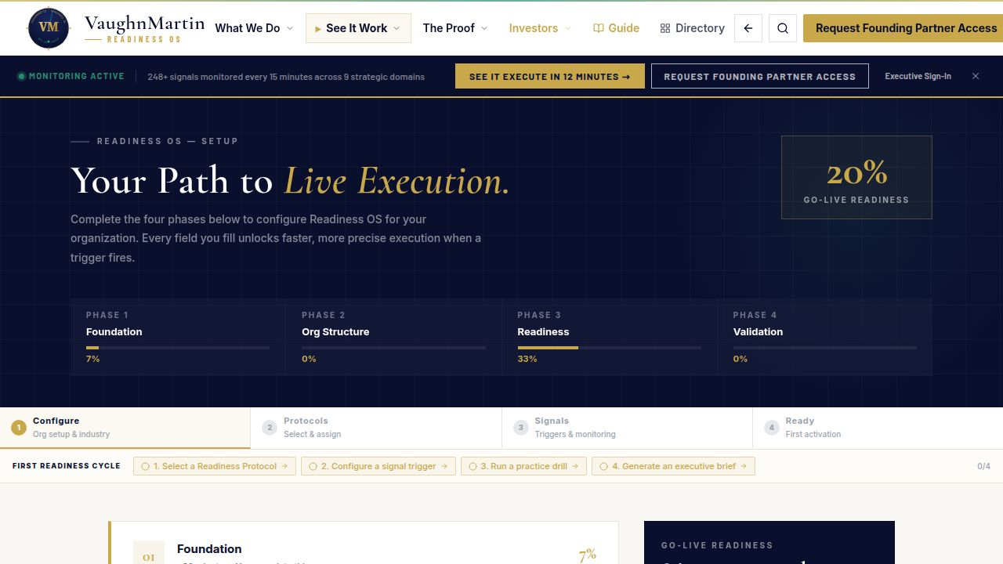
06 / 06
ASK + CLOSE
vaughnmartin.com/founding-partner-program
Category creation:
Preparation Infrastructure
▶ Raise: $[AMOUNT]
▶ Product hardening + enterprise controls
▶ Founding Partner conversions
▶ Repeatable GTM motion
The response is ready before the trigger fires.
"Every enterprise has AI capability. Very few have mobilization readiness. We built that layer. It's live now."
VaughnMartin · READINESS OS

