Slide 1
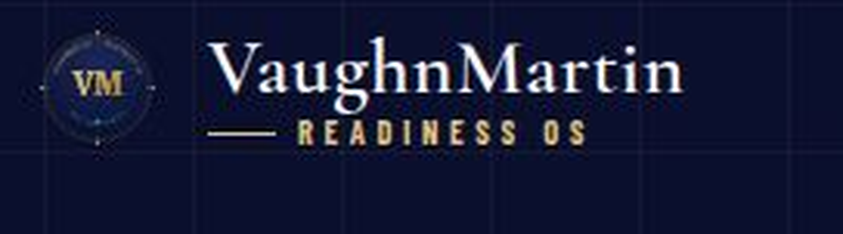
When a strategic trigger fires —
are you ready in 12 minutes,
or starting from zero?
Signal advantage before execution advantage.
The response is ready before the trigger fires.
READINESS OS · FORTUNE 1000 · VAUGHNMARTIN.COM
Confidential — For Authorized Recipients Only
1 / 13

Slide 2
THE PROBLEM
Most organizations don't lose because
they can't execute — they lose because
they detect too late.
TYPICAL RESPONSE TIMELINE
T+0
DAY 14
DAY 30+
SIGNAL
ALIGNMENT
RESPONSE
LATE DETECTION
By the time the trigger is visible, the competitor has already moved.
LOST WINDOW
The trigger fired. The competitor acted. Your organization was still scheduling alignment meetings.
NO PRE-STAGED DECISION PATH
Ownership is contested in real time. No protocol is ready to deploy.
Readiness OS compresses this to 12 minutes — a 3,600× execution head start.
30-DAY COORDINATION DELAY
Alignment meetings begin after the trigger fires — not before.
Who calls who? · Where's the brief? · Who owns it? · Who authorizes?
This is a readiness problem, not a talent problem.
"The window does not wait for the org chart."
2 / 13

Slide 3
THE TWO-STAGE ADVANTAGE
Not just faster response — a compounding edge:
earlier signal window + 12-minute coordinated execution.
Signal Lead Time + Mobilization Compression = Compounding Advantage
SIGNAL LEAD TIME
MOBILIZATION COMPRESSION
System monitoring across 248+ data points and 221 trigger patterns — defined by your organization on your terms, not generic alerts.
170 Readiness Protocols pre-staged across 9 strategic domains. Response architecture ready before the trigger fires.
248+
221
170
9
data points
trigger patterns
Readiness Protocols
strategic domains
3 / 13

Slide 4
WHY NOW
AI capability is accelerating faster than enterprise execution readiness.
AI REALITY
THE EXECUTION GAP
● Capability accelerating
The competitive gap is no longer who has AI — it is who can execute with speed, control, and authority.
AI performance, tooling, and adoption continue to accelerate across all industries.
● Governance lagging
Most organizations can now detect more signals but still struggle to decide and mobilize fast enough.
Safety, accountability, and operational trust frameworks are not keeping pace.
● Adoption mainstream
Readiness OS closes that gap: AI monitors continuously, executives authorize decisively, teams execute in minutes.
AI is no longer experimental — the gap is now who can govern and act on it.
Source: Stanford HAI, AI Index Report 2026 (capability acceleration + governance readiness gap) · Gartner Autonomous Business 2026
VaughnMartin · Readiness OS
4 / 13

Slide 5
THE PRODUCT SYSTEM
Map → Monitor → Decide → Execute → Learn
AI monitors continuously. Executives authorize decisively. Teams execute in 12 minutes.
Define every strategic situation your organization has faced or is likely to face.
248+ data points. Customer-defined thresholds. Every 15 minutes.
Pre-assigned decision rights. Executives authorize. Execution deploys.
Roles, budgets, and communications deploy in 12 minutes.
1
2
3
4
5
MAP
MONITOR
DECIDE
EXECUTE
LEARN
Scenarios
Triggers
Authority
Action
Readiness
Define every strategic situation your organization has faced or is likely to face.
System monitoring of customer-defined thresholds — 248+ data points, every 15 minutes.
Explicit executive authorization at every point. AI monitors. Executives decide.
Roles, budgets, and communications deploy in coordinated sequence in 12 minutes.
Every activation feeds forward — patterns improve the next response cycle.
Every activation feeds forward. Each cycle improves the next.
5 / 13

Slide 6
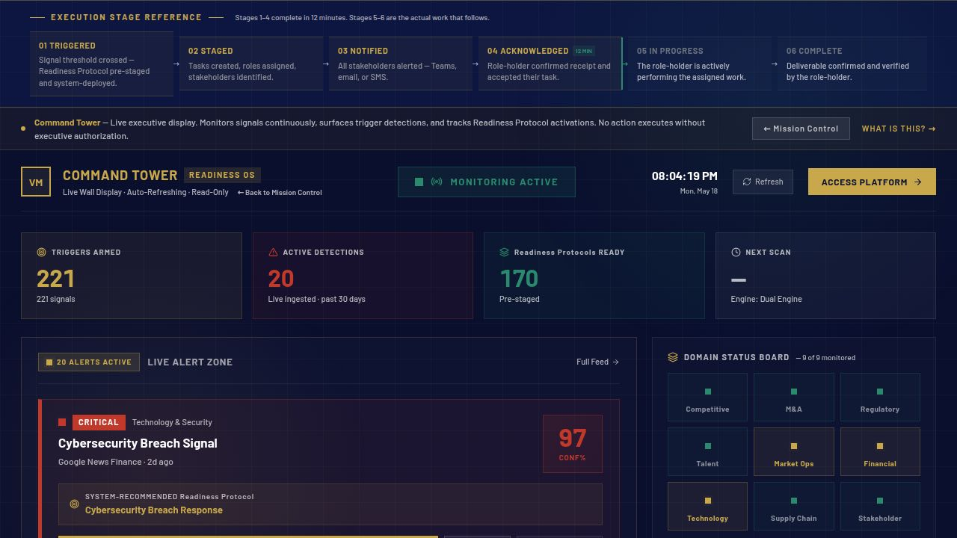

MISSION CONTROL
Where leadership sees what is forming — and what to do now.
vaughnmartin.com/command-tower
EMERGING SITUATION
Live signal detections scored against 221 trigger patterns across 9 strategic domains.
DECISION WINDOW
System-recommended Readiness Protocol surfaced with signal confidence score.
ONE-CLICK AUTHORIZATION
Executive sign-off deploys the pre-staged execution plan immediately.
6 / 13

Slide 7
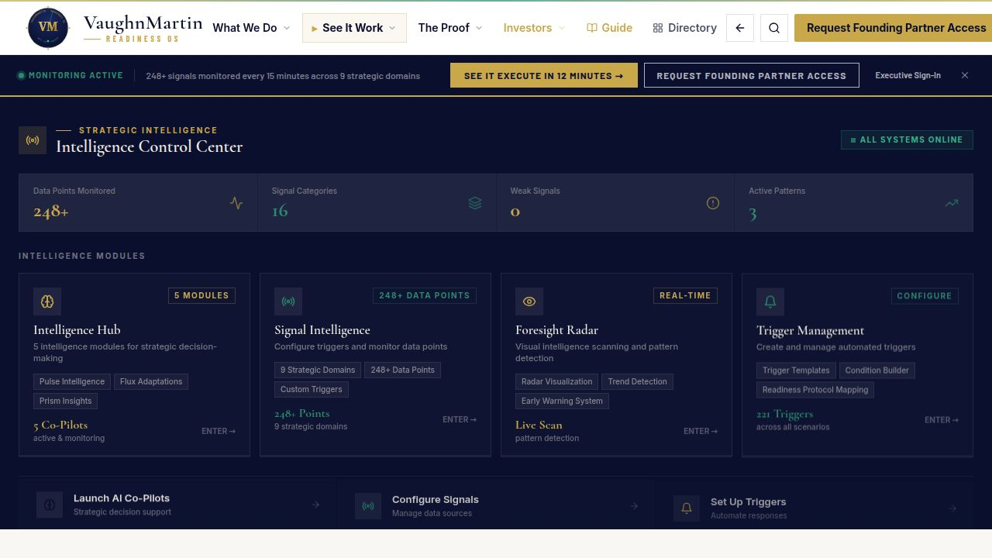
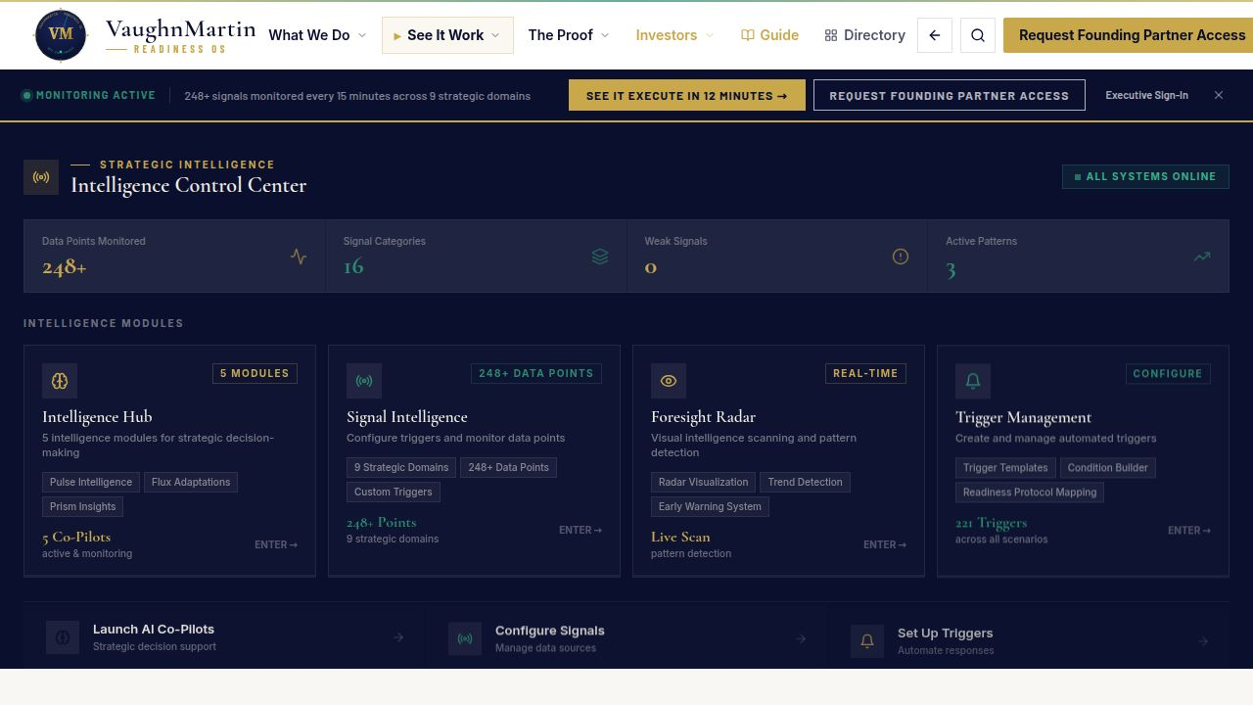
TRIGGER ARCHITECTURE
Detection on your terms, not after the fact.
vaughnmartin.com — Signal Monitoring
CUSTOMER-DEFINED THRESHOLDS
You define what constitutes a trigger — sources, thresholds, escalation paths. Not generic alerts.
248+ DATA POINTS · EVERY 15 MINUTES
Continuous monitoring scored and surfaced before the situation becomes a crisis.
CONTINUOUS PATTERN SCORING
Scored against your defined escalation logic. Signal confidence surfaced at detection.
7 / 13

Slide 8
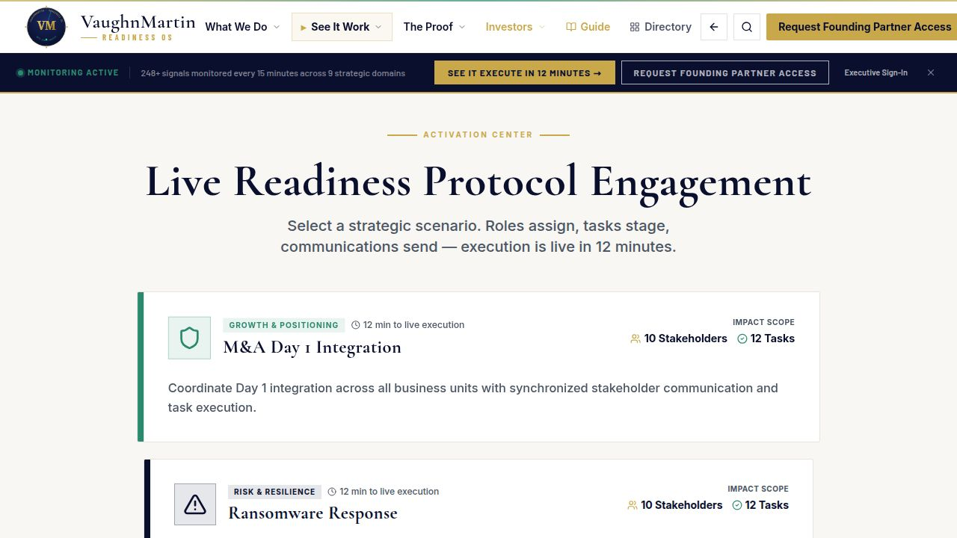
DECISION + GOVERNANCE
AI monitors. Executives authorize.
vaughnmartin.com — Activation Console
readinessOS.vaughnmartin.com — Activation Console · LIVE
⚠ SIGNAL DETECTED · HIGH PRIORITY
09:02:17 · 13F SEC FILING · EDGAR ALERT
Activist Investor — Elliott Management Partners, L.P.
POSITION FILED
CAMPAIGN TYPE
WINDOW TO RESPOND
9.2% stake
Board Representation
Response window open
$2.1B market value
+ Strategic Review
execute before the window closes
HUMAN DECISION AUTHORITY PRESERVED
No Readiness Protocol activates without explicit executive sign-off. The decision stays human.
SYSTEM RISK SCORE
89 / 100 · CRITICAL
SYSTEM RECOMMENDATION
Protocol #42 — Activist Investor Response
28 tasks pre-staged
Legal team and PR firm notified automatically
8 stakeholders mapped with decision rights
Shareholder messaging pre-approved
Board communication drafted and ready
EXECUTIVE AUTHORIZATION REQUIRED
Sarah Chen · Chief Strategy Officer
AUTHORIZE →
VIEW BRIEF
TRACEABLE ACTIVATION PATHWAY
Protocol #42 is staged and ready. Authorization releases 28 tasks across 8 stakeholders.
Every authorization logged with timestamp, decision-maker, and full context — board-ready audit trail.
✓ AUTHORIZED 09:14:33 · Sarah Chen, CSO · Activation ID: ACT-2026-042-04 · Audit logged · Board brief auto-generated
8 / 13

Slide 9
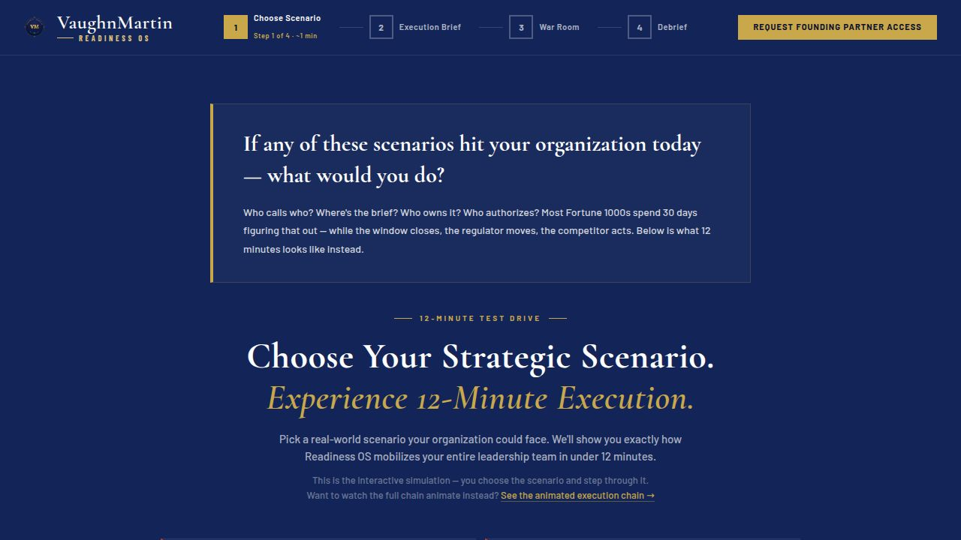
EXECUTION ORCHESTRATION
From decision to coordinated action in 12 minutes.
vaughnmartin.com/12-minute-experience
readinessOS.vaughnmartin.com — Execution Dashboard · Protocol #42
⏱
11:47 ELAPSED
PROTOCOL #42 · ACTIVIST INVESTOR RESPONSE · EXECUTION ACTIVE
0:13 REMAINING
98.3%
ROLES DEPLOYED
BUDGET RELEASED
COMMS STAGED
✓
General Counsel
TOTAL PRE-AUTHORIZED
✓
Board Alert
ROLES · BUDGET · COMMS
Notified · 0:42
$2,400,000
Delivered
Every stakeholder notified. Spending authority unlocked. Messaging pre-staged across all channels.
✓
Chief Strategy Officer
3 cost centers unlocked
✓
Press Hold Statement
Authorized · 1:15
✓ Legal Retainer
Drafted
✓
Chief Financial Officer
$800,000
✓
Shareholder Letter
Briefed · 2:08
✓ PR / Crisis Comms
Drafted
✓
Head of Investor Relations
$400,000
✓
Employee Communication
Active · 3:22
✓ Investment Banking Advisory
Queued
✓
Board Chair
$750,000
✓
Analyst Brief
Alerted · 4:01
Prepared
FULL CROSS-FUNCTIONAL DEPLOYMENT
✓
Communications Director
✓ Board Counsel
✓
SEC Response Template
The entire plan — people, funds, and communications — deploys in a single authorized action.
Engaged · 5:14
$250,000
Ready
◎
External PR Firm
◎ Shareholder Protection Fund
◎
Media Q&A Brief
Activating...
$200,000
In Progress
○
M&A Counsel
○
Town Hall Script
Queued
Pending
✓ FULL CROSS-FUNCTIONAL DEPLOYMENT · 12 minutes · 28 tasks · 6 roles active · $2.4M released · 14 comms staged · Zero meetings required
9 / 13

Slide 10
THE 12-MINUTE SCENARIO
Activist investor discloses 8.3% stake. 9:47 AM.
One trigger. Two completely different organizations.
✕ WITHOUT READINESS OS
✓ WITH READINESS OS
9:47 AM
Disclosure detected by IR team — begins manual distribution list
Signal detected. Protocol #47 identified. Stakeholder map loaded.
9:59 AM
Legal, IR, CEO calendars checked. No common slot until 2 PM.
Board materials pre-staged. Draft communications queued for review.
10:12 AM
Someone suggests pulling the activist response deck from last year
Executive authorization requested — one click to activate.
DAY 14 →
Still in alignment meetings. No coordinated response. The window has closed.
Coordinated response live. Legal, IR, board, external counsel — all notified. 12 minutes.
30 days to mobilize — after the trigger fires
12 minutes — response complete, before the window closes
"The response is ready before the trigger fires."
10 / 13

Slide 11
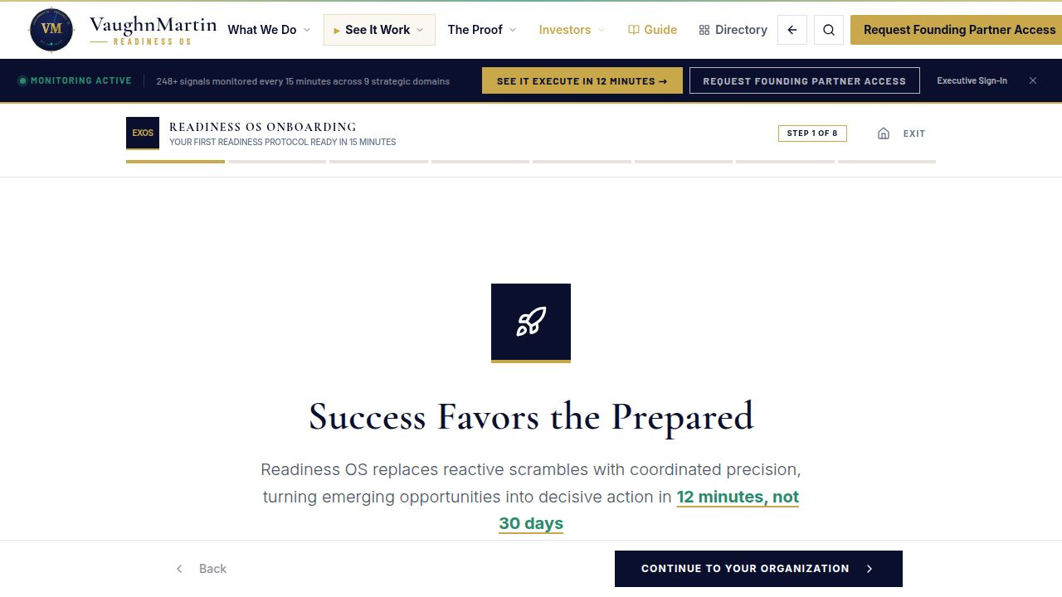
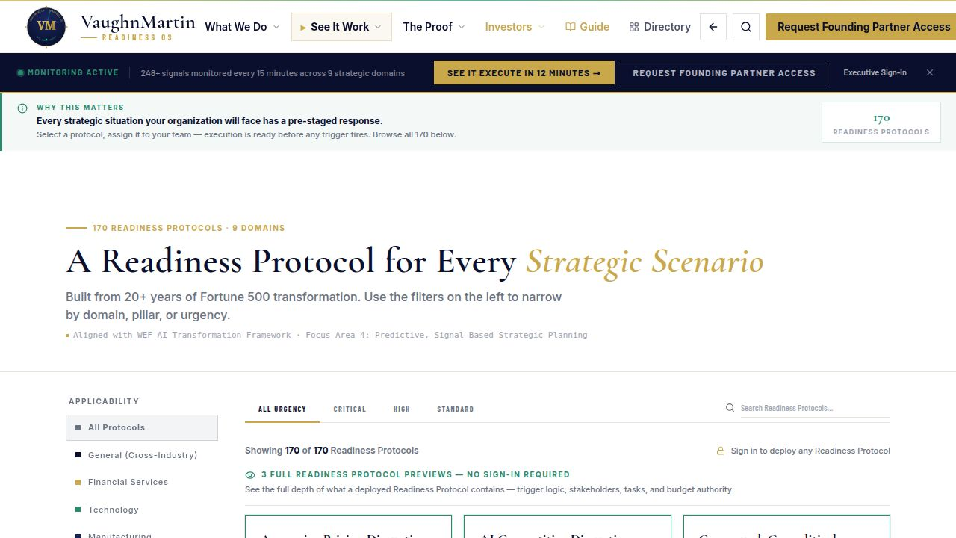
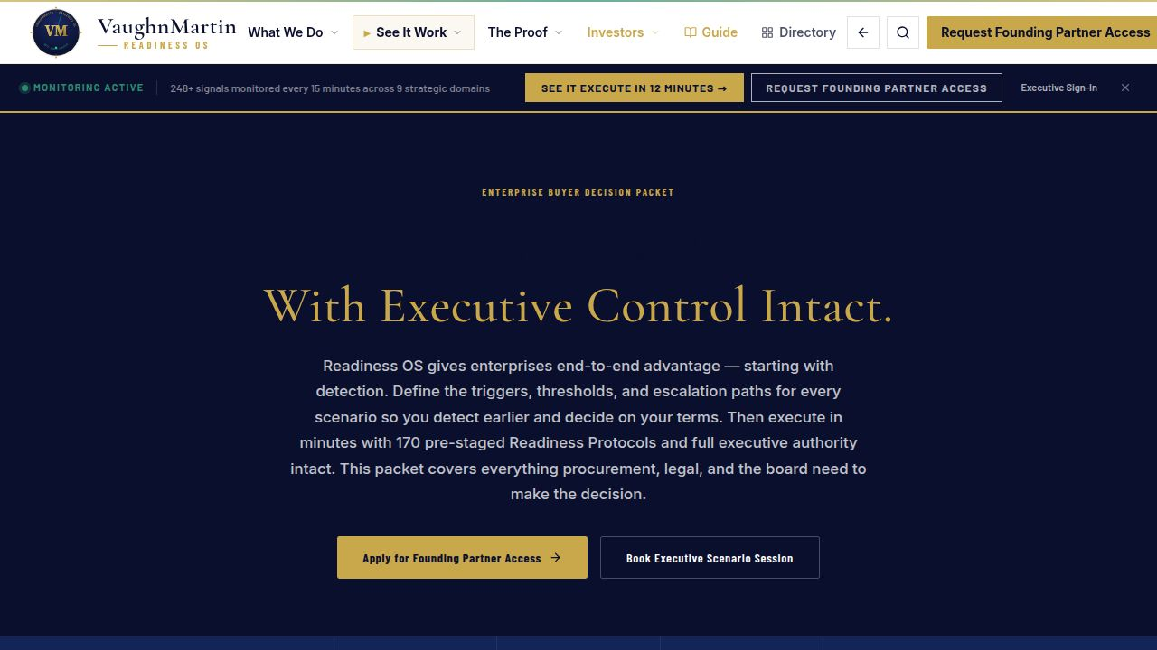
LIVE PRODUCTION PROOF
Live in production. Detection active. Execution architecture staged.
Signal monitoring live. Protocol library armed. Executive authorization pathways ready.
✓
Live onboarding flow and getting-started hub
✓
Live protocol activation: authorization → execution
✓
Live executive decision materials and buyer packet
Onboarding
Protocol Library
Mission Control
Buyer Decision Packet
11 / 13

Slide 12
COMMERCIAL MOTION
Focused entry. Measurable proof. Scalable expansion.
01
02
03
FOUNDING PARTNER
OPERATIONAL
ENTERPRISE
ENGAGEMENT
OUTCOME PROOF
EXPANSION
12 Founding Partners · $75K / 90-day validation · Fortune 1000 readiness leaders · Direct founder access throughout.
Live activation generates documented time-to-execution data. ROI is built from real organizational performance — not projections.
Proven ROI drives expansion across additional domains, protocol packs, and organization-wide deployment.
Success metric: one live trigger handled inside Readiness OS with documented mobilization compression vs. baseline.
Predictable contract growth from validated, quantified outcomes.
12 / 13

Slide 13
Enterprises detect signals.
The gap is mobilization — 30 days vs. 12 minutes.
Readiness OS closes that gap before the trigger fires.
WHO WE'RE PARTNERING WITH
NEXT STEP
Executive Scenario Session
Fortune 1000 organizations and aligned investors. 90-day validation partnership. 12 founding cohort slots.
We walk your specific trigger context through Readiness OS live — from signal detection to 12-minute execution.
REQUEST YOUR SESSION →
"The response is ready before the trigger fires."
founding@vaughnmartin.com · vaughnmartin.com
vaughnmartin.com · founding@vaughnmartin.com
Confidential — For Authorized Recipients Only
13 / 13

