Slide 1
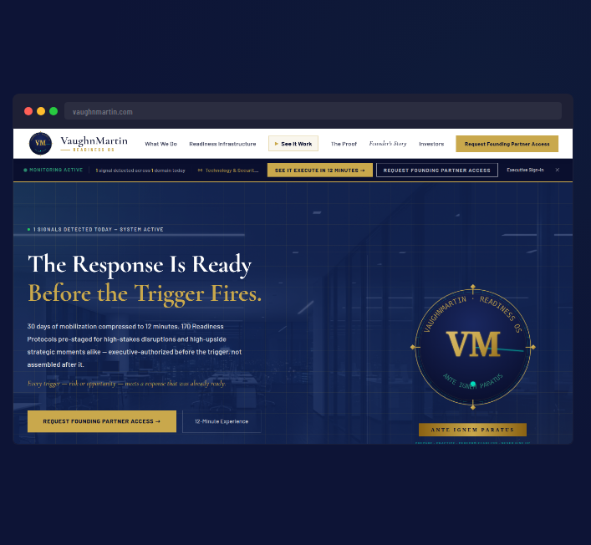
SLIDE 01 · 06
vaughnmartin.com
THE PROBLEM
THE TRIGGER FIRES IN SECONDS.
MOBILIZATION TAKES 30 DAYS.
▶ Fortune 1000 organizations detect strategic triggers quickly
▶ Most still spend weeks aligning ownership, authority, and sequence
▶ The delay is not execution — it is mobilization
"Most organizations do not have a strategy problem. They have a mobilization problem. When a trigger fires, the first weeks are spent figuring out who decides and who owns the response."
VM
VaughnMartin
READINESS OS

Slide 2
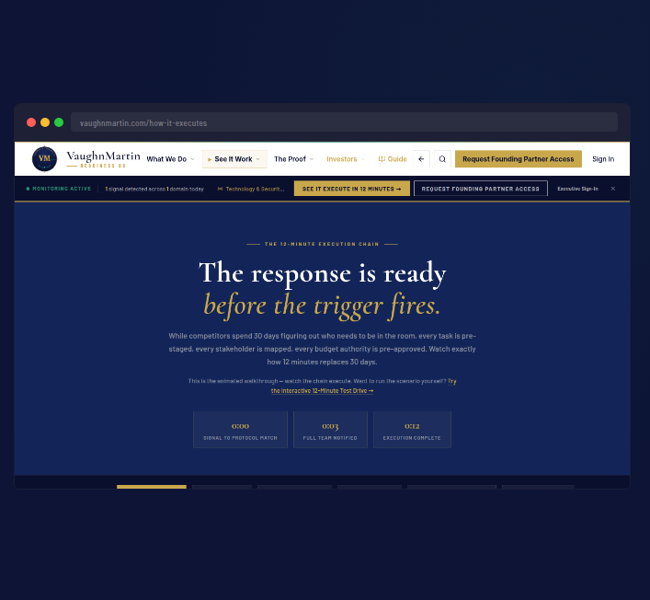
SLIDE 02 · 06
vaughnmartin.com/how-it-executes
THE PRODUCT
READINESS OS:
THE RESPONSE IS READY BEFORE THE TRIGGER FIRES.
▶ 170 Readiness Protocols pre-staged
▶ 221 trigger patterns mapped
▶ 248+ data points monitored every 15 minutes
▶ AI monitors. Executives authorize.
"We built Readiness OS to pre-stage the response architecture before pressure arrives. Authority remains human; mobilization becomes immediate."
VM
VaughnMartin
READINESS OS

Slide 3
SLIDE 03 · 06
vaughnmartin.com/how-it-executes
HOW IT WORKS
FROM TRIGGER TO COORDINATED EXECUTION IN MINUTES.
① Signal detected
② Matching protocol staged
③ Stakeholders notified
④ Executive authorizes
⑤ Execution launches
"The key change is that coordination is pre-built, so when the trigger fires, execution starts."
VM
VaughnMartin
READINESS OS

Slide 4
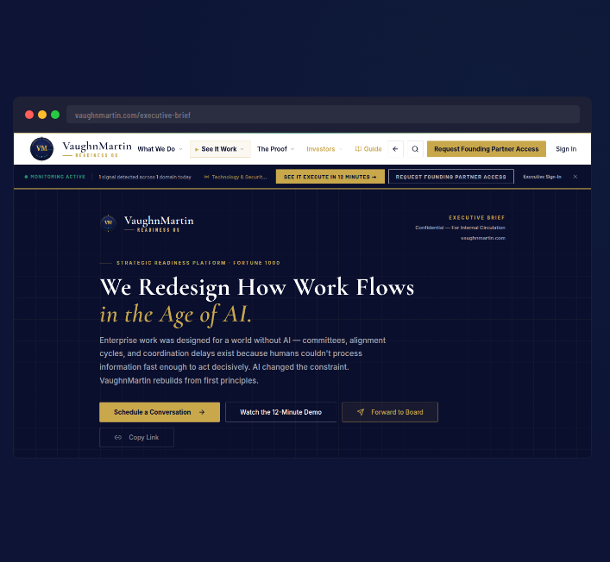
SLIDE 04 · 06
vaughnmartin.com/executive-brief
PROOF — NOW, NOT ROADMAP
BUILT.
LIVE.
IN PRODUCTION NOW.
▶ Production platform live at vaughnmartin.com
▶ Full public execution walkthrough available
▶ Founding Partner cohort open for 90-day validation
"This is not a roadmap concept. The platform is live and testable now."
VM
VaughnMartin
READINESS OS

Slide 5
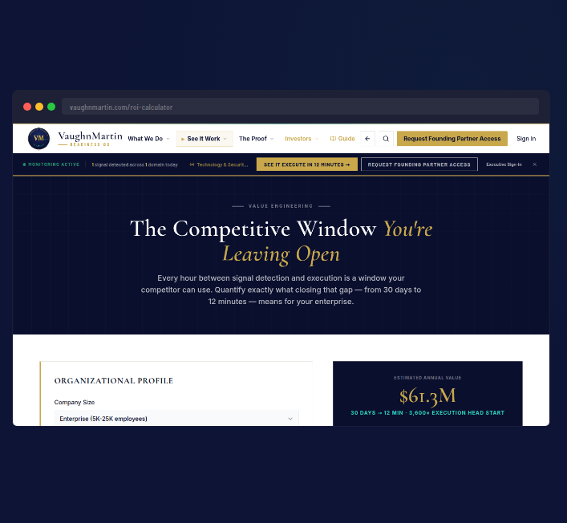
SLIDE 05 · 06
vaughnmartin.com/roi-calculator
BUSINESS CASE
REPLACE EXISTING RESPONSE SPEND WITH EXECUTION INFRASTRUCTURE.
▶ Existing budgets already fund reactive response motions
▶ Readiness OS shifts spend to pre-staged execution readiness
▶ One high-impact trigger handled well can justify annual investment
"We are not asking enterprises to invent new budget. We are replacing existing response spend with a repeatable operating model."
VM
VaughnMartin
READINESS OS

Slide 6
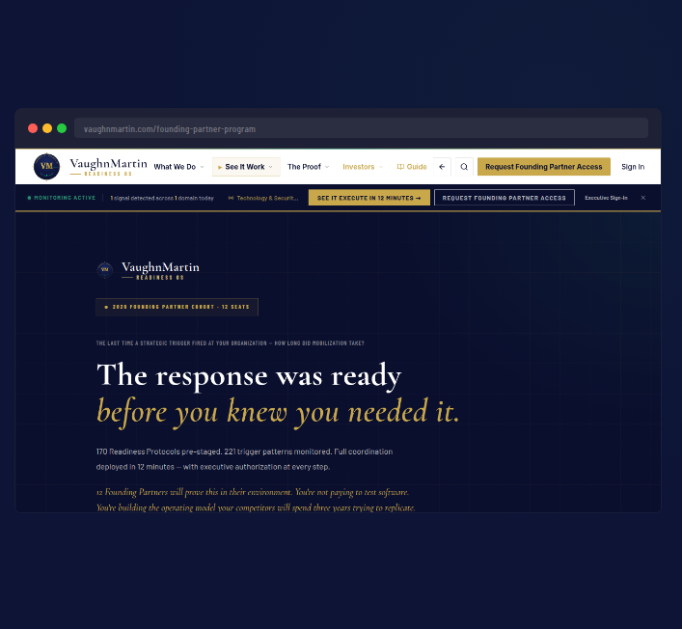
SLIDE 06 · 06
vaughnmartin.com/founding-partner-program
ASK + CLOSE
CATEGORY CREATION:
PREPARATION INFRASTRUCTURE
▶ Raise: $[AMOUNT]
▶ Product hardening + enterprise controls
▶ Founding Partner conversions
▶ Repeatable GTM motion
THE RESPONSE IS READY BEFORE THE TRIGGER FIRES.
"Every enterprise has AI capability. Very few have mobilization readiness. We built that layer. It's live now."
VM
VaughnMartin
READINESS OS

