Slide 1
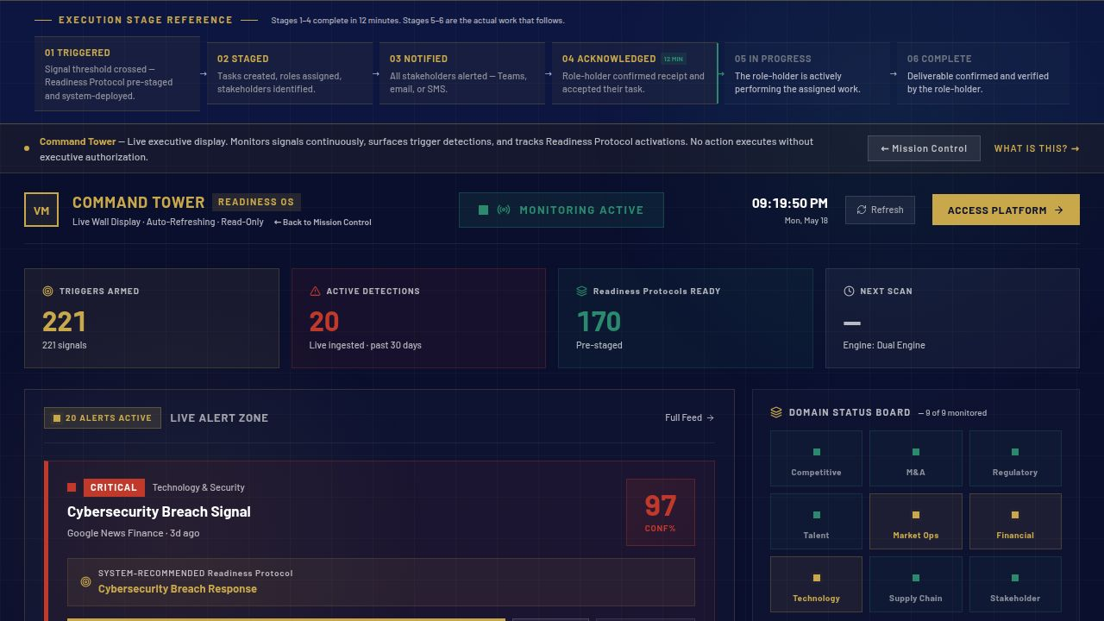
When a strategic trigger fires in your organization—
are you executing in 12 minutes or organizing from scratch?
Signal advantage before execution advantage.
Activist Investor · 91%
Ransomware · 95%
Regulatory Inquiry · 87%
Command Tower · Live production · 221 triggers armed · 20 active detections · 170 protocols ready
01 / 12
AI monitors continuously. Executives authorize decisively.

Slide 2
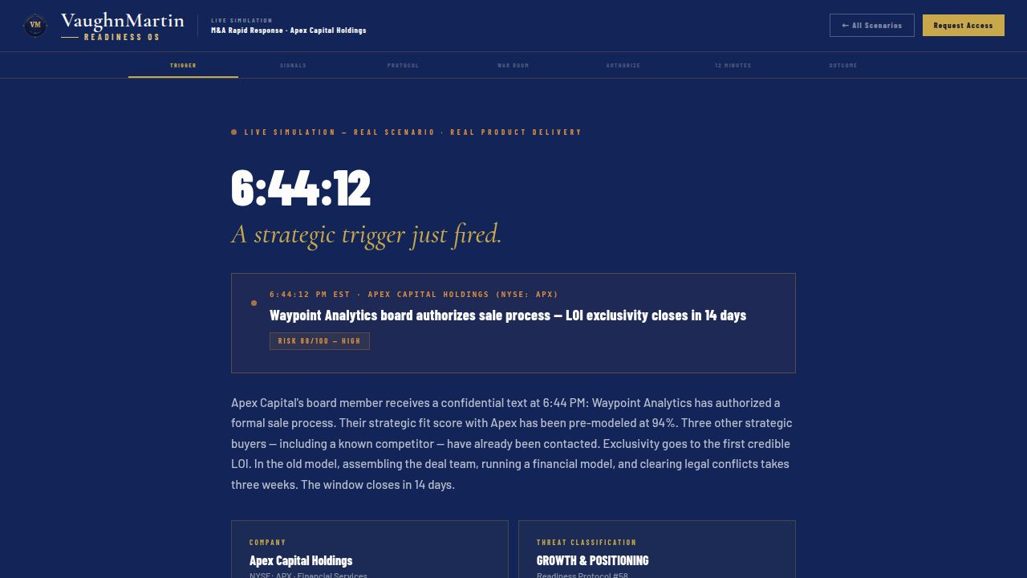
THE REALITY
THIS IS WHAT A TRIGGER LOOKS LIKE — RIGHT NOW
30
Days
Mobilization time before any execution begins.
Coordination starts from zero at every trigger. The window closes before execution begins.
Live simulation · M&A trigger · Risk 88/100 — HIGH · No response pre-staged
02 / 12

Slide 3
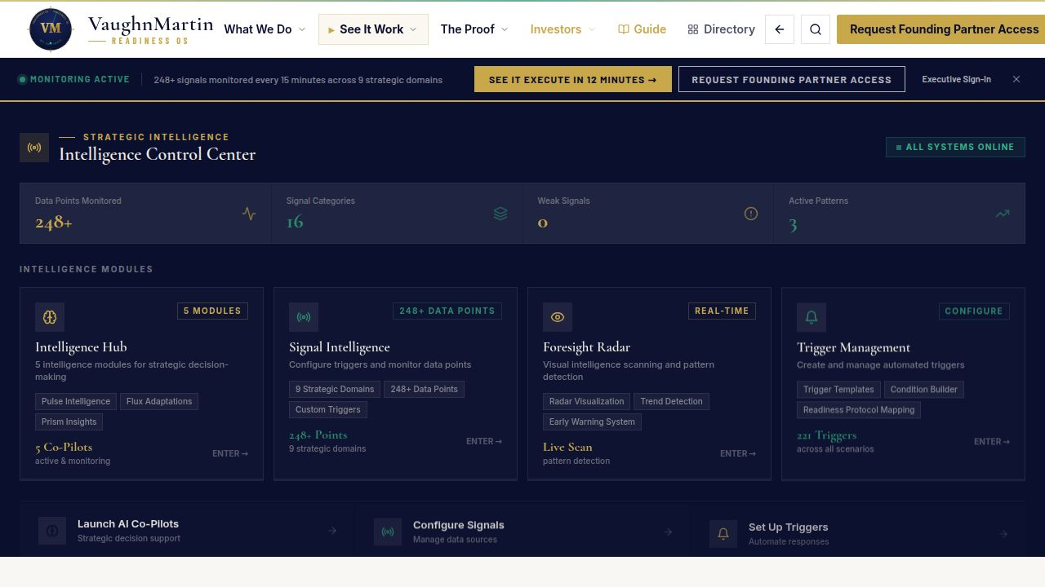
THE PROBLEM IS ALREADY HERE
One of these is forming in your portfolio right now
RISK & RESILIENCE
95%
GROWTH & POSITIONING
91%
RISK & RESILIENCE
87%
Ransomware Attack Confirmed
Activist Investor Pressure Rising
Regulatory Inquiry Opened
● Signal Detected · 248 data points
● Signal Detected · Live Monitoring
● Signal Detected · Threshold Forming
Signal Intelligence feed · vaughnmartin.com · Live detections · production
03 / 12

Slide 4
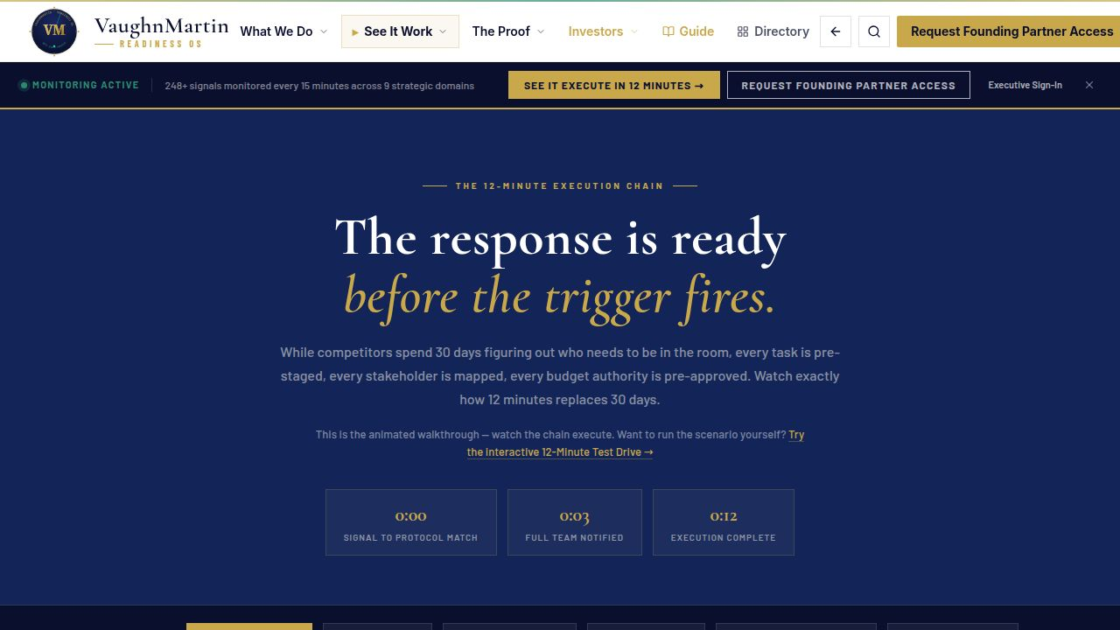
The response is ready
before the trigger fires.
Preparation → Readiness → Fearless
170
221
12 MIN
Readiness Protocols
Strategic Triggers
Full Execution Cycle
vaughnmartin.com/how-it-executes · Live animated 12-minute execution chain
04 / 12

Slide 5
Old Model
VAUGHNMARTIN
"Bolted AI onto the old model"
"Rebuilt the operating model from first principles"
✕
Faster notes from the same slow meetings
✓
Response pre-staged before trigger fires
✕
No readiness architecture before triggers fire
✓
AI monitors. Executives authorize. Teams execute.
✕
Authority unclear when pressure arrives
✓
Governance and auditability built into execution
05 / 12

Slide 6
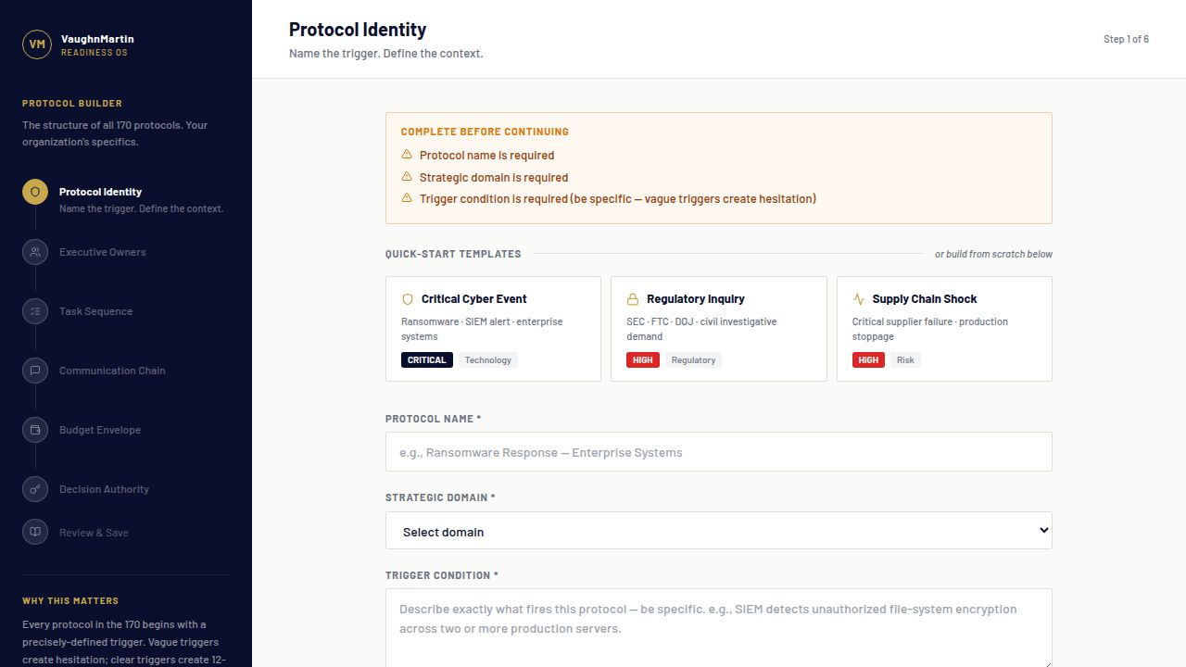
FROM DETECTION TO AUTHORIZED EXECUTION
Signal detected → Protocol activates → Executive authorizes → 12 minutes
SIG
SCR
PRO
STK
AUTH
EXE
Signal Detected
Scored & Classified
Protocol Activates
Stakeholders Notified
Executive Authorizes
Execution Begins
✓ Complete in 12 minutes — 30 days compressed
The alternative: 30 days of mobilization before any execution begins
Protocol Builder · Pre-staged execution architecture · Live in production
06 / 12

Slide 7
BUSINESS VALUE
Readiness is not overhead. It is value protection.
Founding Partner: $75K / 90-day validation
Growth tiers: $75K–$250K annually
If one strategic window is preserved, readiness can pay for itself quickly
The cost of delay is usually higher than the cost of readiness.
07 / 12

Slide 8
BUILT. LIVE. IN PRODUCTION.
Not a roadmap — operating now
170
221
248
15 MIN
Protocols
Triggers
Data Points
Refresh
● Signal Detection Active · Updated Every 15 Minutes · vaughnmartin.com
Signal Intelligence feed · Live detections · vaughnmartin.com
08 / 12

Slide 9
PROOF OF PRODUCTION
From Signal to Authorized Execution in 12 Minutes
Live trigger detected with confidence scoring.
Pre-staged protocol, stakeholders, authority, and tasks ready before pressure.
AI monitors. Executives authorize. Teams execute.
170 protocols · 221 triggers · 248 data points · refreshed every 15 minutes
09 / 12

Slide 10
WHY NOW
AI capability is accelerating faster than enterprise readiness.
Organizations can detect more than ever, but still mobilize too slowly.
Governance and execution readiness are now the competitive bottleneck.
The winners will be companies that pair AI sensing with governed execution speed.
Sources: Stanford HAI AI Index 2026 · Gartner Autonomous Business
10 / 12

Slide 11
THE ASK
Twelve founding partners. One defining cohort.
Partners who want readiness as competitive advantage.
PROGRAM
Founding Partner · 90-Day Validation
COMMERCIAL
$75K / 90 days
COHORT
12 startup to Fortune 500 organizations
RAISE
Open strategic raise · active conversations underway
11 / 12

Slide 12
THREE LINES. THAT'S THE PITCH.
PROBLEM
Enterprises detect more signals, but still mobilize too slowly.
SOLUTION
VaughnMartin pre-stages response so executives authorize in minutes.
OUTCOME
Earlier detection + faster execution protects value before the window closes.
Apply for Founding Partner Access · vaughnmartin.com/founding-partner-program
12 / 12

