Slide 1

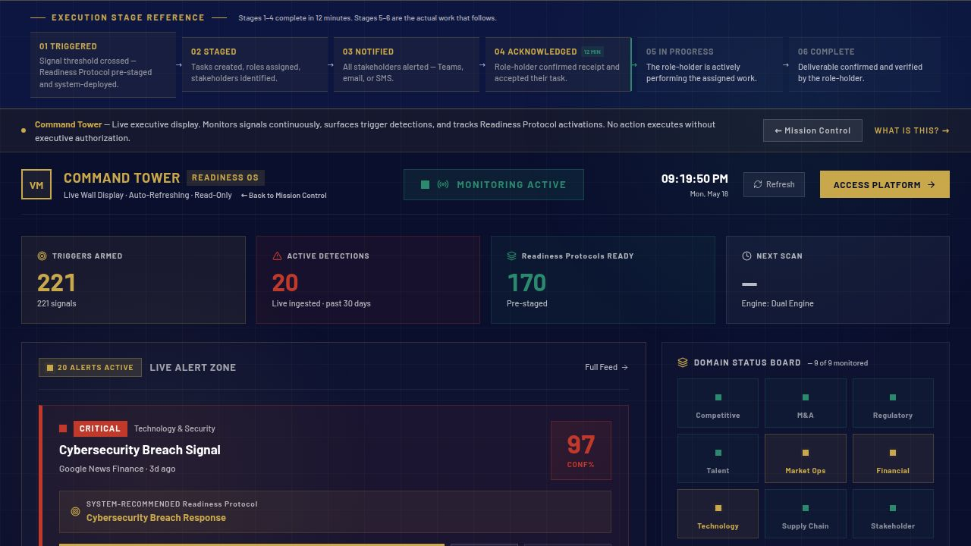
STRATEGIC READINESS PLATFORM · STARTUP TO FORTUNE 500
The response is ready before the trigger fires.
Most enterprises plan to respond. VaughnMartin is already executing.
Activist Investor · 91% confidence
COMMAND TOWER · LIVE SIGNAL MONITORING · PRODUCTION
Ransomware · 95% confidence
Regulatory Inquiry · 87% confidence
AI monitors continuously. Executives authorize decisively. Teams execute.
01 / 11

Slide 2
THE REALITY
THE READINESS QUESTION
30
Who calls who? Where's the brief? Who owns it? Who authorizes?
DAYS
This is a readiness problem, not a talent problem.
Average mobilization time before execution begins.
— Every trigger restarts the mobilization clock from zero
— The window to act closes before execution begins
— Every enterprise has talent. None have pre-staged responses.
02 / 11

Slide 3
THE PROBLEM IS ALREADY HERE
One of these is forming in your organization right now
RISK & RESILIENCE
95%
REGULATORY
87%
GROWTH & POSITIONING
82%
Ransomware Attack Confirmed
Regulatory Inquiry Opened
Market Entry Window Opening
Signal · 248 data points
Signal · threshold crossed
Opportunity · live monitor
221 triggers monitored · 248 data points · refreshed every 15 minutes
03 / 11

Slide 4
THE ANSWER
The response is ready
before the trigger fires.
Preparation → Readiness → Fearless
170
221
12 MIN
Readiness Protocols
Strategic Triggers
Execution Window
AI monitors. Executives authorize. Teams execute.
04 / 11

Slide 5
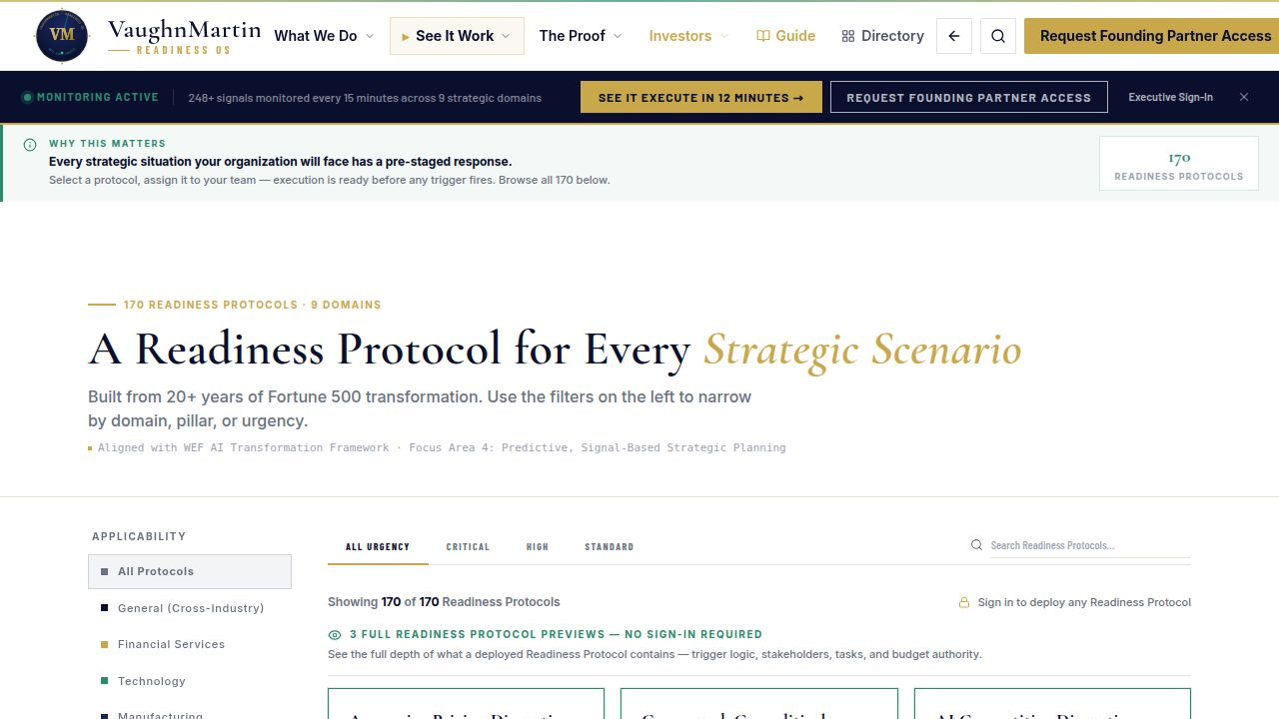
WHY THIS IS DEFENSIBLE
The architecture that separates execution from mobilization
Old Model
VaughnMartin Readiness OS
✕ Faster notes from the same slow meetings
✓ Response pre-staged before the trigger fires
✕ No readiness architecture — triggers catch you cold
✓ 170 protocols · 221 triggers · ready before the moment
✕ Authority unclear when pressure arrives
✓ Executive authorization gate at every activation
✕ 30 days to mobilize before execution starts
✓ 12-minute execution window from signal to action
LIVE PLATFORM · 170 Readiness Protocols · startup to Fortune 500 · vaughnmartin.com
05 / 11

Slide 6
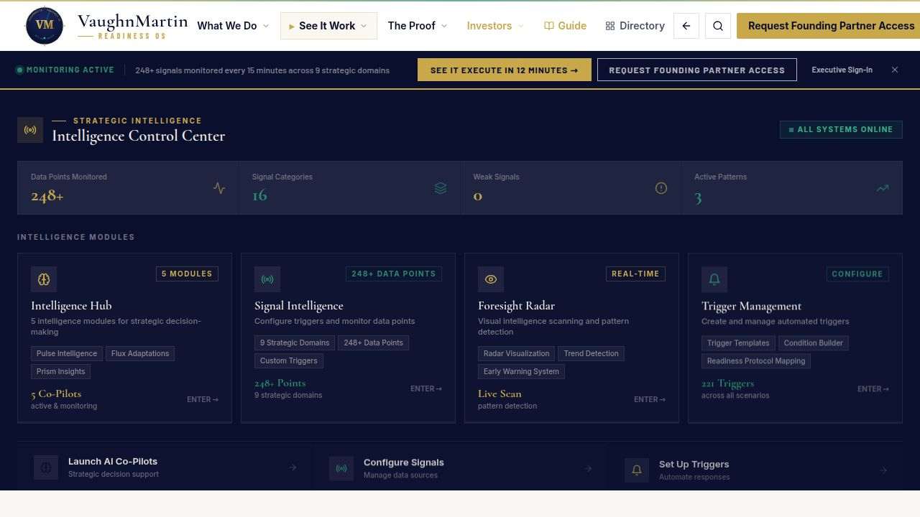
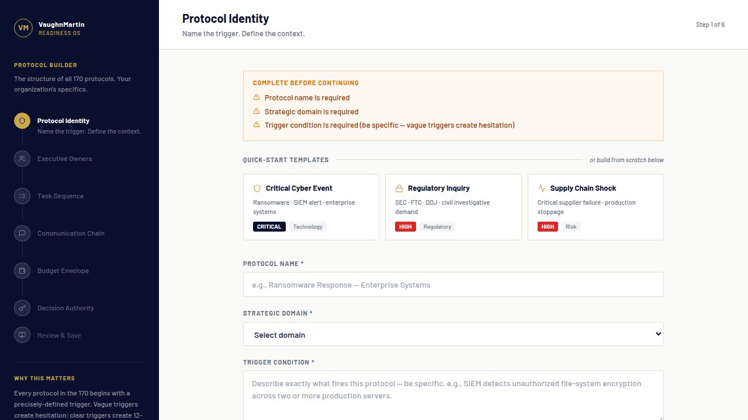
PROOF OF PRODUCTION
From Signal to Authorized Execution in 12 Minutes
01
→
02
→
03
→
04
→
05
→
06
Signal Detected
Threat Classified
Protocol Matched
Team Notified
Executive Authorizes
Response Deploys · 12 MIN ·
LIVE TRIGGER DETECTION · CONFIDENCE SCORING · STARTUP TO FORTUNE 500
PRE-STAGED PROTOCOL · STAKEHOLDERS · AUTHORITY · TASKS READY
AI monitors. Executives authorize. Teams execute.
170 protocols · 221 triggers · 248 data points · 15-minute refresh
06 / 11

Slide 7
BUSINESS VALUE
Readiness is not overhead.
It is value protection.
3,600×
COMMERCIAL LOGIC
Full platform deployment — 170 protocols configured, signals live, team onboarded. Replaces the $400K–$800K consulting retainer. Break-even before the 2nd activation.
Execution head start — 30 days compressed to 12 minutes
FOUNDING PARTNER
$75K / 90 days
▶ Founding Partner: $75K / 90-day validation
GROWTH TIER
$75K–$250K annually
▶ Growth: $75K–$250K annually
COHORT
startup to Fortune 500
▶ Cost of delay is often higher than cost of readiness.
BOARD LINE
Cost of delay > cost of readiness
07 / 11

Slide 8
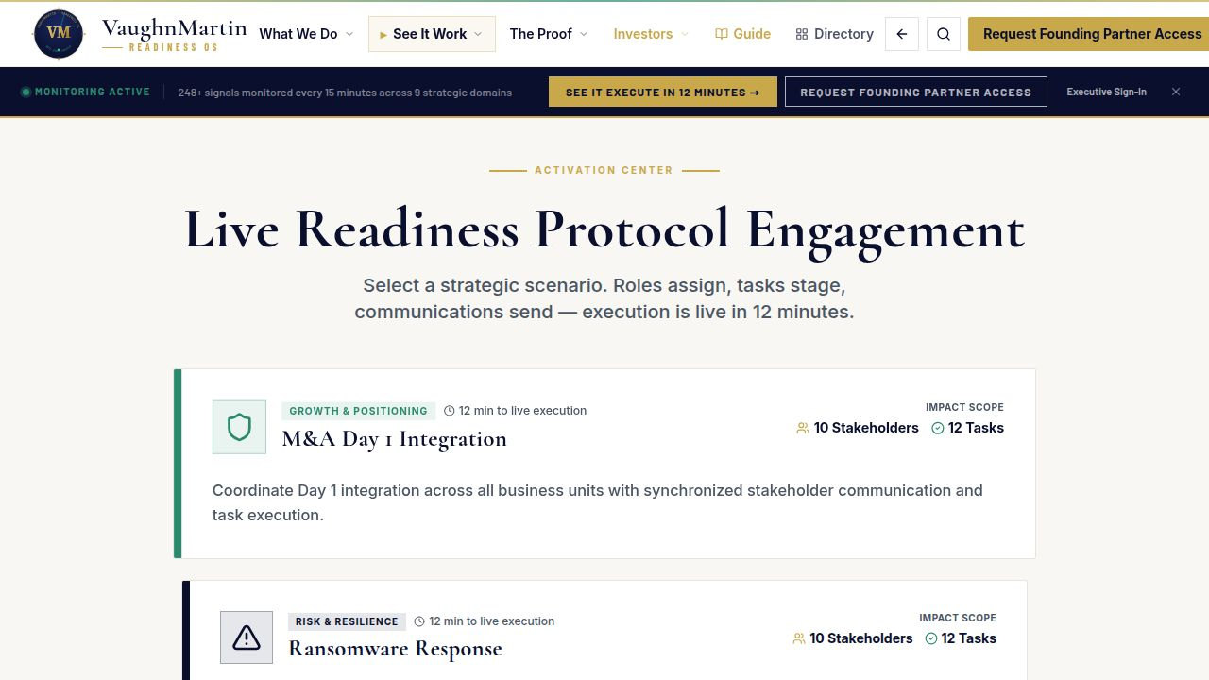
BUILT. LIVE. IN PRODUCTION.
Not a roadmap — operating now
170
221
248
15m
Protocols
Triggers
Data Points
Refresh
Signal Intelligence · Live Detection Feed
Live Activation Console · Execution in Progress
SIGNAL INTELLIGENCE FEED · LIVE DETECTIONS · VAUGHNMARTIN.COM
LIVE ACTIVATION CONSOLE · AUTHORIZED EXECUTION · VAUGHNMARTIN.COM
08 / 11

Slide 9
WHY NOW
AI capability is accelerating faster than enterprise readiness.
01
AI capability accelerating. Enterprise mobilization readiness is not.
02
Execution readiness is now the competitive bottleneck.
03
Winners pair signal detection with governed 12-minute execution.
LIVE ACTIVATION CONSOLE · EXECUTION IN PROGRESS · PRODUCTION
Sources: Stanford HAI AI Index 2026 · Gartner Autonomous Business
09 / 11

Slide 10
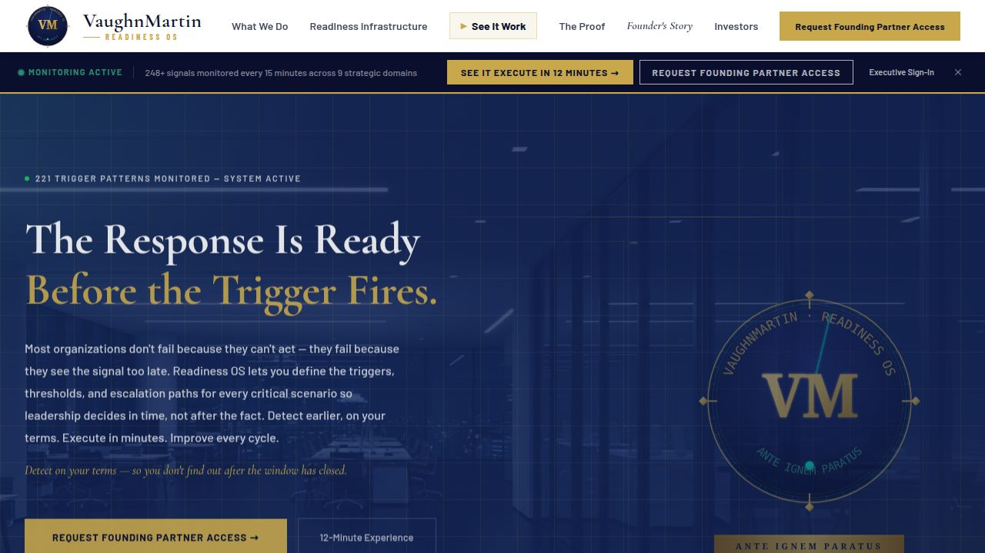
THE ASK
Twelve founding partners. One defining cohort.
Martin Brunke, Founder · 20 years inside enterprise organizations · 5 years on a major college football sideline
12
$75K
F500
Founding Partners
90-Day Validation
Startup to Fortune 500
Partners who want readiness as competitive advantage.
PROGRAM
Founding Partner · 90-Day Validation
COMMERCIAL
READINESS OS · PRODUCTION PLATFORM · VAUGHNMARTIN.COM
$75K / 90 days
DELIVERY
Right-sized by organization maturity
COHORT
12 startup to Fortune 500
SECTORS
All industries · 6 sector packs
RAISE
Open strategic raise · active conversations
Apply for Founding Partner Access
URL
vaughnmartin.com/founding-partner-program
10 / 11

Slide 11
Three lines. That's the pitch.
PROBLEM
Enterprise work was built for a world without AI — coordination delays exist because humans couldn't act fast enough. AI changed the constraint. The operating model hasn't.
SOLUTION
170 Readiness Protocols. 221 strategic triggers. The response pre-staged before the trigger fires. Executives authorize in minutes, not meetings.
OUTCOME
Any organization prepared for every situation it will face is no longer afraid of what comes next. It is fearless.
Apply for Founding Partner Access · vaughnmartin.com/founding-partner-program
11 / 11

