Slide 1

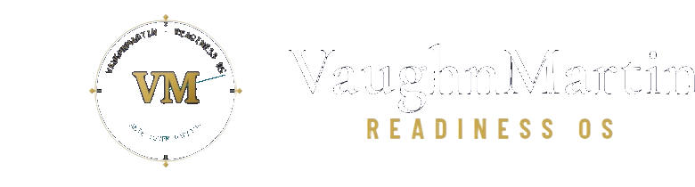
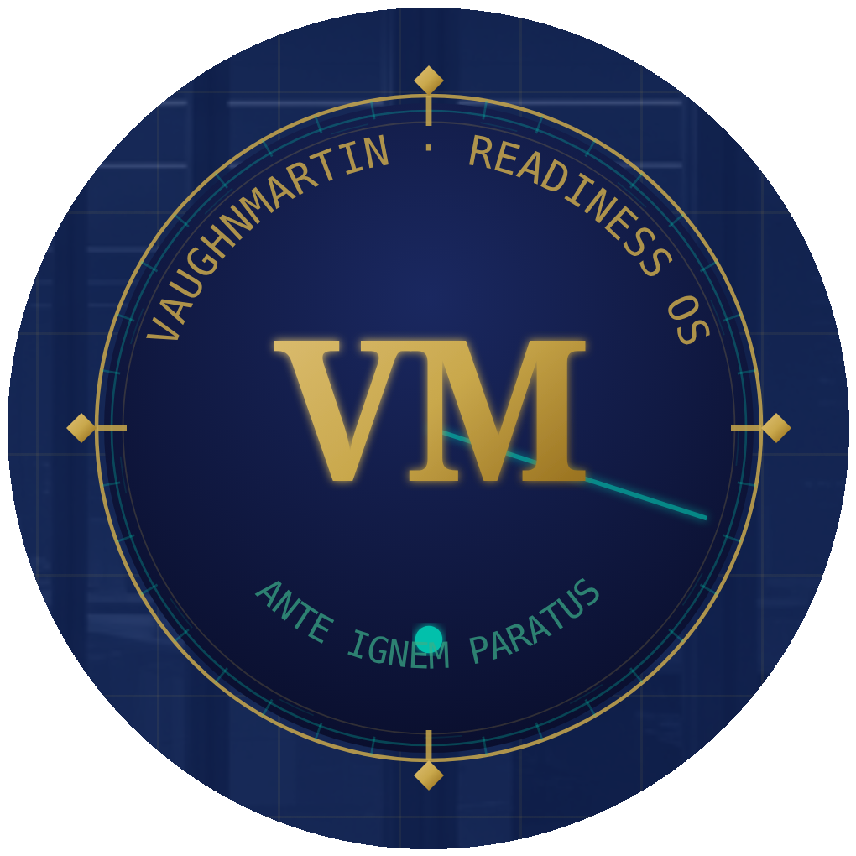
0:20
The Response Is Ready
Before the Trigger Fires.
Readiness OS compresses the 30-day enterprise mobilization cycle to 12 minutes. Pre-staged. System-detected. Executive-authorized.
3,600×
12 MIN
EXECUTION HEAD START
TRIGGER TO WAR ROOM
170
221
READINESS PROTOCOLS
STRATEGIC TRIGGERS
SCHEDULE A CONVERSATION
01 / 10
Notes:
SLIDE 01 — COVER [0:00 – 0:20] TARGET: 20 seconds "Readiness OS compresses the 30-day enterprise mobilization cycle to 12 minutes. Before I explain how — let me show you why that gap is the actual problem." [Pause one beat on the numbers. Don't explain them. Let them land.] KEY NUMBERS TO POINT AT: → 3,600× Execution Head Start (30 days vs. 12 minutes) → 12 Minutes — trigger to war room open → 170 Readiness Protocols — pre-staged → 221 Strategic Triggers — mapped TRANSITION: "Every organization I've studied has the same failure mode..."

Slide 2
── THE PROBLEM ──
0:55
The Mobilization Delay
IS the Crisis.
DETECT
ALIGN
EXECUTE
2–4 WEEKS
3–6 WEEKS
CRISIS WINS
Who monitors the signals? Who decides which ones matter? Who sets the threshold?
Who needs to be in the room? What is the plan? Who approves the first action?
By this point, the window is closed. The opportunity is gone. The damage is done.
"Every vendor bolted AI onto this broken model. Faster spreadsheets. Smarter summaries. Better notes from the same slow meeting. VaughnMartin rebuilds from first principles — because the constraint was never intelligence. It was the operating model."
02 / 10
Notes:
SLIDE 02 — THE PROBLEM [0:20 – 0:55] TARGET: 35 seconds "When a situation the organization has prepared for finally arrives — an activist investor files a 13D, a ransomware attack hits, a supply chain collapses — what happens next in most enterprises?" [Point to DETECT column] "First, two to four weeks figuring out who monitors signals. Who's in the room. What the threshold is." [Point to ALIGN column] "Then another three to six weeks aligning on a plan. Getting approvals. Scheduling the meeting." [Point to EXECUTE column — RED] "By the time execution starts, the window is closed. The window closes. Not because the executives were slow. Because the OPERATING MODEL had no answer pre-staged." "Every solution in this market — Copilot, ChatGPT, strategy consultants — bolted AI onto this same broken model. Faster notes from the same slow meeting." "We didn't do that." TRANSITION: "We rebuilt the operating model itself."

Slide 3
── THE PLATFORM — 5-LAYER OPERATING NERVOUS SYSTEM ──
1:30
Not a Tool.
An always-on operating nervous system for the enterprise.
1
DETECT
Live signal intelligence — 8 sources, 221 triggers, 15-min cycles
2
IDENTIFY
Trigger classification — grouped data points, mandatory conditions, group threshold
3
STAGE
170 Readiness Protocols pre-staged — zero mobilization delay when the trigger fires
4
EXECUTE
Tasks auto-assigned → executive authorizes → war room opens → 12 minutes complete
5
ADVANCE
Institutional memory — every activation improves the protocol, compounds the lead
The response is pre-staged before the trigger fires. Preparation → Readiness → Fearless.
03 / 10
Notes:
SLIDE 03 — THE PLATFORM [0:55 – 1:30] TARGET: 35 seconds "Readiness OS is not a tool you pick up when a situation presents itself. It is infrastructure that never stops running." [Run through layers quickly — point to each colored bar] "Layer 1: The system is always monitoring — 8 live intelligence sources, every 15 minutes, scored against 221 strategic triggers." "Layer 2: When signals cluster, the system recognizes the situation and confirms the threshold — using a proprietary algorithm with grouped data points and mandatory conditions. Not a single signal. An architecture." "Layer 3: Instantly — a pre-staged Readiness Protocol deploys. The war room is armed before anyone picks up the phone." "Layer 4: Tasks are auto-assigned, stakeholders are notified, and the executive authorizes. No action without sign-off. 12 minutes end to end." "Layer 5: Every activation teaches the system. Institutional memory compounds. The longer you are on the platform, the faster and more accurate the response." TRANSITION: "The number everyone asks about is the 3,600× head start. Let me show you what that actually looks like in practice."

Slide 4
── THE 3,600× EXECUTION HEAD START ──
2:05
30 Days
compressed to
12 Minutes.
WITHOUT READINESS OS
WITH READINESS OS
Week 1–2
Identify who monitors this type of signal. Escalate.
0:00
Trigger group threshold met — system detects activation condition
Week 3–4
Align stakeholders. Schedule the meeting. Agree on a plan.
0:02
Protocol #58 deploys automatically — all tasks pre-staged and assigned
Week 5–8
Assign tasks. Get approvals. Begin mobilization.
0:06
Stakeholders notified — war room armed — briefing pre-generated
Week 9+
Execution begins — if the window is still open.
0:12
Executive authorizes — war room opens — execution is live
The response is ready before the trigger fires. · 3,600× Execution Head Start · Executive authority preserved at every step.
04 / 10
Notes:
SLIDE 04 — THE 3,600× HEAD START [1:30 – 2:05] TARGET: 35 seconds "Let me make the 3,600× concrete. This is not a marketing number." [Point to left side] "Without Readiness OS: Week one and two, the enterprise is figuring out who even monitors this type of signal. Week three and four, they're aligning stakeholders. Week five through eight, tasks are finally being assigned. Week nine — if the window is still open — execution begins. That's thirty days just to mobilize." [Point to right side — TEAL column] "With Readiness OS: At minute zero, the system recognizes the situation — the threshold is confirmed, the scenario is classified. The system already knows. At minute two, Protocol 58 deploys automatically — every task pre-staged, every stakeholder pre-identified. At minute twelve, the executive authorizes, and the war room is open." "Thirty days versus twelve minutes. That is the 3,600× execution head start. And the executive makes every decision — the preparation compresses the mobilization, not the authority." TRANSITION: "But here's what separates us from every simulation tool — high-stakes situations don't arrive one at a time."

Slide 5
── COMPOUND INTELLIGENCE — THE DIFFERENTIATOR ──
2:30
Real Crises Arrive
Two at a Time.
12 Compound Protocol Engines activate two playbooks simultaneously. No other platform does this natively.
ACTIVIST INVESTOR + REGULATORY INQUIRY
RANSOMWARE + MEDIA CRISIS
Protocol #58 + Protocol #34 · 10 tasks · dual-track war room
Protocol #12 + Protocol #67 · IT containment + comms run simultaneously
2 PROTOCOLS · SIMULTANEOUS
2 PROTOCOLS · SIMULTANEOUS
✓ Shareholder communication pre-staged and ready
✓ IT isolation protocol activated — no coordination delay
✓ Legal response pre-drafted — awaiting executive sign-off
✓ Customer notification pre-staged — exec approves in 1 click
✓ Board briefing auto-generated in real time
✓ Board report auto-drafted and ready
✓ Regulatory timeline tracked live by system
✓ Media statement armed — release on executive authorization
✓ Media holding statement armed and waiting
✓ Regulatory disclosure pre-staged — filed on schedule
05 / 10
Notes:
SLIDE 05 — COMPOUND INTELLIGENCE [2:05 – 2:30] TARGET: 25 seconds "Here is what separates us from every other platform in this space." [Point to both boxes] "High-stakes situations don't arrive one at a time. An activist investor files a 13D on the same day the DOJ opens an inquiry. Ransomware hits while a product recall is in progress. These aren't edge cases — they are the scenarios that overwhelm enterprises that aren't prepared." "We have twelve Compound Protocol Engines that fire two protocols simultaneously — dual-track war room, no coordination delay, no one waiting for the other team to finish." [Pause] "No other enterprise platform does this natively. Not Copilot. Not any workflow tool. Not a strategy consultant on a retainer." TRANSITION: "And here is why customers don't leave — even after the situation resolves."

Slide 6
── THE COMPOUNDING MOAT — WHY CUSTOMERS DO NOT LEAVE ──
2:52
Every Activation Makes
the Enterprise Smarter. Permanently.
INSTITUTIONAL MEMORY
EXECUTIVE READINESS SCORE
Retrospect™ captures every decision, outcome, and pattern from every activation — building a proprietary playbook dataset from your specific crises. No competitor can replicate it. No consultant can take it when they leave.
0–100 board-level KPI continuously recalculated. Once a board adopts this number — benchmarking it quarterly, reporting it in governance — the switching cost becomes structural. Boards require it. CFOs track it.
→ 67% avg improvement in execution time over 6 months (simulation-validated)
→ New enterprise metric that did not exist before Readiness OS
SELF-IMPROVING PROTOCOLS
BOARD-READY GOVERNANCE
Every activation is classified: Optimization, Mixed-Signal, or Recovery. The system updates trigger conditions and protocol timing from real performance data. It gets faster and more accurate with every use — automatically.
Auto-generated when each war room closes: elapsed time, decisions made, outcome classification, next steps. Governance documentation as a byproduct of execution. Zero manual work.
→ No other platform does this — compounds in value indefinitely
→ Procurement requirement met automatically on every activation
06 / 10
Notes:
SLIDE 06 — THE MOAT [2:30 – 2:52] TARGET: 22 seconds "Every activation compounds the lead. Here is why customers don't leave — even after the situation resolves." [Point to Institutional Memory] "Every decision, every outcome, every pattern from every activation is captured in Retrospect™. That institutional memory is proprietary to the organization — learned from their own activations, not ours. No competitor can replicate it." [Point to Executive Readiness Score] "The Readiness Score becomes a board-level KPI. Once a board is benchmarking it quarterly, the switching cost is structural. They don't leave because the score is theirs." [Point to Self-Improving] "And the system gets better automatically — every activation updates the protocol timing and trigger conditions. No other platform does this." [Short pause] "The longer you are on the platform, the harder it is to leave — and the wider the gap from every competitor grows." TRANSITION: "Now let me show you why the market timing is right now."

Slide 7
── MARKET · MICROSOFT · WHY NOW ──
3:10
$42B Market.
No Incumbent. Right Now.
── THE MICROSOFT UNLOCK ──
$42B
TAM — Enterprise Operating Infrastructure Market
"Every enterprise has Microsoft's AI stack. None have the operating model to use it."
◆ NOT COMPETING
Gartner SPM + GRC + EPMO categories
We complete Microsoft Copilot — the orchestration layer above the investment. We open every enterprise door without competing with the tool on their desktop.
$4.8B
SAM — Mid-Market + Enterprise Readiness Platforms
◆ WHY NOW
Every Azure AI and Copilot deployment created demand for the execution layer above it. No established incumbent owns this orchestration position. The window is open now.
$180M
SOM — Initial Founding Partner Cohort + Pipeline
◆ THE DOOR
"Your Microsoft investment is already in place. Readiness OS is the operating model layer that makes it execute at enterprise speed."
Sources: Gartner Strategic Portfolio Management 2025 · McKinsey Organizational Agility Research 2025 · WEF × Accenture March 2026
07 / 10
Notes:
SLIDE 07 — MARKET + MICROSOFT [2:52 – 3:10] TARGET: 18 seconds
"The market is 42 billion dollars — and no incumbent owns the orchestration layer. This category is brand new."
[Point to Microsoft section]
"Every enterprise already has Microsoft's AI stack — Copilot, Azure OpenAI, Teams, Entra. They have spent billions on intelligence. None of them have the operating model to execute on it at enterprise speed."
"That is our opening line into every account: 'Your Microsoft investment is already in place. We're the operating model layer that makes it execute.'"
"We don't compete with Copilot. We open the door Copilot already unlocked."
TRANSITION: "And the product is not a roadmap — it's live right now."

Slide 8
── PROOF + BUSINESS MODEL ──
3:38
The Product Is Live.
Run it right now. No login.
── BUSINESS MODEL ──
/12-minute-experience
7 live scenarios, no login, no demo call. Run a full Activist Investor or Ransomware response from signal to war room in 12 minutes — during this meeting.
$120K
92%
Average ACV
Target Gross Margin
2–4 Weeks
< 6 mo
/demo-hub
First Results
Payback Period
12 full scenario simulations across all 3 domains. Every industry. CEO, COO, Risk Head walkthroughs. Demonstrable on demand, right now.
── THREE-TIER MODEL ──
READINESS CORE
170 protocols · signal detection · war room
$75K–$120K/yr
/master-demo
FOUNDING PARTNER
$120K–$180K/yr
+ Custom builder · compound engines
Complete 7-phase Activist Investor walkthrough — signal detection through post-activation debrief. Every platform layer in one sequence.
ENTERPRISE
+ Industry packs · multi-org · board suite
$180K–$240K/yr
08 / 10
Notes:
SLIDE 08 — PROOF + BUSINESS MODEL [3:10 – 3:38] TARGET: 28 seconds "The product is live. The 12-Minute Test Drive is public — no login required." [Point to /12-minute-experience] "Go to slash 12-minute-experience right now. Seven scenarios. Full Activist Investor response — signal detected to executive authorization — in twelve minutes. On your phone, on your laptop, right now." NOTE: The Test Drive is the public proof point. Full platform access — the authenticated war room, full protocol library, activation console — requires application through the Founding Partner Program. That is intentional. The full platform is proprietary IP and is not publicly accessible. "This is not a prototype. Not a roadmap. Twelve full scenarios demonstrable on demand." [Pivot to business model — right side] "The model is annual SaaS. Average ACV is a hundred and twenty thousand dollars. Target gross margin is ninety-two percent. First results in two to four weeks. Customer payback under six months." "Three tiers — Core opens the account at seventy-five to a hundred and twenty thousand. Industry packs expand it. Enterprise seals multi-year." TRANSITION: "Here is what we're asking for — and where the money goes."

Slide 9
── THE ASK — FOUNDING PARTNER PROGRAM ──
3:52
$750,000 Seed.
18 months. 3 milestones. Series A positioned on real ARR.
3–5 Founding Partner Agreements Closed
01
Validate enterprise willingness-to-pay at $120K–$180K ACV. Document 2 full activation proof points with real measurable outcomes. The 12-Minute Test Drive converts prospects before the first sales call.
Series A Positioned on Real ARR
02
$625K+ ARR contracted. Two enterprise proof points documented. Land-and-expand path through industry packs active. Institutional memory data visible as a competitive moat. Series A process begins.
Category Defined — Operating Model Layer
03
Analyst community engaged. Microsoft partnership conversations initiated. Board-level Readiness Score becoming a standard enterprise KPI. The category name is ours to define.
USE OF FUNDS: 40% Go-to-Market · 35% Engineering · 15% Operations · 10% Reserves
09 / 10
Notes:
SLIDE 09 — THE ASK [3:38 – 3:52] TARGET: 14 seconds "We are raising seven hundred and fifty thousand dollars — eighteen months, three milestones." [Point to milestones quickly] "Milestone one: close three to five Founding Partners at a hundred and twenty to a hundred and eighty thousand ACV. Document the proof points." "Milestone two: enter Series A with real ARR contracted and the land-and-expand path proven through industry packs." "Milestone three: own the category name. The operating model layer above the Microsoft investment." "The product is built and in production. This round is a go-to-market round — forty percent goes to customer acquisition and sales, thirty-five to engineering for industry packs and enterprise controls, fifteen to operations, ten held in reserve." TRANSITION: [Advance to close immediately]

Slide 10
4:00
PREPARATION → READINESS → FEARLESS
"The response is ready
before the trigger fires."
Every organization that prepares for every situation it will face is no longer afraid of strategic triggers. It is fearless.
The protocols are staged.
The system is armed.
Which enterprises get there first?
SCHEDULE A CONVERSATION
10 / 10
Notes:
SLIDE 10 — CLOSE [3:52 – 4:00] TARGET: 8 seconds [Pause. Let the room settle.] "Every organization that prepares for every situation it will face is no longer afraid of any situation they will face." [One more beat.] "It is fearless." [Leave the slide up. Do not advance. Wait for the question.] --- POST-PRESENTATION --- If they ask for a demo: "Run slash 12-minute-experience right now. No login. Pick Activist Investor." If they ask about competition: "Slide in the appendix of our full deck — or I'll answer it now." If they ask about revenue: "The Founding Partner Program is the revenue proof — three agreements at a hundred and twenty thousand validates the model before Series A."

Slide 11
APPENDIX · IF ASKED
Data & Privacy
Architecture built for enterprise trust — key facts for any procurement or investor conversation
DATA OWNERSHIP
TENANT ISOLATION
Customer data is exclusively owned by the customer. VaughnMartin cannot access it without explicit consent.
Every query is organization-scoped at the database layer — cross-tenant reads are architecturally prevented.
ENCRYPTION
AI & MODEL SAFETY
TLS encrypted in transit. Encrypted at rest via Neon PostgreSQL (SOC 2 Type II certified infrastructure).
All AI processing runs through Azure OpenAI under enterprise data processing agreements — your data does not train the models. AI analysis is sandboxed and cannot directly modify org data.
GDPR ALIGNMENT
SOC 2 ROADMAP
Consent-based access, customer-controlled data deletion, and configurable retention policies are built in.
Database infrastructure is SOC 2 Type II certified today. Platform-level audit is on the GA roadmap. Architecture documentation available on request.
ACCESS CONTROL
Role-Based Access Control enforced at every route — platform admin, executive, and operator roles with fail-closed error handling. Email allowlist gates all logins; open by default, restrictive once any address is added. No Readiness Protocol activates without executive sign-off — every action requires a named human authorization. Audit log captures every decision, activation, and ownership acknowledgment with timestamped attribution.
Full procurement-ready security overview available at /security-compliance · Architecture documentation available on request
Notes:
APPENDIX — DATA & PRIVACY [Flip to if asked] USE WHEN: An investor or enterprise contact asks about data security, AI safety, or compliance. TALKING POINTS: → Customer data is owned by the customer. VaughnMartin cannot access it without explicit consent. → Every query is org-scoped at the database layer — cross-tenant reads are architecturally prevented, not just policy. → AI processing runs through Azure OpenAI under enterprise data processing agreements. Your data does not train their models. → TLS encrypted in transit. Encrypted at rest. Neon PostgreSQL infrastructure is SOC 2 Type II certified today. → Platform-level SOC 2 audit is on the roadmap for GA. We have a full architecture documentation package available on request. → No Readiness Protocol activates without executive sign-off — every action requires named human authorization. IF THEY PUSH ON SOC 2: "Our infrastructure is certified today. The platform audit is scheduled as part of GA. For Founding Partners working with us during the validation period, we can share the full security architecture document." Direct them to: vaughnmartin.com/security-compliance

Slide 12
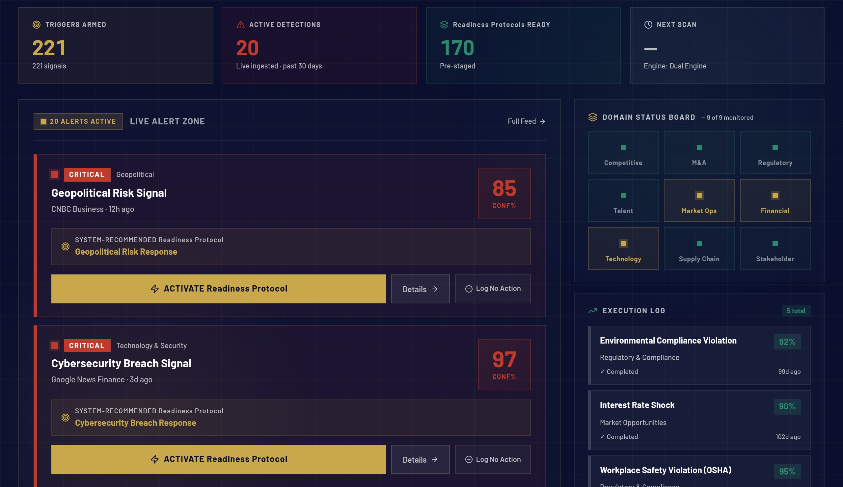
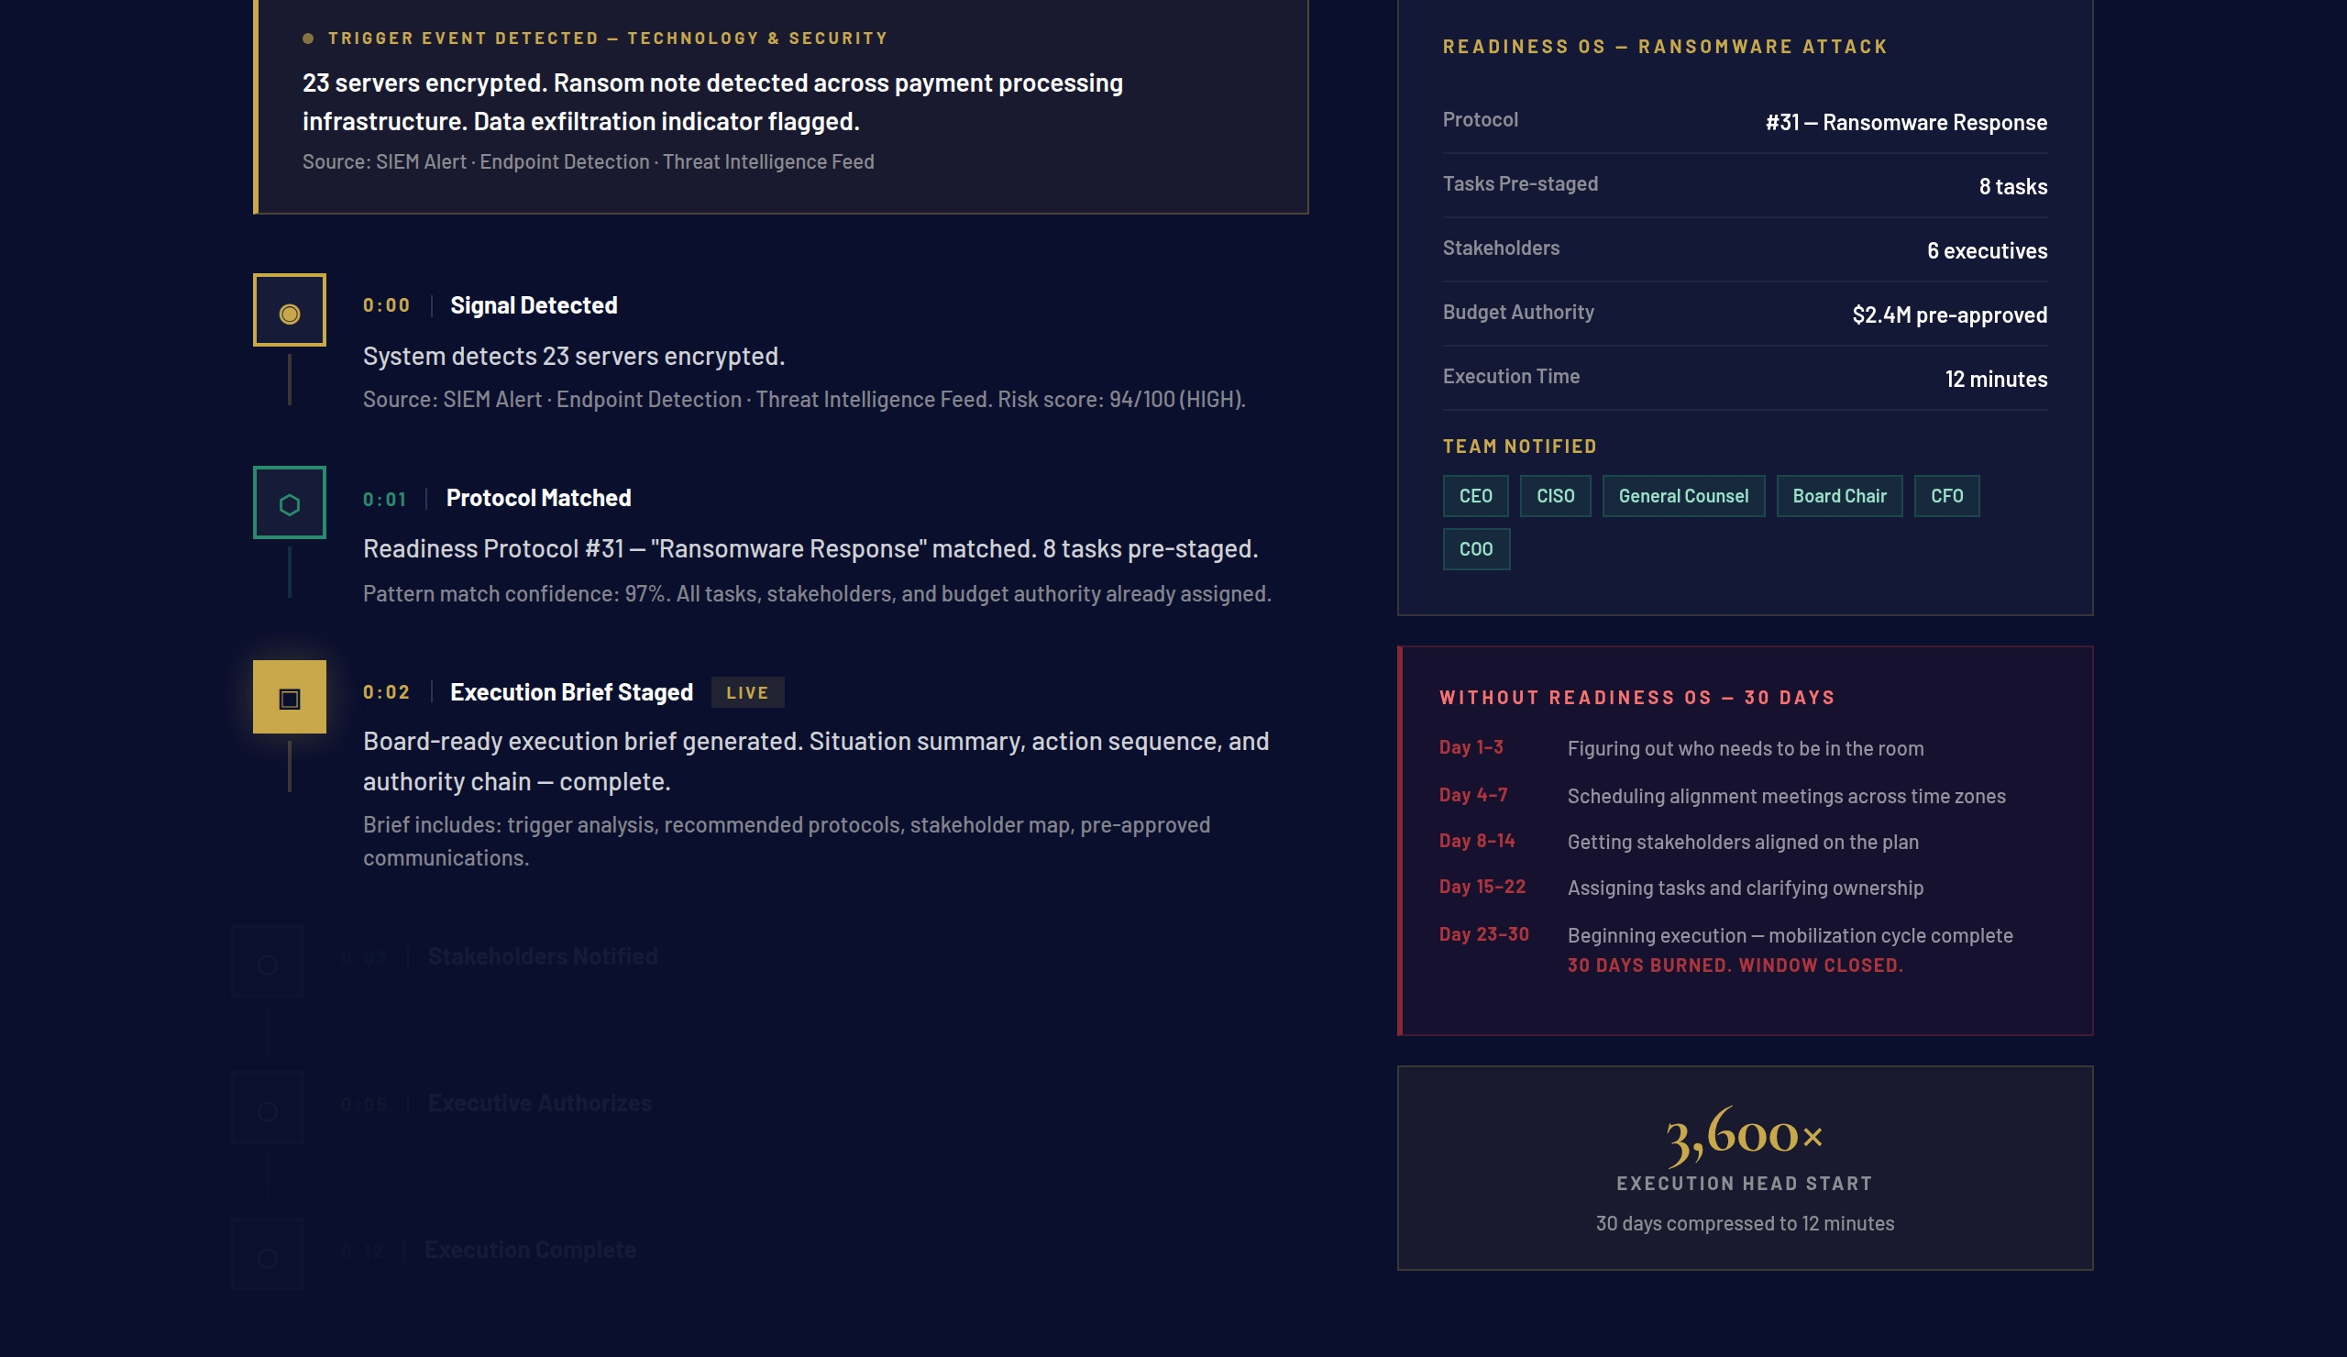
APPENDIX · LIVE PRODUCT — SIGNAL INTELLIGENCE & EXECUTION
The System Is Always On.
Live signal monitoring → trigger detection → protocol staged → war room open. All in 12 minutes.
COMMAND TOWER — LIVE SIGNAL FEED
EXECUTION CHAIN — SIGNAL TO WAR ROOM
221 strategic triggers monitored continuously across 8 intelligence sources. Signal groups scored in real time — threshold met means the protocol is already staged.
The animated signal → protocol → task assignment → executive authorization → war room open chain. 12 minutes complete. The response was pre-staged before this moment.
Live product — accessible now at vaughnmartin.com · No login required for the 12-Minute Test Drive
Notes:
APPENDIX — LIVE PRODUCT: SIGNAL INTELLIGENCE & EXECUTION CHAIN [Flip to if asked to see the product] USE WHEN: An investor says "can you show me the product?" or "what does it actually look like?" TALKING POINTS: → Left screenshot: The Command Tower. This is live — 221 triggers monitored across 8 sources every 15 minutes. The score you see recalculates continuously. This is not a mock. → Right screenshot: The Execution Chain. This is the animated signal → protocol → task assignment → executive authorization → war room open sequence. Every step you see here happens in the live product. THEN OFFER: "Go to vaughnmartin.com/12-minute-experience right now — no login. Pick Activist Investor or Ransomware. You'll see the full cycle in twelve minutes." NOTE: The 12-Minute Test Drive is public. The full Command Tower, full war room, and full protocol library are behind the Founding Partner access gate.

Slide 13
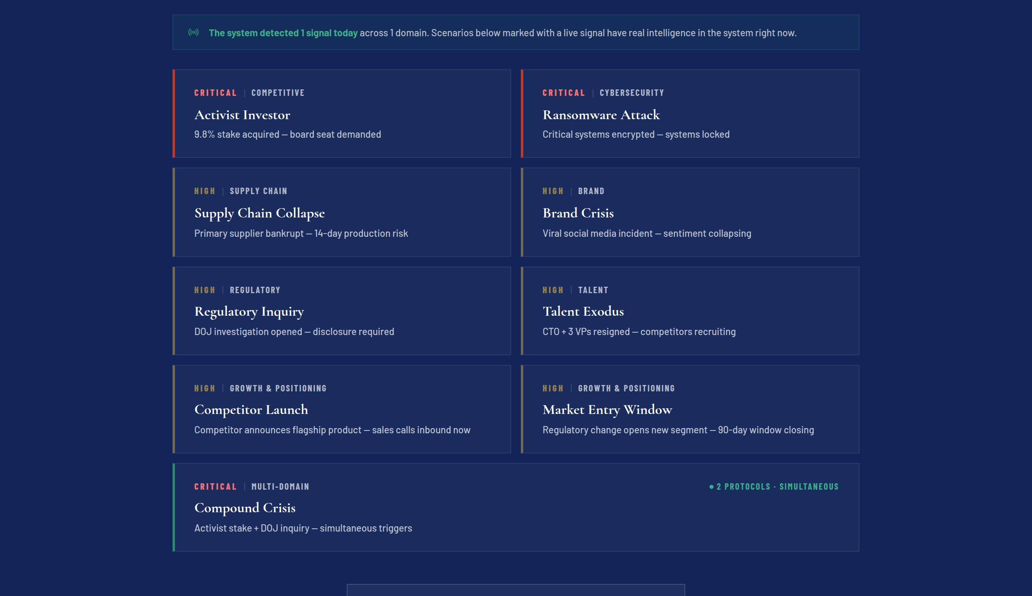
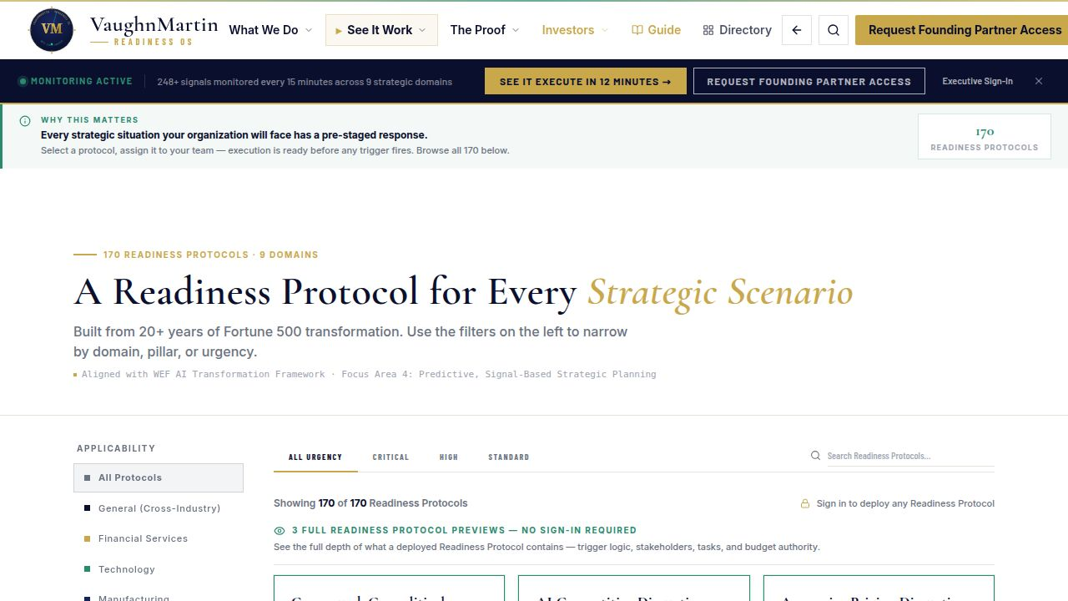
APPENDIX · LIVE PRODUCT — TEST DRIVE & PROTOCOL DEPTH
Run It Right Now. 170 Protocols Ready.
7 live scenarios, no login. Any investor can experience a full crisis response in 12 minutes — during this meeting.
12-MINUTE TEST DRIVE — 7 LIVE SCENARIOS
170 READINESS PROTOCOLS — PRE-STAGED DEPTH
Public access. No login. Activist Investor, Ransomware, Supply Chain, M&A — full signal → war room → debrief cycle. Run it now at /12-minute-experience.
Every protocol mapped across GROWTH & POSITIONING, RISK & RESILIENCE, and TRANSFORMATION. 12 Compound Protocol Engines for simultaneous multi-threat response.
Live product — accessible now at vaughnmartin.com · No login required for the 12-Minute Test Drive
Notes:
APPENDIX — LIVE PRODUCT: TEST DRIVE & PROTOCOL DEPTH [Flip to if asked about scale or proof] USE WHEN: An investor asks "how do I know it works?" or "how deep is the protocol library?" TALKING POINTS: → Left screenshot: The 12-Minute Test Drive. Seven scenarios, no login, full cycle. This is your live proof — available during this meeting. → Right screenshot: The Protocol Library. 170 Readiness Protocols mapped across GROWTH & POSITIONING, RISK & RESILIENCE, and TRANSFORMATION. 12 Compound Protocol Engines for simultaneous multi-threat response. This is what "pre-staged" means at depth. IF THEY WANT TO RUN IT NOW: Have them open vaughnmartin.com/12-minute-experience on their phone. If they want to see more: "Full access is through the Founding Partner Program — that is the correct path for any organization ready to engage."

Slide 14
APPENDIX · SOURCES & REFERENCES
Sources & References
VaughnMartin Readiness OS · Investor Pitch · May 2026 · vaughnmartin.com
Slides 1, 4 · 30-Day Mobilization Baseline & 3,600× Calculation
VaughnMartin operational research — 20+ years direct experience across Ford, Toyota, Lockheed Martin, Charles Schwab, and Boyd Gaming. McKinsey Organizational Agility Research (2025). Calculation: 30 days × 24 hrs × 60 min = 43,200 min ÷ 12 min = 3,600×. Baseline is average Fortune 1000 cross-functional mobilization cycle.
Slide 7 · $42B TAM / $4.8B SAM / $180M SOM
Gartner Strategic Portfolio Management 2025 (SPM + GRC + EPMO combined categories). McKinsey 2025 coordination cost research. WEF × Accenture Strategic Readiness Report, March 2026. SAM: ~25K target accounts × $200K avg ACV. SOM: 600 customers × $300K avg ACV by Year 5.
Slide 6 · 67% Execution Improvement
VaughnMartin simulation-validated performance modeling based on platform activation cycle data. Labeled "simulation-validated" on slide. Baseline: enterprise crisis response timelines across GROWTH & POSITIONING, RISK & RESILIENCE, and TRANSFORMATION domain scenarios.
Slide 8 · Platform Metrics
VaughnMartin Readiness OS production system, May 2026. All platform layers live in production. 221 strategic triggers. 170 Readiness Protocols. 12 Compound Protocol Engines. 8 live signal sources on 15-minute monitoring cycles. Verifiable at vaughnmartin.com
Slide 8 · Business Model & Unit Economics
VaughnMartin internal pricing model. $120K Average ACV based on Founding Partner tier mid-point. 92% Target Gross Margin based on SaaS infrastructure cost modeling at scale. <6 Month Payback Period derived from enterprise crisis cost avoidance vs. annual platform fee. 2–4 Weeks First Results based on onboarding timeline: Week 1 setup, Weeks 2–4 live protocols.
Access & Verification · Financial projections are forward-looking estimates · Confidential
12-Minute Test Drive available without login at vaughnmartin.com/12-minute-experience. Full platform access requires application — the Founding Partner Program is the current access path. Full platform capabilities represent VaughnMartin intellectual property and are not publicly accessible. Platform metrics cited are live production figures from the authenticated environment.
VaughnMartin Readiness OS · Confidential — For Qualified Investor Use Only · vaughnmartin.com
Notes:
APPENDIX — SOURCES & REFERENCES [Flip to if sources are challenged] USE WHEN: An investor challenges the $42B TAM, the 3,600× figure, or asks where the numbers come from. KEY SOURCE EXPLANATIONS: $42B TAM: Gartner Strategic Portfolio Management 2025 — SPM + GRC + EPMO combined categories. This is the enterprise coordination, governance, and execution infrastructure market. $4.8B SAM: Same Gartner source, scoped to Fortune 5000 and PE-backed enterprises at target ACV. 3,600×: This is math, not marketing. 30 days × 24 hours × 60 minutes = 43,200 minutes. Divided by 12 minutes = 3,600×. The 30-day baseline is average Fortune 1000 cross-functional mobilization from McKinsey Organizational Agility Research (2025). 67% execution improvement: Simulation-validated — labeled as such on Slide 6. Not a customer cohort claim. Platform metrics (221 triggers, 170 protocols, 8 sources): Live production system. Verifiable at vaughnmartin.com — authenticated environment only. Business model: Internal pricing model. All metrics labeled as targets where applicable.

