Slide 1

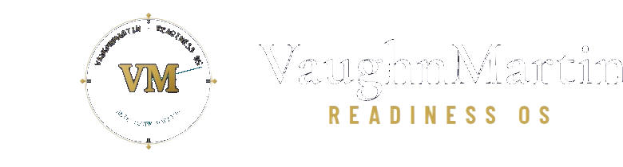
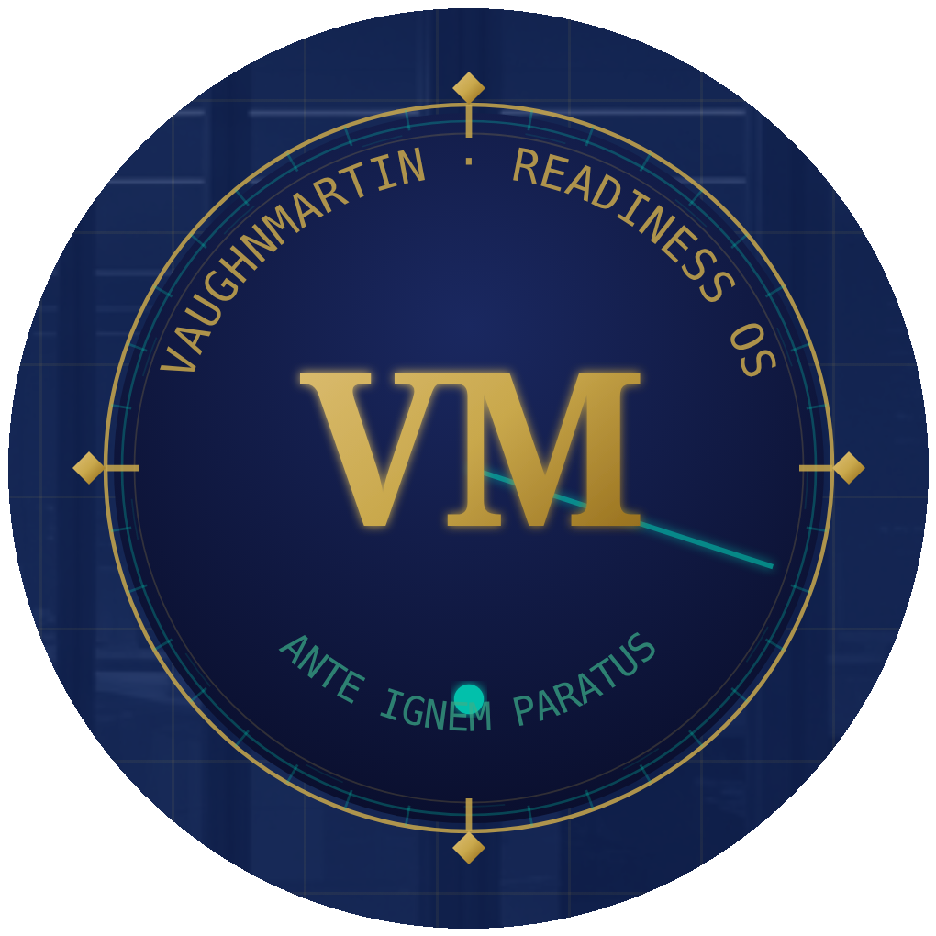
● MONITORING ACTIVE · 1 SIGNAL DETECTED · SYSTEM ARMED
READINESS OS · LIVE
The Response Is Ready
Before the Trigger Fires.
Readiness OS compresses the 30-day enterprise mobilization cycle to 12 minutes — pre-staged, system-detected, executive-authorized.
3,600×
12 MIN
170
221
EXECUTION HEAD START
TRIGGER TO WAR ROOM
READINESS PROTOCOLS
STRATEGIC TRIGGERS
FOUNDING PARTNER PROGRAM
00 / 18

Slide 2
── THE PROBLEM ──
The Mobilization Delay
IS the Crisis.
When a strategic trigger fires, organizations spend weeks just getting organized — before a single decision is made. The delay is not a symptom. It IS the crisis.
DETECT
ALIGN
EXECUTE
2–4 WEEKS
3–6 WEEKS
CRISIS WINS
Who monitors signals? Which ones matter? Who decides the threshold?
Who needs to be in the room? What is the plan? Who approves it?
By this point the window has closed. The opportunity is gone. The damage is done.
"In any organization — startup to Fortune 500 — when a strategic trigger fires, the enterprise spends weeks just to MOBILIZE before execution even begins. That mobilization delay is the real crisis."
01 / 18

Slide 3
── WHY CURRENT SOLUTIONS FAIL ──
Everyone Bolted AI Onto
The 40-Year-Old Operating Model.
The constraint was never intelligence. It was the operating model underneath it. Faster spreadsheets. Smarter summaries. Better notes from the same slow meeting.
SOLUTION
WHAT IT DOES
WHAT IT MISSES
Microsoft Copilot
Summarizes meetings faster
The operating model that acts on those summaries
ChatGPT / Claude
Answers questions in real time
Pre-staged execution before the question is asked
Strategy Consultants
Builds the plan after crisis hits
Speed, cost ($250K+), and institutional memory
Workflow Automation
Executes predefined tasks
Trigger detection, compound crises, executive auth
Scenario Planning
Documents possible futures
Staged, authorized, executable response protocols
VaughnMartin rebuilds from first principles. Not faster tools. A new operating model. Pre-staged protocols replace real-time coordination. Pattern detection replaces committee deliberation.
02 / 18

Slide 4
── THE PLATFORM ARCHITECTURE ──
An Always-On Operating
Nervous System for the Enterprise.
Not a tool you pick up when the crisis hits. Infrastructure that never stops running — detecting, staging, executing, and learning.
01
DETECT
8 sources · 15-min cycles · 221 triggers mapped · risk scoring · Readiness Score · Command Tower always live
Live Signal Intelligence
02
IDENTIFY
Proprietary algorithm · √signals × 8 · LOW / MEDIUM / HIGH · grouped data points · mandatory conditions · group threshold
Trigger Classification
03
STAGE
170 Readiness Protocols + 12 Compound Engines pre-built and staged — zero delay when the trigger fires
Protocol Pre-Staging
04
EXECUTE
Tasks assigned · stakeholders notified · executive authorizes · war room opens · 12 minutes end to end
War Room & Executive Auth
05
ADVANCE
Debrief classification · score update · protocol refinement · board reports · compounding value every activation
Institutional Memory Loop
03 / 18

Slide 5
── DETECT PHASE — LIVE SIGNAL INTELLIGENCE ──
The System Never Sleeps.
Continuous monitoring. Automatic scoring. Always armed.
Eight live intelligence sources are monitored every 15 minutes, scored against 221 strategic triggers using a proprietary risk algorithm.
8
15
◆ Executive Readiness Score
0–100 board-level KPI · continuously recalculated from live signals, protocol activations, and debrief outcomes · once boards track this number, you own the relationship permanently
LIVE INTELLIGENCE SOURCES
MINUTES BETWEEN SCAN CYCLES
◆ Command Tower
Full-screen executive display · live trigger detections · multi-protocol status · system statistics · always-on mission control for the C-suite · real-time risk scoring visible
221
16
◆ Risk Scoring Algorithm
STRATEGIC TRIGGERS MAPPED
TRIGGER PATTERN CLASSIFIERS
Proprietary: √signals × 8 · auto-classifies LOW (<35) / MEDIUM (35–74) / HIGH (75+) · routes directly to appropriate Readiness Protocol
◆ Regulatory Calendar
Compliance deadlines tracked · GDPR, SOX, FDA, SEC · urgency-flagged · readiness sprints triggered automatically before deadline windows close
04 / 18

Slide 6
── DETECT PHASE — TRIGGER ARCHITECTURE ──
Triggers Are Not Single Signals.
Grouped data points. Individual thresholds. Mandatory conditions.
Each trigger is an architecture — a defined group of data points that must collectively meet specific conditions before a playbook deploys.
── THE THREE-THRESHOLD MODEL ──
── EXAMPLE: ACTIVIST INVESTOR TRIGGER GROUP ──
Group Threshold: 4 of 5 data points valid · ★ = Mandatory (must be present)
LAYER 1 — DATA POINT THRESHOLD
Each individual data point has its own metric it must meet to become a valid signal. A regulatory filing. A sentiment score below baseline. A volume anomaly. Until a data point clears its individual metric, it does not count toward the group trigger.
★ MANDATORY
SEC 13D Filing Detected
VALID ✓
> 5% ownership disclosure filed
◆
Institutional Position Change
VALID ✓
> 2% change in 30-day window
LAYER 2 — MANDATORY CONDITIONS
Specific data points within a group can be flagged as mandatory. The group cannot fire — regardless of how many other signals are valid — unless every mandatory data point has been met. Eliminates false positives on partial signal sets.
◆
Board Communication Volume
VALID ✓
> 40% above 90-day baseline
◆
Proxy Advisor Engagement
PENDING
2+ advisors engaged — monitoring
LAYER 3 — GROUP THRESHOLD
◆
Media Sentiment Score
Once individual data points are validated, the group itself must cross a final threshold — a required number or combination of valid signals. Only when the group threshold is met does the playbook trigger and move to execution.
Sentiment index < 35 (negative zone)
VALID ✓
→ Protocol #58 Activist Investor Defense deploys · 12-minute execution begins
4 / 5 VALID · MANDATORY MET → PROTOCOL #58 TRIGGERED — WAR ROOM OPEN
05 / 18

Slide 7
── IDENTIFY PHASE — PROTOCOL ARCHITECTURE ──
170 Core Protocols. 12 Compound Engines.
6 Industry Packs. Pre-staged before the trigger fires.
Built in the Identify phase — each protocol is a complete deployment architecture with roles, tasks, communications, and escalation paths.
GROWTH & POSITIONING
RISK & RESILIENCE
TRANSFORMATION
→ Competitor Displacement Sprint
→ Ransomware Response Protocol
→ Workforce Transformation (6,720 roles)
→ M&A Rapid Response (LOI in 48h)
→ FDA Recall & Safety Crisis
→ Digital Platform Migration
→ Market Entry Acceleration
→ Supply Chain Collapse
→ Post-M&A Integration Sprint
→ Go-to-Market Sprint
→ Data Breach & Privacy Crisis
→ Energy Grid Failure Response
→ Partnership Crisis Response
→ DOJ Investigation Response
→ Food Safety Crisis Protocol
→ Brand Reputation Defense
→ Activist Investor Defense
→ Regulatory Compliance Sprint
+ INDUSTRY PROTOCOL PACKS: Healthcare · Financial Services · Manufacturing · Energy · Retail · Technology
06 / 18

Slide 8
── COMPOUND INTELLIGENCE — THE DIFFERENTIATOR ──
Real Crises Don't Arrive
One at a Time. Two protocols fire simultaneously.
12 Compound Protocol Engines activate two protocols simultaneously when crises overlap. No other enterprise platform does this natively.
ACTIVIST INVESTOR + REGULATORY INQUIRY
RANSOMWARE + MEDIA CRISIS
Protocol #58 + Protocol #34 · 10 tasks · dual-track war room · 12-minute authorization
Protocol #12 + Protocol #67 · IT containment + comms run in parallel · zero coordination delay
2 PROTOCOLS · SIMULTANEOUS ACTIVATION
2 PROTOCOLS · SIMULTANEOUS ACTIVATION
✓ Shareholder communication pre-staged
✓ IT isolation protocol activated
✓ Legal response pre-drafted & ready
✓ Customer notification pre-staged
✓ Board briefing auto-generated
✓ Board report auto-drafted
✓ Regulatory timeline tracked live
✓ Media statement ready to release
✓ Media holding statement ready
✓ Regulatory disclosure pre-staged
12 Compound Protocol Engines · Cross-domain simultaneous response · No other platform does this natively
07 / 18

Slide 9
── EXECUTE PHASE — THE 12-MINUTE CHAIN ──
Signal to War Room.
12 minutes. Executive authority preserved at every step.
When the trigger group threshold is met, the playbook deploys automatically. Every element pre-staged in the Identify phase activates now.
12 MINUTES · END TO END
01
02
03
04
05
SIGNAL DETECTED
PROTOCOL STAGED
TASKS ASSIGNED
EXECUTIVE AUTHORIZES
WAR ROOM OPEN
Scored against 221 trigger groups
Playbook deploys instantly
Stakeholders notified automatically
No action without sign-off
Full coordination console live
Real Organizational Stakeholders
Decision Log & Audit Trail
Ownership Close-Out Gate
Actual executives — not placeholders
Every decision captured for governance
Formal verdict required post-activation
Board-Ready Report
Post-Activation Debrief
Protocol Score Update
Auto-generated when war room closes
Optimization / Mixed-Signal / Recovery
System improves from every activation
08 / 18

Slide 10
── ADVANCE PHASE — THE COMPOUNDING MOAT ──
Every Activation Makes the
Enterprise Smarter. Permanently.
The longer you are on the platform, the more defensible your position — and the harder it is to leave. The intelligence is yours, not ours.
INSTITUTIONAL MEMORY
EXECUTIVE READINESS SCORE
Retrospect™ captures every decision, outcome, and pattern. Builds a proprietary playbook dataset from your specific activations — not generic templates. No competitor can replicate it.
0–100 board-level KPI continuously recalculated. Once a board adopts this number — benchmarking quarterly — you own that relationship. Boards require it. CFOs track it.
→ 67% avg improvement in execution time over 6 months
→ New enterprise metric that did not exist before Readiness OS
BOARD-READY ACTIVATION REPORTS
DEBRIEF & PROTOCOL IMPROVEMENT
Auto-generated when each war room closes. Elapsed time, decisions made, outcome classification, next steps. Zero manual work. Governance documentation as a byproduct of execution.
Every activation classified: Optimization, Mixed-Signal, or Recovery. System updates protocol trigger conditions from real performance data. Compounds in accuracy with every use.
→ Procurement requirement met automatically on every activation
→ Self-improving — no other platform does this
09 / 18

Slide 11
── MARKET OPPORTUNITY ──
The Operating Model Market
Has Never Been Captured.
Every AI investment created the need for the operating model beneath it. That market is new, growing, and unoccupied at the orchestration layer.
$42B
── WHY NOW ──
TAM
→ AI changed the speed of information — the enterprise operating model has not caught up
Enterprise Operating Infrastructure Market
→ Every Microsoft Copilot and Azure AI investment creates demand for the execution layer above it
SAM
$4.8B
Mid-Market + Enterprise Readiness Platforms
→ Enterprise boards now require documented readiness for governance, audit, and regulatory compliance
SOM
$180M
→ The window to define this category is now — no established incumbent owns the orchestration layer
Initial Founding Partner Cohort + Pipeline
10 / 18

Slide 12
── STRATEGIC POSITIONING ──
Every Enterprise Has Microsoft's AI Stack.
None Have the Operating Model to Use It.
We are not competing with Microsoft Copilot. We are completing it — the orchestration layer above the Microsoft investment.
THE MICROSOFT ENTERPRISE STACK
◆ NOT A REPLACEMENT
READINESS OS
We don't replace any Microsoft product. We make all of them deliver enterprise value at the speed AI enables — which is exactly what the board paid for.
The Operating Model Layer — orchestrates above everything
Microsoft Copilot Studio
◆ THE MISSING LAYER
Workflow automation + AI agents
Microsoft provides intelligence. We provide the operating model that acts on it. Without Readiness OS, Copilot gives you faster notes from the same slow meeting.
Microsoft Teams
Communication + stakeholder coordination
◆ THE SALES MOTION
"Your Microsoft investment is already in place. Readiness OS is the operating model layer that makes it execute at enterprise speed."
Azure OpenAI
Intelligence + language models
Microsoft Entra
◆ THE DEFENSIBILITY
Identity + access management
Microsoft sells horizontal tools. We sell a vertical operating model with 170 protocols, compound intelligence, and institutional memory. Not replaceable.
11 / 18

Slide 13
── BUSINESS MODEL ──
Annual SaaS + Land and Expand.
Core opens the account. Industry packs grow it.
Three-tier pricing with a built-in expansion path — from core protocols to industry packs to enterprise deployment.
READINESS CORE
FOUNDING PARTNER
ENTERPRISE
$60K – $120K / yr
$120K – $180K / yr
$180K – $240K / yr
✓ 170 cross-industry protocols
✓ Everything in Core
✓ Everything in Founding Partner
✓ 3 strategic domains
✓ Custom protocol builder
✓ Industry Protocol Pack(s)
✓ Signal detection & scoring
✓ Compound protocol engines
✓ Multi-org deployment
✓ War Room + Executive Auth
✓ Quarterly executive reviews
✓ Board-ready report suite
✓ Standard board reporting
✓ Priority implementation
✓ Dedicated customer success
EXPAND PATH: Core → + Industry Protocol Pack → + Compound Engine → Enterprise Multi-Year
── UNIT ECONOMICS ──
$120K · Average ACV
92% · Target Gross Margin
2–4 Weeks · Implementation
< 6 mo · Payback Period
12 / 18

Slide 14
── PROOF — THE PRODUCT IS LIVE NOW ──
You Can Run the Product
Right Now. No Login Required.
Not a prototype. Not a roadmap. A live operating system with 12 full scenarios demonstrable on demand — before, during, or after this meeting.
12-MINUTE TEST DRIVE
DEMO EXPERIENCE CENTER
/12-minute-experience
/demo-hub
7 live scenarios. No login. No demo call. Run a full Activist Investor or Ransomware response from signal to executive authorization in 12 minutes.
12 full scenario simulations across all 3 strategic domains. CEO, COO, and Risk Head walkthroughs. Industry-specific: Pharma, Financial Services, Manufacturing, Retail.
7 SCENARIOS · 6 SINGLE-DOMAIN + 1 COMPOUND
12 FULL SIMULATIONS · ALL 3 DOMAINS · LIVE
MASTER DEMO
SHADOW STRATEGY SIMULATOR
/master-demo
/simulation-studio
Complete 7-phase Activist Investor walkthrough. Signal detection through post-activation debrief. Every platform layer in one continuous execution sequence.
Digital twin — run any scenario without real execution. Test protocol response, stakeholder coverage, and execution timing before a real trigger fires.
7-PHASE WALKTHROUGH · FULL PLATFORM DEPTH
SIMULATION · ZERO REAL ACTIVATION RISK
13 / 18

Slide 15
── TRACTION & TEAM ──
Built by Enterprise Operators.
Validated by Industry Leaders.
The platform is live, the protocols are built, and the scenarios are demonstrable — right now, on demand.
170
221
12
14
PROTOCOLS Built & Staged
TRIGGERS Mapped & Scored
LIVE SCENARIOS Demonstrable
PLATFORM Modules Live
MARTY BRUNKE — Founder & CEO
DR. KERRY HUANG — Strategic Validation
Enterprise operator and systems architect. Built VaughnMartin from a singular insight: the mobilization cycle — not the crisis — is where organizations fail. The IDEA Framework and 170 Readiness Protocols are the result of mapping every strategic scenario an enterprise encounters and pre-staging the response architecture before the trigger fires.
"The Readiness OS framework addresses the most consistent failure mode in enterprise crisis response — the mobilization gap. The pre-staged protocol architecture is the correct structural solution to a problem that has cost enterprises billions in delayed response."
── FOUNDING PARTNER PROGRAM ──
── PLATFORM VALIDATION ──
90-day validation partnerships · Custom protocols · Quarterly executive reviews · Priority roadmap
✓ Live signal detection operational — 8 sources, real-time continuously
✓ All 12 demo scenarios fully functional — demonstrable on demand
✓ War Room, Command Tower, Debrief — all live and operational
✓ Executive Readiness Score calculating from live signals now
14 / 18

Slide 16
── FINANCIAL PROJECTIONS ──
Conservative Path to Scale.
Founding Partners fund the proof. Enterprise funds the growth.
Three-year model: Y1 validates willingness-to-pay, Y2 enters Series A with real ARR, Y3 establishes category leadership.
YEAR 1
YEAR 2
YEAR 3
$625K
$3.75M
$8M+
ARR
ARR
ARR
→ 3–5 Founding Partner agreements
→ 18–22 enterprise clients
→ 40+ enterprise accounts
→ $120K–$180K ACV average
→ Industry Packs launched — upsell active
→ Multi-year contract renewals
→ First 2 enterprise proof points
→ Compound Engine expansion revenue
→ Channel partnerships active
→ Industry Pack development begins
→ Series A positioned on real ARR
→ International market entry
Based on 3–5 Founding Partner agreements Y1 at $120K–$180K ACV · 92% target gross margin · conservative enterprise expansion
15 / 18

Slide 17
── THE ASK ──
Raising $750K Seed.
18 months. Three milestones. Series A ready.
Three milestones that build on each other — each one de-risks the next raise.
$750,000
MILESTONE 1
Close 3–5 Founding Partner Agreements
Validate enterprise willingness-to-pay at $120K–$180K ACV. Document 2 full activation proof points with real outcomes and measurable executive decisions.
SEED ROUND · 18-MONTH RUNWAY
MILESTONE 2
Series A Positioned on Real ARR
Enter the Series A process with $625K+ ARR contracted, two enterprise proof points, and a documented land-and-expand path through industry packs.
── USE OF FUNDS ──
60% Product & Engineering
MILESTONE 3
Category Defined — Operating Model Layer
25% Go-To-Market
Establish the category with analyst community. Microsoft partnership conversations initiated. Institutional memory data visible as a competitive moat.
15% Operations
16 / 18

Slide 18
PREPARATION → READINESS → FEARLESS
"The response is ready
before the trigger fires."
Every organization that prepares for every situation it will face is no longer afraid of strategic triggers. It is fearless. That is the structural outcome Readiness OS delivers — not as a promise, but as architecture.
The protocols are staged.
The system is armed.
The only question is which enterprises get there first.
APPLY FOR FOUNDING PARTNER ACCESS
17 / 18

Slide 19
── APPENDIX — PITCH DEFENSE · OBJECTION HANDLING ──
Every Hard Question.
Pre-staged.
The six objections that most frequently arise — answered precisely, no hedging.
Isn't this just workflow automation?
Why won't Microsoft build this?
Workflow tools execute tasks you define in the moment. We pre-stage the entire response before the trigger exists — including compound crises, executive authorization, and institutional memory. Different category.
Microsoft builds horizontal intelligence. We build a vertical operating model with 170 protocols, compound engines, and institutional memory that compounds. A horizontal tool cannot replicate a vertical model.
How do you sell into enterprise?
What's your defensibility?
Through the Founding Partner Program — 90-day validation at $120K–$180K ACV. The 12-Minute Test Drive at /12-minute-experience converts executives before the first call. Demonstrable on demand, no login.
Institutional memory from each activation is proprietary — learned from their crises, not ours. The Executive Readiness Score creates board-level switching costs that compound over time. Structurally hard to leave.
Why now?
What if the market is too early?
Every Copilot and Azure AI investment created demand for the operating model above it. No established incumbent owns the orchestration layer. The Microsoft framing opens every enterprise door without competing.
The product is live. Twelve scenarios demonstrable today with no login. Enterprise boards already require documented readiness for governance and audit. The category name is new — the need is not.
18 / 18

Slide 20
APPENDIX · IF ASKED
Data & Privacy
Architecture built for enterprise trust — key facts for any procurement or investor conversation
DATA OWNERSHIP
TENANT ISOLATION
Customer data is exclusively owned by the customer. VaughnMartin cannot access it without explicit consent.
Every query is organization-scoped at the database layer — cross-tenant reads are architecturally prevented.
ENCRYPTION
AI & MODEL SAFETY
TLS encrypted in transit. Encrypted at rest via Neon PostgreSQL (SOC 2 Type II certified infrastructure).
All AI processing runs through Azure OpenAI under enterprise data processing agreements — your data does not train the models. AI analysis is sandboxed and cannot directly modify org data.
GDPR ALIGNMENT
SOC 2 ROADMAP
Consent-based access, customer-controlled data deletion, and configurable retention policies are built in.
Database infrastructure is SOC 2 Type II certified today. Platform-level audit is on the GA roadmap. Architecture documentation available on request.
Full procurement-ready security overview available at /security-compliance · Architecture documentation available on request

