Slide 1
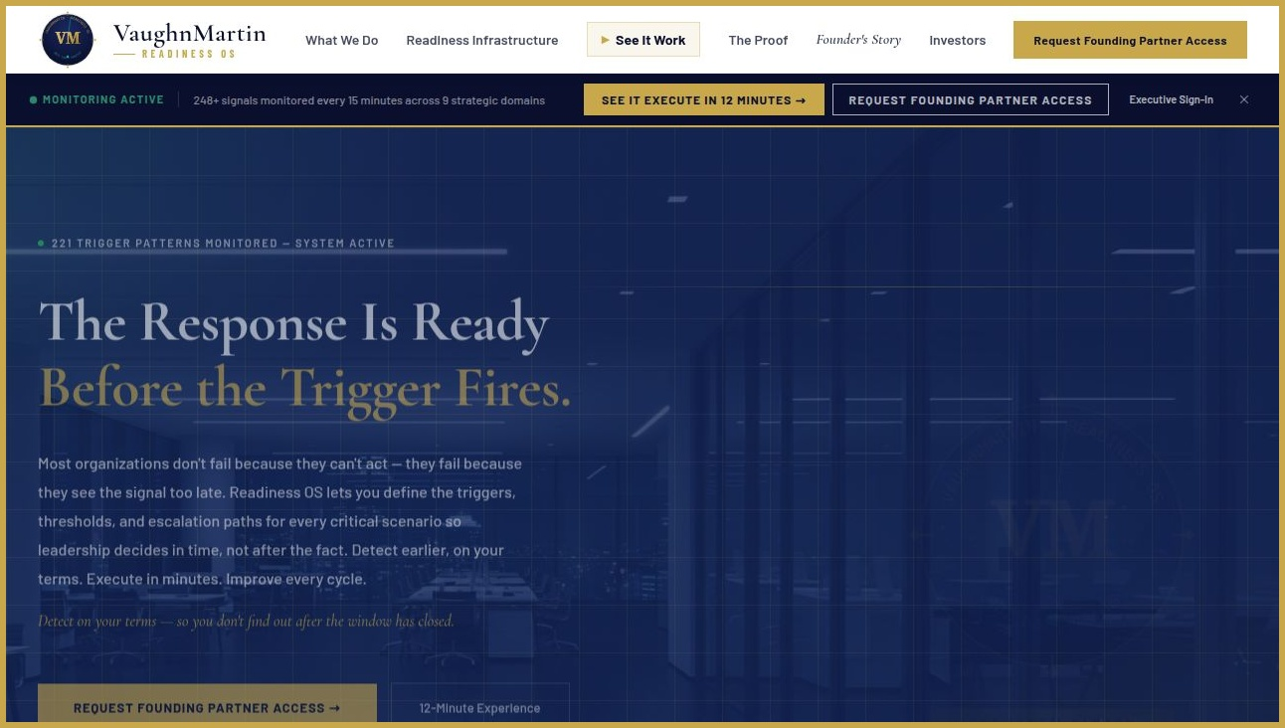
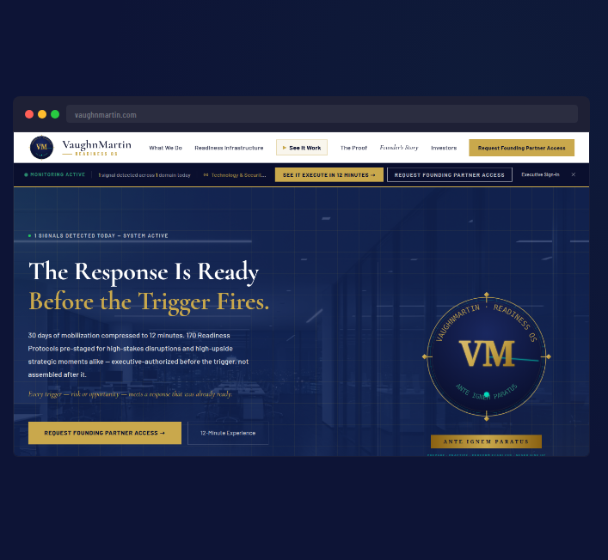
SLIDE 01 · 08
vaughnmartin.com
THE PROBLEM
MOST ORGANIZATIONS FIND OUT TOO LATE.
THOSE THAT DON'T STILL TAKE 30 DAYS TO RESPOND.
VM
▶ DETECTION GAP Most organizations find out about strategic triggers after the window has closed — signals unmonitored, thresholds undefined
▶ MOBILIZATION GAP Even when detected, the first 30 days are spent figuring out who owns the response — before execution even begins
▶ BOTH GAPS COMPOUND Find out late. Mobilize slowly. The trigger keeps moving while the organization stands still.
READINESS OS
MARKET OPPORTUNITY · Enterprise coordination failures put an estimated $4.4T in annual value at risk. Preparation Infrastructure is the unclaimed software layer.
"Most organizations do not have a strategy problem. They have a detection and mobilization problem. The trigger fires — and they find out late. Then they spend 30 days figuring out who decides."
VM
VaughnMartin
READINESS OS
Notes:
SOURCE REFERENCE: 30-day mobilization baseline — VaughnMartin operational research across 20 years Fortune 1000 experience. McKinsey Organizational Agility Research 2025.

Slide 2
SLIDE 02 · 08
THE FOUNDER
STANFORD UNIVERSITY · 5 YEARS
FOOTBALL COACHING
BUILT FROM BOTH WORLDS.
· Major college football is a billion-dollar operation
· 40-second play clock — full organizational coordination
· Preparation architecture built before game day
· Every trigger response pre-staged before pressure arrives
· The preparation IS the execution
▶ 5 years coaching major college football at Stanford
▶ 20 years inside Ford, Toyota, Lockheed Martin, Charles Schwab
▶ The preparation discipline that wins games was missing from enterprise
▶ Built in 2023 to close that gap permanently
VM
THE INTERSECTION
READINESS OS
FORTUNE 1000 OPERATIONS · 20 YEARS
ENTERPRISE LEADERSHIP
· Ford · Toyota · Lockheed Martin
· Charles Schwab · Boyd Gaming
· Watched the 30-day mobilization failure repeat
· Same preparation gap — different trigger, same delay
· Built Readiness OS in 2023 to end that pattern
"Very few people get exposure to both worlds at the depth where those lessons translate directly into each other. I did. And I built the infrastructure that closes it."
VM
VaughnMartin
READINESS OS

Slide 3
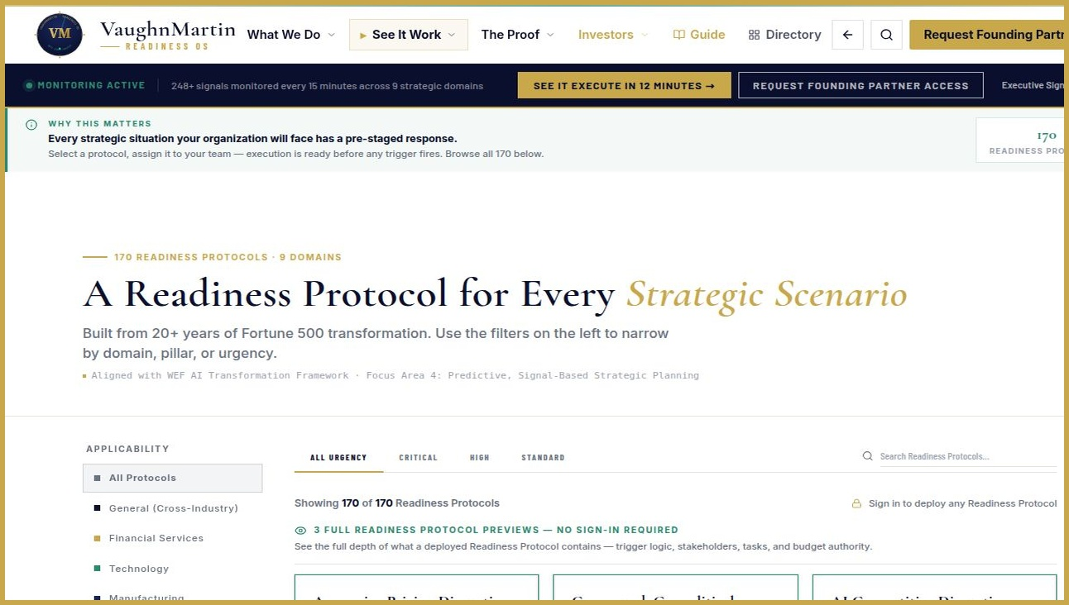
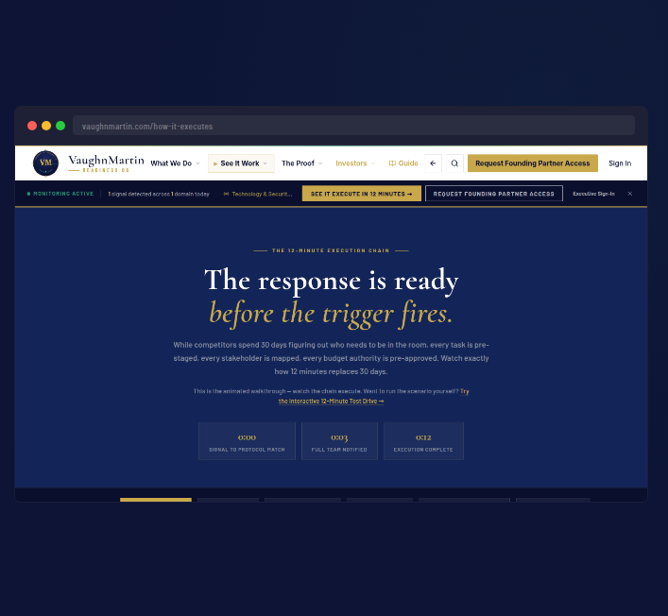
SLIDE 03 · 08
vaughnmartin.com/how-it-executes
THE PRODUCT
READINESS OS:
THE FULL ADVANTAGE
OPERATING SYSTEM.
VM
▶ MAP Define every trigger, threshold, and escalation path on your terms. 221 trigger patterns across 9 strategic domains — defined before pressure arrives.
▶ MONITOR 248+ data points. 16 signal categories checked every 15 minutes. Signals surfaced before they go public — detection on your terms.
▶ DECIDE Four real choices including Stand Down. System monitors signals continuously. Executives authorize. Always.
▶ EXECUTE Roles, budgets, internal comms, external comms, PR. Full coordinated response in 12 minutes.
▶ LEARN Close-Out Gate encodes every activation into future protocols. +18% readiness improvement per cycle.
READINESS OS
Readiness OS gives organizations end-to-end advantage: detect on your terms, decide with authority, execute in 12 minutes, and improve every cycle.
VM
VaughnMartin
READINESS OS
Notes:
SOURCE REFERENCE: All five phases live in production — VaughnMartin Readiness OS, Rev 31, May 2026. vaughnmartin.com

Slide 4
SLIDE 04 · 08
WHERE COMPETITORS STOP SHORT
WHY WE WIN
Signal Labs
THE MOAT COMPOUNDS.
COMPETITORS START AT ZERO.
Routes the signal. Stops before the response is staged.
ServiceNow
Automates workflows after alignment. We pre-stage the alignment.
Microsoft Copilot
Produces intelligence. None have the operating model to use it. We are that layer.
McKinsey
Arrives after the trigger fires. We were ready before it.
VM
▶ Every activation encodes what held — preparation compounds over time
▶ Signal intelligence calibrated to each organization's specific readiness state
▶ 18 months of activations creates intelligence no competitor can replicate
THE MOAT — WHAT MAKES US HARD TO CATCH
READINESS OS
Compounding
Loop
Org Context
Intelligence
Encoding
Permanence
Close-Out Gate encodes learning after every activation. Preparation compounds continuously.
Signal confidence + preparedness score. No generic platform replicates this.
18 months of activations creates an intelligence layer competitors cannot offer on day one.
"Every enterprise has Microsoft's AI stack. None have the operating model to use it. Readiness OS is that layer — not a replacement, an orchestrator."
VM
VaughnMartin
READINESS OS
Notes:
SOURCE REFERENCE: Competitor positioning — Signal Labs April 2026, ServiceNow documentation, Microsoft Copilot Work Trend Index 2026, McKinsey public advisory positioning.

Slide 5
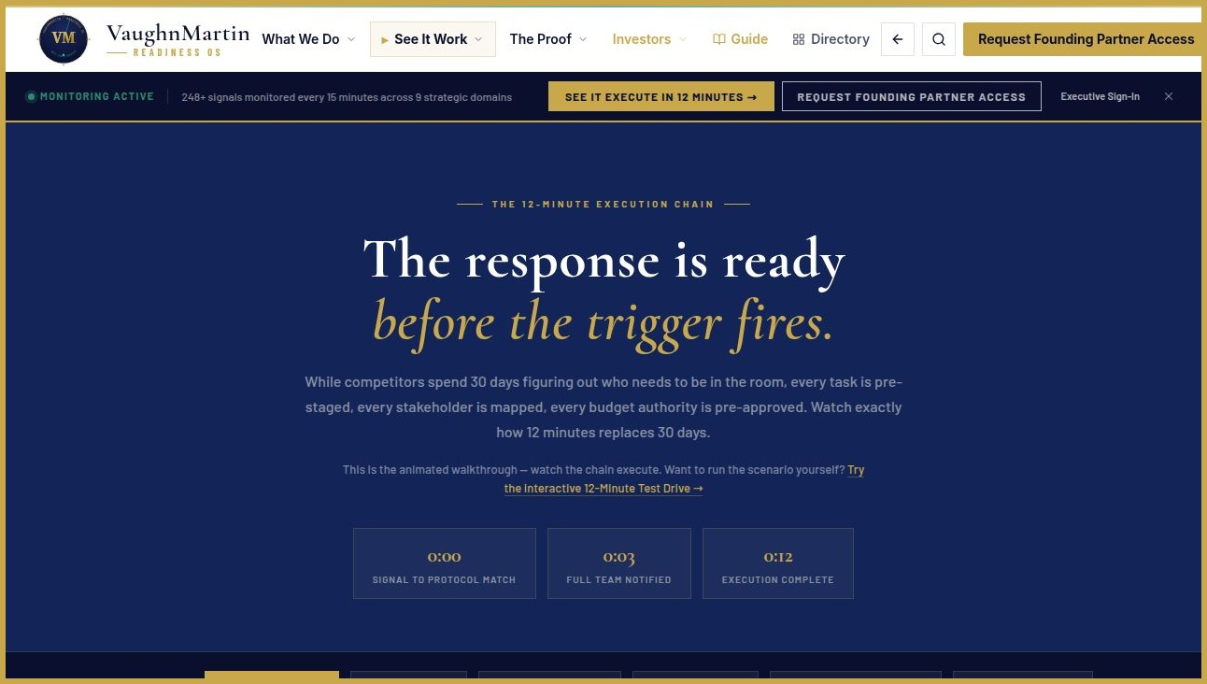
SLIDE 05 · 08
vaughnmartin.com/how-it-executes
HOW IT WORKS
FROM TRIGGER TO COORDINATED EXECUTION IN MINUTES.
VM
① Signal detected — confidence scored against 221 trigger patterns
② Matching protocol staged across relevant domains
③ Stakeholders notified with context and decision brief
④ Executive authorizes — four real choices including Stand Down. No action deploys without explicit authorization.
⑤ Execution launches — 12 minutes from signal to live response
READINESS OS
"The key change is that coordination is pre-built, so when the trigger fires, execution starts."
VM
VaughnMartin
READINESS OS
Notes:
SOURCE REFERENCE: 12-minute activation — VaughnMartin Readiness OS platform specification. 3,600× = 43,200 min ÷ 12 min. vaughnmartin.com/how-it-executes

Slide 6
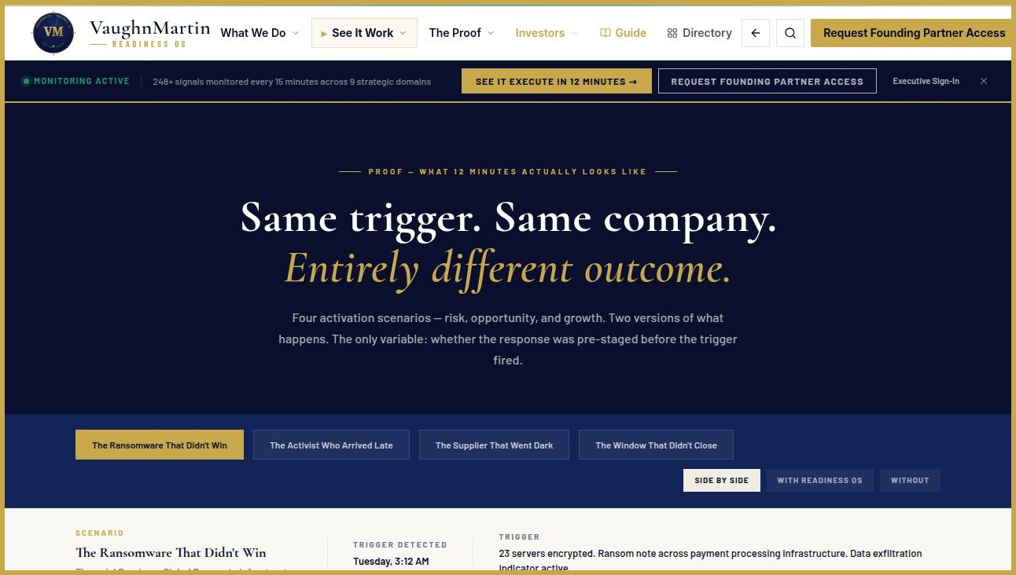
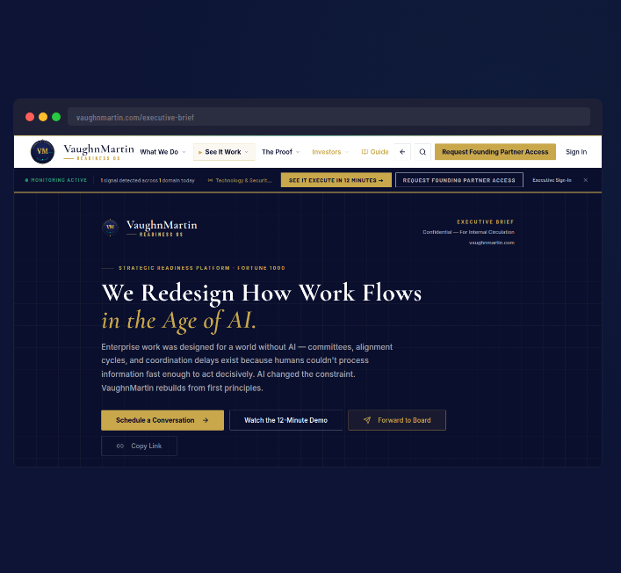
SLIDE 06 · 08
vaughnmartin.com/executive-brief
PROOF — NOW, NOT ROADMAP
SAME TRIGGER.
ENTIRELY DIFFERENT OUTCOME.
THREE SCENARIOS. REAL NUMBERS.
VM
▶ RANSOMWARE ($14B company) Without: $47M in regulatory penalties, customer notification Day 14. With: $0 in penalties, systems isolated in 12 minutes, notification in 4 hours.
▶ ACTIVIST INVESTOR ($28B company) Without: Board seat conceded, stock -11%. With: No concessions, stock +4% recovery — company response issued before Elliott's first press statement.
▶ SUPPLY CHAIN COLLAPSE ($8B company) Without: $47M in production losses + $12M in customer penalties, 7 weeks disruption. With: $0 losses, $0 penalties, continuity maintained.
READINESS OS
"Same trigger. Same company. $47M in penalties or $0. 7 weeks of disruption or 0 days. The only variable: whether the response was pre-staged before the trigger fired."
VM
VaughnMartin
READINESS OS
Notes:
SOURCE REFERENCE: Platform in production — vaughnmartin.com. Rev 31, May 2026. Built 2023. Executive brief at vaughnmartin.com/executive-brief.

Slide 7
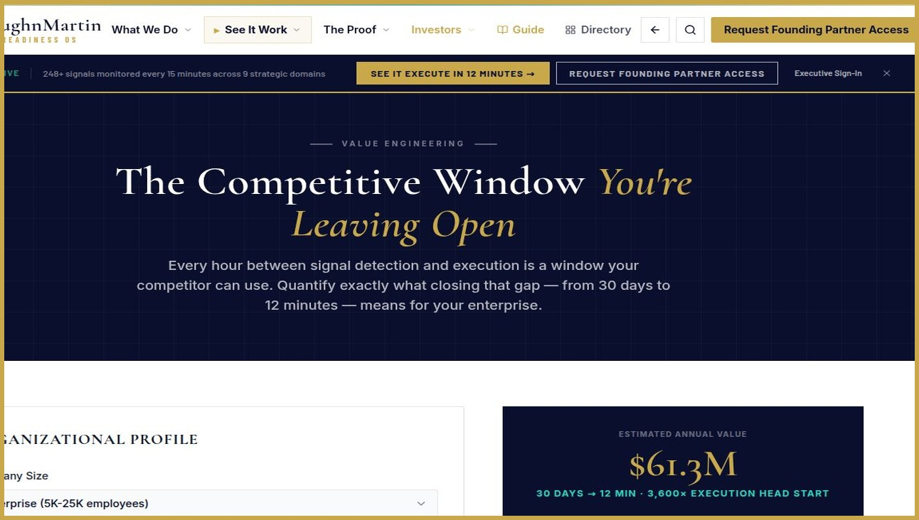
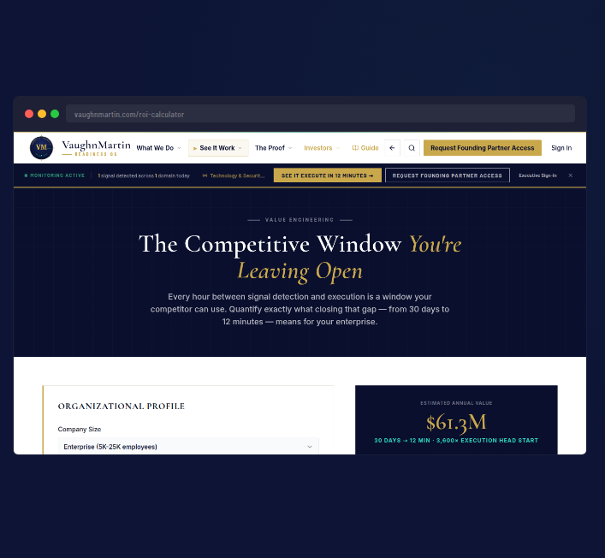
SLIDE 07 · 08
vaughnmartin.com/roi-calculator
BUSINESS CASE
REPLACE EXISTING RESPONSE SPEND WITH EXECUTION INFRASTRUCTURE.
VM
▶ Every enterprise has already invested in Microsoft's AI stack — Readiness OS is the operating model layer that makes that investment executable
▶ Readiness OS shifts existing response budgets from reactive to pre-staged — no new budget category required
▶ Estimated $61.3M annual value for enterprises facing 3+ strategic triggers — modeled from live ROI data
READINESS OS
"Every enterprise already paid for the stack. We are not asking for new budget — we are completing an investment already made."
VM
VaughnMartin
READINESS OS
Notes:
SOURCE REFERENCE: $61.3M estimated annual value — VaughnMartin ROI Calculator, Enterprise 5K–25K employees. vaughnmartin.com/roi-calculator

Slide 8
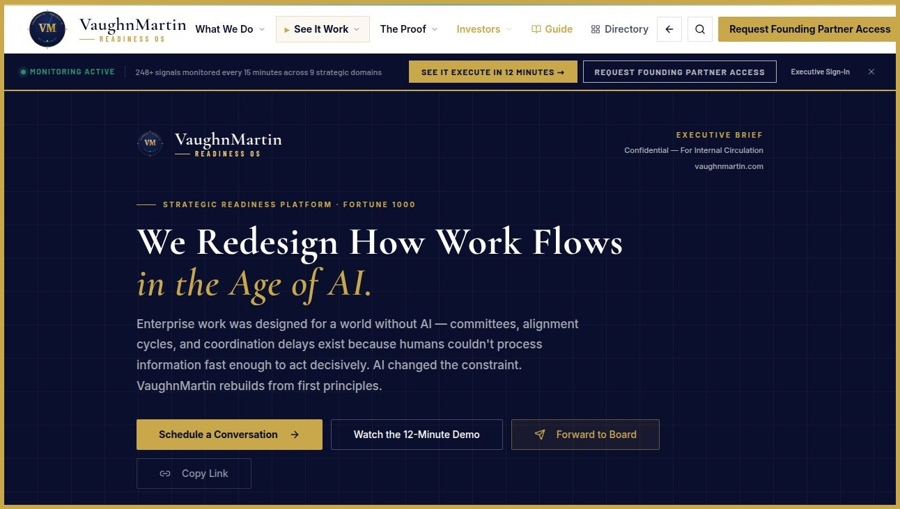
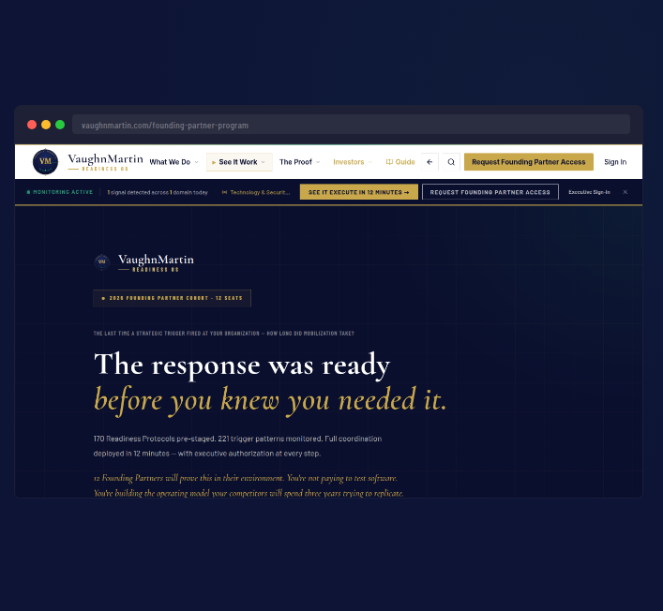
SLIDE 08 · 08
vaughnmartin.com/founding-partner-program
ASK + CLOSE
CATEGORY CREATION:
PREPARATION INFRASTRUCTURE
▶ Raising: Up to $1,000,000
▶ Product hardening + enterprise controls
▶ Founding Partner conversions + Repeatable GTM
VM
READINESS OS
18-MO RUNWAY · Mo.6 3 partners recurring · Mo.9 Controls complete · Mo.12 Repeatable GTM + proof stories
PRICING · Founding Partners $75K–$250K/yr · Growth from $75K · Annual recurring · No per-seat pricing
THE RESPONSE IS READY BEFORE THE TRIGGER FIRES.
"Every enterprise has AI capability. Very few have mobilization readiness. We built that layer."
VM
VaughnMartin
READINESS OS
Notes:
SOURCE REFERENCE: Capital requirements — VaughnMartin internal analysis. Founding Partner Program: 12 seats, 2026 cohort. vaughnmartin.com/founding-partner-program.

Slide 9
APPENDIX
SOURCES & REFERENCES
VaughnMartin Readiness OS · Investor Pitch · May 2026
Slides 1 & 5
Slide 7
30-Day Mobilization Baseline & $4.4T Market
$61.3M Estimated Annual Value
VaughnMartin operational research — 20 years direct experience across Ford, Toyota, Lockheed Martin, Charles Schwab, and Boyd Gaming. McKinsey Organizational Agility Research (2025). $4.4T enterprise value at risk from coordination failures.
VaughnMartin ROI Calculator — Enterprise profile (5K–25K employees), 3+ strategic triggers annually. Value modeled on time saved × enterprise coordination cost rate. Publicly interactive: vaughnmartin.com/roi-calculator
Slide 3
Slide 4
Platform Metrics — Five Phases All Live
Competitor Positioning
VaughnMartin Readiness OS production system, Rev 31, May 2026. All five phases (Map, Monitor, Decide, Execute, Learn) live in production. 248+ data points across 16 signal categories. 221 triggers. 170 Protocols. vaughnmartin.com
Signal Labs: company materials, April 2026. ServiceNow: platform documentation. Microsoft Copilot: Work Trend Index 2026. McKinsey: public advisory positioning.
Slide 5
Slide 8
12-Minute Activation & 3,600× Head Start
Capital Requirements — Up to $1,000,000
VaughnMartin platform performance specification. Calculation: 30 days × 24 hrs × 60 min = 43,200 min ÷ 12 min = 3,600×. Baseline is average Fortune 1000 cross-functional mobilization cycle. vaughnmartin.com/how-it-executes
VaughnMartin internal capital requirements analysis, May 2026. Founding Partner Program: 12 seats, 2026 cohort. vaughnmartin.com/founding-partner-program. Platform built 2023, in production now.
All platform metrics are live production figures verifiable at vaughnmartin.com · Financial projections are estimates based on VaughnMartin ROI methodology · Confidential — For Investor Use Only

