Slide 1


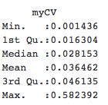
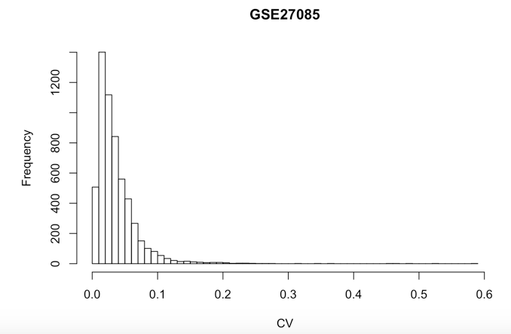
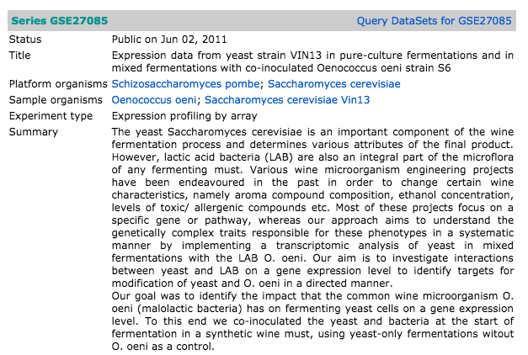
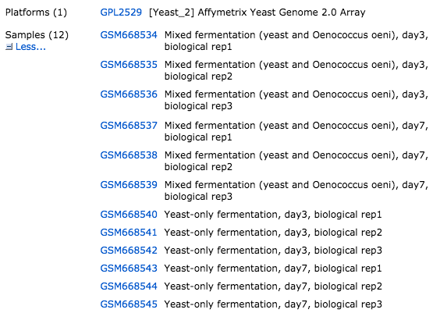
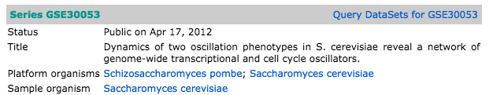
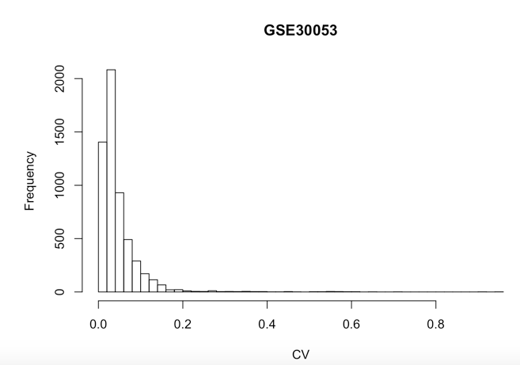
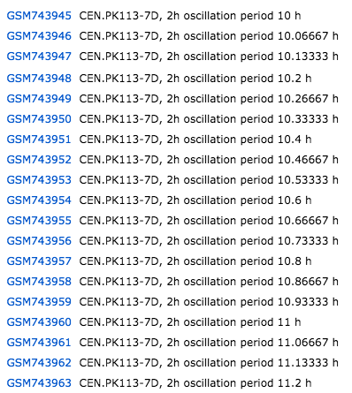
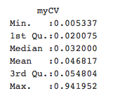
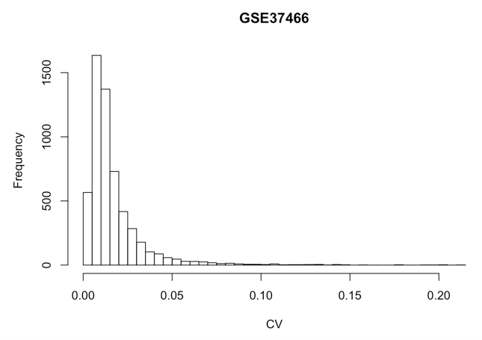
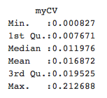
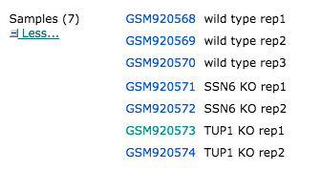
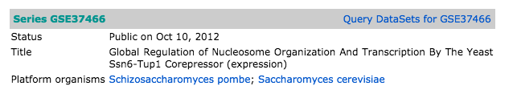
Estimate gene expression robustness from microarry expression data sets in Saccharomyces cerevisiae.
Ashlee Beverett; Jayden Le Blanc; Nilin Gupta; Hong Qin
Department of Biology, Spelman College, Atlanta, GA 30314
Abstract
The robustness of intracellular gene networks reflects cell’s ability to maintain homeostasis in the face of changing environments. One way to measure robustness is the ratio of standard deviation to the mean, known as the coefficient of variation (CV). Large CV indicates a wide range of changes in the internal states of a system and hence less robust. Small CV indicates a narrow range of changes in the internal states of a system and hence a fairly robust system. Here, we focus on the robustness of intracellular gene networks in in the model organism of Saccharomyces cerevisiae. We obtained a number of gene expression data sets from NCBI GEO, and estimate CV for every gene. We found that the distribution of CV by genes is skewed, with majority of genes with very small CV values, but a small number of genes with extremely CV values. Hence, majority of the genes have robust gene expression levels despite environmental changes.
Design of the Study
Results
NCBI GEO data base _-> retrieve Gene expression data sets (GEO Query) → Normalized expression -> calculate CV -> compare all data sets.
Add a picture of GEO, picture of CV?
Materials and Methods
NCBI GEO data base
Examples of data sets.
GEO Query
Introduction
Robustness of gene network
Fluctuation of gene expression levels in different conditions
Cellular aging
Results
Conclusions
In conclusion, dfgsdfgsdfgsdfg.
-- long tail distribution skewed to the right
Concept of Robustness
Robustness = Ability of cells to maintain homeostasis in the presence of genetic, environmental, and stochastic variations.
Robustness can be measured by coefficient of variation (CV).
CV = Standard deviation / Mean
References
1sdfgsdfgs
2. asdgasdgsdfg
Smaller CV
Larger CV
Acknowledgement
Funding: We would like to give our thanks and appreciation for a seed grant from the Spelman CHDRE Award from the NCMHD (Grant number 5P20MD000315-05), NSF RUI 1022294.
Less noise
More robust
More noise
Less robust
Hypothesis
asdfasdfasdf.
Notes:
Long tail distribution

