Slide 1

JPMC: Direct Data Consumption
Matthew K. Bryduck

Slide 2












JPMC: Technology Stack
GitHub
Jenkins
AWS
IntelliJ
Java 8
Maven 2.3.2
JUnit 4.11
Mockito 1.9.5
SLF4J 1.7.25
Project Lombok 1.18.4
Apache Spark 2.2.0.2.6.3.4-1
Apache Hadoop 2.6.0
Scala 2.11
AWS SDK 1.11.765

Slide 3
AWS EMR Overview: Elastic Map Reduce
Is a managed Hadoop and Spark Service
Integrates well with other AWS services.
Decouples storage and computing
Utilize EC2 instances
Uses EMR file system to Read/Write to S3

Slide 4
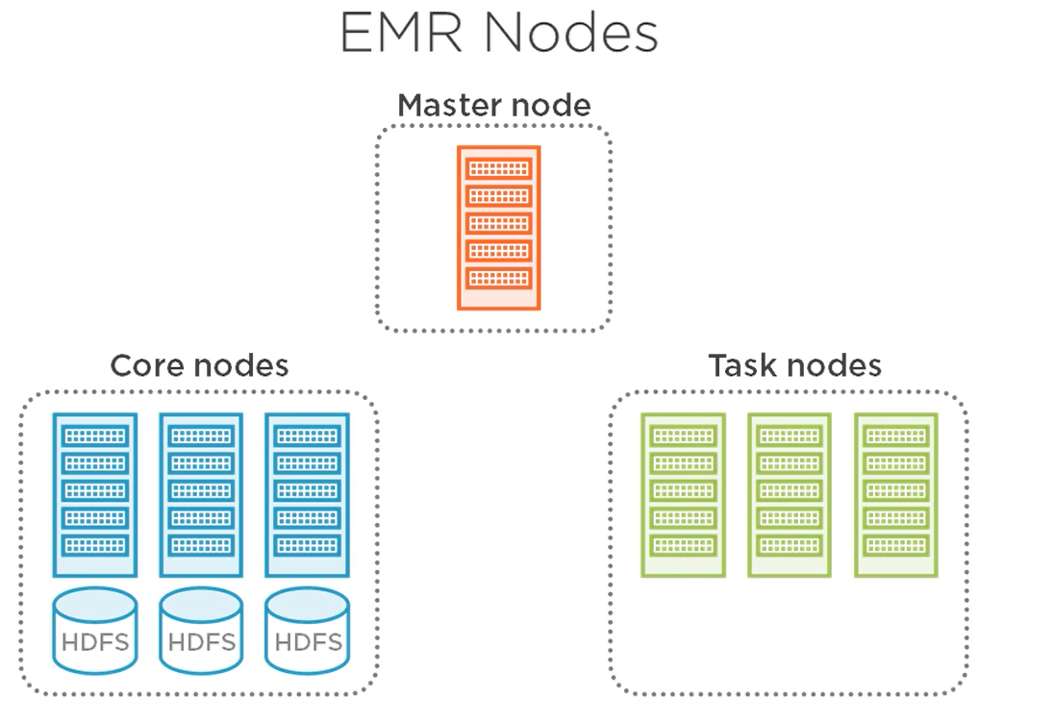
AWS EMR Diagram: Elastic MapReduce
Master node(s) – manage the core nodes of the cluster. Can have up to three
master nodes.
Core node(s) – run HDFS and execute various task sent by the master node.
The number of core nodes can vary, from at least one to as many
as needed.
Task node(s) – are only about computations. Such as run as running some
MapReduce task. The number of task nodes can vary from
zero to as many as needed.

Slide 5
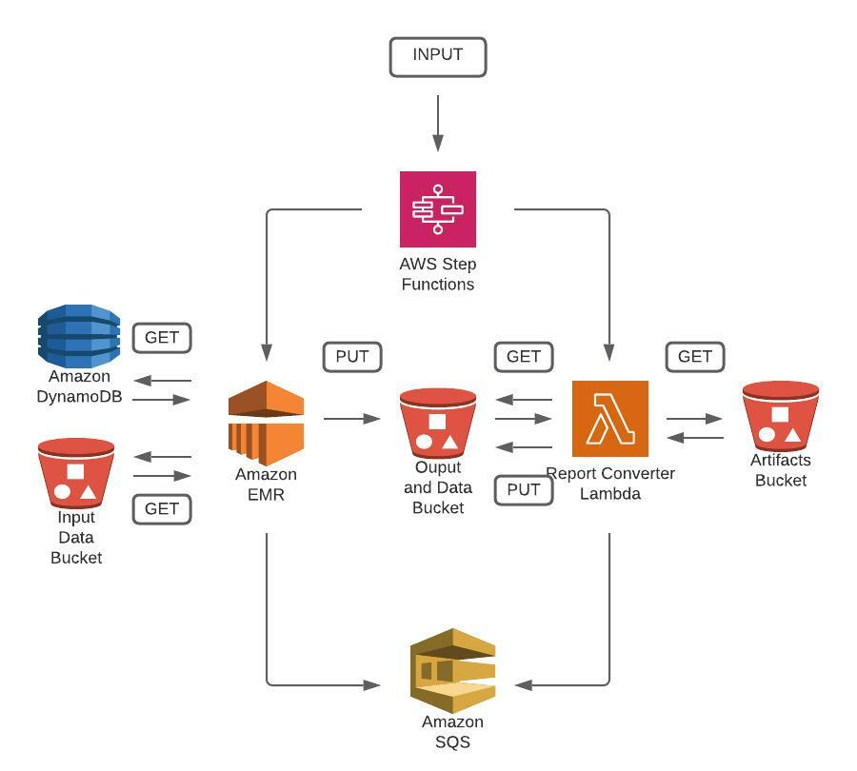
EMR Application: Architectural Overview

Slide 6
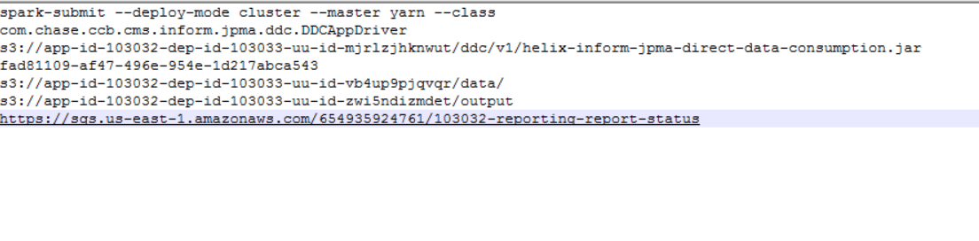
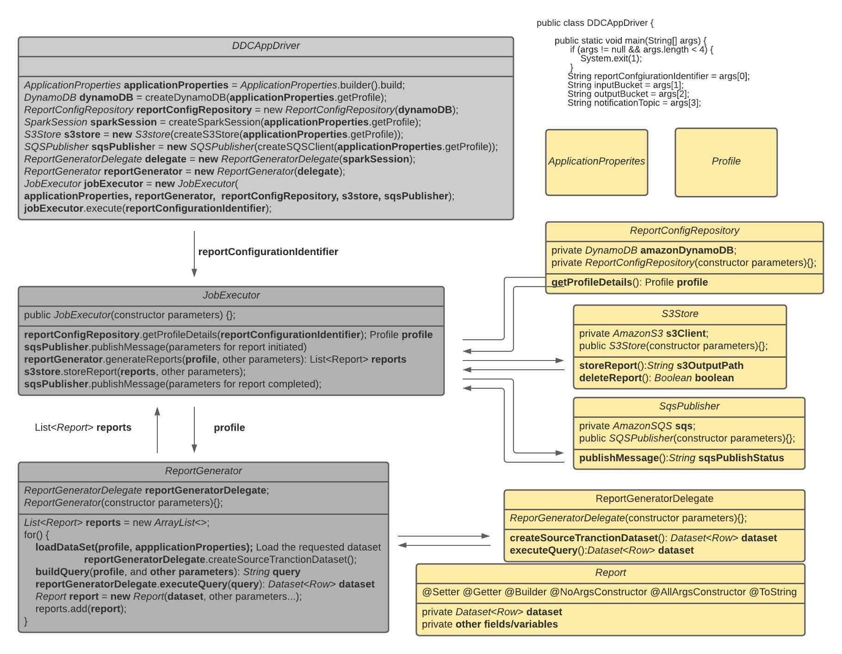
AWS EMR Input

Slide 7
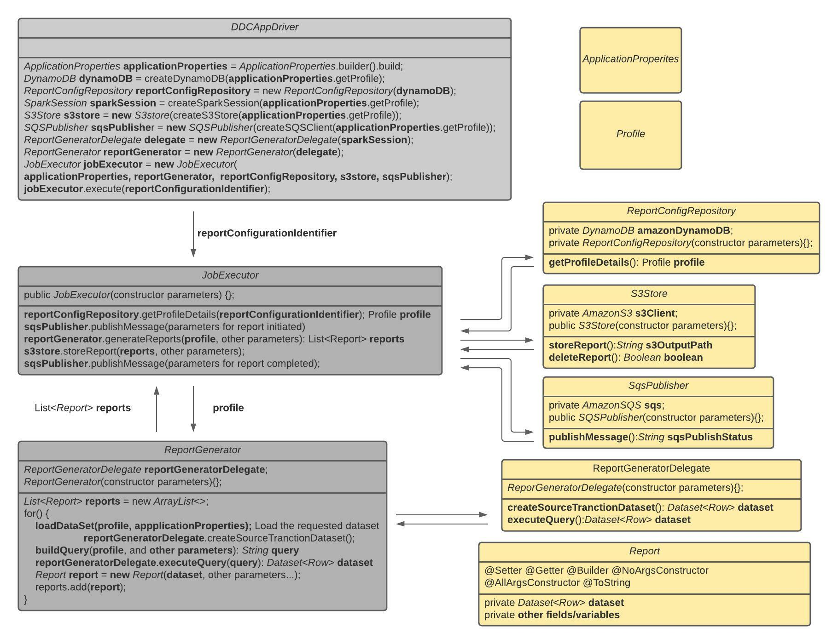
EMR Application Overview

Slide 8
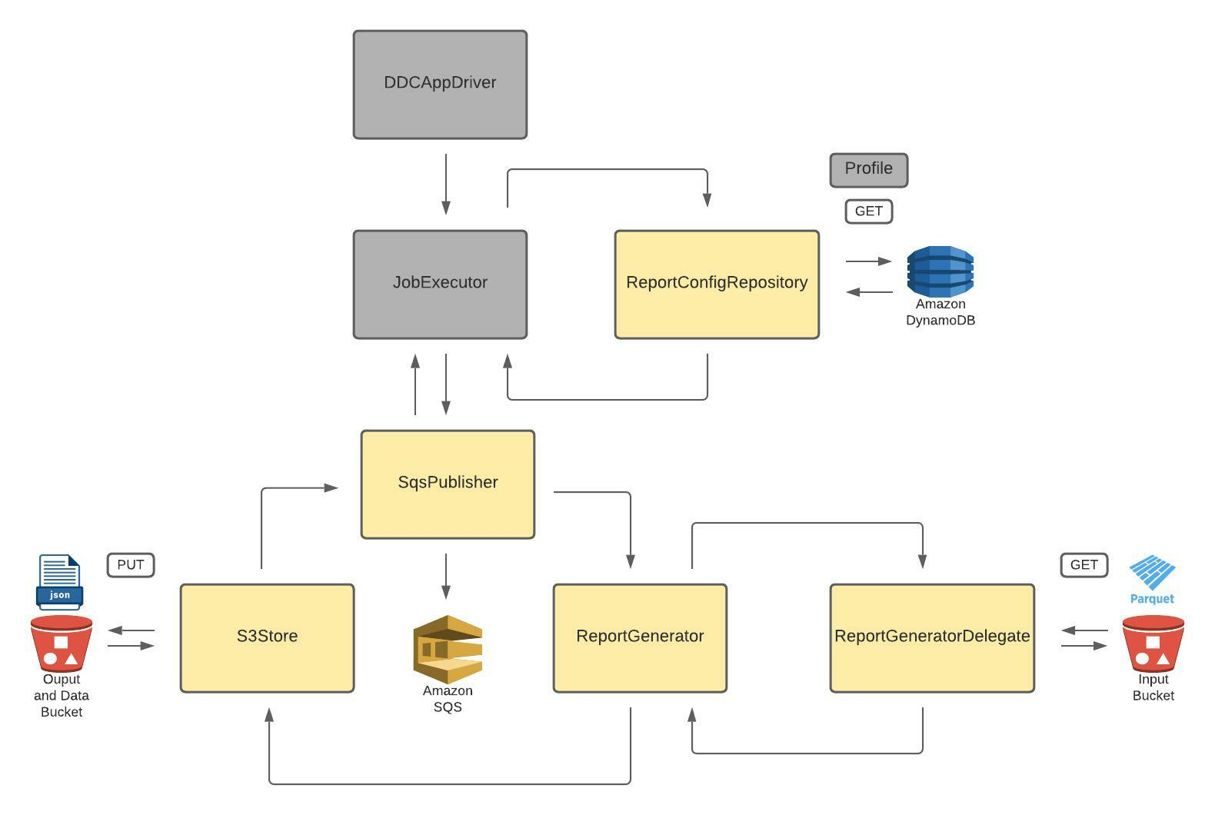
EMR
Application Lifecycle

Slide 9
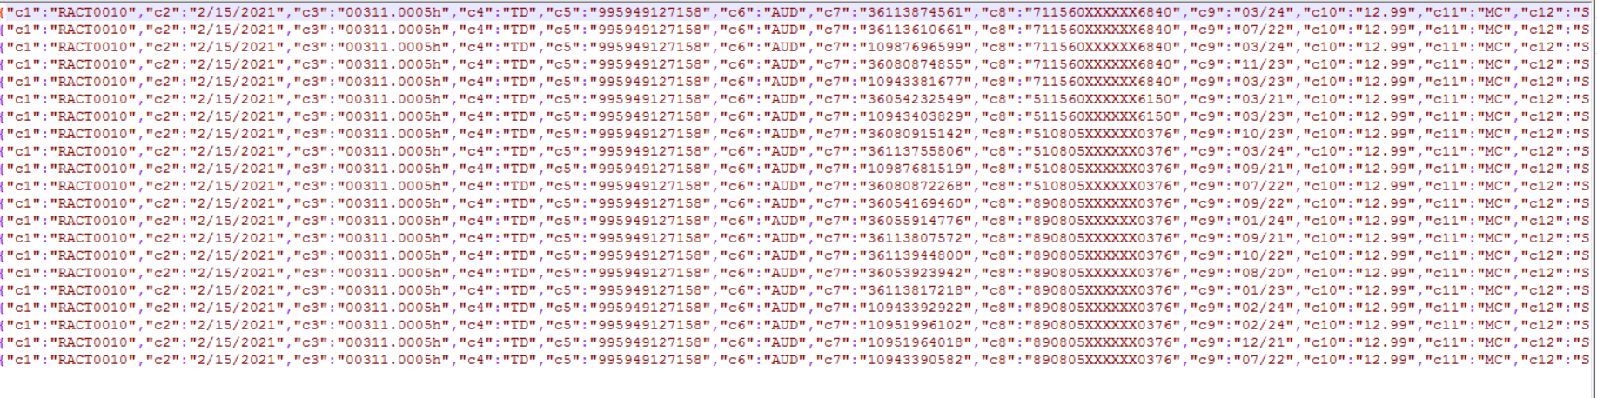
AWS EMR Output

