Slide 1

JPMC: PDF Converter Lambda Function POC
Matthew K. Bryduck

Slide 2












JPMC: Technology Stack
GitHub
Jenkins X
Terraform
AWS
IntelliJ
Java 11
Maven 3.2.4
JUnit 4.13.2
Mockito 3.9.0
SLF4J 1.7.30
Lombok
iText 7.1.8
AWS SDK

Slide 3
JPMC: Project Context and Requirements
Upstream application, an EMR on EKS cluster, is running Apache Spark jobs against a table in a data lake based on a report configuration.
EMR application outputs data in the form of a text file of json objects.
EMR application should call the PDF Converter Lambda with two parameter. Those parameters are the data and PDF template.
PDF report should never run over page width.
Header and trailer data should be dynamically populated and separate from table data.
Title should be properly formatted.
JPMC logo should be included.

Slide 4
JPMC: Assignment
Build one PDF template.
01
Build the PDF Converter Lambda Function.
02
Validate against sample data.
03

Slide 5
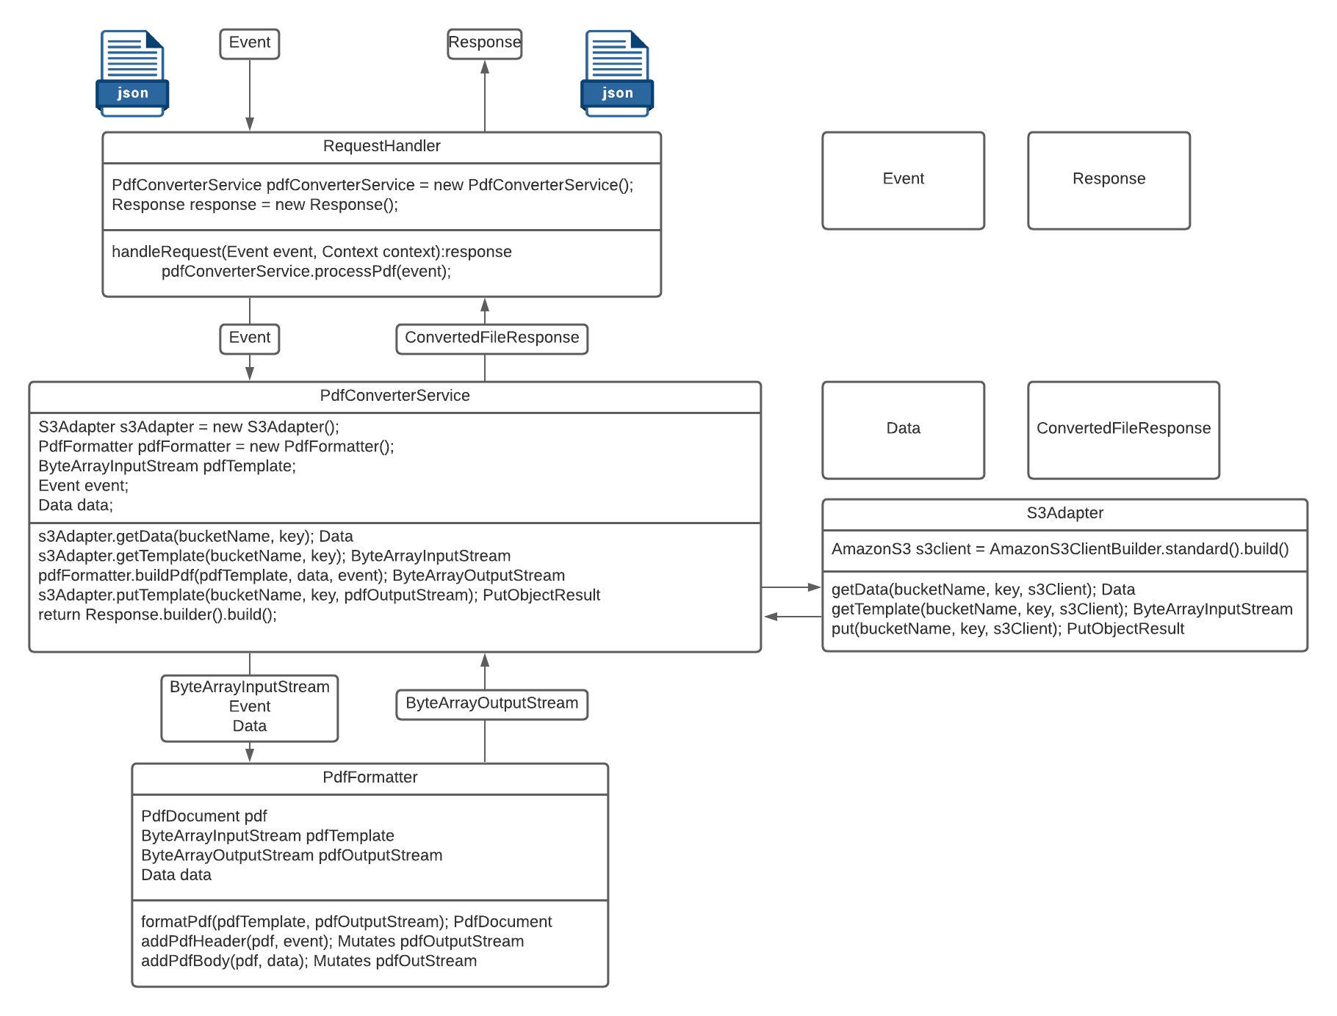
JPMC: PDF Converter Application

Slide 6
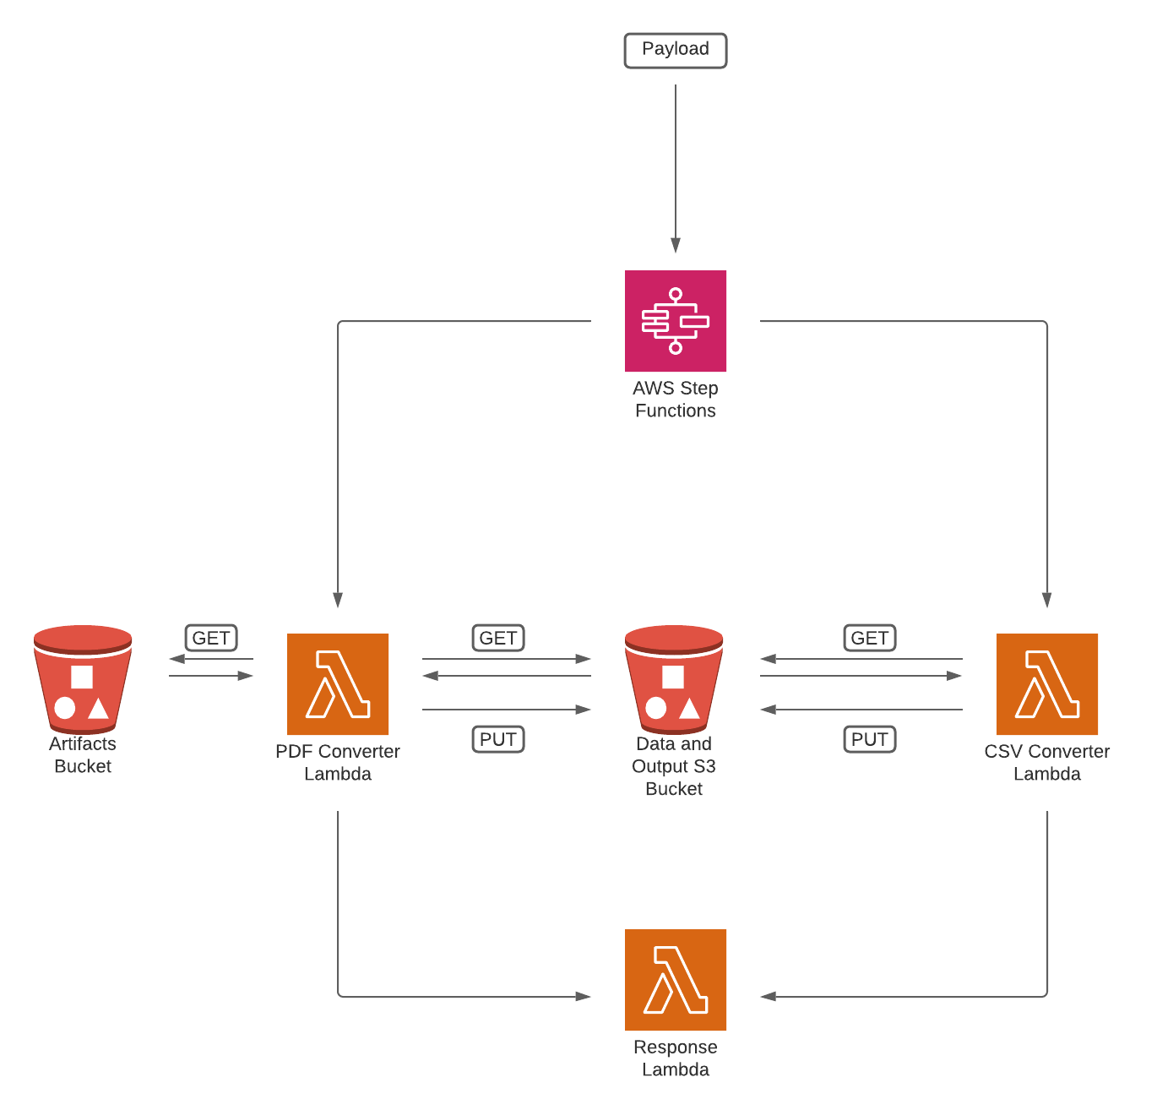

JPMC: PDF Converter Architectural Overview

Slide 7
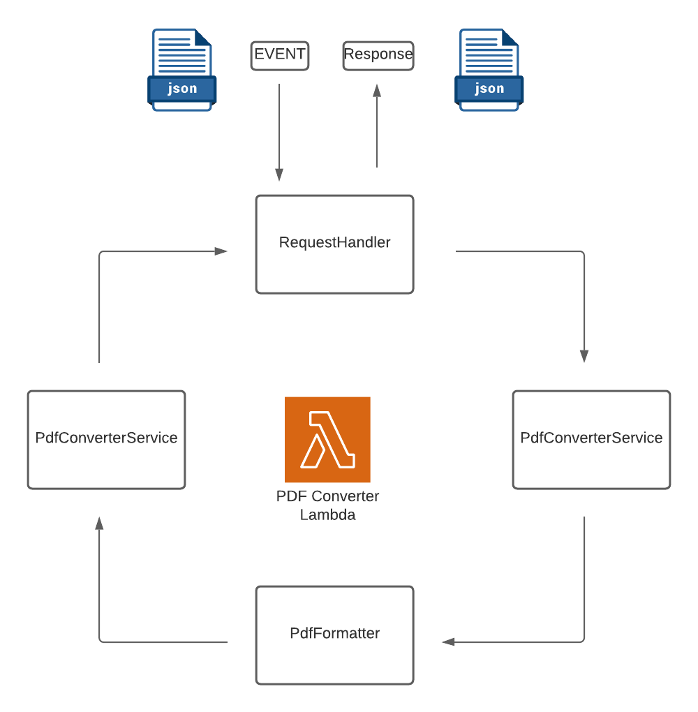
JPMC: PDF Converter
Application Flow

