Slide 1

Learning Incoherent Sparse and Low-Rank Patterns from Multiple Tasks
Jianhui Chen
Computer Science & Engineering
Arizona State University
Joint work with Ji Liu and Jieping Ye

Slide 2



Learning Multiple Tasks
Task 1
Task 2
Task m
Single Task Learning (STL)
Multi-Task Learning (MTL)
Learn f₁
Learn f₂
Learn f_{m}
Learn f_{1 ,} f_{2, …} f_{m} simultaneously

Slide 3
Outline
Introduction
Multi-Task Learning Formulations
Projected Gradient Scheme
Main Algorithms
Experiments

Slide 4
Motivation
Goal of Multi-task learning ?
Improve the overall generalization performance.
How can the performance be improved?
Learn the tasks simultaneously via exploiting tasks relationship.
When do we need multi-task learning?
When there are a number of related tasks, but the training data is limited for each task.

Slide 5
Introduction
MTL has been studied from many perspectives:
  share hidden units of neural networks among similar tasks [Caruana’97; Baxter’00]
  model task relatedness via the common prior distribution in hierarchical Bayesian models [Bakker’03, Schwaighofer,’04; Yu’05; Zhang’05 ]
  learn the parameters of Gaussian Process covariance from multiple tasks [Lawrence’04]
  extend kernel methods and regularization networks to MTL setting [Evgeniou’05]
  learn a shared low-rank structure from multiple tasks [Ando’05; Chen’09]
  employ trace norm regularization for multi-task learning [Abernethy’09; Argyriou’08; Obozinski’09; Pong’09]
Notes:
In the past decade, many approaches have been proposed for MTL.

Slide 6
Applications
MTL has been applied in many areas such as
  Bioinformatics [Ando’07]
  Medical image analysis [Bi’08]
  Web search ranking [Chapelle’10]
  Computer vision [Quattoni’07]
  …...

Slide 7
Outline
Introduction
Multi-Task Learning Formulations
Projected Gradient Scheme
Main Algorithms
Experiments
Notes:
In this work, we propose a novel multi-task learning formulation.

Slide 8



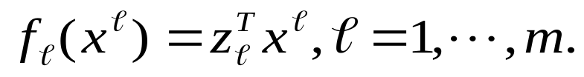
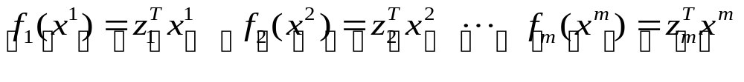
Learning Multiple Tasks
Task 1
Task 2
Task m
Linear classifiers:
Task 1
Task 2
Task m
correlated via underlying relationship

Slide 9
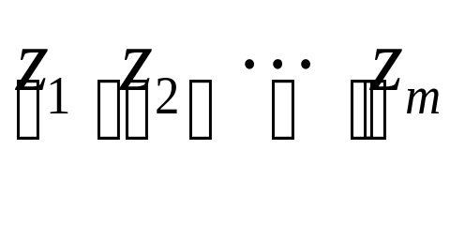
Sparse and Low-Rank Structure
The task relationship can be captured as (Argyriou’08; Pong’09)
low-rank structure
Multiple tasks may have sufficient difference and the discriminative features can be sparse.
sparse structure
Low-rank and sparse structures are desirable.

Slide 10
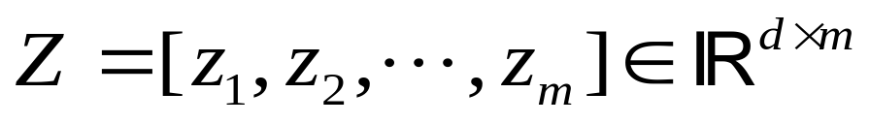

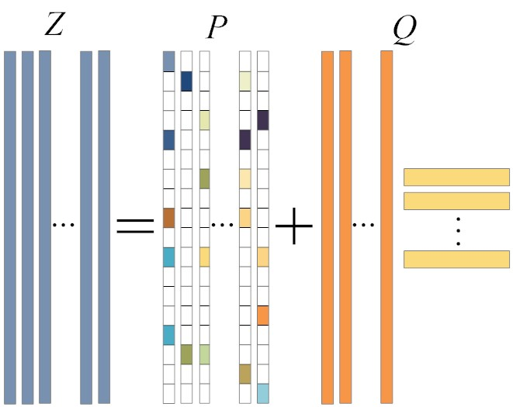
Sparse and Low-Rank Structure
Transformation matrix
Incoherent sparse and low-rank structure
=
+
Transformation Matrix
Sparse Component
Low-Rank Component
Notes:
Based on this assumption, we can induce the incoherent structure in the transformation Z.

Slide 11
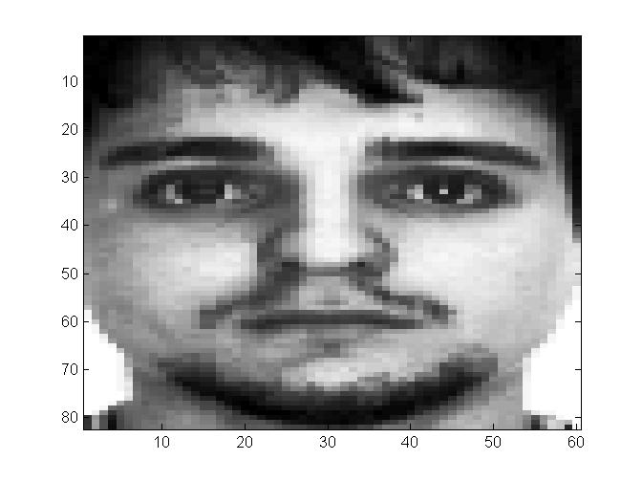
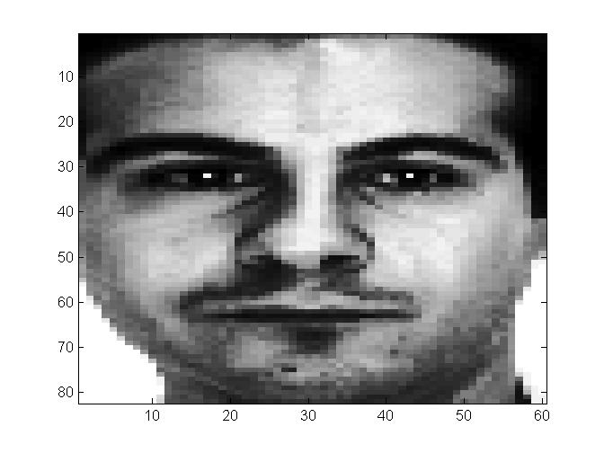
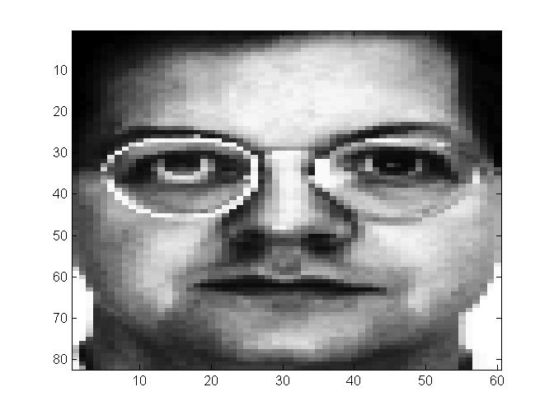
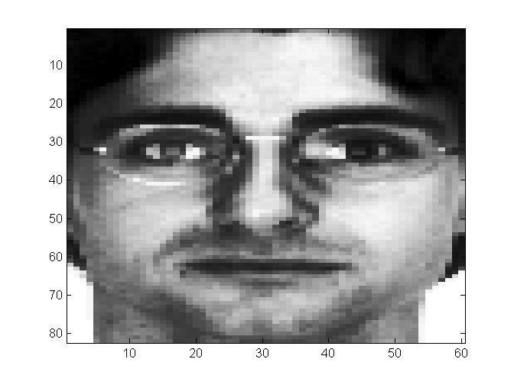
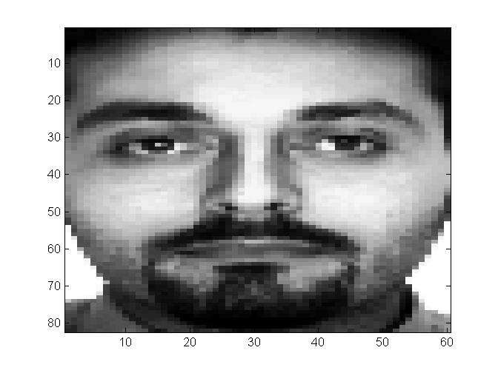
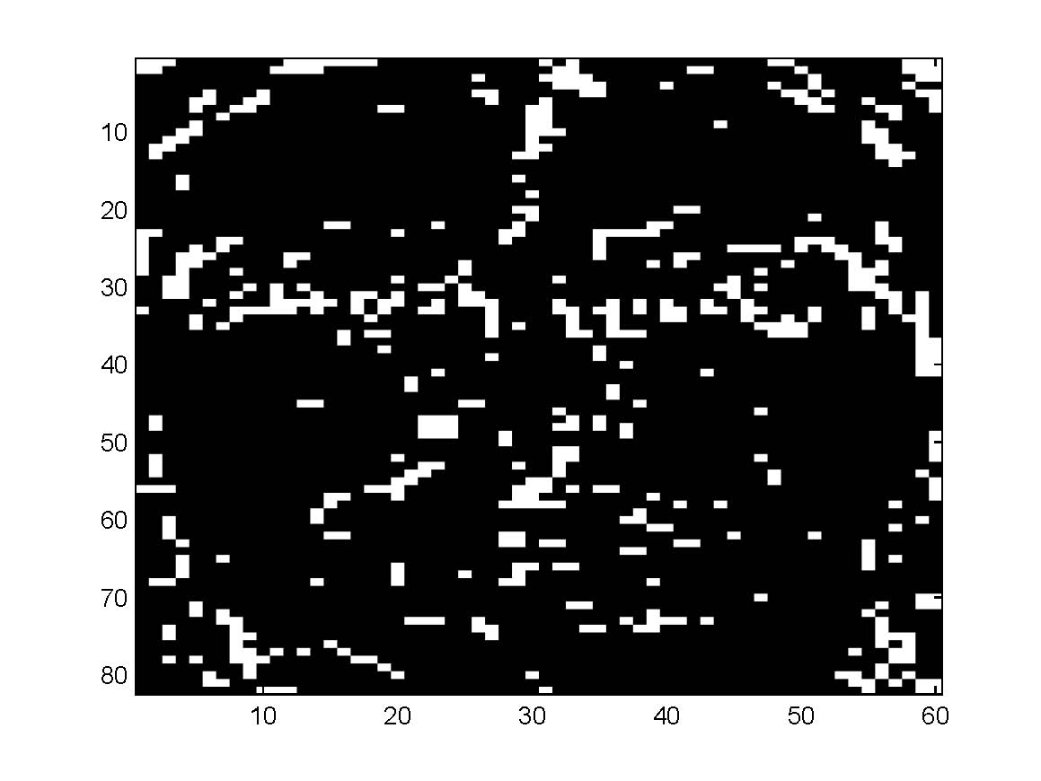
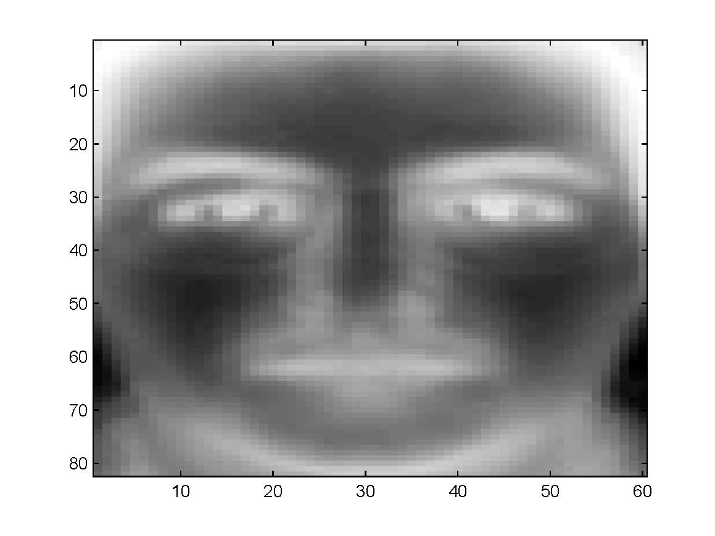
Sparse and Low-Rank Structure
Rough shape of the faces
Detailed facial marks

Slide 12
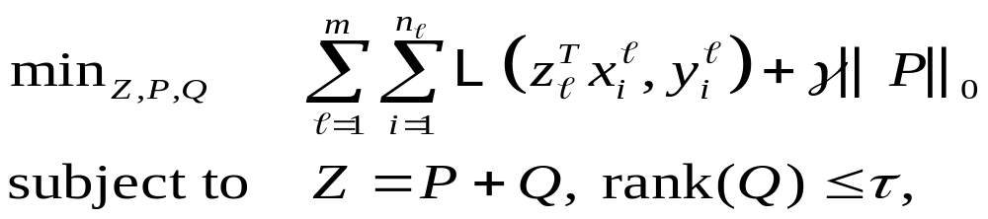
Muti-task Learning Formulation
The proposed MTL Formulation
Smooth convex loss
Sparse structure
Low-rank structure
Incoherent structure
The proposed formulation is non-convex .
This problem NP-hard.

Slide 13
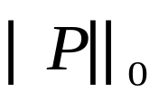
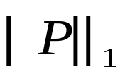


Convex Envelop
We consider a convex relaxation via non-convex term substitution.
Substitution using convex envelops
convex envelop
The convex envelope is the tightest convex function approximate the non-convex function from below.
Notes:
B can be seen as the best convex approximation o f A.

Slide 14
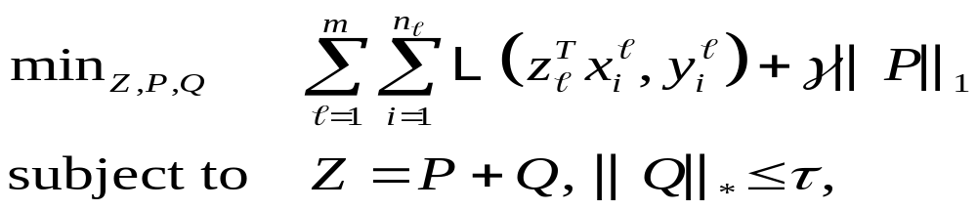
Convex Formulation
A convex relaxation
Substituted convex envelopes
The formulation is
convex
non-smooth
constrained
It can be reformulated as a semi-definite program
Notes:
This limitation further motives us to develop efficient algorithms ..

Slide 15
Outline
Introduction
Multi-Task Learning Formulations
Projected Gradient Scheme
Main Algorithms
Experiments
Notes:
We propose to apply the Projected Gradient Scheme to solve the convex relaxation.

Slide 16
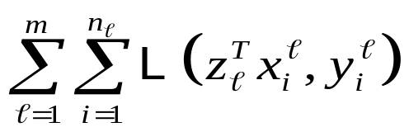





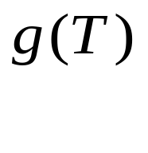



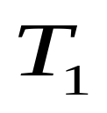
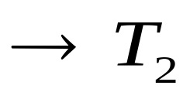
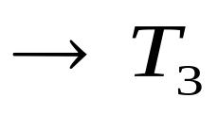


Projected Gradient Scheme
A compact form the convex relaxation
Smooth term
Non-smooth term
Convex domain set
Projected gradient scheme finds the optimal solution T* via a sequence

Slide 17
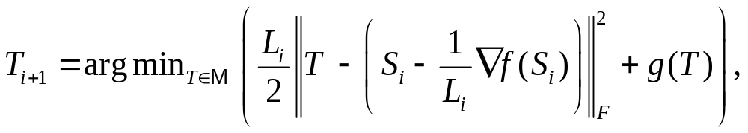
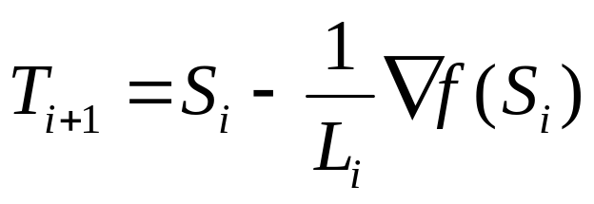
Projected Gradient Scheme
The key component in projected gradient scheme
step size
solution point
searching point
If g(T) = 0 and M is all Real space, then

Slide 18
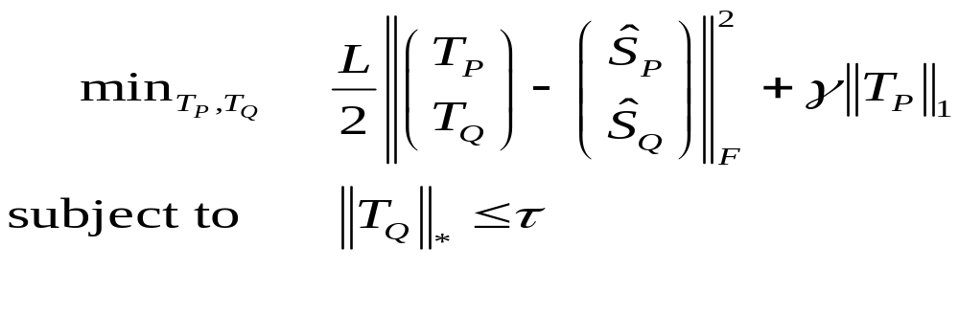
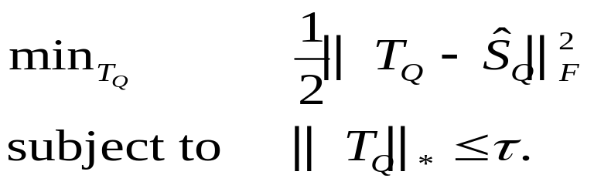

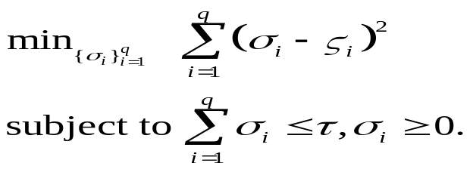
Projected Gradient Scheme
For the convex relaxation, the key component is
A closed form solution
Solved via an SVD + a projection

Slide 19
Outline
Introduction
Multi-Task Learning Formulations
Projected Gradient Scheme
Main Algorithms
Experiments

Slide 20
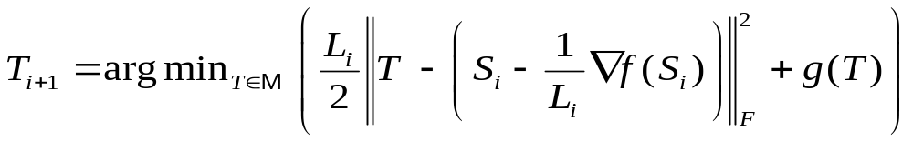
Main Algorithms
Main components of the algorithms
find the appropriate step size 1 / L_{i} via line search
solve the optimization
Projected gradient algorithm (PG)
set S_{i} = T_{i}
attain the convergence rate at Ο(1/k)
Accelerated Projected gradient algorithm (AG)
set S_{i} = (1+α_{i})T_{i} – α_{i}T_{i-1}
attain the convergence rate at Ο(1/k²)

Slide 21
Outline
Introduction
Multi-Task Learning Formulations
Projected Gradient Scheme
Main Algorithms
Experiments

Slide 22
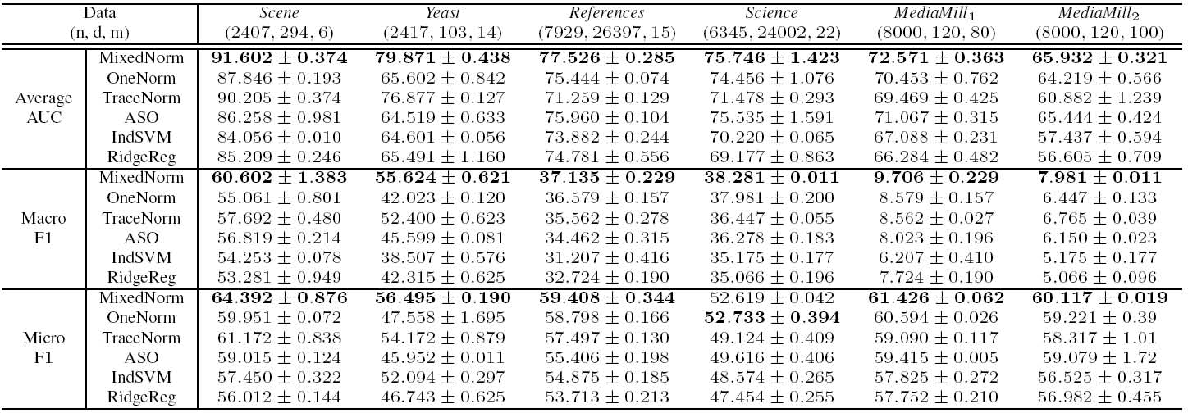
Performance Evaluation
Key observations
Incoherent structure improves performance
Sparse structure is effective on multi-media data
Low-rank structure is important on image and gene data

Slide 23
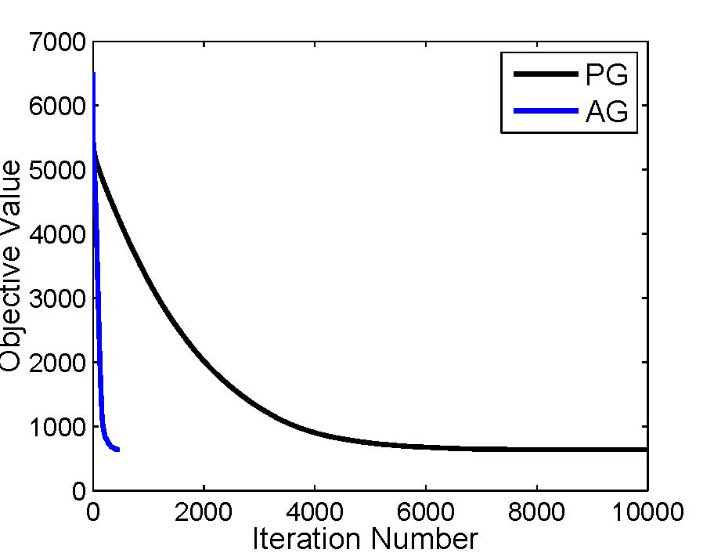
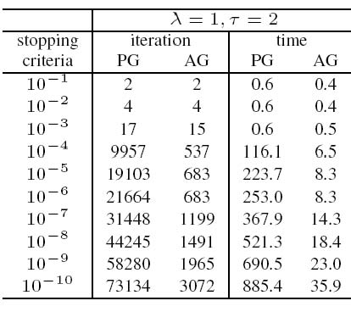


Efficiency Comparison
AG is more efficient than PG for solving the proposed MTL formulation

Slide 24
Conclusion
Main Contributions
  Propose MTL formulations and the efficient algorithms
  Conduct experiments for demonstration
Future Work
  Conduct theoretical analysis on the MTL formulations
  Apply the MTL formulation on real-world application

Slide 25
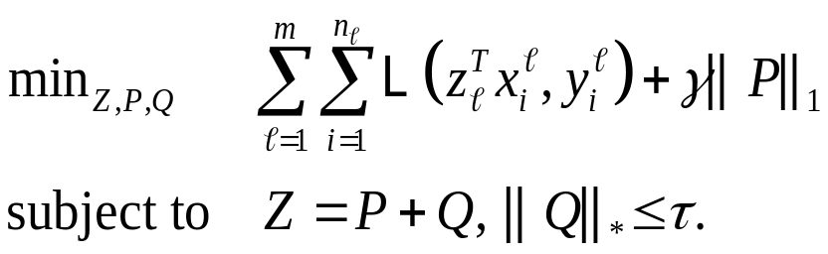
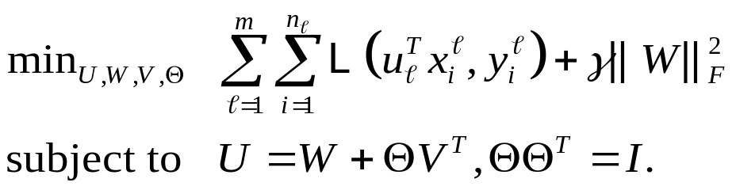
Comparison with ASO MTL
The proposed formulation
ASO algorithm
The tasks are coupled via a low- dim structure (Q), which is induced by a trace norm constraint.
The (independent) high-dim feature map (P) is sparse.
The formulation is convex, leading to a globally optimal solution.
Tasks are coupled using a low-dim structure (Θ), which is induced by an orthonormal constratint.
The (independent) high-dimensional feature map (W) is dense in general.
The formulation is non-convex and generally we can only find a local solution.

