Slide 1
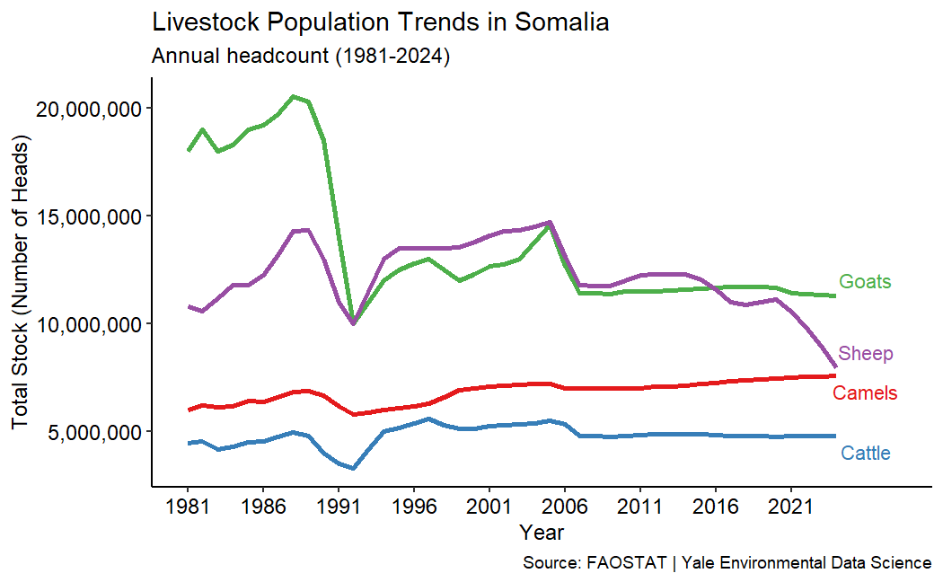
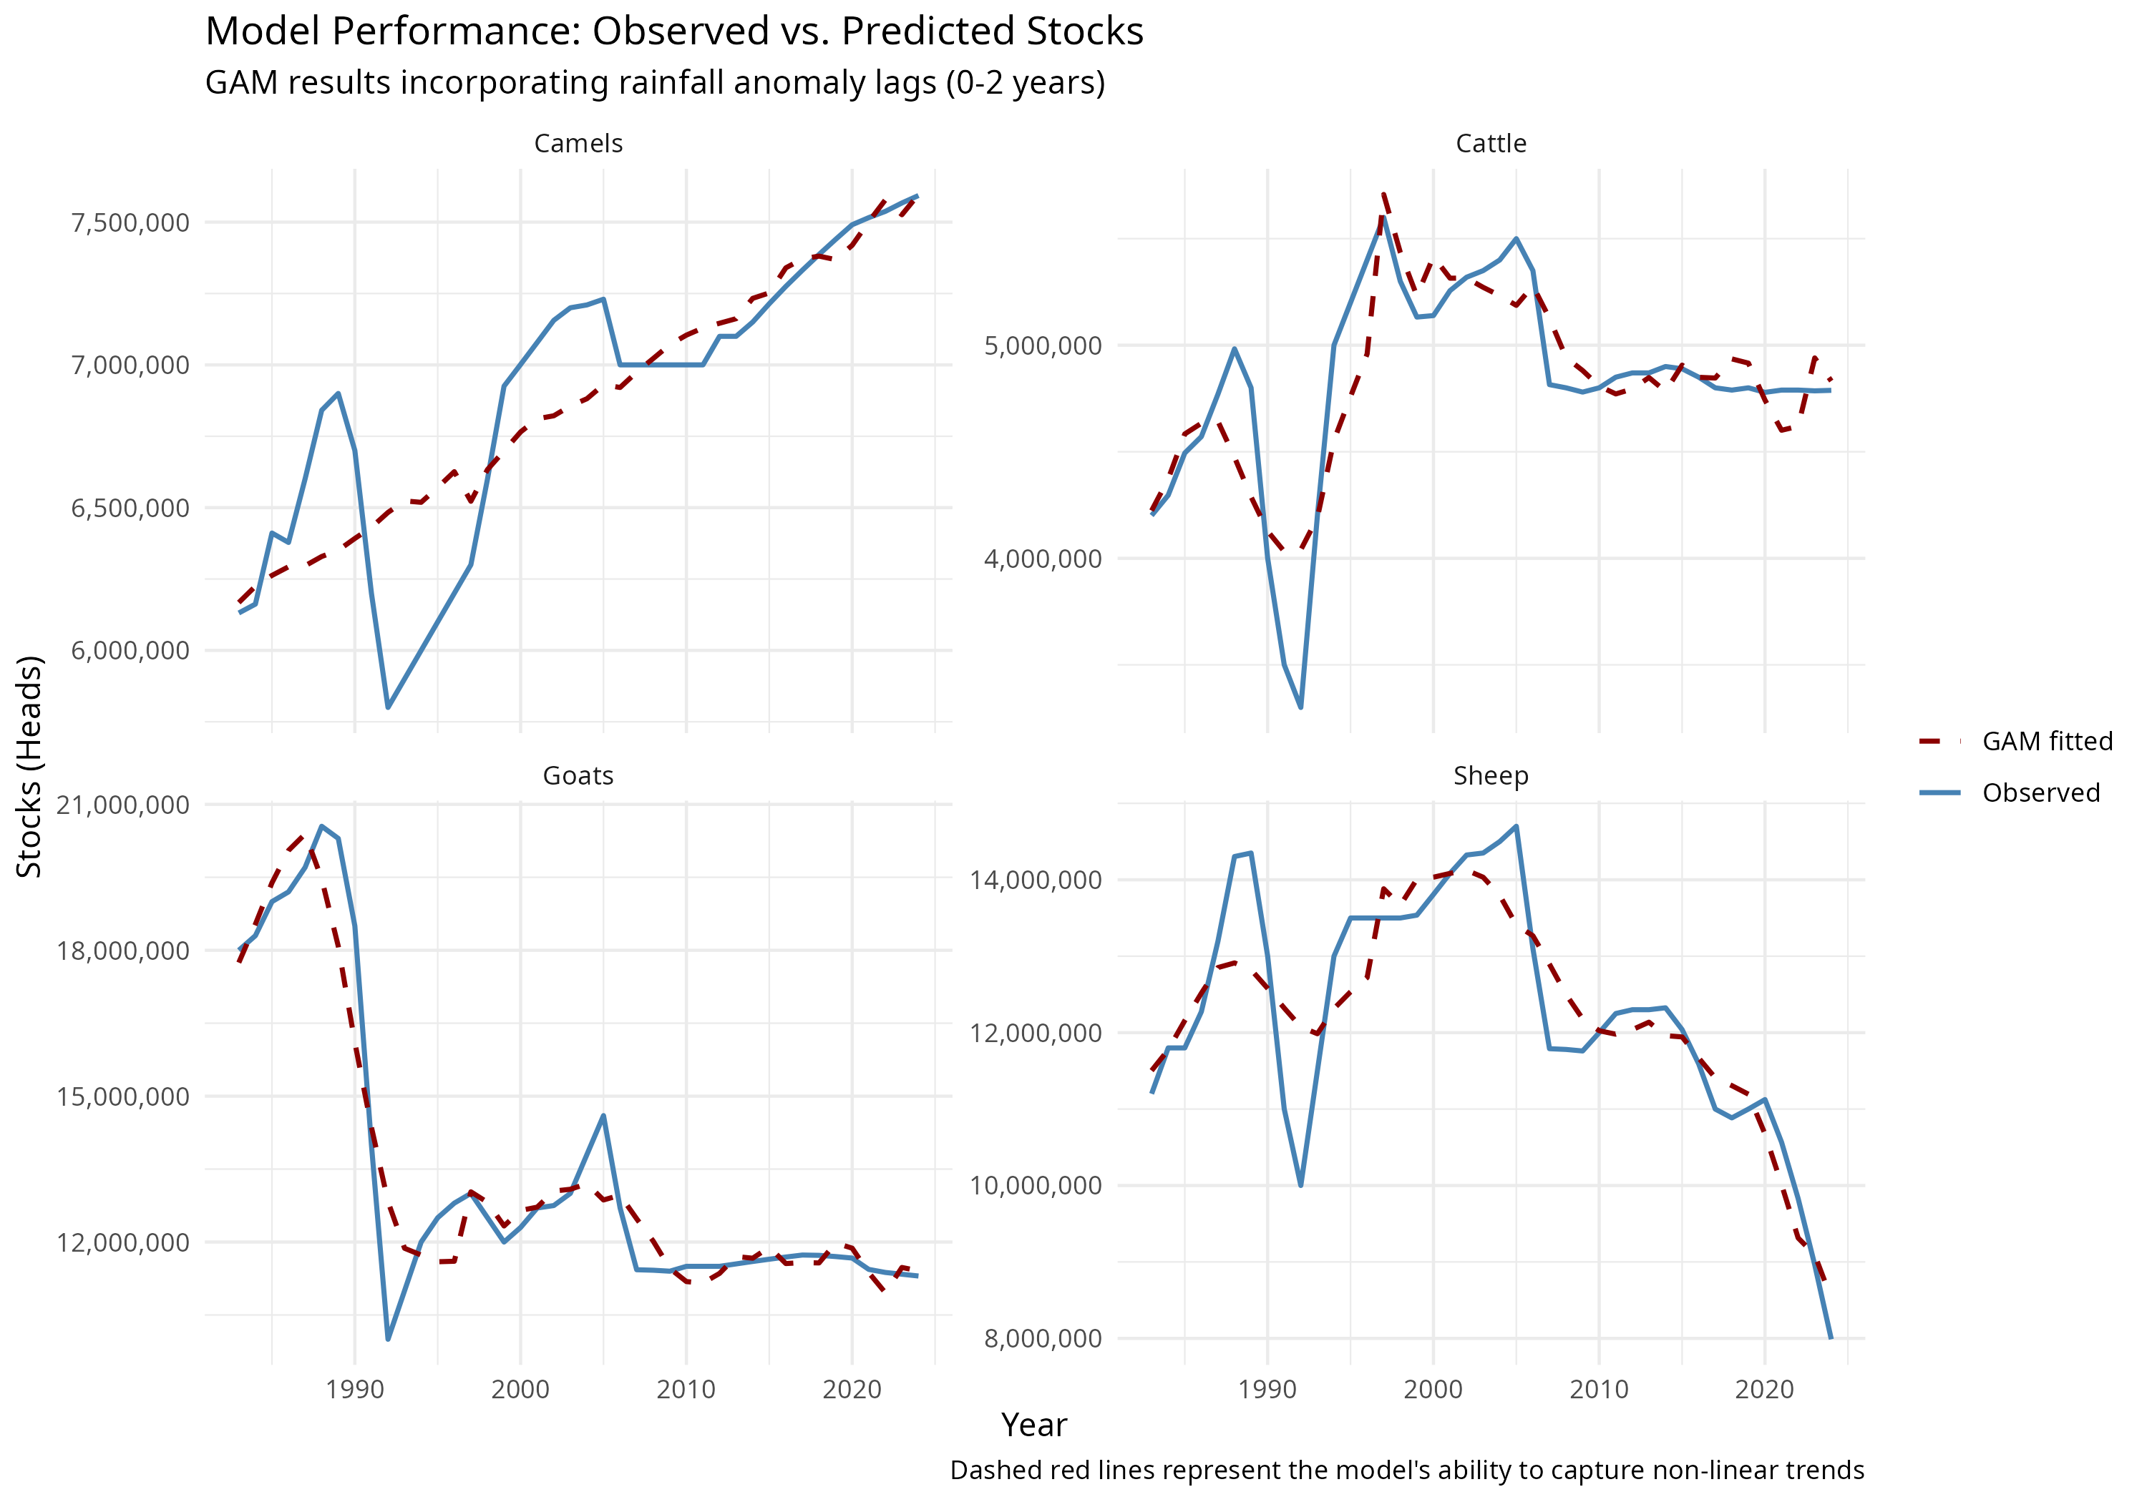
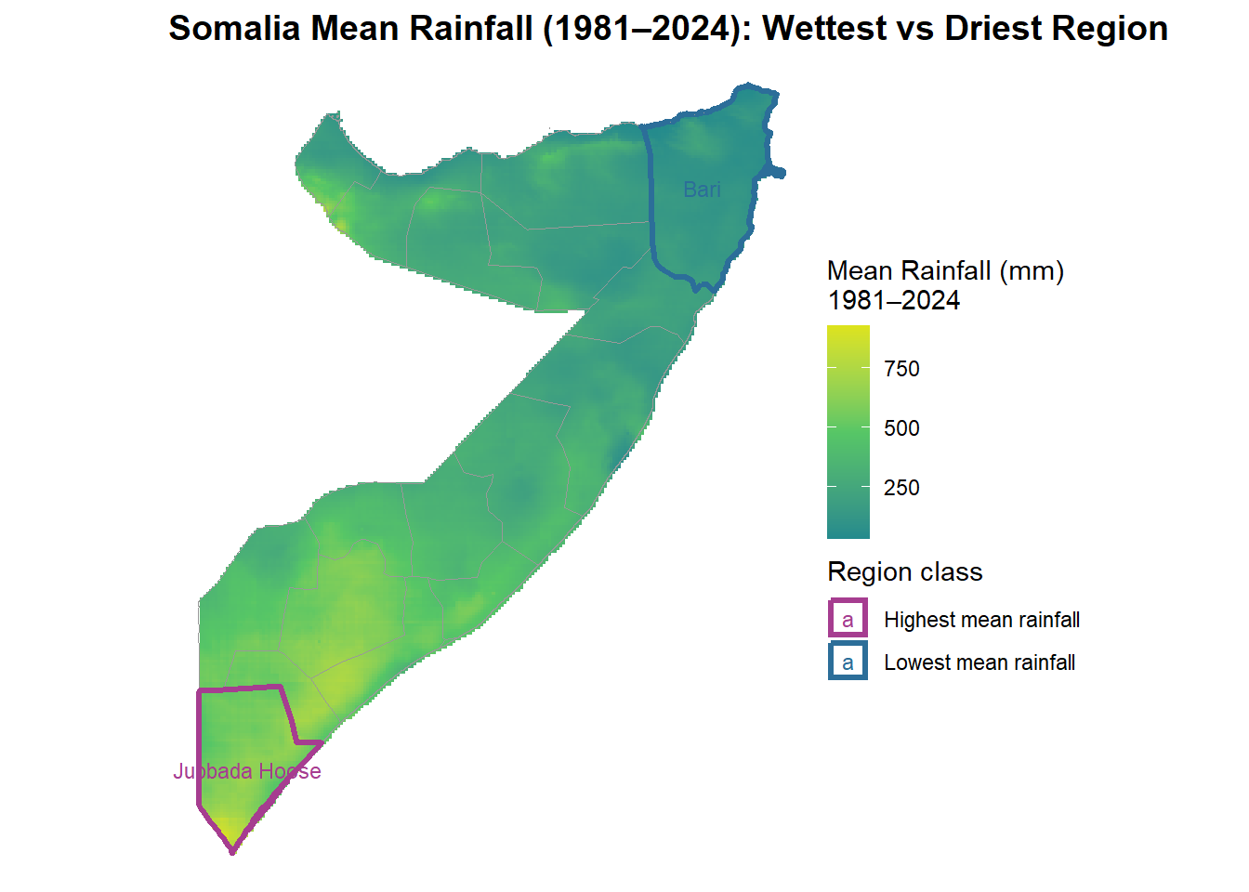
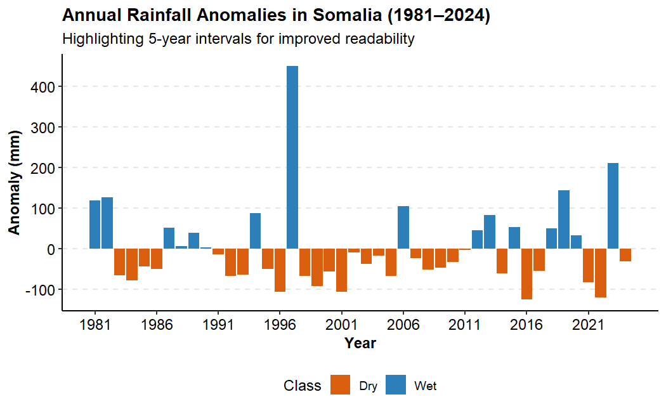
Climate Livestock Dynamics in Somalia
Rainfall Trends and Shifts in Pastoral Livestock Stock Across Somalia (1981–2024)
MOHAMED SAID | ENVIRONMENTAL DATA SCIENCE CAPSTONE| YALE SCHOOL OF THE ENVIRONMENT, YALE UNIVERSITY
March 2026
The Environmental Issue: Climate Variability Threatens Somalia’s Livestock Economy
Data & Methods
Key Finding/ Insights
CHIRPS satellite rainfall (1981–2024) combined with FAOSTAT livestock data.
Rainfall shows no long-term trend, but strong year-to-year variability.
Livestock account for 80% of exports and underpin pastoral livelihoods.
Livestock respond differently to climate variability:
Camels increasing
Goats declining
Cattle relatively stable
R spatial analysis used to map rainfall variability across Somalia.
Somalia experiences extreme rainfall variability and frequent droughts.
Generalized Additive Models (GAMs) used to test climate–livestock relationships.
Environmental shocks destabilize pasture availability and herd survival.
Interpretation / Implications
Livestock trends reflect climate plus markets, conflict, and pastoral mobility.
National rainfall averages may hide important regional climate impacts.
Future work should integrate regional climate indicators and socio-economic data.

