Slide 1
Unit 2
Organizing

Slide 2
INRODUCTION
The word organization has two common meanings.
The first meaning signifies an institution, for example we refer to a school as an organization. The second deals with organization as a process i.e. the process of organizing which is the second basic managerial function and which mainly refers to the way work is divided and allocated among members of the organization with the aim of goal attainment.
Organizing is “determining what tasks are to be done, who is to do them, how the tasks are to be grouped, who reports to whom, and where decisions are to be made.”
Basic elements of the process of organizing which include:
Division of work, departmentalization, span of management, authority and power, line and staff relations and organizational design.

Slide 3
DEFINITION OF ORGANIZING
Koontz defines organizing as "the grouping of activities necessary to attain objectives, the assignment of each grouping of activities to a manager with authority necessary to supervise it, the provision for coordination vertically and horizontally in the enterprise structure.
Process of identifying and grouping the work to be performed, defining and delegating responsibility and authority and establishing relationships for the purpose of ensuring people to work together effectively.
Chester I Bernard, "Organising is a system of co-operative activities of two or more persons."

Slide 4
TYPES OF ORGANIZATION
Formal Informal

Slide 5
Formal Organisation
The formal organization is legally, deliberately and rationally constituted by defining the duties, authorities and responsibilities of employees individually and collectively. The mutural relationship between different individuals and groups is determined as per rules, regulationsl and policies of the enterprise.
Characteristic/ Features of formal organisation
Laid down by the top management to achieve organisational goals.
Prescribes the relationships amongst the people working in the organisation.
The organisation structures is consciously designed to enable the people of the organisation to work together for accomplishing the common objectives of the enterprise

Slide 6
Organisation structure concentrates on the jobs to be performed and not the individuals who are to perform jobs.
In a formal organisation, individuals are fitted into jobs and positions and work as per the managerial decisions. Thus, the formal relations in the organisation arise from the pattern of responsibilities that are created by the management.
A formal organisation is bound by rules, regulations and procedures.
In a formal organisation, the position, authority, responsibility and accountability of each level are clearly defined.
Organisation structure is based on division of labour and specialisation to achieve efficiency in operations.
A formal organisation is deliberately impersonal. The organisation does not take into consideration the sentiments of organisational members.
The authority and responsibility relationships created by the organisation structure are to be honoured by everyone.

Slide 7
INFORMAL ORGANIZATION
Informal organisation refers to the relationship between people in the organisation based on personal attitudes, emotions, likes, dislikes etc.
An informal organisation is an organisation which is not established by any formal authority, but arises from the personal and social relations of the people.
These relations are not developed according to procedures and regulations laid down in the formal organisation structure; generally large formal groups give rise to small informal or social groups.
These groups may be based on same taste, language, culture or some other factor. These groups are not pre-planned, but they develop automatically within the organisation according to its environment.

Slide 8
Characteristics/ features of informal organisation
Informal organisation is not established by any formal authority. It is unplanned and arises spontaneously.
Informal organisations reflect human relationships. It arises from the personal and social relations amongst the people working in the organisation.
Formation of informal organisations is a natural process. It is not based on rules, regulations and procedures.
The inter-relations amongst the people in an informal organisation cannot be shown in an organisation chart.

Slide 9
In the case of informal organisation, the people cut across formal channels of communications and communicate amongst themselves.
The membership of informal organisations is voluntary. It arises spontaneously and not by deliberate or conscious efforts.
Membership of informal groups can be overlapping as a person may be member of a number of informal groups.
Informal organisations are based on common taste, problem, language, religion, culture, etc. it is influenced by the personal attitudes, emotions, likes and dislikes etc. of the people in the organisation.

Slide 10
ORGANISATION CHARTS
Harold Koontz and Cyril O' Donnell, "Every organisation can be charted, for a chart is nothing more than an indication of how departments are tied together along their principal lines of authority."
George R Terry, "A chart is a diagrammatical form which shows important aspects of an organisation including the major functions and their respective relationships, the channels of supervision, and the relative authority of each employee who is in charge of each respective function."
According to Louis A Allen, "The organisation chart is a graphic means of showing organisation data. Organisation charts are snap-shots; they show only the formal organisation and depict it for only a given moment in time."
In the word of J Batty, "An organisation chart is a diagrammatic representation of the framework or structure of an organisation."

Slide 11
ADVANTAGES OF ORGANIZATIONAL STRUCTURE
Organisation chart gives a clear picture of the organisation structure and the relationships that exist in an organisation.
It shows at a glance the lines of authority and responsibility. From it, the individuals can see who their associates are, to whom they report and from whom they get instructions.
By providing a detailed and clear picture of the authority relationships existing in an organisation, they help to avoid misunderstanding of jurisdictional problems and minimise organisational conflicts.
It plays a significant part in organisation improvement by pointing out inconsistencies and deficiencies in certain relationships. When management sees how its organisation structure actually looks, it may discover some unintended relationships.

Slide 12
DISADVANTAGES OR LIMITATIONS OF ORGANIZATIONAL CHARTS
Organisation chart shows only the formal relationships and fails to show the informal relations within the organisation. Informal relationships are also important in any organisation.
It gives rise to a feeling of superiority and inferiority which causes conflicts in the organisation and affects team-spirit adversely.
It does not show the relationships that actually exist in the organisation but shows only the "supposed to be" relationships.

Slide 13
Structure of Organization
Functional Structure
Divisional Structure

Slide 14
Functional Structure
CHARACTERISTICS：
  consolidates human knowledge and skills with respect to specific activities in order to provide depth of expertise
Functional
Grouping
CEO
Engineering
Marketing
Production

Slide 15
Advantages of Functional Structure
  It is logical reflection of functions
  It maintains power and prestige of major function
  It follows principle of occupational specialization
  It simplifies training
  It furnishes means of tight control at top
  Convenient supervision
Disadvantages of Functional Structure
  De-emphasis of overall company objectives
  Responsibility for profits is at the top only
  Slow adaptation to changes in environment
  Limits development of general managers

Slide 16
Divisional Structure
CHARACTERISTICS：
  also called product structure or strategic business units
  departments are grouped based on organizational outputs
Divisional
Grouping
CEO
Product
Product
Product
Division 1
Division 2
Division 3

Slide 17
Advantages of Divisional Structure
  More attention and effort on product line
  Permits growth and diversity of products and services
  Improves coordination of functional activities
  Places responsibility at the divisional level
  Furnishes measurable training ground for general manager
Disadvantages of Divisional Structure
  Requires more persons with general manager abilities
  Overlapping of functions
  Excessive expenditure
  Duplication of efforts
  Self centered

Slide 18
Meaning of Centralization
Centralization is a form of organizational structure where the decision making capability rests with the top management. A couple of hand-picked members are entitled to create strategies, determine the goals and objectives based on which an organisation will function.
In a centralized organisation, the top management sets rules and procedures which are then communicated to the lower-level employees, who are expected to carry out the same without questioning the authority.
The advantage of such a structure is, it allows employees to have a well-defined framework within which all work needs to carried out.
The disadvantage of such a structure is that it increases the time taken to arrive at a decision. As decision-making authority lies with selected people from top management, it may result in biased decision making.

Slide 19
Meaning of Decentralization
Decentralization is another form of organizational structure that functions by delegating decision-making capabilities to multiple teams across geographies.
In such an organization, most of the planning, strategy and decision to implement them are taken by the people in the middle and lower level of management.
The advantage of decentralization is that the employees are empowered to make their own decisions that will benefit the organization, which results in a high level of employee satisfaction and boosts the productivity of an organization.
Decentralization enables low-level employees to gain leadership skills, which can contribute to the growth of the organization in the long run.

Slide 20
Centralization vs. Decentralization
The difference between Centralization and Decentralization is that centralization in an organization involves planning and decision-making power is given completely in the hands of senior management. It implies that all power and authority is concentrated at the highest level. Decentralization in an organization involves the delegation of power by middle management or lower management.

Slide 21
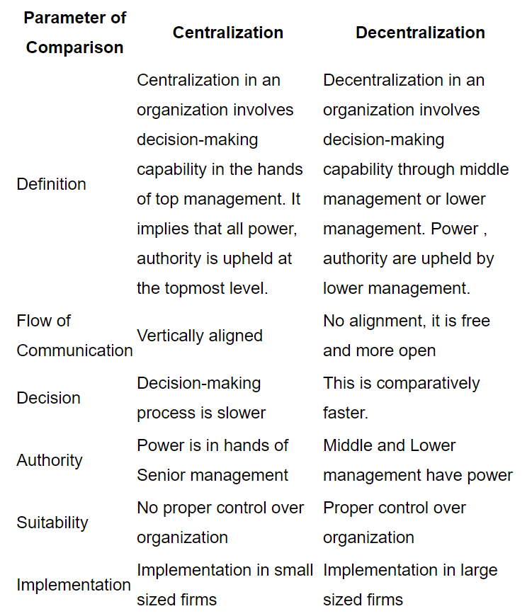

Slide 22
Delegation
Douglas C. Basil “Delegation refers to a manager’s ability to share his burden with others. It consists of granting authority or the right to decision making in certain defined areas and charging subordinates with responsibility for carrying through an assigned task.”

Slide 23
Characteristics of Delegation
1. Delegation takes place when a manager grants some of his powers to subordinates.
2. Delegation occurs only when the person delegating the authority himself has that authority i.e. a manager must possess what he wants to delegate.
3. Only a part of authority is delegated to subordinates.
4. A manager delegating authority can reduce, enhance or take it back. He exercises full control over the activities of the subordinates even after delegation.
5. It is only the authority which is delegated and not the responsibility. A manager cannot abdicate responsibility by delegating authority to subordinates.

Slide 24
Importance of Delegation
Effective Management: Delegation provides a breathing space to managers by sharing their workload. As a result, managers can concentrate on tasks with higher priority. Further, freedom from routine work allows for exploration of new ideas.
Employee Development: With the help of delegation, we assign new responsibilities to employees. This allows for them to work on a domain which is different from the monotonous routine work, helping them to develop new skills and discover hidden talents. Thus, delegation leads to the development of employees by providing them to expand their area of operation and helping them to grow. Effectively, it increases their future prospects and breeds future managers.
Motivation of Employees: Through the process of delegation, superiors entrust suitable subordinates with the tasks that are assigned to them. This not only leads to the development of talent but also has various psychological benefits. This is because, the faith and trust displayed in the subordinate build his confidence and self-esteem, which ultimately drives him to work harder.
Facilitation of Growth: As mentioned, delegation provides employees with opportunities to develop and effectively trains them as better decision makers and managers. This further aids in the process of expansion of an organisation, as it already has the suitable workforce which is competent enough.

Slide 25
Elements of Delegation
Assignment of Responsibility: The first step in delegation is the assignment of work or duty to the subordinate i.e. delegation of authority. The superior asks his subordinate to perform a particular task in a given period of time. It is the description of the role assigned to the subordinate. Duties in terms of functions or tasks to be performed constitute the basis of delegation process.
Grant of Authority: The grant of authority is the second element of delegation. The delegator grants authority to the subordinates so that the assigned task is accomplished. The delegation of responsibility without authority is meaningless. The subordinate can only accomplish the work when he has the authority required for completing that task.
Accountability: Although delegation eases out the job of superiors and has several benefits for both superior and subordinate, the superior is still accountable for the task. Accountability is the answerability for the final outcome of a job. All things considered, regardless of the delegation, we consider the superior completely answerable for the tasks. This further means that delegation involves no transfer of accountability.

Slide 26
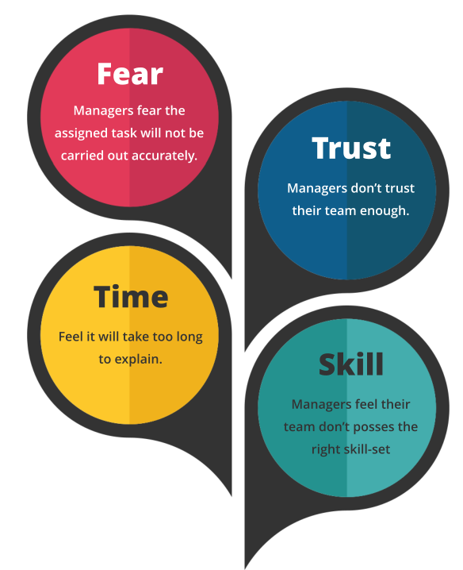
Reasons Why Managers Fail to Delegate

