Slide 1
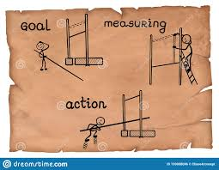
Unit – 3
Controlling

Slide 2
INTRODUCTION
Control is a fundamental managerial function. With the help of controlling, the management measures the performance of the subordinate units.
Controlling is associated with planning. Control can come into effect only when plans have been adopted and instructions are issued to all affected by designing the plans to take appropriate actions. The objective of control is to see that everything is carried out in its predetermined order.
Controlling is a continuous process of measuring actual results of operations of an organization, in comparison with the standards laid down as a guide. Proper Control smoothen the working of an organization.
Controlling involves setting up standards of individuals and organizational performance and measuring actual performance.

Slide 3
Definitions
According to George Jerry:
“Determining what is being accomplished, i.e. evaluating the performance and if necessary applying corrective measures to see that the performance takes place according to the plans.”
According to Henry Fayol:
“Control consists in verifying whether everything occurs in conformity with the plan adopted, the instructions issued and the principles established.”
According to Koontz and O’Donnell:
“Controlling implies measurement of accomplishment against the standard and the correction of deviations to assure attainments of objectives according to plans.”

Slide 4
Expected Outcome
e.g. 100 Units
Started with some objective in mind
Larger the Gap,
Lesser the control
Actual Outcome e.g. 98 units

Slide 5
FEATURES OF CONTROL
Control is the function of Management
Control is a follow-up action to the other functions of Management. This function is performed by all the managers in the organization.
Control is a continuous process
Control process does not stop anywhere. It involves analysis of establishment of standards policies and procedure and taking corrective actions.
Control is flexible and dynamic process
It involves continuous review of standard of performance.

Slide 6
Control is forward looking
Control is always related to future events as we can’t control past events. Corrective measures for wastage and production can be taken for future with past reference
Planning and Controlling are closely related
Planning is based on control and control on planning. Control includes setting of standards and measurement of performance. So it is more important in planning. It helps in establishing new aims, change in structure, staff pattern and changes in the direction technique.
The essence of control is action
Process of control will finish when corrective action is taken. This action is depending upon setting of standard and comparison of standard with actual. Deviation has to be controlled and minimum wastage will be achieved.

Slide 7
IMPORTANCE OF CONTROL
Basis for future action:
A continuous flow of control information provides the basis for future action. It gives correct action and gives correct picture.
Control helps in decision making:
The control system helps the management to take right decision. Follow-up action is essential for successful completion of objective.
It helps in decentralization:
Control helps the top management to get the feedback information which helps them to ensure that the decision taken at the lower level is helpful for implementation of policies.

Slide 8
Helps in co-ordination:
It helps to each member of organization to move towards common goal with co-ordinate direction. It provides boundaries for pre determined goals and provide guidance for each member.
It has positive impact on employee:
The existence of control system has positive impact on the behavior of the employee. Employees are cautious because actual results are compared with expected one.
Control helps to point out Managerial weakness:
Control depends upon proper feedback so it help in to point out managerial weakness.

Slide 9
STEPS IN CONTROL PROCESS
Establishment of standards:
The first step in control process is the setting up of standards of measurement. Standards represent criteria for performance. A standard acts as a reference line or a basis of comparison of actual performance. Standards should be set precisely and preferable in quantitative terms.
Measurement of performance:
The second step is to measure actual performance of various individuals, groups or units. Management should measure the performance and compare it with the standards.

Slide 10
Comparing performance with standards:
Comparison is easy where standards have been set quantitatively as in production and marketing. In other cases, where results are intangible and cannot be measured quantitatively, direct personal observation, inspection and reports are a few methods used for evaluation. The evaluation will reveal some deviations from the set standards. The evaluator should point out the defects or deficiencies in performance and investigate the causes responsible for these.
Taking corrective actions:
The final step in the control process is taking corrective actions so that deviations may not occur again and the objectives of the organization are achieved. This will involve taking certain decisions by the management, replanning or redrawing of GOALS or STANDARDS, reassignment of classification of duties.

Slide 11
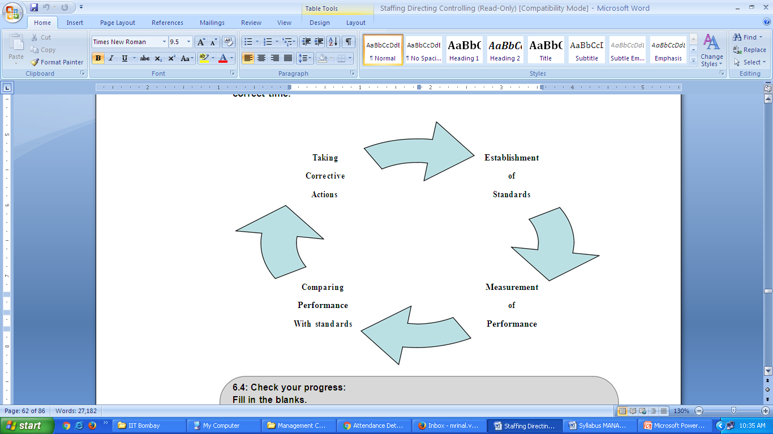

Slide 12
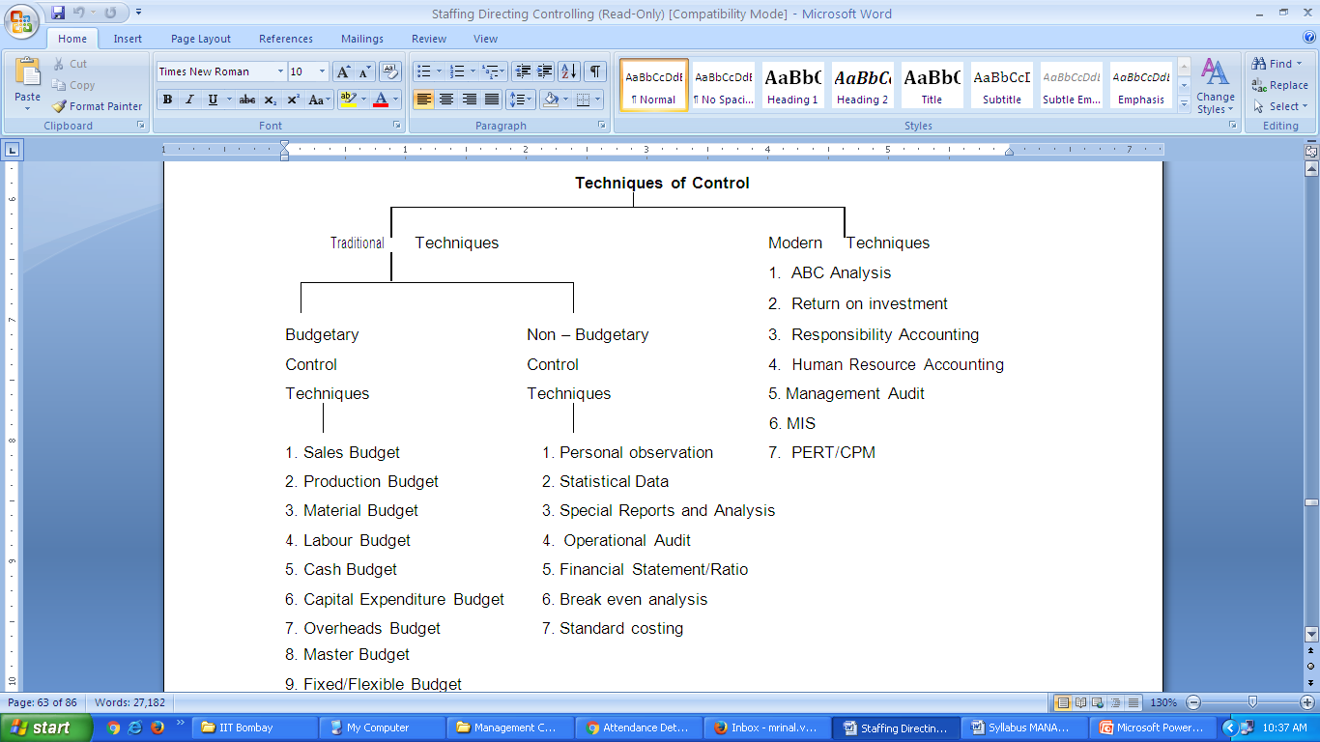
TECHNIQUES OF CONTROL

Slide 13
Traditional Techniques
Budgetary Techniques
Non Budgetary Techniques

Slide 14
a) Budgetary Control
Budgetary control means the supervision of output and expenditure by the provision of budgets issued to production departments before work is commenced, authorizing the amount of expenditure to be allowed under each heading.
According to W.W. Bigg:
“The term Budgetary Control is applied to a system of management and accounting control by which all operations and output are forecasted as far ahead as possible and the actual results when known are compared with the budget estimates.”

Slide 15
Objectives of Budgetary Control
To Plan the policy of business.
To co-ordinate the activities of a business.
To control each function so that the best possible results are obtained.
Providing an impersonal control of expenditure.
Defining the goals of the enterprise and providing long and short period plans for attaining these goals.
Promoting co-operation between executive, in accepting policies and executing plans.
Eliminating departmental accumulation of cost and performance data for control purposes.
Securing desired performance, both in terms of money, materials, men and physical targets.

Slide 16
b) Non- budgetary control techniques
Personal observation:
This is the most effective means of control. Deviations are discovered much earlier and promptly corrected. It enhances motivation and morale of the employee of the organization.
Statistical data:
Data presented in the form of charts, graphs and diagrams provide a quick understanding of the problem. This technique is applied specifically in the field of quality control (Standard Deviation)
Special reports:
Special reports prepared by experts through special investigations, are useful in specific cases. Sometimes statistical and accounting reports are not satisfactory to control.

Slide 17
Ratio analysis:
The control of total functioning in an organization becomes possible by an analysis of the profitability, liquidity and solvency ratios. E.g. the “financial statement analysis” facilitates diagnosing the suitability of a business venture.
Break even analysis:
The break-even analysis is an analysis of the inter-relationship between cost, volume and profit. It is also called as cost volume profit analysis.
A break even chart is prepared for this analysis. This chart presents graphically the relationship between sales and expenses under different conditions. In other words, it examines the interrelationship of changes in cost volume and profits.
The break even chart shows the break even points, the point of zero profits and zero losses. It can be expressed in terms of units produced. It serves as a control aid in a number of ways, as it predicts the profit at different levels of sales or production volumes.

Slide 18
Operational Audit :
Internal Audit or operational audit is carried out by the special stall of the operations and accounts of an enterprise, in order to provide overall review of performance. It is used to check and balance on daily operations.
Standard Costing:
This technique is often used for cost reduction and cost control. Under standard costing standards for materials, labour, overheads and other components of total cost are fixed and actual costs are compared with these standard costs and variances are analyzed to find out their causes. Standard costing is also used as the basis for budgeting and incentive plans.

Slide 19
Modern Techniques
ABC Analysis
Management Audit
Responsibility Accounting
PERT & CPM
Return on investment (ROI)
Human resource accounting
Management Information System (MIS)

Slide 20
a) ABC Analysis
ABC analysis is a method of material control according to value. The basic principle is that high value items are more closely controlled then the low value items. The materials are grouped according to the value and frequency of replenishment during a period.
‘A’ Class items : Small percentage of the total items, but having higher values.
‘B’ Class items : More percentage of the total items, but having medium values.
‘C’ Class items : High Percentage of the total items, but having low values.
ABC analysis is popularly known as “Always Better Control”. It is also known as “Control by Importance and Exception”. It is based on the concept of Selective Inventory Management.

Slide 21
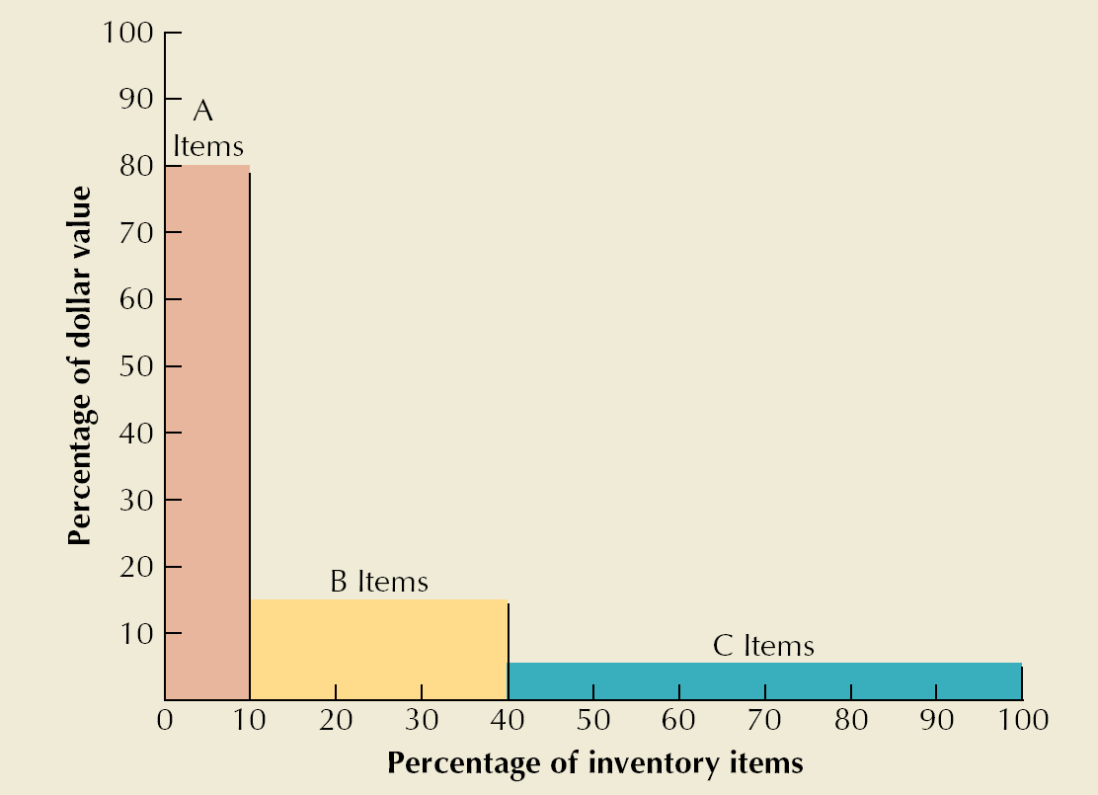
ABC Classification
Class A
  5 – 10 % of units
  70 – 80 % of value
Class B
  30 % of units
  15 % of value
Class C
  50 – 60 % of units
  5 – 10 % of value

Slide 22
b) Management Audit
Management Audit is implied as an attempt to evaluate the performance of various management functions and processes with a view to improve its efficiency and productivity on the basis of certain pre-determined acceptable norms or standards. It is an audit, “to examine, review the various policies and actions of the management on the basis of certain objective standards”.
c) Responsibility Accounting
It is a system of accounting where each departmental head is held responsible for the performance of his department. Each department is considered as a responsibility center and its manager is held responsible for the target fixed for his unit.

Slide 23
d) PERT & CPM
Programme Evaluation and Review Technique (PERT) and Critical Path Method (CPM) follow the same principle.
This method was firstly introduced in American Navy in 1958. This method has been utilized to produce equipment in Navy. This is mainly concern with to reduce process time to produce a particular product.
Every work undergoes many processes till completion stage. Every process requires certain time. According to this technique time required is being set. It also shows time required for each event. A map is prepared to show the time required to complete each process.

Slide 24
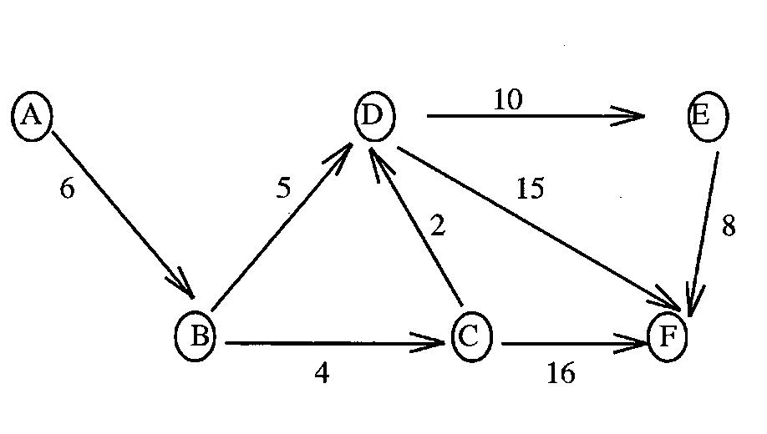
E.g. to complete a work, A, B, C, D, E following events are required.
In the above figure A, B, C, D, E, F are the processes and arrow shows the time require to complete one even. The starting time and ending time is shown by circles.

Slide 25
e) Return on investment (ROI)
It is also called as Rate of Return. This technique can be used for planning and controlling. It is derived from a ration between the total profit and the total investment of an organization. Return on investment helps to evaluate the functioning of an organization by calculating total profit earned so far.
f) Human resource accounting
Most of the control techniques calculate financial performance in terms of costs, profits, revenues and other factors. However the most important factor is human resource that is overlooked. The human resource accounting by Likert helps in the calculation of human resources.

Slide 26
g) Management Information System (MIS)
For the purpose of efficient control it is necessary to have adequate, reliable accurate and timely information or feed back or operations. It is the quality of data that determines the quality of managerial decision. But data need to be processed to make it information. Electronic Data processing (EDP) devices. Like computer permits economical and quick storage and processing of huge data.
The use of electronic devices has led to the development of integrated information systems which provide regular flow of information required for decision making and control. It is known as MIS. Thus MIS is a system that provides relevant information in the right form and at the right time to different managers for the purpose of planning and control.
MIS is useful is reducing time, cost and energy required for collection, processing and supply of information to various organizational units. By improving the quality and quantity and timeliness of information, MIS makes planning and control more effective and efficient

