Slide 1
Motivation
Motivation is the process of generating enthusiasm among subordinates to dedicate their integrated efforts towards achieving the objectives of the business.
Motivation, enthuses workers to work with utmost sincerity, potentiality and in the interest of the enterprise.
Accordint to W.G. Scott, “Motivation means a process of stimulating people to action to accomplish desired goals”

Slide 2
Need and Importance of Motivation
Inspiring employees to work
Improving workers’ efficiency
Creating supporting work environment
Maximum utilisation of resources
Stability in work force
Establishing harmonious relationship between employers and employees
Ensures achievement of organisational goals.

Slide 3
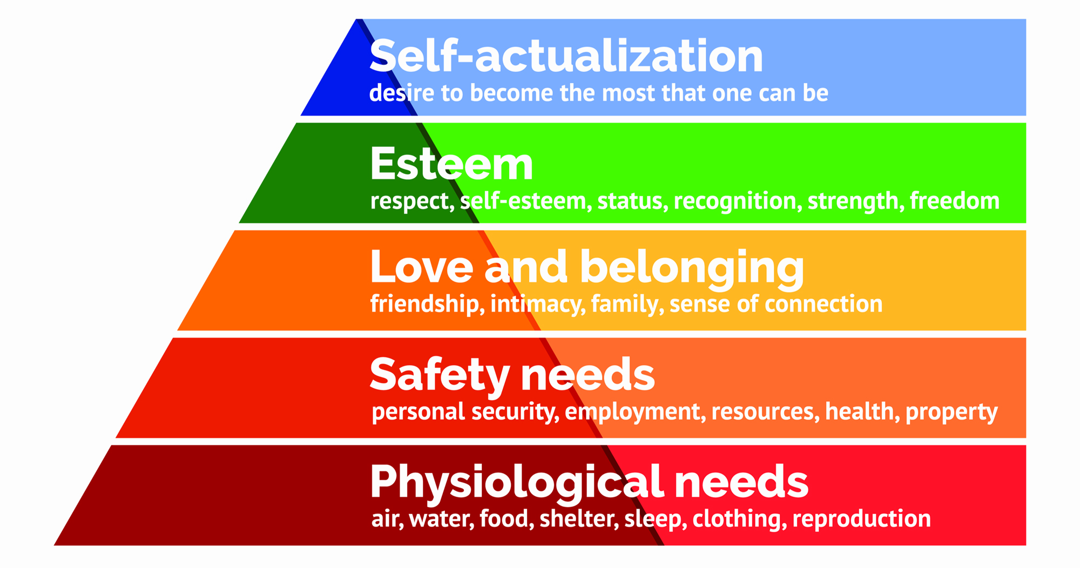
Theories of Motivation
Maslow’s Needs Theory

Slide 4
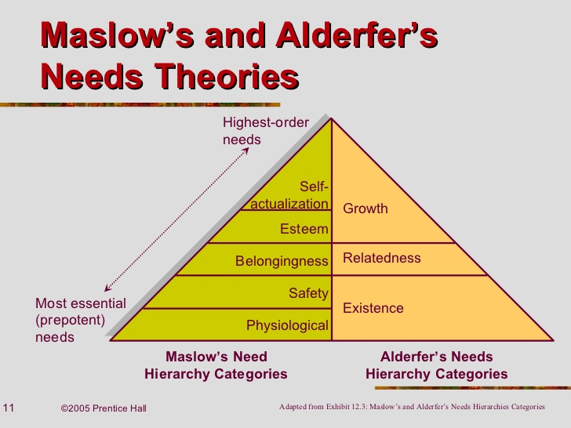

Slide 5
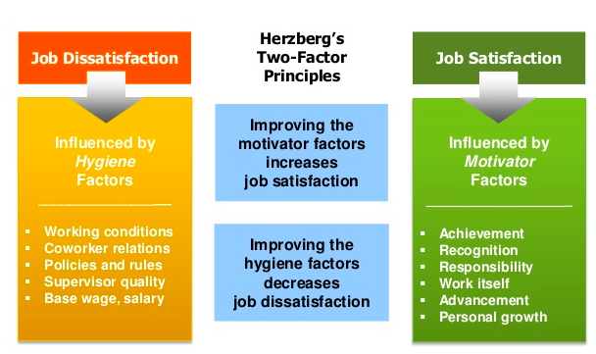

Slide 6
